Slide 1
Minnesota Geospatial Advisory Council
March 3, 2021

Slide 2
Welcome
Introductions
Approve agenda
Approve December and January minutes

Slide 3
Agenda
Time | Topic
10:00 | Welcome, introductions, approve previous minutes
10:10 | Committee annual reports and edits to EPC charter – Review and accept
10:15 | GAC accomplishments and work plan – Review and approve
10:25 | Making progress on GAC priorities and initiatives; metrics, etc.
10:40 | Outreach Committee Success Story Hub
10:50 | Lidar update
11:00 | Break
11:05 | Archiving implementation report and Pilot Workgroup approval
11:20 | Legislative update
11:25 | GAC priority projects and initiatives updates
11:45 | Announcements
noon | Adjourn

Slide 4
Agenda Item 2
Committee Annual Reports and Edits to EPC Charter – Review and Accept
All

Slide 5
Agenda Item 3
GAC Accomplishments and Work Plan – Review and Approve
Mark Kotz

Slide 6
Agenda Item 4
Making Progress on GAC Priorities and Initiatives; Metrics, Etc.
Cory Richter, Dan Ross

Slide 7
Agenda Item 5
Outreach Committee Success Story Hub
Brad Anderson, Kyle Wikstrom

Slide 8
Agenda Item 6
Update on the Minnesota Lidar Plan
3D Geomatics Committee Co-Chairs
Sean Vaughn (DNR-MNIT)
Gerry Sjerven (MN Power)

Slide 9
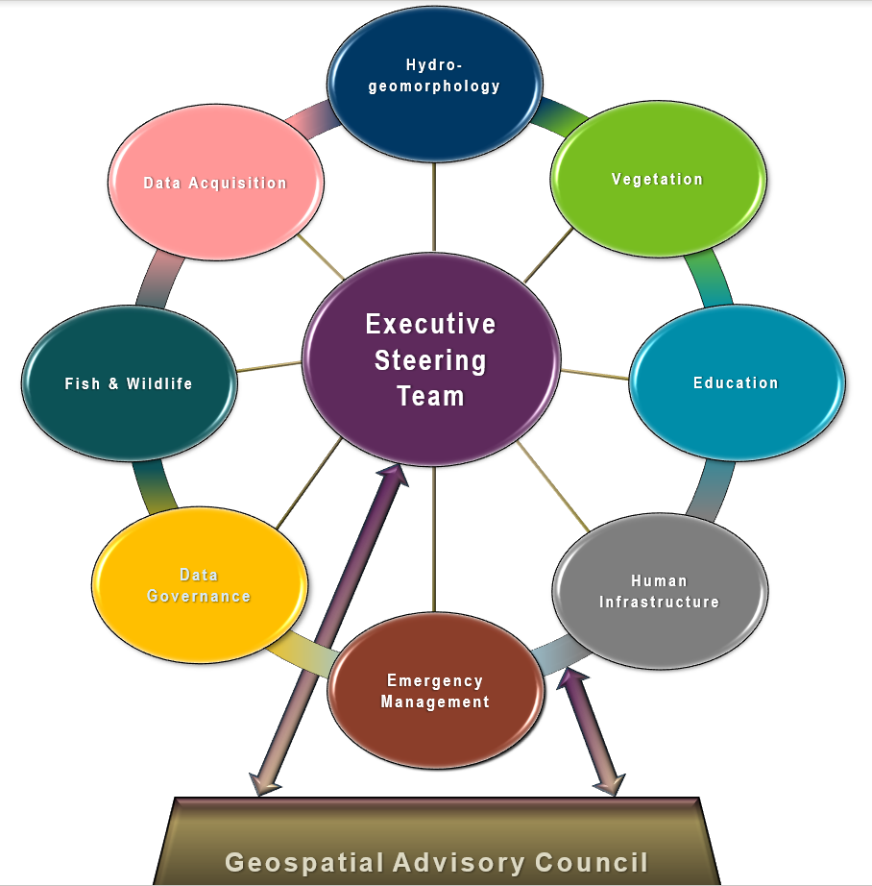
3DGeo Workgroups
3DGeo Workgroup Update
Workgroups/Subgroups
Hydrogeomorphology
Vegetation
Education
Human Infrastructure & Cultural Resources
Data Acquisition
Notes:
Sean – 3DGeo Background
What is the GAC?
The Minnesota Geospatial Advisory Council is the coordinating body for the Minnesota geospatial community.
Cross-section of organizations that include counties, cities, universities, business, nonprofit organizations, federal and state agencies, tribal government, and other stakeholder groups.
What is the 3D Geomatics Committee?
The 3D Geomatics Committee (3DGeo) is a committee under GAC that works to identify and promote the need for planning, funding, acquisition, and management of three-dimensional geomatic data and derived products.
Sector Expertise
Lidar acquisition relies on subject matter expertise from different sectors in 3DGeo

Slide 10
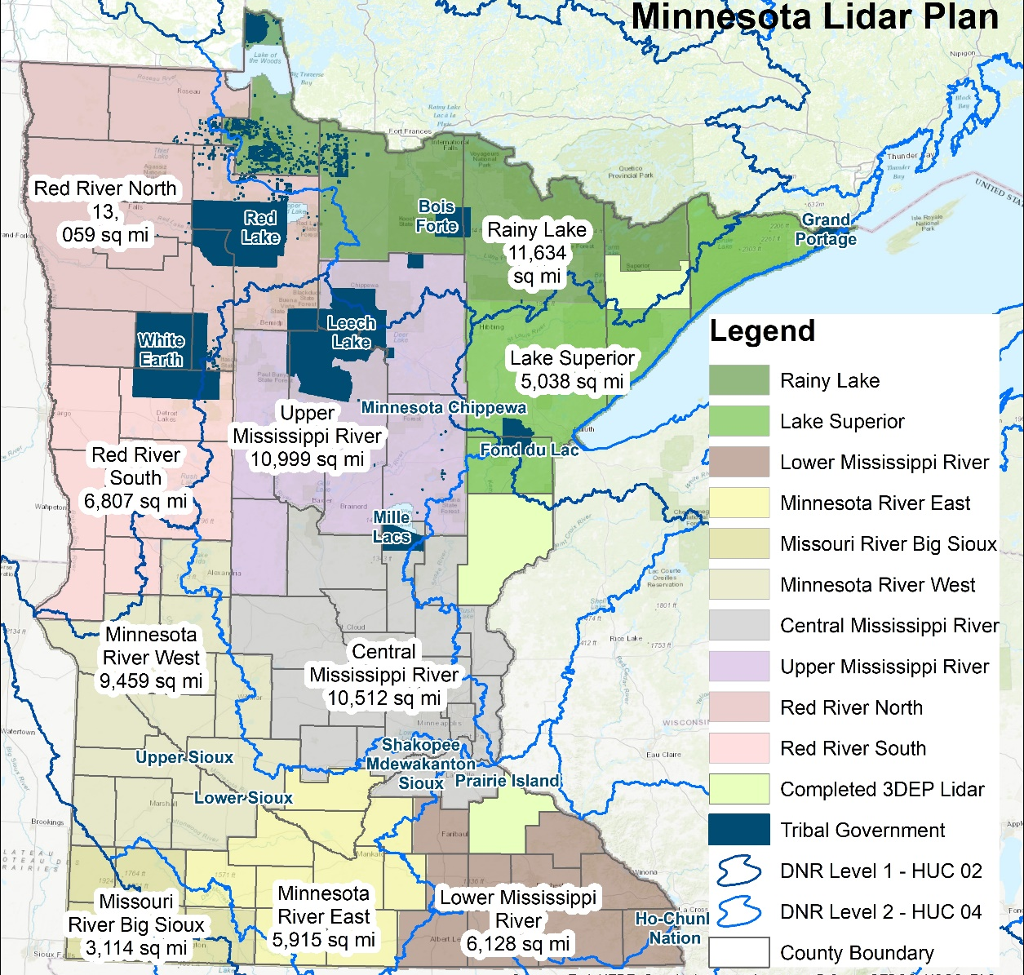
Lidar Acquisition Updates

Slide 11
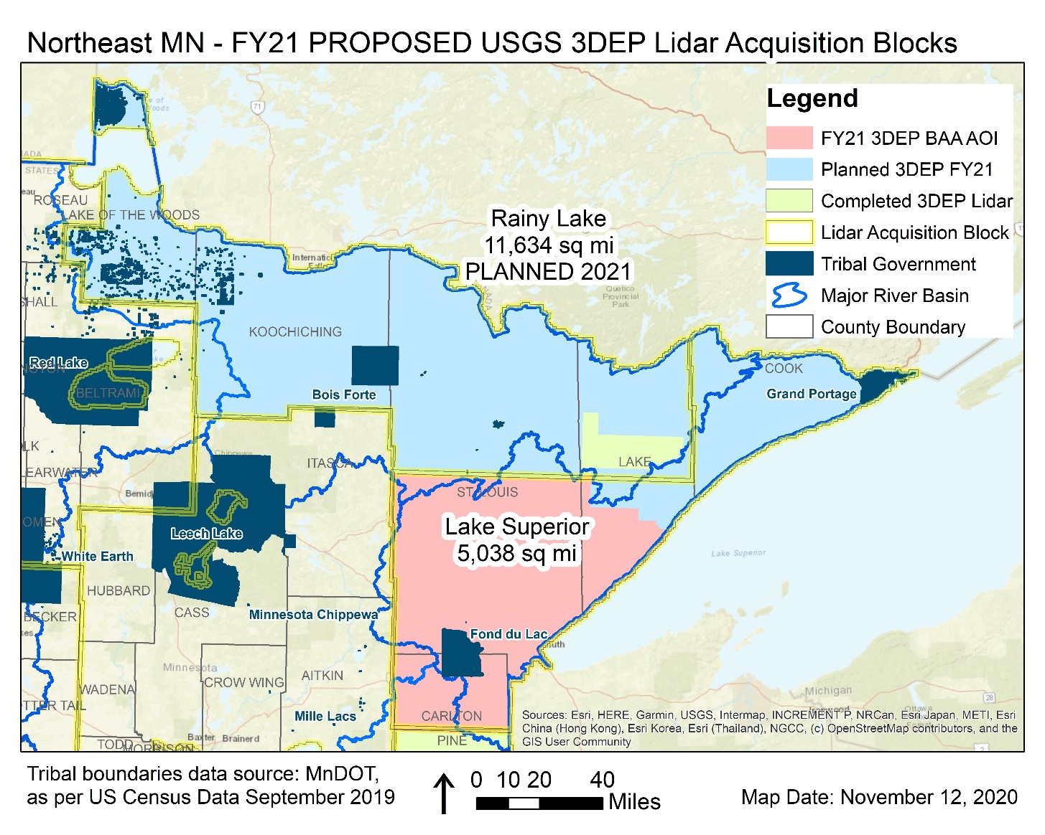
Lidar Acquisition Updates
North East Forested LAA
Rainy Lake LAB Kickoff Meeting Thursday 03/04/21
QL1 Lidar to be flown Spring 2021
Lake Superior “Recommended for funding” by 3DEP as a Spring 2021 collection
Joint Funding Agreements being finalized
LAB Partners:
USGS, NRCS State and Federal Offices, MN DNR, MnDOT, MnGeo, Lake and St Louis Counties

Slide 12
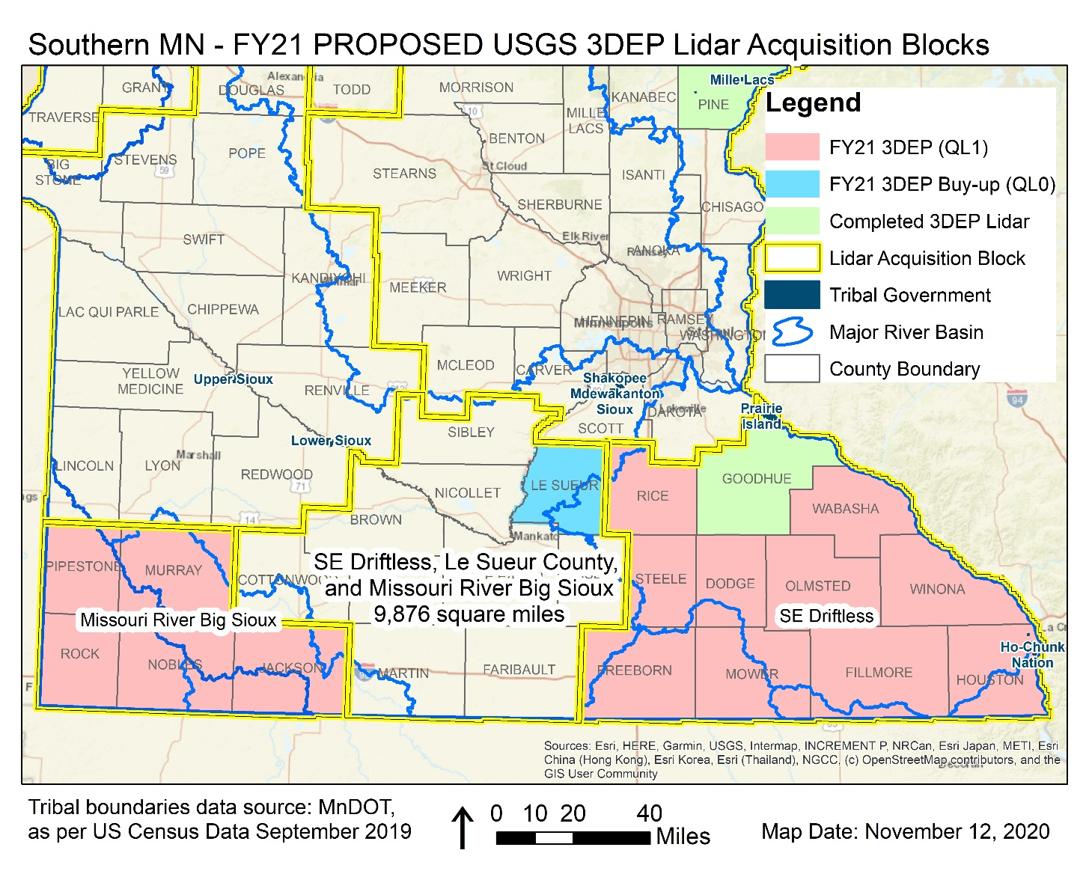
Lidar Acquisition Updates
Rainy Lake LAB
Goodhue County collected QL0 in Spring 2020
Pine County also has 3DEP lidar, QL2
The SE Driftless, Le Sueur, and Missouri River Big Sioux block applications were “Recommended for funding” by 3DEP as a Spring 2021 collection
LAB Partners:
USGS, NRCS State and Federal Offices, MnDOT, MnGeo, and Nobles, Le Sueur, Winona, and other partners

Slide 13
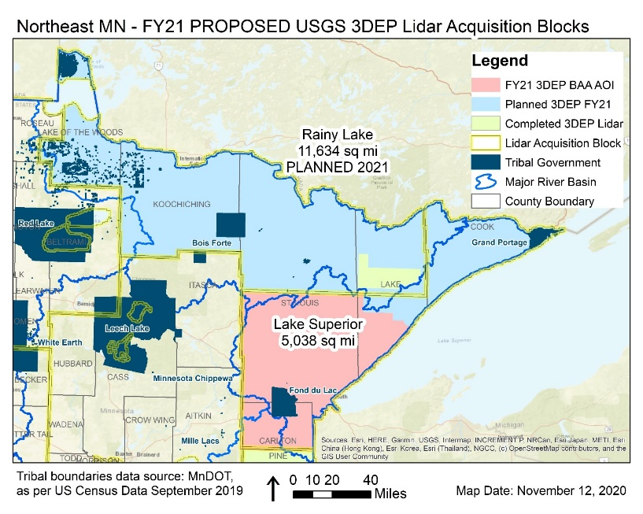
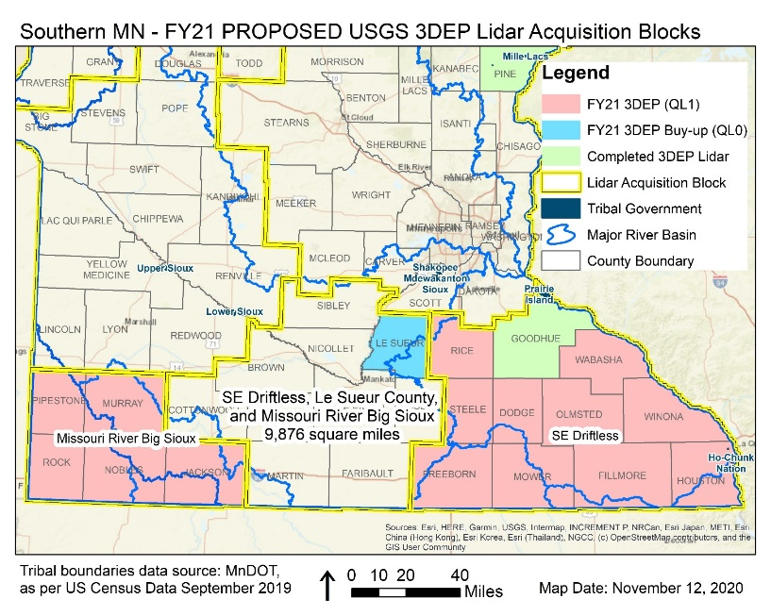
Lidar Acquisition Updates
Stakeholder coordination and collaboration of the MN Lidar Plan is the success to this massive initiative.

Slide 14
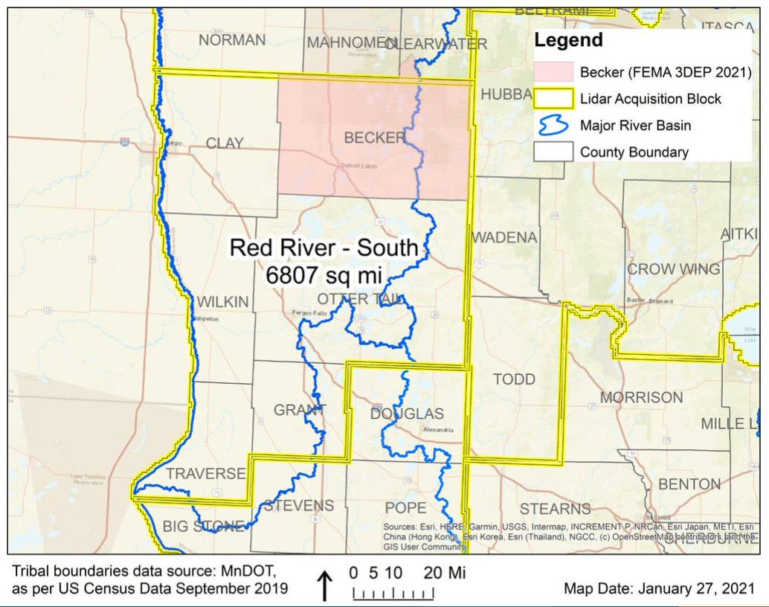
Lidar Acquisition Updates

Slide 15
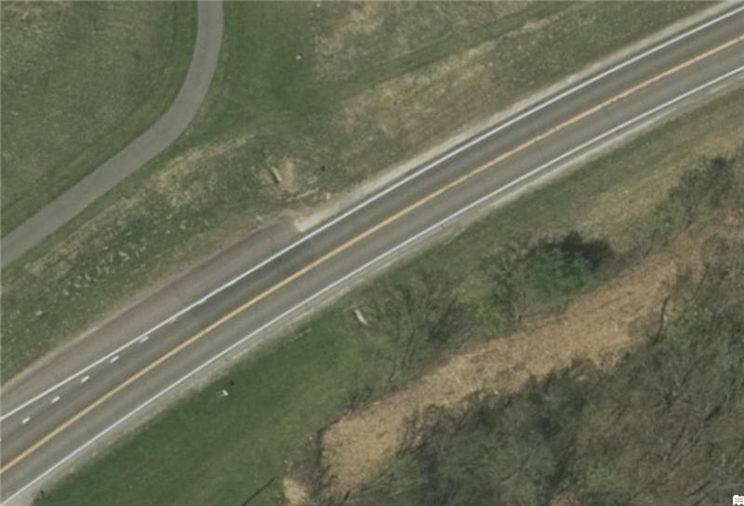
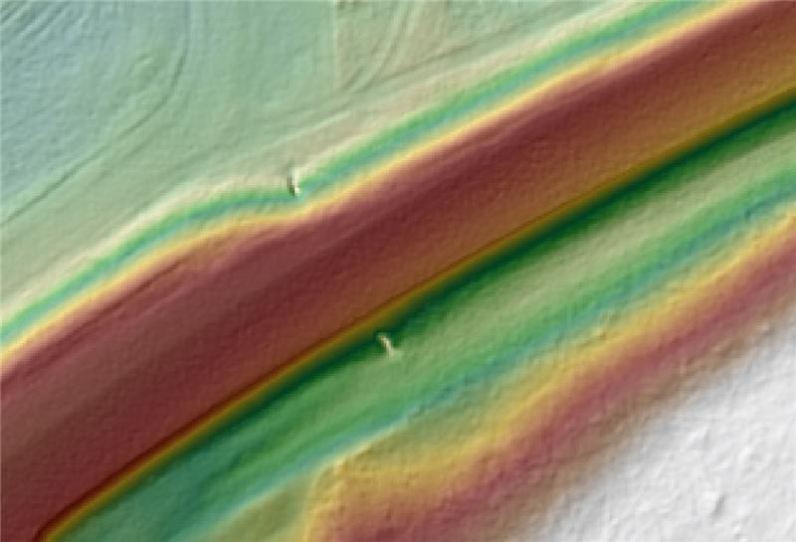
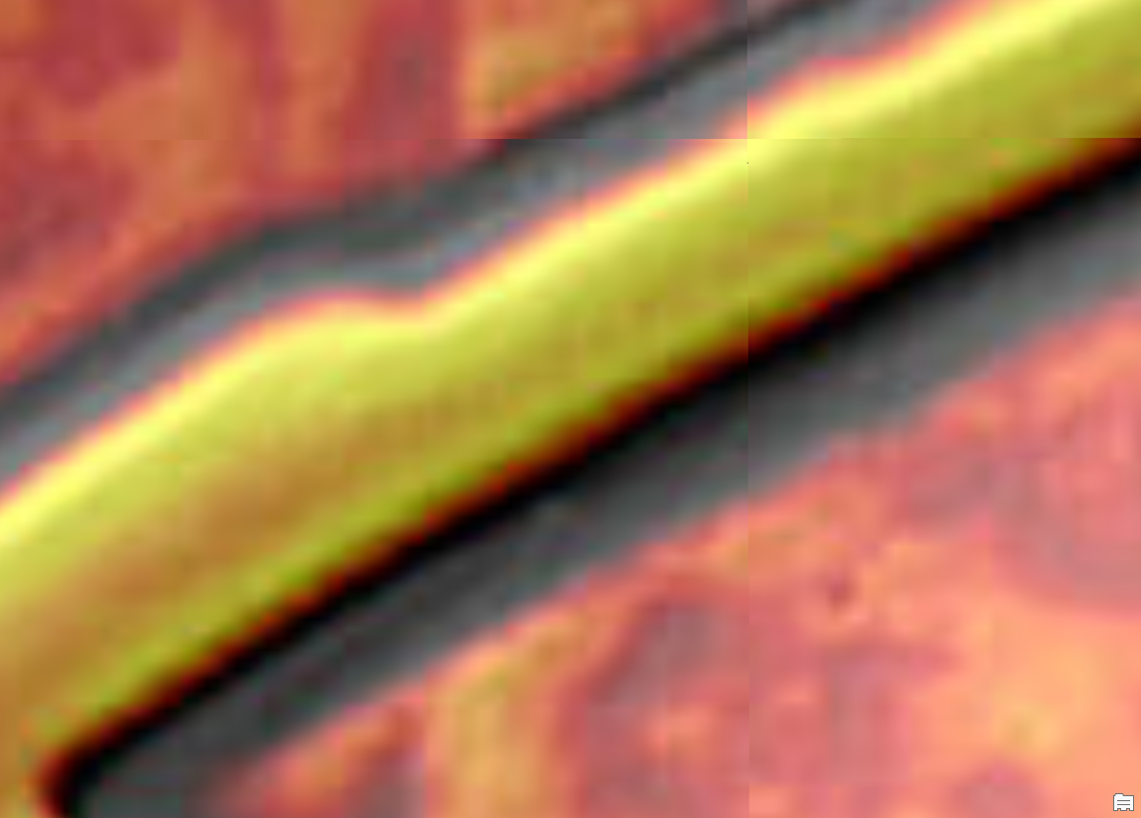
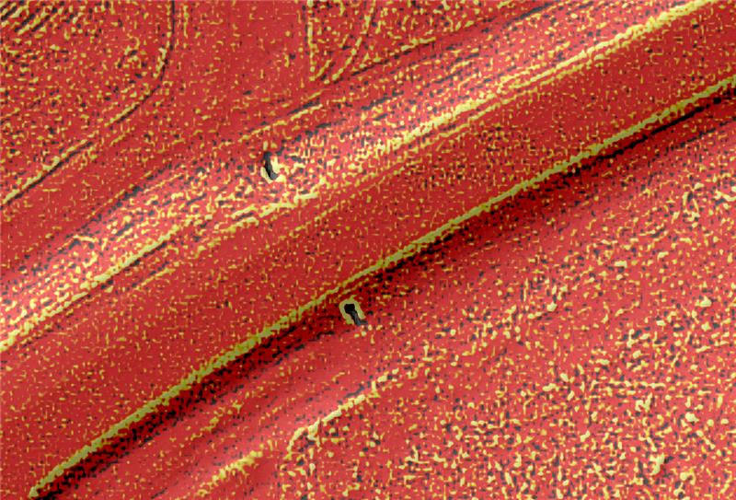
Early Results – Culvert Capture High Density QL0 (30pts/m²)
Existing 1-meter DEM
Existing 3-meter DEM
QL0 1-foot DEM
Existing 3-meter DEM HPI
QL0 1-foot DEM HPI
Notes:
GIS results provided by Rick Moore
MnDOT Accuracy Test Results
Evaluation of High-Density Quality Level – 0 (HD QL0)
2020 Goodhue County Lidar Procurement Project
3DGeomatics Lidar Acquisition Team Member Colin Lee (MnDOT Photogrammetrist) and MnDOT surveyors from the District-6 office analyzed a sample of high-density quality level-0 (HD QL0), lidar point cloud data (~30 point per square meter) from the 2020 Goodhue County lidar data acquisition.
HD QL0 Criteria
Standard QL0 ≥ 8.0 Pulse Density (ANPD) [pulse/m²]
High Density QL0 ≥ 30+ Points/ m² (exceeds minimum base spec for QL0 with a work order defined additional amount of points equal to or greater than 30 points per sq meter [suggested description described as HD QL0 or HD QL0-30])
Results
Test points represent open, hard, smooth surfaces.
The test results are showing that 90% of the lidar points evaluated have elevation values within 0.033 (ft) to 0.066 (ft) of actual, onsite, vertical survey results.
As expected, a few outliers are falling up to 0.30 (ft) outside of the 90% distribution
Unit Conversion
Converting these results to centimeters, we see that the vertical accuracy of this HD QL0-30 lidar data is within 1.0 (cm) to 2.0 (cm) of onsite, vertical survey results.
These values are better than the minimum lidar base specification of ≤ 0.03 m (≤ 3.0 cm / 1.181 in).
0.033 ft = 0.396 inches = 1.00584 cm
0.066 ft = 0.792 inches = 2.01168 cm
Disclaimer
All publicly funded QL-0 lidar acquisitions must adhere to the USGS Lidar Base Specification vertical accuracy, pulse spacing and density criteria. Although the 2020 Goodhue County QL0 lidar data procurement project collected Quality Level 0 (QL0), Non-vegetated vertical accuracy RMSEz = 5.0 cm as defined by USGS Lidar Base Specifications, the statement of work (SOW) was unique, it specified the acquisition collect lidar points at 30 points per square meter nominal pulsed density.
The Goodhue SOW stated:
Aggregate Nominal Pulse Spacing (ANPS) (m) ≤0.35
Aggregate Nominal Pulse Density (NPD) (pls/m2) ≥ 8.0
DEM cell size (minimum) = 1.5m /1 foot
Point cloud deliverable must ≥30

Slide 16
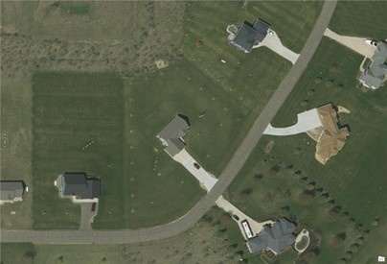
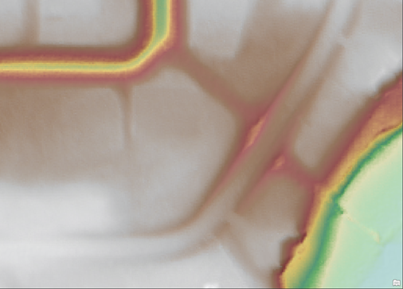
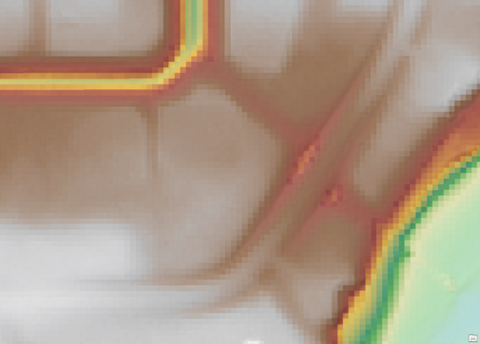
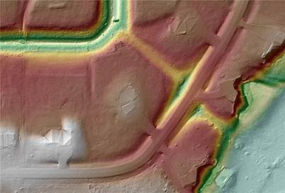
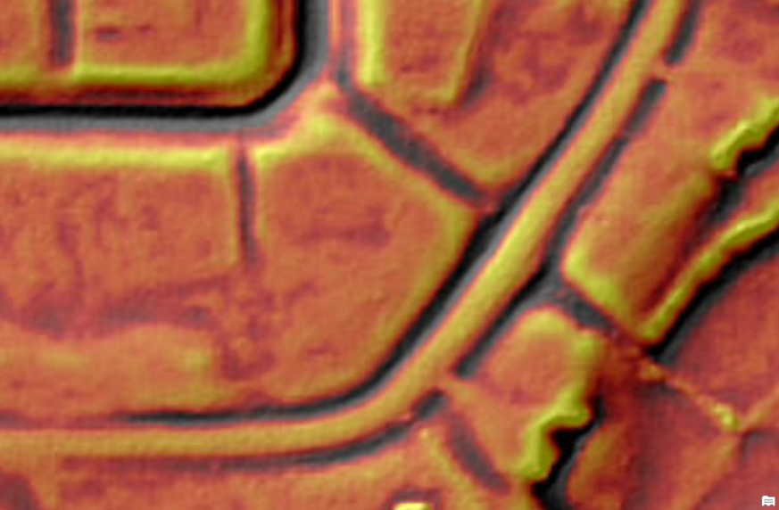
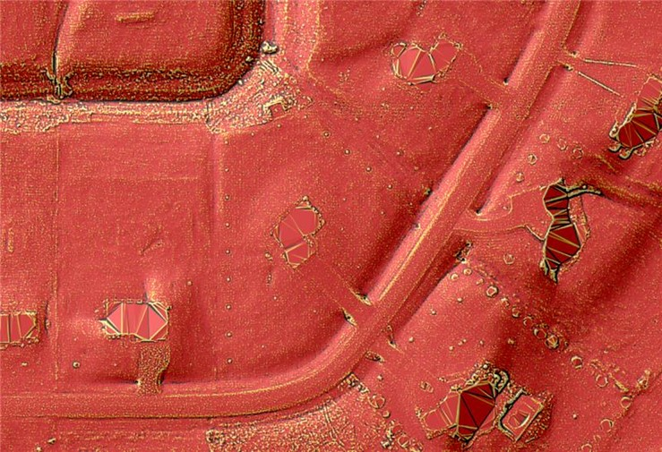
Early Results – Culvert Capture High Density QL0 (30pts/m²)
Existing 1-meter DEM
Existing 3-meter DEM
QL0 1-foot DEM
Existing 3-meter DEM HPI
QL0 1-foot DEM HPI
Notes:
GIS results provided by Rick Moore
MnDOT Accuracy Test Results
Evaluation of High-Density Quality Level – 0 (HD QL0)
2020 Goodhue County Lidar Procurement Project
3DGeomatics Lidar Acquisition Team Member Colin Lee (MnDOT Photogrammetrist) and MnDOT surveyors from the District-6 office analyzed a sample of high-density quality level-0 (HD QL0), lidar point cloud data (~30 point per square meter) from the 2020 Goodhue County lidar data acquisition.
HD QL0 Criteria
Standard QL0 ≥ 8.0 Pulse Density (ANPD) [pulse/m²]
High Density QL0 ≥ 30+ Points/ m² (exceeds minimum base spec for QL0 with a work order defined additional amount of points equal to or greater than 30 points per sq meter [suggested description described as HD QL0 or HD QL0-30])
Results
Test points represent open, hard, smooth surfaces.
The test results are showing that 90% of the lidar points evaluated have elevation values within 0.033 (ft) to 0.066 (ft) of actual, onsite, vertical survey results.
As expected, a few outliers are falling up to 0.30 (ft) outside of the 90% distribution
Unit Conversion
Converting these results to centimeters, we see that the vertical accuracy of this HD QL0-30 lidar data is within 1.0 (cm) to 2.0 (cm) of onsite, vertical survey results.
These values are better than the minimum lidar base specification of ≤ 0.03 m (≤ 3.0 cm / 1.181 in).
0.033 ft = 0.396 inches = 1.00584 cm
0.066 ft = 0.792 inches = 2.01168 cm
Disclaimer
All publicly funded QL-0 lidar acquisitions must adhere to the USGS Lidar Base Specification vertical accuracy, pulse spacing and density criteria. Although the 2020 Goodhue County QL0 lidar data procurement project collected Quality Level 0 (QL0), Non-vegetated vertical accuracy RMSEz = 5.0 cm as defined by USGS Lidar Base Specifications, the statement of work (SOW) was unique, it specified the acquisition collect lidar points at 30 points per square meter nominal pulsed density.
The Goodhue SOW stated:
Aggregate Nominal Pulse Spacing (ANPS) (m) ≤0.35
Aggregate Nominal Pulse Density (NPD) (pls/m2) ≥ 8.0
DEM cell size (minimum) = 1.5m /1 foot
Point cloud deliverable must ≥30

Slide 17
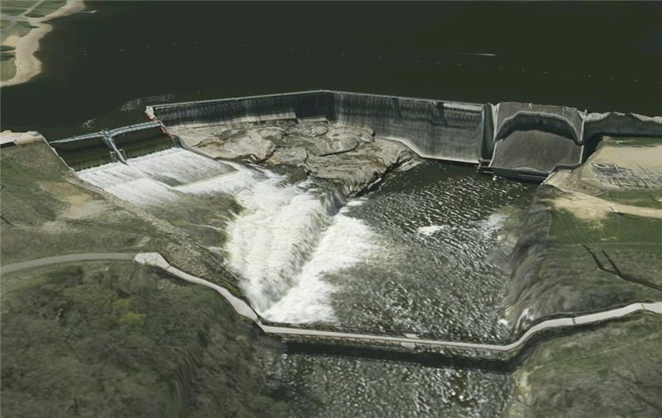
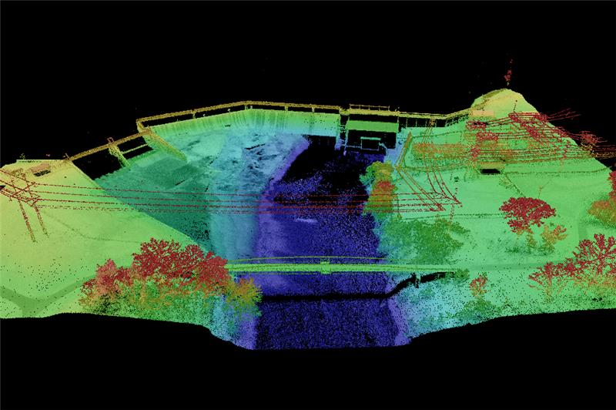
Early Results
Imagery colored QL0 Lidar Point Cloud. Lake Byllesby Dam & Reservoir Dakota County.
HD QL0 Lidar Point Cloud. Lake Byllesby Dam & Reservoir Dakota County.

Slide 18
Next steps
Future Acquisitions Under Consideration
Central Mississippi River LAB
Red River North & South LAB
Upper Mississippi River LAB
Other LAB's considered as potential partners are identified

Slide 19
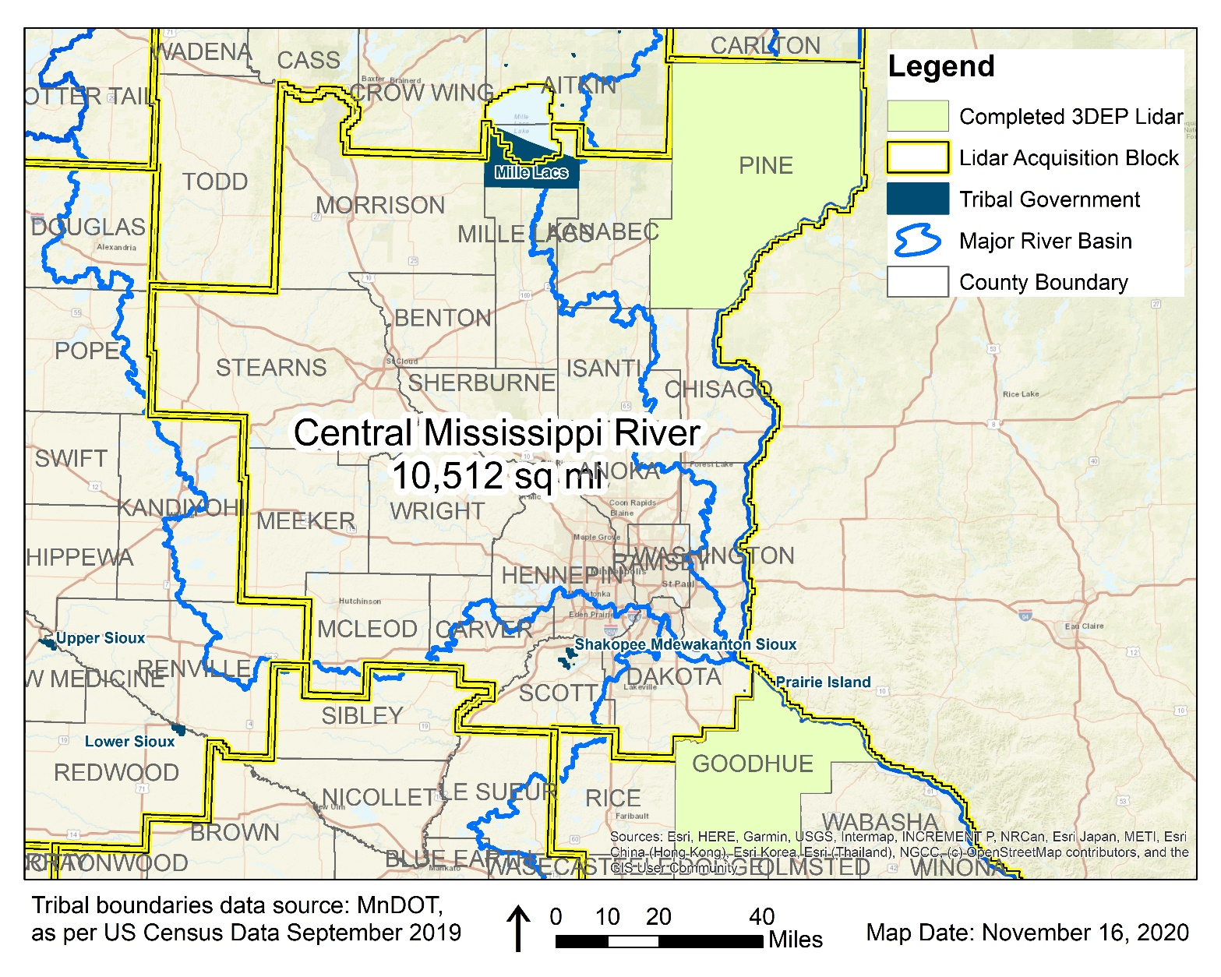
Outreach: Central Mississippi River Lidar Acquisition Block
Estimated USGS 3DEP Contribution |  | Total Partner Contributions Needed
% | $ | % | $
40% | $1,387,584 | 60% | $2,081,376
10,512 square miles at $330 per square mile = $3,468,960 TOTAL

Slide 20
Break

Slide 21
Agenda Item 8
Archiving Implementation Report and Pilot Workgroup Approval
Ryan Mattke

Slide 22
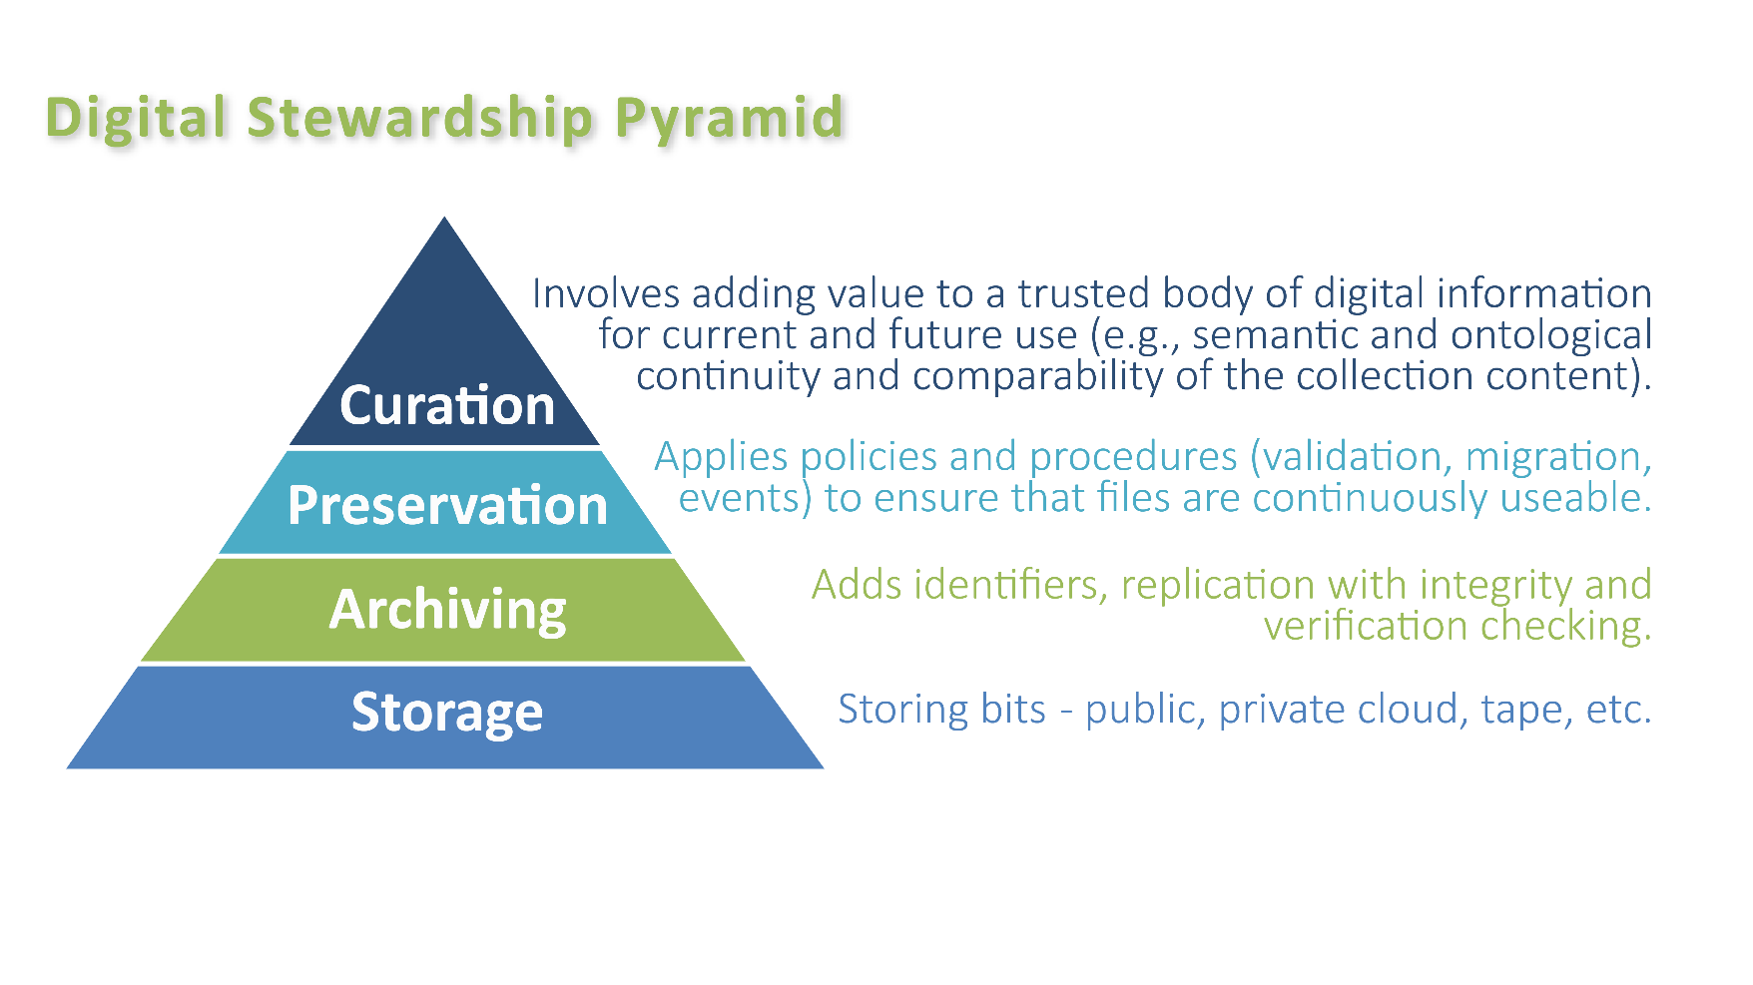
Archiving Implementation Workgroup - Final Report
Mission statement:
Define and facilitate the implementation of an archive for Minnesota geospatial data by building on the work of the Archiving Workgroup

Slide 23
Archiving Implementation Workgroup
Members:
Sarah Barsness* - Minnesota State Archives
David Brandt⁺ - Washington County
Jennifer Corcoran - MN DNR
Jon Hoekenga - Met Council
Melinda Kernik - UMN Libraries
Len Kne* - UMN / U-Spatial
Leanne Knott - Goodhue County
Carol Kussmann ⁺ - UMN Libraries
Brent Lund* - MNIT / MnGeo
Karen Majewicz^{* +} -UMN Libraries (Vice Chair)
Andra Mathews ⁺ - MN DOT
Ryan Mattke^{* +} - UMN Libraries (Chair)
Nancy Rader - MNIT / MnGeo
Soren Rundquist - EWG
Zeb Thomas - MNIT / MN DNR
Ben Timerson - MN DOT
Brandon Tourtelotte ⁺- Pro-West & Associates
* Subgroup Lead
⁺ Final Report Subgroup

Slide 24
Archiving Implementation Workgroup - Final Report
Final Report - Selected Key Findings:
1. Program Design
Governance framework consists of a GAC Archiving Committee, an Operations Group, and a Working Team
Staffing needs will be ongoing and include at least one full-time Archivist. Recommendations also include at least one Archival Assistant and a software developer ‒ full time at first, part-time after launch.
Coordination strategy includes an outline of the benefits for the Minnesota geospatial community, as well as specific roles for Data Providers, Data Consumers, and Project Sponsors

Slide 25
Archiving Implementation Workgroup - Final Report
Final Report - Selected Key Findings:
2. Technology
File formats – the archive will store the original formats, but may also create and store alternative formats.
Metadata – necessary for archiving includes descriptive metadata, structural & technical metadata, and administrative metadata.
Infrastructure – recommendations for storage, discovery platform, and exit strategy.

Slide 26
Archiving Implementation Workgroup - Final Report
Final Report - Selected Key Findings:
3. Workflows
Building on the previous work outlined in the Archiving Strategy Report, the group devised two paths for adding geospatial data to the archive:
Path 1: Data ingested from the Commons – all Commons data will by default be eligible for archiving and will be added to the archive on an annual basis or more frequently as deemed by the Archivist or data provider.
Path 2: Items added directly from data providers – all other eligible data. This data will receive curatorial review before being accepted, and the Archivist will work with the data provider to prepare files for consumption.

Slide 27
Archiving Implementation Workgroup - Final Report

Slide 28
Archiving Implementation Workgroup - Final Report

Slide 29
Archiving Implementation Workgroup - Final Report
Final Report - Selected Key Findings:
The archive system will require continual administration and management. These tasks are designed to ensure accurate preservation and continuous accessibility of the collections. Key activities will include:
Data management
Fixity checks
Performing backups
Verifying file format accessibility
Conducting systems Review

Slide 30
Archiving Implementation Workgroup - Final Report
Final Report - Selected Key Findings:
4. Funding
Our Funding strategy recommendation is to pursue a legislative appropriation while also exploring the potential for grant funding during the implementation phase.

Slide 31
Archiving Pilot Workgroup - Proposed
Final Report - Selected Key Findings:
TIMELINE
Phase 1:
Research
2019-2020
Phase 2:
Pilot & Proposal
2021-2022
Phase 3: Implementation 2023
Phase 4:
Ongoing Operations
2024 and beyond

Slide 32
Archiving Implementation Workgroup - Final Report
Next Steps
Create an Archiving Pilot Workgroup
Continue to pursue funding strategies in order to build the foundation for a funding ask, likely in the 2023 legislative session.

Slide 33
Archiving Implementation Workgroup - Final Report
Questions?

Slide 34
Archiving Pilot Workgroup - Proposed
Mission Statement:
Evaluate and test a range of potential archive technologies, create a proof of concept with sample sets of data, and continue to perform community outreach in order to build on the work of the Archiving Implementation Workgroup and the Archiving Workgroup.
Objectives:
Evaluate and test potential archive technologies
Create a proof of concept with pilot data sets in a repository
Send appropriate communications in order to continue to build support for the archiving effort within identified stakeholder communities

Slide 35
Archiving Pilot Workgroup - Proposed
Group Members
Pilot Subgroup
Sarah Barsness - Minnesota State Archives
Melinda Kernik – UMN Libraries
Carol Kussmann – UMN Libraries
Karen Majewicz – UMN Libraries (Subgroup Lead)
Ryan Mattke – UMN Libraries
Zeb Thomas - MNIT / MN DNR
Outreach Subgroup
Andra Mathews – MN DOT
Ryan Mattke – UMN Libraries (Subgroup Lead)
Nancy Rader - MNIT / MnGeo
Resource People (consulted as needed)
Jon Hoekenga - Met Council
Randy Knippel - Dakota County
Brent Lund - MNIT / MnGeo
Jesse Reinhardt - Hennepin County

Slide 36
Archiving Pilot Workgroup - Proposed
Planned activities and deliverables:
Evaluate and test potential archive technologies (May-October 2021)
Draft outline of presentation for GIS/LIS (May 2021)
Create a proof of concept with pilot data sets in a repository (October 2021)
Engage with data creators at various levels of government, academic institutions, and relevant stakeholders (begin sending communications by July 2021)
Present at 2021 GIS/LIS (October 2021)
Report for GAC (December 2021)

Slide 37
Archiving Pilot Workgroup - Proposed
Questions?

Slide 38
Agenda Item 9
Legislative Update
Dan Ross
Digital Coast Act – signed December 2020
Provides statutory authority for and revises the National Oceanic and Atmospheric Administration's (NOAA's) Digital Coast program. (The program currently exists under NOAA to provide data, tools, and training that communities use to manage their coastal resources.)
Victoria Reinhardt – NACo efforts

Slide 39
Agenda Item 10
Updates on GAC Priority Projects and Initiatives
Cory Richter

Slide 40
Updates on GAC Priority Projects and Initiatives
1. Most recent success
2. Experiencing a barrier?
3. Next task

Slide 41
GAC Priorities
GAC Rank | Project or Initiative Description | Status | Project Owner | Champion
1 | All Public Data Free and Open | Active |  | many
2 | Parcel Data | Active | Alison Slaats | Mark Kotz
3 | Updated and Aligned Boundary Data | Active | Preston Dowell | Dan Ross
4 | Road Centerline Data | Active | MnGeo | Dan Ross
5 | Address Points Data | Active | MnGeo | Dan Ross
6 | Underground Utilities Data | Active | Steve Swazee | Barb Cedarberg
7 | Critical Infrastructure Data | Active | Stacey Stark | Steve Swazee
8 | New Lidar Acquisition | Active | Gerry Sjerven | Dan Ross
9 | Image Service Improvements | Active | Alison Slaats | Dan Ross
10 | Archiving Implementation | Active | Ryan Mattke | many
11 | Culvert Data Standard | Active | Rick Moore | Jonathan Lord
12 | U.S. National Grid Materials | Active | Randy Knippel | Randy Knippel

Slide 42
GAC Priorities
GAC Rank | Project or Initiative Description | Status | Project Owner | Champion
13 | Accurate Hydro-DEMs | Active | Sean Vaughn | many
14 | Remonumentation of Section Corners | Active | Pat Veraguth | Dan Ross
15 | Trails Data Standard | Active | Sandra Yassin
16 | Success Stories for Geospatial Technology | Active
17 | Geospatial Commons Advisory Group | Inactive
18 | NG911 Forum | Inactive
19 | Basemap Services | Inactive
20 | Parks Data Standard | Inactive
21 | Optical, Lidar, Radar, Aerial and Satellite Imagery Strategy | Inactive
22 | High-res Climate Projection Data | Inactive
23 | Criminal Justice Info Best Practices | Inactive

Slide 43
GAC Priorities
GAC Rank | Project or Initiative Description | Status | Project Owner | Champion
24 | Licensed Businesses Data | Inactive
25 | Snow Emergency Parking Restriction Data | Inactive
26 | Geospatial Data Asset Inventory | Inactive
27 | Property Crimes Data | Inactive
28 | Street Parking Restrictions Data Standard | Inactive

Slide 44
Priority 2: Statewide publicly available parcel data
Most recent success:
Meeting of the Parcel and Land Records Committee and establishment of an Open Data Parcel subcommittee co-chaired by Ryan Stovern and Alison Slaats. The goal of the subcommittee is to build an aggregated parcel data viewer, educate end users on proper parcel data usage, work with outreach committee to advocate for open data.
2. If you are experiencing a barrier:
none
3. Next task:
Set up of meeting of subcommittee to define next steps and timeline to work towards sharing parcel data publicly for open data counties

Slide 45
Priority 3: Updated and aligned boundary data
Most recent success:
The Parcel and Land Records Committee established the Boundary Alignment subcommittee.
2. If you are experiencing a barrier:
none
3. Next task:
A goal of the subcommittee is to build a PLSS inventory map and increase awareness on why alignment is necessary.

Slide 46
Priority 4: Road Centerline Data
Most recent success:
Internal statewide aggregation of road centerlines with address ranges to the NG911 data model
2. If you are experiencing a barrier:
Challenges but not barriers
3. Next task:
Snapping across county boundaries

Slide 47
Priority 5: Address Points Data
Most recent success:
Statewide aggregation of address points to the NG911 data model
2. If you are experiencing a barrier:
Challenges but not barriers – not currently available to provide to the public
3. Next task:
Statewide aggregation of updated data from authoritative sources

Slide 48
Priority 8: New Lidar Acquisition
Most recent success:
Successful grants for NE MN and Southern MN
2. If you are experiencing a barrier:
Challenges but not barriers
3. Next task:
Completion of Joint Funding Agreements with each funding partner and completion of Task Order for each acquisition

Slide 49
Priority 9: Improvements to the MnGeo Image Service, such as Web Mercator support, tiling, and complementary options such as “composite of latest leaf off imagery”, and downloading options
Most recent success:
Update of image service with Ramsey County 0.5 ft 2020 leaf-off imagery (natural color and CIR)
Update of composite image service with 2020 leaf-off imagery of the 7-county Twin Cities metropolitan area and 2019 statewide NAIP leaf-on imagery from the USDA Farm Service Agency
2. If you are experiencing a barrier:
none
3. Next task:
Follow up on recommendations of Image Service Sustainability Committee to add and retire some image layers.

Slide 50
Priority 14: Remonumentation of all section corners
Most recent success:
Parcel and Land Records Committee established the Remonumentation subcommittee.
2. If you are experiencing a barrier:
none
3. Next task:
A goal of the subcommittee is to build a legislative proposal for remonumentation

Slide 51
Agenda Item 11
Announcements

Slide 52
Next Meeting
May 26, 2021

