Slide 1
Spring Aerial Imagery program

Slide 2
Why Spring Imagery?
Outgrowth of a multi-agency effort to update the National Wetland Inventory for Minnesota
Primarily funded by the ENRTF as recommended by LCCMR
Intent is to meet or exceed the federal wetland mapping standards

Slide 3
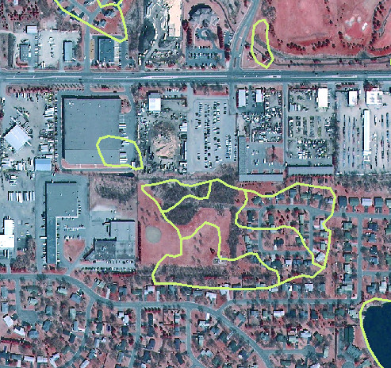
Why do we need a NWI update?
Lake Superior
Some things have changed
since 1980s.
Some things were never that accurate.

Slide 4
Imagery Specifications
Statewide Acquisition
Spring, leaf-off
0.5-meter resolution
Four spectral bands (R, G, B, NIR)
Orthorectified & stereo
USGS quarter quad tiles

Slide 5
SAIP – Acquisition Status & Data Access
Five phases over seven years
Imagery already acquired for three phases
Northeast
East-Central
South
Accessed through MnGeo image server
Upcoming phases
Central Lakes – 2013
Northwest - 2015
http://geoint.lmic.state.mn.us/cgi-bin/wms?

Slide 6
SAIP – Funding & Management
Base funding from ENRTF
Co-managed by DNR & MnGeo
Partner funding
Resolution buy-up
Expanding acquisition area
USGS/NGA | Dakota County
NOAA | Scott County
DNR | Sibley County
MPCA | Murray County
Metropolitan Council | St. Louis County
MMCD | McLeod County
 | Rice County

Slide 8
Partnership Opportunities
Why?
Support program
Improve accuracy
Complete specific area of interest
Increase resolution/detail
How?
Joint Powers Agreement
Interagency Agreement
Purchase Order

Slide 9
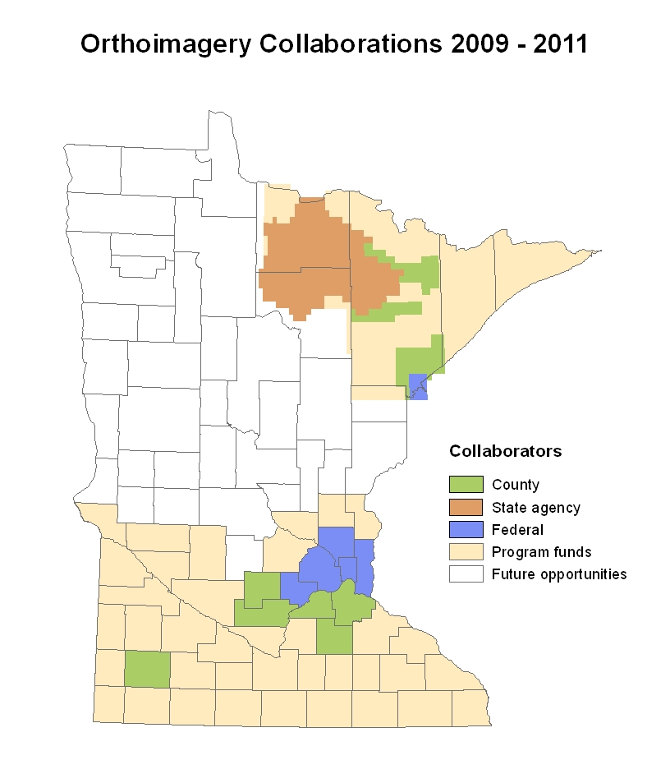

Slide 10
Spring Aerial Imagery Program Partnerships 2009 – 2011

Slide 11
McLeod County
Christy Christensen
GIS Director
Hutchinson, MN
christy.christensen@co.mcleod.mn.us

Slide 12
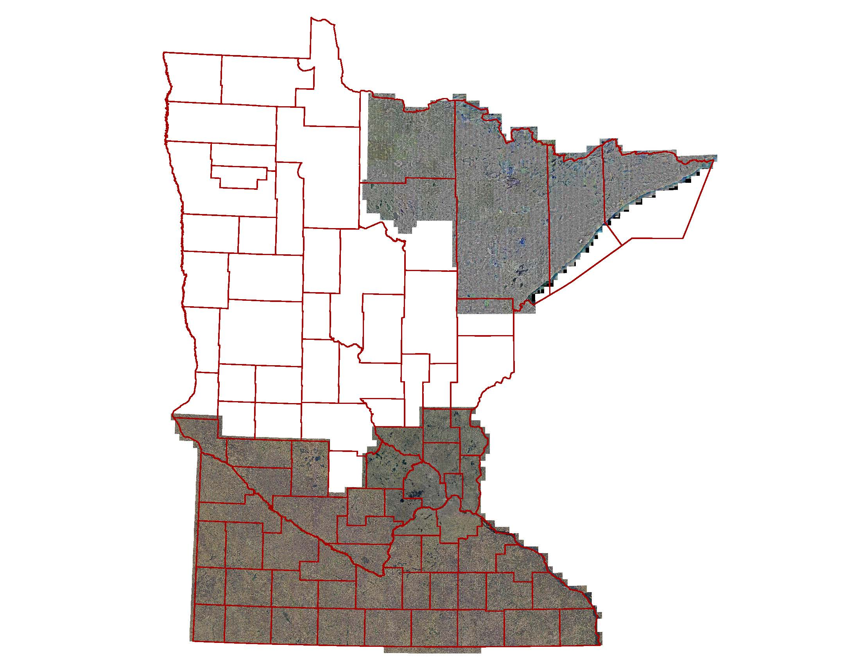
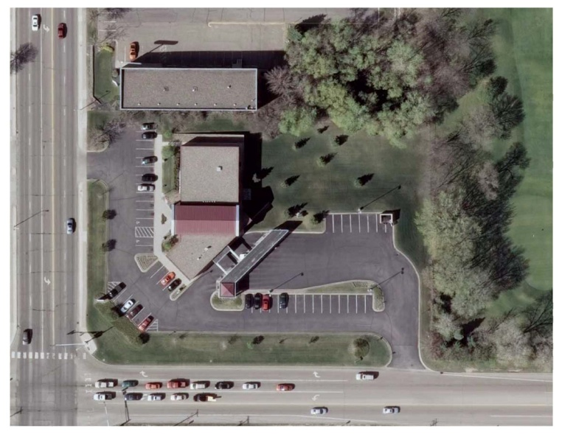

Slide 13
Next Steps
If you’re interested in discussing a buy-up,
Or interested in learning more,
Or have suggestions to improve the program:
Contact Chris Cialek or Steve Kloiber
chris.cialek@state.mn.us steve.kloiber@state.mn.us
If you have a colleague in the target region
Let them know about buy-up options

Slide 14
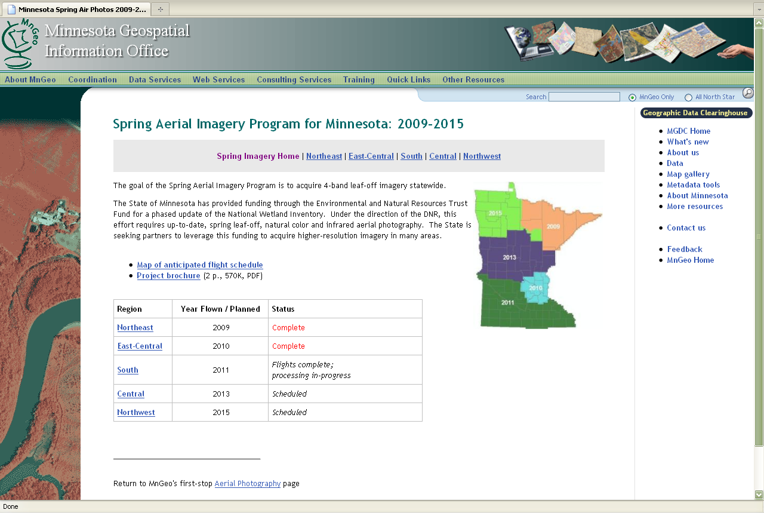
http://www.mngeo.state.mn.us/chouse/airphoto/spring2009-2015.html

