Slide 1
Minnesota LiDAR
Wednesday , November 4th 2015, 1:00 pm – 3:00 pm
MPCA Building, Training Room 2 (Lower Level)
Minnesota LiDAR:
Reviving / restructuring the work of the former Elevation, and Hydrography Committees and the existing LiDAR R&E Committee into a new committee to deal with LiDAR related issues for Minnesota.
1

Slide 2
Introduction
2

Slide 3
Format
2 Hours
  First Hour
    Introduction
    Review of Topics
  Second Hour
    Discussion
        Topics
        New Ideas

Slide 4
Introductions
  Please Introduce Yourself
      Name and Organization only.
Notes:
Inform those attendees who are new to DEM Modification for hydrologic applications of DEMs
LiDAR is continually attracting new users to the technology.
Introduce the need benefits of a regional / statewide culvert inventory by WATERSHED.

Slide 5
Objective
  Scope the possibility of reviving/restructuring the work of the former LiDAR, Elevation, and Hydrography Committees into a new committee to deal with LiDAR related issues.
  Model the structure based on former Elevation Committee.
Notes:
Inform those attendees who are new to DEM Modification for hydrologic applications of DEMs
LiDAR is continually attracting new users to the technology.
Introduce the need benefits of a regional / statewide culvert inventory by WATERSHED.

Slide 6
Committee Mission
  Coordinate and Collaborate on LiDAR related topics and issues in Minnesota.
  Guide LiDAR collection, management, dissemination, application, and derived products (including Hydrography) for Minnesota.
Notes:
Inform those attendees who are new to DEM Modification for hydrologic applications of DEMs
LiDAR is continually attracting new users to the technology.
Introduce the need benefits of a regional / statewide culvert inventory by WATERSHED.

Slide 7
Outcomes
      Consensus on need for a new committee.
      Indication of the level of interest for member participation
      Interest in serving as committee chair, co-chair, or workgroup leader
Notes:
Inform those attendees who are new to DEM Modification for hydrologic applications of DEMs
LiDAR is continually attracting new users to the technology.
Introduce the need benefits of a regional / statewide culvert inventory by WATERSHED.

Slide 8
Outcomes (continued)
      Intent to move forward to develop charter and work plan.
      General outline of issues to be included (beyond what we listed in the announcement).
      Existing LiDAR Research and Education Committee is mostly a group of technical folks specializing in water resource and terrain analysis.
      How do we represent other emerging areas of application and expertise?
          Vegetation/Forestry – Tyler and Rick
          Product – Sean (HPI), Steve (River polygons).
Notes:
Inform those attendees who are new to DEM Modification for hydrologic applications of DEMs
LiDAR is continually attracting new users to the technology.
Introduce the need benefits of a regional / statewide culvert inventory by WATERSHED.

Slide 9
Catalysts
9

Slide 10
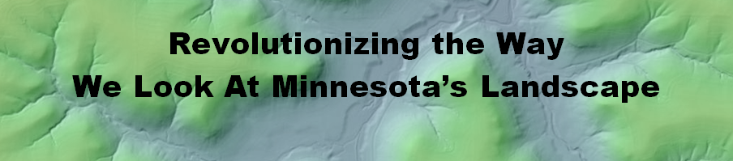
Catalysts
LiDAR
  LiDAR is the Great Educator for Helping Resource Managers Convey the Conservation Message to Customers/Citizens.
10

Slide 11
      Existing LiDAR Research and Education Committee is mostly a group of technical folks specializing in water resource and terrain analysis.
      How do we represent other emerging areas of application and expertise?
            Vegetation/Forestry –
            DNR Resource Assessment will be receiving a $1 million grant to collect high density (12ppm) bathymetric LiDAR over a 500,000 acre area.
                We will need a lot of help/advice with planning the collect so that it is beneficial to a wide variety of stakeholders.
  Existing LiDAR Research and Education Committee is mostly a group of technical folks specializing in water resource and terrain analysis.
  How do we represent other emerging areas of application and expertise?
  Vegetation/Forestry – Tyler and Rick
  Product – Sean (HPI), Steve (River polygons).
  Touch on the Buffer Mapping Initiative
  Most important message –
      Proper replication of landscape hydrology in DEMs.
Notes:
Inform those attendees who are new to DEM Modification for hydrologic applications of DEMs
LiDAR is continually attracting new users to the technology.
Introduce the need benefits of a regional / statewide culvert inventory by WATERSHED.

Slide 12
Catalyst (Continued) -Timing
I feel the timing is right.
        Proposed twice in the past couple years.
        Hydrography – Team is still in place in the agencies
        A forestry/veg team is emerging.
        One team of folks related to Hydro is .
            Susanne Maeder
            Mark Olsen
            Chris Sanocki
            Sean Vaughn
            Lyn Bergquist
            Glenn Radde
            Steve Kloiber

Slide 13
Catalyst (Continued) -Hydrography
  Build awareness - Continue to build recognition and support for statewide NXG-Hydro.
    GIS community support and outreach.
  Proper replication of landscape hydrology in published Hydro-modified DEMs (hDEMs).
  EleHydro - Bringing LiDAR & Hydrography together in the same development and management architecture.
  Bring LiDAR & Hydrography together in the same development and management architecture.
Notes:
Inform those attendees who are new to DEM Modification for hydrologic applications of DEMs
LiDAR is continually attracting new users to the technology.
Introduce the need benefits of a regional / statewide culvert inventory by WATERSHED.

Slide 14
Catalyst (Continued) -Hydrography
2014 GIS/LIS
Questions on – Hydrography
Watercourse Spatial Data
    Is existing, readily available authoritative watercourse hydrography, meeting all of your business needs?
        e.g. 1:24 K WBD and MN DNR watersheds; NHD and DNR watercourses.
    Are you deriving your own hydrography from LiDAR data and or LiDAR-derived products to meet this need?
        If yes, then why?
14

Slide 15
Catalyst (Continued) -Hydrography
2014 GIS/LIS Consortium
Panel Session
Audience Identified Priority
1. New Accurate Hydrography
Hydrography (line-work) that lines up with/coincident with
  a. Water conveyance landforms captured by LiDAR .
  b. Water visible on aerial imagery (e.g. DOQs)
Notes:
Explain we created the guidance document.

Slide 16
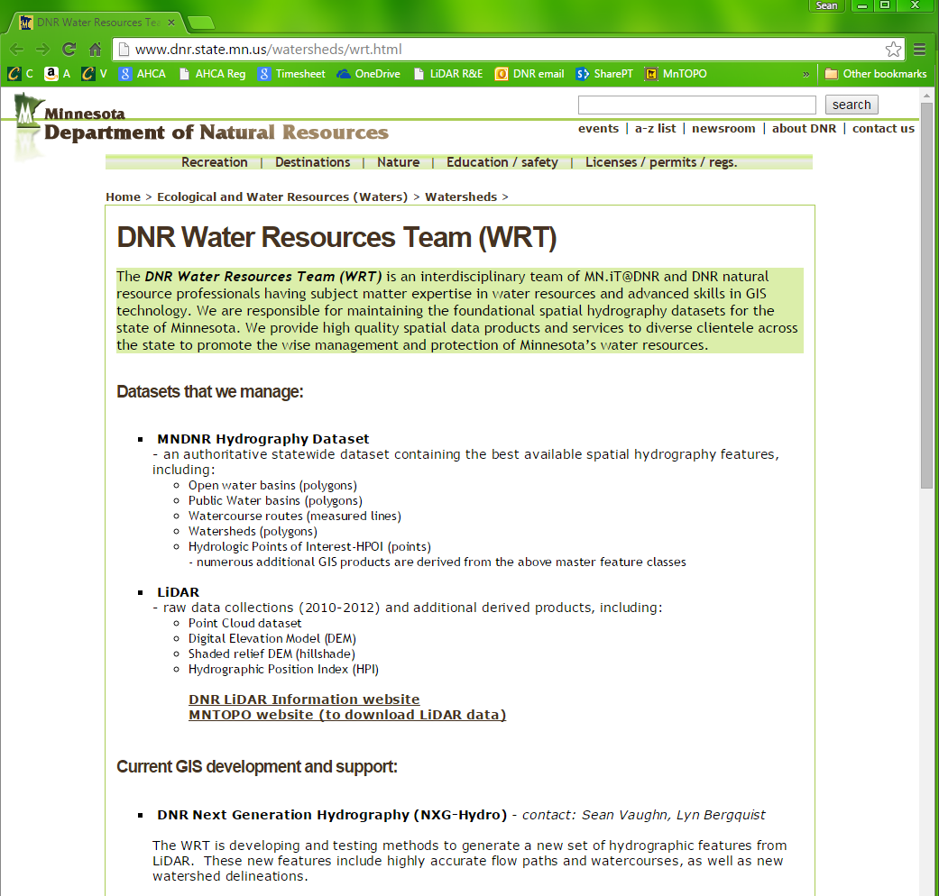
Catalyst (Continued) -Hydrography
DNR GIS Water Resources Team
Strengthened the role of WRT in watercourse generation.
Interdisciplinary Coordinated approach.

Slide 17
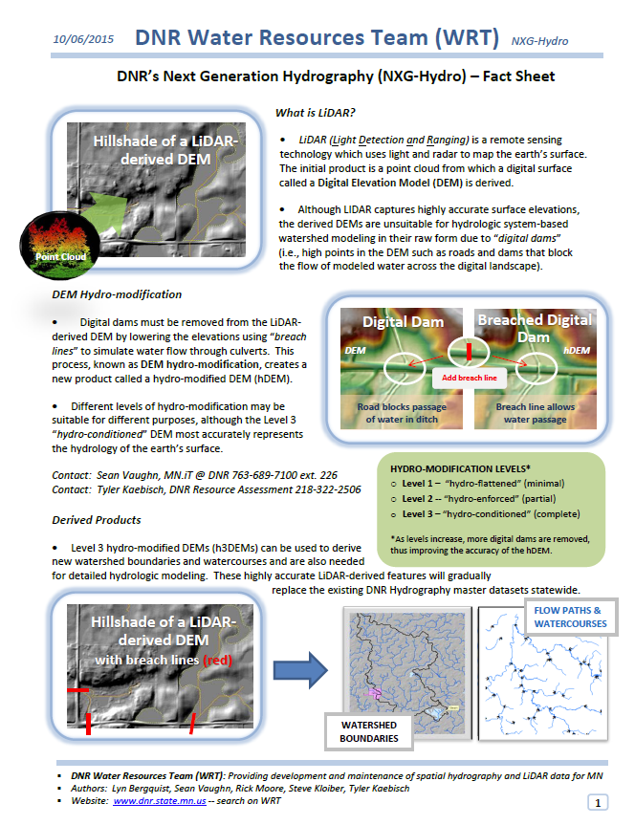
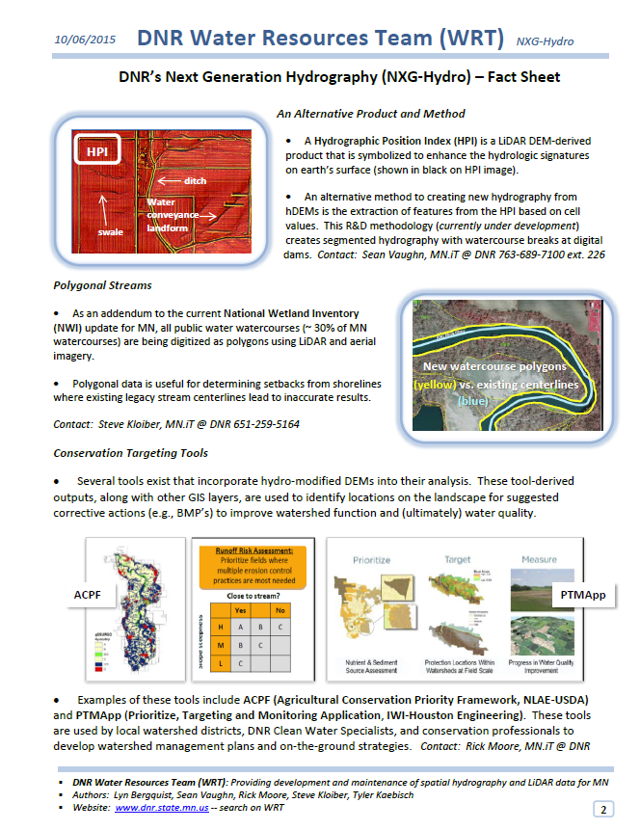
WRT NXG-Hydro – Watercourses Flyer

Slide 18


Catalyst (Continued) -Hydrography
2015 GIS/LIS
Watercourse Hydrography Development from LiDAR­derived Products - Creating Next Generation Watercourse Hydrography (NXG­Hydro) for Minnesota’s Landscape.
Sean Vaughn
GIS Hydrologist | LiDAR Steward
Tyler Kaebisch
Research Analysis Specialist
Rick Moore
LiDAR/Watershed Data Steward
Steve Kloiber
NWI

Slide 19
WRT Approach Recognizes ( 1)
  The “Big Picture”
        Our responsibility is to produce a product that serves the greatest number of business needs.
  The need for one hydrography database for Minnesota based on modern and accurate base datasets (i.e LiDAR and DOQs).
        Watersheds
        Watercourses
  Mix of methods and project-by-project to get the job done
      We are still developing methods and policy to support NXG-Hydro.
Notes:
Inform those attendees who are new to DEM Modification for hydrologic applications of DEMs
LiDAR is continually attracting new users to the technology.
Introduce the need benefits of a regional / statewide culvert inventory by WATERSHED.

Slide 20
Goals / Discussion Topics
20

Slide 21
Goals (Topics for Discussion)
LiDAR Outreach:
Improving education directed at both technical and managerial staff about the business needs and emerging sciences related to LiDAR.
Build support for more LiDAR and hydro-terrain analysis training.
Have coordinated approaches to ancillary data collection (i.e. culverts, digital dam breach lines) that allow for the development of hydro-modified DEMs.

Slide 22
Goals (Continued)
LiDAR Collection:
Planning for and promoting coordinated LiDAR collections.
This committee will help guide plans for new statewide, regional and project-based LiDAR collections that meets national 3DEP standards.
Although a new statewide collect may appear to be a lofty goal at this point in time Minnesota needs to be poised for drafting proposals in the 3DEP process.

Slide 23
Goals (Continued)
LiDAR Data Management and Data Dissemination:
Steering decisions, and building support and coordinated approaches to management and dissemination,
Support for increased hardware and software needs for managing LiDAR data including future LiDAR collections.

Slide 24
Goals (Continued)
LiDAR-Derived Next Generation Hydrography
(NXG-Hydro):
Support the development of an updated, denser hydrography base derived from LiDAR: developing the process for creating this update; developing a strategy for creating statewide layers (including coordination and funding).
Revisit the processes by which this raw data is converted to DNR Hydrography and NHD.

Slide 25
Goals (Continued)
Terrain Analysis:
Support and monitor the creation of statewide products for hydro-terrain analysis (e.g., SPI, CTI etc.).
        hydro-modification activities that support conservation practices so that the funds being expended to create hydro-modified DEMs result in more consistent products that can be made available to other users.

Slide 26
Discussion
26

Slide 27
Discussion (Continued)
We do not have all the answers coming into this meeting.
We will not have all the answers as we conclude.
What is the general interest in pursuing this?
What are people most interested in?
Who is willing to participate as a chair or co-chair?
Structure, -One committee and work groups, or many committees?

Slide 28
Wrap Up
28

Slide 29
Our Next Steps
Formation of a new committee?
  Steer LiDAR data Collection and Management for Minnesota
    Steer LiDAR-Hydrography development

Slide 30
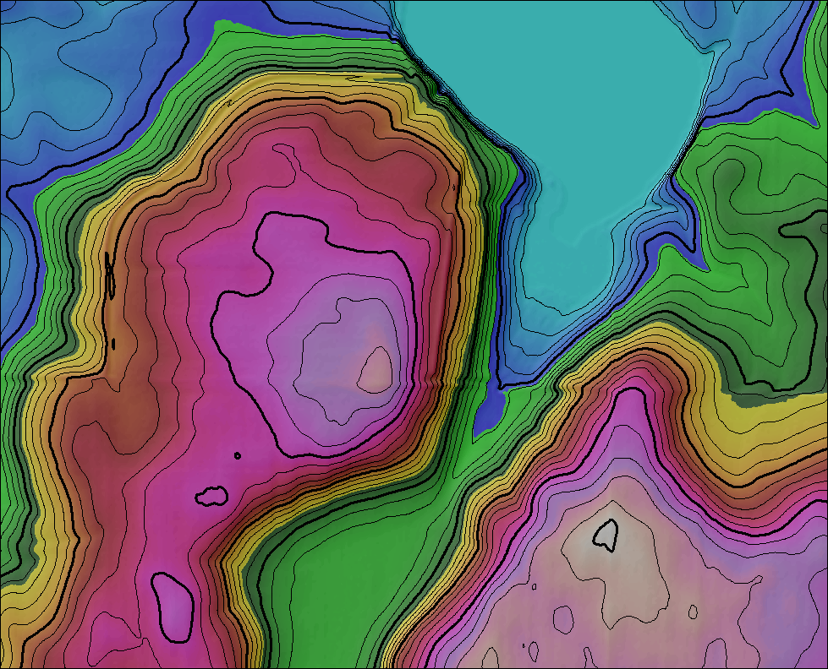
END
Wrap Up:
30

