Slide 1
Minnesota Elevation Mapping Project
Metro Area Collect
1/13/2011
Tim Loesch
Minnesota Department of Natural Resources

Slide 2
Metro Area LiDAR Project
Agenda
  Welcome and Introductions
  Overview of Minnesota Elevation Mapping Project
    LiDAR Specifications
    Project Deliverables
  Costs and Collection Buy-Up Options
  Partnerships
    Survey Test Shots
    GIS Contacts

Slide 3
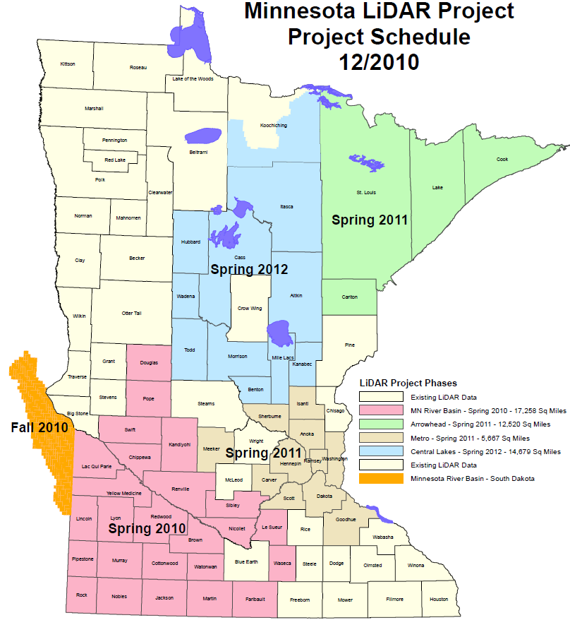
Metro Area LiDAR Project
Clean Water Legacy Funds
  $5,600,000 funding
  Project Phases
    MN River Basin
      Funded and acquisition complete
    Arrowhead Region
      Funded – Spring 2011
    Metro Region
      Funded – Spring 2011
    Central Lakes Region
      Unfunded – Spring 2012

Slide 4
Metro Area LiDAR Project
State Specifications
  Modeled after USGS Base LiDAR Spec V13
    Vertical Accuracy 15 cm
    Horizontal Accuracy < 1m
    Projection - UTM Zone 15
    Horizontal Datum - NAD83
    Vertical Datum – NAVD88
    Nominal Pulse Spacing 1.5 meters

Slide 5
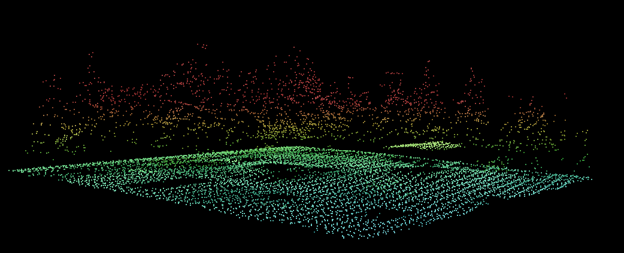
Metro Area LiDAR Project
Data Deliverables
  Classified LiDAR Points – LAS format
    Bare Earth
    Bridges
    Buildings
    Vegetation
    Water

Slide 6
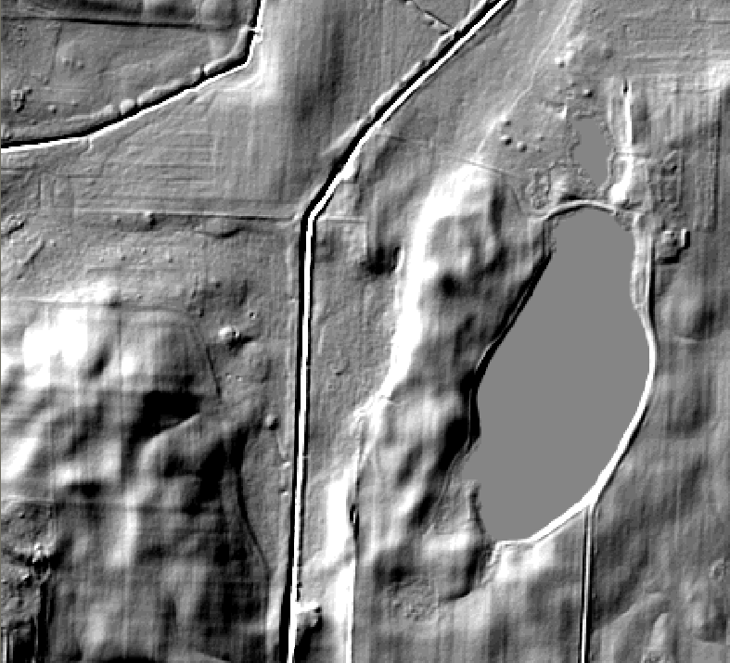
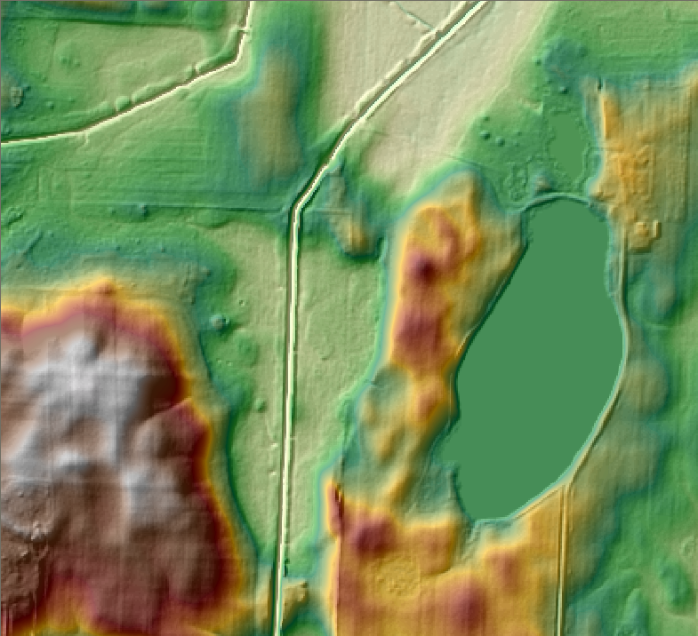
Metro Area LiDAR Project
Digital Elevation Models
  One Meter
  Three Meter
  Hillshade
  Hydro Flattened using Edge of Water Breaklines

Slide 7
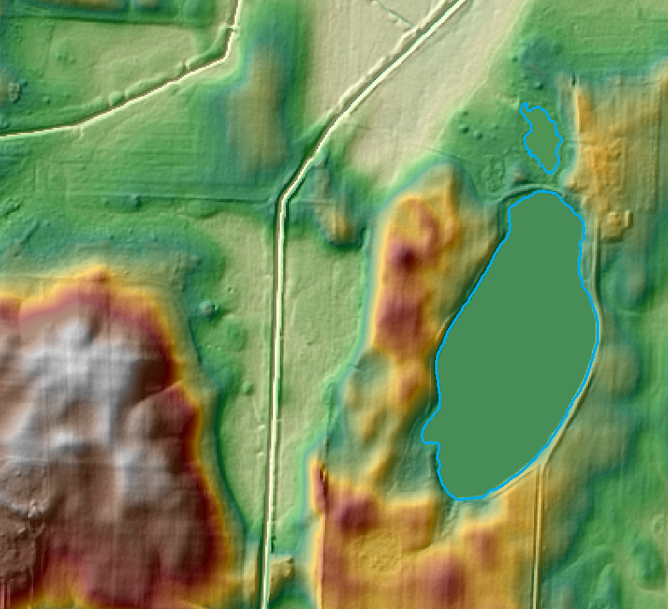
Metro Area LiDAR Project
Data Deliverables
  Edge of Water Breaklines
    Lakes and Ponds > 2 acres
    Rivers and Streams > 100’ wide
    Used for:
      Hydro Flattening
      Contour Enforcement

Slide 8
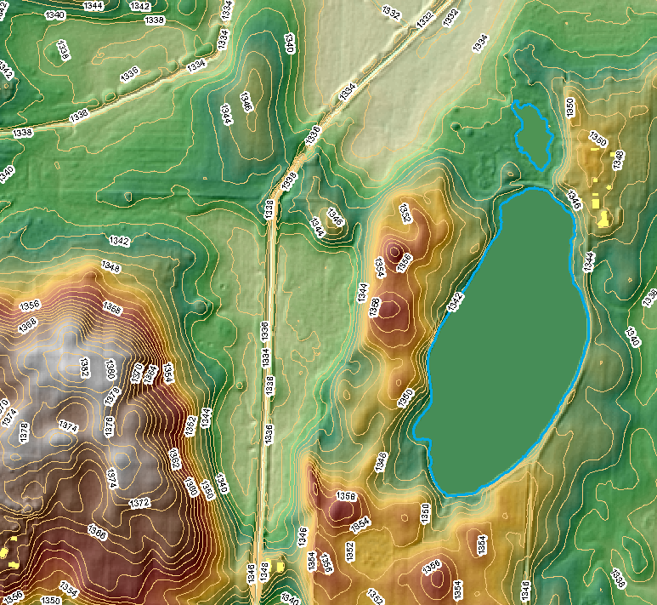
Metro Area LiDAR Project
Data Deliverables
  2’ Contours
  Building outlines

Slide 9
Metro Area LiDAR Project
Data will be provided to county partners
  External Hard Drive that you keep
    LiDAR points (LAS Files)
    DEMs – 1 and 3 meter
    Hillshades
    2’ contours
    Building outlines
  All products delivered in ESRI Geodatabase format

Slide 10
Metro Area LiDAR Project
Project Costs
  Eleven Counties
    Anoka, Carver, Dakota, Goodhue, Hennepin, Isanti, Meeker, Ramsey, Scott, Sherburne, Washington
  5,667 Square Miles
Pulse Spacing | Cost/sq mile | Total Cost
1.5 | $133.12 | $754,391

Slide 11
Metro Area LiDAR Project
Buy up Options
  The selected vendor has quoted some buy-up costs for increased point density
  Costs listed below are examples but vendor claims they can produce anything up to 12 pts/meter
Pulse Spacing | Cost/sq mile | Minimum Area | Total Est. Cost
2pts/meter² | $190.12 | 1000 square miles | $190,000
5pts/meter² | $419.00 | 1000 square miles | $490,000
12pts/meter² | $861.00 | 1000 square miles | $891,000

Slide 12
Metro Area LiDAR Project
Buy-up costs are the responsibility of the counties interested
County will need to work with vendor:
  Specifications
  Contracting
  Invoicing
DNR will still receive data and do QA/QC

Slide 13
Metro Area LiDAR Project
Partnership Opportunities
  Validation Points
    To help ensure that we get what we pay for
  GIS Points of Contact
    To server internal county customer needs

Slide 14
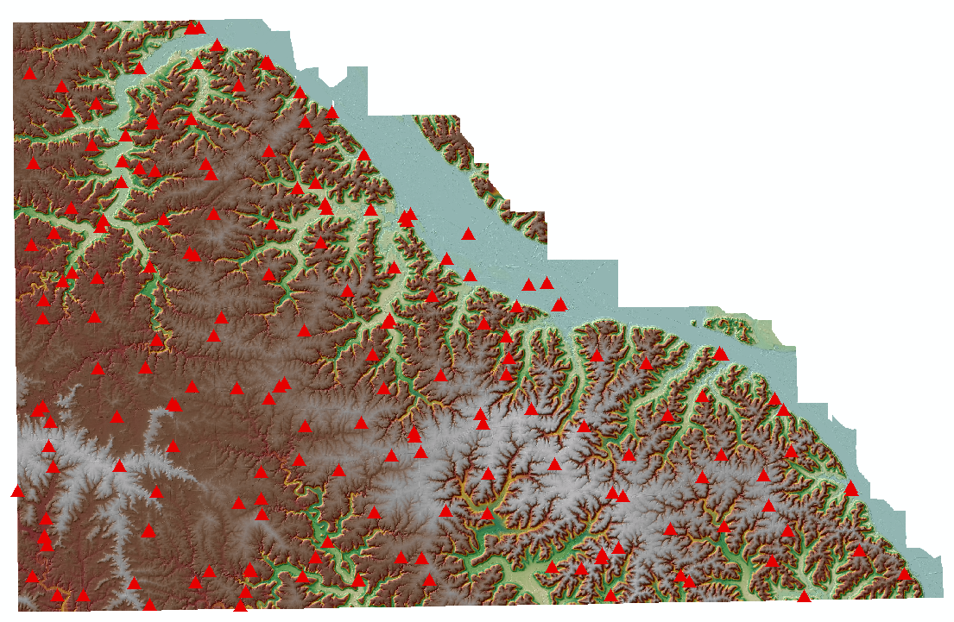
Validation Points
Winona County Validation Points

Slide 15
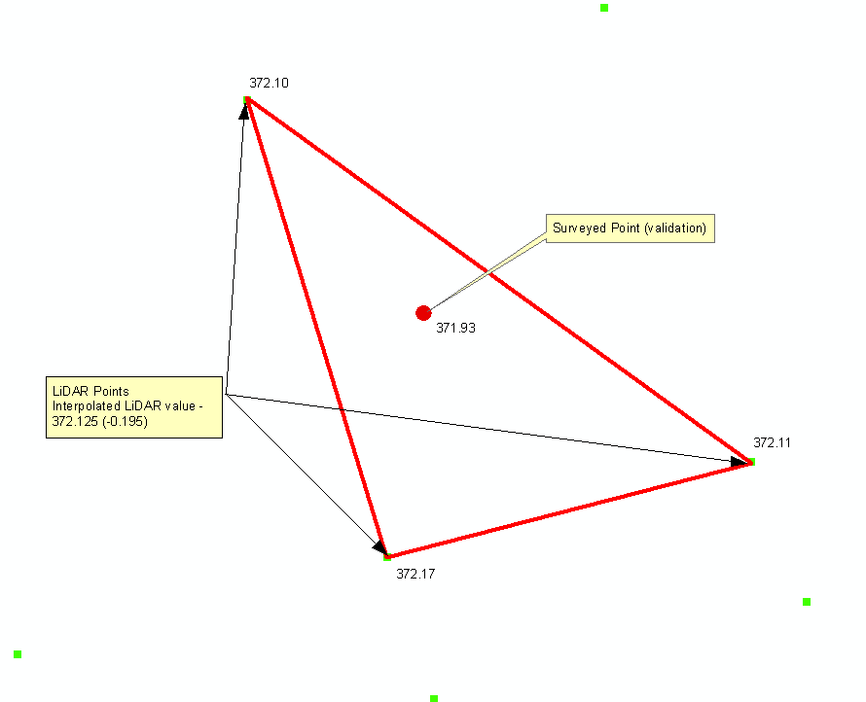
Validation Points
371.93
LiDAR points
Interpolated Value
372.115

Slide 16
Validation Points
--------- Report Summary ---------
Error Mean: -0.116
Error Range: [-0.435,0.143]
Skew: -0.305
RMSE(z): 0.161
NMAS/VMAS
Accuracy(z) (90% CI): ±0.265
ASPRS/NSSDA
Accuracy(z) (95% CI): ±0.315
176 control points included in summary out of 176
- 0 control points turned off
- 0 control points returned no-data
--------- Control Points ---------
Name Control X Control Y Control Z Surface Z Error
L1O0 604760.340 4878787.629 201.217 201.389 -0.172
L5U1 608921.294 4878065.350 201.488 201.806 -0.318
L1O2 610991.353 4876621.369 200.214 200.397 -0.183
L1O3 607292.402 4874401.804 233.428 233.606 -0.178
L1O4 622397.772 4873262.387 207.292 207.356 -0.064
L1O5 626922.206 4869248.810 202.936 202.969 -0.033
L1O6 631669.497 4863815.331 200.254 200.333 -0.079
L1O7 635439.901 4857649.190 375.011 375.070 -0.059
L1O8 625518.897 4864620.423 385.756 385.722 0.034
L2T9 621174.012 4864494.226 388.359 388.470 -0.111
L2T10 620283.975 4857065.579 386.810 387.048 -0.238

Slide 17
Validation Points
Winona County Validation Report
RMSE across cover Types

