Slide 1
The
Minnesota Geospatial Commons
State Government Geospatial Advisory Council
November 8, 2011

Slide 2
Overview
Introduction: The Opportunity
David Arbeit, MnGeo
What is the Geospatial Commons
Mark Kotz, Met Council
The Architecture and the Missing Pieces
Tim Loesch, DNR

Slide 3
Data Sharing Services in Minnesota
Minnesota organizations have demonstrated a strong commitment to collaborating to meet their data needs.
Joint data development
“Liberal” distribution policies
Commitment to standards
Organizational relationships
Technology innovations

Slide 4
The Foundation for a Minnesota
Enterprise GIS Architecture
The 1997 report of the Governor’s Council on Geographic Information offered a high level foundation for a statewide data discovery and delivery architecture.

Slide 5




Minnesota Geospatial is “Portal Rich”
More than any other state, Minnesota has encouraged use of its geospatial resources through portals.
MN Geospatial Data Clearinghouse
DNR Data Deli
MnDOT Data Portal
MetroGIS DataFinder
MnGeo/MetroGIS Service Finder
MN GeoIntegrator

Slide 6
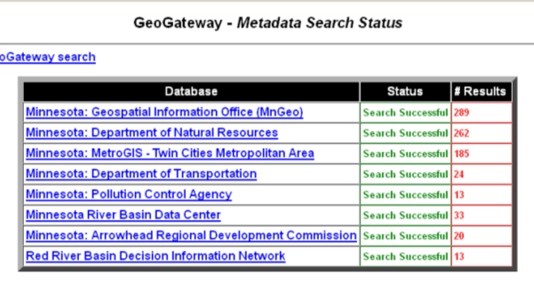
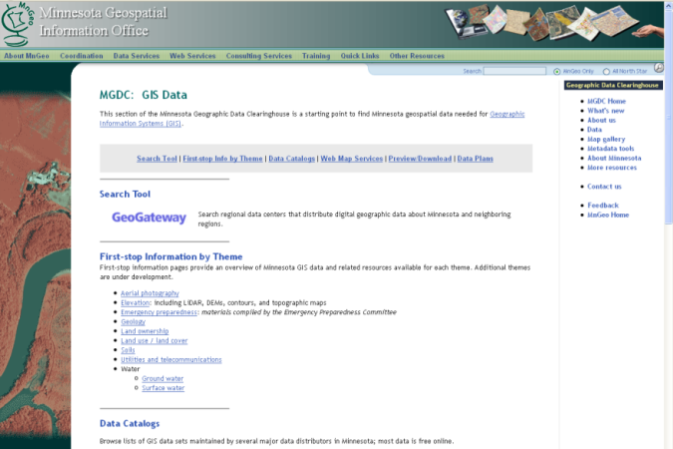
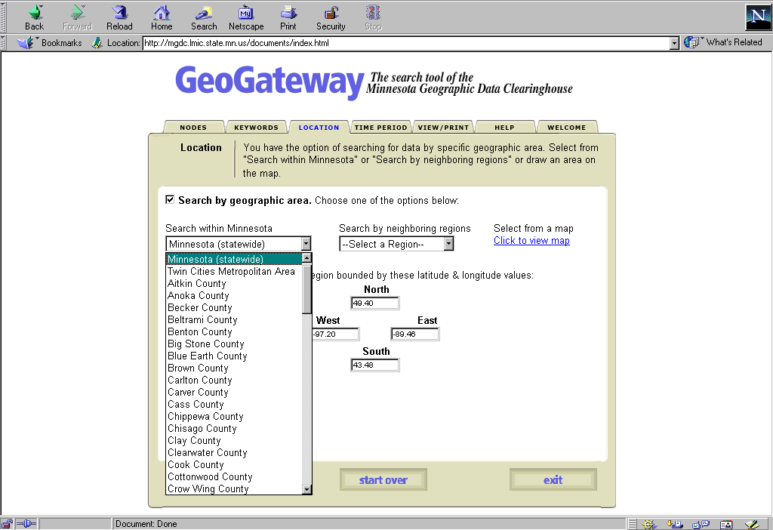
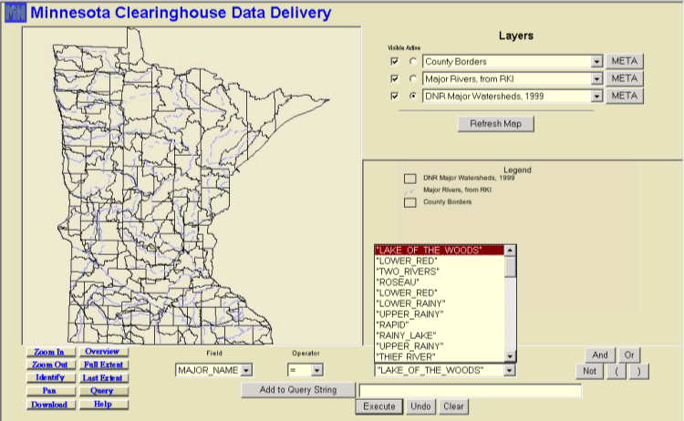
Minnesota Geospatial is “Portal Rich”
More than any other state, Minnesota has encouraged use of its geospatial resources through portals.
MN Geospatial Data Clearinghouse

Slide 7
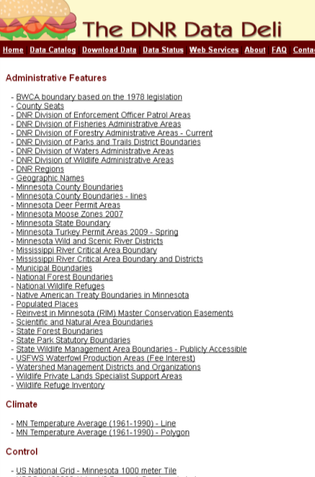
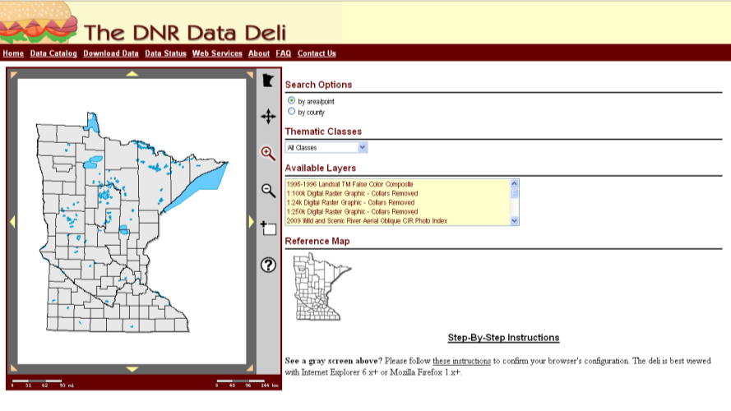
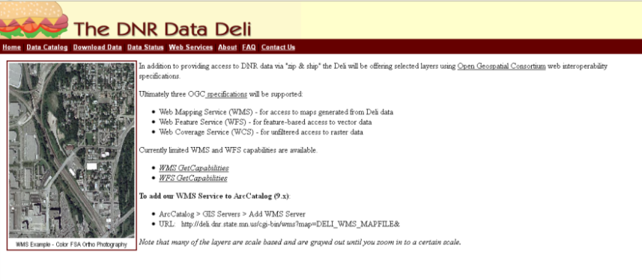
Minnesota Geospatial is “Portal Rich”
More than any other state, Minnesota has encouraged use of its geospatial resources through portals.
DNR Data Deli

Slide 8
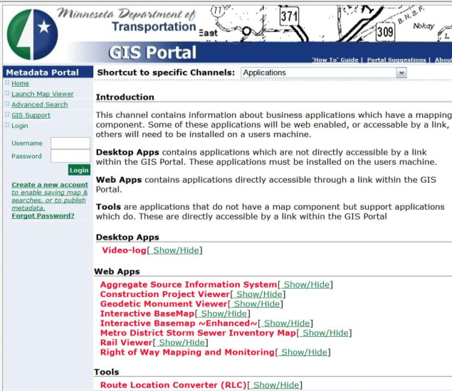
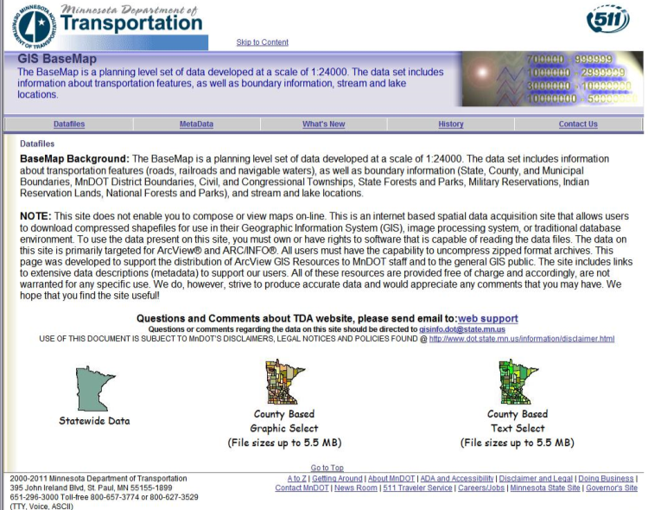
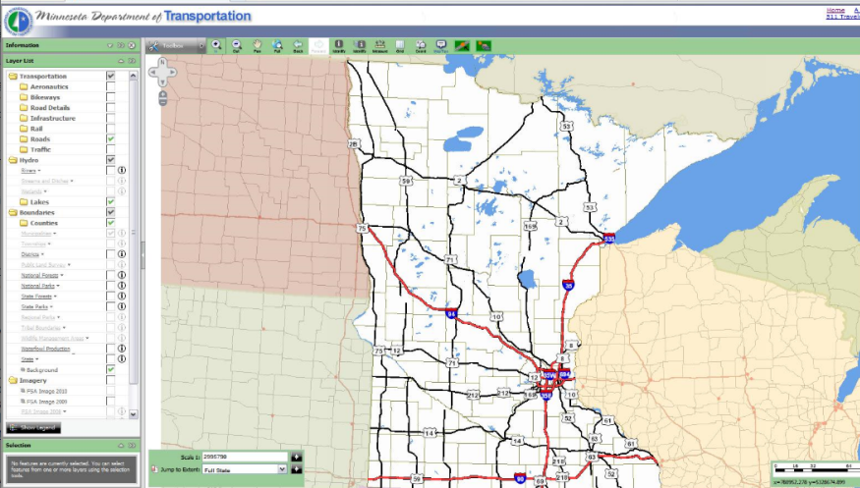
Minnesota Geospatial is “Portal Rich”
More than any other state, Minnesota has encouraged use of its geospatial resources through portals.
MnDOT Data Portal

Slide 9
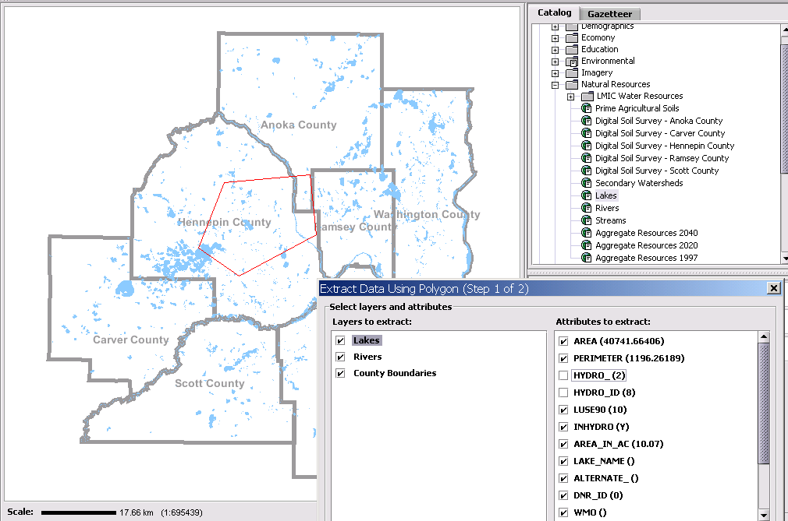
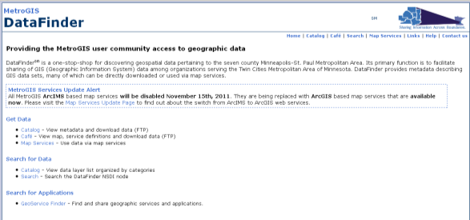
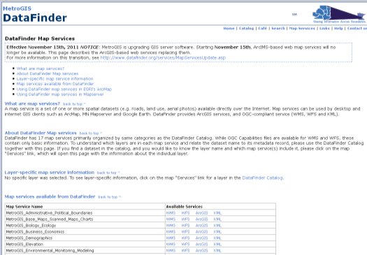
Minnesota Geospatial is “Portal Rich”
More than any other state, Minnesota has encouraged use of its geospatial resources through portals.
MetroGIS DataFinder

Slide 10
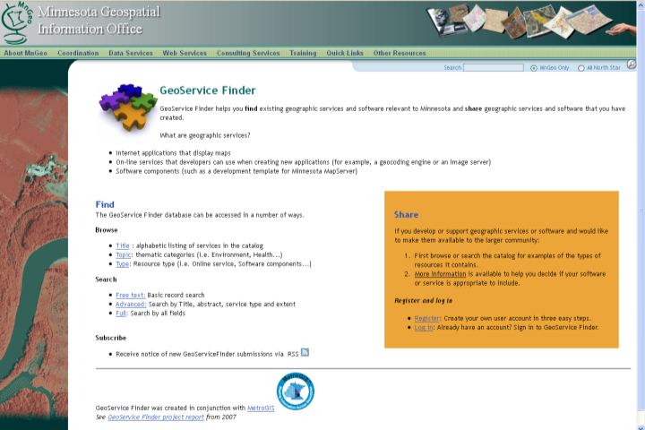
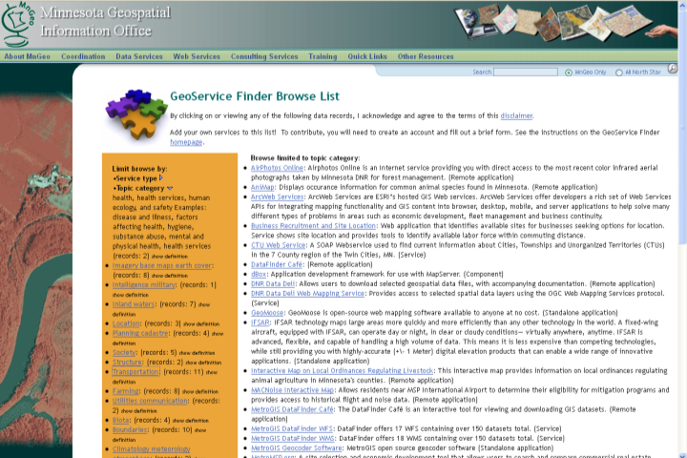
Minnesota Geospatial is “Portal Rich”
More than any other state, Minnesota has encouraged use of its geospatial resources through portals.
MnGeo/MetroGIS Service Finder

Slide 11
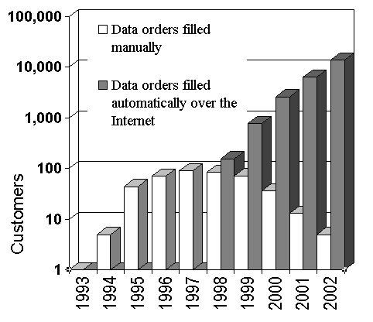
Data Delivery is on the Rise
Web technology has dramatically increased data delivery from LMIC’s web site.
The DNR, MetroGIS, Mn/DOT and other Minnesota providers have experienced similar growth.

Slide 12

Orthoimagery: WMS Images Served
Fiscal Year

Slide 13
Enterprise Geospatial Services Architecture
Service providers identify & document services
Broker Organization
Service
Provider
Catalog
Service
Service
Support
Services
Consumer applications interact directly with Service Providers
Query for
Service
Consumers learn about services through a broker catalog service
Access
Service
Consumer
Consumer

Slide 14
GeoIntegrator
An Architectural Framework for Enterprise GIS
GeoIntegrator was envisioned as a foundation for implementing a statewide architecture.
A distributed architecture that builds on the Minnesota GeoGateway and MetroGIS Data Café applications.
Compatible with agency ArcIMS and MapServer distribution solutions
Allows host agencies to maintain data in native formats.
Delivers data in formats needed by users.
Offers flexible data extracts.

Slide 15
GeoIntegrator Architectural Diagram
Data Warehouse
ArcIMS Instance [LMIC]
GeoIntegrator
Data
Distribution
Client
Data Warehouse
ArcIMS Instance [Mn/DOT]
Web Browser Requests
GeoIntegrator
Cascading &
Extracting
Web Map Service
Data Warehouse
ArcIMS Instance
[Met Council]
Standardized Metadata Records
Data Warehouses
ArcIMS Instances
[Others]
GeoIntegrator Distribution Client can browse and download data.
GeoIntegrator Extract and Map client can extract data from native formats, translate data, and produce a map for viewing or printing.
Security Module
[Future]
Data Warehouse
WMS Instance [DNR]
Data Warehouses
WMS Instances [Others]

Slide 16
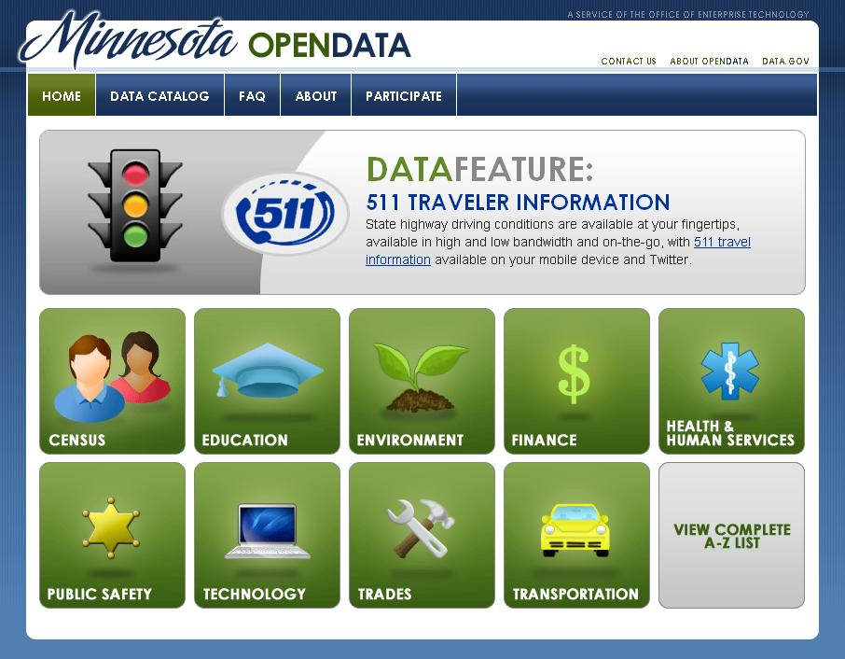
Data.Gov
Data.Gov has been implemented by OET as an Enterprise resource for data and e-gov service discovery.

Slide 17
Minnesota Geospatial is “Portal Rich”
More than any other state, Minnesota has encouraged use of its geospatial resources through portals.
MN Geospatial Data Clearinghouse
DNR Data Deli
MnDOT Data Portal
MetroGIS DataFinder
MnGeo/MetroGIS Service Finder
GeoIntegrator
Which One to Use?

Slide 18
The Geospatial Commons
A next-generation data discovery, distribution and service site that supports the entire enterprise.
MN Geospatial Data Clearinghouse
DNR Data Deli
MnDOT Data Portal
MetroGIS DataFinder
MnGeo/MetroGIS Service Finder
GeoIntegrator
MN Geospatial Data Clearinghouse
DNR Data Deli
MnDOT Data Portal
MetroGIS DataFinder
MnGeo/MetroGIS Service Finder
GeoIntegrator
Mn Geospatial Commons

Slide 19
Opportunity
Minnesota is rich in geospatial data
Geospatial web services are being shared and used to build complex applications
Popular mapping sites have propelled demand
Geospatial infrastructure is costly to maintain
Existing portals need updating
An enterprise solution is needed to provide high-availability, performance, security, scalability, etc.
Stakeholders are ready for enterprise solutions

Slide 20
What is the “Commons”?
A single place we all go to find and share geospatial resources
Functions?

Slide 21
Input from:
Initial Workgroup
  Federal
  State
  Regional
  County
  City
  Non-profit
Stakeholder Agencies
  DNR
  Met Council
  Mn\DOT
  MnGeo
User/Producer Survey
  Nearly 540 responses
  Casual map users to GIS professional

Slide 22
Key Functions
Find
Evaluate
Share
Administer

Slide 23
Key Functions -
Find
Search
  Structured interface
  Spatial (e.g. bounding box)
  Metadata
  Google accessible
Catalog (viewable page)
Registry (back end database)

Slide 24
Key Functions -
Evaluate
Metadata viewer
Map viewer
Download data or connect to web services
User Reviews (quality, reliability, etc.)
Web service monitoring (automated, objective)

Slide 25
Key Functions -
Share
Publish
  Metadata
  Data for download
  Services for consumption

Slide 26
Key Functions -
Administer
User Accounts
Harvesting
Administrative Policies

Slide 27
Test Implementation
Proof of concept
Defined high level design
Conclusions:
  No perfect portal tool exists – customization needed
  We can all use one data publishing sites
  Launched metadata workgroup (ISO/NAP, services)
  Dovetail with state and federal open data initiatives
  We need a broker
Commons Workgroup webpage: http://www.mngeo.state.mn.us/workgroup/commons/

Slide 28
Test Implementation
How does the DNR Fit in?
  Participated in the Geospatial Commons
  Data Deli is aging
  DNR is a microcosm of State Government
  Consume and Produce Data
  Have infrastructure Expertise

Slide 29
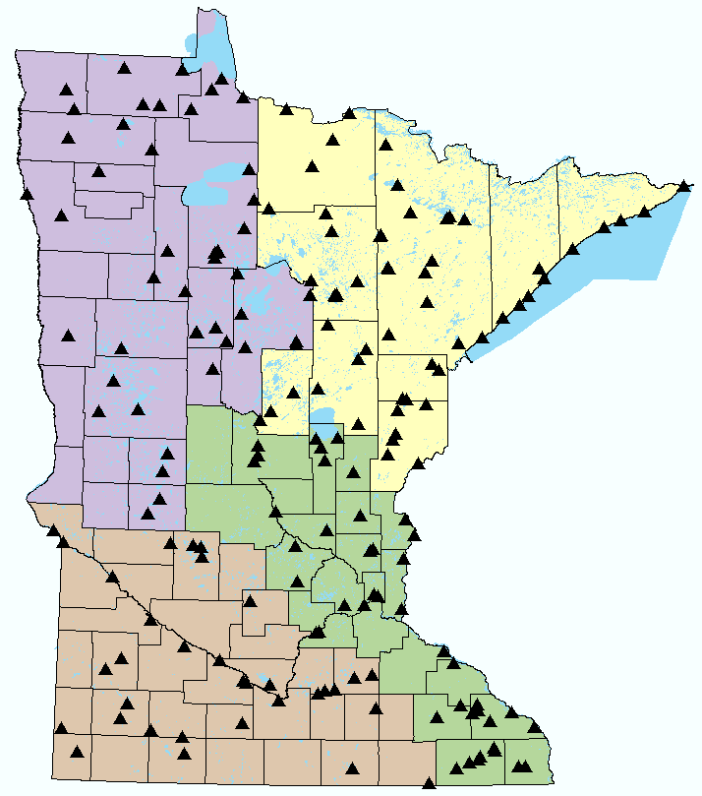
The DNR Workplace
A Very Distributed Workforce:
275 sites
2000 Employees
Varied skill sets
Access to the data they need
When they need it
No matter where they are

Slide 30
The Challenge
The Data Resource Site (DRS)
  Enterprise GIS V1.0
  Structured set of data, metadata and software
  Deployed in 2002
  ArcView 3x and Arc/Info (not ArcGIS)
  Coverages, Librarian and Shapefiles
  AMLs, Avenue and VB6
  Hub and Spoke replication

Slide 31
The Challenge
“The Times They are a Changin’ ... ”
  GIS science advances
  GIS software upgrades
  New technologies developed
  Data formats evolve
  Personnel evolves/revolves
Must be responsive to all of these

Slide 32
The Challenge
And then along came….
  ArcGIS 10
    VB6 no longer supported
    New Data Structures
    File Geodatabase API
      DNR has strong ties to OpenSource Software
  Data Deli is aging
  Geospatial Commons Project

Slide 33
Where do we go from here?
Our Charge at the DNR
Build a DNR Enterprise GeoInformation System
Ulterior motive
build a framework that allows DNR to share and exchange information with other entities

Slide 34
THE GEOSPATIAL DATA RESOURCE SITE

Slide 35



FUNDAMENTAL CONCEPTS
A GDRS is an organized collection of
GIS Data and Applications
Notes:
File based resources – local, flexible, familiar
Database resources – centralized, accessible across local area networks
Web service based resources – wide availability, cached imagery, WMS, slippy maps, geoprocessing services

Slide 36

FUNDAMENTAL CONCEPTS
A GDRS is self documenting
Notes:
System metadata describes all of the current content.
System scripts or GDRS Manager rebuild system metadata after content changes.

Slide 37


FUNDAMENTAL CONCEPTS
GDRSs can relate to one another
Notes:
As parent to child (a GDRS can be used to create a child GDRS)
As peer to peer (A GDRS can serve updates to peer and accept updates from peer as well)

Slide 38

FUNDAMENTAL CONCEPTS
A GDRS exists within an ecosystem
Notes:
Any number of GDRSs can interact with one another, providing authoritative data and updates to the others

Slide 39

GOALS
Notes:
We want to simplify the data management workflow
Creating new data and app resources
Publishing workflow
Maintenance workflow
Entire system needs to be easy to comprehend
Simple XML schemas
Simple organizational structure
Recognizable folder and file naming conventions

Slide 40

GOALS
Flexibility
Notes:
FLEXIBILITY
For both developers and users
Back end system metadata should support a variety of clients
Mid – level programmer should be capable to build on top of the system
Power users should be able to poke around and figure out how the pieces fit together
The architecture should not require a specific software solution .

Slide 41

GOALS
Standards Based
Notes:
Use standard s based tools and technologies
Take advantage of open standards wherever possible (EPSG Codes, GDAL data type nomenclature)
Use open toolkits – XML, Python, JSP that are lend themselves to simple and straightforward solutions
Emphasize “Convention” over “Configuration” as an architectural paradigm. (From Ruby)
Convention over configuration (also known as coding by convention) is a software design paradigm which seeks to decrease the number of decisions that developers need to make, gaining simplicity, but not necessarily losing flexibility.

Slide 42

GOALS
Inter-organizational orientation
Notes:
Inter-organizational orientation
Shift from a DNR-centric design view to one that includes other agencies and can eventually accommodate public participation as well.

Slide 43

SYSTEM ARCHITECTURE
Publishing and Sharing
Notes:
Describe different kinds of GDRS (personal, org, public)
Describe concepts of:
Server Registry (with server status reports)
GDRS Registry
Content Registry
Desired Conditions Registry
All implemented in PostgreSQL alongside a...
ESRI Geoportal (java, apache tomcat)
GDRS metadata harvested to portal
Portal provides search + discovery mechanisms
JSP web requests result in XML results that GDRS Manager and system scripts can use for update and publishing.
Enables building desired conditions and workplans that pull date from multiple sources.
Register as Publisher and make your data available...

Slide 44
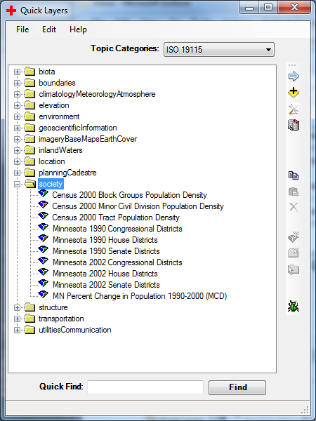
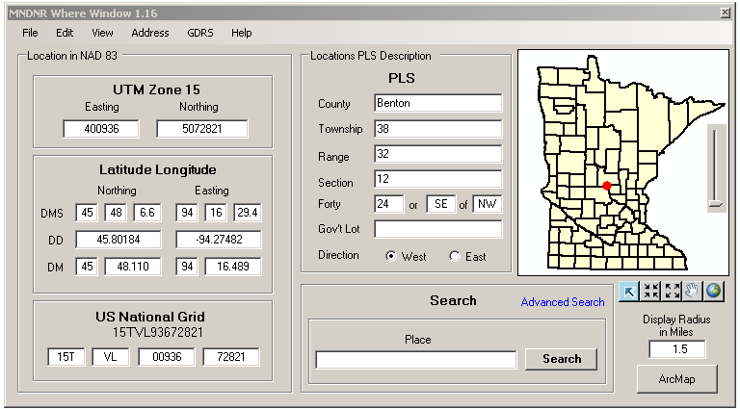
Common Tools
QuickLayers and LandView
Notes:
Around for over 11 years – Arcview 3, 9, 10.
Data structure changes but access remains constant.
ArcMap Add-In

Slide 45
Where do we go from here?
How does this relate to the “Geospatial Commons”?
  GDRS as a common publishing and data sharing architecture
  Portal to publish, discover and access data
GDRS
Geospatial Commons
?

Slide 46
Where do we go from here?
What’s Missing…..
  Geospatial Broker
    Database and API
      Data publishers
      Reliability (web services)
      Facilitate Updates (file based)
      Security (Roles and Groups)
  Minnesota State GIS Enterprise Conceptual Architecture Design (2005)

Slide 47

Where do we go from here?
From a Hub and Spoke system

Slide 48


Where do we go from here?
Federated system
I need data
MN Geospatial Commons
Find
Evaluate
Share
Administer
Query
Broker
Broker
Data or services
Remember users
Notify when updates
Water Quality Data
Aerial Photos
MPCA
MnGeo
Lake Data
DNR

Slide 49




Where do we go from here?
To a true federated system
MN Geospatial Commons
Find
Evaluate
Share
Administer
Your Name Here!
GDRS
Broker

