Slide 1
STATE GOVERNMENT Geospatial Advisory council
November 13, 2012

Slide 2
AGENDA
Welcome and Call to Order
Introductions
Approval of the September 26, 2012 Meeting Minutes
Esri ELA Update –10 min
Committees and Workgroups
Break – 5 minutes
Review and discussion of draft Committee/Workgroup document (formation, governance, support, operation, expectations, charter, and work plan) – 30 minutes
Geospatial Technical Committee – 5 min
Optimization – 5 min
MnGeo’s Services – 15 min
MnGeo Project Priorities Survey Results – 10 min
Other Business
Future FY13 Meetings: January 8, March 12, and May 14, 2013
Adjourn

Slide 3
Esri ELA Update
Chris Cialek

Slide 4
Esri ELA
Esri Contract
Signed 09/28/2012
3-year term: 10/1/12 – 09/30/2015
Cost: +5% over last ELA = $567,000/year
FIRST PAYMENT DUE: DECEMBER 1
New Interagency Agreements (IA)
Set up for 3-years; sent out last month w/contract
Due ASAP; invoice to follow; payment next week
Contract Extension IA Amendments
Issued last week; please get signed; invoices follow
Charges reduced by ~$58,000

Slide 5
ELA Status
 | ESRI ELA Partner | IA Sent | IA Executed | Invoice Sent | Invoice Paid | Old IA Amend Sent | Old IA Amend Executed | Invoice Sent | Invoice Paid
1 | ADMINISTRATION | 10/24 |  |  |  | 11/1
2 | AGRICULTURE | 10/24 | 11/5 | 11/9 |  | 10/31
3 | BOARD OF WATER & SOIL RESOURCES | 10/24 | 11/13 | 11/13 |  | 11/1
4 | COMMERCE | 10/24 |  |  |  | 11/1
5 | CORRECTIONS | 10/24 |  |  |  | 11/1
6 | EDUCATION | 10/24 | 11/6 | 11/9 |  | 11/5
7 | EMPLOYMENT & ECONOMIC DEVELOPMENT | 10/24 | 11/6 | 11/9 |  | 11/1
8 | HEALTH | 10/26 |  |  |  | 11/5
9 | HUMAN SERVICES | 10/23 | 11/6 | 11/13 |  | 11/6
10 | IRON RANGE RESOURCES AND REHABILITATION | 10/24 | 11/6 | 11/9 |  | 11/6
11 | METROPOLITAN COUNCIL | 10/25 |  |  |  | 11/6
12 | MINNESOTA HOUSING FINANCE AGENCY | 10/23 | 11/8 | 11/9 |  | 11/7
13 | NATURAL RESOURCES | 10/24 |  |  |  | 10/31
14 | OET | 11/13
15 | POLLUTION CONTROL AGENCY | 10/25 |  |  |  | 11/5
16 | PUBLIC SAFETY | 11/6 |  |  |  | 11/7
17 | TRANSPORATION | 10/26 |  |  |  | 11/1

Slide 6
Discussion - Committees & Workgroups – How do we optimize their efforts?

Slide 7
Committees
Committees and Subcommittees
Digital Cadastral Data
Digital Elevation
LiDAR Research and Education
Emergency Preparedness
Hydrography
Outreach
Standards

Slide 8
Workgroups
Workgroups
Geocoding
Geospatial Commons
Metadata

Slide 9
Discussion: Committees and Workgroups
Discussion: Committees and Workgroups – 30 min
You asked for guidelines…
What is needed?
Need to be active?
Need regular attendance and output?
Facilitated by MnGeo – resource impact?
New that are needed?
Are there committees that need to sunset?
Projects versus workgroups?

Slide 10
Geospatial Technical Committee

Slide 12
Geospatial Technical Committee
The Geospatial Technology Committee is responsible to:
Approve geospatial policies, standards and planning initiatives
Approve exceptions to geospatial policies and standards
Recommend plans for transforming state agency-level geospatial operations and extending the technology to a broader community of customers
Oversee the development and maintenance of a stable enterprise-level funding strategy for geospatial operations
ISRM Asst. Commissioner | Chris Buse | Member
State Enterprise Architect | Jeff Fanning | Member
GIS Architect | Hal Watson | Member
Chief Geospatial Officer | Dan Ross | Chair
Service Delivery Asst. Commissioner | Thomas Schaeffer | Member
Agency Support Asst. Commissioner | Tong, Tu | Member
Agency CIO | Robert Maki | Co-Chair
State Agency Business Representative | Cassandra Isackson | Member
State Agency Business Representative |  | Member
State Agency Business Representative |  | Member
Geospatial SME | Mike Dolbow | Member
Geospatial SME | Mark Kotz ** | Member
Geospatial SME | Mark Olsen | Member
What’s next?
Finish seating of members – November
Begin Meetings – December/January

Slide 13
Geospatial Technical Committee
What’s next?
Finish seating of members – November
Begin Meetings – December/January
Sunset State Government Geospatial Advisory Council?
Depends on legislation
Proposing meeting Feb 6th
Will continue to meet if legislation requires

Slide 14
Optimization (update) - Phase Four of Consolidation

Slide 15
Three Key Areas
Identify and sequence the service opportunities
Early wins with visible measurable, and high-value results for both stakeholders and employees
Build the common processes and infrastructure that make service improvements possible
Infrastructure, data coordination &management, application development and management…
Think outside the box
Innovations program, communities of interest, employee feedback, new savings & investment strategies
Notes:
To tackle these issues and take advantage of the opportunities we need to do three things simultaneously: develop a service strategy that can meet the objectives in our strategic plan and that demonstrate value to our customers; create the foundation that makes us ready for change – common processes, common policies, an integrated organization, etc.; and then think outside the box. There are no instructional manuals that outline the steps to IT consolidation and to building an effective and efficient organization. We need to take advantage of every idea and opportunity to figure out the details of how we do things differently, and how we capitalize on this opportunity that has been handed to us

Slide 16
Coming Soon: Tactical Plan(s)
What | Why | When
Enterprise 2-year tactical plan | Define objectives, milestones and projects that will get us down the road | early September
Divisional plans | Readying our services and processes for successful centralization | October
HR and training plan | Define how we align current jobs with centralization, manage attrition, leverage skills, standardize positions and build careers at MN.IT Services | October
Agency-based office plans | Defining order of activity that meets the overall objectives | November
Make the “factory side” of IT super efficient so we can focus our people, money and creativity on the services that most directly make a difference for our customers and citizens
Notes:
In order to create our own illustration, we need to make some decisions, and that’s what’s coming next.
We will start with an enterprise 2-year tactical plan that begins to dissect the stack of IT services and determine the best way to make them more efficient.
Will they all be centralized immediately? There are dependencies that have to be taken into consideration, and we can’t create chaos as we change. So the changes will be mapped out to keep disruption to a minimum.
Will they all be centralized at MN.IT Central? Remember that we are trying to “think outside the box.” But we know that the MN.IT divisions need to do some foundational planning to be sure that we know that we’re ready for service optimization. That’s the second row on this slide.
One of the most important plans coming soon is the HR plan. We can’t make a change in service delivery until we know how it impacts people and how we are going to manage roles, skills, training, attrition. Our goal is not just to move people around in boxes, but to leverage skills, train people for the future, and build careers that serve our employees and the State.
Finally, agency-based offices will create individual plans for how and in what order they will implement their share of the tactical plan. This will take time and everyone’s plan will look different.

Slide 17
Click to add the caption or title for the picture

Slide 18
Functional Alignment, IT Leadership and Oversight
implement organizational consistency
standardize agency policies and management practices
develop functional alignment between MN.IT Central and agency-based offices in order to better define roles, skills and expectations and to foster collaboration and interoperability.”
overarching goal of the MN.IT Cloud service strategies is to align service delivery functions across the enterprise

Slide 19
The Geospatial Aspect
We will improve service level management for geospatial services and align agency geospatial resources appropriately within MN.IT, with the following objectives:
• Standard geospatial services are integrated in the MN.IT Service Catalog.
• Enterprise geospatial needs are identified and prioritized.
• MN.IT is supported by a single set of geospatial policies and standards.
• Geospatial services leverage common infrastructure, application and data management processes and tools.

Slide 20
Time frames and deliverables
A complete set of enterprise policies for geospatial services will be published by the end of Q4, FY13, and the executive branch will share a common geospatial infrastructure and data foundation by the end of Q4, FY14.

Slide 21
The draft detail….
 | Enterprise Goals, Leadership & Oversight
 | FY13 |  |  | FY14
 | Q2 | Q3 | Q4 | Q1 | Q2 | Q3 | Q4
Geospatial Services Policies and Standards | New Geospatial Governance Team |  |  | 100% complete policies and standards
Improve service level management for all MnGeo services | Stakeholder Review Sessions completed | Enterprise projects identified and prioritized Service catalog identified and published | Resource Plan identified and available Service/Project request process standardized and published Service Metrics identified and in use | Strategic Plan updated
Full Timeframe | 2 years
Key Benefits | Increased ability to respond to service needs, share data, systems and resources. Better cross-agency geospatial communication and problem-solving; improved service to customers; common metrics and standard reporting.

Slide 22
More draft details….
 | Enterprise Goals, Leadership & Oversight
 | FY13 |  |  | FY14
 | Q2 | Q3 | Q4 | Q1 | Q2 | Q3 | Q4
Geospatial Services Optimize and standardize core geospatial service delivery Infrastructure Data Management Application Development and Management Guidance, governance and support Innovation | Optimization teams identified Agency needs and skill requirements identified Innovation topics defined and prioritized Small teams formed | Infrastructure assessment complete Governance, skill development Service Request process Metrics identified Infrastructure available | Infrastructure alignment plan DM assessment complete Application assessment complete Resources available to support startups and agency projects Innovation happening | DM optimization plan Application optimization plan Single geospatial Service Desk | Common process and tools defined | Common process/tools in place | Infrastructure Optimization Complete DM optimization complete Application optimization complete
Full Timeframe | 2 years
Key Benefits | More efficient use of infrastructure and software licensing, common practices in place and used for data and application management, consistent service request process, better alignment of geospatial resources and skill sets, more agencies implementing geospatial as part of core business processes and systems

Slide 23
Next steps
Tactical Plan draft complete this week…
Each of the five areas will fall under a project
One project or many?
The approach
We will align other with projects where we can (e.g. MN Geospatial Commons with Data Management)
We will need to identify resources to work on these
We will need to balance with the business need
Need to be complete in two years
This will likely limit our ability to engage in some new efforts
Meeting with larger agencies first

Slide 24
MnGeo Services

Slide 25
Service offerings will change a bit….
Reduce/Refocus?
Geospatial Coordination
More?
About the same?
1
Coordination, Outreach, Communication Intra-government (agencies) Inter-government (Counties, Feds) Extra-government
25%
Data Coordination Data gaps Data Standards Data stewardship Aggregation of 3rd party data Enterprise licensing
Technology Coordination Project & procurement review Agency-based enterprise resources New enterprise technologies
3
2
28%
2%
6
Guidance Mentoring Best practices
Training Formal, technical
7
Data Services Deployment of an Enterprise Data Library
5
4
Web Services Map services (OGC) Capability services (geocode)
0%
Consulting & Project Support In-source vs. outsource
1%
5%
3%
36%
8
Technical Infrastructure
Technical Support

Slide 26
Project Priorities Survey Results

Slide 27
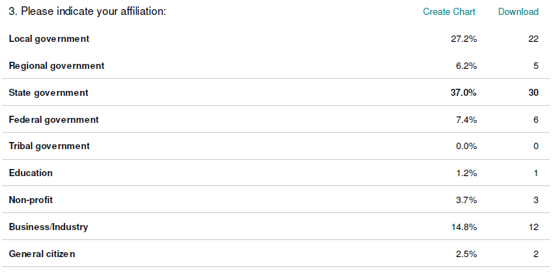
Broader Stakeholder Community Who responded….

Slide 28
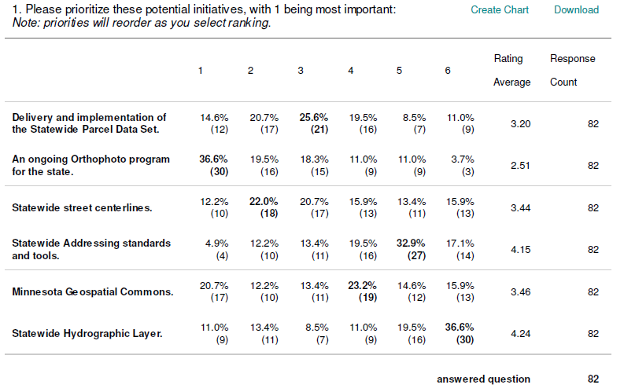
Broader Stakeholder Community

Slide 29
Statewide Advisory Council
LiDAR/Elevation Data Delivery (already underway)
Minnesota Geospatial Commons
Sustainable Program for Orthophotos
Statewide Parcel Integration
Street Centerlines (already underway)
Statewide Addresses (many tied to Centerlines)
Statewide Hydrography

Slide 30
Stakeholder identified priorities from meetings
LiDAR/Elevation Data Delivery (already underway) BSC* SAC
Minnesota Geospatial Commons (4) (1)
Sustainable Program for Orthophotos (1) (2)
Statewide Parcel Integration (2) (3)
Street Centerlines (already underway) (3) (4)
Statewide Addresses (many tied to Centerlines) (5) (5)
Statewide Hydrography (6) (6)
We will likely have some activity on the first 5?
Need to figure out how to resource
Will be limited by optimization
*BSC = broad spatial community
Notes:
Stakeholders have identified 7 important effort
Provide a short sentence on each….

Slide 31
Other Business
Proposed Future FY13 Meeting: Feb 6
Adjourn

