Slide 1
State Agency Advisory Council
February 6, 2013

Slide 2
AGENDA
Call to Order, Welcome & Introductions 5 Min
November 13, 2012 Meeting Minutes 5 Min
Committee and Workgroup Guide 15 Min
List of comments from both Councils
Updated guide
2013 Legislative Session 15 Min
Esri Master Purchase Agreement and Managed Services 20 Min
Updates:
Geospatial Optimization 5 Min
Geospatial Technical Committee – members, meeting(s) 2 Min
MnGeo Priorities – What projects will MnGeo focus on? 3 Min
Announcements:
Governor’s Commendations 1 Min
Council member terms end June 30 5 Min
Next Meeting?
Adjourn

Slide 3
Committee and Workgroup Guide
List of comments from both Councils
Updated guide

Slide 4
Legislative Session
2013 Legislative Session
Geospatial Commons - budget
MnGeo Legislation (Housekeeping, eliminate State Gov. Council, data sharing)
Discussion: How do we get detailed input about adverse impacts of data sharing?
Other legislation that members are aware of affecting our community?

Slide 5
Esri Master Purchase Agreement and Managed Services – Discussion
What is it?
Master Purchase Agreement –
Products not covered by ELA
Regional and local, government – discounts for software and PT
Managed Services
Who wants/needs it?
How do we approach it?
Cloud services security concerns?

Slide 6
Updates
Geospatial Optimization
Geospatial Technical Committee – members, meeting(s)
MnGeo Priorities – What projects will MnGeo focus on?

Slide 7
Functional Alignment, IT Leadership and Oversight
implement organizational consistency
standardize agency policies and management practices
develop functional alignment between MN.IT Central and agency-based offices in order to better define roles, skills and expectations and to foster collaboration and interoperability.”
overarching goal of the MN.IT Cloud service strategies is to align service delivery functions across the enterprise

Slide 8
The Geospatial Aspect
We will improve service level management for geospatial services and align agency geospatial resources appropriately within MN.IT, with the following objectives:
Standard geospatial services are integrated in the MN.IT Service Catalog.
Enterprise geospatial needs are identified and prioritized.
MN.IT is supported by a single set of geospatial policies and standards.
Geospatial services leverage common infrastructure, application and data management processes and tools.

Slide 9
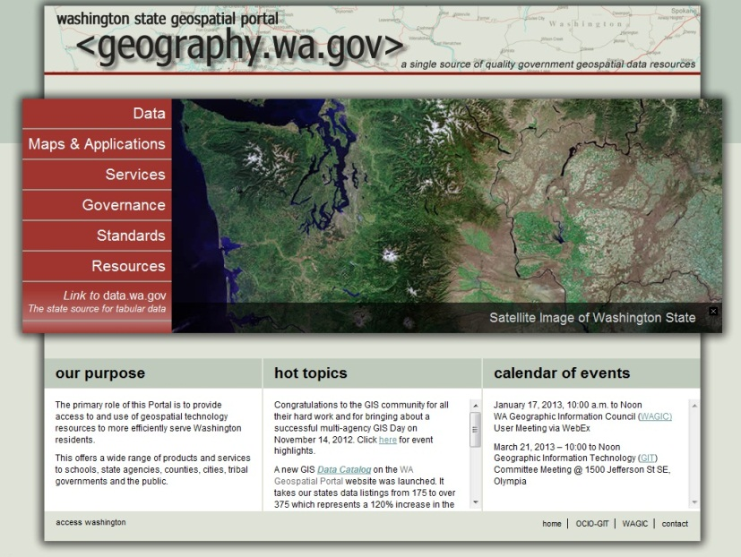
Where are we at with Geospatial Optimization?
Small teams working together to take a first cut
Two primary efforts at this time:
Infrastructure and Data optimization
MN Geospatial Commons
Service Catalog
SharePoint Sites
Working on hiring a PM
More to come
CKAN Example: OpenColorado.org
Notes:
Much like other MN.IT consolidation efforts, the initial focus is on making sure we use the same terms.
For Infrastructure and Data, a GeoCommons group led by Mark Kotz is meeting, defining requirements, and testing candidate solutions. An example candidate is CKAN, which Data.gov is going to migrate to soon.
For the Service Catalog, the group is taking MnGeo’s catalog, which revolves around the AppGeo 2009 study, and making sure @Agency services are either included or added on. Chris Buse tells us this is very much like an effort the Information Security teams took on a few years ago.
We have SharePoint sites set up and we are hiring a PM for these efforts

Slide 10
Next steps
Decision - One project or many?
The approach
We will align other with projects where we can (e.g. MN Geospatial Commons with Infrastructure, hosting and data management)
We will need to identify resources to work on these
We will need to balance with the business need
Need to be complete in two years
This will likely limit our ability to engage in some new efforts
Meeting with larger agencies first

Slide 11
Geospatial Technology Committee
The Geospatial Technology Committee is responsible to:
Approve geospatial policies, standards and planning initiatives
Approve exceptions to geospatial policies and standards
Recommend plans for transforming state agency-level geospatial operations and extending the technology to a broader community of customers
Oversee the development and maintenance of a stable enterprise-level funding strategy for geospatial operations
ISRM Asst. Commissioner | Chris Buse | Member
State Enterprise Architect | Jeff Fanning | Member
GIS Architect | Hal Watson | Member
Chief Geospatial Officer | Dan Ross | Chair
Service Delivery Asst. Commissioner | Thomas Schaeffer | Member
Agency Support Asst. Commissioner | Tu Tong | Member
Agency CIO | Robert Maki | Co-Chair
State Agency Business Representative | Cassandra Isackson - MnDOT | Member
State Agency Business Representative | Jackie Mines - DPS | Member
State Agency Business Representative | Karen Schirle - DHS | Member
Geospatial SME | Mike Dolbow | Member
Geospatial SME | Mark Kotz ** | Member
Geospatial SME | Mark Olsen | Member
What’s next?
Meeting February 20th and every 3rd Wednesday thereafter
Intro to GIS first 2 meetings

Slide 12
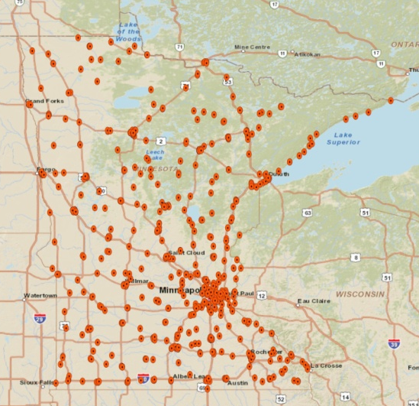
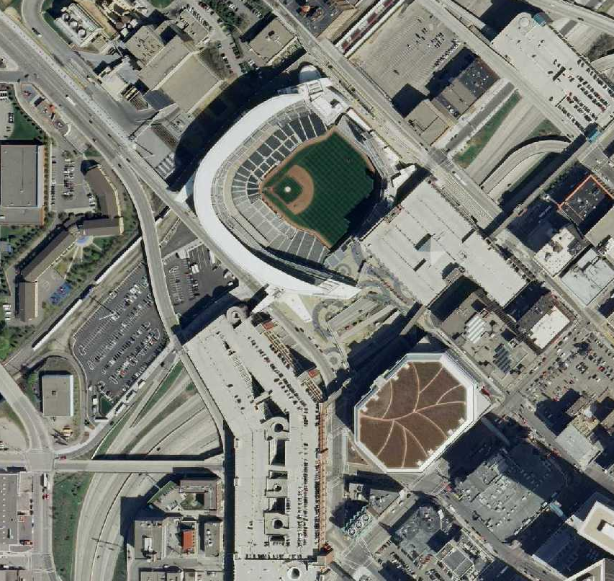
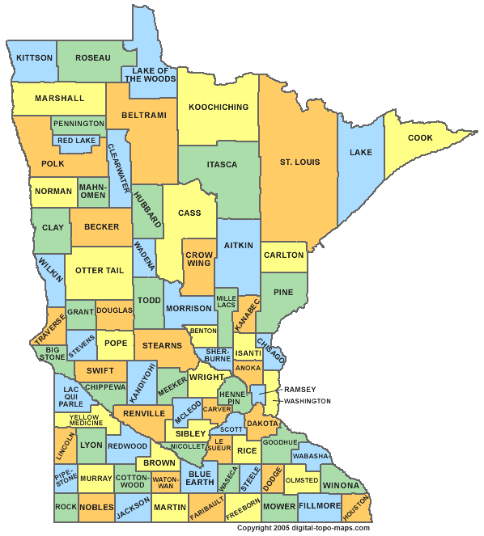
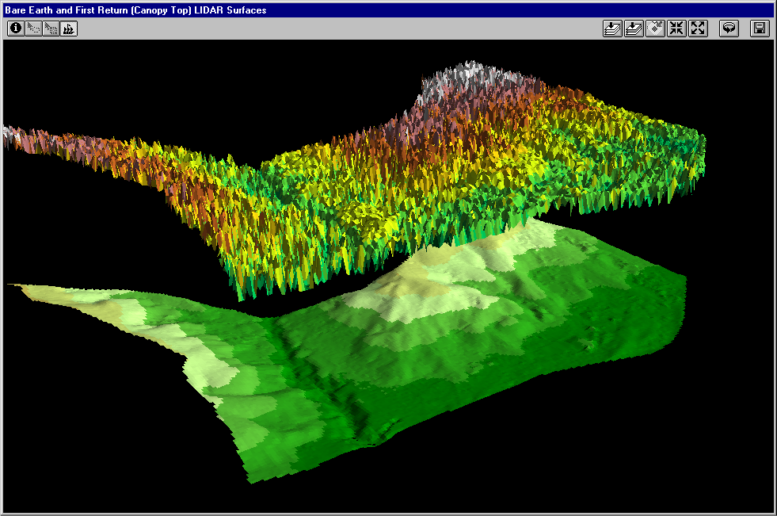
Update on Current Project Priorities

Slide 13
Stakeholder identified priorities from meetings
LiDAR/Elevation Data Delivery (already underway)
Minnesota Geospatial Commons
Sustainable Program for Orthophotos
Statewide Parcel Integration
Street Centerlines (already underway)
Statewide Addresses (may be tied to Centerlines)
Statewide Hydrography
Need to figure out how to resource
Will be limited by optimization
Notes:
Stakeholders have identified 7 important effort
Provide a short sentence on each….

Slide 14
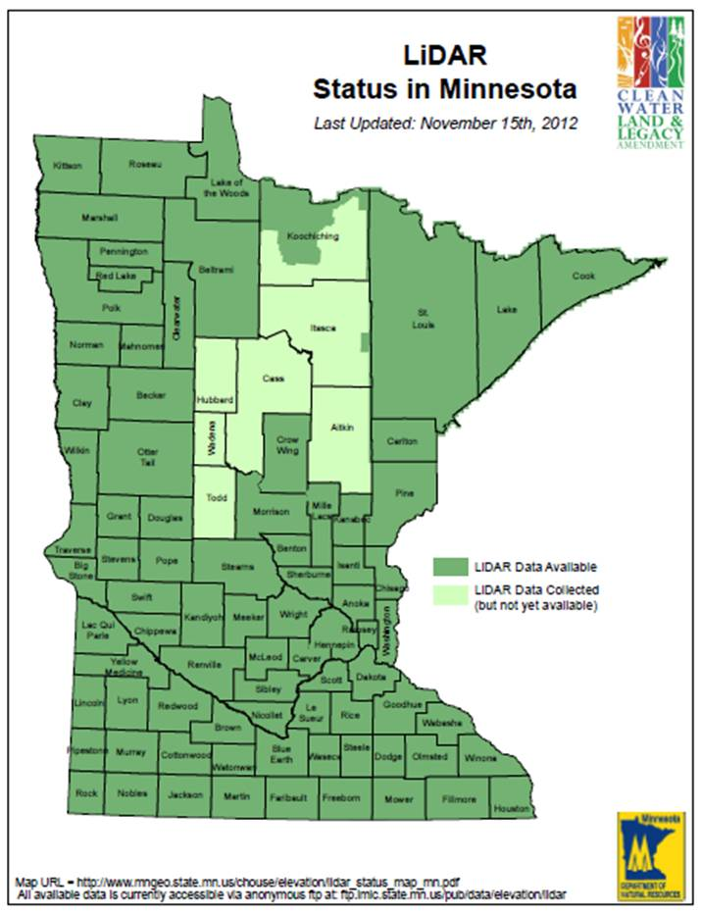
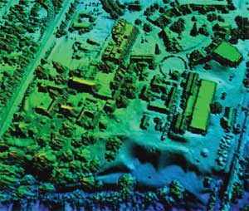
LiDAR
Partnership with MN DNR to:
FTP Site
Develop Data Download Portal

Slide 15
MN Geospatial Commons
A single place we all go to find and share geospatial resources
Where are we?
Working on hiring
Align with infra and data
Nailing down the scope
Eval of the tools
CKAN, Geonode, Esri Portal
Evaluate
Share
Administer
Find

Slide 16
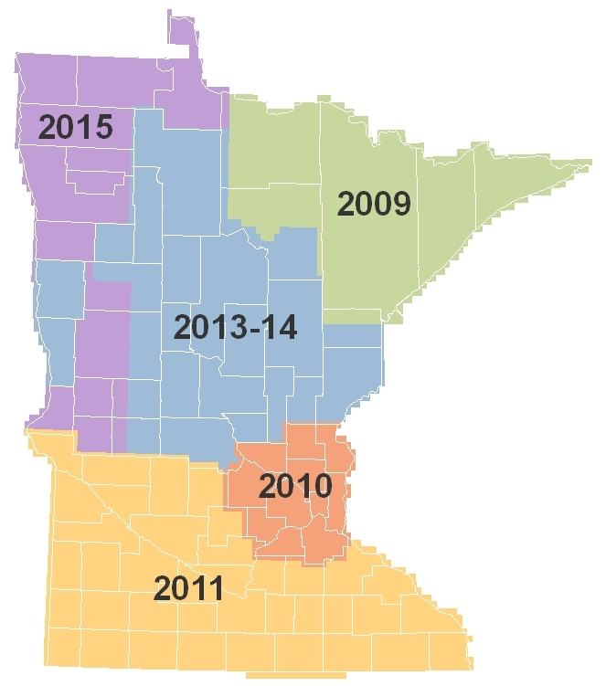
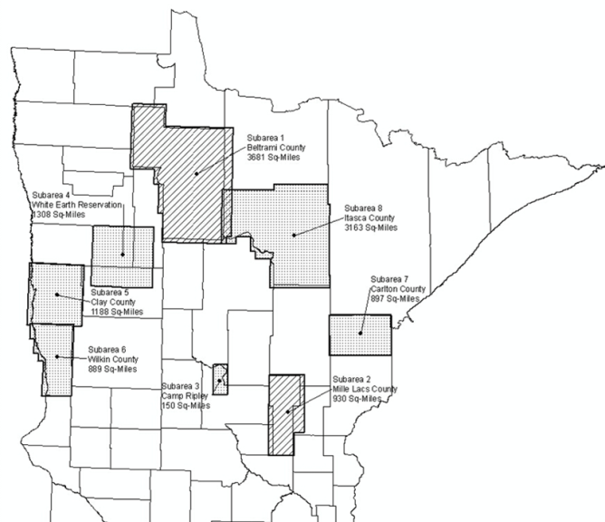
Statewide Aerial Imagery Program
Phase 4 Currently Underway
Eight well-qualified vendor proposals evaluated late January
Currently under negotiations with highest-scoring vendor
Anticipate signed contract later this month
Eight partners intending to cost-share
Investments: Phases 1 through 4
State Program Funds: $1,200,000
Partnership Funds: $ 835,000
Notes:
Statewide Aerial Imagery Program (SAIP)
Five Phases Planned
We’re beginning the 4th now:
Technical Proposals have been evaluated
A top-scoring vendor has been identified
Final negotiations are currently underway with that vendor
Plan is to have a contract fully executed later this month
There are 8 partners involved in this next phase:
Beltrami County
Carlton County
Camp Ripley
Clay County
Itasca County
Mille Lacs County
White Earth Nation
Wilkin County
About $1.2 in Legacy funds have been committed thus far
About a $51K spend for project administration
GF primarily for outreach in developing and managing partnerships
For every $100 of state money investing in this program, $67 are added by non-State partners

Slide 17
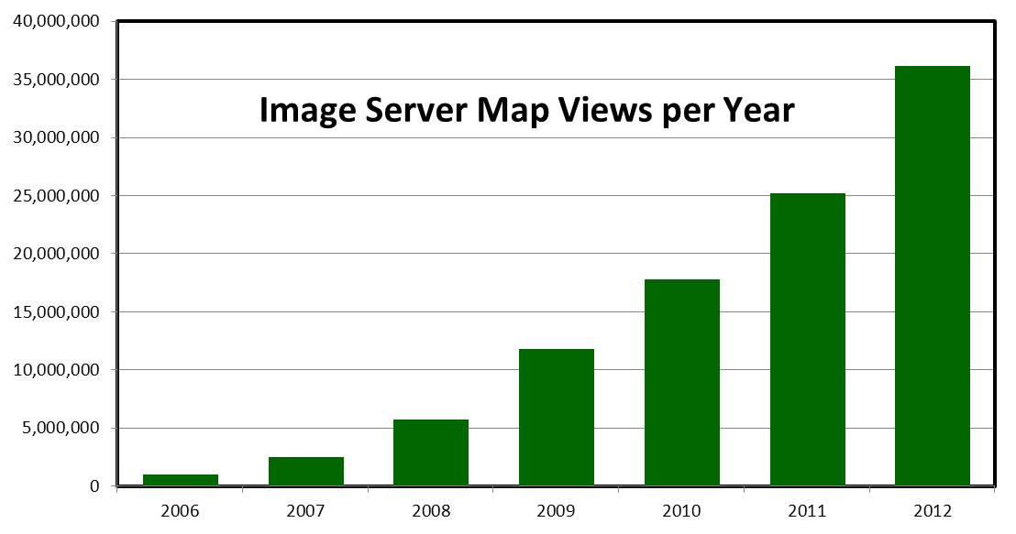
Notes:
Statewide imagery is freely available from MnGeo.
The MnGeo imagery service is experiencing over 35 million hits a year.

Slide 18
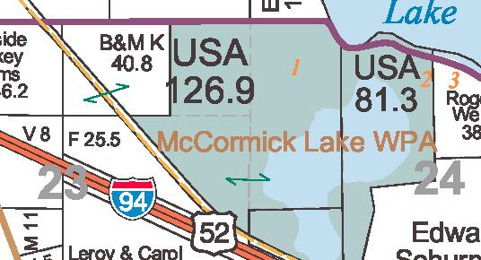
STATEWIDE PARCEL INTEGRATION PROJECT Business Plan Development
Legislation
License Agreement
Exchange Guideline
Regional Collaborations
Department of Revenue Project

Slide 19
Street Centerlines
Multi Government/Agency
MnDOT, MnGeo, Met Council
Single Authoritative Centerline
Common tools
Roads and Highways at MnDOT
Pilot and Partners
Stearns, Benton, Carver, Ramsey, Mahnomen?
White Earth Nation
NextGen 911

Slide 20
National Hydrography Dataset (NHD)
NHD consists of . . . .
Hydrographic features for making maps
A national stream addressing system
A modeling network for navigating upstream/downstream
A maintenance infrastructure
Additional tools to enhance use of data
Notes:
Graphic – St. Louis River Basin is the central basin – emptying into Lake Superior. Hydro features include lakes, rivers for mapping (1-d, 2-d), rivers for networking (1-d); A system of Watershed Boundaries (WBD) is also included. Those are the red lines on this graphic.
Flow volume and velocity within catchments

Slide 21
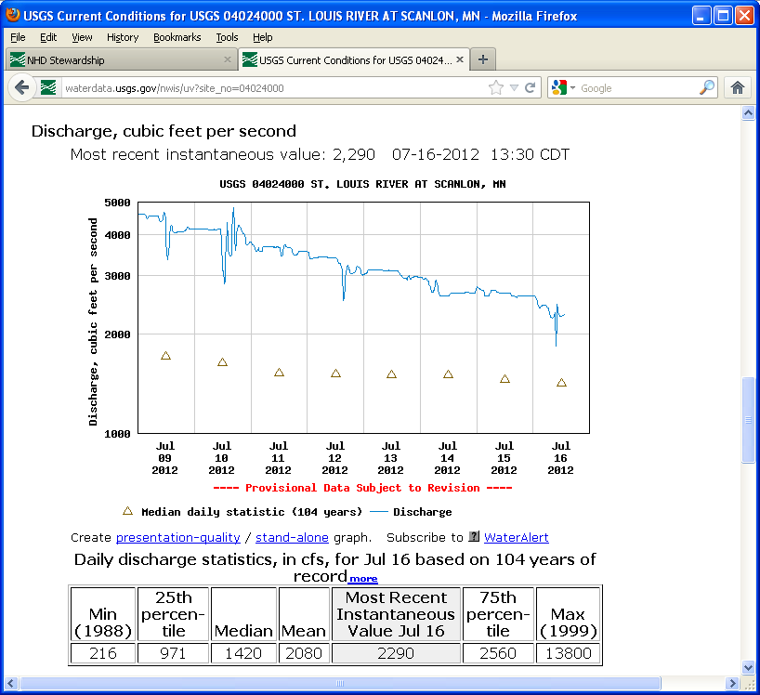
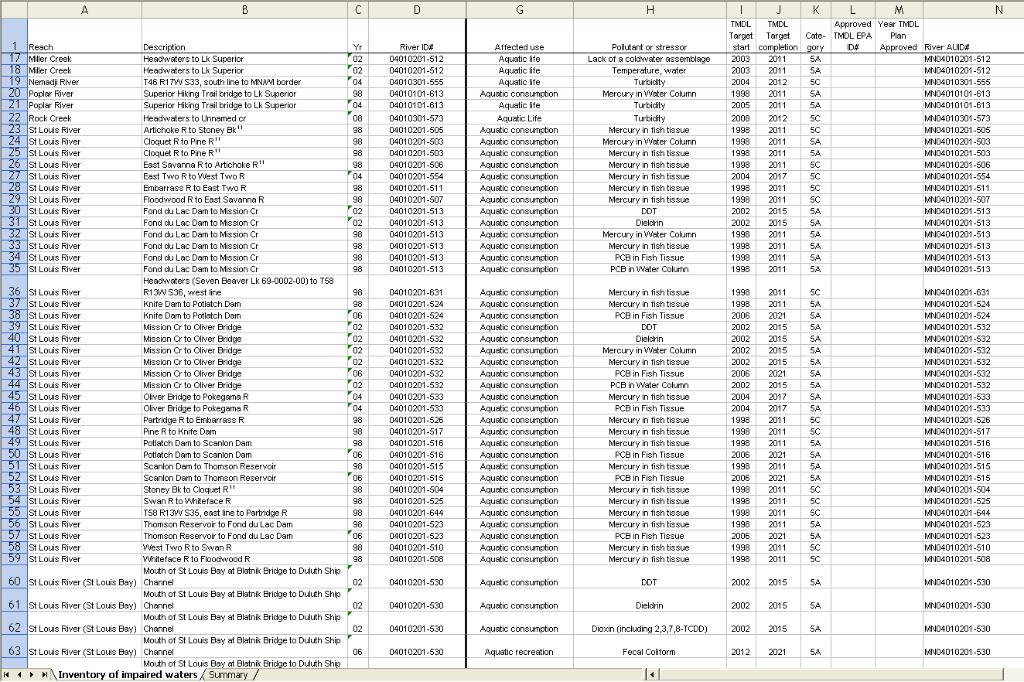
NHD: A Framework for Data Integration
USGS Stream Gages
St. Louis River at Scanlon, MN
MPCA Water Quality Assessments
St. Louis River Basin
Notes:
Linear Referencing, or ‘Reach Indexing’ enables referencing of features or characteristics of a river to the NHD as ‘events’, and the integration of tabular data into the GIS. Data in tables is maintained elsewhere, and pulled into the NHD via its geographic reference and its ‘Source Feature ID’. Examples of indexed data can include: points: dams, stream gages, water quality monitoring stations, discharge points, spills; lines: fisheries habitat improvement areas, stream stabilization project areas, water quality assessment areas, fisheries sampling areas.
Examples on slide: USGS stream gages referenced to the NHD are linked by the gage number to the USGS website where you can pull up images of reference information such as streamflow, or download the historic streamflow record from USGS. MPCA has identified stream segments as ‘water quality assessment units’ for purposes of reporting to EPA under the Clean Water Act. MPCA assembles their water quality assessment data in tables and georeferences them by assessment unit id.
Reporting of impaired waters

Slide 22
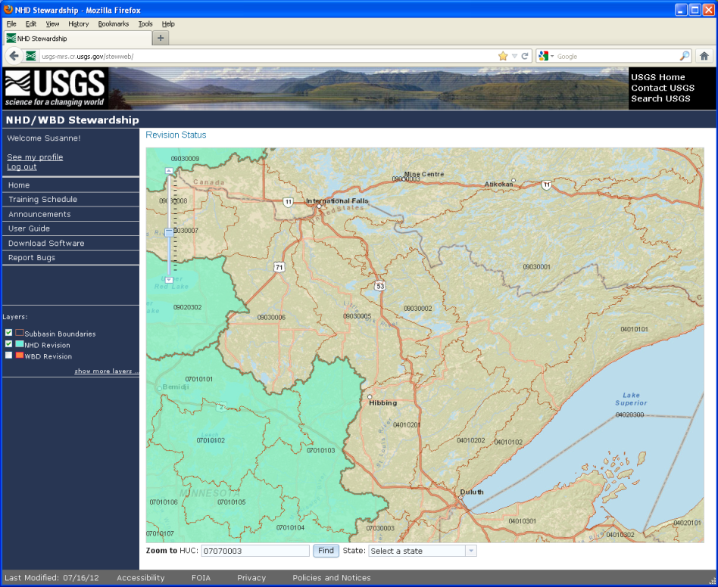
NHD: National Framework; Collaborative Partners
Shared Development Environment
National Sponsor - USGS
Federal Partners – EPA, USFS, BLM
Participants - State, Regional and Tribal Governments
State Stewardship
USGS Site controls editor access, tracks updates
MnGeo as MN Steward
MPCA, USFS, Met Council as additional editors
Multi-state and Multi-national
Notes:
For Minnesota water is a very important data layer. Building a statewide hydrography data layer is a sizable effort.
Here is an example of collaboration to help build the hydrography foundational data layer.
This collaboration enables us to share data across state boundaries – e.g., MPCA share water assessment data with Wisconsin, Iowa, on shared waters; DNR can calculate watershed area upstream of a lake (adding upstream areas in other states from WBD); data are being ‘harmonized’ with Mexico and Canada; this graphic shows the ‘Rainy Headwaters’ including both US and Canada area. It is important to be have consistent data over whole watersheds (not stopped by arbitrary state or national boundaries).

Slide 23
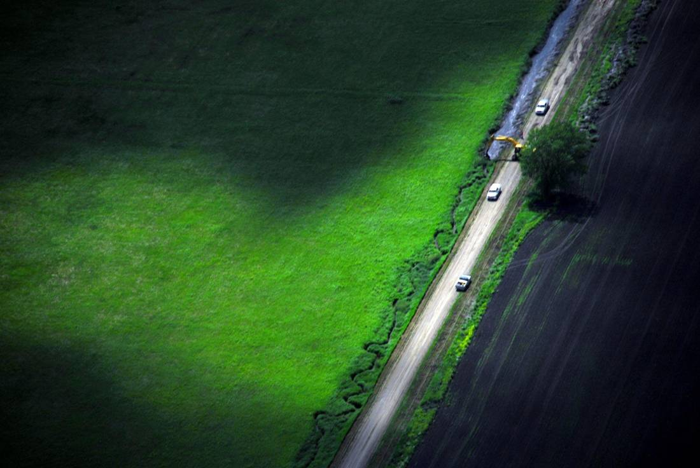
Development of a Statewide Altered Watercourse Layer

Slide 24
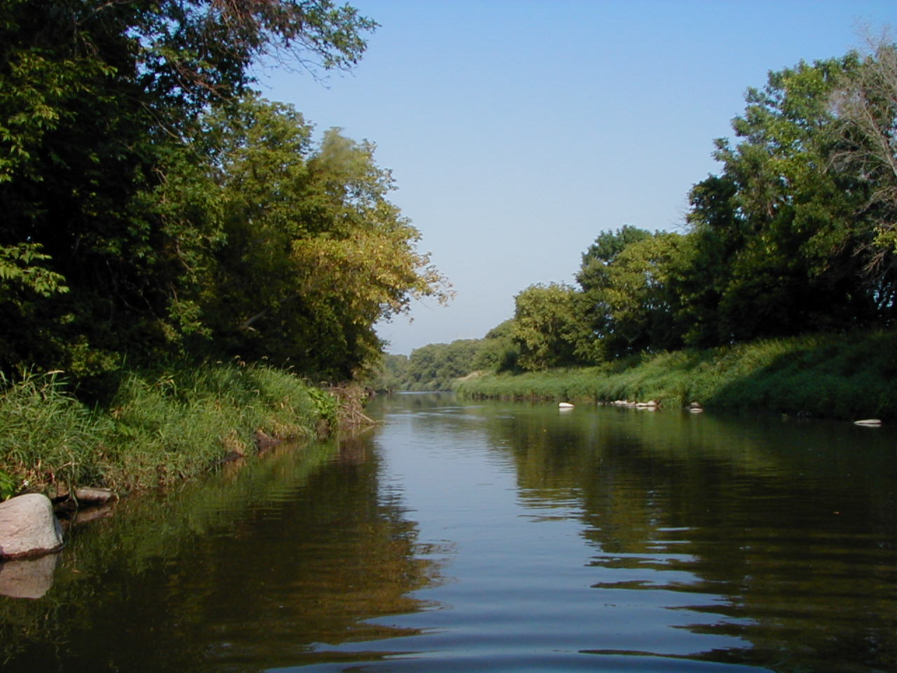
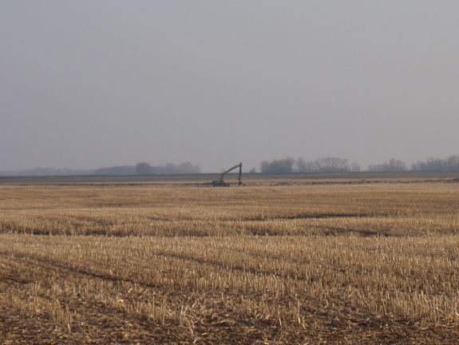
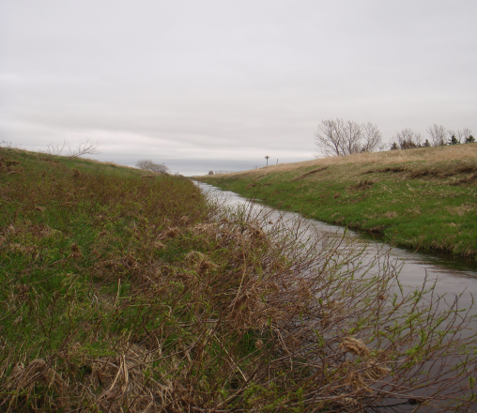
Altered Watercourse
An altered watercourse is a stream/river or portion of a stream/river that has been modified in such a way to alter its natural course
Channel alterations include:
Channelized streams, ditches and impoundments
Channel alterations do not include:
Beaver dams, dredging, rip-rap, removed snags and wetlands

Slide 25
FY2012 Projects: Altered Water Courses
Client: MN Pollution Control Agency
Funding: Clean Water, Land and Legacy Amendment
Budget: Estimated at $465,000
Deliverables: Highly detailed, enhanced NHD GIS data
Who Benefits: State Agencies – PCA, DNR, BWSR; Federal Agencies – EPA, U.S. Forest Service, Soil Conservation Service

Slide 26
Announcements
Governor’s Commendations
Council member terms end June 30, 2013

Slide 27
Other Business
Proposed Future FY13 Meetings
Depends on outcome of legislative changes
Adjourn

