Slide 1
The Minnesota Geospatial Commons Project Update
Mark Kotz, Chair Geospatial Commons Workgroup
Statewide Geospatial Advisory Council – June 30, 2011

Slide 2
Background
MetroGIS Policy Board
MnGeo & Advisory Councils
Coordinating Committee
Technical Leadership Workgroup
Geospatial Commons Workgroup
MnGeo Standards

Slide 3
Opportunity
MN: Much data, many services – more coming
No single web location to find or share
Especially web services
Geo Services Finder = separate
Some agency data publishing sites are aging
Connect data resources behind the scenes
New ISO metadata standards
Many benefits to working together

Slide 4
What is the “Commons”?
A single place we all go to find and share geospatial resources
Enterprise environment = Integrated behind-the-scenes data and service sharing for state agencies, others

Slide 5
Who is Working on It?
Sponsoring Agencies
DNR
Met Council
Mn/DOT
MnGeo

Slide 6
Input from:
Initial Workgroup
Federal
State
Regional
County
City
Non-profit
Stakeholder Agencies
User/Producer Survey
Nearly 540 responses
Casual map users to GIS professional

Slide 7
Key Functions
Find
Evaluate
Share
Administer

Slide 8
Key Functions -
Find
Search
Structured interface
Spatial (e.g. bounding box)
Metadata
Google accessible
Catalog (viewable page)

Slide 9
Key Functions -
Evaluate
Metadata viewer
Map viewer
Download data or connect to web services
User Reviews (quality, reliability, etc.)
Web service monitoring (automated, objective)

Slide 10
Key Functions -
Share
Publish
Metadata
Data for download
Services for consumption

Slide 11
Key Functions -
Administer
User Account
Publish
Notifications – registered user
Harvesting (producer & site admin)
Catalog maintenance
Security & User management
Administrative Policies

Slide 12
Test Implementation
Proof of concept
Defined high level design
Installed ArcGIS GeoPortal Extension v9.3
MnGeo hosting
Implementing out-of-box functions
Supplied test metadata from multiple agencies
Evaluated customization needs
Launched metadata workgroup (ISO/NAP, services)

Slide 13
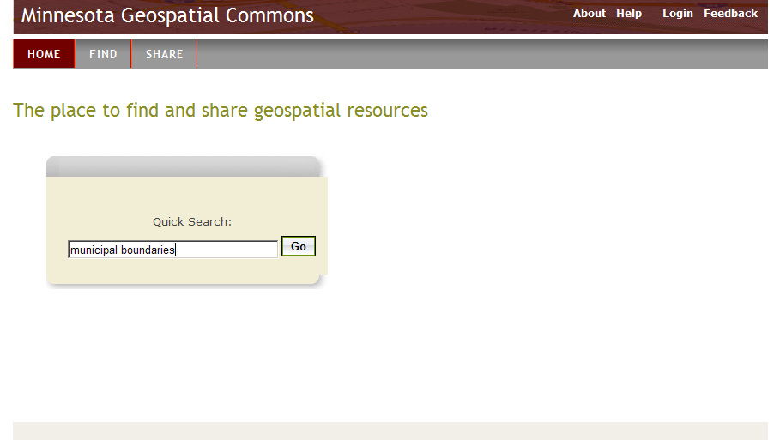

Slide 14
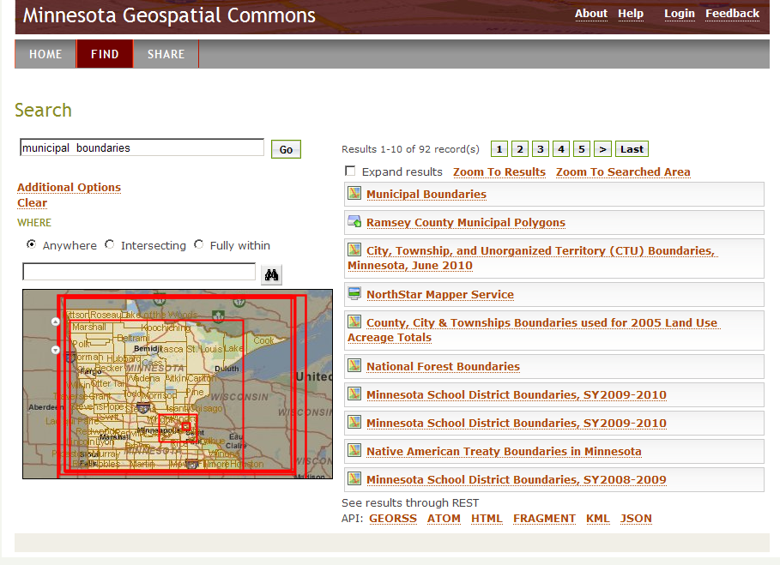

Slide 15
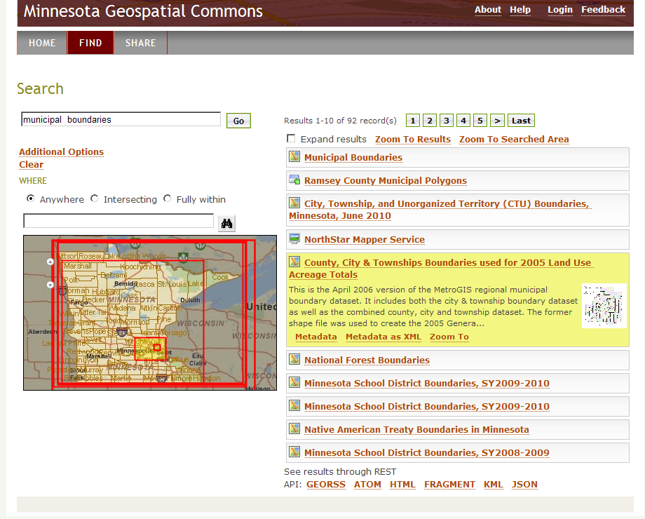

Slide 16
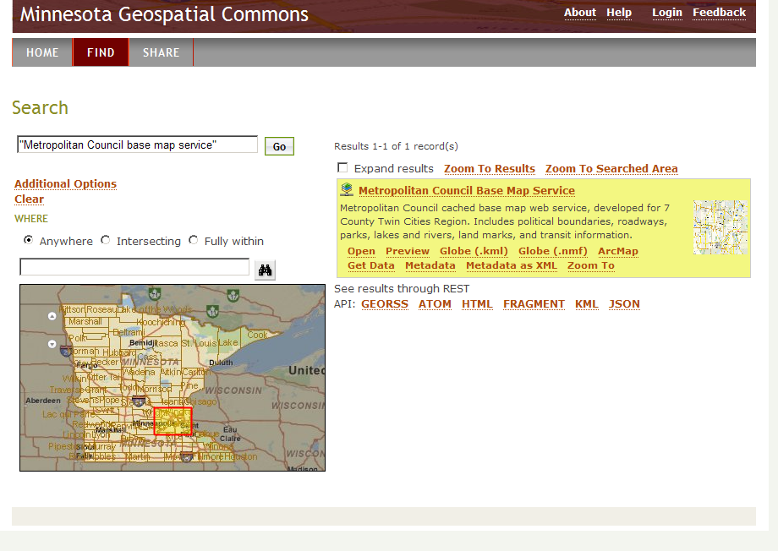

Slide 17
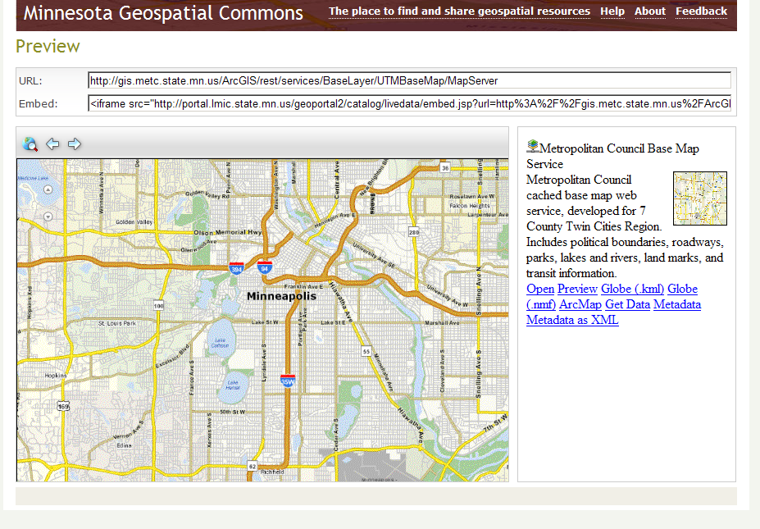

Slide 18
Conclusions
No perfect portal tool exists
Esri product still best choice for our needs
Significant customization needed
Lower priority function may not be implemented
Very possible to eliminate some/all? agency data publishing sites
Dovetail with state and federal initiatives for public access to data – wider audience

Slide 19
Sponsor Input
On the right track!
Think bigger
Integrate with our infrastructure = enterprise environment
We need more detailed business requirements, etc.
Form steering committee = handful of CIOs
Each designate a representative to the workgroup
Develop a project charter, then detailed work plan
Timing? Charter approved by August…

Slide 20
Questions? Feedback?
Phase 1 Active Workgroup Members
Chris Cialek, MnGeo
Jim Dickerson, MnGeo
Jessica Fendos, DEED
Josh Gumm, Scott County
John Harrison, Mn/DOT
Mark Kotz, Met. Council (Chair)
Susanne Maeder, MnGeo
Chris Pouliot, DNR
Nancy Rader, MnGeo
Hal Watson, DNR
Paul Weinberger, Mn/DOT
Mark Kotz
GIS Database Administrator
Metropolitan Council
mark.kotz@metc.state.mn.us
www.mngeo.state.mn.us/workgroup/commons

