Slide 1



Minnesota Geospatial Advisory Council
December 20, 2023

Slide 2
Agenda Item 1
Introductions
Approve agenda
Approve September minutes

Slide 3
Introductions
  Non-profit organizations
  Jessica Fendos, LOGIS
Business
  Kendis Scharenbroich, Pro-West & Associates
  Gerry Sjerven, Minnesota Power
Higher Education
  Len Kne, U-Spatial / UMN Twin Cities
  Stacey Stark, U-Spatial / UMN Duluth
  Shana Crosson, U-Spatial, Research Computing, UMN Twin Cities
MetroGIS
  David Brandt, Washington County
MN GIS/LIS Consortium
  Leanne Knott, City of Red Wing
Surveyor
  Pat Veraguth, Douglas County
At-large
  Cory Richter, Ramsey County
  Heather Albrecht, Hennepin County
  Britta Maddox, Anoka County
Chief Geospatial Information Officer (ex-officio)
  Alison Slaats, MnGeo
City, Twin Cities metro
  Dennis Tumberg, City of Chanhassen
City, Greater Minnesota
  Vacant
County, Twin Cities metro
  Victoria Reinhardt, Ramsey County
County, Greater Minnesota
  Christy Christensen, McLeod County
Regional government, Twin Cities metro
  Tanya Mayer, Met Council
Regional government, Greater Minnesota
  Jill Amundson, West Central Initiative
State agencies
  Kari Geurts, DNR
  Ben Timerson, MnDOT
Federal government
  Jeff Bloomquist, Risk Management Agency, USDA
  Mitch Bergeson, US Geological Survey
Tribal government
  Ryan Bonney, Shakopee Mdewakanton Sioux Community

Slide 4
Agenda
Time | Topic | Time | Topic
10:00 | Call to order, Introductions, approve agenda and previous minutes | 10:55 | Break & Networking
10:15 | Review and Accept Committee Summaries (All) Outreach Committee Update (Bontrager) | 11:05 | Annual Priority Projects Survey Results (Maddox)
10:20 | 3D Geomatics update (Sjerven/Vaughn) | 11:50 | Announcements or Other Business (All)
10:30 | PLSS Update (Veraguth/Thurnau) | 12:00 | Adjourn
10:35 | Open/Opt-In Data Update (Anderson)
10:40 | Updates from MN GIO (Slaats)
10:50 | GAC NSGIC Accounts (Wakefield)

Slide 5
Approve Minutes
Approve September Meeting Minutes

Slide 6
Agenda Item 2
2. Committee/Workgroup Reports – Review and Accept (All)
2a. Outreach Committee Update (Bontrager)

Slide 7
Outreach Committee Update
Committee Mission: Promote the value and importance of the geospatial infrastructure by facilitating geospatial storytelling and actively engaging public policy makers and stakeholders.
Objectives/Vision:
  Tell geospatial stories in venues where they can inform and influence policy makers and others seeking to improve government operations, economic development, and quality of life in Minnesota.
  Create a foundation for open data in Minnesota by connecting with local government representatives to increase the availability of free geospatial data for all Minnesotans.
  Develop and provide guidance for content maintenance of esri hub sites for the GAC and its committees.
  Promote the work of the GAC and its committees through social media outreach.
Structure:
  Chair: Andra Bontrager, MNIT@MNDNR
  Open Data Subcommittee
    Co-Chairs: Heather Albrecht, Hennepin County & Norm Anderson, MNIT@MNGEO
  Success Stories Workgroup
    Chair: Len Kne, UMN

Slide 8
Agenda Item 3
3. 3D Geomatics Update (Sjerven/Vaughn)

Slide 9
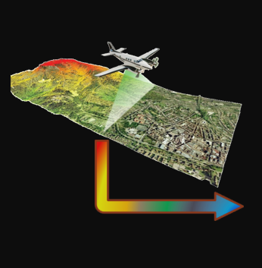
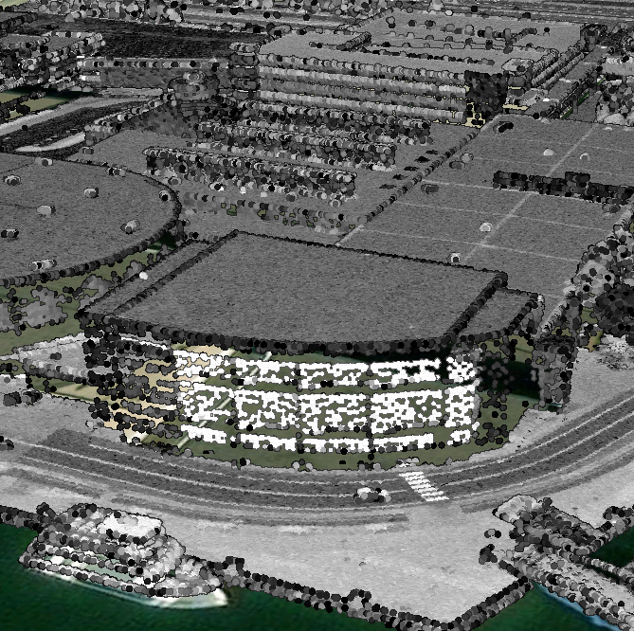
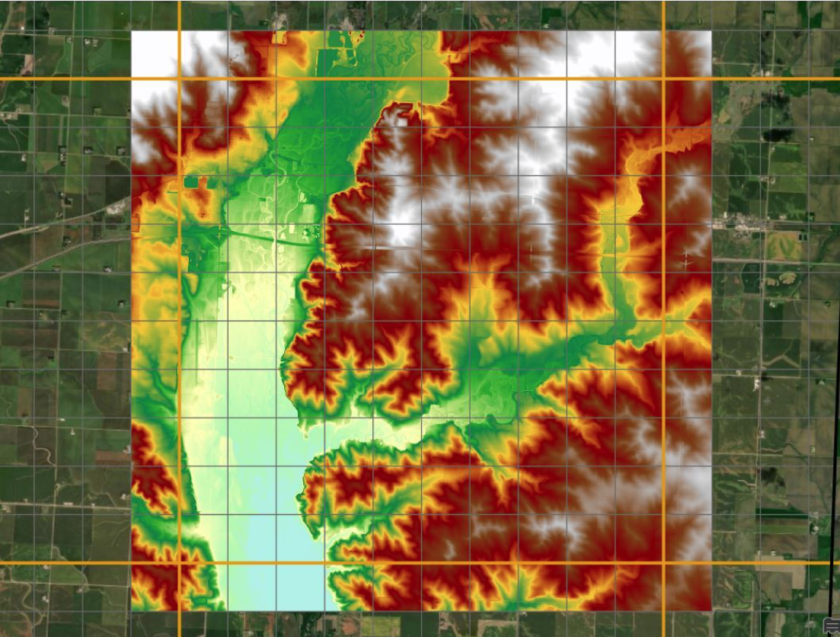
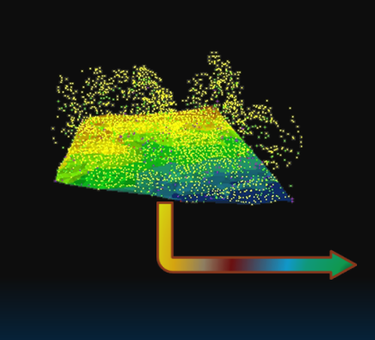
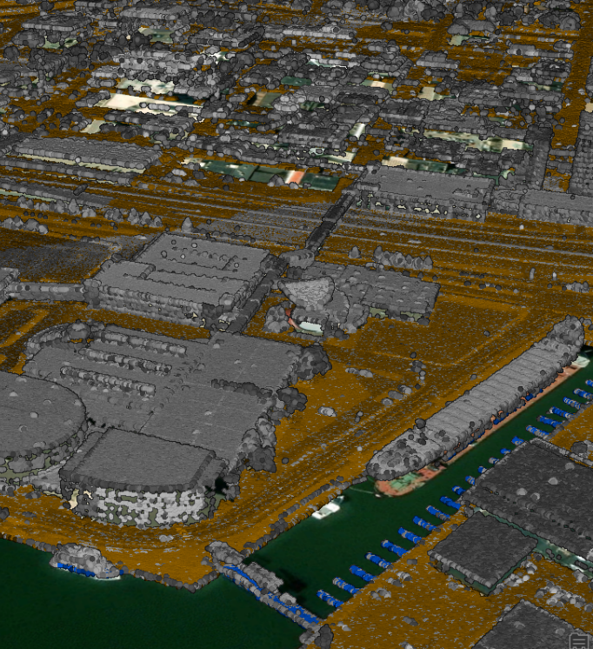

3D Geomatics Committee Update:
Status of the Minnesota Lidar Plan
December 20, 2023
Gerry Sjerven
Sean Vaughn
Clinton Little
3D Geomatics Committee

Slide 10

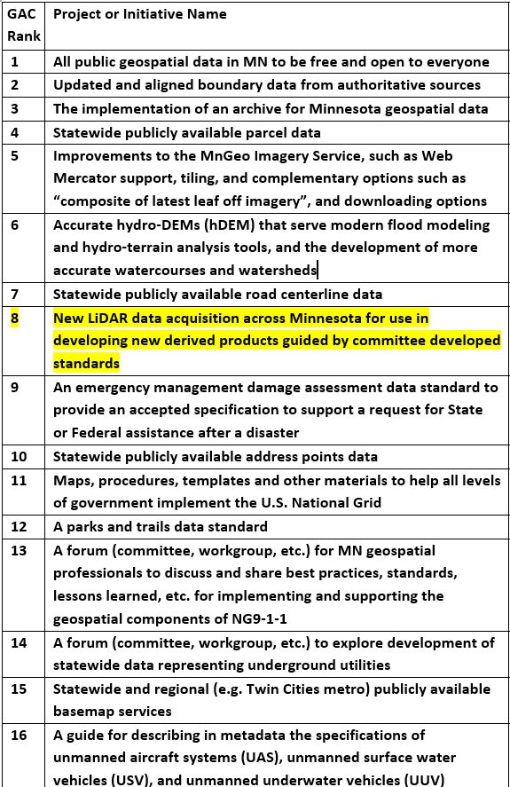
Committee Development Standards
GAC Priority Description:
New Lidar data acquisition across Minnesota for use in developing new derived products guided by committee developed Standards.
Following Our Original Course:
Please recall the initial establishment of this committee, the part that we often forget is the guided by ‘committee development standards’.
Notes:
3DGeo Background
GAC priorities list, built by a robust survey. 3DGeo initiatives are recognized as high priorities (3 out of 20 geospatial challenges)

Slide 11
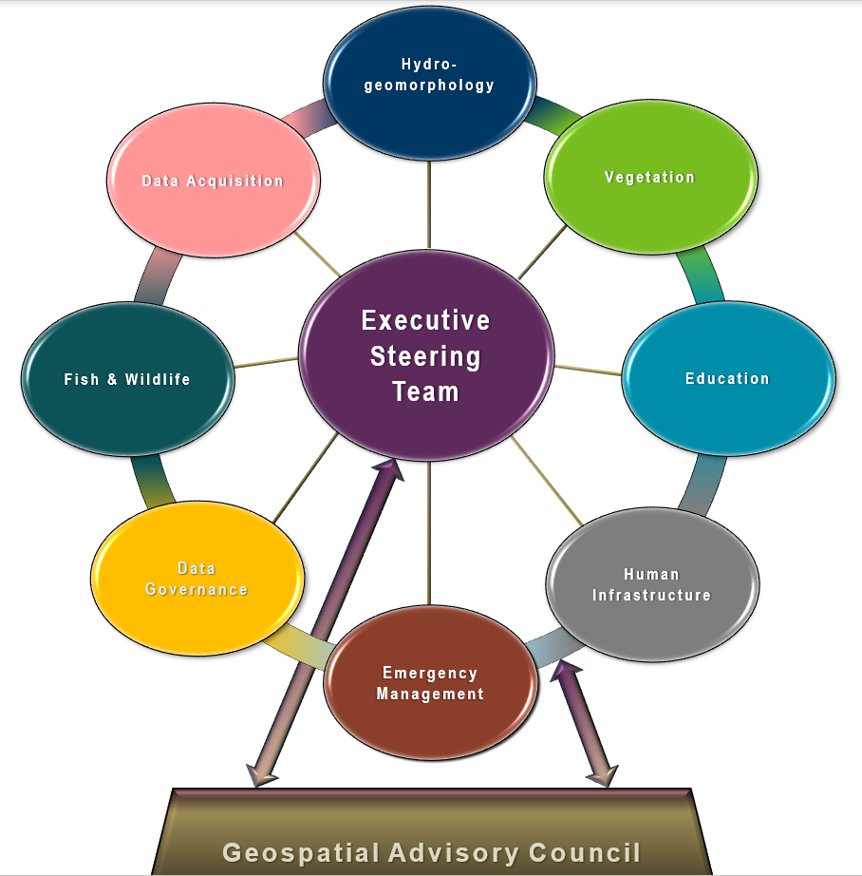
Geospatial Advisory Council (GAC) 3D Geomatics Committee
Geospatial Advisory Council
The Minnesota Geospatial Advisory Council (GAC) is the coordinating body for the Minnesota geospatial community.
Cross-section of organizations that include counties, cities, universities, business, nonprofit organizations, federal and state agencies, tribal government, and other stakeholder groups.
3D Geomatics Committee
The 3D Geomatics Committee (3DGeo) is a chartered committee under GAC that works to identify and promote the need for planning, funding, acquisition, and management of three-dimensional geomatic data and derived products.
Notes:
Sean – 3DGeo Background
What is the GAC?
The Minnesota Geospatial Advisory Council is the coordinating body for the Minnesota geospatial community.
Cross-section of organizations that include counties, cities, universities, business, nonprofit organizations, federal and state agencies, tribal government, and other stakeholder groups.
What is the 3D Geomatics Committee?
The 3D Geomatics Committee (3DGeo) is a committee under GAC that works to identify and promote the need for planning, funding, acquisition, and management of three-dimensional geomatic data and derived products.
Sector Expertise
Lidar acquisition relies on subject matter expertise from different sectors in 3DGeo

Slide 12

3DGeo - Data Acquisition Workgroup
Mission:
The Data Acquisition Workgroup promotes procurement of foundational 3D data for Minnesota.
Co-Chairs
Sean Vaughn, Alison Slaats, and Gerry Sjerven, Clinton Little
Lidar Acquisition Subgroup:
Alison Slaats (MnGeo), Sean Vaughn (MNIT DNR), Gerry Sjerven (MN Power), Clinton Little (DNR), Dan Ross (NSGIC), Jennifer Corcoran (DNR), Colin Lee (MnDOT), Matt Baltes (NRCS), Joel Nelson (U of MN), Joe Sapletal (Dakota Co), Mark Reineke (Widseth), and Brandon Krumwiede (NOAA), Terry Zien (USACOE), Jill Pohjonen (DNR).
Notes:
Sector Expertise
Lidar acquisition relies on subject matter expertise from different sectors in 3DGeo

Slide 13
3DGeo Committee and Workgroup - Next Steps
Acquisition Workgroup has been very successful
Recall ‘committee development standards’
New Subgroups
  Lidar Derivatives Subgroup
  Lidar-derived Hydrography Subgroup
Update the workplans for the 3D Geomatics Committee and workgroups
Update meeting frequencies and membership rosters
Notes:
3D Geomatics and Acquisition Workgroup - Next Steps

Slide 14
2023 3DGeo – Accomplishments
  3DGeo 3DEP Compliant Lidar Status web map was released.
  Completed review and update of the 3DEP Data Delivery Option (OPR and FVA Data) document.
  Derivatives subgroup delivered sample data derived from lidar to MnGeo staff for testing with ESRI.
  Lidar-derived Hydrography Outreach Talking Points document created.
  Team members delivered 8 - 3DGeo 3DEP lidar presentations to stakeholders, partners and customers.
Notes:
Clint

Slide 15
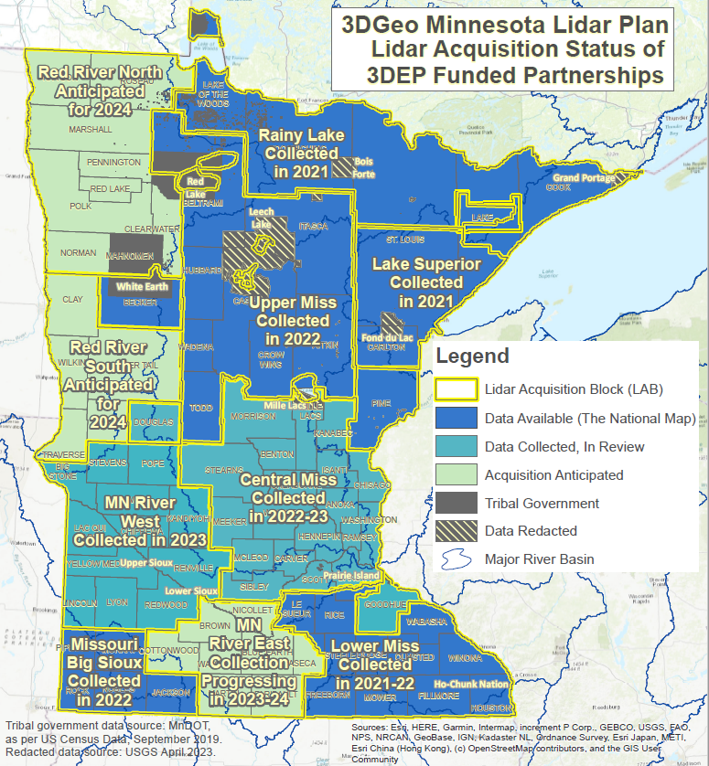



3D Geomatics: Funding, Agreements, and Acquisition
Contributions to Minnesota Lidar ($millions)
Minnesota Partners: $ 7.55
USGS 3DEP: $19.08
Other Federal $ 0.45
Total: ~$27.08M
Minnesota Funding Partners
59 Funding Partners
81,500 Square Miles of New Lidar
$92.59* Cost/mi² For MN Partners
* Estimated per mi² of lidar. 59 unique funding partners and local tax dollars working collaboratively for consistent data acquisition. $92.59 value: 1) not specific to a LAB, 2) total partner contributions of $7,545,761.44 (10/04/2023), 3) doesn’t include federal contributions
Notes:
7.55 + 19.08 + 0.45 = 27.08 million
65,359 + 16,141 = 81,500 square miles of lidar collected
81,500/$7,545,761.44 = 92.586 (using lidar acquisition miles)
Acquisitions are coordinated by the GAC’s 3DGeo Committee
Statewide 3DEP Certified QL1 Lidar
Minnesota’s Lidar Plan divides up the state into lidar acquisition areas (LAA) based on political (county) and watershed boundaries
Grant funds are available from USGS for lidar acquisition because there is a national need for a consistent nationwide elevation layer
3DGeo is working to organize lidar acquisition so that Minnesota can take advantage of this USGS federal funding opportunity
Economies of scale are achieved
The bigger the collection footprint to lower the cost

Slide 16
Next
3DEP…
Notes:
Clint

Slide 17
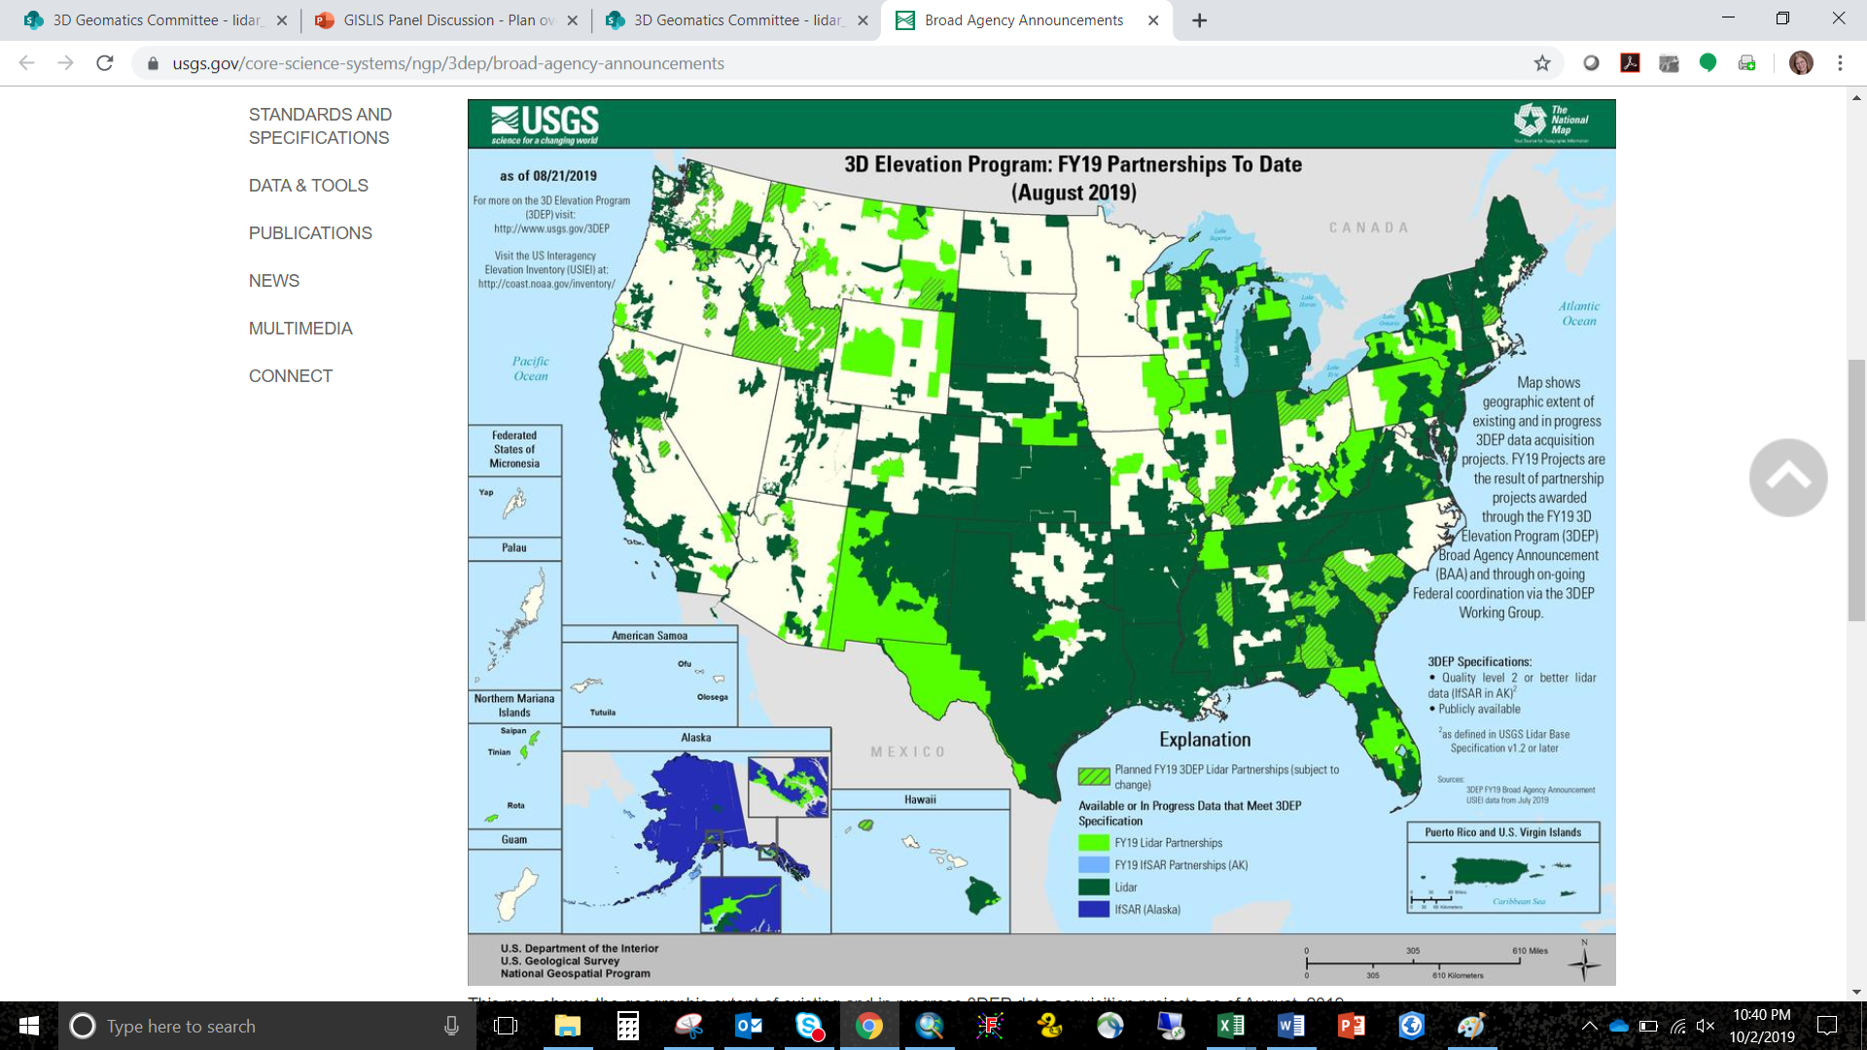
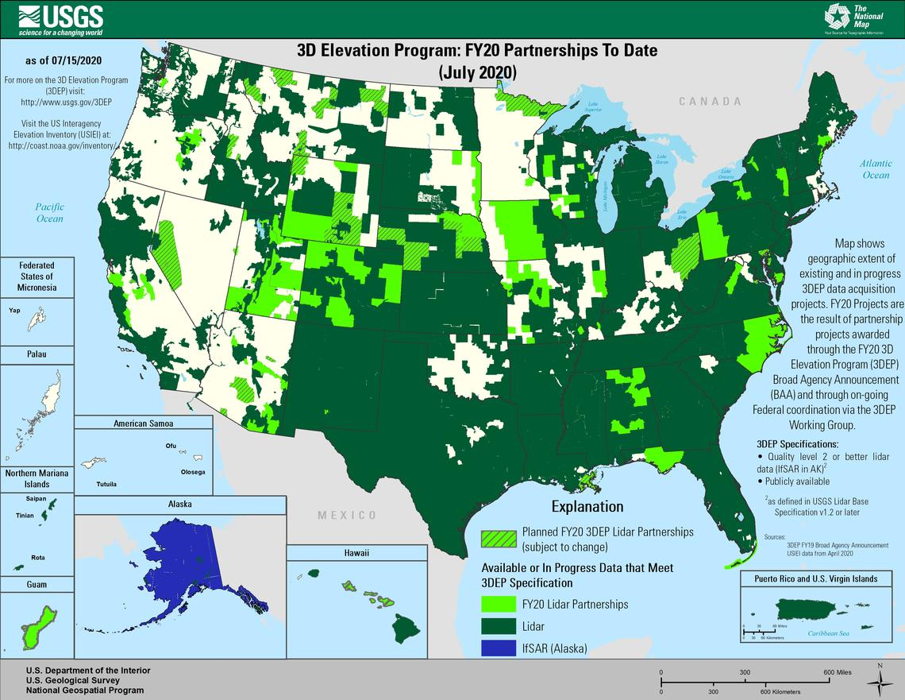
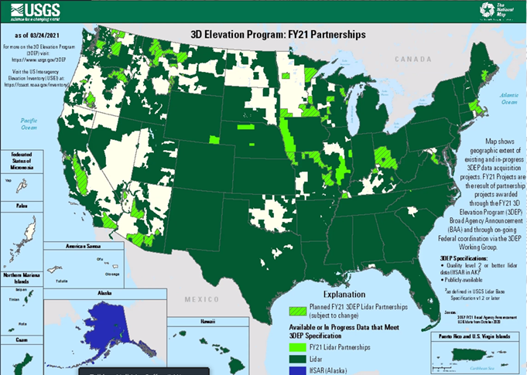
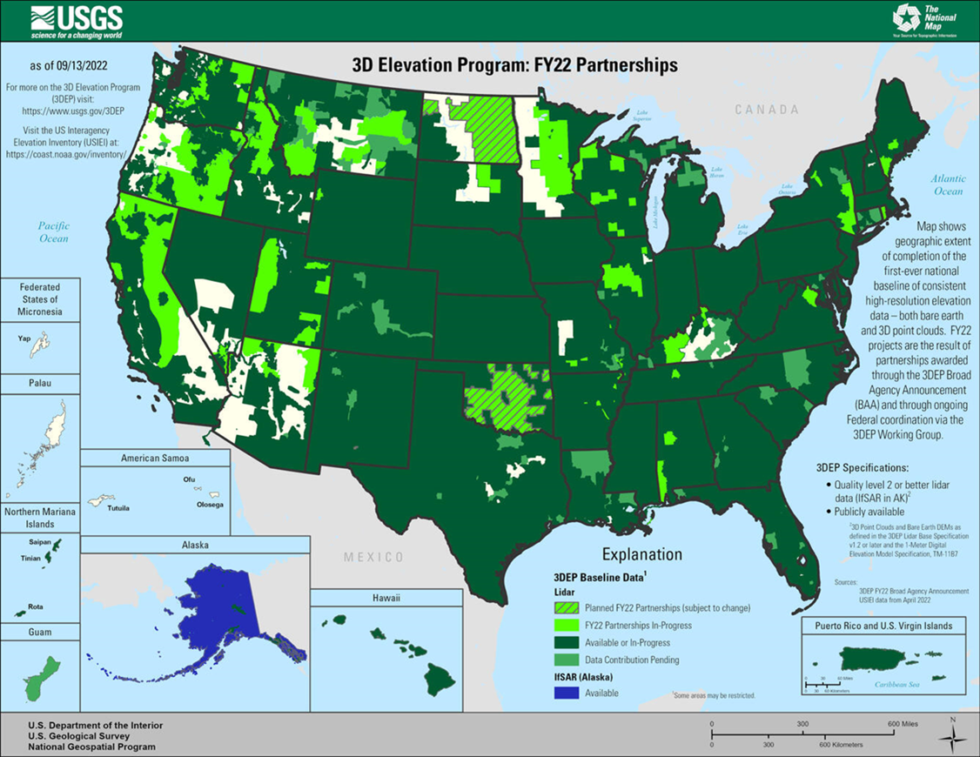
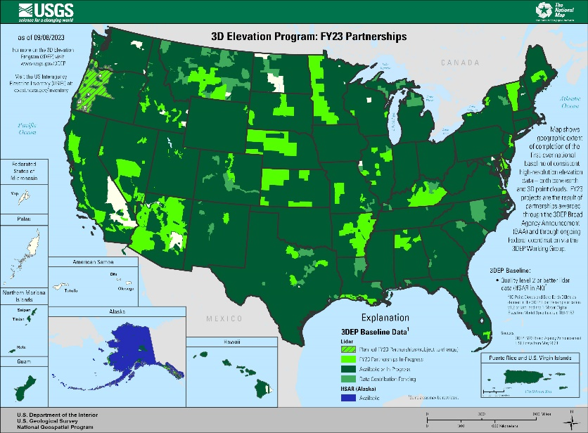
USGS 3DEP - Partnership Funded Compliant Data
2019
Maps show geographic extent of completion of the first-ever national baseline of consistent high-resolution elevation data –both bare earth and 3D point clouds – identified by the U.S. Interagency Elevation Inventory (USIEI) that meet 3DEP base level specification. -USGS https://www.usgs.gov/media/images/fy22-status-3dep-quality-data
2020
2021
2022
2023

Slide 18
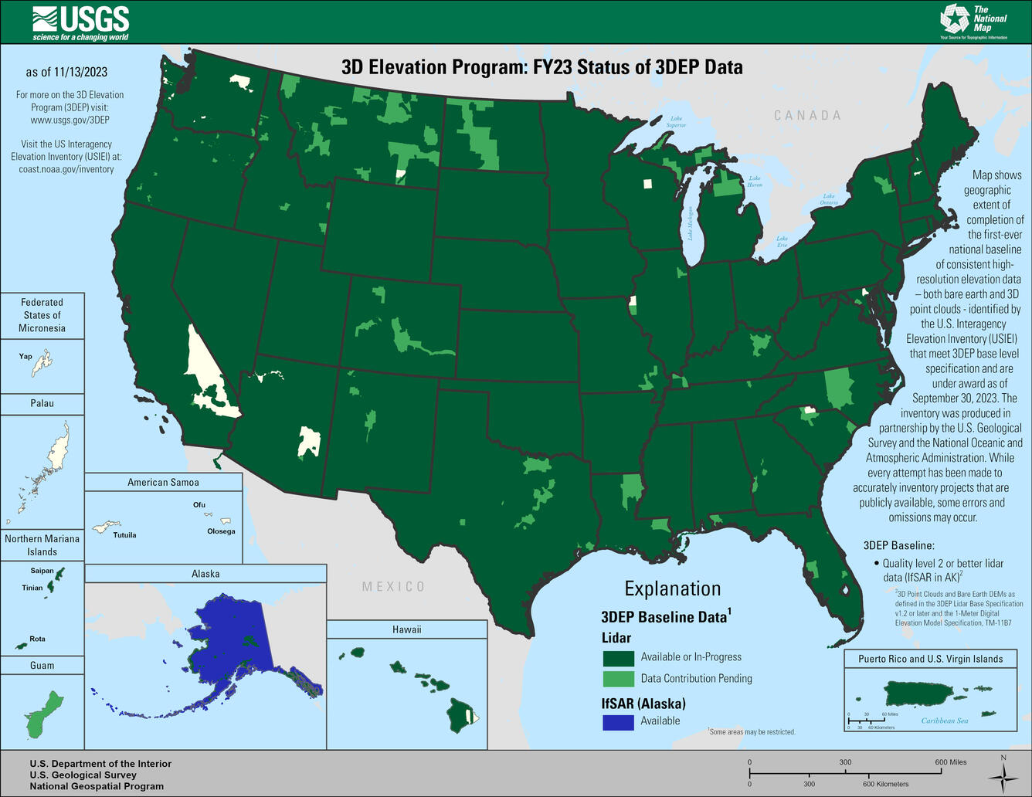
USGS 3D Elevation Program (3DEP)
3D Elevation Program (3DEP)
Systematically guiding the collection of 3D elevation data in the form lidar data for the United States, and the U.S. territories
3DEP Status Map
= Data Available or In-Progress
3DEP Certified Data
  Standardized by USGS Lidar Base Specification
  Consistent high-resolution nation-wide elevation data
  Supports Next Generation Hydrography
Dark Green
Notes:
Link to Map: https://www.usgs.gov/3d-elevation-program

Slide 19
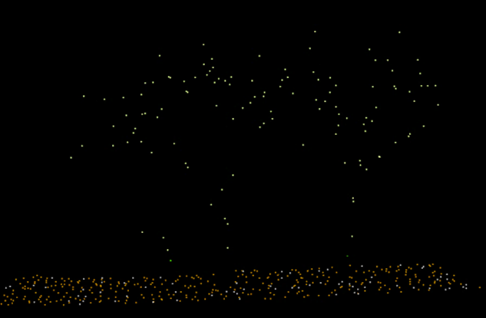

Minnesota Lidar → Temporal Lidar Data
Awareness: Two Versions of Authoritative Lidar Data For MN
First Generation Lidar (1stGEN)
  Legacy, Low Density (2008 - 2012)
  Quality Level – 3 Lidar (QL3), no longer meets spec
Second Generation Lidar (2ndGEN)
  Current, High Density (2021 - 2025)
  Quality Level – 0 Lidar (QL0) [Le Sueur & Olmsted County]
  Quality Level – 1 Lidar (QL1)
  Quality Level – 2 Lidar (QL2) [2019, Pine County]
QL3
QL1

Slide 20
Next
2 New Subgroups formed in 2023…
Notes:
Clint

Slide 21
3DGeo – New Subgroups in 2023
New Subgroups
  Lidar Derivatives Subgroup
  Lidar-derived Hydrography Subgroup
  Administration (location & charter)
  Location: Subgroups of the 3DGeo Data Acquisition Workgroup
  Charter: Operate under the charter of the 3D Geomatics Committee

Slide 22
3DGeo – New Subgroups in 2023 – Lidar-derived Hydrography Subgroup
CURRENT
ACTIVITY: 10K+ Processing Window (Roving Kernel)
Operates on the 3DGeo Tiling Scheme
A 10K selection of 1K tiles, plus a selection of 1K tiles exterior to the 10K tile, resulting in a 144 1K tile window.
Approximately 20 to 30-minute processing time to create these products
Processing and Derivatives
Focal Statistics
DEM (0.5m)
Hillshade (0.5m)
HPI (0.5m)
Contours
Notes:
Recent Activity: Creating a Foundation
Build a Team of Champions
Create a Names for the Initiative and Products
Write a Mission Statement
Build Awareness
Membership Recruitment (Jan)
Conduct Outreach and Education

Slide 23
3DGeo – New Subgroups in 2023 – Lidar Derivatives Subgroup
1. Lidar Derivatives Subgroup
  Mission Statement:
    …seeks to identify, define, and publish best practices for lidar derivatives by aligning existing, proven legacy techniques with new advancements in lidar-derived product development.
  Co-chairs:
    Joe Sapletal (Dakota County)
    Sean Vaughn (MNIT)
    Jesse Reinhardt (Hennepin County)
Notes:
The Lidar-DERIVATIVES Subgroup of the 3DGeo Data Acquisition Workgroup is a group of geospatial technologists united as a 3DGeo community of practice that seeks to identify, define, and publish best practices for lidar product development by aligning existing, proven legacy techniques with new advancements in lidar-derived product development

Slide 24
3DGeo – New Subgroups in 2023 – Lidar-derived Hydrography Subgroup
2. Lidar-derived Hydrography Subgroup
  Mission Statement:
    …is a team of geospatial technologists united as a 3DGeo community of practice that works to bring Next Generation Hydrography (NXG-HYDRO) to Minnesota developed from lidar technology.
    Capitalizing on the subject matter expertise of its leadership and general membership, the 3DGeo Subgroup provides guidance and education to stakeholders and decision makers on Lidar-derived Hydrography (LDH).
Champions
Jamie Schulz (DNR MNIT – Fisheries)
Sean Vaughn (DNR MNIT – EWR)
Clinton Little (DNR – Coastal Program)
Jen Crea (MPCA MNIT )
Notes:
The 3DGeo Lidar-derived Hydrography Subgroup is a team of geospatial technologists united as a 3DGeo community of practice that works to bring Next Generation Hydrography (NXG-Hydro) developed from lidar technology to Minnesota. Capitalizing on the subject matter expertise of its leadership and general membership, the 3DGeo Subgroup provides guidance and education to stakeholders and decision makers on Lidar-derived Hydrography (LDH).
With guidance from the 3DGeo Hydrogeomorphology Workgroup, the Minnesota 3D Geomatics Data Acquisition Lidar-derived Hydrography Subgroup is building the foundation for a Mn3D-Hydro initiative

Slide 25
3DGeo – New Subgroups in 2023 – Lidar-derived Hydrography Subgroup
CURRENT
ACTIVITY: With guidance from the 3DGeo Hydrogeomorphology Workgroup, the Minnesota 3D Geomatics Data Acquisition Lidar-derived Hydrography Subgroup is building the foundation for a Mn3D-Hydro initiative.
EXECUTIVE
AGENCY
SPONSOR: This Lidar-derived Hydrography initiative will need a state agency sponsor with multiple state agencies supporting the effort.
GEOSPATIAL
COMMUNITY: Work in 2024 to make this initiative a 2025 GAC Priority.
Notes:
Recent Activity: Creating a Foundation
Build a Team of Champions
Create a Names for the Initiative and Products
Write a Mission Statement
Build Awareness
Membership Recruitment (Jan)
Conduct Outreach and Education

Slide 26
Next
Wrap Up…
Notes:
Clint

Slide 27


3DGeo - Next Steps
Agriculture
Hydrologist
You
Transportation Engineer
You don't have to have money or be a decision maker to share your ideas.
You can be a voice of support.
Please serve as a champion for 3DGeo Initiatives.
Forester
Dam Engineer
Environmental Services
Engineering
Resource Mgmt
GIS Specialist
Floodplain Manager
GIS
Natural
Resource
Specialist
Surveyor
Assessor
County
Emergency Management
3D Geo
Notes:
Please serve as a champion for 3DGeo Initiatives in the GAC and your place of employment
Sean’s email to Empower stakeholder who can’t bring money but can bring and promote a voice of support for why new HD lidar is needed.
Joes response - We (3DGeo) is the trunk of the tree (Joe’s analogy)

Slide 28
Agenda Item 4
4. PLSS Update (Thurnau/Veraguth)

Slide 29

PLSS Monument Grant Development
MnGeo Survey Coordinator Onboarded October 25th
Meetings with: Finance, Procurement, OGM, MNIT Legislative Director, General Counsel
Office of Grants Management (OGM) Training
Request for Proposal (RFP) converted to new OGM template
PLSS Preservation Committee has met weekly since Nov. 6th
Developed application exhibits & FAQs
Grant overview presentation at MSPS Winter Meeting
Outreach & discussions with counties & land surveyors
Submitted RFP & application to MNIT General Counsel for review
Research & review of Grant Management Solutions

Slide 30

PLSS Monument Grant Next Steps
Acquire & Develop Grant Management Solution. (6-8 weeks)
Consider & Incorporate General Counsel comments.
Outline & Finalize Financial & Procurement Grant Process’
Outline Pre-award Risk Assessment Process
Final reviews of RFP and application exhibits
Implement & test grant management system
Open application period end of January or beginning of February
Award & execute first grant award contracts March-April 2024
PLSS Legislation will be considered in the next legislative session.
Questions?

Slide 31
Agenda Item 5
5. Open/Opt-In Data Update (Anderson)
4 distinct maps -
  Open Data Counties: Counties that share their data freely, on their own site and on the Geospatial Commons
  Parcel Opt-In Counties: Counties that have agreed to include their parcel data in the statewide GAC-standard parcel dataset on the Geospatial Commons
  Road Centerline, Address Point and Emergency Service Zone Opt-In Counties: Counties that have agreed to include their (NG911) data in the statewide GAC-standard datasets on the Geospatial Commons as soon as it is available
  Recently published – 1st Generation Road Centerlines : Counties that have agreed to include their road centerline data in the first public statewide GAC-standard road centerline dataset on the Geospatial Commons

Slide 32
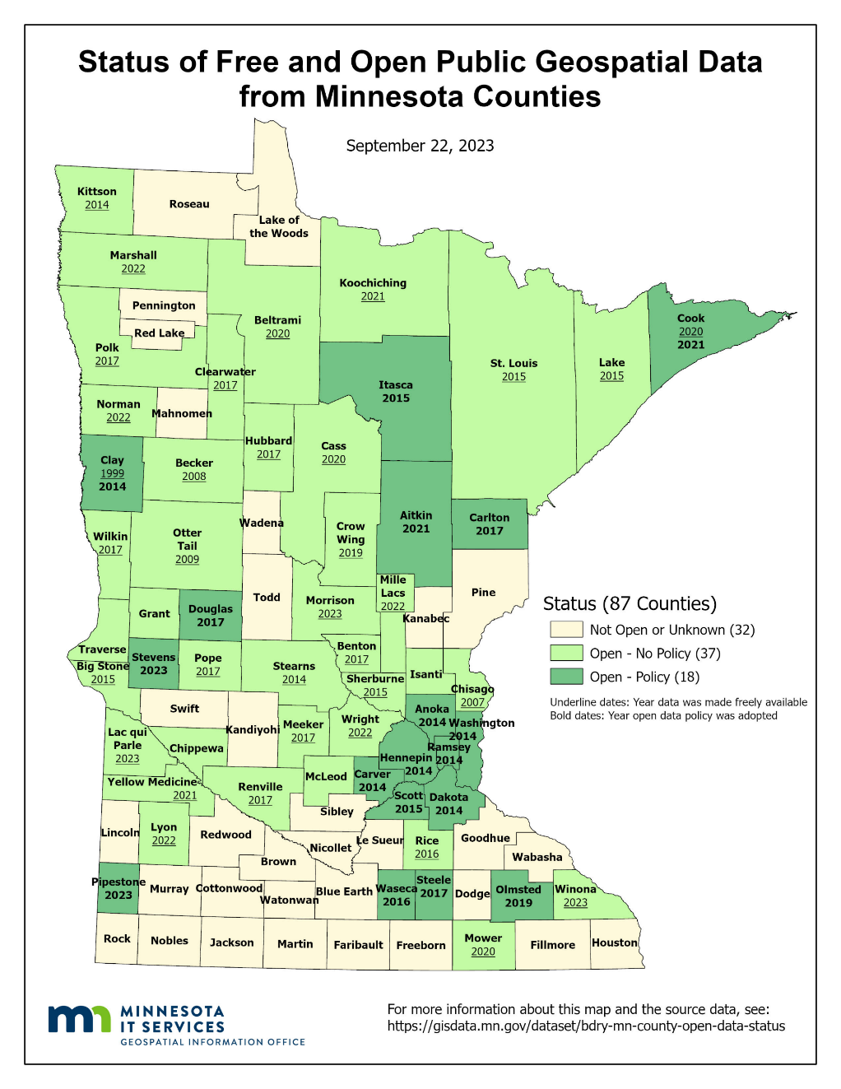
Status of Free and Open Data Public Geospatial Data
Status | Number of Counties | Total
Open - Policy | 18 | 55
Open - No Policy | 37
Not Open or Unknown | 32 | 32
Additions since last update: Morrison & Winona
https://gisdata.mn.gov/dataset/bdry-mn-county-open-data-status

Slide 33
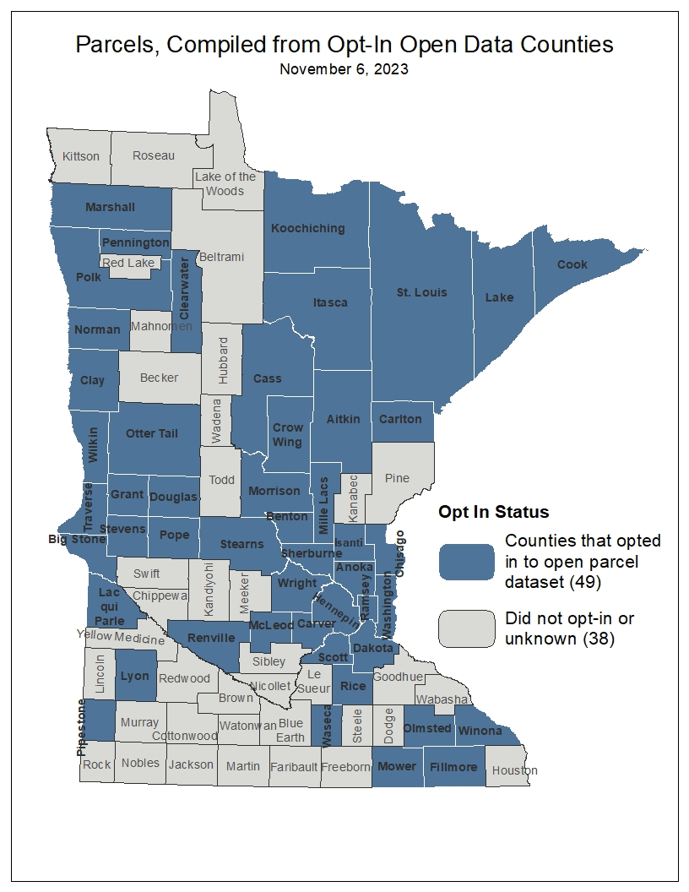
Statewide Publicly Available Parcel Data
Published quarterly
Most recent update, November 6, 2023
  New Counties: Cass, Lac qui Parle, McLeod, Morrison, Pipestone
  Coming soon:
  Create a secure ArcGIS Online statewide feature layer for internal (government) use
https://gisdata.mn.gov/dataset/plan-parcels-open

Slide 34
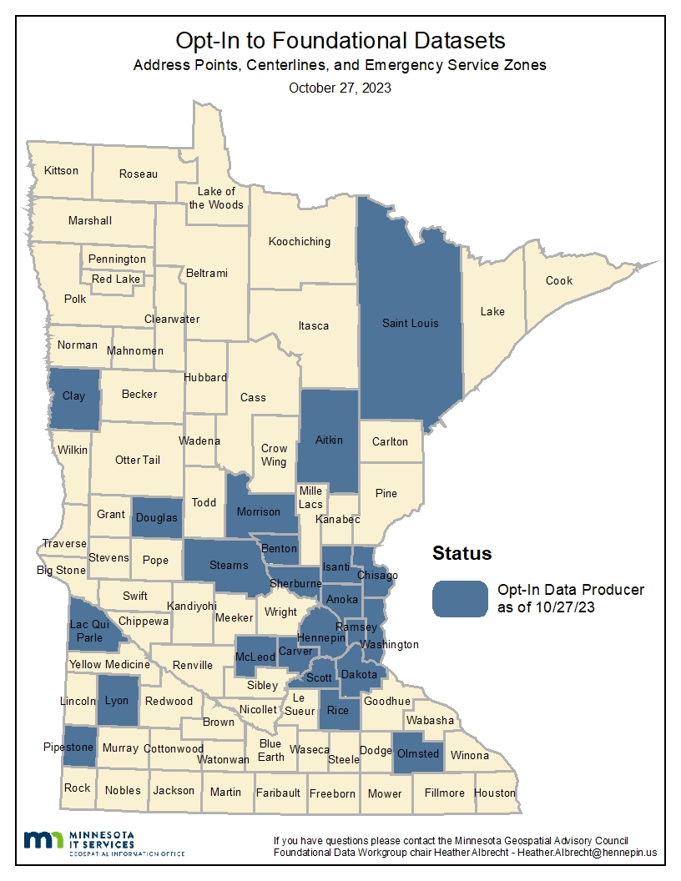
Road Centerline, Address Points and Emergency Service Zones
Opt-In to share RCL, ADP and EMZ’s
  21 Counties have opted in!
  Peer to Peer process modeled after PLRC parcel sharing efforts
  Work being done by Open Data sub-committee (Outreach Committee)
  Outreach volunteers needed!

Slide 35
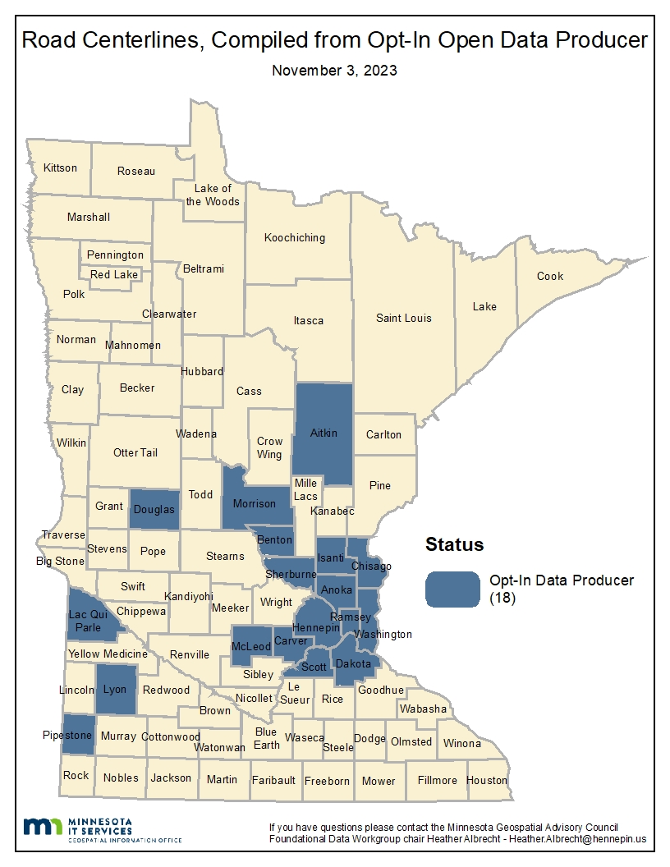
Road Centerline Dataset Published!
1st Road Centerline dataset published!
  Compiled from Opt-In Open Data Counties November 30th (soft launch)
  https://gisdata.mn.gov/dataset/trans-road-centerlines-open
  Coming soon:
  Broadcast announcement for road centerlines
  Publish Address Points, Complied from Opt-In Open Data Counties

Slide 36
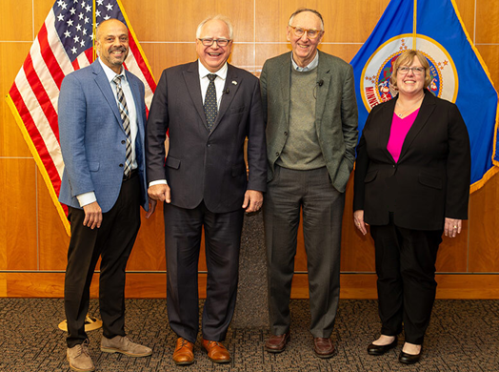
Agenda Item 6
6. Updates from MnGeo (Slaats)
October 31 - Governor Walz, Jack Dangermond and Alison Slaats presented to state agency senior leadership about using GIS to support One Minnesota plan, and data-driven decision making
Technology Modernization Fund (TMF)
  MNIT has funds for modernization of technology
  MnGeo has applied for TMF funds to update the Geospatial Commons. Goals of the work are to upgrade architecture and refresh website. Web service-based architecture would result in more Commons resources with services.
  Request: letter of support from the GAC for MnGeo TMF application

Slide 37
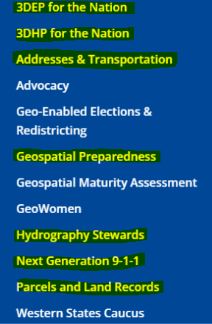
Agenda Item 7
7. GAC NSGIC Accounts (Wakefield)
  Every member now has an activated account at NSGIC.org
  Username = email address - create or recover password at log-in
  Accounts can access a range of resources
    Initiatives: Specific – active - organized activities/topics
    Communities: Topic based list serves/discussion boards
    Knowledge Base/Learning Link: Search by keyword or category for past webinars,
    archived conference materials, white papers, and more!
    My.NSGIC: tracks activities and interests for each member (with nice help page!)
  MANY people in states across the US are working on the same initiatives as we are in MN.
  We can partner, learn, share and collaborate!

Slide 38

Break & Networking

Slide 39
Agenda Item 9
9. Annual Priority Projects Survey Results (Maddox)
See the packet for a descriptive list of projects/initiatives ranked in the survey.
9a. Recruitment

Slide 40
Agenda item 13
Updates on GAC Priority Projects and Initiatives
David Brandt

Slide 41
Updates on GAC Priority Projects and Initiatives
Most recent success
Experiencing a barrier?
Next task
Request for Assistance

Slide 42
GAC Priorities
Project or Initiative Description | Status | Project Owner | Champion
Parcel Data | Active | Ryan Stovern | Alison Slaats
Critical Infrastructure Data Workflow | Active | Stacey Stark | Steve Swazee
Updated and Aligned Boundary Data | Active | Preston Dowell | Alison Slaats
Address Points Data | Active | MnGeo | Alison Slaats
Road Centerline Data | Active | MnGeo | Alison Slaats
Culvert Data Standard | Active | Rick Moore | Andrea Bergman
Publication of Open Foundational Data | Active | David Brandt, Randy Knippel | Alison Slaats
Lidar Data | Active | Gerry Sjerven | Alison Slaats
U.S. National Grid Materials | Active | Randy Knippel | Randy Knippel
Remonumentation of All Section Corners | Active | Pat Veraguth | Alison Slaats
MnGeo Image Service Improvements | Active | Alison Slaats | Alison Slaats
Geodata Archive Implementation | Active | Ryan Mattke | many

Slide 43
GAC Priorities
Project or Initiative Description | Status | Project Owner | Champion
Underground Utilities Data Sharing Team | Active | Steve Swazee | Barb Cederberg
Success Stories for Geospatial Technology | Active | Outreach Committee | Len Kne
Geospatial Commons Advisory Group | Recruitment | Ben Timerson
Hydro-DEMs | Active | Sean Vaughn | many
Summary Crime Data | Active | Britta Maddox
NG9-1-1 Geospatial Forum | Recruitment
Parks Data Standard | Inactive | Standards Committee?
State Business License Data | Inactive
Street Parking Restrictions Data Standard | Inactive | Standards Committee?
Snow Emergency Parking Data Practices | Inactive
Strategy Team for All Types of Imagery | Inactive | Imagery Team?
Basemap Services | Inactive
Inventory of MN GeoData Assets | Inactive

Slide 44
Critical Infrastructure Data Workflow
Most recent success:
If you are experiencing a barrier:
Next Task:
  (In committee reports)

Slide 45
Updated and Aligned Boundary Data
Most recent success:
If you are experiencing a barrier:
Next Task:
  (In committee reports?)

Slide 46
Publication of Open Foundational Datasets
Most recent success:
  Parcels were published in November
  Road Centerlines were published in November
If you are experiencing a barrier: Is this the same as CANDO?
Next Task:
  Publish Address Points
  Start building Emergency Service Zone Commons resource

Slide 47
Culvert Data Standard
Most recent success:
  • Finalized Culvert Data Standard survey questions to be sent out to the geospatial community in Minnesota to survey the extent of their LGU's culvert ineventory and provide data for the development of a standard.
  • Culvert Data Standard Geospatial Survey is prepped and ready to be sent out to geospatial community the first week of January with assistance from MnGEO staff.
  • Working with DNR Stream Practitioners group and other groups to identify needs from their viewpoint in the creation of a Culvert Data Standard
If you are experiencing a barrier: Identifying the right time to send out the survey to garner the most responses from the geospatial professionals involved in culvert inventories. Off field season identified and timeline adjusted.
Next Task:
  Survey will remain open for the month of January.
  Survey responses will be reviewed and categorized in identifying attributes that are common among all entities. Discussions amongst the Subgroup and eventual larger group on the attributes needed for a standard will begin.
Request for Assistance:
  Assistance provided by MnGeo is much appreciated

Slide 48
Lidar Data Acquisition
Most recent success:
  Presented Lidar Panel at the MN GIS/LIS Consortium Conference.
  Developed new subgroups - Lidar derivatives subgroup and Lidar-Derived Hydrography
  Approved the Basin ID standard from the Hydrogeomorphology group and forwarded it to the Standards committee for next steps.
  The entire state is either 'Available or In-Progress' for data acquisition.
  Data has been been delivered to MnGEO (Data Custodian) and available through The National Map https://www.usgs.gov/programs/national-geospatial-program/national-map
If you are experiencing a barrier:
  Managing expectations on delivery of derived products as raw data arrives.
Next Task:
  Acquisition Workgroup is working on new Workplan for 2024.
  Meeting Frequency is being reviewed and membership confirmed.
  Opportunity to review and revise the State Lidar Plan.

Slide 49
U.S. National Grid Materials
Most recent success:
Project Team efforts are focused on spearheading development of a national effort known as the US National Grid Institute (usngi.org). Recent successes include:
  Creation of an outreach trifold appropriate for national use
  Considerable IT development which is consolidating all USNG related websites and functions within a unified hosting structure belonging to the USNGI, Florida State University funding three full time interns to work on a variety of USNGI outreach and technical projects, California Finance Department USNGI Board member working with US Census on potential use of USNG for 2030 census compilation and analysis
  Engagement with FEMA and other federal agencies to correct USNG deficiencies in current issued map products, and Finalization of USNGI Board membership, administrative procedures and future operational plans
If you are experiencing a barrier: None except as noted in submission of the EPC's report.
Next Task:
The USNGI Board top ten priorities for 2024 are as follows:
  Finish USNGI Website
  Rework USNG Center
  Finish national map uploader
  Finish ELM production guide
  Develop professional administrative/correspondence standards
  Work with the FCC to incorporate USNG as communication standard
  Issue a USNG adoption report by end of 2024
  Develop flow of content to USNGI Facebook
  Formally issue a basic USNG brochure
  File with FHWA to set the USNG ELM design as a national standard

Slide 50
Remonumentation of All Section Corners
Most recent success:
If you are experiencing a barrier: Is this the same as PLSS?
Next Task:

Slide 51
MnGeo Image Service Improvements
Most recent success:
If you are experiencing a barrier:
Next Task:

Slide 52
Geodata Archive Implementation
Most recent success:
The Big Ten Geospatial Information Network is nearing completion on a report outlining what it would look like to build a Geodata Archive for the Big Ten. Much of the work of the Archiving Workgroup will be utilized for this exploration.
If you are experiencing a barrier:
The main barrier for this work over the past six or so years has been a lack of funding, but we're hoping to work around that by building the archive for the entire Big Ten Geospatial Information Network.
Next Task:
Determining costs and software options for different ways of implementing an archive. Based on our draft report, we have been given the green light to proceed. We hope to receive more formal approval in late February, following the submission of a final report.
Request for Assistance
Not so much assistance as (future) input -- how can we leverage this to archive Minnesota data?
Would a Big Ten Geodata Archive serve the need for a Minnesota Geodata Archive?

Slide 53
Underground Utilities Data Sharing Team
Most recent success:
  Project received PHMSA grant of $100,000 on 10/1/23 for build out of FuzionView software (fuzioview.org). Total committed funding now at $225,000. In negotiations with Michigan 811 for their participation in the project.
  Development team now fully staffed: Project manager, documentarian, UI developer and two programmers.
Next Task:
  Continue development of software as directed by Project Leadership Team.
  Conduct project outreach as requested and submitted.
  In-person events:
    January 17 - AGC-MN, St. Paul
    February 26-28 - Utility Safety Partners, Banff
    March 18-19 - Facility Notification, New Orleans
    March 18-20 – DCA/AGA Workshop, Kansas City
    April 14-18 - CGA Conference and Expo, Colorado Springs (submitted) o
    May 29-31 - MN Transportation Conference and Expo (submitted)

Slide 54
Success Stories for Geospatial Technology
Most recent success:
If you are experiencing a barrier:
Next Task:
In Committee Reports

Slide 55
Accurate hydro-DEMs (hDEM)
Most recent success:
If you are experiencing a barrier:
Next Task:

Slide 56
Summary Crime Data
Most recent success: Stagnant due to workload.
Next Task: Looking for a new owner.
Request for Assistance: Anyone willing to be the new project owner?

Slide 57
Agenda Item 10
10. Announcements or Other Business (All)

Slide 58
Next Meeting
March 20, 2024
10 am – Noon, online only

Slide 59
Adjourn
Thank you

