Slide 1
Welcome
- Introductions
- Approve Agenda
- Approve Dec. Minutes

Slide 2
Agenda Item 2
Discussion & Action
Review and Approval of Committee and Workgroup Summaries

Slide 3
Discussion:
MnGeo Support for Committees and Work Groups
  Initial thoughts…
  Support will include:
    Assistance with initial committee/workgroup startup and operation
    Templates for charter, work plan, reports, meeting minutes and website
    Website for committees and workgroups – content will be provided by the committee or workgroup
    Publication of committee/workgroup generated reports
    Advice if requested
  Committees and workgroups will provide:
    Meeting logistics (scheduling rooms, arranging for video, etc.)
    Meeting minutes (minimum of: date, attendance, topics discussed, decisions made and action items; other information and details may be added as determined by the committee/workgroup)
    Distribution list of members and interested parties
    Web site content
    Periodic written updates of activity and progress
    Development of stakeholder communications which will go through MnGeo

Slide 4
Agenda Item 3
Parcels and Land Records Committee Update

Slide 5
Agenda Item 4
Discussion & Action
Review Charter and Work Plan of the Outreach Committee

Slide 6
Agenda Item 5
Discussion
Governance and Relationship with the Geospatial Technical Committee (GTC)

Slide 7
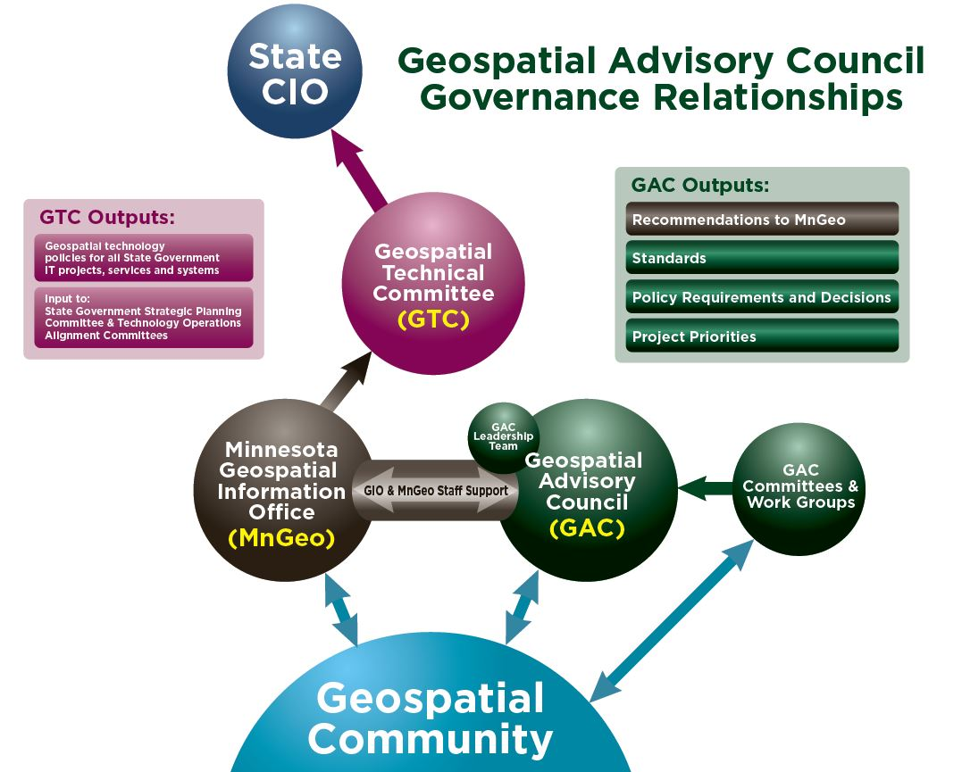

Slide 8
Break – Networking

Slide 9
Agenda Item 7
Discussion & Action
Sector Reporting

Slide 10
Agenda Item 8
Action
Governor’s Geospatial Commendation Award
Submissions due May 31st, 2016

Slide 11
Governor’s Commendation Award
Awards from the Governor’s office for activities that exemplify the use of GIS to improve services within Minnesota.
Criteria:
Promote effective investments in geospatial information
Promote geospatial information as a shared public resource
Support the establishment and use of geospatial standards and guidelines
Champion collaboration among geospatial practitioners and related stakeholders
Educate and inform policymakers related to the value
and use of geospatial technology
Provide a forum for ideas and issues to be shared
and acted upon by the geospatial community
Encourage geospatial education at all levels

Slide 12
Governor’s Commendation Award
Standards are high; award is not always given
Deadline for nominations: May 31, 2016
Council awards committee evaluates the nominations and makes recommendations to advise the CGIO, the CIO, and the Governor’s Office
  Volunteers needed for this year’s committee
  Work done in June, mostly by email
More information on the award webpage: www.mngeo.state.mn.us/awards/gov_commendations/
  How to nominate a project
  Past winners

Slide 13
Agenda Item 9
Discussion
MnGeo Image Server Governance

Slide 14
Agenda Item 10
Discussion
Legislative Update

Slide 15

10. Vegetation Buffer Mapping Project
Public Ditch GIS data has been filtering into the DNR for processing.
  Received data from 26 county/ditch authorities
Have developed on-line tools to help DA’s without digital data to identify public ditches by selecting/tracing existing linear features or by adding new features that are absent from the DNR’s current base data
Preliminary Buffer maps will start rolling out by County/Ditch Authority the week of 3/7/2016 for review.
  Published as a web based map and County/Ditch Authority and SWCD staff will have access.
  Purpose of this review is to have the locals validate that the public ditch data was translated accurately
Status maps that display our progress will be available on the Buffer web page.
  Will be released as each is completed and reviewed by the local authority
http://www.dnr.state.mn.us/buffers/index.html
Notes:
Will release as each is completed and reviewed by the local authority.

Slide 16
10. Minnesota Statute 114D.50 - Clean Water
Subd. 5.Data availability.
Data collected by the projects funded with money from the clean water fund that have value for planning and management of natural resources, emergency preparedness, and infrastructure investments must conform to the enterprise information architecture developed by the Office of MN.IT Services. Spatial data must conform to geographic information system guidelines and standards outlined in that architecture and adopted by the Minnesota Geographic Data Clearinghouse at the Minnesota Geospatial Information Office. A description of these data that adheres to the Office of MN.IT Services geographic metadata standards must be submitted to the Minnesota Geospatial Information Office to be made available online through the clearinghouse and the data must be accessible and free to the public unless made private under chapter 13. To the extent practicable, summary data and results of projects funded with money from the clean water fund should be readily accessible on the Internet and identified as a clean water fund project.

Slide 17


10. Parks and Trails
Two Projects:
Website/App for access to parks and trails data
  Discovery and gateway to info about Parks and Trails of significance in MN
    Facilitate Trip Planning
    Amenities and Facilities
    Mobile
Legacy Fund Parks and Trails
  Survey of use of parks of regional significance
  App for tracking grants
  Data Standard for parks and trails
Both to be complete in FY 16-17
Notes:
Increase traffic to partner sites

Slide 18
10. National Geospatial Data Act
Hatch, Warner - Bipartisan Geospatial Data Act (Senate File S.740 - https://www.congress.gov/bill/114th-congress/senate-bill/740/text)
The Geospatial Data Act will:
Codify and strengthen OMB Circular A-16 – delivery of the NSDI
Require federal agencies to implement international consensus standards,
Assist in eliminating duplication,
Avoid redundant expenditures,
Accelerate the development of electronic government to meet the needs and expectations of citizens and agency programmatic mandates,
Improve the efficiency and effectiveness of public management,
Provide a clear definition for geospatial data and metadata,
Require an accounting of the costs associated with the acquisition or creation of geospatial data,
Improve government transparency and availability to public information.

Slide 19
10. National Geospatial Data Act
Looking for:
Additional sponsors in the Senate (10 so far)
    Just picked up Senator Cotton - Arkansas
Support from the Geospatial Community
Support from the States
Council letter sent to show support for this bill

Slide 20
11. Updates on Major Initiatives
Dan Ross

Slide 21

11. Next Generation 9-1-1 GIS Project
Status Update
3/2/2016

Slide 22
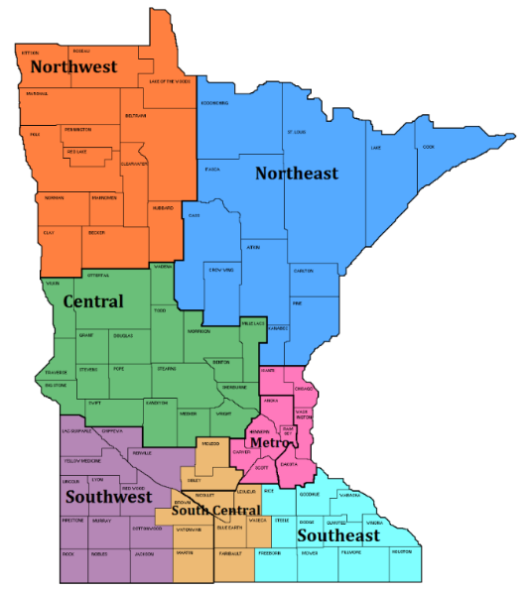
NG9-1-1 GIS Project Update
2016 Goals
  GIS Data Collection, Assessment, and Preparation
    Data Readiness Profiles
      Metro/NE – Q2 CY16
      All regions – Q4 CY16
    MSAG/GIS Sync Projects – begin Q2 CY16
  GIS Data Workflow and Repository
    Data uploads and portal – Q2 CY16
    Normalization – Q2 CY16
    Validation – Q2 CY16
    Aggregation – Q3 CY16
    Provision ECRF/LVF/Commons – begin Q3/Q4 CY16
  MN NG9-1-1 GIS Data Standards
    Draft review – begin Q1 CY16
    Approval – Q3 CY16

Slide 23

MSAG/GIS Sync Projects
    Required GIS Data
      Street centerlines with address ranges
      Address points
      Public Safety Answering Point (PSAP) boundaries
      Emergency Service boundaries
        Fire
        Law Enforcement
        Emergency Medical Service
      Data maintenance boundaries
    Synchronize with 9-1-1 Data
      Master Street Address Guide (MSAG)
      Automatic Location Information (ALI)
      English Language Translation (ELT)

Slide 24
MN NG9-1-1 GIS Standards
  Developing GIS data requirements for NG9-1-1 in Minnesota
  Aligning with NENA standards and validate against similar standards
    Other states (IA, KS, ND, TN, TX) and MRCC
  Standards Workgroup working on Version 1.0
  Stakeholder review of v1.0 – starting late February 2016
    Metropolitan Emergency Services Board (MESB)
    GIS Subcommittee and stakeholders
    NG9-1-1 Committee and PSAP stakeholders

Slide 25
MN NG9-1-1 GIS Standards
  Stakeholder approval of v1.0 – Q3 CY16
    Metropolitan Emergency Services Board (MESB)
    GIS Subcommittee
    NG9-1-1 Committee
    Statewide Emergency Communications Board (SECB)
    Statewide Geospatial Advisory Council (SGAC)
    MN Information Technology Agency (MNIT)

Slide 26
12. MnGeo Priority Projects

Slide 27
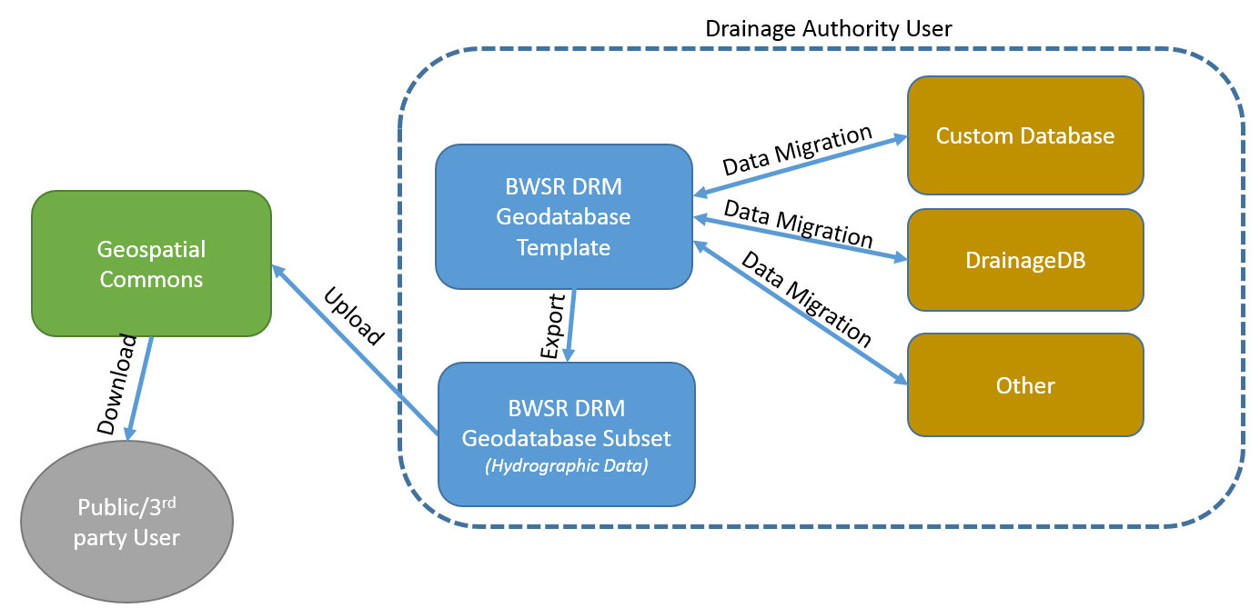
12. Drainage Records Modernization
    On schedule
    Creates standard data model for public drainage ditches
    Published in MN Geospatial Commons
    Working to identify two counties to test new data model and guideline

Slide 28
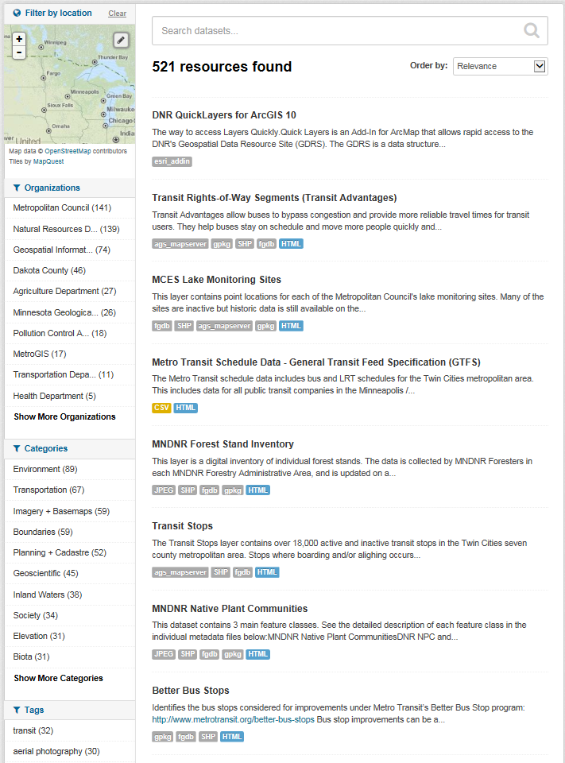
















12. MN Geospatial Commons
Status
Focus - Migration of all significant state geospatial resources to the Geospatial Commons
Published resources accessible
  17 Organizations
  521 Resources
The site is now open to broader participation
  Integrating partners who want to represent their data via the Geospatial Commons
Itasca
County

Slide 29
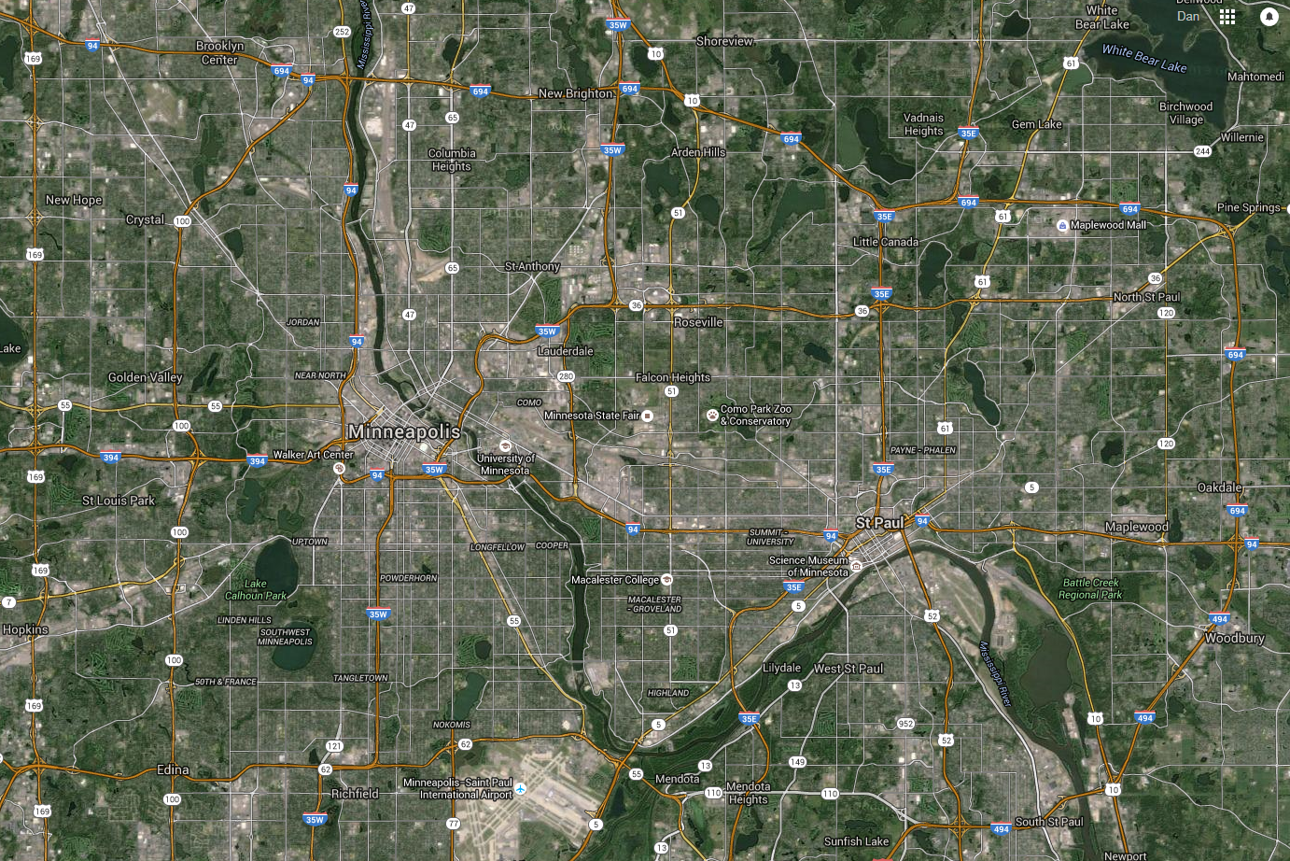

12. Aerial Imagery Master Contract
Goal: preselect a set of qualified vendors to bid on work orders without the need to go through the RFP process
For these services:
      Digital Aerial Photography: Orthoimagery and Stereo; all seasons; Resolution Range: 5 cm (2”) to 50cm (1.5’)
      Planimetric Mapping: General specifications intended to provide flexibility
      Customized Products: Hardcopy prints; photo mosaics; cartographic enhancements
Went into effect on January 15, 2016
In force for two years, with a three year extension option

Slide 30
12. Aerial Imagery Master Contract Vendors
Aerial Services, Inc (ASI) Cedar Falls, IA
Ayres Associates Madison, WI
Continental Mapping Consultants Sun Prairie, WI
Geophex Surveys Raleigh, NC
GRW Lexington, KY
Mapping Resources Group, Inc. Zimmerman, MN
Quantum Spatial Lexington, KY
Sanborn Colorado Sp, CO
Surdex Corporation Chesterfield, MO

Slide 31
12. Parcels
Background
In the works for some time
www.mngeo.state.mn.us/committee/standards/parcel_attrib/parcel_attrib.html
Business plan developed some time ago
Multiple standards have slowed the approval process
Data sharing beginning to open up thus bringing forward the need to move forward on a standard
Recent statewide data collection efforts require that a standard needs to be moved forward

Slide 32
12. Status of current effort….
Parcels and Land Records Committee and State Agencies to move standard forward
  DCDATS proposed standard with new ownership characteristics from NE MN work www.mngeo.state.mn.us/committee/cadastral/index.html
Collecting, standardizing, and aggregating
  45 counties so far
  Will be requesting updates

Slide 33









MnDOT instance of Esri Roads and Highways in production
Moving toward conflation of non-state data (Ramsey and Carver)
Align with Metro counties GIS Centerlines, Next Generation 9-1-1 efforts
Focus is on data flow from non-state road authorities
Statewide Centerline Initiative
To develop, test, refine, publish and perpetuate a single state- wide roadway dataset that meets the needs of a diverse user community…

Slide 34

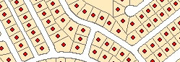
12. Address Points
Multiple efforts going on…
MetroGIS – develop and implement a workflow and technical solution for gathering address point data from the seven metro counties, aggregating the data into one file and distributing the points, metadata and other supplementary information to the user community.
Next Generation 9-1-1 – create and perpetuate a standards-based statewide address point file suitable for meeting the needs of NextGen 9-1-1
Where we are at – Comparing data models, assessing data received by counties, working on a draft standard

Slide 35
Agenda Item 13
Discussion
Announcements and Other Business

