Slide 1
Welcome
- Introductions
- Approve Agenda
- Approve March Minutes

Slide 2
Agenda Item 2
Discussion & Action
Review and Accept Committee and Workgroup Summaries

Slide 3
Agenda Item 3
Hydrography and Elevation Committees Update
David Brandt

Slide 4
Agenda Item 4
Discussion & Action
Sector Reports
Brad Anderson: Greater Minnesota Cities Sector
Andra Bontrager: Nonprofit GIS Sector

Slide 5
Nonprofit GIS Sector Overview
“GIS data must be shared among government agencies, nonprofits and academic institutions in order to best contribute to the public good.”
--- NSGIC in affiliation with the FGDC “Geospatial Data Sharing” (2011)
Non-profit GIS sector
Research and analysis, fundraising and development, advocacy, community resource mapping
ESRI’s nonprofit organization program & open-source GIS applications
MN GIS/LIS exemplary leader
Ongoing Issues
Limited in quantity as a sector of the GIS community (<5%)
Fiscal and personnel limitations to sector capacity
Lacking internal coordination of GIS resources
Solutions
Increase GIS collaborations within and outside of sector (user groups, networking)
Use existing resources more effectively (MN GIS/LIS newsletter, list serves)
Increase awareness of GIS applications within non-gis nonprofit sector
Geospatial
Community
Notes:
1. Brief overview of your sector
2. How is the GAC relevant to your sector / how can the GAC’s mission benefit your sector?
3. What is your strategy for communicating with your sector about the GAC?

Slide 6
Nonprofit GIS Sector Overview
Minnesota Geospatial Advisory Council
Mission: Act as a coordinating body for the Minnesota geospatial community.
GAC and the Nonprofit GIS Sector
Nonprofit stakeholders utilize public data and implement best practices
GIS services, training opportunities, and assistance
Forum for involvement and resources for collaborations
Coordinating Communication
In development… meeting people!
MN GIS/LIS newsletter ‘call for participation’
Re-establish the non-profit users group and/or create list-serve
Geospatial Advisory Council
Notes:
1. Brief overview of your sector
2. How is the GAC relevant to your sector / how can the GAC’s mission benefit your sector?
3. What is your strategy for communicating with your sector about the GAC?

Slide 7
Agenda Item 5
Discussion
GIS/LIS Consortium Conference Update
Gerry Sjerven

Slide 8
Break – Networking

Slide 9
Agenda Item 7
Discussion & Action
Accessibility for Geospatial Content
Jay Wyant and Kitty Hurley

Slide 10
Map Accessibility
June 1, 2016
Kitty Hurley – MN.IT Services @ Health
Kim Wee - MN.IT Services @ Education
Jay Wyant – Office of Accessibility
Notes:
Map Accessibility
June 1, 2016
Kitty Hurley – MN.IT Services @ Health
Kim Wee – MN.IT Services @ Education
Jay Wyant – Office of Accessibility

Slide 11
AGENDA
State Guidelines for Accessibility
Static Maps
Interactive Maps
What can we all do – next steps
Resources

Slide 12

State Guidelines for Accessibility
Section 508 or the Rehabilitation Act of 1973
WCAG 2.0, AA
Provision 363A.42 Public Records; Accessibility

Slide 13
Map Accessibility
Blindness
Color-blindness
Low vision
Deafness
Motor impairments
Cognitive impairments
Notes:
Map accessibility is important to people with the following disabilities:
Blindness
Color-blindness
Low vision
Deafness
Motor impairments
Cognitive impairments
Online maps (both static and interactive) are inaccessible to vision impaired people so a textual alternative (long description) must always be provided. It is also important to include accessibility features within the map so it is accessible to people with other disabilities e.g. by making the map non-reliant on JavaScript and keyboard accessible.

Slide 14
Static Maps
Alternative text
Data table
Color, texture, and/or symbols
Notes:
PDF’s, JPG (online or in a document):
Alternative text/Long descriptions – provide a description of the image
Data Table – provide a data table of the information being displayed on the map.
Color, Texture, and Symbols – High contrast color combinations, symbol, and/or texture differences. Don’t rely on color to differentiate important parts of the map; use borders to separate one area from another, use different types of shading and change of color to indicate different areas
Keyboard accessibility (?) – For those that have some interaction within the map, ensure your map is accessible via a keyboard. This may not always apply to a static map, but it could depending on how you, or your organizing define a static map.

Slide 15
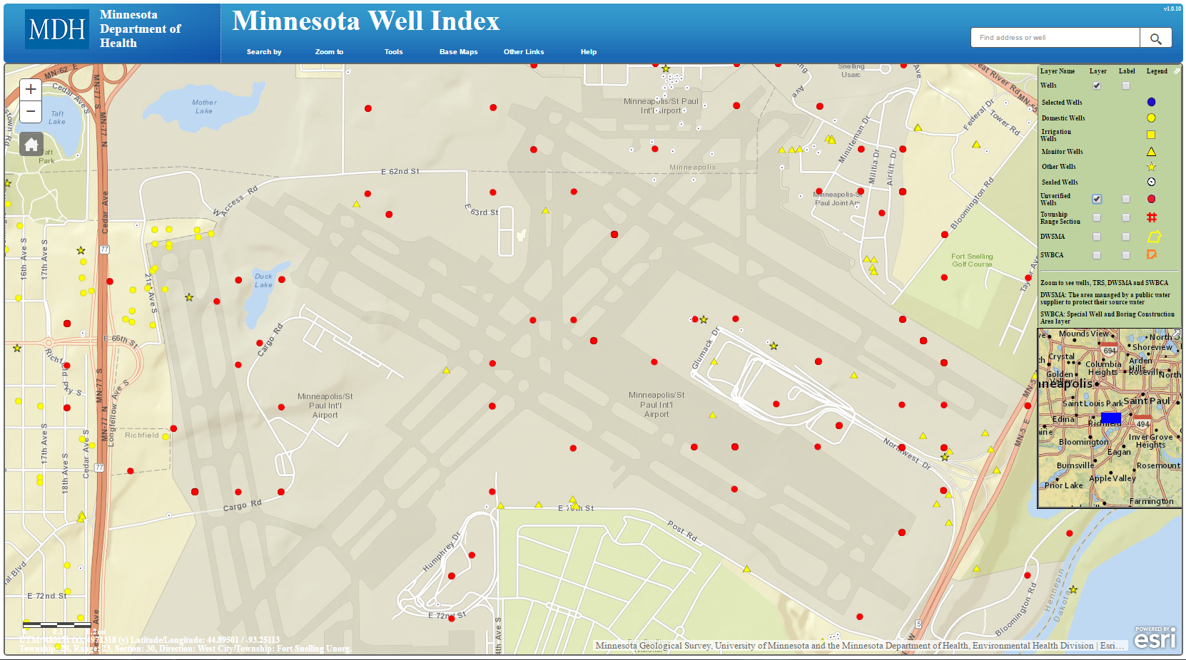
Demo – Static Map
Before (Normal vision)
Notes:
Demo – Static Map: Slide 1 of 4 (https://apps.health.state.mn.us/mndata/asthma_staticmaps#1)
Not all maps are posted to the web, but they might be shown to accessible audiences inside, or outside the organization!
This may be an interactive map, but the basic cartography principles of static maps still apply!
The importance of color, and symbols!
In this case, accessibility improvements help ALL audiences discern the data/information in a more meaningful way.

Slide 16
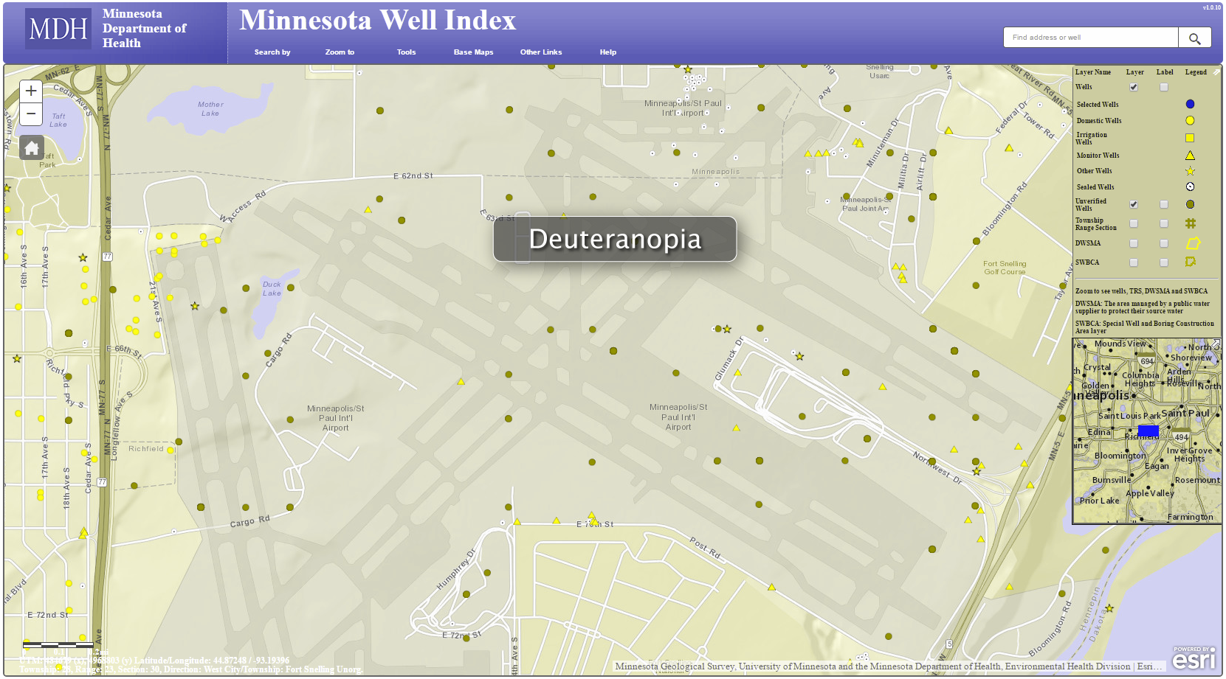
Demo – Static Map
Before (Deuteranopia)
Notes:
Demo – Static Map: Slide 1 of 4 (https://apps.health.state.mn.us/mndata/asthma_staticmaps#1)
Not all maps are posted to the web, but they might be shown to accessible audiences inside, or outside the organization!
This may be an interactive map, but the basic cartography principles of static maps still apply!
The importance of color, and symbols!
In this case, accessibility improvements help ALL audiences discern the data/information in a more meaningful way.

Slide 17
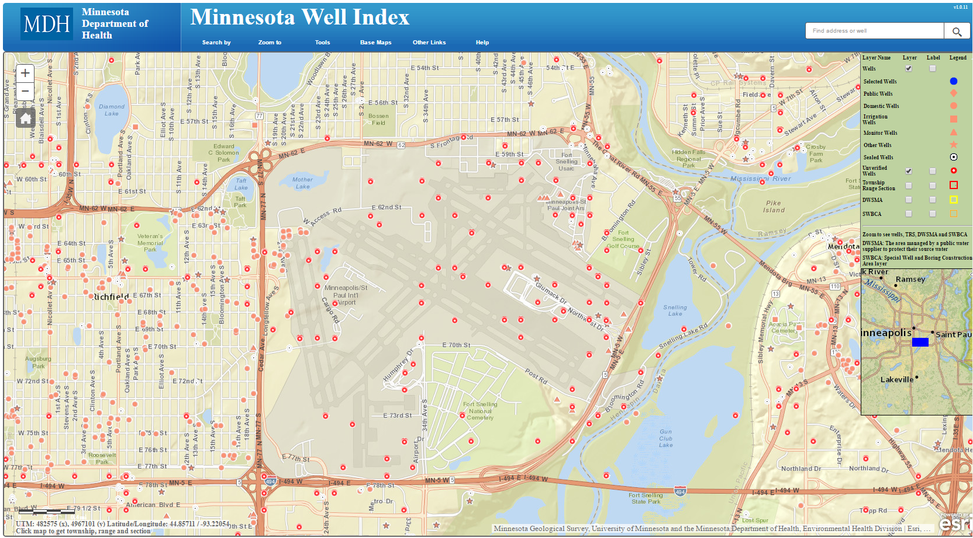
Demo – Static Map
After (Normal vision)
Notes:
Demo – Static Map: Slide 3 of 4 (https://apps.health.state.mn.us/mndata/asthma_staticmaps#1)
Not all maps are posted to the web, but they might be shown to accessible audiences inside, or outside the organization!
This may be an interactive map, but the basic cartography principles of static maps still apply!
The importance of color, and symbols!
In this case, accessibility improvements help ALL audiences discern the data/information in a more meaningful way.

Slide 18
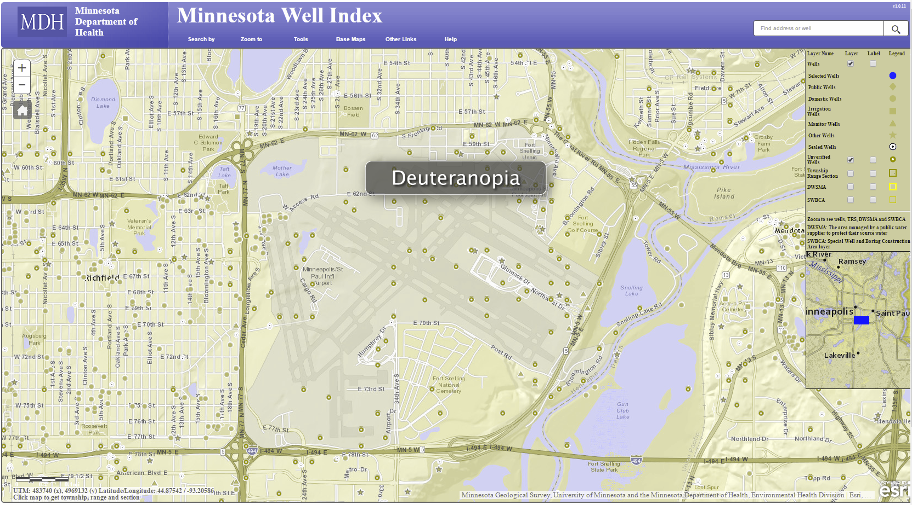
Demo – Static Map
After (Deuteranopia)
Notes:
Demo – Static Map: Slide 4 of 4 (https://apps.health.state.mn.us/mndata/asthma_staticmaps#1)
Not all maps are posted to the web, but they might be shown to accessible audiences inside, or outside the organization!
This may be an interactive map, but the basic cartography principles of static maps still apply!
The importance of color, and symbols!
In this case, accessibility improvements help ALL audiences discern the data/information in a more meaningful way.

Slide 19
Interactive Maps
Table and/or list
Map controls (Zoom in/out)
Keyboard accessible
Content available
Focus
Notes:
With interactive maps, we need to keep in mind everything just discussed with static maps, plus…
Table/List – Supplement a map with a table and/or list to give users a different perspective, and provide the same content in a different way. Users interpret information differently.
Map controls (Zoom in/out) – are the elements on the page accessible? If using a 3rd party plugin, is it accessible?
Keyboard accessible/Data entry – are the fields labeled properly, tab order, etc.
Content available– Is there a map legend available, and open on load? If the map has clickable areas that would display additional information, is this information available via the keyboard, available to the screen reader and other assistive technologies?
Focus – is the keyboard focus sufficient

Slide 20
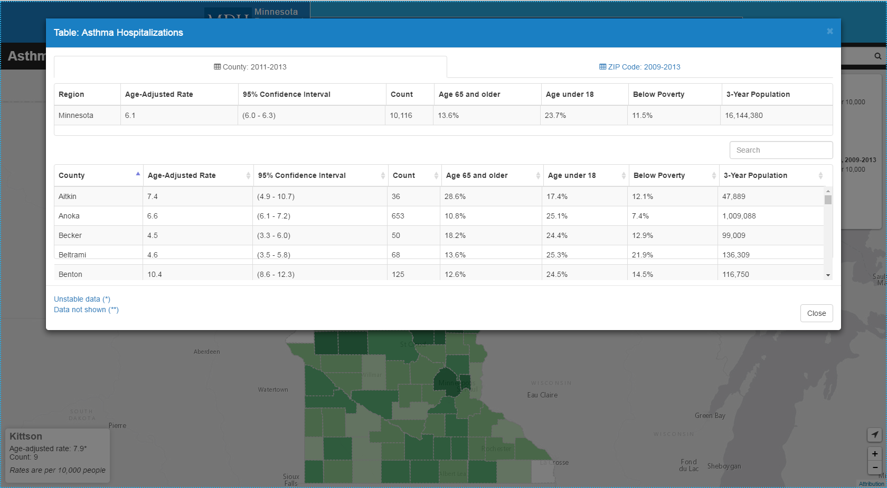
Demo – Interactive Map
Notes:
Demo – Interactive Map (https://apps.health.state.mn.us/mndata/webmap/asthma.html):
Skip Navigation
Skip to content (Good example: http://www.webaim.org)
Skip to table (Good example: https://apps.health.state.mn.us/mndata/webmap/asthma.html)
Include a table and/or list to help showcase many ways to interpret the data
Route-based
Map-based
“Tab” through content throughout the map

Slide 21

Next Steps
How do we keep the communication channels open?
What groups should we talk to?
Get the word out
Notes:
Focus on action items going forward – particularly for maps community of interest group.

Slide 22
Resources
Office of Accessibility website (http://mn.gov/mnit/accessibility)
Map Accessibility Guidelines (https://github.com/maptime/map-accessibility-guidelines)

Slide 23
Notes:
Questions?

Slide 24
Thank you!
Kitty Hurley – kitty.hurley@state.mn.us
Kim Wee – kim.wee@state.mn.us
Jay Wyant – jay.wyant@state.mn.us

Slide 25
Agenda Item 8
Action
U.S. National Grid
Steve Swazee

Slide 26


Slide 27
U.S. National Grid
Update

Slide 28
A Stitch in Time, Saves Nine
USNG – What and Why
FEMA Directive 092-5
Related Issues
Way Forward?

Slide 29
USNG – What and Why

Slide 30
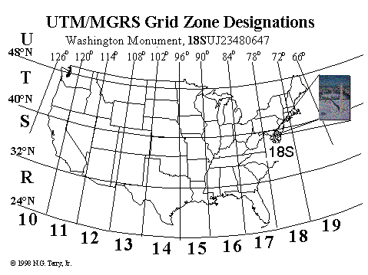
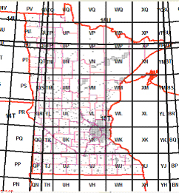
U.S. portion of the Military Grid Reference System (MGRS) – alpha numeric UTM geo-referencing system created by DoD and NATO after WWII
A USNG spatial address is broken down into three parts:
  Grid Zone Designation; for a world-wide unique address.
  100,000-meter Square Identification; for regional areas.
  Grid Coordinates; for local areas. (15T VK 9215 7775)
Federal cartographic standard FGDC-STD-011-2001
Minnesota cartographic standard since 03/25/2009

Slide 31

35%

Slide 32


The Pitfall of Latitude/Longitude:
Degrees, Decimal Degrees (DD.DDDD°)…OR?
Degrees, Minutes, Seconds (DD° MM’ SS”)….OR?
Degrees, Minutes, Decimal Minutes (DD°MM.mm’)

Slide 33
The Long Road
April 2001 – Michael Buckley, Director FEMA Tech. Services Div., Mitigation Directorate Letter to USGS
December 2001 – FGDC publishes cartographic standard
January 2005 – Florida becomes 1st state to adopt USNG for response
July 2008 - CJCSI 3900.01C Position Reference Procedures
March 2009 – Minnesota becomes 1st state to publish a cartographic standard
May 2009 – FEMA Asst. Administrator William Carwile “Goals” Letter
November 2009 – NSARC Catastrophic Incident Search and Rescue Addendum to the National Search and Rescue Manual
November 2011 – NSARC Land Search and Rescue Addendum to the National Search and Rescue Manual
June 2013 - Homeland Security Geospatial Concept of Operations
October 2015 – FEMA issues Directive 092-5

Slide 34
FEMA Directive 092-5

Slide 35
We Aren’t In Kansas Anymore
http://www.napsgfoundation.org/wp-content/uploads/2015/10/FEMAD092-5_dated.pdf

Slide 36

Potentially a Minnesota Expense
Worth 10’s of Millions of Dollars
FEMA
Funding
NG9-1-1
CAD/COP
Legal

Slide 37

Implementation: USFA, NFPA, NASAR, NAPSG, GITA, 3M and others

Slide 38
Related Issues

Slide 39
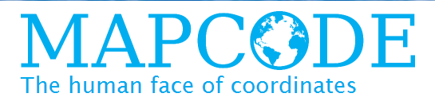










Slide 40

what3words
October 28: ESRI Promotes what3words for ER

Slide 41

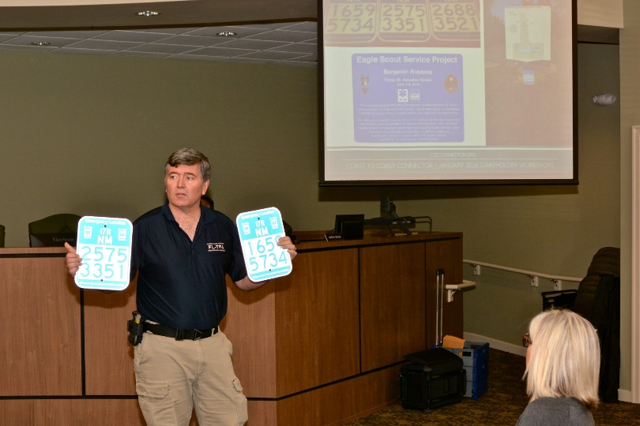
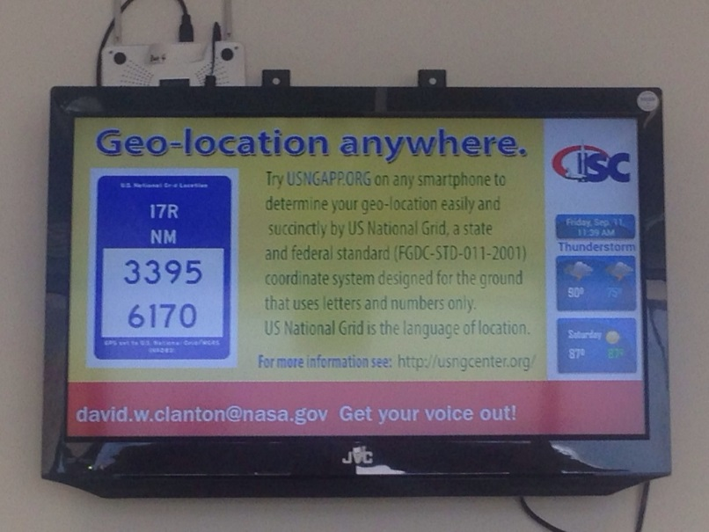
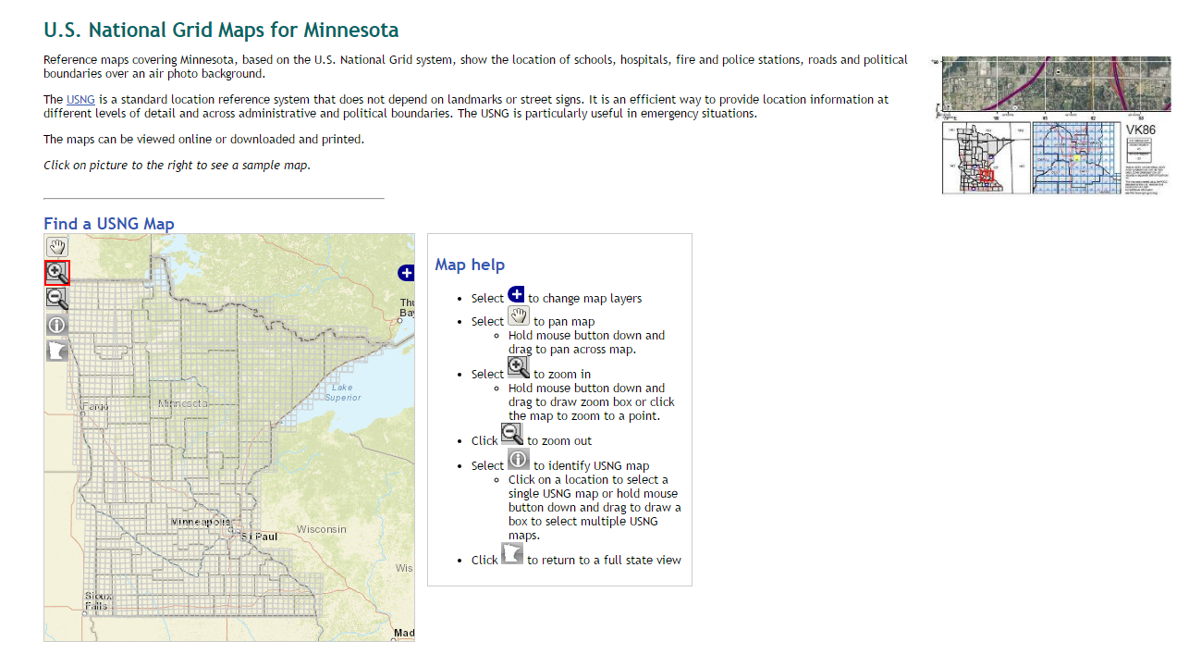
No Place to Run, No Place to Hide

Slide 43
Way Forward?

Slide 44
Takeaways
A USNG paradigm shift has occurred
Being proactive vs. reactive could potentially save government in MN 10’s of millions
USNG implementation tools are readily available
Best practices and aggressive outreach are low cost examples of things that can be done now

Slide 45
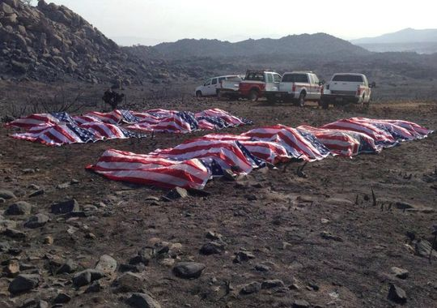
Yarnell Hill Fire
Photo credit: USA Today
Notes:
On June 30, 2013, 19 brave wildland firefighters lost their lives while fighting the Yarnell Hill fire. These young men had been sent in to battle this fire without maps or any geospatial support while their wives, girlfriends, children, and families waited for them at home. As they began a trek toward a position of what was thought would be a position of safety for changing weather conditions they were overtaken by a wall of flame. In a last ditch attempt to save their lives – they deployed their “fire shelters” – a multilayered sleeping bag type item which wildland firefighters grimly refer to as their “shake and bake bag”. With their last transmission they let the world know their end had come. Yet, in near vicinity, was an airborne tanker full of retardant. Useless in the attempt to save these young men because neither party could effectively communicate Where. How many more lives need to be lost before we wake up and realize that as a nation we are standing around holding the horses when it comes to this issue? To continue to do so is going to put all of us on the wrong side of history.

Slide 46

MnGeo Emergency Preparedness Committee
Steve Swazee
Cell: (612) 239-6981
Home: (651) 456-5411
sdswazee@sharedgeo.org

Slide 47


Slide 48
Agenda Item 9
Discussion
Legislative Updates
Dan Ross, Kari Geurts

Slide 49

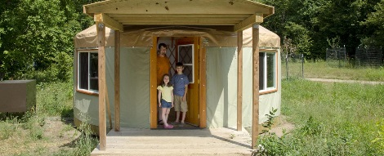


Parks and Trails of Regional Significance
Project 1: Responsive website that allows users to discover resource by activity, amenity, or map
  Will drive traffic to local more detailed sites
  Ability to search surrounding area
  In contracting phase
  To be complete June 30th, 2017
Project 2: Survey of use, development of a data standard, and tracking legacy fund spend for parks and trails
  Contract in place
  To be complete June 30th, 2017

Slide 50

Vegetation Buffers
Kari Geurts

Slide 51
Agenda Item 10
Discussion
Updates on Major Initiatives

Slide 52

Next Generation 9-1-1 GIS Project
Status Update
Adam Iten
6/1/2016

Slide 53
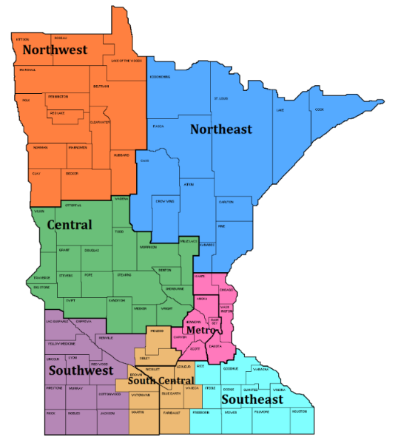
NG9-1-1 GIS Project Update
2016 Goals
  GIS Data Collection, Assessment, and Preparation
    Data Readiness Profiles
      Metro/NE – Q2 CY16
      All regions – Q4 CY16
    Data Preparation Projects – begin Q2 CY16
  GIS Data Workflow and Repository
    Data uploads and portal – Q2 CY16
    Normalization – Q2 CY16
    Validation – Q2 CY16
    Aggregation – Q3 CY16
    Provision ECRF/LVF/Commons – begin Q3/Q4 CY16
  MN NG9-1-1 GIS Data Standards
    Stakeholder review – begin Q1 CY16
    Approval – Q3 CY16

Slide 54
MN NG9-1-1 GIS Standards
  Stakeholder review – started February 2016
    Metropolitan Emergency Services Board (MESB) – ongoing
    Metro Regional Centerline Collaborative (MRCC) – ongoing
    MN PSAP and GIS Managers – started 3/18
    MN GAC Standards Committee – started 4/6
    ECRF, LVF, and other NG9-1-1 vendors – starting June/July 2016
    Neighboring states – starting June/July 2016

Slide 55
MN NG9-1-1 GIS Standards
  Stakeholder approval of v1.0 – Complete Q3 CY16
    Metropolitan Emergency Services Board (MESB)
    GIS Subcommittee
    NG9-1-1 Committee
    Statewide Emergency Communications Board (SECB)
    MN Geospatial Advisory Council (MGAC)
    MN Information Technology Agency (MNIT)

Slide 56

Communication Plan
  ECN website
    Project newsletter - Issue #3 available now
  Monthly
    GIS Subcommittee meeting
    NG9-1-1 Committee meeting
    SECB meeting
  Quarterly
    Regional PSAP/GIS meetings
    MN Geospatial Advisory Council

Slide 57
Agenda Item 11
Discussion
MnGeo Priority Projects
Dan Ross

Slide 58
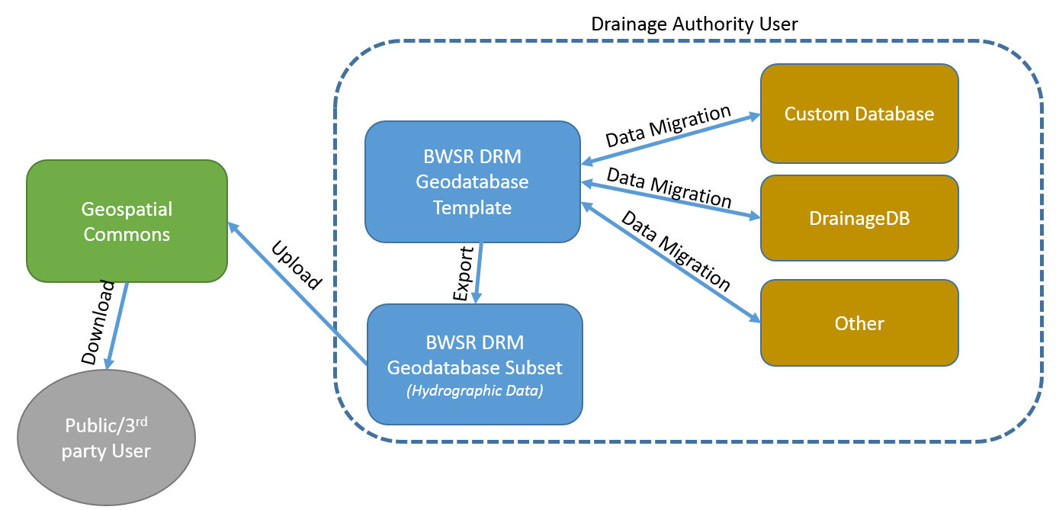
Drainage Records Modernization
    On schedule
    Creates standard data model for public drainage ditches
    Will be published in MN Geospatial Commons
    Working to identify two counties to test new data model and guideline
    Complete December 2016

Slide 59
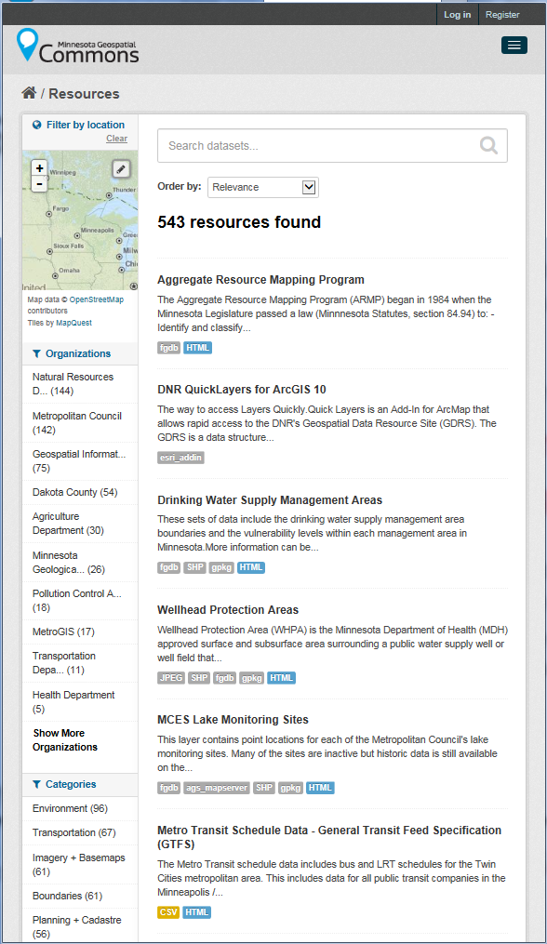

















MN Geospatial Commons
Status
Focus - Migration of all significant state geospatial resources to the Geospatial Commons
Published resources accessible
  18 Organizations
  543 Resources
The site is now open to broader participation
  Integrating partners who want to represent their data via the Geospatial Commons
Itasca
County

Slide 60
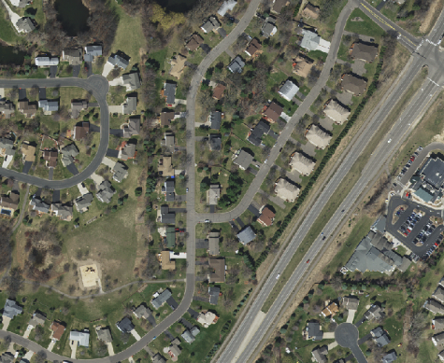
Master Contract for Aerial Imagery
To provide a list of experienced pre-approved vendors from which State Agencies and Cooperative Purchasing Venture (CPV) member organizations can contract for medium-to-high resolution orthoimagery and planimetric mapping services in a streamlined process through individual custom work orders.
Nine vendors were selected and master contracts were executed in January 2016.
The Metropolitan Council issued the first Work Order Solicitation associated with the Aerial Imagery Master Contract in January.
The Surdex Corporation was awarded the work order to acquire Metro-wide 4-band, 30-cm imagery this spring.
Since then, four Metro counties – Anoka, Carver, Dakota and Scott – executed additional contracts through the program to buy-up to 15-cm (6-inch) imagery.
Raw imagery was acquired between April 9 and 22, 2016.
Partners are now working with the vendor to determine appropriate pilot ortho-processing areas and color balance parameters.

Slide 61
Parcels - Status of current effort….
Parcels and Land Records Committee and State Agencies moving standard forward
  DCDATS proposed standard with new ownership characteristics from NE MN work www.mngeo.state.mn.us/committee/cadastral/index.html
Collecting, standardizing, and aggregating
  67 counties so far
  Will be requesting updates
While the data will be available to government agencies many counties have asked the state not to share parcels obtained for their counties. With that approach it is likely we will never achieve a statewide shared parcel layer.

Slide 62









MnDOT instance of Esri Roads and Highways in production
Moving toward conflation of non-state data (Ramsey and Carver)
Align with Metro counties GIS Centerlines, Next Generation 9-1-1 efforts
Focus is on data flow from non-state road authorities
Statewide Centerline Initiative
To develop, test, refine, publish and perpetuate a single state- wide roadway dataset that meets the needs of a diverse user community…

Slide 63

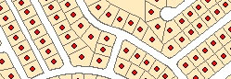
Address Points
Multiple efforts going on…
MetroGIS – Developing and implementing a workflow and technical solution for gathering address point data from the seven metro counties, aggregating the data into one file and distributing the points, metadata and other supplementary information to the user community.
Next Generation 9-1-1 – Creating and perpetuating a standards-based statewide address point file suitable for meeting the needs of NextGen 9-1-1
Where we are at – Comparing data models, assessing data received by counties, working on a draft standard

Slide 64
Discussion - Collecting, Standardizing and Aggregating Data
Authoritative Data
Questions:
What level should data be aggregated?
Challenges to address:
Data sharing?
  Several partners want requests pointed to them
Data will change in many cases - standardized and aggregated - metadata
What questions do you have?
Provide:
Common method for accepting data
Common standards to move data into
Common methods for validating data
Consistent communications about data quality and updates
File GDB
(change or full upload)
Shapefile
(change or full upload)
Alert
ETL
ETL
GDRS
Statewide
GDB
(Statewide Model)
MN Geospatial Commons
Standardized
Aggregated
Perhaps a goal for this Council for the coming year?

Slide 65
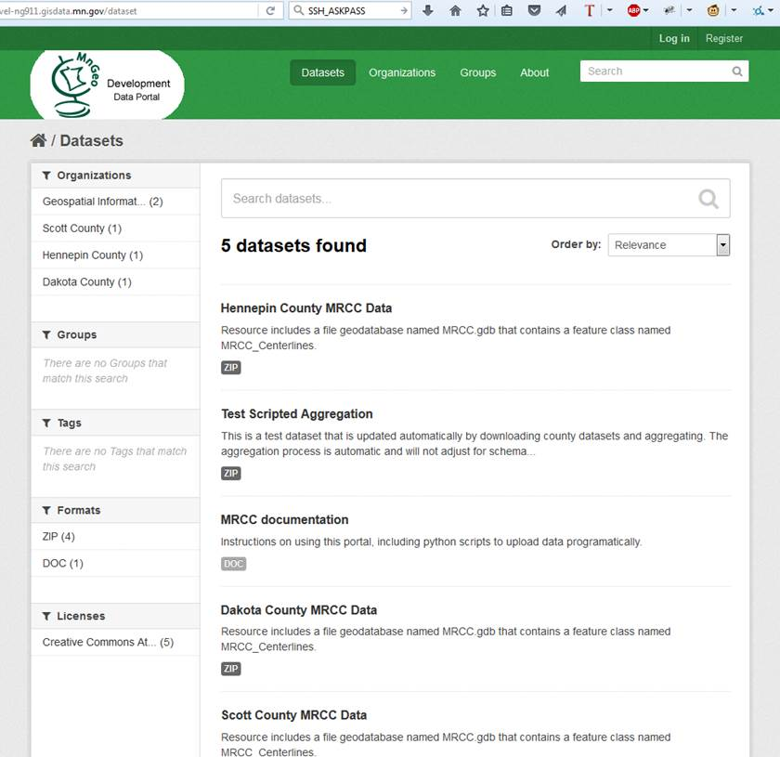
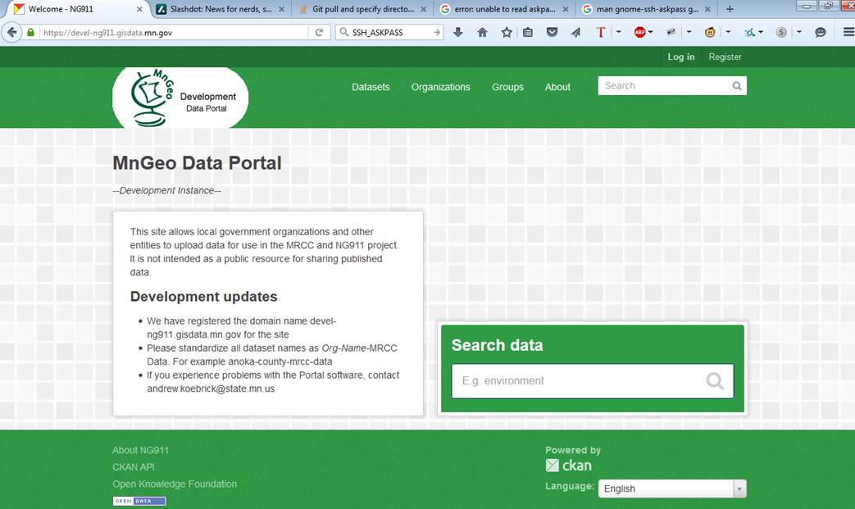
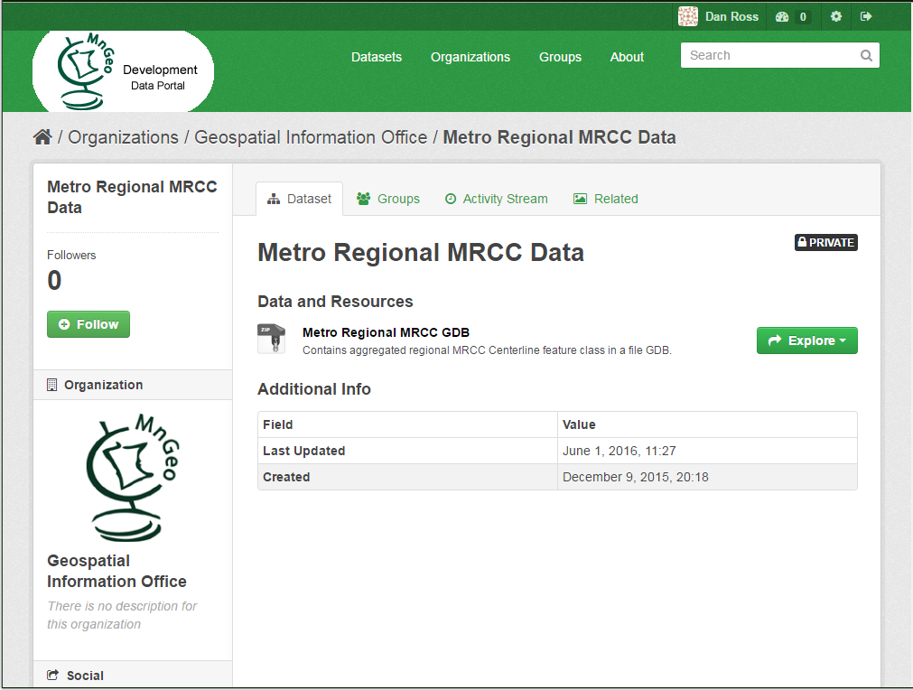
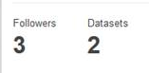


Constructing a viable path
Data Repository and Portal
Bringing together data for
multiple efforts…

Slide 66
Agenda Item 12
Discussion
Announcements and Other Business

