Slide 1
Welcome - Introductions - Approve Agenda - Approve June Minutes

Slide 2
Agenda Item 2 Discussion & Action Review and Accept Committee and Workgroup Summaries

Slide 3
Agenda Item 3 Discussion Future of LiDAR/Hydro Panel at Conference
Gerry Sjerven and Dan Ross

Slide 4
LiDAR/Hydrology Panel
Updates and New Topic Discussions on 3DEP, DEM Hydro-modification, Hydrography Development and the Need to Establish a New LiDAR Committee for Minnesota.
Panel Schedule
Intro
3DEP- Overview (USIEI, SeaSketch, BAA)
hDEM- Background (Standard, LOD/LOA, flow paths, NXG-Hydro, Funding)
hDEM – Demonstration of Findings
Committee- Elevation-Hydro Committee
Wrap-up & Prep for Panel
Discussion of Open Topics
Closing Remarks

Slide 5
Agenda Item 4 Discussion GIS/LIS Consortium Conference Update
Gerry Sjerven

Slide 6
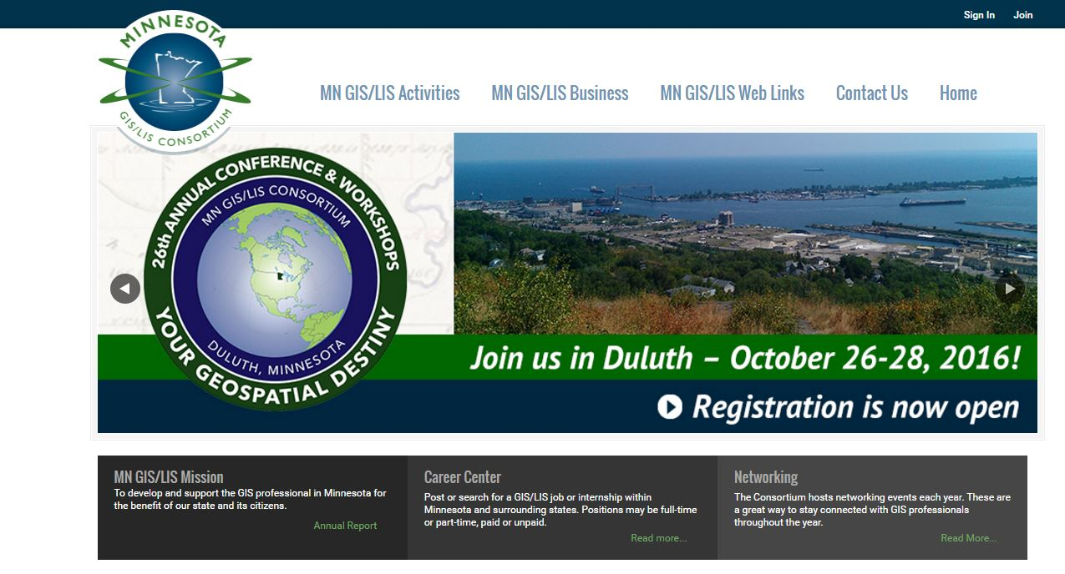
26th Annual Conference & Workshops
Your Geospatial Destiny

Slide 7
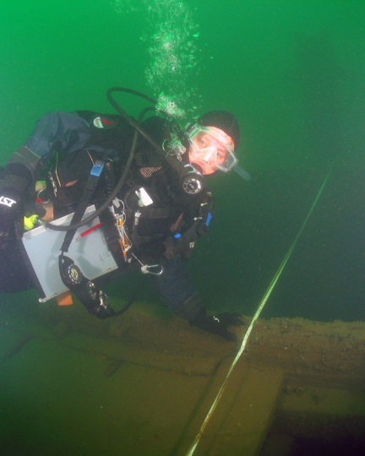
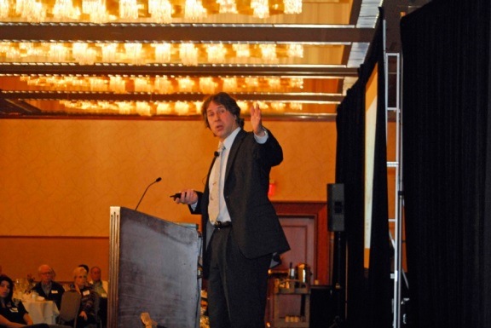
26th Annual Conference & Workshop Keynote Speakers
Thursday October 27, 2016
Carrie Sowden, Archaeological Director for the Peachman Lake Erie Shipwreck Research Center at the Great Lakes Historical Society www.inlandseas.org
Friday October 28, 2016
Dana Starkell - Paddle to the Amazon www.paddletotheamazon.com

Slide 8
26th Annual Conference & Workshop Important Dates
October 7th -Early Registration Closes
October 25th - Networking Event, 7 West Taphouse
October 26th - Second Annual Educator Day
October 26th - Reception in Geolounge followed by welcome event at Grandma’s Saloon
October 27th - Vendor reception at the DECC, followed by conference social at the Holiday Inn including local craft brews.
October 28th - Fun Run, registration closes Sept. 30
Tour the research vessel R/V Blue Heron
Esri Hands-on Lab

Slide 9
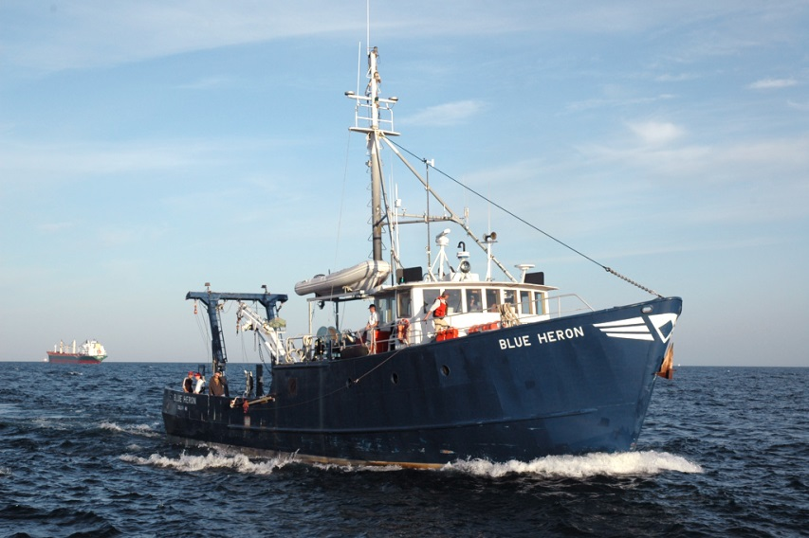
Tour the R/V Blue Heron
October 26th and 27th
Tours available from 1:30-4:30pm
Sign up for tours, weather permitting

Slide 10
26th Annual Conference Workshops
Introduction to Collector for ArcGIS
Get started using Python with GIS
Using Geoprocessing Services with JavaScript API
Parcel Fabric 101
Making a Web Map Like That
Designing a Long-Term GIS Vision & Implementation Plan
Creating simple GIS applications with Python
CAD and GIS Collaboration
Running Enterprise GIS Systems in God Mode
Intermediate Collector for ArcGIS
Advanced Python: Build your Own Classes and Modules
ArcGIS Web AppBuilder: Basics of Creating Custom Themes and Widgets
Parcel Fabric 601
Q is the Bee’s Knees
SQL 101: Spatial Data Revealed
Open Data Portals: What, Why, How?
ArcGIS for Server: Administration and Advanced Topics

Slide 11
26th Annual Conference Sessions
44 Sessions
Minnesota Geospatial Advisory Council
Session 20: Thursday, Oct. 27, 1:30-3pm
Outreach Committee; Kari Geurts, Len Kne, Michelle Trager, Geoff Maas, Brad Anderson
LiDAR/Hydrology Panel
Session 38: Friday, Oct. 28, 8:30-10am
Sean Vaughn, Ron Wencl, Rick Moore, Tyler Kaebisch, Gerry Sjerven
Data Sharing Panel
Session 44: Friday, Oct. 28, 10:30-Noon
Dan Ross

Slide 12
Agenda Item 5 Discussion Open Data Effort and Survey Update
Len Kne and Kari Geurts

Slide 13
Break – Networking

Slide 14
Agenda Item 7 Discussion Sector Reports
John Mackiewicz: Business Sector
Danielle Walchuk: Nonmetro Regional Government Sector

Slide 15
Minnesota Geospatial Advisory Council Sector Report
September 28 | 2016

Slide 16
GAC Mission Benefits
Geospatial Commons
Map Services
Downloaded data
Promotion of critical data
LIDAR
Aerial Photography
Standards/Workgroups
MetroGIS Tile Scheme
GAC allows us to provide more value
UX
Data Updates
Data
Quality
Carto and Perform.

Slide 17
Communication Strategy
WSB promotes GAC initiatives and standards that directly and indirectly impact our clients through our user group meetings
WSB works with our Public Sector clients to enhance participation in GAC initiatives
Centerline Road Data Review
Storm Sewer Data Model
Opportunities exist to improve through user groups

Slide 18
Agenda Item 8 Discussion & Action Engaging and Coordinating with Regional User Groups
Mark Kotz

Slide 19
Ideas for Engaging with Regional User Groups
Let them know that the GAC is a partner
Define how we can all benefit from a stronger relationship
Give them opportunity to suggest initiatives for the GAC
Liaisons from each to/from the GAC
Invite to meetings
Reporting to/from the GAC

Slide 20
Agenda Item 9 Discussion Parcel Data Standard Update
Geoff Maas

Slide 21
Agenda Item 10 Discussion & Action Recognizing Accomplishments and Setting Goals for the Year
Mark Kotz

Slide 22
Accomplishments and Goals - Proposal
Short annual report
Committees provide content. GAC too.
Use calendar year

Slide 23
Agenda Item 11 Discussion Legislative Updates
Dan Ross

Slide 24
Clean Water Fund Language
Proposing a change in language to Minnesota Statutes 2015 - 114D.50
Subd. 5. Data availability. Data collected by the projects funded with money from the clean water fund that have value for planning and management of natural resources, emergency preparedness, and infrastructure investments must conform to the enterprise information architecture developed by the Office of MN.IT Services. Spatial data must conform to geographic information system guidelines and standards outlined in that architecture and adopted by the Minnesota Geographic Data Clearinghouse Geospatial Commons at the Minnesota Geospatial Information Office. A description and a copy of these data that adheres to the Office of MN.IT Services geographic metadata standards must be submitted to the Minnesota Geospatial Information Office to be made available online through the clearinghouse Minnesota Geospatial Commons and the data must be accessible and free to the public unless made private under chapter 13. To the extent practicable, summary data and results of projects funded with money from the clean water fund should be readily accessible on the Internet and identified as a clean water fund project.

Slide 25
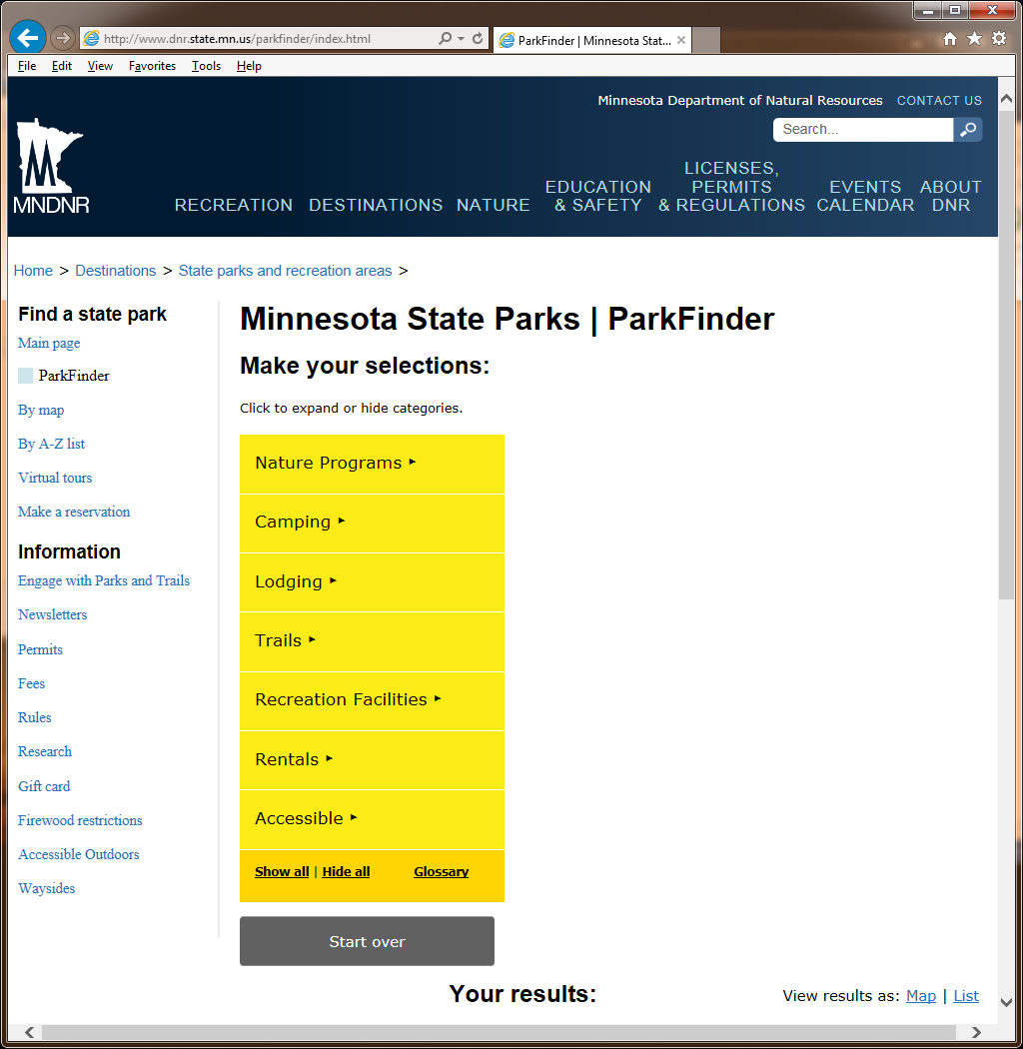
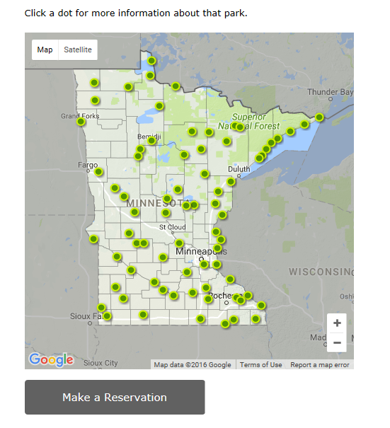
Parks and Trails
Parks and Trails Legacy Fund (U of M)
Data standard for parks and trails
Website for tracking grant funding and planning
To be complete June 2017
Responsive Website for Parks and Trails (DNR)
Searchable by activity/amenity or map
Brings users to more detailed local data
To be complete June 2017

Slide 26
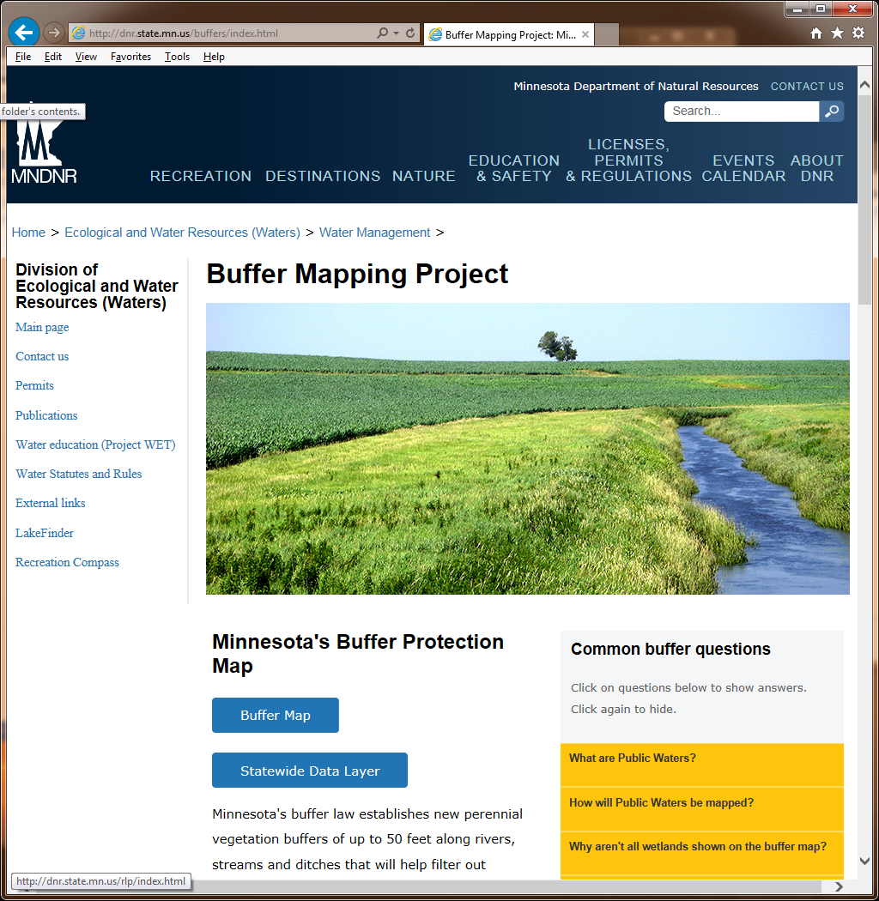
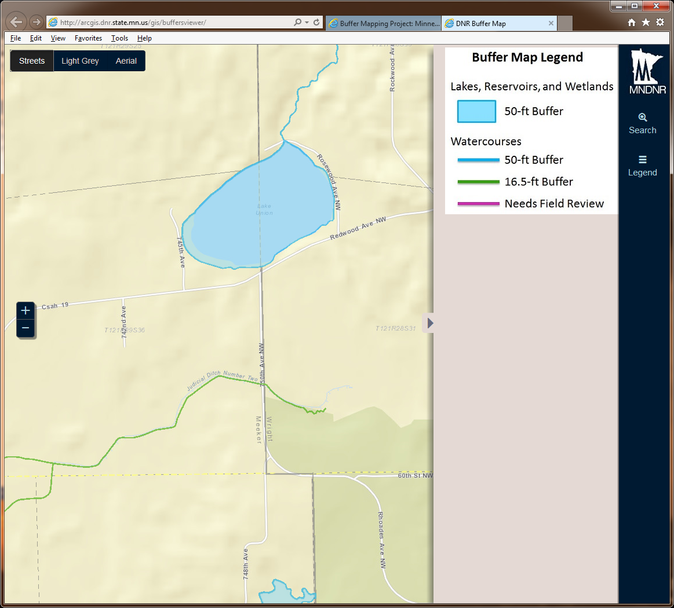
Buffers Mapping

Slide 27
Agenda Item 12 Discussion Updates on Major Projects and Initiatives

Slide 28
Next Generation 9-1-1 GIS Project Status Update Adam Iten

Slide 29
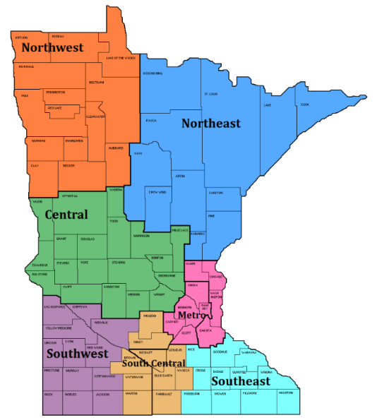
NG9-1-1 GIS Project Update
2016 Goals
GIS Data Collection, Assessment, and Preparation
Data Readiness Profiles
Metro/NE – complete Q2
All regions – complete end of Q4
Data Preparation Projects
Metro/NE – begin Q2
Central/SE – begin Q4
NW, SW, SC – begin early 2017
GIS Data Workflow and Repository
Data uploads and portal – begin Q1 CY16
Normalization and Validation – begin Q1 CY16
Aggregation – begin Q4 CY16
Provision ECRF/LVF/Commons – begin Q4 CY16
MN NG9-1-1 GIS Data Standards
Next stakeholder review – October 2016
Approval of Version 1 – early 2017

Slide 30
MN NG9-1-1 GIS Standards
Developing GIS data requirements for NG9-1-1 in Minnesota
Aligning with NENA standards and validate against similar standards
Other states (IA, KS, ND, TN, TX) and MRCC
Standards Comparison spreadsheet
Standards Workgroup working toward Version 1.0
Second stakeholder review – October 2016

Slide 31
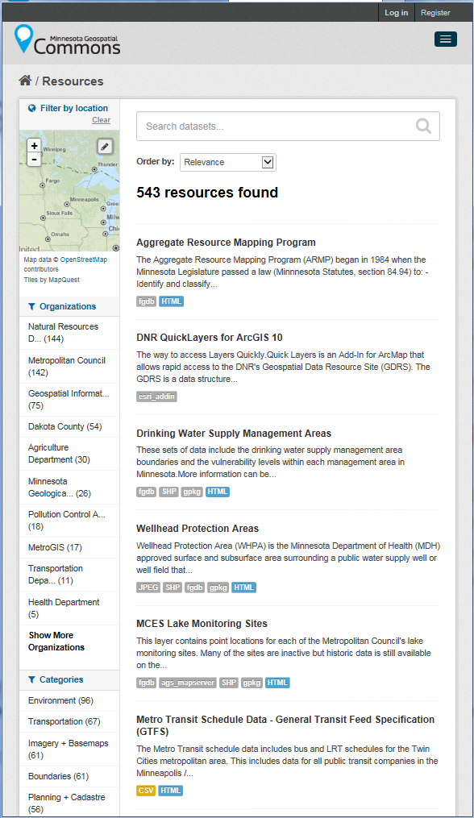
MN Geospatial Commons
Status
Focus – Discovery of all significant state and partner geospatial resources to the Geospatial Commons
Published resources accessible
20 Organizations
579 Resources ( 36)
The site is now open to broader participation
Integrating partners who want to represent their data via the Geospatial Commons
Ramsey and Waseca Counties added
Rice County coming
Will undergo somewhat of a refresh in the coming months
Itasca
County

Slide 32
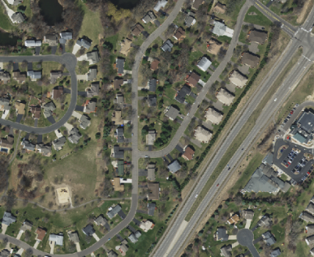
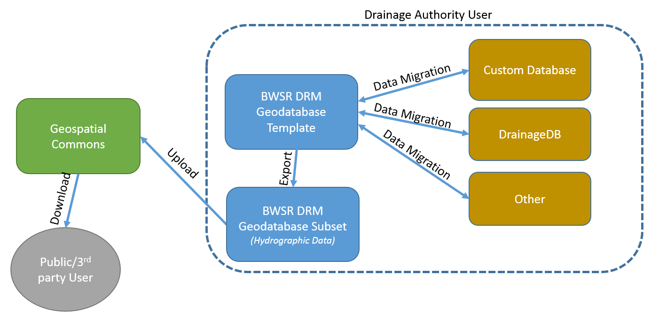
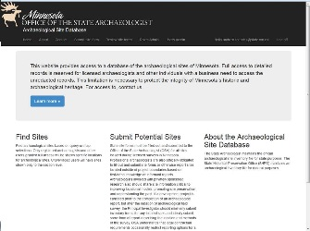
Master Contract for Aerial Imagery
Master Contract for Aerial Imagery
The Metropolitan Council and four Metro counties – Anoka, Carver, Dakota and Scott – executed additional contracts through the program to buy-up to 15-cm (6-inch) imagery.
Available in MnGeo image service before the end of the calendar year
Drainage Records Modernization
Data template, Guidelines, Map Viewer
Complete December 2016
State Archeologist Web Application – OSA, MNDOT, SHPO
Digital, secure system for managing inventory of archaeological sites, surveys, and associated forms and documents
Complete December 2016

Slide 33
Parcels - Status of current effort….
Parcels and Land Records Committee and State Agencies moving standard forward
DCDATS proposed standard with new ownership characteristics from NE MN work www.mngeo.state.mn.us/committee/cadastral/index.html
Collecting, standardizing, and aggregating
84 counties so far
Will be requesting updates
While the data will be available to government agencies many counties have asked the state not to share parcels obtained for their counties. With that approach it is likely we will never achieve a statewide shared parcel layer.

Slide 34
Statewide Centerline Initiative
Provide:
Common method for accepting data
Common standards
Common methods, tools for validating, standardizing, aggregating data
RFI on the Street
Consistent communications about status
Authoritative Data
RCE
(MnDOT)
Future Option
File GDB
(change or full upload)
Shapefile
(change or full upload)
R&H
MnDOT
(MnDOT model)
RCE
Alert
ETL Conflation
ETL Conflation
Alert
ETL
Conflation
R&H
MnDOT or MnGEO
Statewide
GDB
(Statewide Standard)
MN Geospatial Commons
Public Access
Alert
ETL
Standardized
Aggregated
GDRS
State Agencies

Slide 35
Address Points
Multiple efforts going on…
MetroGIS – Developing and implementing a workflow and technical solution for gathering address point data from the seven metro counties, aggregating the data into one file and distributing the points, metadata and other supplementary information to the user community.
Next Generation 9-1-1 – Creating and perpetuating a standards-based statewide address point file suitable for meeting the needs of NextGen 9-1-1 and other purposes
Where we are at – Assessing data received by counties, working on a draft standard

Slide 36
Agenda Item 13 Discussion Announcements or Other Business

