Slide 1

Minnesota Geospatial Advisory Council
September 19, 2017

Slide 2
Welcome
Introductions
Approve agenda
Approve May minutes

Slide 3
Agenda
Time | Topic
11:20 | Accept committee summaries and update to Standards Committee work plan
11:25 | Update on letters of support
11:25 | GAC annual process and logistics
11:35 | Approve new 3D Geomatics Committee
11:45 | Geospatial Data Act
12:00 | Break, networking
12:30 | Local Update of Census Addresses (LUCA) program
12:50 | Sector report (Kerr)
1:00 | EPC update on USNG
1:10 1:30 | MN GAC priority projects Elect chair, vice chair, leadership team
1:40 | Announcements

Slide 4
Agenda Item 2
Review, discuss and accept committee summaries
Review and accept updated Standards Committee work plan

Slide 5
Agenda Item 3
Update on letters of support
Mark Kotz

Slide 6
Letters of Support
NSGIC conference in Duluth 2018
LCCMR proposal “Improving Watershed Management by Modernizing Hydrography Data”

Slide 7
Agenda Item 4
GAC annual process and logistics
Mark Kotz, Nancy Rader

Slide 8
Committees
Emergency Preparedness
Outreach
Parcels and Land Records
Standards
3D Geomatics

Slide 9
Annual Process
Identify statewide projects and initiatives
Get feedback from sectors
Prioritize
Annual reports - accomplishments and work plans
Repeat

Slide 10
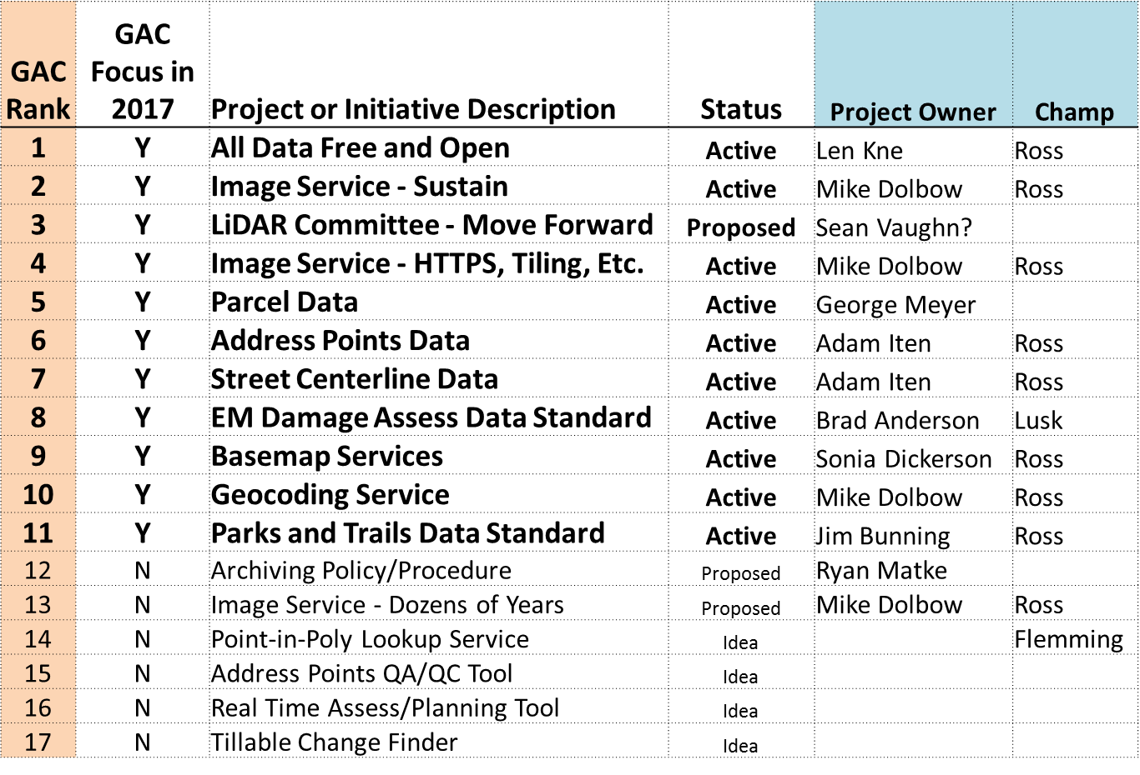
2017 GAC Priorities

Slide 11
GAC Priorities Process
Create a list of proposed projects and initiatives
  Existing and new
Assess the value of each
  GAC members advocate for sectors
  100% response!
Assess likelihood of success
Preliminary priority calculation
GAC discusses and adjusts

Slide 12
Why Create Priorities?
To create a voice for the MN geospatial community
To direct work plans of the GAC and its committees
To recommend to MnGeo
To allow other organizations to compare priorities and align efforts
To inform outreach and policy related efforts

Slide 13
Logistics
Representing your “Sector”
NSGIC membership

Slide 14
GAC Process and Logistics
Questions?

Slide 15
Agenda Item 5
Approve new 3D Geomatics Committee
Gerry Sjerven, Sean Vaughn

Slide 16
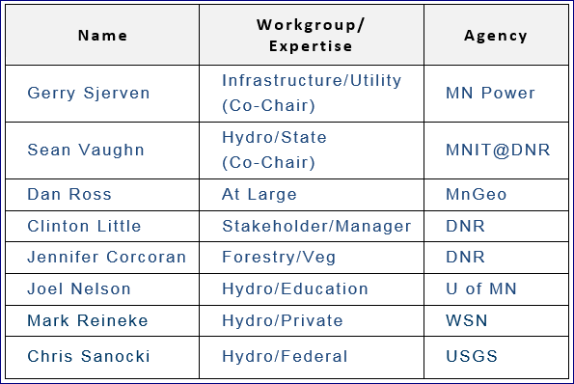
New Committee Formation
New LiDAR/Elevation Committee Direction
Co-Chairs
  Gerry Sjerven
  Sean Vaughn
Steering Committee

Slide 17
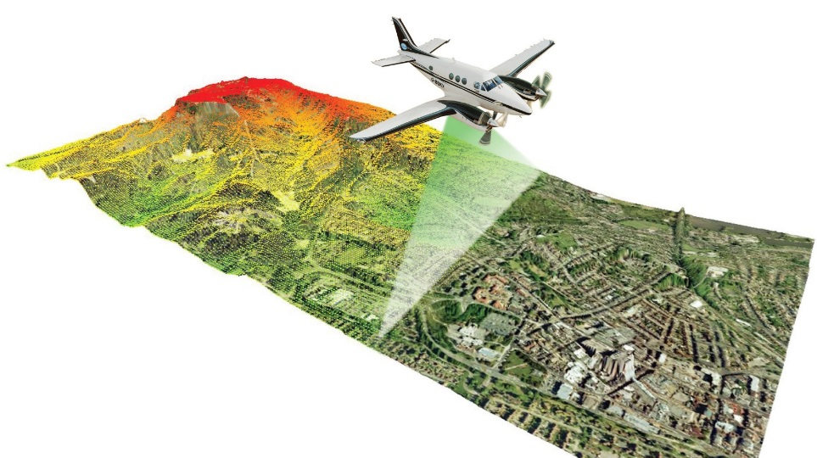
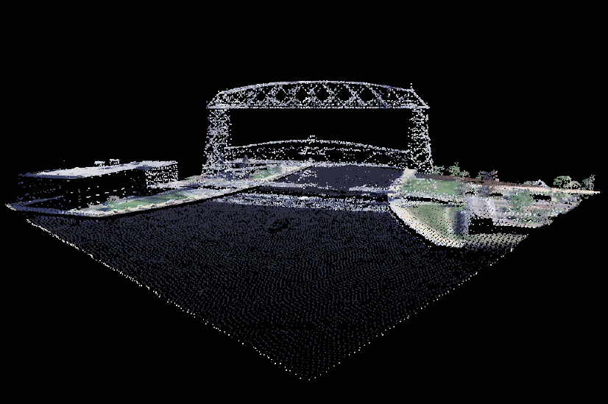
New Committee Name
Naming Design
  Progressive
  Keeps Pace with the Technologies
  Marketable
  Memorable
3D
  3D mapping has taken hold as the phrase that encompasses all things mapped in a point cloud.
  A 3D Industry has formed that includes 3D Sensing, 3D Processing, and 3D Visualization

Slide 18
New Committee Name
Committee on 3D Geomatics
Naming Design – Definition Examples
  Dictionary.com - a science concerned with using mathematical methods on data about the earth's surface.
  Wikipedia - Geomatics (including geomatics engineering), also known as surveying engineering or geospatial science (including geospatial engineering and geospatial technology), is the discipline of gathering, storing, processing, and delivering geographic information or spatially referenced information. In other words, it "consists of products, services and tools involved in the collection, integration and management of geographic data“.

Slide 19
New Committee Name
Committee on 3D Geomatics
Mission Statement
  The Committee on 3D Geomatics (3DGeo) works to identify and promote the need for planning, funding, acquisition, and management of geomatic data and derived products. The committee engages multiple disciplines in Minnesota for the benefit of its resources and citizens; promoting the value, importance, and use of this complex and voluminous information.

Slide 20
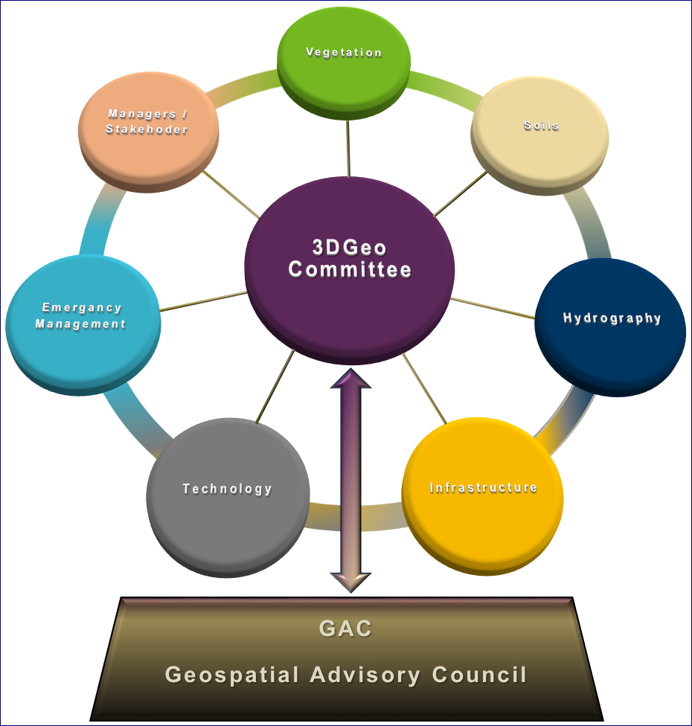
3DGeo Committee Organization
Multidiscipline Committee
Each Discipline Comprised of Subject Matter Experts
Discipline Approach Evolved Out of November 2015 Meeting

Slide 21
New Committee Organization
Hydrography
  Hydro-modified DEM
  Water Quality Tools
  NXG-Watercourses
  NXG-Watersheds
Infrastructure
  Utilities/Power/Water
  Transportation
  Buildings/Solar Mapping
  Facilities
  Surveying
Vegetation
  Forest Resources
  Wetland Mapping
Soils
  Slope
  Type Mapping

Slide 22
New Committee Organization
Technologies
  Procurement
  Servers/Dissemination
  3D Sensing/Laser Scanning/Mapping
  UAV/UAS/Drone
Emergency Management
  Emergency Response
  Law Enforcement
Managers / Stakeholders
  Non Subject Matter Expertise
  Agency Specific Managers
  Private Sector Leads
Other Possibilities
  Cultural/Archaeology
  Mining
  Ground Penetrating Radar
  Outreach & Education / Funding

Slide 23
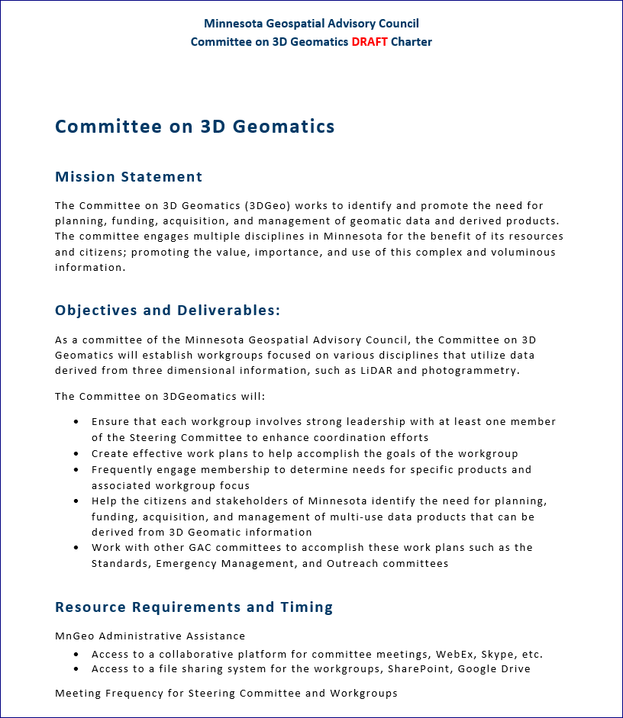
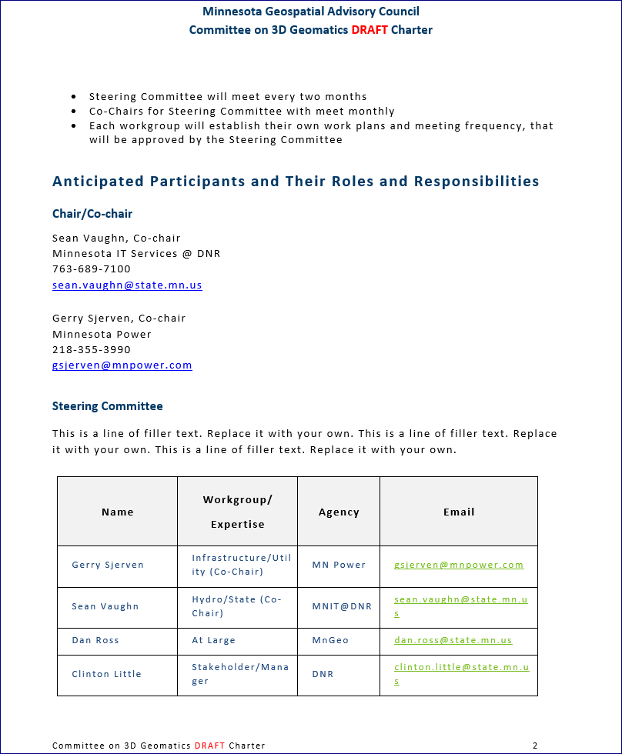
3DGeo Committee Charter

Slide 24
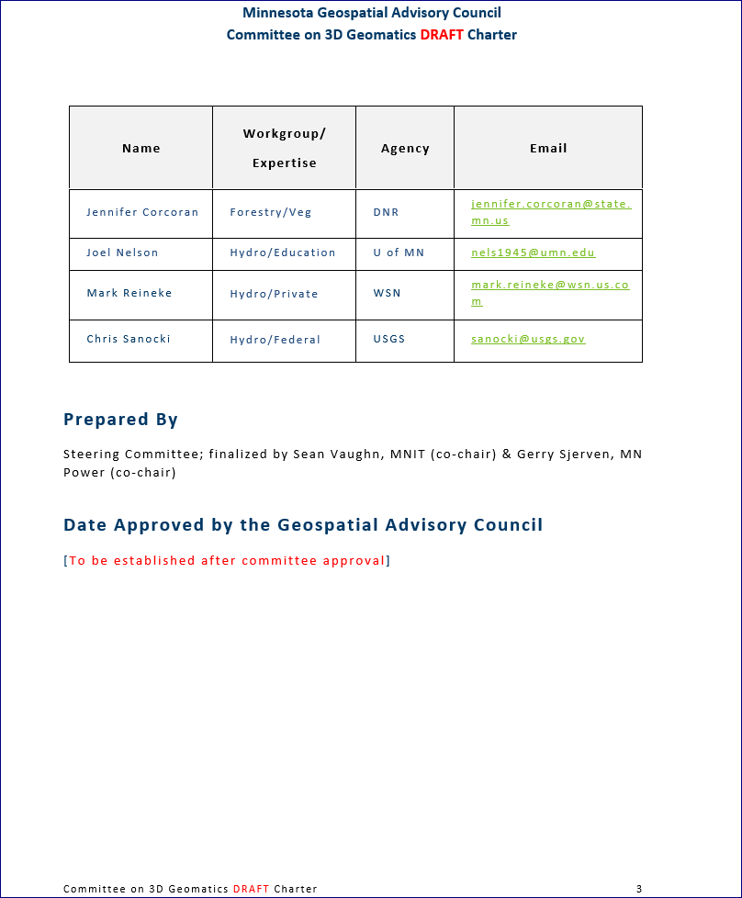
3DGeo Committee Charter

Slide 25

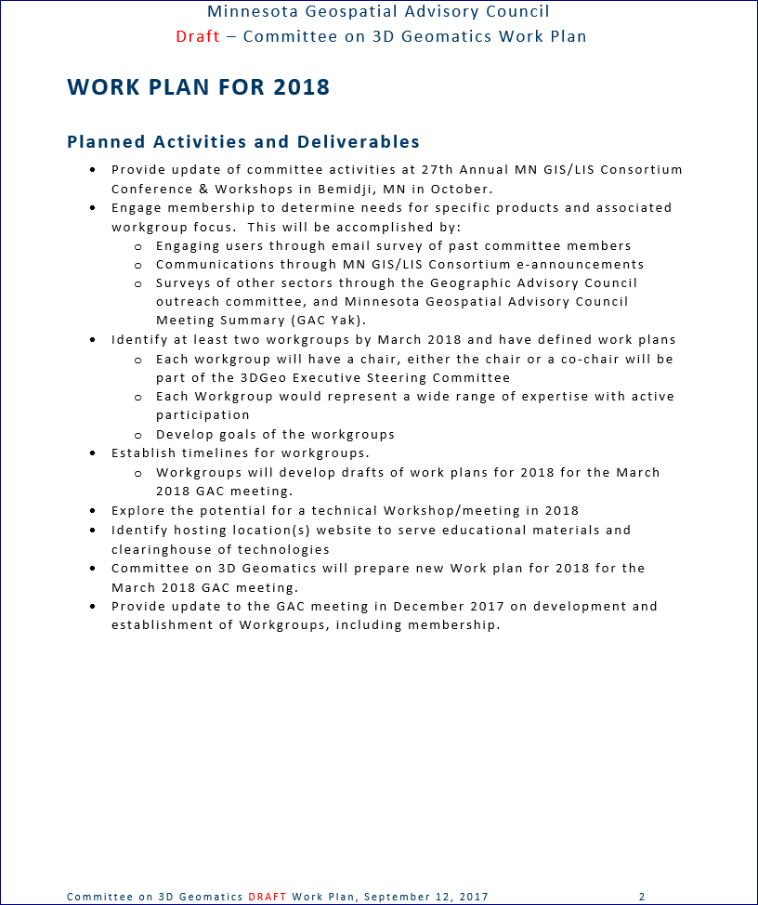
3DGeo Committee Work Plan

Slide 26
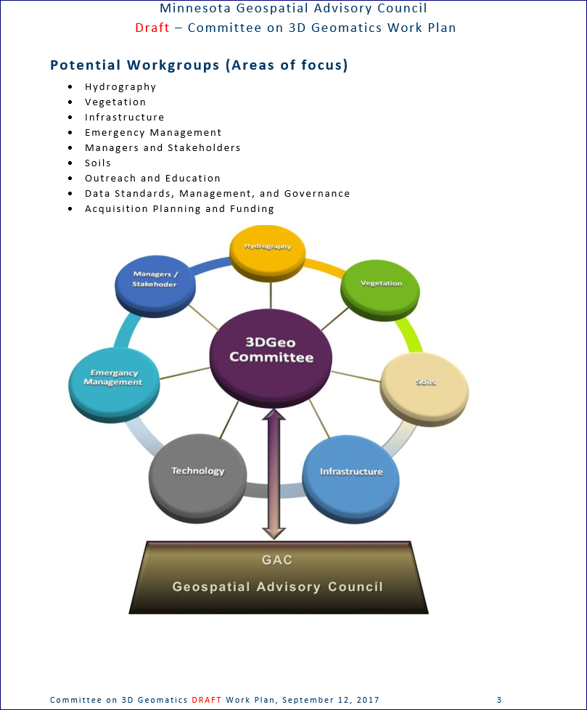
3DGeo Committee Work Plan

Slide 27
Agenda Item 6
Geospatial Data Act
Mark Kotz

Slide 28
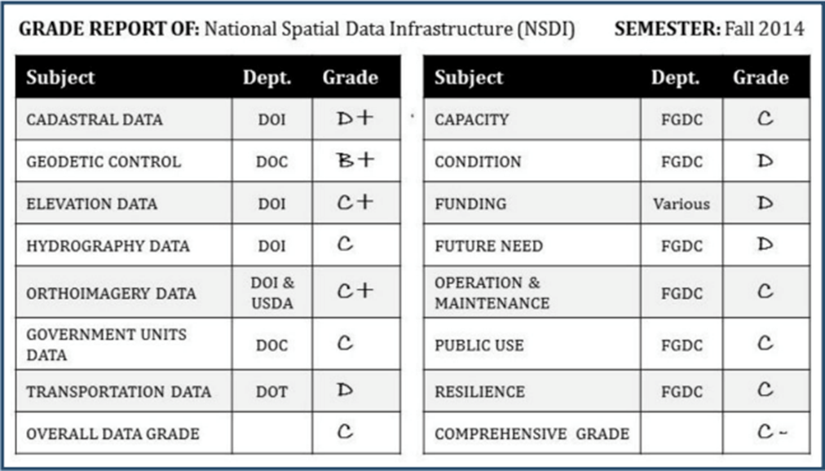
Geospatial Data Act
NSDI Report Card, COGO
Full report

Slide 29
Geospatial Data Act
2015 legislation stalled
Reintroduced 2017 US House and Senate
“establishes a clear vision, assigns responsibility, provides authority and ensures oversight of Federal activities by Congress” (NSGIC)

Slide 30
Geospatial Data Act
Reaction from national geospatial organizations
  Mostly good intent
  Some problematic language
Language may change
GAC reaction options
  Wait vs. letters support/oppose

Slide 31

Break - Networking

Slide 32
Agenda Item 8
Local Update of Census Addresses (LUCA) Program (Susan Brower, State Demographer)

Slide 33
Minnesota Geospatial Advisory Committee – September 2017
Susan Brower | susan.brower@state.mn.us

Slide 34


Slide 35
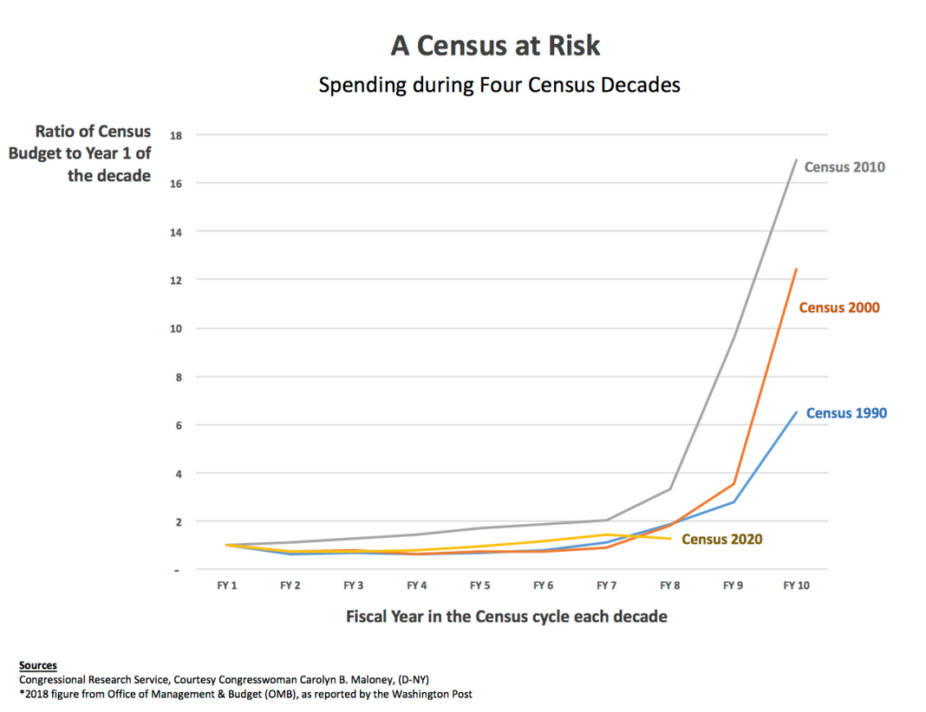

Slide 36



The 2020 Census is about:
POWER
MONEY
DATA

Slide 37
2010 Congressional Reapportionment

Slide 38
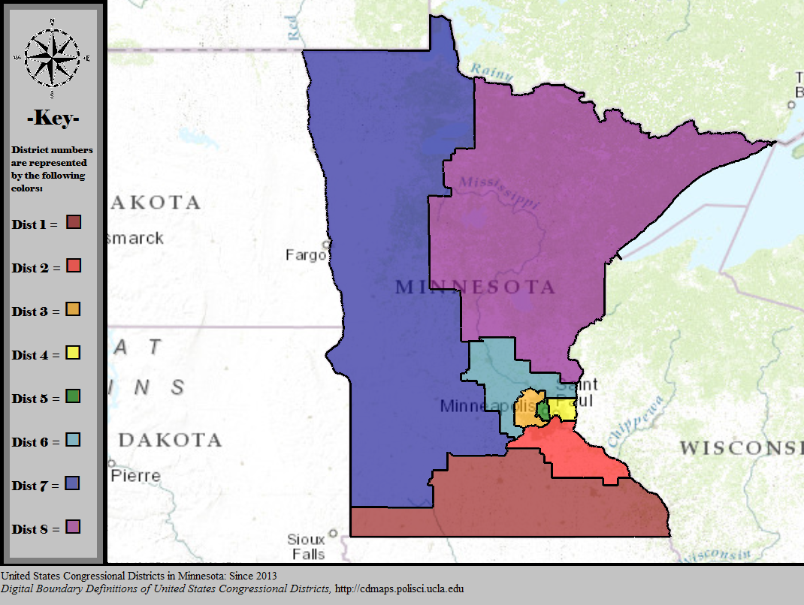
How would MN Congressional Districts change if we were to lose a seat?

Slide 39
Political representation at the state-level, also based on census counts
Districts with lower counts expand; higher counts contract after redistricting

Slide 40
The 2020 Census is about:
POWER
MONEY
DATA

Slide 41

Census counts guide the distribution of dollars
More than 400 billion federal dollars are distributed to state and local governments each year on the basis of census data
At least $1,532 per person is allocated by the federal government to Minnesota each year (that’s $15,320 for the decade)

Slide 42

The 2020 Local Update of Census Addresses (LUCA) program
LUCA is the U.S. Census Bureau program that allows cities to review and comment on the addresses that will be used to conduct the 2020 Census.

Slide 43
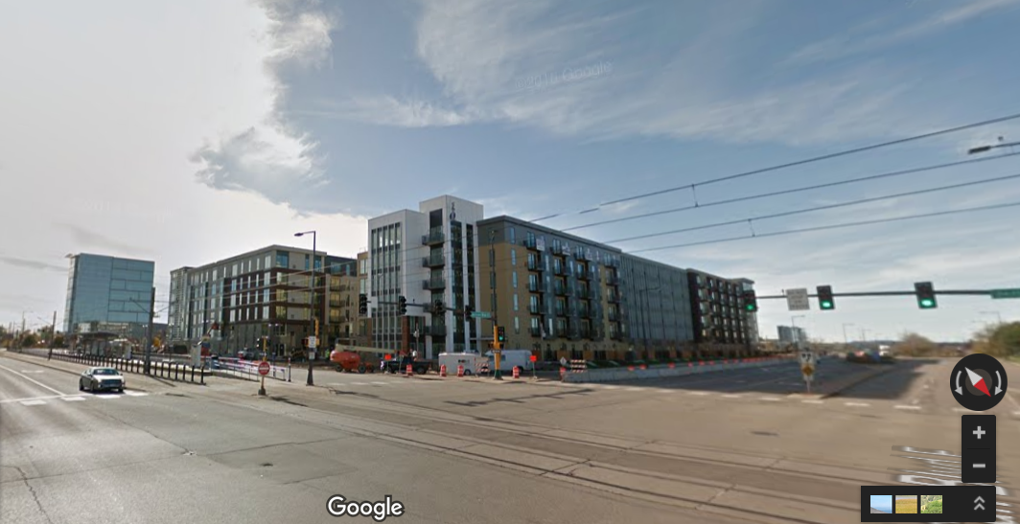
LUCA: A little work could pay big dividends
1 new housing development with ~400 units and ~600 residents
= ~ $8.4 million in federal funds to state and local governments between 2020 and 2030

Slide 44
LUCA: What do you need to do to participate?
Make sure your city is registered with the Census Bureau for the LUCA.
Prioritize the LUCA work within your city. It’s coming up quickly and has a brief review window. Blink and you will miss it.

Slide 45
LUCA: Important Dates
Registration packets mailed to highest elected officials (e.g. Board Chairs) this month, July 2017
Deadline to return register with the Census Bureau is December 15, 2017.
Review period runs for 3 months; begins February 2018.
More details about the LUCA can be found here: www.census.gov/geo/partnerships/luca.html

Slide 46
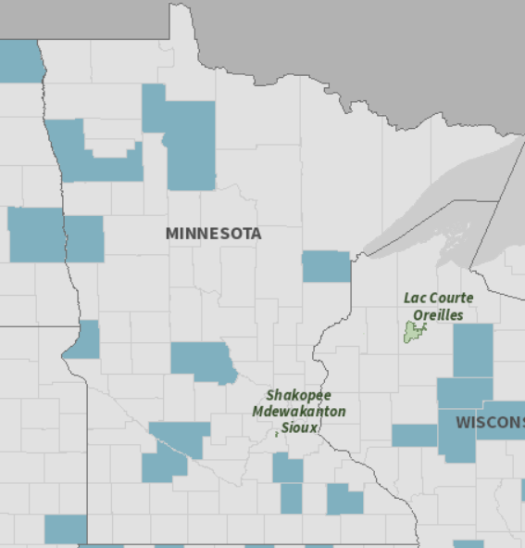
So far
11 counties registered for the 2020 LUCA
To see which governments have registered for LUCA, view the Registered LUCA Participants map on the Census Bureau's 2020 LUCA site

Slide 47
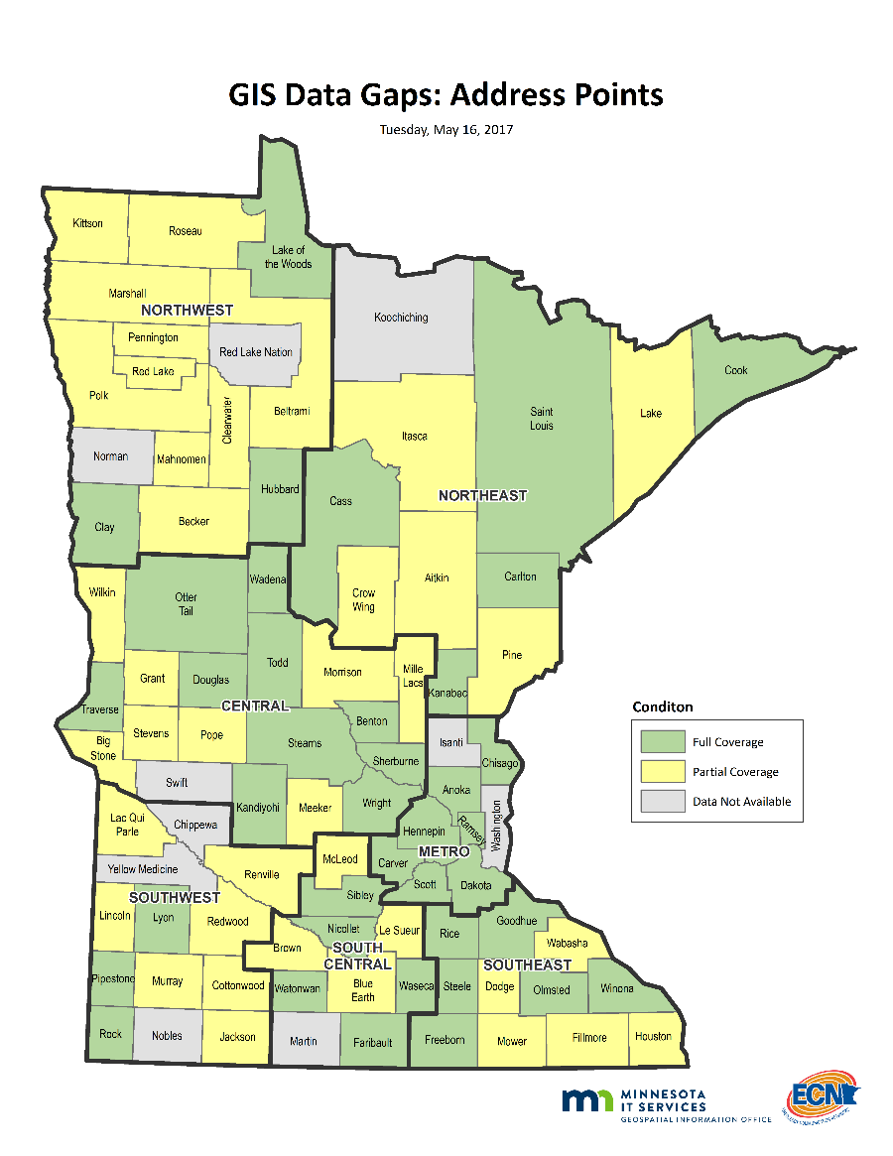
If you can’t participate in the LUCA, help us participate on your behalf
The State of Minnesota (State Demographic Center) also plans to participate in the LUCA using state administrative data sources
NG911 data being compiled now
Help us make sure that your data are included in the state-level database

Slide 48
Agenda Item 9
Sector report (Kerr)
Healthography - Introduction to Mapping and GIS

Slide 49

Healthography:
Introduction to Mapping and
Geographic Information Systems
Madeleine J. Kerr, PhD, RN
Associate Professor
University of Minnesota School of Nursing
Acknowledgement:
Notes:
Hello, I’m Madeleine Kerr and this is an introduction to mapping and GIS.

Slide 50

Healthography Definition¹
“How where you live affects your health and well-being”. APHA, 2014.
Health is more than health care. Many factors contribute to health.
¹ American Public Health Association theme for annual meeting, Nov. 15-19, 2014, New Orleans.
Notes:
Does where you live matter to your health? This billboard from the American Public Health Association conference hints at the answer. Your Zip Code shouldn’t predict how long you’ll live, but it does. Having health insurance and health care is important – but much of what affects our health occurs outside of hospitals and clinics. It’s hard to live a healthy life if you live in an unhealthy place.

Slide 51
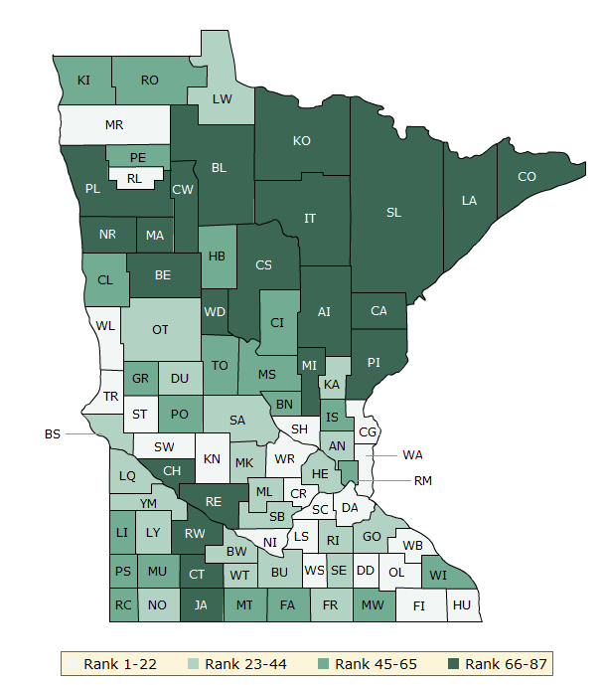
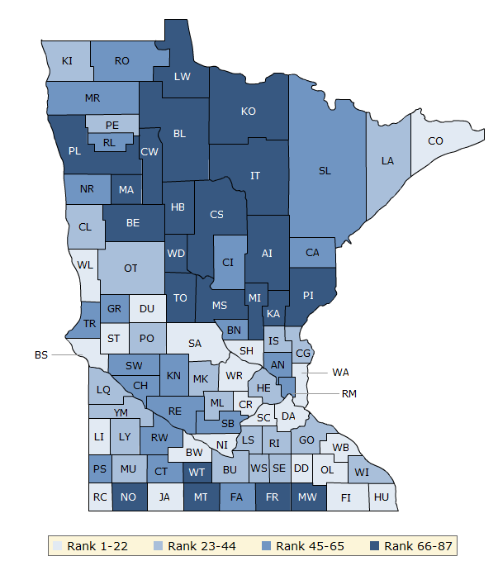
Minnesota Health Outcomes
Health Outcomes
Health Factors
County Health Rankings & Roadmaps. http://www.countyhealthrankings.org
Notes:
Here you see maps that provide insights about the health of Minnesotans. The County Health Rankings help us see how where we live, learn, work and play influences how healthy we are and how long we live.
On the left, the green map shows the distribution of Minnesota’s health outcomes , based on an equal weighting of length and quality of life. Lighter shades indicate better performance in the summary rankings.
On the right, the blue map displays Minnesota’s summary ranks for health factors , based on weighted scores for health behaviors, clinical care, social and economic factors, and the physical environment.

Slide 52
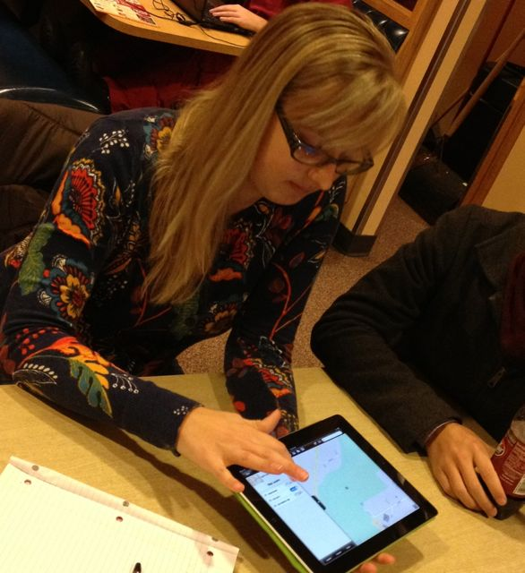
Geo-Spatial Activities with Undergraduate Nursing Students
    Age-friendly Cities Checklist
    Omaha System Windshield Survey
    Crisis Mapping
Technical support was provided by
U-Spatial at the University of Minnesota

Slide 53
AGE-FRIENDLY CITIES CHECKLIST
N3115: Health Informatics & Information Technology
N4305: Community-based care of families across the lifespan

Slide 54
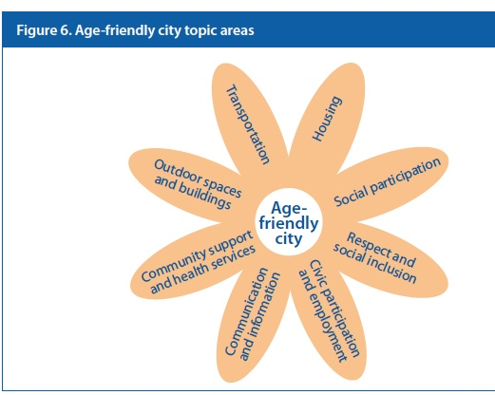
Global Age-Friendly Cities
World Health Organization effort to address environmental & social factors that contribute to active and healthy aging
http://www.who.int/ageing/age_friendly_cities_guide

Slide 55
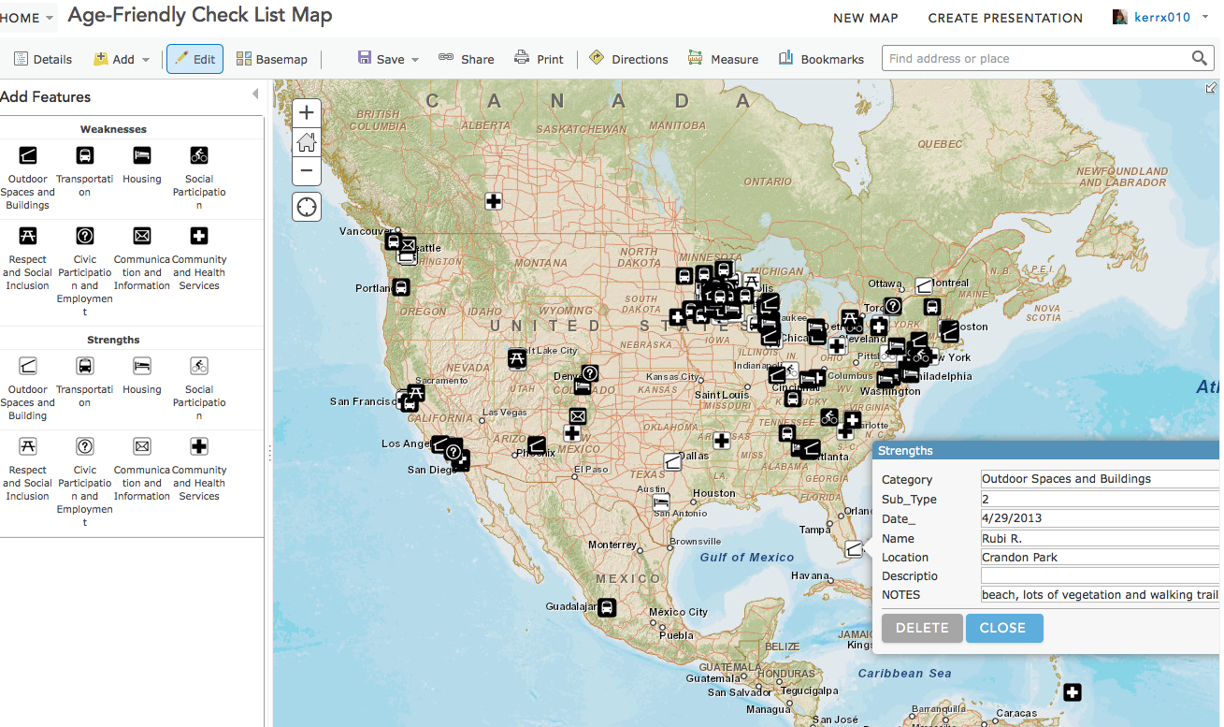
Age-Friendly Cities Mapping
Notes:
To enter a data point, In the menu bar, click the edit button to reveal the legend of weaknesses and strengths
-In the legend, select the category you would like to record on the map.
-Click on the map at the location of your weakness or strength.
- In the pop-up box, you will see the category you chose at the top.
On the Sub-Type line, insert the number for the age-friendly feature that best matches what you observed. (see Code sheet)
e.g. Outdoor Spaces and buildings 2= Green spaces and outdoor seating are sufficient in number, well-maintained and safe.

Slide 56

Age-Friendly Cities Planning:
Practicum in Dakota County
Questions:
How many miles of walking paths?
Are there sufficient park benches?
Notes:
Walking & Paths
-Average walk score for the city?
--Does the city have walking or biking paths? How many miles?
Parks
-# of parks in the city? How many acres of parkland?
-Adequate # of benches? [go to the parks and count the benches?]

Slide 57
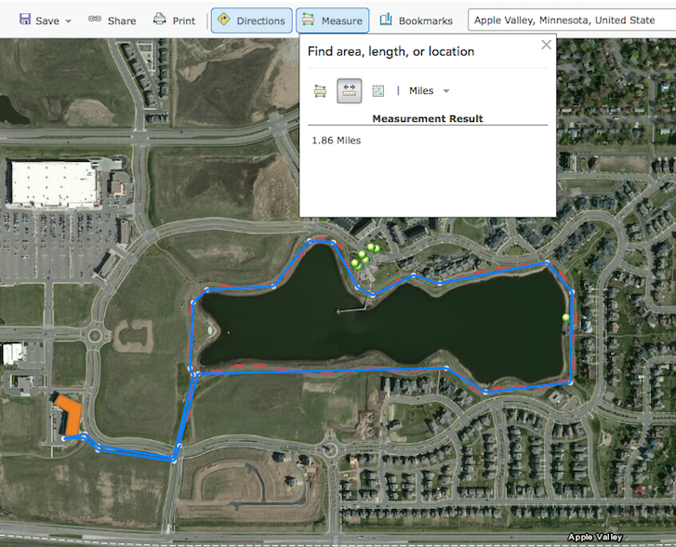
Age-Friendly Cities Planning with Dakota County
Orange polygon= senior housing
Green point=
park bench
Red line= paved path
Blue line= measurement

Slide 58
Crisis Mapping
N3115: Health Informatics & Information Technology

Slide 59
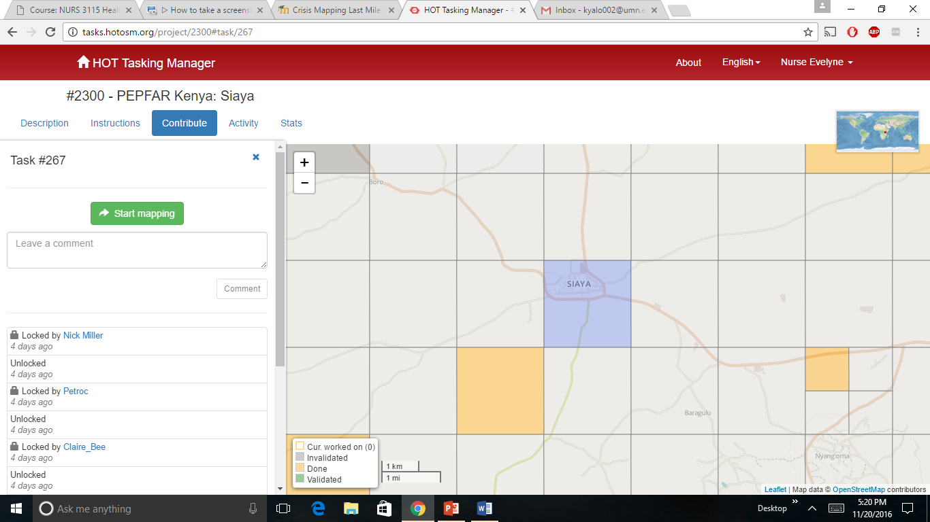
Humanitarian OpenStreetMap Team Activity:
Example- US President’s Emergency Plan for AIDS Relief (PEPFAR)
“It meant a lot to me to be part of such a great cause. I felt proud knowing that I had helped …even with being over 8,000 miles away.”
BSN student

Slide 60
OMAHA SYSTEM WINDSHIELD SURVEY PROJECT
N4305: Community-based care of families across the lifespan

Slide 61
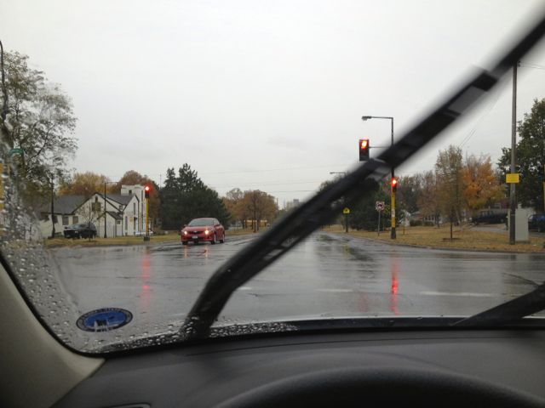
Background
Windshield surveys are a practical brief community assessment tool in public health nursing practice
Notes:
Students in public health often perform a brief community assessment called a windshield survey during clinical experiences. As the name implies the windshield survey is a first look at a community through the car’s windshield. The student or group of students are asked to use their senses (sight, hearing, smell) to learn about a community as they drive, walk or use public transportation to get around the community.
Windshield survey data includes observational data as well as some inferences based on these first hand observations. WS data are an initial descriptive assessment of the community.

Slide 62
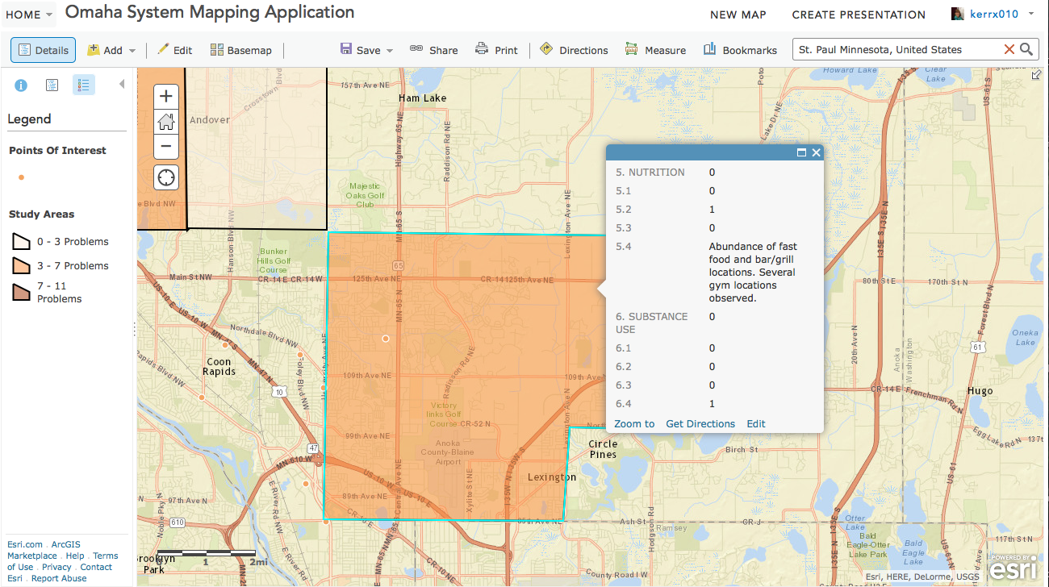

Windshield Survey Mapping:
BSN clinical assignment
Checklist of 11 problems from the Omaha System

Slide 63
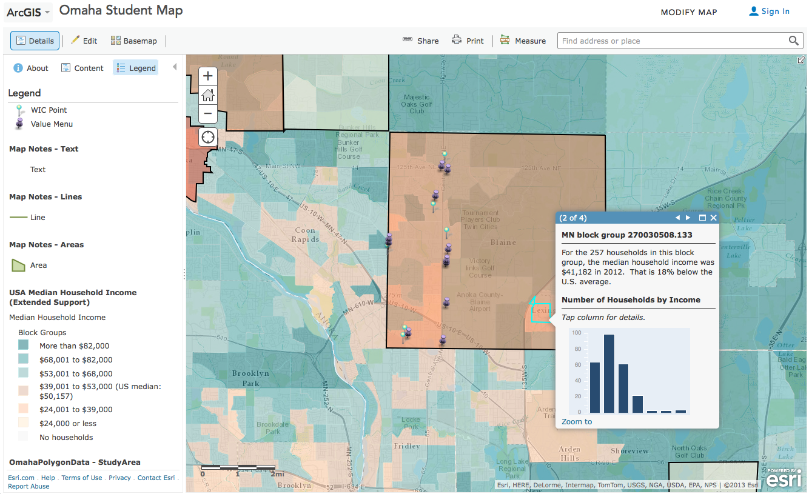

Student practicum in Anoka County: WIC Vendors vs. Fast Food Value Menus
Purple point= restaurant with value menu
Green point= WIC nutrition program vendor

Slide 64

Relevance of GAC? Connection to Minnesota communities

Slide 65
Agenda Item 10
Emergency Preparedness Committee Update on U.S. National Grid (Knippel)

Slide 66
Emergency Preparedness Committee
Damage Assessment
U.S. National Grid
Randy Knippel
Dakota County GIS Manager
EPC Co-Chair

Slide 67
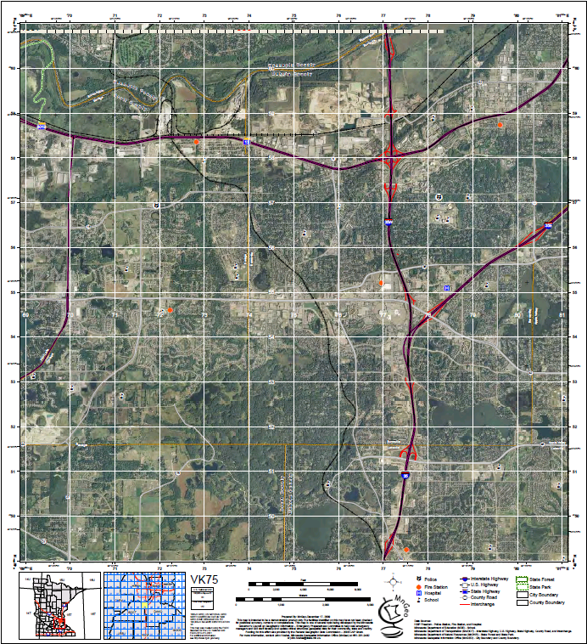
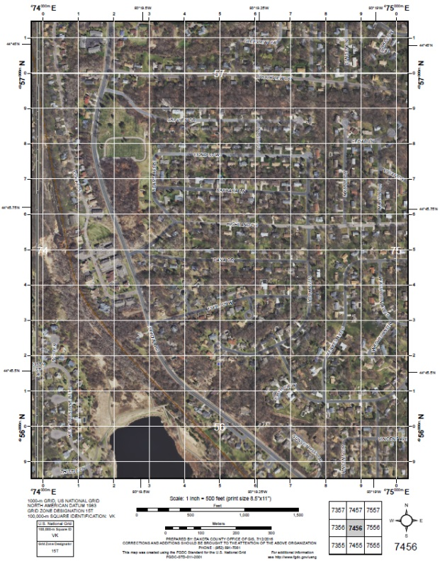
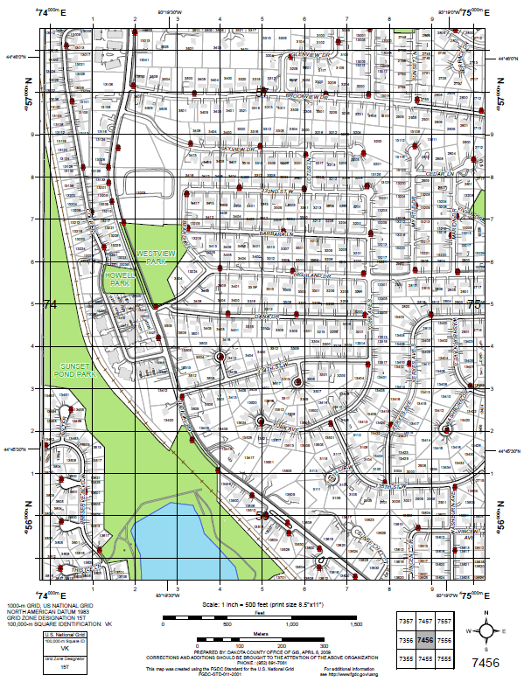
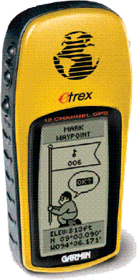
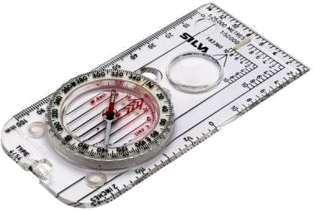
Maps!

Slide 68
Use Maps!
60
59
58
57
56
55
54
53
52
51
50
Grid 75 56
Then up!
Read right,
70 71 72 73 74 75 76 77 78 79 80
Notes:
Each page in the fire map book represents one of the squares on the larger maps.

Slide 69
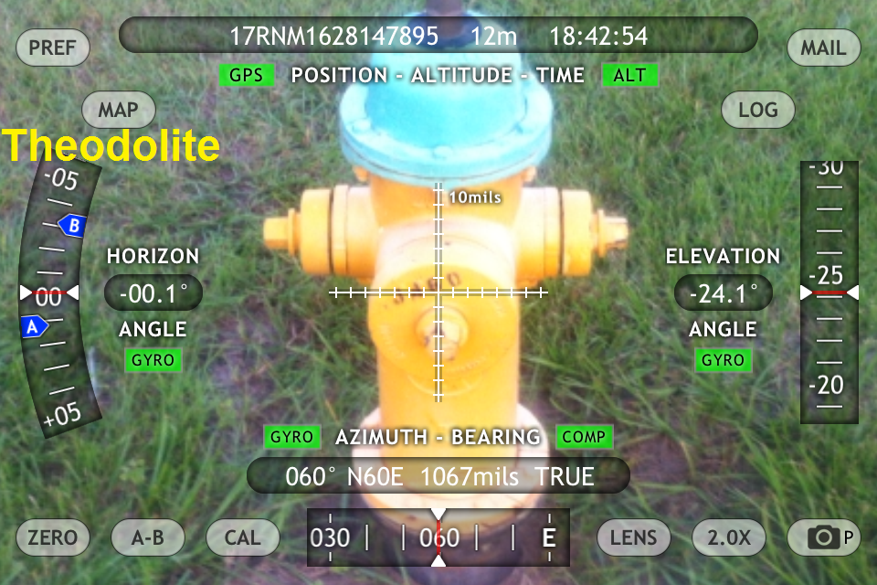
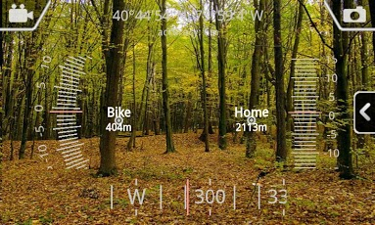
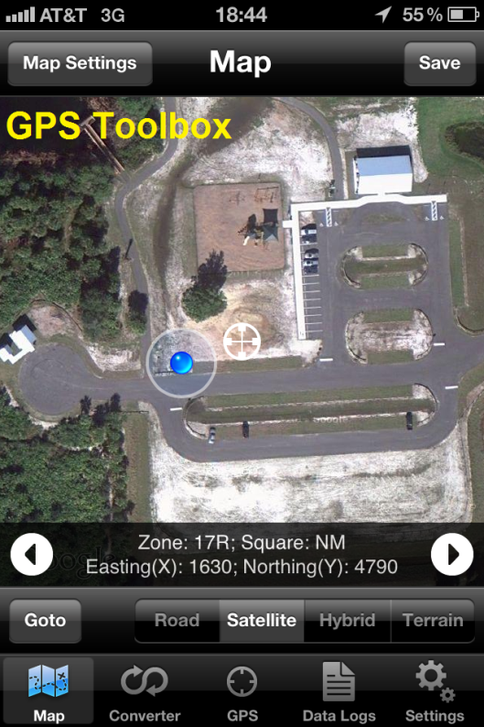
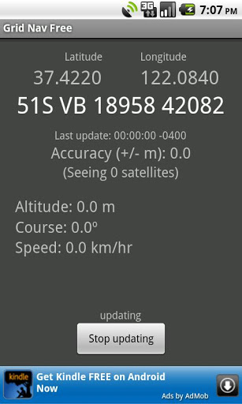
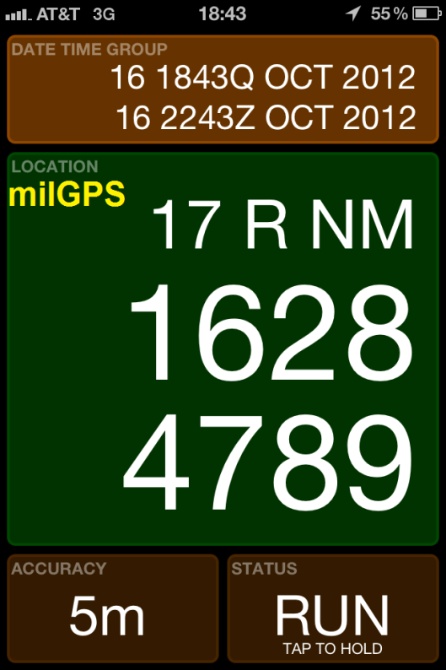
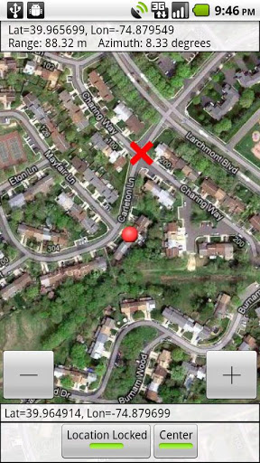
GeoCam
Mobile Apps
GridNav
MyMGRS

Slide 70
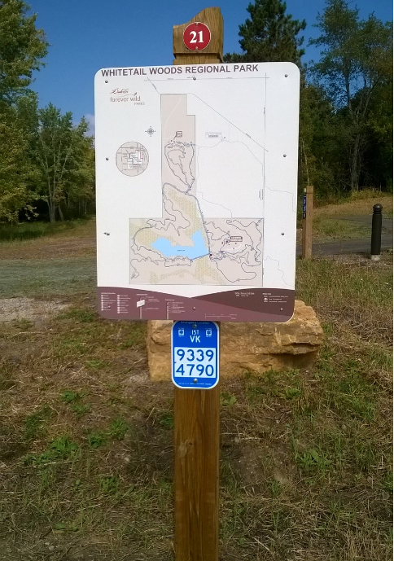

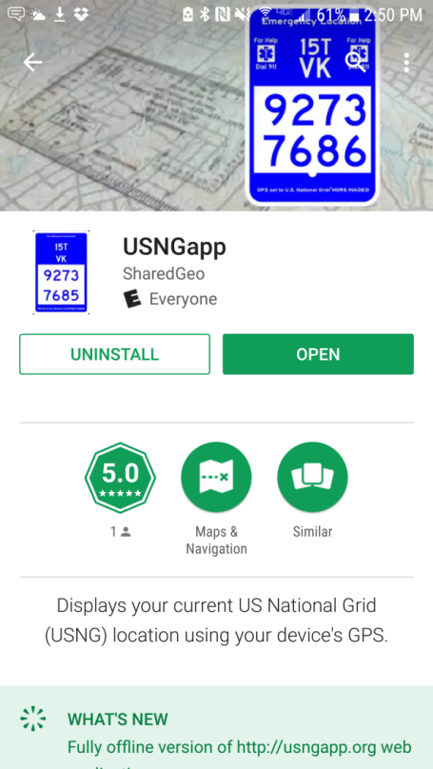


Emergency Location Markers

Slide 71

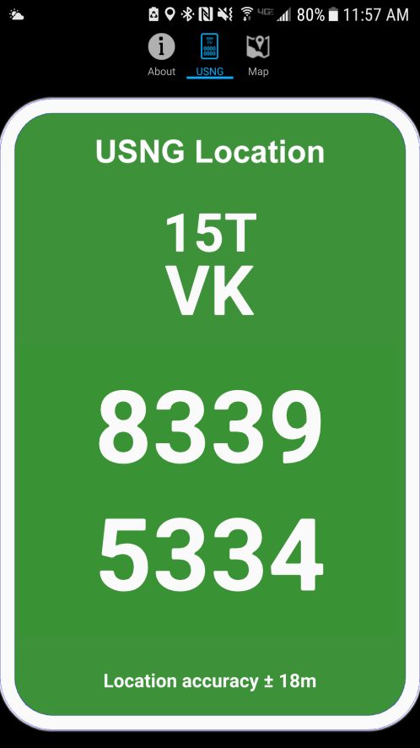
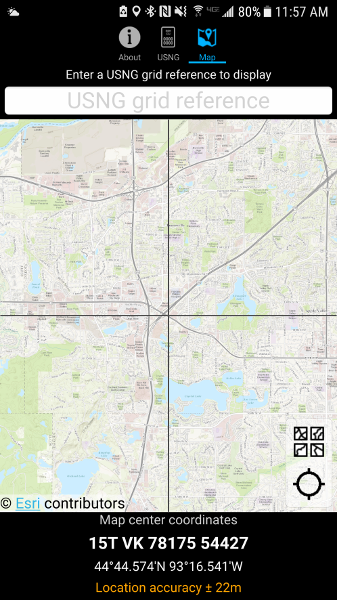
MyUSNG

Slide 72
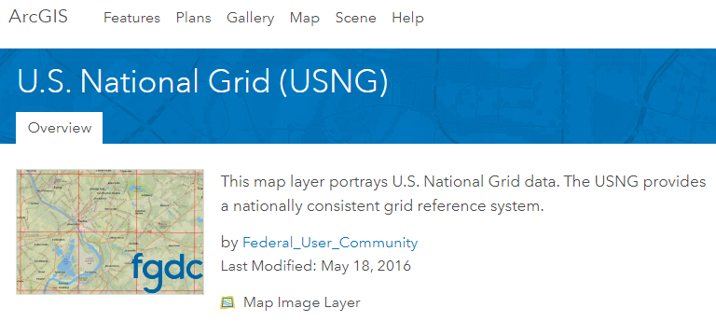

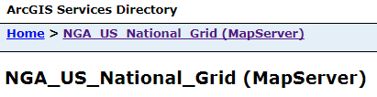

Esri

Slide 73


Upper Midwest
U.S. National Grid Summit
UW LaCrosse, WI
33 Registered attendees (MN, IA, WI)
  15 from emergency services sector
  18 from GIS sector

Slide 74


http://usngcenter.org

Slide 75
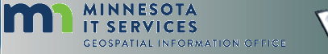

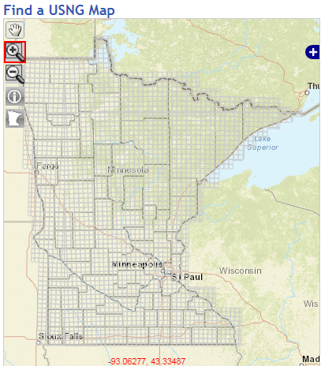
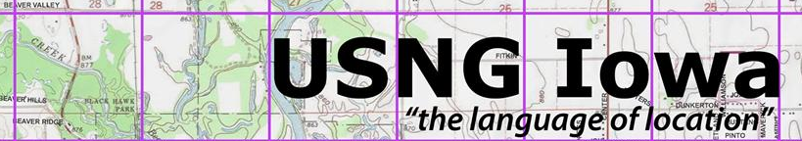
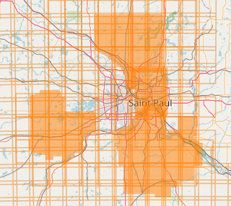
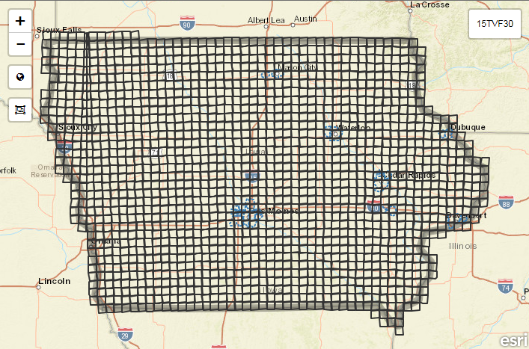

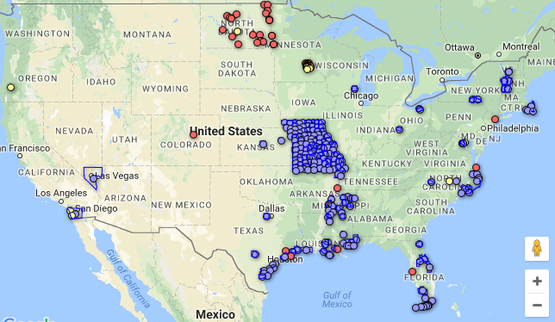

Momentum Building
Locally & Nationally

Slide 76
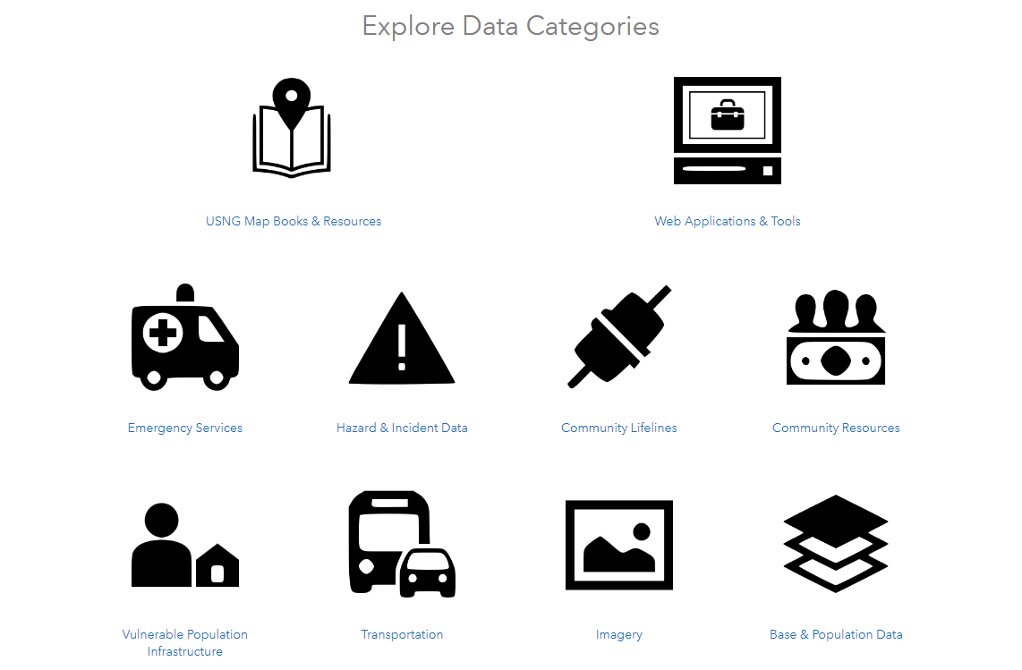

Slide 77




However…

Slide 78


Slide 79
Agenda Item 11
Updates on MN GAC priority projects and initiatives
GAC Rank | Project or Initiative Description | Status | Project Owner | Champion
1 | All Data Free and Open | Active | Len Kne | Ross
2 | Image Service - Sustain | Active | Mike Dolbow | Ross
3 | LiDAR Committee - Move Forward | Proposed | Sean Vaughn?
4 | Image Service - HTTPS, Tiling, Etc. | Active | Mike Dolbow | Ross
5 | Parcel Data | Active | George Meyer
6 | Address Points Data | Active | Adam Iten | Ross
7 | Street Centerline Data | Active | Adam Iten | Ross
8 | EM Damage Assess Data Standard | Active | Brad Anderson | Lusk
9 | Basemap Services | Active | Sonia Dickerson | Ross
10 | Geocoding Service | Active | Mike Dolbow | Ross
11 | Parks and Trails Data Standard | Active | Jim Bunning | Ross

Slide 80
Agenda Item 12
Elect Chair, Vice Chair, Leadership Team (Kotz)

Slide 81
Agenda Item 13
Announcements or other business

Slide 82
Thank you!
Next meeting is Wednesday, December 6, 2017

