Slide 1
Minnesota Geospatial Advisory Council
March 28, 2018

Slide 2
Welcome
Introductions
Approve agenda
Approve December minutes

Slide 3
Agenda
Time | Topic
11:15 | Approve Standards Committee revised charter
11:20 | Approve committee and GAC work plans
11:35 | Approve Parcel Data Transfer Standard and update to Address Point Standard
11:50 | Policy and procedure for archiving geospatial data
12:10 | Break, networking
12:40 | Web Emergency Operations Center (EOC) update
12:50 | National Agriculture Imagery Program licensing update
12:55 | Sector reports: Tribal Government GIS; MetroGIS
1:15 | Governor’s commendation award
1:20 | Legislative update and MPA update
1:25 | Updates on GAC priority projects and initiatives
1:45 | 3D Nation Elevation Requirements and Benefits Study
1:50 | Announcements

Slide 4
Agenda Item 2
Review and approve Standards Committee revised charter

Slide 5
Agenda Item 3
Review and approve committee and GAC work plans

Slide 6
Agenda Item 3
Committee 2017 Accomplishments and 2018 Work Plans
3D Geomatics Committee page 6
Emergency Preparedness Committee page 11
Outreach Committee page 16
Parcels and Land Records Committee page 19
Standards Committee page 21

Slide 7
Agenda Item 3
GAC 2017 Accomplishments and 2018 Work Plan

Slide 8
Agenda Item 3
GAC 2017 Accomplishments
Approved the Minnesota Address Point Data Standard
Launched the new 3D Geomatics Committee
Launched emergency management damage assessment data standard subgroup
Sunsetted Digital Elevation & Hydrography Committees & Metadata Workgroup
Sent letter of support for an LCCMR proposal
Sent letters in support of the Geospatial Data Act
Presented to the Assoc. of Minnesota Emergency Managers
Panel presented at GIS/LIS Consortium Conference
Changed GAC sectors
Identified and prioritized statewide geospatial projects

Slide 9
Agenda Item 3
GAC 2018 Work Plan
Approve a state parcel data transfer standard
Launch a group to identify and recommend policies and procedures for archiving and preserving historical geospatial data in Minnesota
Promote and facilitate progress on the statewide geospatial projects and initiatives identified by the GAC
Continue to increase outreach to the geospatial and related communities
Increase the outreach to and input from members of the geospatial community when defining GAC annual priorities
Identify and prioritize statewide geospatial projects

Slide 10
Agenda Item 4
Standards Committee Report:
Address Point Data Standard v. 1.1
Proposal for Parcel Data Transfer Standard
Geoffrey Maas, GISP
Chair, Standards Committee
MetroGIS Coordinator, Metropolitan Council

Slide 11
Agenda Item 4
Standards Committee ‘Maintenance’
Address Point Data Standard v. 1.1
Several attributes use the domain ‘Yes, No, Unknown’
Standardized the field width from 7 characters to 10 characters
Facilitates uniformity both within and across standards

Slide 12
Agenda Item 4
Request for approval of the proposed
Minnesota Parcel Data Transfer Standard

Slide 13
Agenda Item 4
Minnesota Parcel Data Transfer Standard
>> Significant multi-year effort;
>> Many individuals and agencies involved;
>> Important geospatial resource;
>> Parcel data = foundational dataset;

Slide 14
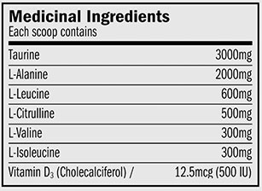
Agenda Item 4
What does it contain?
Alignment to other standards

Slide 15
Agenda Item 4
What does it contain?
90 attributes in 6 element categories:
>> Identification Elements (2)
>> Address Elements
>> Area Elements
>> Tax and Survey Elements
>> Ownership and Administration Elements
>> PLSS Elements

Slide 16
Agenda Item 4
What does it contain?
90 attributes in 6 element categories:
>> Identification Elements (2)
>> Address Elements (17)
>> Area Elements
>> Tax and Survey Elements
>> Ownership and Administration Elements
>> PLSS Elements

Slide 17
Agenda Item 4
What does it contain?
90 attributes in 6 element categories:
>> Identification Elements (2)
>> Address Elements (17)
>> Area Elements (6)
>> Tax and Survey Elements
>> Ownership and Administration Elements
>> PLSS Elements

Slide 18
Agenda Item 4
What does it contain?
90 attributes in 6 element categories:
>> Identification Elements (2)
>> Address Elements (17)
>> Area Elements (6)
>> Tax and Survey Elements (57)
>> Ownership and Administration Elements
>> PLSS Elements

Slide 19
Agenda Item 4
What does it contain?
90 attributes in 6 element categories:
>> Identification Elements (2)
>> Address Elements (17)
>> Area Elements (6)
>> Tax and Survey Elements (57)
>> Ownership and Administration Elements (3)
>> PLSS Elements

Slide 20
Agenda Item 4
What does it contain?
90 attributes in 6 element categories:
>> Identification Elements (2)
>> Address Elements (17)
>> Area Elements (6)
>> Tax and Survey Elements (57)
>> Ownership and Administration Elements (3)
>> PLSS Elements (5)

Slide 21
Agenda Item 4

Slide 22
Agenda Item 4
1998

Slide 23
Agenda Item 4
Brief Development History
State-Level Development
1998 – Land Records Modernization Committee
Created by the Governor’s Council on Geographic Information
“…to promote the development of digital parcel data in Minnesota.”

Slide 24
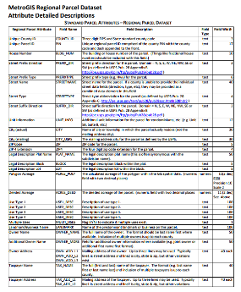
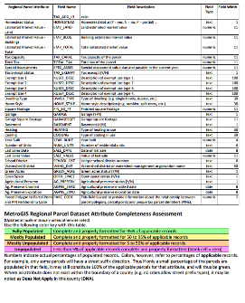
Agenda Item 4
Origin of the Standard
September 1999: Seven Metropolitan Counties
By 2002: Standard set of attributes
Metro Regional Parcel Dataset

Slide 25
Agenda Item 4
Recognition of the importance of parcel data
2004
“Foundation for Coordinated GIS:
Minnesota’s Spatial Infrastructure”
2007
National Research Council
“National Land Parcel Data – A Vision for the Future”
2012
“Business Plan for Statewide Parcel Data Integration”

Slide 26
Agenda Item 4
Data production
2008-2009:
>> Many counties producing digital parcel data;
>> State agencies requesting it from counties;
Land Records Modernization Committee is tasked to make data exchange simpler;
Changes name to Digital Cadastral Data Committee

Slide 27
Agenda Item 4
Creation of first version of parcel standard
2008-2009: Digital Cadastral Data Committee
>> Leverage the existing Metro Parcel Standard
>> Created first version of the standard
Digital Cadastral Data Attribute Standard
>> Discussed, refined and fine-tuned;
>> Regional meetings to discuss the standard and
methods of data exchange;

Slide 28
Agenda Item 4
Review of first version of parcel standard
2010: Digital Cadastral Data Committee
Digital Cadastral Data Attribute Standard (v. 1.0)
Sent to the Standards Committee on December 2, 2011
Public review period June 2012 – January 2014

Slide 29
Agenda Item 4
Second version of the parcel standard
2014-2015: Parcels and Land Records Committee
The Digital Cadastral Data Committee rebrands itself as the Parcels and Land Records Committee
The parcel standard was revised with the input received from the June 2012-January 2014 review period, renamed
the Parcel Data Transfer Standard (v. 2.0)

Slide 30
Agenda Item 4
Formal public review period
2016-2017:
The modified Parcel Data Transfer Standard (v. 2.0) was submitted to the Standards Committee, approved for another round of public review
October 2016 – January 2017: 90-day public review period
All stakeholder input documented and published

Slide 31
Agenda Item 4
Public Review Contacts (2016-2018):
City, County, Regional, State, Tribal, Federal
GIS and Survey professionals
Private, Non-profit, Academic Interests
Minnesota Association of Assessing Officers
eCRV Working Group (Dept. of Revenue)

Slide 32
Agenda Item 4
“The Freeze”
February 2017:
Parcels and Land Records Committee and
Standards Committee review the stakeholder input
Parcels and Land Records Committee ‘freezes’ action on the
Parcel Data Transfer Standard until the completion of the
Address Point Data Standard
Informal input on Parcel Data Transfer Standard during 2017

Slide 33
Agenda Item 4
Alignment with Address Point Data Standard
December 2017:
Address Point Data Standard is adopted on 12/6/2017
Parcel Data Transfer Standard is aligned with it;
Further minor revisions and modifications
January – February 2018:
Version 3.2 of the Parcel Data Transfer Standard out for a
30-day public review period

Slide 34
Agenda Item 4
Final Public Review
February 2018:
>> Public comments on v. 3.2 collected and published
February 26, 2018:
>> Standards Committee reviews stakeholder input;
>> Very minor refinements, corrections, alignments;
>> Approved the Parcel Data Transfer Standard;
>> Recommends it to the GAC for adoption;

Slide 35
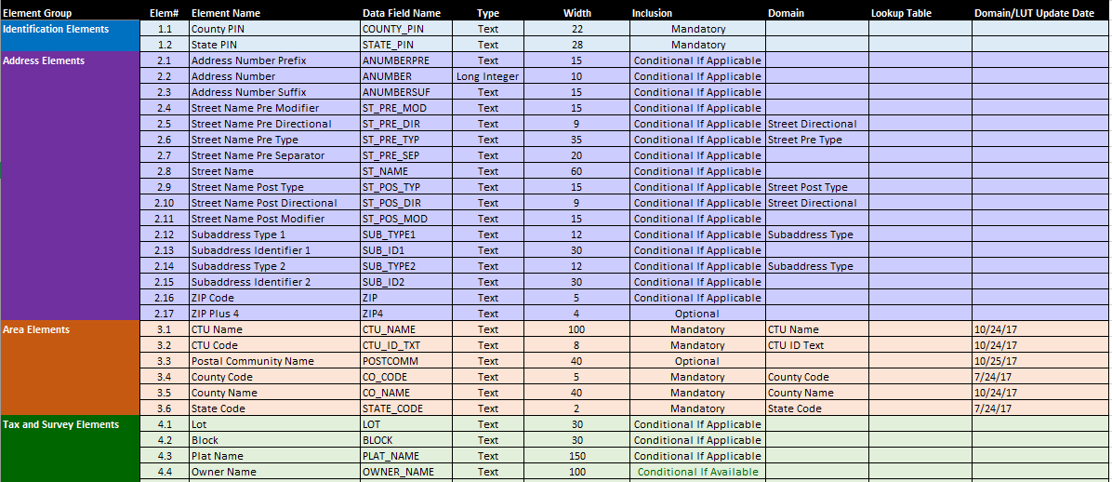
Agenda Item 4
Proposed Parcel Data Transfer Standard

Slide 36
Agenda Item 4
Request from the Standards Committee and
Parcels and Land Records Committee to the
Geospatial Advisory Council
to approve the proposed
Parcel Data Transfer Standard

Slide 37
Agenda Item 5
Policy and procedure for archiving geospatial data
Ryan Mattke

Slide 38
Archiving Minnesota Geospatial Data
Ryan Mattke
John R. Borchert Map Library

Slide 39
Definitions

Slide 40
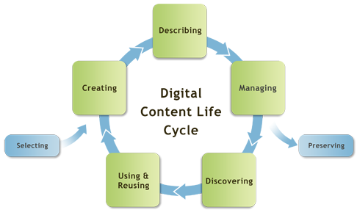

Slide 41
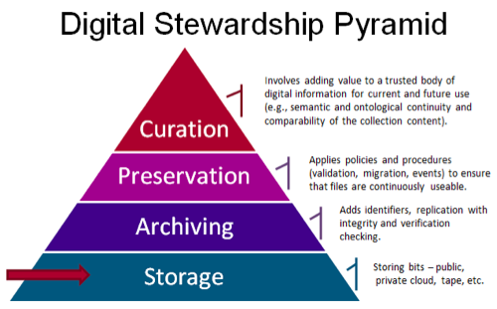

Slide 42
Historical (“Old”) Data
Parcels
Survey Info
Aerial Imagery
Utilities
Permits (right-of-way, ordinance, utility, etc.)
Construction Plans
Easements, Openings, Vacations
Maps (street, parks, natural resources, transit, etc.)
Field Books and/or notes

Slide 43
Why archive? Why now?
Historical versions are useful to:
Researchers, Planners, Historians, Genealogists, Surveyors, curious residents
Open Data Initiatives
Data Rescue Initiatives
Preserving at-risk data

Slide 44
Why archive? Why now?
Reaching a Tipping Point
Many areas have been born-digital (as GIS data, rather than paper maps) for 10-12 years
Big Ten Geospatial Data Project
Collaboration between 12 institutions in nine states
We can use this as a model of distributed work

Slide 45
Why archive? Why now?
Minnesota Digital Library
Aggregates, and facilitates access to, digital objects from 187 participating historical societies, special archives, libraries and other organizations.
Once objects are in one place, archiving and preservation is that much easier

Slide 46
University of Minnesota Libraries
UMN University Libraries
Library Administration is receptive to the idea of archiving this data
Map Library is already de facto archive for aerial photographs and many state-produced paper maps

Slide 47
University of Minnesota Libraries
Data Management & Curation Expertise
Documented curation procedures for different type of data (including geospatial)
https://www.lib.umn.edu/datamanagement/archiving
Data Repository for the University of Minnesota
Repository that enables access, discovery, reuse, citation, and fulfills grant requirements
https://conservancy.umn.edu/handle/11299/166578

Slide 48
Minnesota State Archivist
Had a conversation with Shawn Rounds (in 2015)
State Archivist has a handful of geospatial data sets, but does not generally collect data
Since most/all geospatial data created by government agencies in MN is not directly related to the business of government, it would be out of scope for archiving with the State Archivist
As long as MnGeo and other major players are involved in the conversation, the State Archivist is fine with any decisions made

Slide 49
Example: Land Use data
GIS data existed for Twin Cities historical land use
Created by the Met Council
Available via MN Geospatial Commons (previously available through MetroGIS DataFinder)
Faculty member in Civil Engineering needed earlier data
Hired a graduate student to digitize data for 1958, 1968, and 1978 from paper maps
Data has been downloaded 230 times in the past four years

Slide 50
Questions to Ponder
Data Curation and Retention
Who decides what is kept?
How is that decision made?
Funding?
Legal issues?

Slide 51
Questions to Ponder
Documented Agreement
Legislative action?
Administrative action?

Slide 52
Action
Possible Plan
Form a Working Group?
Recommendation by the end of the year?

Slide 53
Break - Networking

Slide 54
Agenda Item 7
Web Emergency Operations Center (EOC) update
David Bendickson

Slide 55
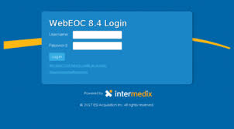
Minnesota Homeland Security and Emergency Management
WebEOC 8.4 Implementation
David L Bendickson
MN National Guard Emergency Management Program Coordinator
651-268-8887
David.l.Bendickson.mil@mail.mil

Slide 56
Prior to HSEM’s implementation, there was a mix of systems being used:
WebEOC: Hennepin County
DLAN (Disaster Local Area Network): HSEM
Knowledge Center: HSEM Regions 2 & 6
HSEM REP used a separate stand alone system
WebEOC is used by:
45 states
Nuclear Generating Power Industry
All FEMA Regions (Minnesota in FEMA Region V)
Funding Sources: REP
General Fund
Grant Money
David L Bendickson
MN National Guard Emergency Management Program Coordinator
651-268-8887
David.l.Bendickson.mil@mail.mil

Slide 57
WebEOC incidents are accessible by permission
Significant Events are created by HSEM, are visible statewide
There will be a county/tribe/City (of first class) section. Incidents/events created by the County/Tribe/City are only visible at their level and the state level.
For Example, if Dakota County creates an incident, it will be visible by Dakota County officials and HSEM. MNVOAD, other state agencies, and surrounding counties would not see the Dakota County Incident.
Users can log into different incidents.
David L Bendickson
MN National Guard Emergency Management Program Coordinator
651-268-8887
David.l.Bendickson.mil@mail.mil

Slide 58
WebEOC will be able share information from:
iCAROL: Crisis Referral and Helpline Software
Damage Assessment Tool (In development)
Damage Declarations
Director Update
David L Bendickson
MN National Guard Emergency Management Program Coordinator
651-268-8887
David.l.Bendickson.mil@mail.mil

Slide 59
WebEOC Damage Assessment Tool
One of the biggest technology changes for how HSEM conducts business
Currently being tweaked
Uses Lat/Long (DD)
Previously people impacted by storms had multiple damage assessments
State, Local, MNVOAD
This will allow a single damage assessment and multiple agencies will be able to share information. It will allow information to be received and processed faster
When an incident happens in a jurisdiction, the county/tribe/city can request activation keys. HSEM will have a quick idea of the extent of the damage based on how many keys are requested. Each jurisdiction has 5 users.
If a user is offline (no network capability), they can store data and dump it into WebEOC once internet is restored.
David L Bendickson
MN National Guard Emergency Management Program Coordinator
651-268-8887
David.l.Bendickson.mil@mail.mil

Slide 60
Details on training will be released by HSEM upon completion of the hiring process.
Beta Testing/training occurred at the SEOC during SB LII.
This is a living system, the first disaster will be the first real test.
WebEOC Leadership Team:
John Moore, Recovery and Mitigation Branch Director
john.moore@state.mn.us
651-201-7453
Jacob Beauregard, Mutual Aid and Logistics Coordinator
jacob.beauregard@state.mn.us
(651)201-7474
Chad Hanson, REP WebEOC Administrator
Chad.Hanson@state.mn.us
651-201-7423
TBD (Interview Process Ongoing) All Hazards WebEOC Administer
David L Bendickson
MN National Guard Emergency Management Program Coordinator
651-268-8887
David.l.Bendickson.mil@mail.mil

Slide 61
For more information: Jacob Beauregard, Mutual Aid and Logistics Coordinator WebEOC Program Manager
jacob.beauregard@state.mn.us
(651)201-7474
David L Bendickson
MN National Guard Emergency Management Program Coordinator
651-268-8887
David.l.Bendickson.mil@mail.mil

Slide 62
Agenda Item 8
NAIP Imagery Licensing update
Dan Ross

Slide 63
NAIP
National Agriculture Imagery Program (NAIP) program is considering moving to a licensed model. If FSA does move to that model, it will likely have a significant impact on the availability of imagery for Minnesota.
Why a potential move?
Cost-saving measure
Cost-share partners have been $3.1M short over the past few years
Removing NAIP from the public domain will have impacts to other agencies
Licensed data cannot be shared with other departments or the public

Slide 64
NAIP
NSGIC Midyear Meeting – Salt Lake
Facilitated Session – Outcomes will be shared
Survey of states
National Imagery Summit – May 22-23rd Washington DC.
Looking for Input from state and local government
NAIP discussion will be a key component
NSGIC will attend along with 3 states

Slide 65
Agenda Item 9
Sector report:
Tribal Government GIS
Scott Abel

Slide 66
Agenda Item 9
Sector report:
MetroGIS
David Brandt

Slide 67
Agenda Item 10
Governor’s geospatial commendation award
Nancy Rader

Slide 68
Agenda Item 11
Nominations for Governor’s Geospatial Commendation awards
Awards from the Governor’s office for activities that exemplify the use of GIS to improve services within Minnesota.

Slide 69
Governor’s Commendation Award
Criteria (same as the council’s guiding principles):
Promote effective investments in geospatial information
Promote geospatial information as a shared public resource
Support the establishment and use of geospatial standards and guidelines
Champion collaboration among geospatial practitioners and related stakeholders
Educate and inform policymakers related to the value and use of geospatial technology
Provide a forum for ideas and issues to be shared and acted upon by the geospatial community
Encourage geospatial education at all levels

Slide 70
Governor’s Commendation Award
Standards are high; award is not always given
Council Awards Committee evaluates the nominations and makes recommendations to advise the CGIO, CIO, and Governor’s Office
Work done in June, mostly by email
Volunteers needed for this year’s committee
Deadline for nominations: May 29
More info: www.mngeo.state.mn.us/awards/gov_commendations/
How to nominate a project
Past winners

Slide 71
Agenda Item 11
Legislative update and MPA update
Dan Ross and Mike Dolbow

Slide 72
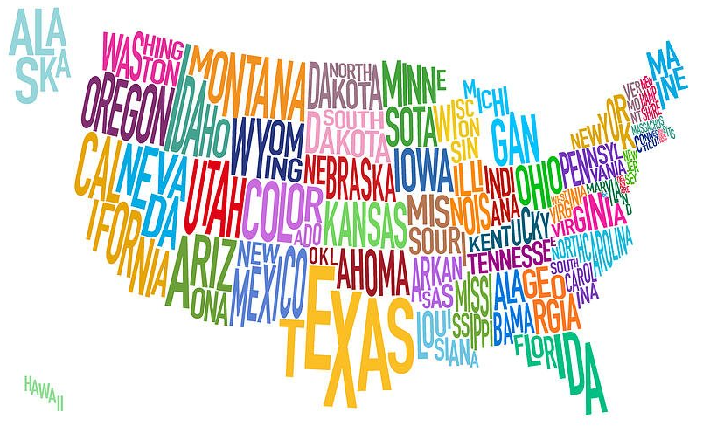
Agenda Item 11- Legislative Update
Minnesota
No specific geospatial legislation
Some related to tracking opioids
NSGIC
Digital Coast Act
Fund NOAA’s Digital Coast Program (ROI of 250%)
NG911 Act
Endorse nationwide deployment of NG911 over 10 years
Provisions related to federal funding (but no specific amounts)
3DEP Authorization & Appropriations

Slide 73
Agenda Item 12
Updates on GAC priority projects and initiatives
Mark Kotz

Slide 74
Agenda Item 12
GAC Rank | Project or Initiative Description | Status | Project Owner | Champion
1 | All Data Free and Open | Active | Len Kne | Dan Ross
2 | Image Service - Sustain | Active | Mike Dolbow | Dan Ross
3 | Address Points Data | Active |  | Dan Ross
4 | Street Centerline Data | Active |  | Dan Ross
5 | Image Service Enhancements | Active | Mike Dolbow | Dan Ross
6 | Archiving Policy/Procedure | Proposed | Ryan Mattke | many
7 | Parcel Data | Active | George Meyer
8 | Updated & Aligned Boundary Data | Proposed | Preston Dowell
9 | Image Service – Dozens of Years | Active | Mike Dolbow | Dan Ross
10 | EM Damage Assess Data Standard | Active | Brad Anderson, Cory Richter
11 | LiDAR data and related standards | Active | Gerry Sjerven
12 | Basemap Services | Active | Sonia Dickerson | Dan Ross
13 | Parks and Trails Data Standard | Active | Jim Bunning | Dan Ross

Slide 75
Agenda Item 12
Image Service Sustainability: Group members (right) established at one point; need a “project manager” or more committed “owner”
Image Service Improvements:
HTTPS available at https://imageserver.gisdata.mn.gov/
Currently investigating Web Mercator via 102100
Robert Bigelow
Jeff Bloomquist
Mike Dolbow
Pete Jenkins
Dennis Kepler
Steve Kloiber
Matt McGuire
Ryan Mattke
Joe Sapletal
Alison Slaats
Annette Theroux
Zeb Thomas
Notes:
This group was established a few years ago – but you can tell it’s old since two original members (Chris Cialek and Ron Wencl) are now retired. And it hasn’t done much because it needs a leader. You can tell that there’s a lot of interest, though.
Details on HTTPS access for the WMS are now published on the MnGeo website. We are looking into the support for 102100; it’s possible that will take less time than we originally thought, but it’s still something that has to be fit inside of our other work.

Slide 76
Agenda Item 13
3D Nation Elevation Requirements and Benefits Study
Gerry Sjerven and Dan Ross

Slide 77
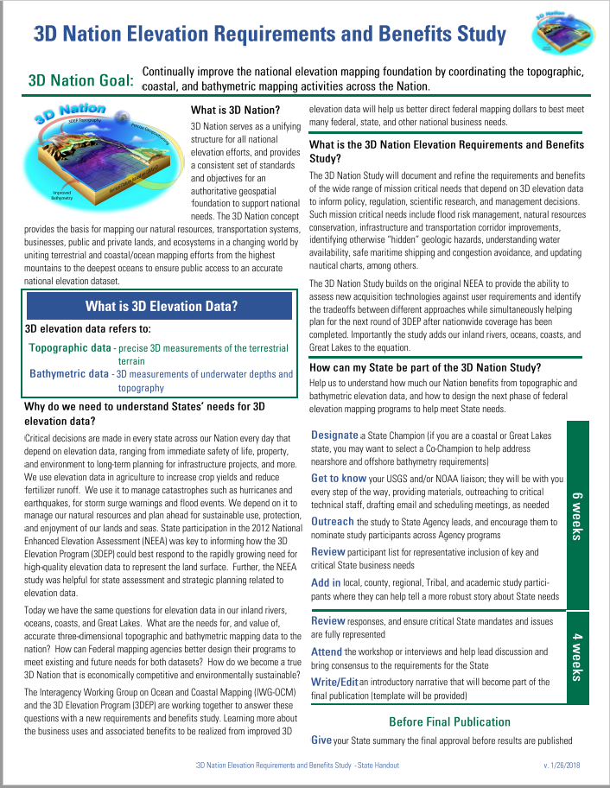
3D Nation Elevation Requirements and Benefits Study
What is the 3D Nation Elevation Requirements and Benefits Study?
The 3D Nation Study will:
Document and refine the requirements and benefits of the wide range of mission critical needs that depend on 3D elevation data to inform policy, regulation, scientific research, and management decisions.
Identify mission critical needs
Provide the ability to assess new acquisition technologies against user requirements
Identify the tradeoffs between different approaches
Help to plan for the next round of 3DEP
The 3D Nation Study builds on the original NEEA
We are here

Slide 78
Agenda Item 14
Announcements or other business

Slide 79
Thank you!
Next meeting is Wednesday, May 30, 2018

