Slide 1

Minnesota Geospatial Advisory Council
May 30, 2018

Slide 2
Welcome
Introductions
Approve agenda
Approve March minutes

Slide 3
Agenda
Time | Topic
11:15 | Review and accept committee summaries
11:20 | Thank you letters to members and supervisors
11:25 | Updates on GAC priority projects and initiatives
11:45 | MnGeo support for priority GAC projects
11:55 | Break, networking
12:25 | MnDOT’s State Plane and Low Distortion Projections Proposals
12:45 | The Value of Accurate Section Corners
1:05 | Modernizing Land Records System
1:25 | Sector report
1:35 | Legislative update
1:40 | Announcements

Slide 4
Agenda Item 2
Review and accept committee summaries

Slide 5
Agenda Item 3
Thank you letters to members and supervisors
Mark Kotz

Slide 6
Agenda Item 3
Thanks member
Educates supervisor about GAC and value of participation (helps justify participation)
Will need list of supervisors’ emails

Slide 7
Agenda Item 4
Updates on GAC priority projects and initiatives
Mark Kotz

Slide 8
Agenda Item 4
GAC Rank | Project or Initiative Description | Status | Project Owner | Champion
1 | All Data Free and Open | Active | Len Kne | Dan Ross
2 | Image Service - Sustain | Active | Mike Dolbow | Dan Ross
3 | Address Points Data | Active |  | Dan Ross
4 | Street Centerline Data | Active |  | Dan Ross
5 | Image Service Enhancements | Active | Mike Dolbow | Dan Ross
6 | Archiving Policy/Procedure | Proposed | Ryan Mattke | many
7 | Parcel Data | Active | George Meyer
8 | Updated & Aligned Boundary Data | Proposed | Preston Dowell
9 | Image Service – Dozens of Years | Active | Mike Dolbow | Dan Ross
10 | EM Damage Assess Data Standard | Active | Brad Anderson, Cory Richter
11 | LiDAR data and related standards | Active | Gerry Sjerven
12 | Basemap Services | Active | Sonia Dickerson | Dan Ross
13 | Parks and Trails Data Standard | Active | Jim Bunning | Dan Ross

Slide 9
Agenda Item 5
MnGeo support for priority GAC projects
Dan Ross

Slide 10

Free and Open Data Proposal
Goal: create an aggregated, standardized layer of parcel data for open data counties
  Notify counties of plans and target date
    Provide opportunity to correct us on the schema translation, raise any concerns
  Update current aggregation code to match new standard
  Publish the layer on the Geospatial Commons

Slide 11
Image Service Sustainability Proposal
Goal: create a “decision matrix” to decide when layers can be retired from the MnGeo WMS service
  Leverage input from volunteers
  Publish matrix for comment
  Determine an archiving path
Of Historical Significance?
Statewide Coverage?
Resolution / Accuracy

Slide 12

Break - Networking

Slide 13
Agenda Item 7
MnDOT’s State Plane and Low Distortion Projections Proposal
Geoff Bitner, MnDOT

Slide 14
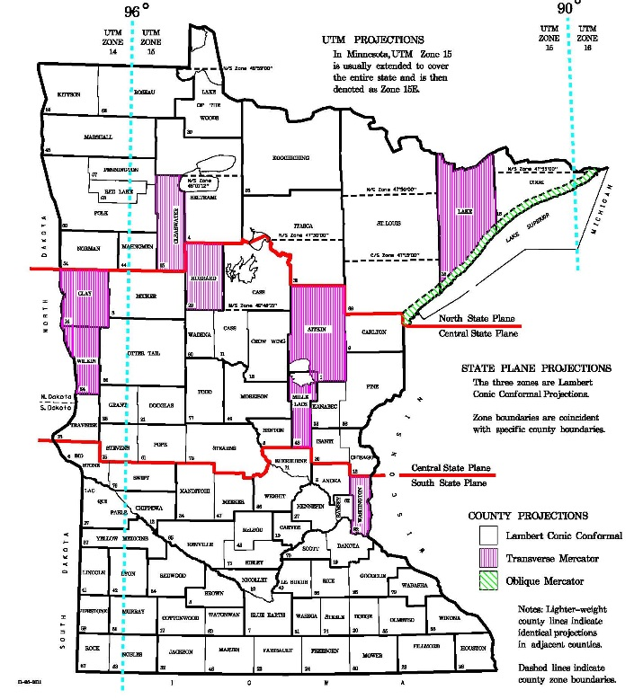
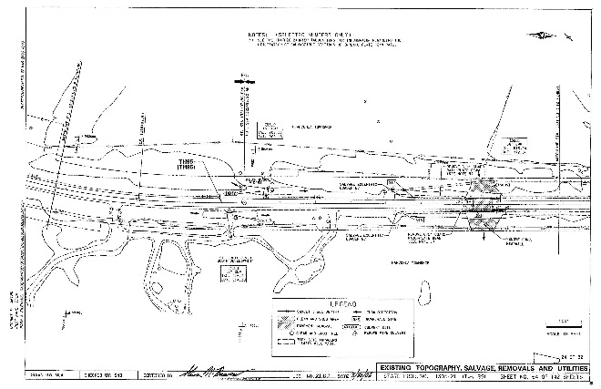
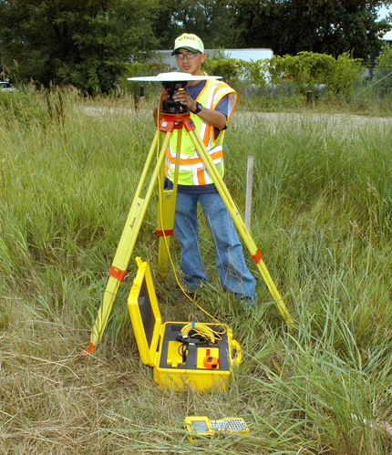
MnDOT’s State Plane &
Low Distortion Projections Proposals
Geoff Bitner, LS & NGS designated State Geodetic Coordinator
Geospatial Advisory Council Meeting
May 30, 2018

Slide 15
MnDOT’s Proposal
The Minnesota Department of Transportation would like to propose to the National Geodetic Survey (NGS) that they redefine Minnesota’s State Plane Coordinate System from the current three zones to a single zone.
To make such a proposal requires a coordinated request from stakeholders (DOT, GIS or Cartographer offices, professional societies, etc.).

Slide 16
Purpose of Today’s Presentation
Gain support for a single State Plane zone
Provide background and justification information to support the proposal
Present MnDOT’s plan to upgrade the County Coordinate System
Answer questions

Slide 17
Background and Justification Information

Slide 18
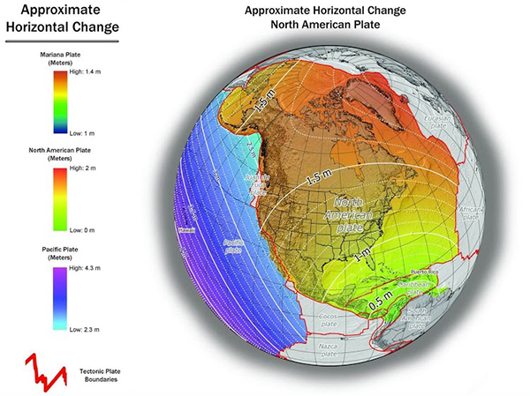
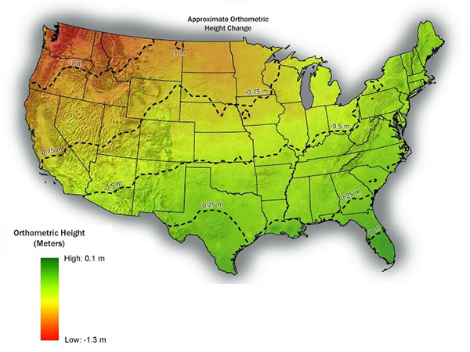
Background & Justification Information
New datum in 2022 (Reference Frame)
Expect coordinate shifts of ≈ 1.0m-1.5m
Expect elevation shifts of ≈ -0.75m

Slide 19
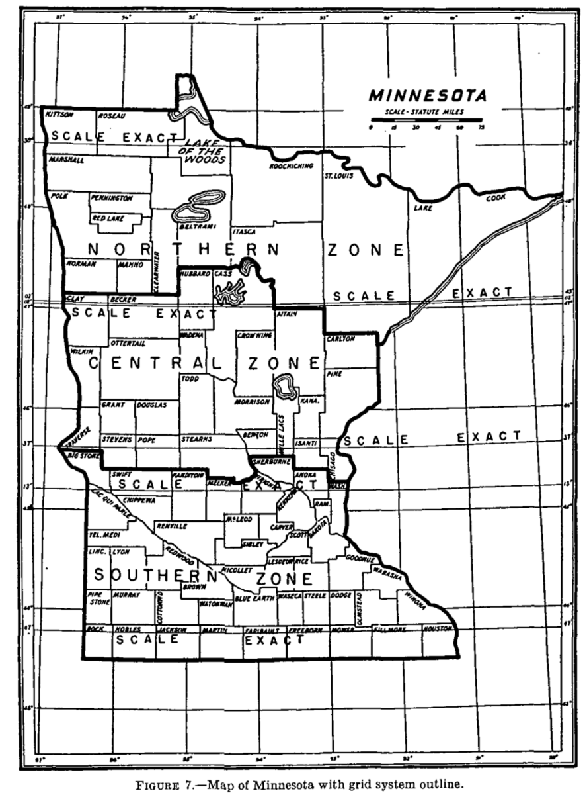
Background & Justification Information
A Little History
Developed in 1930s
Considered a practical solution for engineering
Three zones in MN
Distortions ≈ 1:10,000 on the ellipse or ≈ ½ ft/mile
Never really “took off”
Notes:
See page 2, https://www.ngs.noaa.gov/PUBS_LIB/ManualNOSNGS5.pdf
Minnesota State Plane Coordinate System
The State Plane Coordinate (SPC) system was introduced nationally in the 1930s by the U.S. Coast & Geodetic Survey to accommodate the needs of surveying, mapping and engineering projects. Based on both the Lambert Conformal Conic and Transverse Mercator projections, State Plane Coordinate systems were developed for every state such that there would be no more than one foot of distortion in every 10,000 feet of distance (on the ellipsoid). The scale of the Lambert Conformal Conic projection varies from north to south: therefore, it is used mostly for areas that extend in an east-west direction. The Transverse Mercator projection varies in scale in an east-west direction, making it most suitable for areas primarily extending north and south.
There are three zones in the Minnesota State Plane Coordinate System: South, Central, and North. All are based on the Lambert Conformal Conic projection. The division between adjacent zones occurs along various county lines. Figure 2-(reference full page image on page 14) shows the boundaries of the three zones. Provision for overlap exists, so points near a boundary may be calculated on each of the two pertinent zones.
Each state plane is an imaginary plane surface that cuts through the surface of the earth along two latitudinal lines within the zone. It is along these lines that the scale factor is 1.0. In the center of a zone the plane is below the ground surface, while it is above the ground in the northern and southern portions of the zone.
For the NAD 27, the state plane coordinates are x and y values on a Cartesian grid in units of feet, whose ranges of values are from 1,000,000 to 10,000,000 feet for x and 100,000 to 1,000,000 feet for y. When NAD 83 was developed by the National Geodetic Survey, the SPC system was redefined based upon the NAD 83 datum and published in meters, rather than feet. In addition, SPC 83 was assigned a different false easting and false northing than SPC 27 so that coordinate values in the two systems could easily be distinguished.
Page 138 of Special Publication 1936
For these reasons the Lambert conformal projection with three zones was adopted for Minnesota. (See fig. 7.) It will be noticed
that the junction lines between adjacent zones follow the county boundary lines; and therefore all stations in any county are included
in the same zone. Since, however, some surveys will extend across these artificial boundaries, the coordinates of stations which lie
within what may be termed the borderland of two contiguous zones are given on both systems. With these data, in extending a survey
a short distance beyond a boundary, the engineer will not have to go from one system of coordinates to the other. Care must always be
taken, however, to use in direct combination only coordinates which are given (311 the same system. Where it is necessary to go from one system to another, suitable directions for so doing will be found in Special Publication No. 193.
Horizontal Reference – Horizontal Control, NOAA Technical Report NOS 88 NGS 19, June 1980, page 23-24
About I 932, a decision was made to compute plane coordinates from the geographic positions and to publish this information as part of the horizontal control data. A careful study was made by O.S. Adams to determine what types of projections would be most suitable as bases for plane coordinate systems, as well as the most desirable size for the area to be included in each independent zone. He found that the Lambert conformal conic projection was excellent for areas of greatest extent in an east-west direction and the transverse Mercator projection for
areas of greatest extent in a north-south direction. Regarding the size of the area, the individual counties were considered to be too small, as their use would have involved frequent zone changes. Many States were too large to be considered as a single zone. The criterion finally adopted made the area such that the maximum scale error would rarely exceed 1 in I 0,000. This meant that the larger States had to be divided
into two or more zones with widths not greater than about 158 miles. The boundaries between zones were made to follow county boundaries so that only one zone would be needed in any one county. Liberal overlaps of the zones were provided in the computation of coordinates. Today, this policy is still followed by NGS and will be retained in the new adjustment.
Using the State Plane Coordinate Systems
Plane coordinates for stations established or for values published by the NGS are computed immediately after the adjustment is completed. To avoid negative values for the station coordinates, a constant is added to the x values derived by the computations. The essential plane coordinate data for a station consist of the following items: the name of the State, the designation of the zone used as a basis for the computations, the x and y coordinates of the station in feet (latest listings also shown in meters), the mapping angle or the difference between geodetic and grid azimuths at each station, which is known as the (} or .6.a angle, and finally the grid azimuth of at least one line radiating from the station.
Other azimuths may be derived by direct computation simply by differencing the coordinates and using standard trigonometric formulas that are well known to surveyors and engineers. On those occasions when geodetic azimuths are available, the grid azimuths can be obtained by applying the mapping angle for the station of interest. Forward and back grid azimuths should differ by exactly 180°. However, when employing the mapping angle, there may be small differences, especially when the stations are located at some distance north or south from the central parallel for the Lambert projection and east or west of the central meridian where the transverse Mercator grid is employed. These differences are identified as the second term or (t-T) corrections. They can be computed by the formulas given with the plane coordinate projection tables available for each State, Puerto Rico, the Virgin Islands, and American Samoa (U.S. Coast and Geodetic Survey). Acceptable approximations may be computed using simplified formulas given in Technical Report 36, Geodetic and grid angles-State coordinate systems (Simmons 1968). If a station is near the edge of a zone, coordinate data on the adjacent zone are also given so that the user may use whichever zone is most convenient and avoid the additional computations required to change from one zone to another.
One difficulty with plane coordinates is that the area covered by a single zone is limited in extent, because it is impossible to represent a large
area of the Earth's surface on a plane surface without serious distortions. This means that surveys covering fairly large areas will sometime include stations in more than one plane coordinate zone. Another difficulty is that the grid azimuths at a station will not be referred to the true meridian except for stations located at the central meridian on which that particular State plane coordinate system is based. In other words, the convergence of the meridians cannot be incorporated in a rectangular system of coordinates. However, it can easily be computed and the true meridian passing through each point determined. One other minor difficulty should be mentioned. If optimum accuracy is desired in surveys
based on these coordinates, scale factors must be used in certain areas of each coordinate zone. The scale factor is unity along two lines in each zone, but is less than unity between these lines and greater than unity outside them. The size of the factor in each case depends upon the distance from the lines.

Slide 20
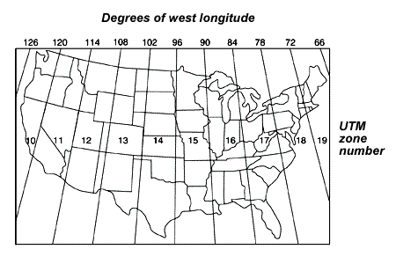
Background & Justification Information
Current Statewide & Regional Mapping
UTM misused for statewide mapping

Slide 21
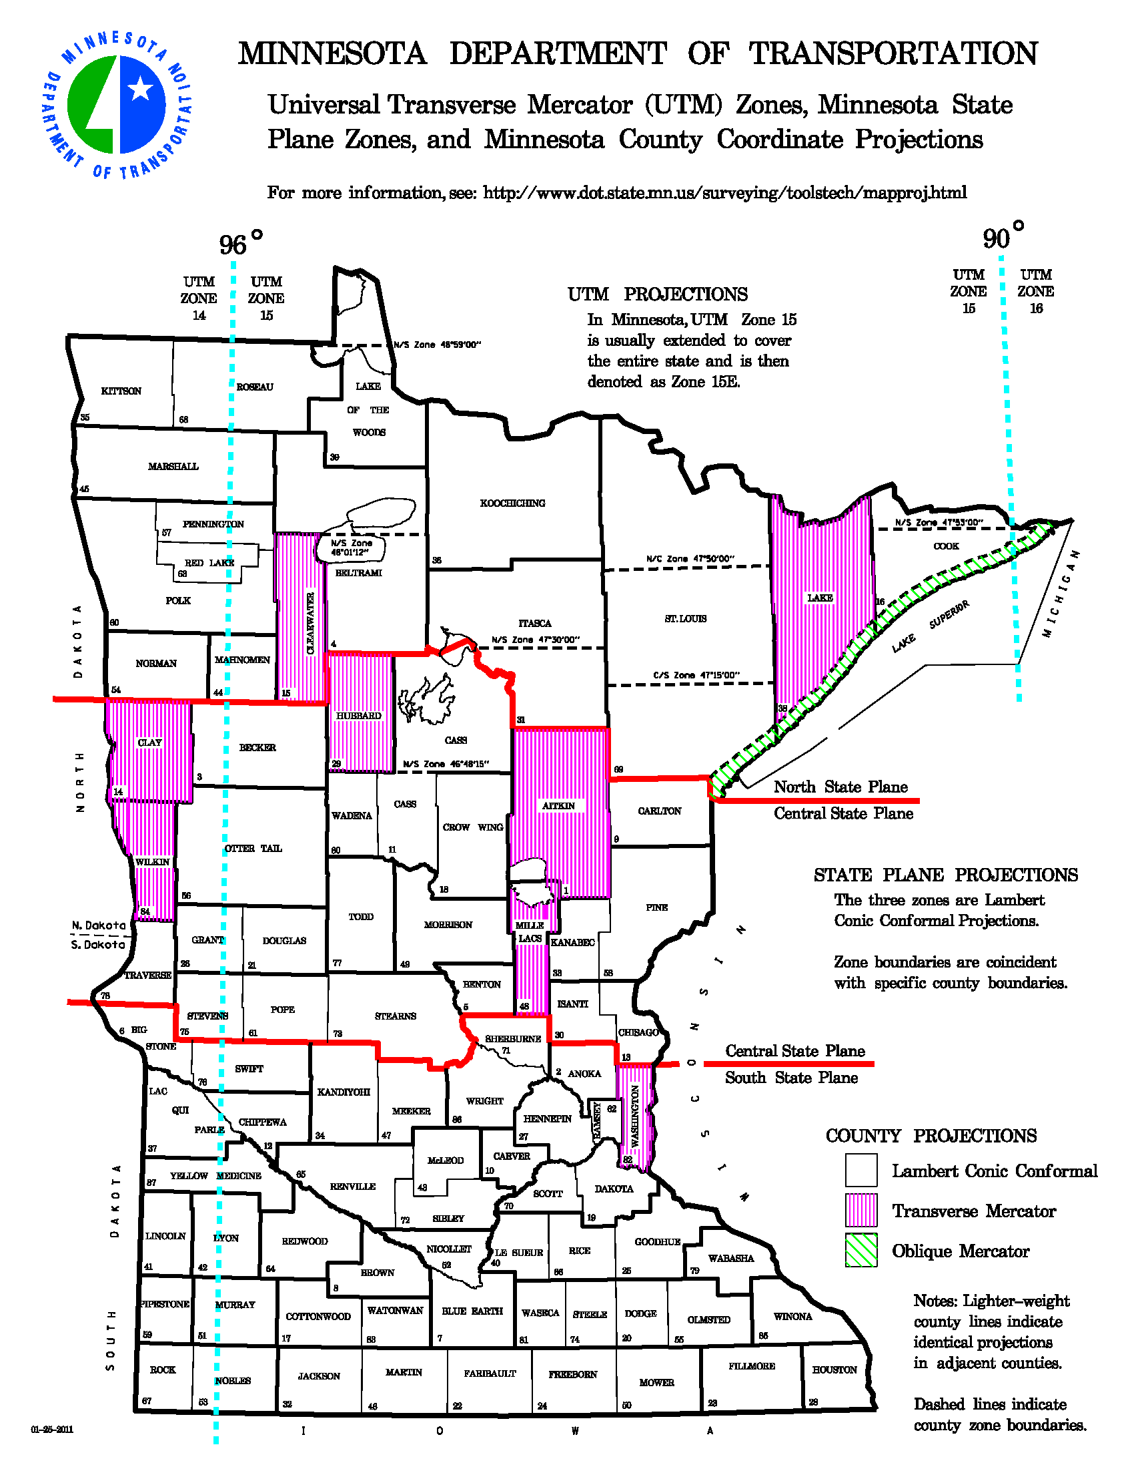
Background & Justification Information
Current Statewide & Regional Mapping
UTM misused for statewide mapping
Becomes problematic when using GPS and online positioning services
Distortions ≈ 1:2,500 that’s ≈ 2 ft./mile

Slide 22
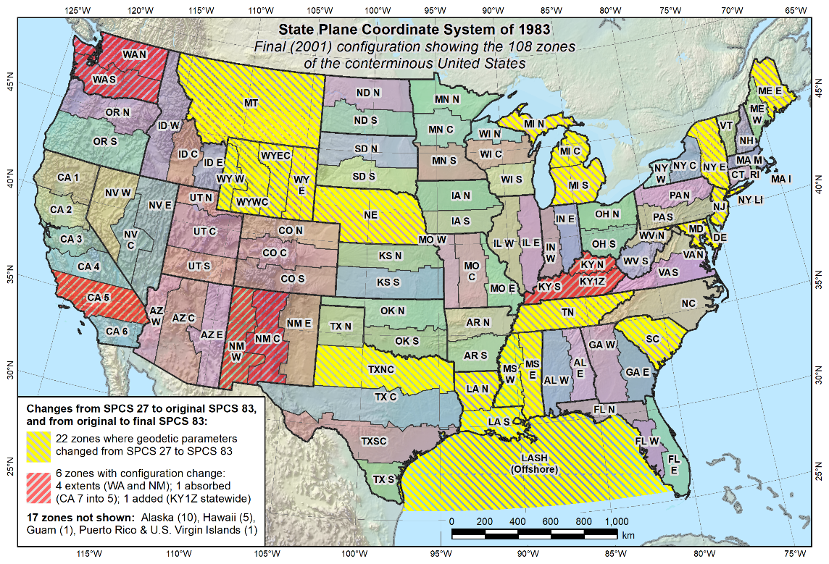
Background & Justification Information
The Proposal
A single zone like:
  Montana
  Nebraska
  Tennessee
  South Carolina

Slide 23
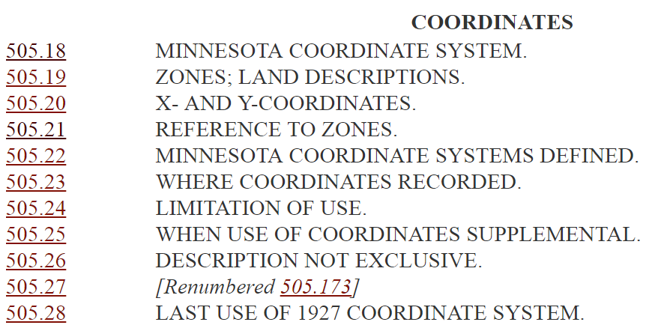
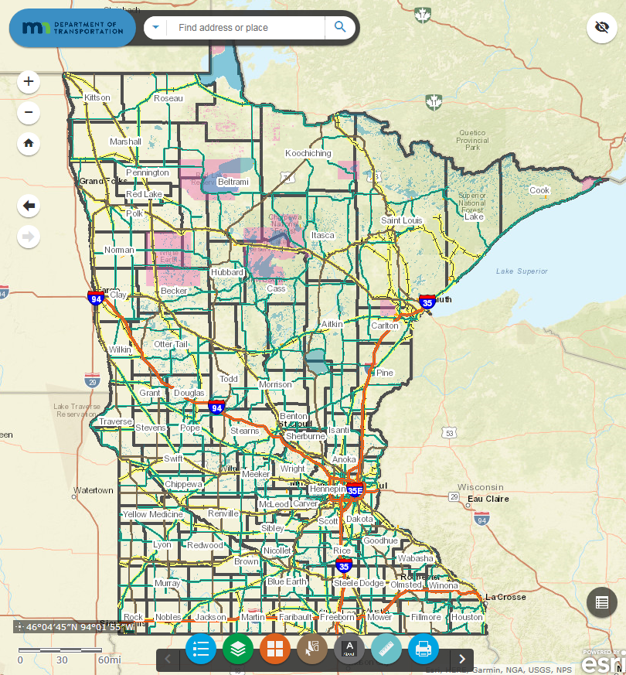
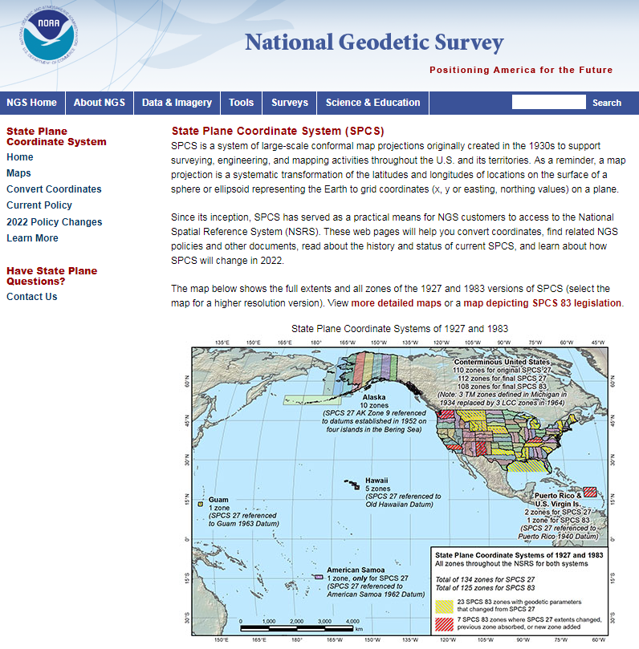
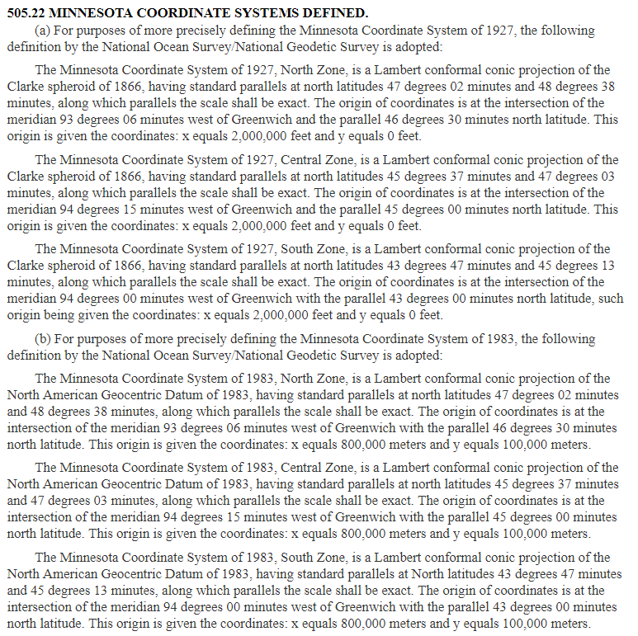
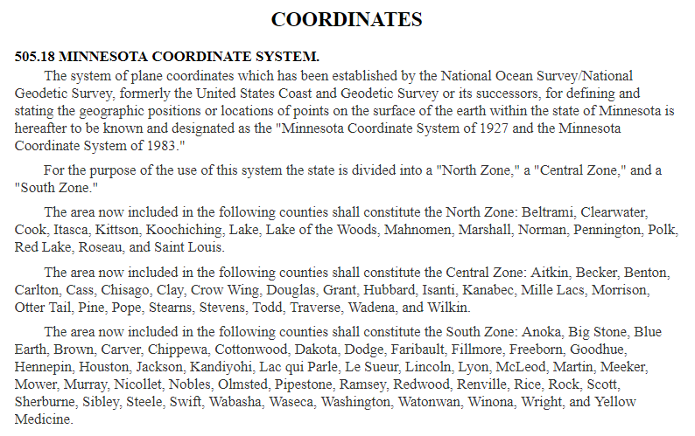
Background & Justification Information
Justification
Current SPCS not used
UTM is misused
Simplify legislation
NGS will do the work
Provide a legitimate coordinate system for regional and statewide planning purposes

Slide 24
MnDOT’s Low Distortion Projections Project

Slide 25
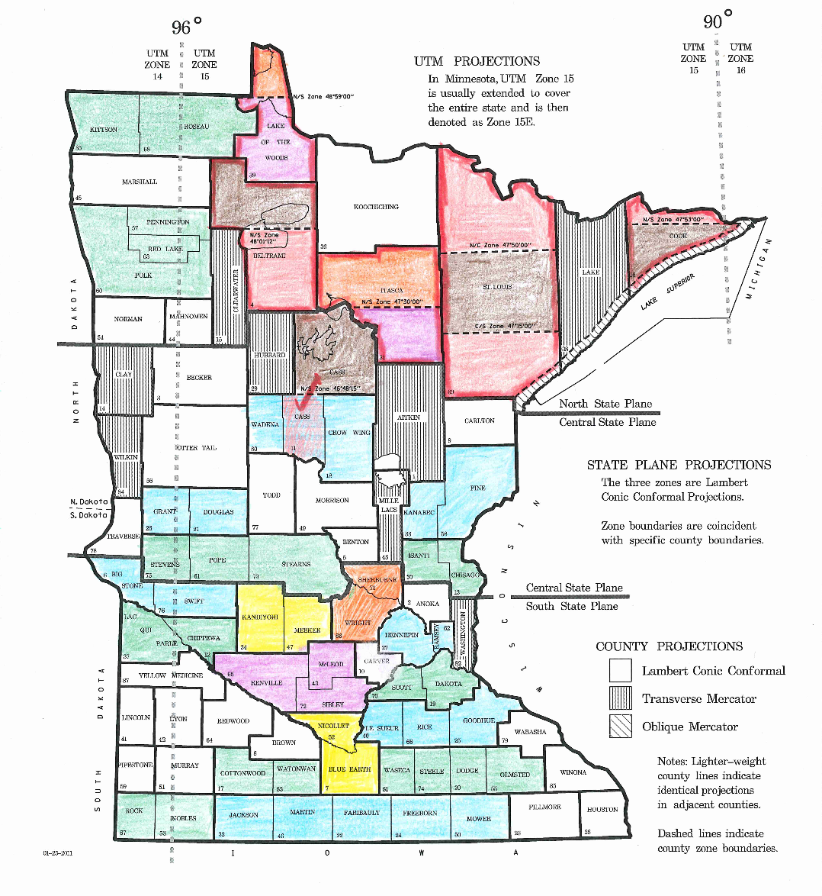
Current County Coordinate System
Background
87 Counties
67 unique ground planes
  Multiple names for a single set of parameters
  Ex. – Jackson, Martin, Faribault, Freeborn, & Mower – all share the same semi-major & minor axis, parallel, origin, etc.

Slide 26
Current County Coordinate System
Background
87 Counties
67 unique ground planes
Low distortions ≈0.10ft/mile

Slide 27
Current County Coordinate System
Background
87 Counties
67 unique ground planes
Low distortions ≈0.10ft/mile
Based on a modified ellipsoid
Low Distortion Projection
Earth Surface
Ellipsoid
State Plane/UTM
Notes:
3. Scale an existing published map projection “to ground”.
Referred to as “modified” State Plane when an existing SPCS projection definition is used.
Problems:
• Generates coordinates with values similar to “true” State Plane (can cause confusion).
Can eliminate this problem by translating grid coordinates to get smaller values.
• Often yields “messy” parameters when a projection definition is back-calculated from the
scaled coordinates (in order to import the data into a GIS).
More difficult to implement in a GIS, and may cause problems due to rounding or
truncating of “messy” projection parameters (especially for large coordinate values).
Can reduce this problem through judicious selection of “scaling” parameters.
• Does not reduce the convergence angle (it is same as that of original SPCS definition).
In addition, the arc-to-chord correction may be significant; it can reach ½ arc-second
for a 1-mile line located 75 miles from the projection axis (this correction is used
along with the convergence angle for converting grid azimuths to geodetic azimuths).
• MOST IMPORTANT: Usually does not minimize distortion over as large an area as
the other two methods.
Extent of low-distortion coverage generally decreases as distance increases from
projection axis (i.e., central meridian for TM and central parallel for LCC projection).
State Plane axis usually does NOT pass through the project area and may be oriented
perpendicular to the long dimension of a project, decreasing area of coverage.

Slide 28
Current County Coordinate System
Background
87 Counties
67 unique ground planes
Low distortions ≈0.10ft/mile
Based on a modified ellipsoid
Earth Surface
Ellipsoid
Notes:
2. Scale the reference ellipsoid “to ground”.
A map projection referenced to this new “datum” is then designed for the project area.
Problems:
• Requires a new ellipsoid (datum) for every coordinate system, which makes it more
difficult to implement than an LDP.
• New datum makes it more complex than an LDP, yet it does not perform any better.
• Generates new set of latitudes that can be substantially different from original latitudes.
Change in latitude can exceed 3 feet per 1000 ft of topographic height, depending on
method used for scaling the ellipsoid (this case is for scaling with constant flattening).
Can lead to confusion over which latitude values are correct.

Slide 29
Current County Coordinate System
Background
87 Counties
67 unique ground planes
Based on a modified ellipsoid
Low distortions ≈0.10ft/mile
Issues With Current County Coordinate System
Multiple names for single set of parameters
Difficult to model parameters in GIS
Inconsistent with modern practice

Slide 30
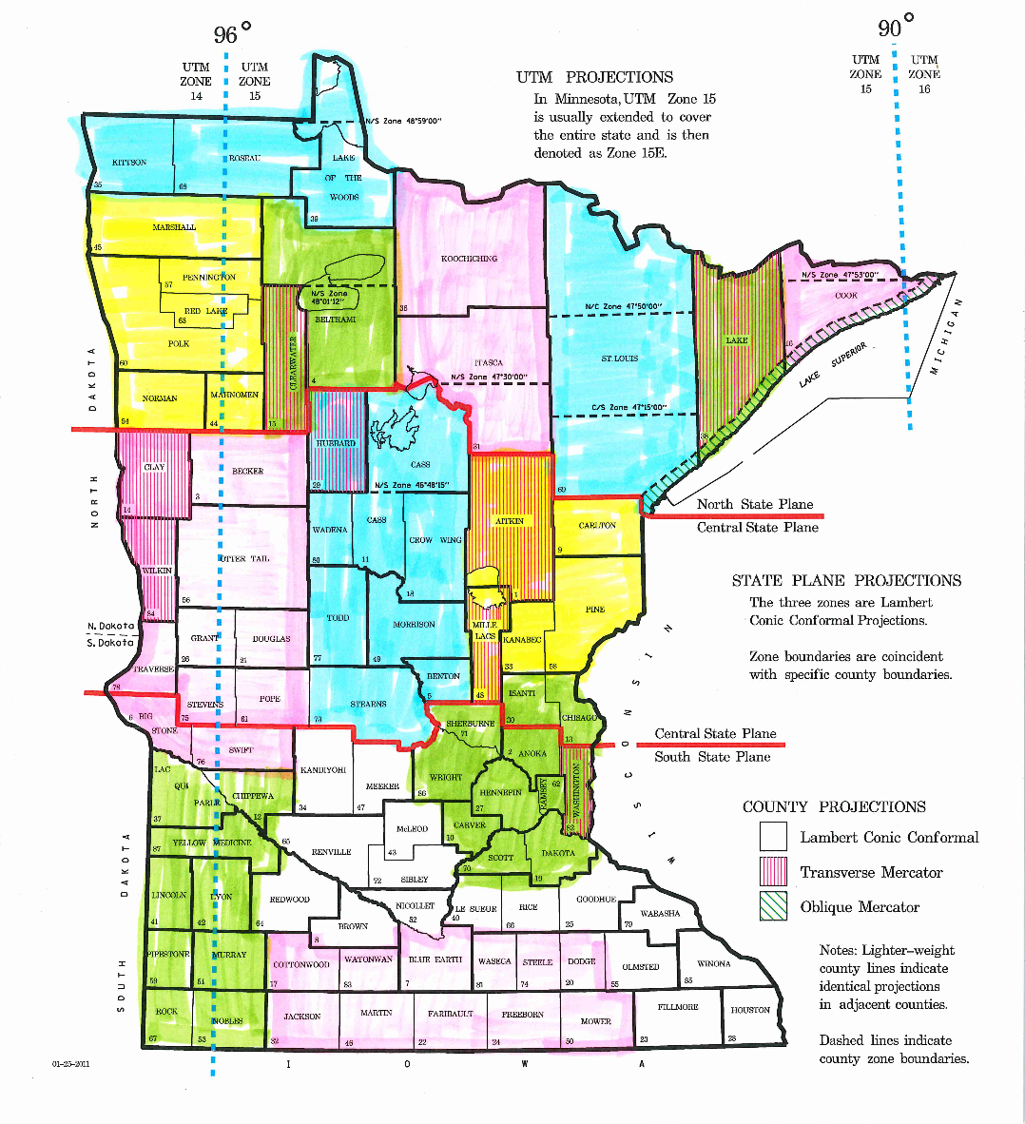
New Low Distortion Projections
Proposed Characteristics
Regional approach
  Reduce zones from
  67 to ≈ 20
Zone parameters limited to 70 miles wide, elev. change <800ft to achieve ≈ 0.10ft/mile
In keeping with modern practice
NGS may host as “special purpose zones”

Slide 31
Summarize So Far
Proposal for a Single Zone State Plane Coordinate System
Current system is unused
UTM is misused
Opportunity is now
Develop a new LDP, Regional Coordinate System
Current county system is outdated and doesn’t follow modern practice
Opportunity is now

Slide 32
Timeline and Next Steps
Development of new datum (reference frame) is driving this proposal and timeline
National Geodetic Survey is developing the new datum for release in 2022

Slide 33
Timeline and Next Steps
August 31, 2018
  Accepting comments on Federal Register notice
Usage of current SPCS in your organization…
Whether the proposed default SPCS2022 definitions will impose a hardship or be beneficial…
Whether there is insufficient or excessive flexibility in the characteristics of SPCS2022…
Whether the deadlines are acceptable and realistic…
Use of “special purpose” zones…
Notes:
https://www.federalregister.gov/documents/2018/04/18/2018-08141/policy-and-procedures-documents-for-the-state-plane-coordinate-system-of-2022
Usage of current SPCS in your organization, how your organization expects to use SPCS2022, and whether it will facilitate migration to the 2022 TRFs.
Whether the proposed default SPCS2022 definitions will impose a hardship or be beneficial to your organization.
Whether there is insufficient or excessive flexibility in the characteristics of SPCS2022 that can be established through user input.
Whether the deadlines are acceptable and realistic for making requests or proposing characteristics for SPCS2022.
Whether including “special purpose” zones as part of SPCS2022 would be beneficial, problematic, or irrelevant to your organization.

Slide 34
Timeline and Next Steps
August 31, 2018
  Accepting comments on Federal Register notice
December 31, 2019
  Request for single zone
Request for design change
Point of contact
List of state stakeholders with contact for each group
Design criteria
Notes:
https://geodesy.noaa.gov/INFO/Policy/files/DRAFT_SPCS2022_Procedures.pdf
2. Requirements for stakeholder requests and proposals of SPCS2022 designs
a. Must comply with all SPCS2022 policies and procedures, including all technical specifications.
b. Applies to requests and proposals for initial designs of SPCS2022 and modifications of existing SPCS2022 zones.
c. The required information can be supplied using the NGS SPCS2022 Request and Proposal Form, available at https://geodesy.noaa.gov/SPCS/.
Remark: When these procedures are approved, the following listed requirements will be removed from the procedures and placed in a form available from the NGS website.
State whether it is a request for designs by NGS or a proposal for designs by a contributing partner.
ii. Name and contact information for at least one main point of contact for the overall submittal.
iii. List of the state stakeholder organizations supporting the submittal. For submittals from national or regional multi-state organizations, such organizations can be listed as stakeholders, but at least one state stakeholder organization for the affected state(s) must be included.
iv. Name and contact information for at least one point of contact for each listed stakeholder group. The main point of contact can fulfill this role for one or more
stakeholder groups (for example, a representative of a state DOT who is also an officer in a state professional surveying or engineering association).
v. Distortion design criterion (for example ±50 ppm for all zones within a state).
vi. Provide expected number of zones (can be estimated if not known exactly) and a description of how the zone boundaries will be defined. Zones may be defined using irregular polygons, such as counties, groups of counties, aggregated townships, DOT districts, etc., or by using rectangular latitude and longitude bounds. The actual zone extents are provided as part of the design submittal (see Section 3).
vii. Projection types (if known). It is sufficient to state that projection types will be determined in the design process.
viii. If output of SPCS2022 coordinates in feet are desired, specify the type of foot (international or U.S. survey). Note that the type of foot used cannot conflict with
relevant state statute. If there is supporting statute (or similar authoritative record), provide a reference to the relevant source.
ix. Preferences (if any) for grid origin false northing and easting values within the zone(s).
x. Specify a single 2022 Terrestrial Reference Frame to which the zones are referenced (North American, Caribbean, Pacific, or Marianas).
d. Providing all required information is the responsibility of the submitter.
e. Proposed designs by contributing partners must be approved by NGS before any submitted designs will be reviewed by NGS.

Slide 35
Timeline and Next Steps
August 31, 2018
  Accepting comments on Federal Register notice
December 31, 2019
  Request for single zone
December 31, 2020
  Request to host LDP
MnDOT is developing new zones
Will need to solicit support from stakeholders
Submit to NGS

Slide 36
Action Items
MnDOT requests that the Geospatial Advisory Council:
Review the Federal Register notice
Direct concerns and questions about a single zone State Plane Coordinate System proposal to Geoff Bitner, MnDOT
If the Council agrees with the proposal, prepare to support MnDOT as discussed

Slide 37
Links to Federal Register &
NGS Policy, Procedure, and SPCS website
Federal Register - https://www.federalregister.gov/documents/2018/04/18/2018-08141/policy-and-procedures-documents-for-the-state-plane-coordinate-system-of-2022
NGS Draft Policy - https://geodesy.noaa.gov/INFO/Policy/files/DRAFT_SPCS2022_Policy.pdf
NGS Draft Procedure - https://geodesy.noaa.gov/INFO/Policy/files/DRAFT_SPCS2022_Procedures.pdf
NGS State Plane Coordinate System website - https://www.ngs.noaa.gov/SPCS/index.shtml

Slide 38
Questions?
Geoff Bitner, LS
geoffrey.bitner@state.mn.us
651-366-3490

Slide 39
Agenda Item 8
The Value of Accurate Section Corners
Chris Mavis

Slide 40
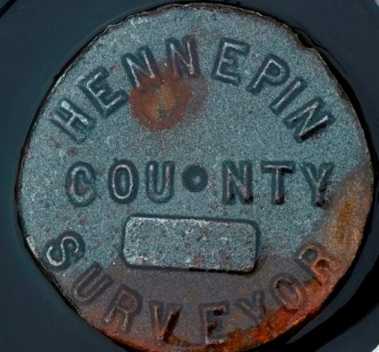
The Value of Accurate PLSS Corners
Notes:
PLSS Framework 1 mile squares
Things that pin done the framework are the corners
Vocabulary

Slide 41
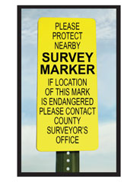
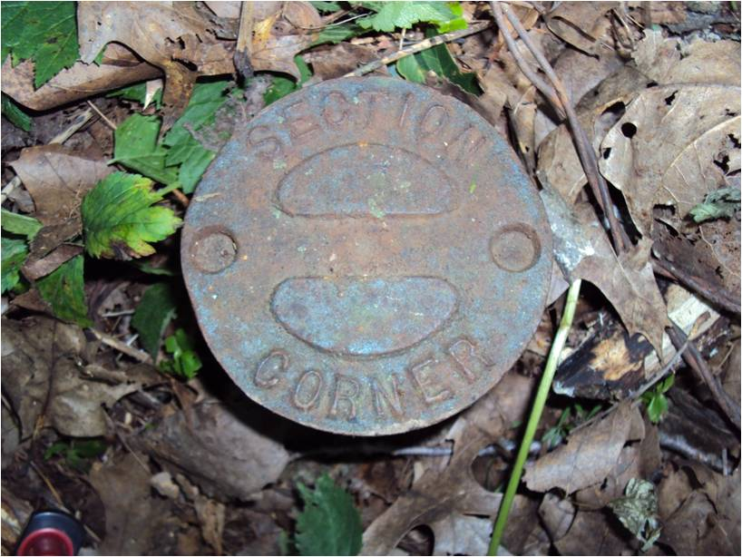
Why corners matter
Define the boundaries of nearly every property in Minnesota
Land Surveyors still use PLSS corners to define boundaries
The PLSS is the framework for a lot of digital data

Slide 42
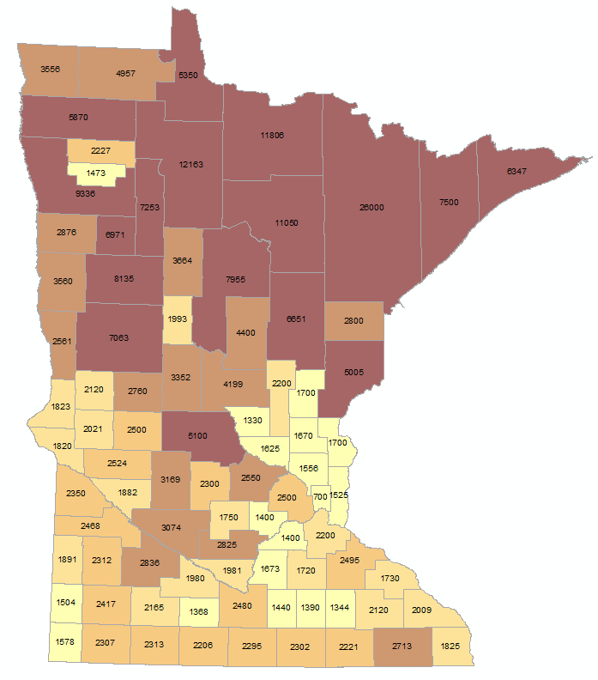
PLSS Corners by the numbers
Notes:
From 700 in Ramsey, 2500 in Hennepin to 26000 in St Louis

Slide 43

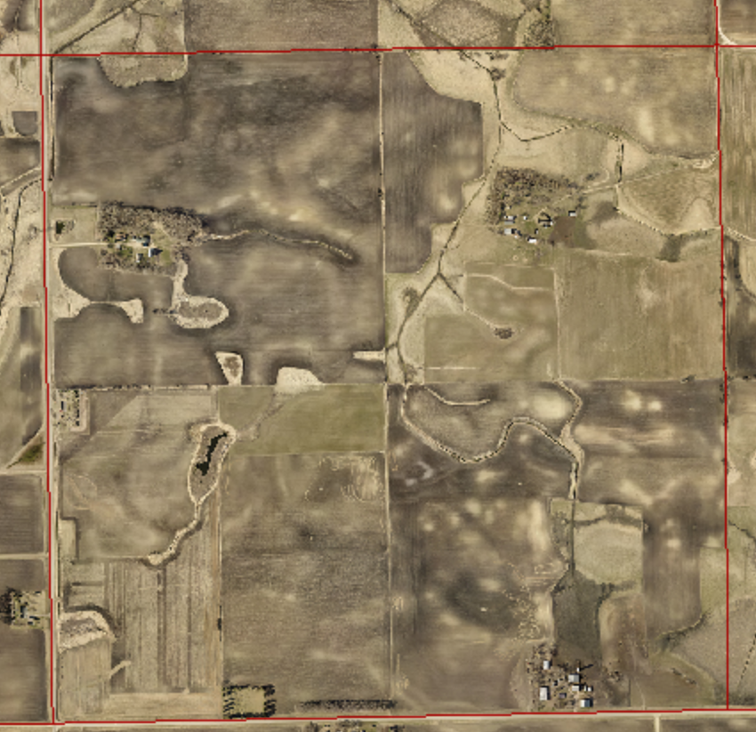
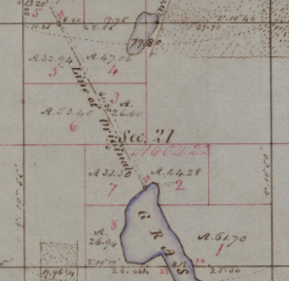



Corners drive economics
Notes:
Economic value was driven by the first settlers buying land based on the PLSS framework
Further subdividing the land
Defining natural resource boundaries
Establishing farms
Building cities
All based on the PLSS corners

Slide 44
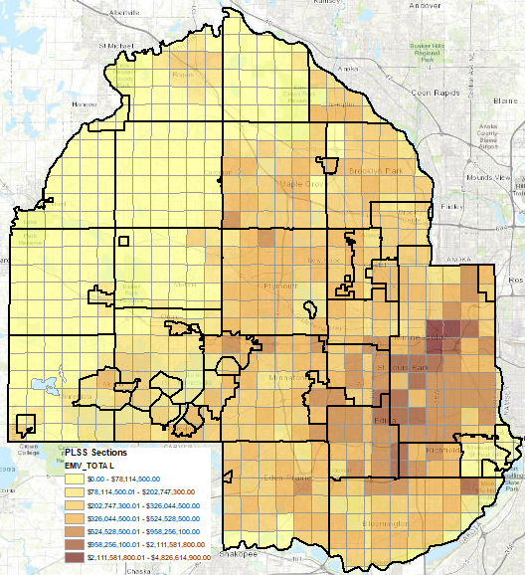
Value in dollars
Notes:
162 billion dollars of EMV
425k parcels
Increasing data and higher expectations for consumption

Slide 45
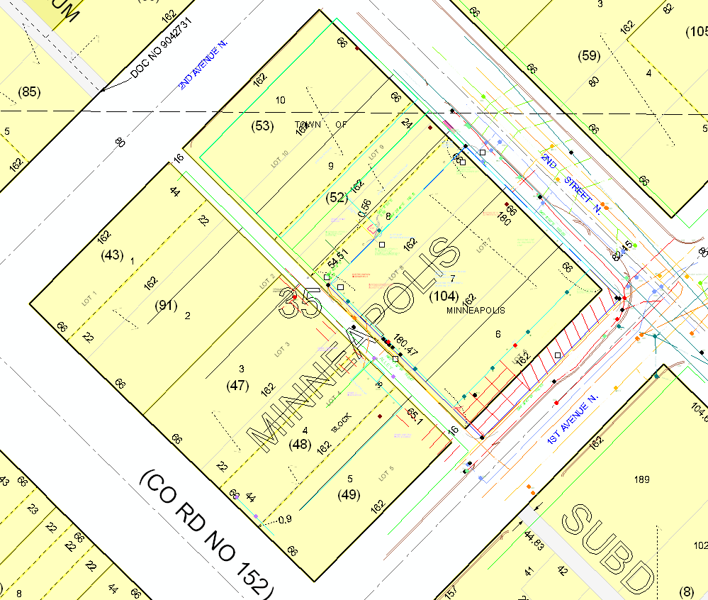
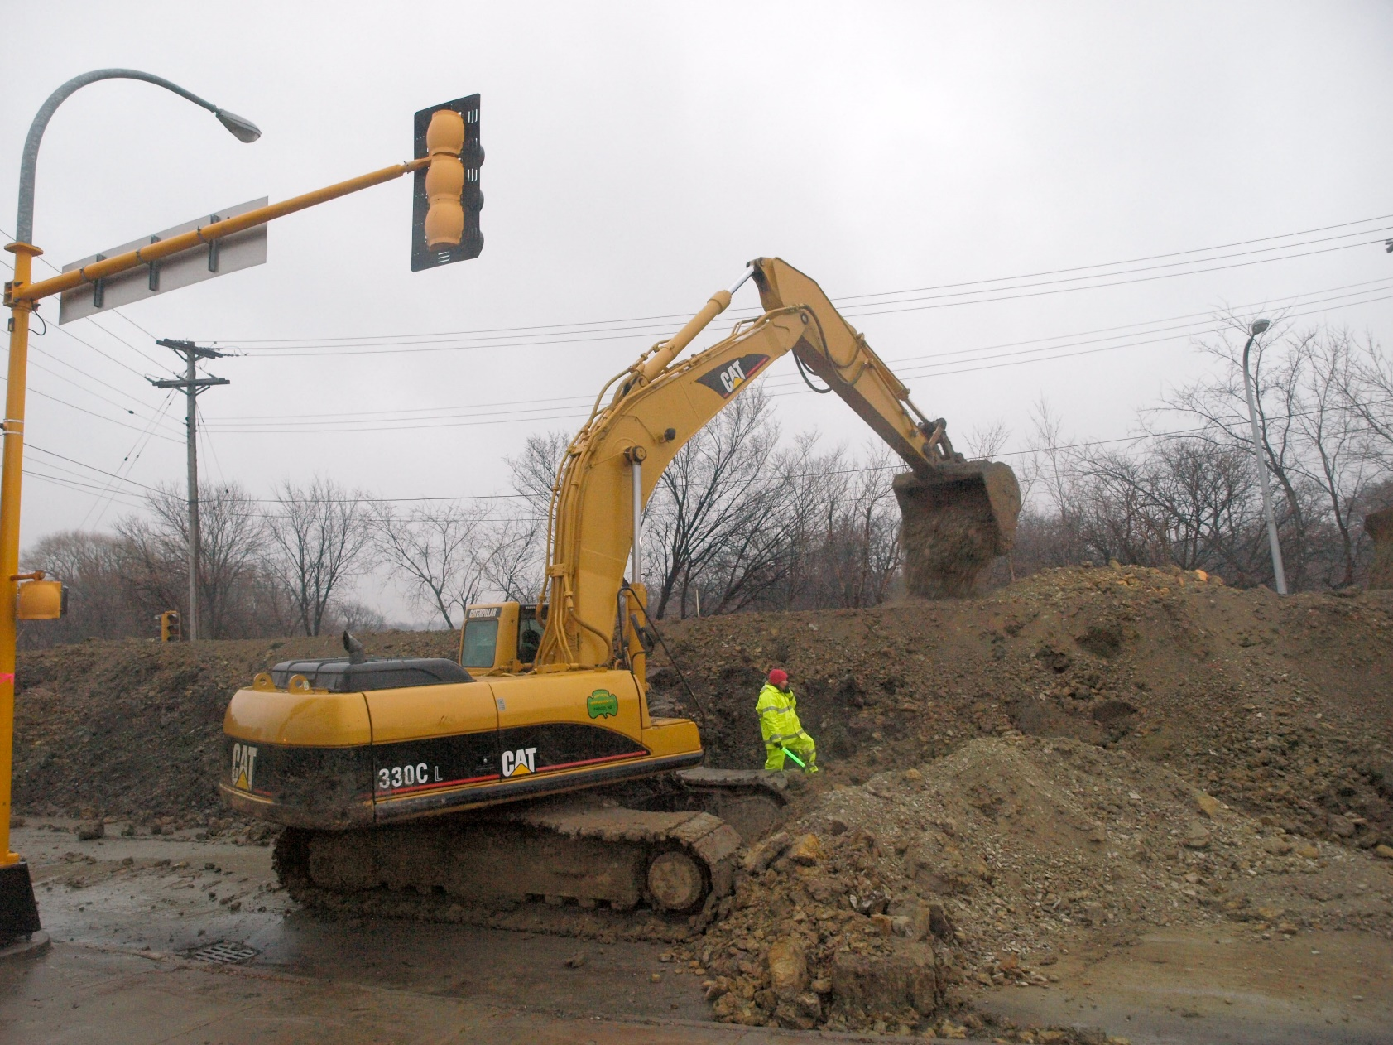

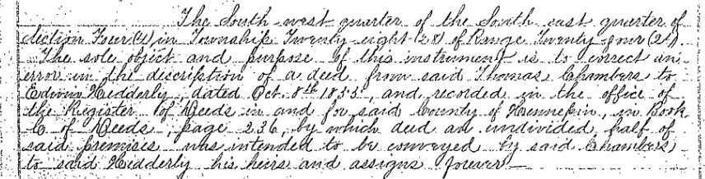
Accurate corners insure location
This Photo by Unknown Author is licensed under CC BY-SA
Notes:
Value is derived from accuracy. Decisions have a greater certainty with higher accuracy.
Accurate corners insure location in the field and digitally for:
Legal descriptions
New plats tied into PLS corners
Easements for waterways
Infrastructure
Digital data (increasing demand and expectation for)
Lack of confidence = Time & MONEY

Slide 46
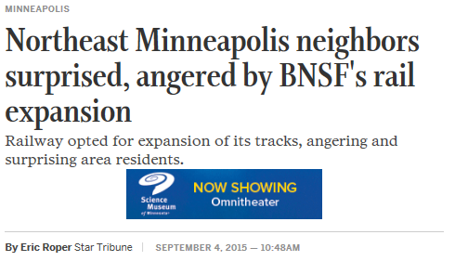
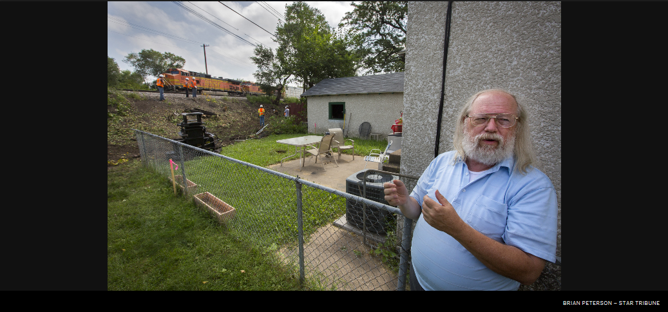
A short story

Slide 47
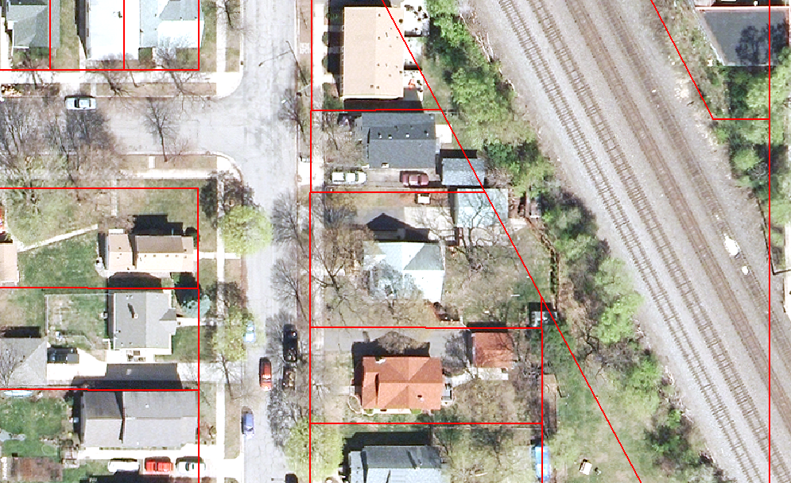
Before
Notes:
Our digital data was a mess and data consumers didn’t have a high degree of confidence in it

Slide 48
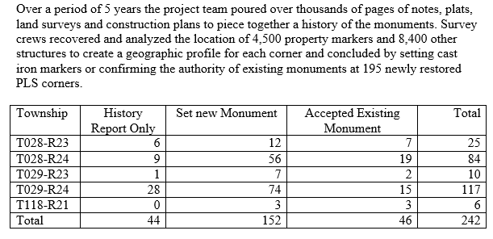
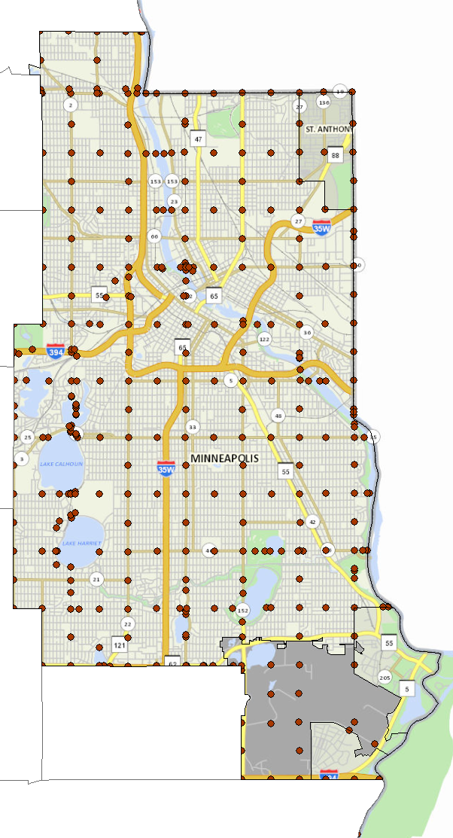
Minneapolis remonumentation
Notes:
A Mpls remonumentation story that shows the intersection of the real and digital worlds

Slide 49
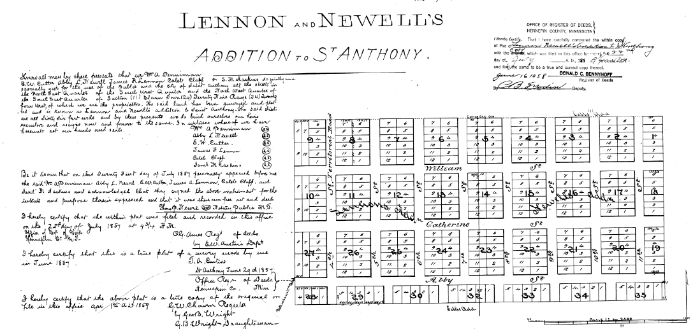
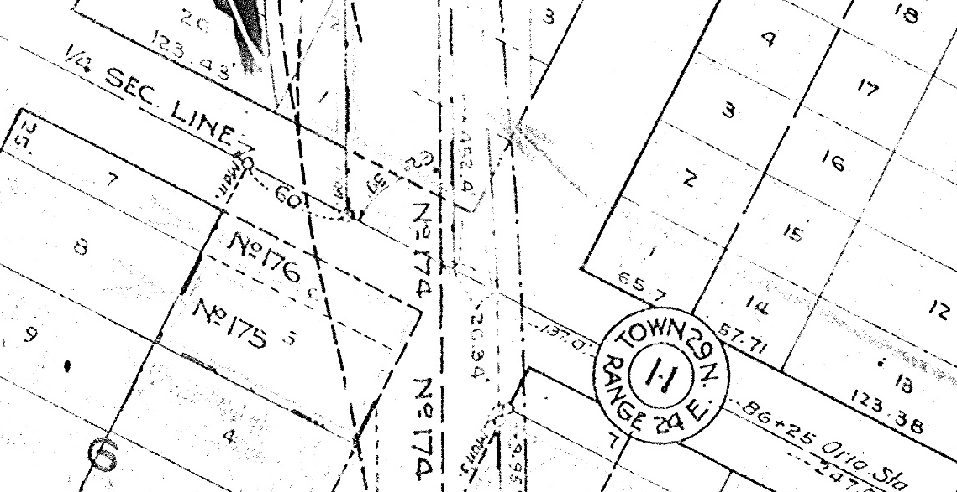
Corners for analysis

Slide 50
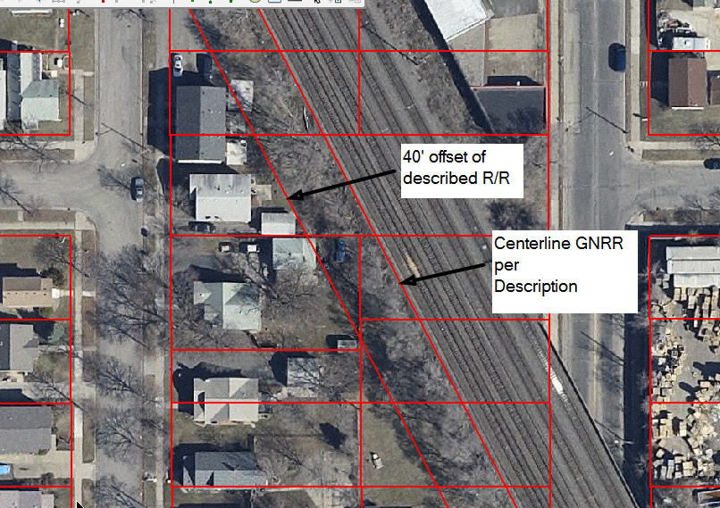
Confidence in results

Slide 51
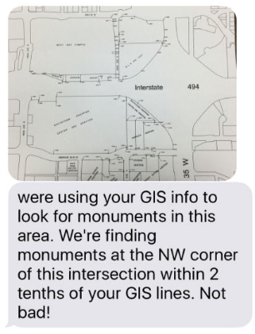
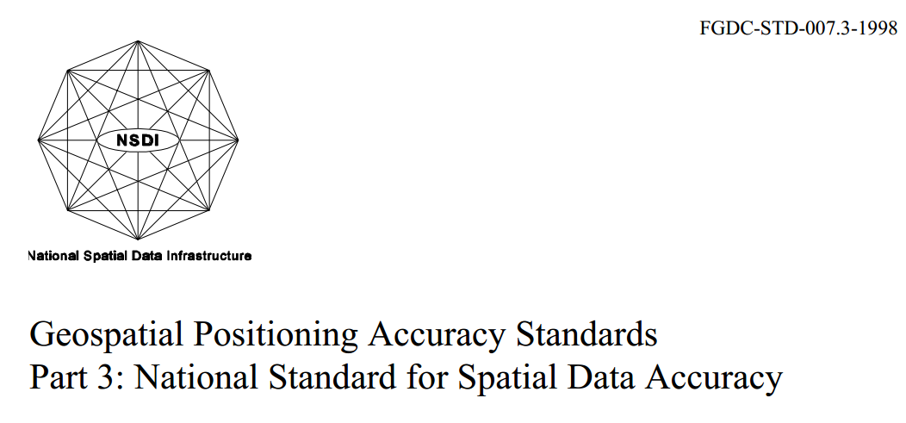
Trust in location
2.27294941947 | 95% Confidence
Notes:
NSSDA study

Slide 52
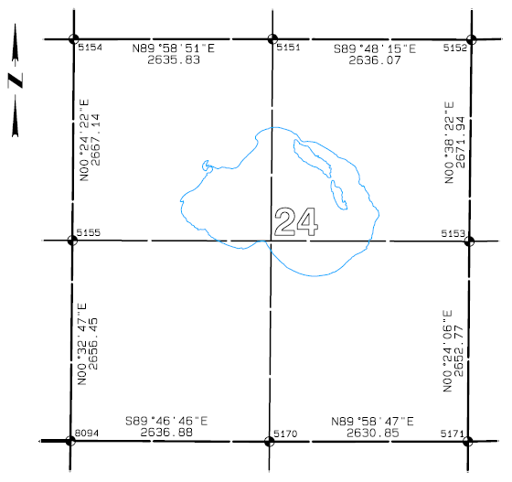
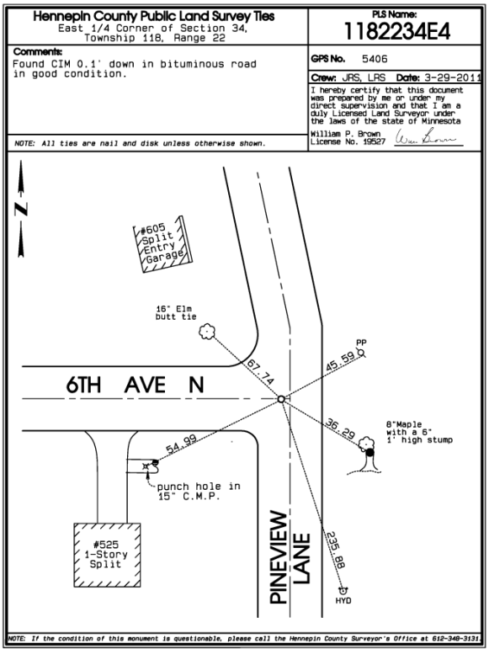
It starts with the corners
Certainty in spatial locations
Business enablement
Benefits future generations
Notes:
What is the value of accurate corners?
Allows us to know where things are at, in real life and digitally
Property transactions are faster and more assured
Corners will be used by generations in the future

Slide 53
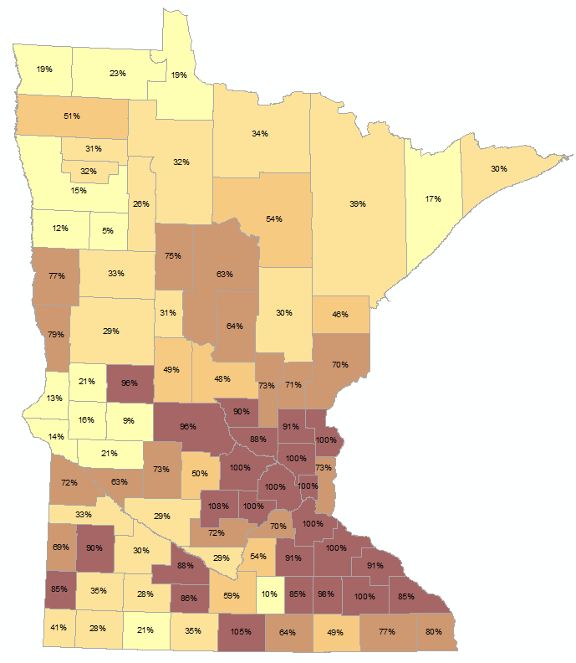
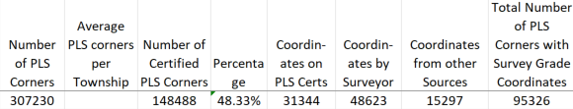
Where have all the corners gone?
Notes:
Over time, we’ve lost track of corners. They’ve been dug out, ignored, not perpetuated
In 1981 the first remonumentation effort was started in MN and that’s where it languished
About ½ are certified
Between 5 & 100%
Less than a third have survey grade coordinates
We need help to get these numbers up

Slide 54
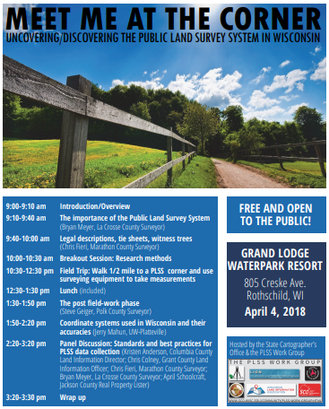
Notes:
WI example that we’d like to try here. MACS is asking for partners

Slide 55
Agenda Item 9
Modernizing Land Record System
Susan Ledray, Hennepin County Examiner of Titles

Slide 56
Agenda Item 10
Sector report: Federal Government
Jeff Bloomquist, USDA

Slide 57
Geospatial Federal GIS Update
Jeffrey Bloomquist

Slide 58
Federal GIS Contacts:
Usda Risk Management Agency:
Jeff Bloomquist
USDA Natural Resource Conservation Services
Matt Baltes
USDA Farm Service Agency
Dan Root
US Forest Service
Eric Gdula
US FISH & Wildlife
Brian Huberty
US Census
Duane Best
NOAA
Brandon Krumwiede
USGS
Chris Sanocki
National Parks
Stephen Marian
Army Corp
Keith LEClaire
Bureau of Land Management
Robert Mandzi

Slide 59
Lightning Update
US Census
The Census Bureau is currently identifying Regional Agencies and County
governments to review and adjust the Census Statistical Areas (census tracts,
census block groups, and census designated places). The review program will
begin in early 2019.
USDA
NAIP is in flux current farm bill proposal is $23 million per year.
US Fish & Wildlife
Satellite Needs work group Survey is going on this summer.
NWI is finishing up in Minnesota this fall

Slide 60
Agenda Item 11
Legislative update
Dan Ross and Mike Dolbow

Slide 61
Geospatial Data Act
Direct work of Federal Geographic Data Committee (FDGC)
Provide greater clout to FGDC’s National Geospatial Advisory Committee (NGAC)
Provide Congressional oversight over geospatial activities
Require federal agencies to coordinate and partner with other federal agencies, state, tribal and local governments, academia and private sector
Notes:
The bill establishes a clear vision, assigns responsibility, provides authority and ensures oversight of Federal activities by Congress.
Codify the existing executive orders and other guidance documents that direct work by the Federal Geographic Data Committee (FGDC) toward the NSDI.
Provide FGDC with the authority to make other agencies follow existing common sense rules
Provide Congressional oversight over geospatial activities of FGDC members and other agencies.
Require reporting that will allow Congress to track progress on the NSDI and ensure funding is spent wisely.
Provide a great deal more clout to input developed by the multi-sector membership of the National Geospatial Advisory Committee (NGAC) and require the FGDC to address NGAC’s concerns — not just dictate what NGAC should work on.
Require Federal agencies to coordinate and work in partnership with other Federal agencies, agencies of state, tribal and local governments, institutions of higher education, and the private sector to efficiently and cost-effectively collect, integrate, maintain, disseminate and preserve geospatial data.

Slide 62

Geospatial Data Act
Senate - working with intelligence committees to potentially get final redline language this week; will take language from OMB and intel to Commerce Committee and request markup
House - no further movement
Looking for additional co-sponsors

Slide 63
Other Legislative Priorities
Digital Coast Act
  Funds NOAA’s Digital Coast
NG911 Act
  Program (ROI of 250%)
  Endorse nationwide deployment of NG911 over 10 years
  Provisions related to federal funding (but no specific amounts)

Slide 64
Digital Coast Act
Digital Coast Partnership meeting held in DC week of May 7
Hill briefing with NOAA that week
Need more Republicans to sign on to Digital Coast Act in House - currently 5 Republicans and 13 Democrats
Currently in Natural Resources Committee / Subcommittee on Water, Power & Oceans

Slide 65
Next Generation 9-1-1 Act
Furthers the deployment of NG9-1-1 services to enhance and upgrade nation’s 9-1-1 systems
Identical bills introduced in Nov. 2017
Hold-ups
  Not bipartisan (need Republicans to sign on)
  Increases responsibility of National 911 Office, but no funding level included - not sure what it would cost and cost study held up in OMB
  Concerns about states raiding 911 funds
  NG9-1-1 might be included in broader national infrastructure

Slide 66
Agenda Item 12
Announcements or other business

Slide 67
Adjourn
Thank you!
Next meeting is Wednesday, September 5, 2018

