Slide 1



Minnesota Geospatial Advisory Council
December 5, 2018

Slide 2
Welcome
Introductions
Approve agenda
Approve September minutes

Slide 3
Agenda
Time | Topic
11:15 | Review and accept committee summaries
11:20 | Minnesota Geospatial Image Service Sustainability Plan
11:30 | Standards Committee update
11:40 | Filling vacant GAC seats
11:45 | Surveyor seat on GAC
11:55 | GAC presentations at GIS/LIS and NSGIC conferences
12:00 | Break, networking
12:30 | Geospatial Priorities Survey results and 2019 GAC priorities
1:15 | Sector report: Utilities
1:25 | Legislative updates
1:30 | Updates on GAC priority projects and initiatives
1:45 | Announcements

Slide 4
Agenda Item 2
Review and accept committee summaries

Slide 5
Agenda Item 3
Minnesota Geospatial Image Service Sustainability Plan
Matt McGuire

Slide 6
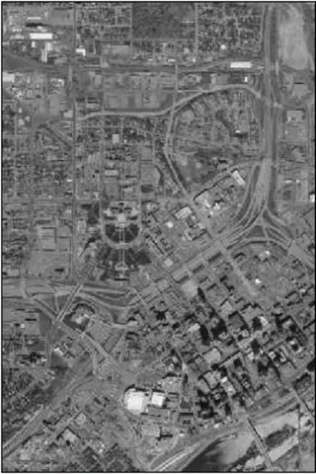
MnGeo Image Server Storage Issue Summary
Started with 6 layers
Now 77 layers
Adding layers every year
No present danger, but not sustainable
Which layers to remove?

Slide 7
Goal
Create a “decision matrix” to determine which layers can be retired from the MnGeo Image Service
Create a work team to implement the decision matrix on a periodic basis
Communicate layer status

Slide 8
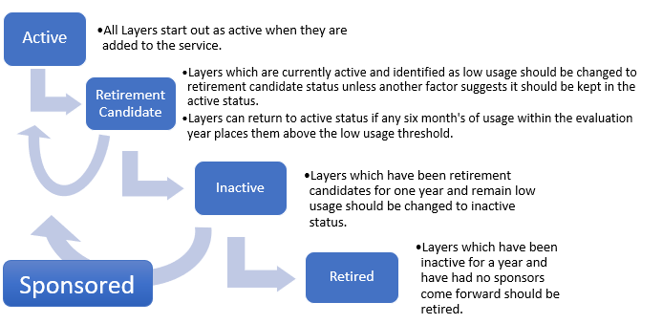
Key Proposal Elements: Image Layer Life Cycle

Slide 9
Key Proposal Elements: Decision Factors
Usage – Easy to measure and track. This is the prime factor.
Other factors
  Coverage
  Resolution
  Time of year (leaf on/off)
  Historical Significance
Layer Title | Usage | Usage (percent of total)
2009 color Isle Royale | 4576 | 0.00%
2008 color Twin Cities | 4514 | 0.00%
2013 cir Meeker | 4439 | 0.00%
2013 cir Carver | 3142 | 0.00%
2009 color south shore WI | 2044 | 0.00%
2013 cir Dakota | 2029 | 0.00%
2011 cir Murray | 2015 | 0.00%
2013 cir Scott | 1311 | 0.00%
2010 cir Dakota | 775 | 0.00%
2011 cir Rice | 400 | 0.00%
2010 cir Scott | 277 | 0.00%

Slide 10
Key Proposal Elements: Roles and Responsibilities
GAC
  Create Maintenance Team Workgroup
  Ensure communication with Archival Workgroup
  Pass layer status changes to MnGeo
MnGeo
  Keep list of layers and status
  Make layer status changes as communicated by GAC
  Maintain usage statistics and other layer metadata
Maintenance Team
  Review existing layers
  Make layer status changes based on Decision Factors
  Notify GAC of recommended layer status changes
  Consider decision factors and make changes if necessary

Slide 11
Next Steps
Proposal team requests that the GAC:
  Review the plan
  At the March meeting:
    Approve of the plan
    Create a Committee/Workgroup to work the plan

Slide 12
Proposal Team
Joe Sapletal, Dakota County
Jennifer Corcoran, DNR
Mike Dolbow, MnGeo
Dennis Kepler, DNR
Steve Kloiber, MNIT DNR
Ryan Mattke, University of Minnesota
Zeb Thomas, MNIT DNR
Matt McGuire, Metropolitan Council

Slide 13
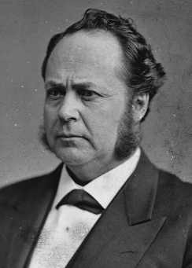

Agenda Item 4
Standards Committee Update
Geoffrey Maas, GISP
Chair, Standards Committee
MetroGIS Coordinator, Metropolitan Council
Andra Mathews, GISP
Vice Chair, Standards Committee
GIS Specialist, Minnesota Center for Environmental Advocacy

Slide 14
Agenda Item 4
Progress on standards
Address Point Data Standard
>> Adopted in December 2017
>> Modified twice during 2018 (to v. 1.2)
Parcel Data Transfer Standard
>> Adopted in March 2018
>> Currently in a 45-day public review

Slide 15
Agenda Item 4
Why change a standard once it is adopted?
Usage of standard by community reveals
its various issues and “glitches”;
Standards were developed independently, their
use and publication gives us a chance to
examine, align and fix them

Slide 16
Agenda Item 4
Address Point Data Standard (v. 1.2)
Very minor tweaks
Expanding & improving domains values
Aligning parts/terms with other standards

Slide 17
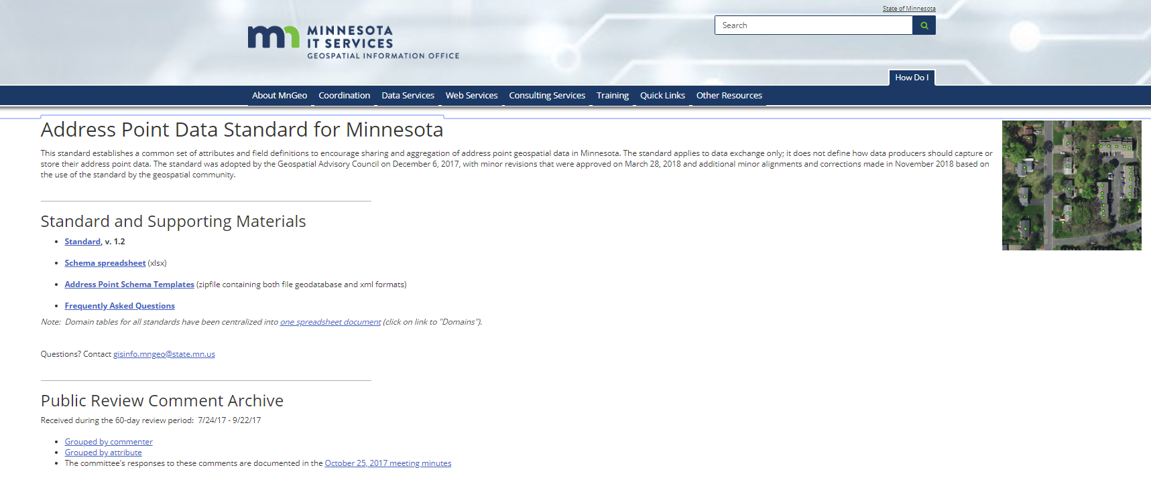
Agenda Item 4
Standard document
.xlsx spreadsheet
Schema templates
FAQ
Public comments

Slide 18
Agenda Item 4
Parcel Data Transfer Standard (v. 1.1)
Currently in a 45-day public review period
Now Conditional (not Mandatory)
COUNTY_PIN
STATE_PIN
TAX_NAME
Not every parcel has a PIN or Tax Name

Slide 19
Agenda Item 4
Parcel Data Transfer Standard (v. 1.1)
Point to Polygon Relationship (POLYPTREL)
0 = Information not available
1 = Parcel with single PIN, 1:1 relationship to address
2 = One of multiple tax PIN parcel points
(e.g. condominiums) associated with a single parcel polygon (e.g. common area) in the polygon dataset

Slide 20
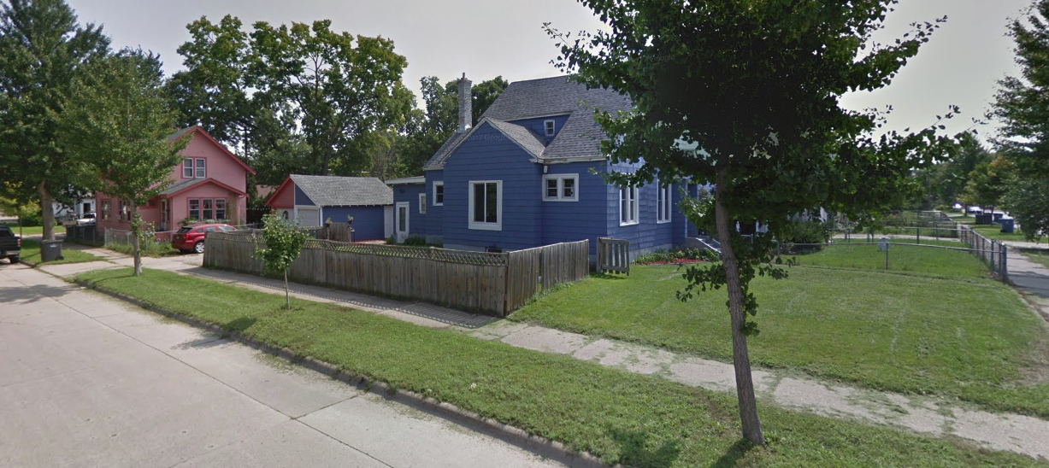
Agenda Item 4

Slide 21
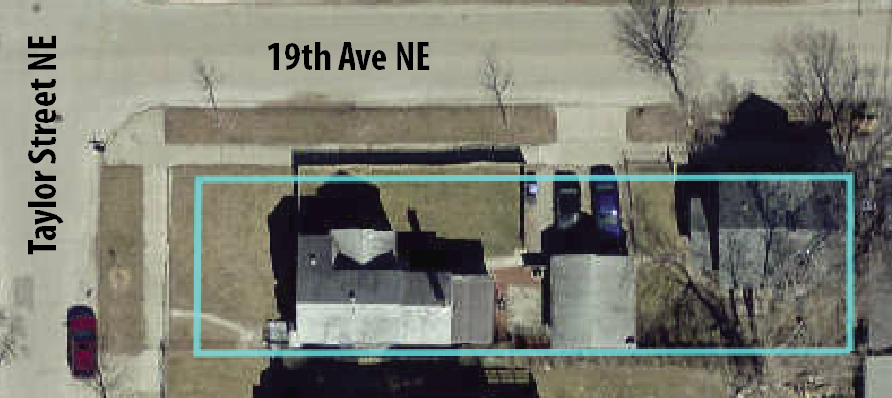
Agenda Item 4

Slide 22
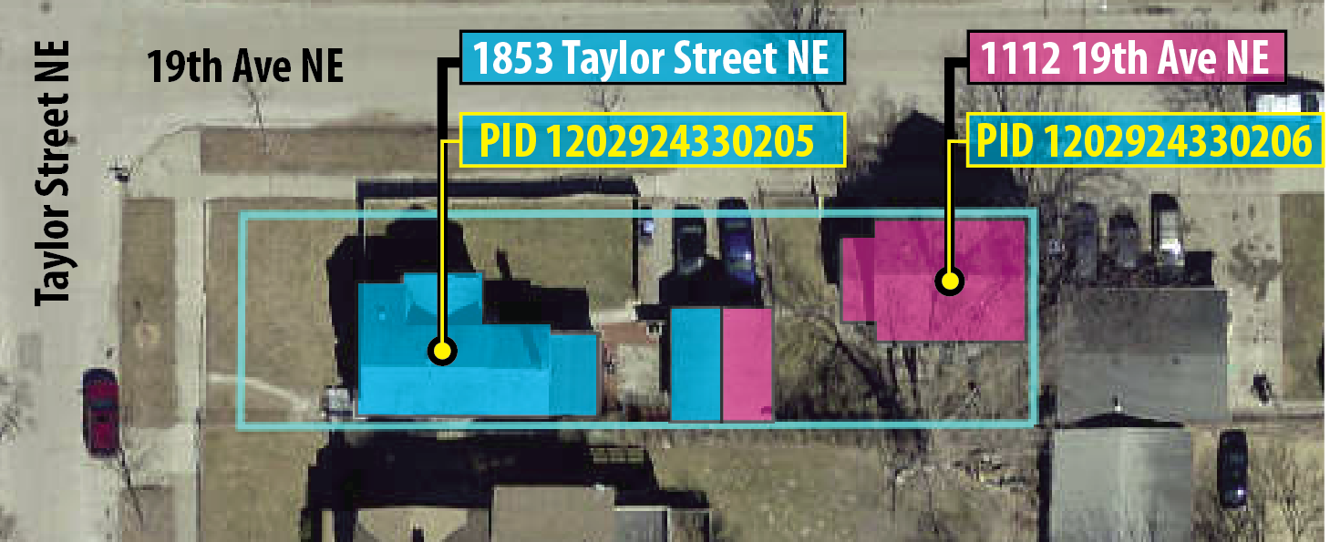
Agenda Item 4

Slide 23
Agenda Item 4
N_STANDARD (populate if no PIN or TAX_NAME):
10 = Common Area
11 = Right of way
12 = Easement
13 = Ownership unknown
14 = Gap between parcel boundary descriptions
15 = Water body
16 = Ditch
17 = Walkway
18 = Preliminary parcel where PIN not yet assigned
98 = Other non-parcel features
99 = Unspecified non-parcel feature

Slide 24
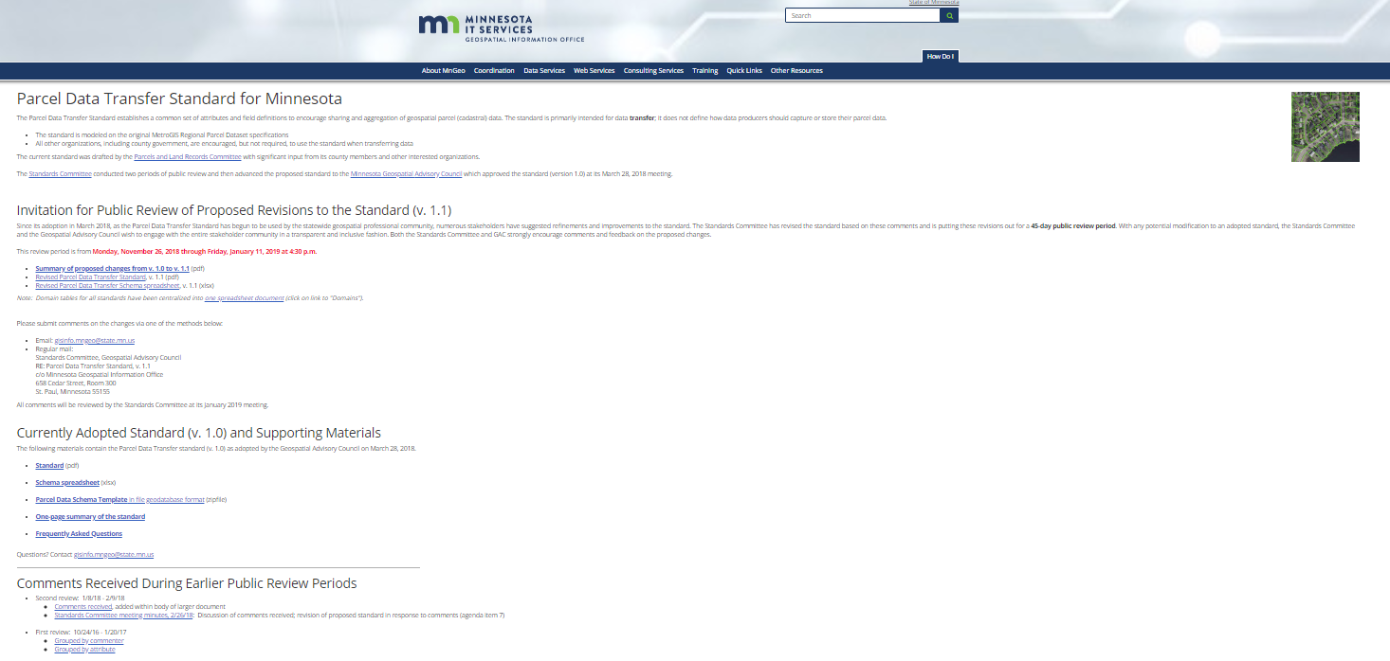
Agenda Item 4
Proposed v. 1.1
Current standard (v. 1.0)
Public comments

Slide 25
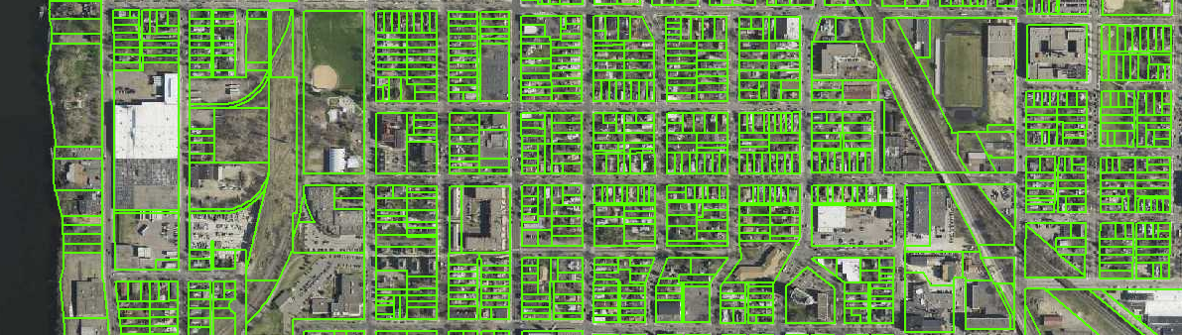
Agenda Item 4
Parcel Data Transfer Standard
Proposed changes to v. 1.1
Available for public review until
4:30 p.m., Friday, January 11, 2019

Slide 26
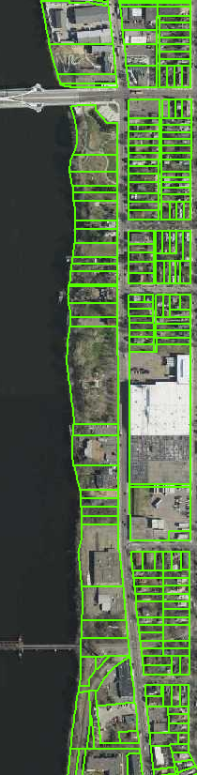

Agenda Item 4
Metro Regional Parcel Dataset
Next iteration will be in the new
Parcel Data Transfer Standard
Significant effort by the
Seven Metro Counties

Slide 27

Agenda Item 4
MetroGIS 2019 Work Plan
(#5 Priority)
Parcel Best Practices Guide
& Reference Document
Aligned to PDTS
Definitions
Examples
Best Practices

Slide 28
Agenda Item 4
MN Road Centerline Standard (MRCS)
Transfer standard for road centerlines to serve many “downstream” business uses:
>> NextGen9-1-1
>> Geocoding
>> Routing
>> Cartographic representation
>> LRS: Linear referencing (…eventually…)

Slide 29
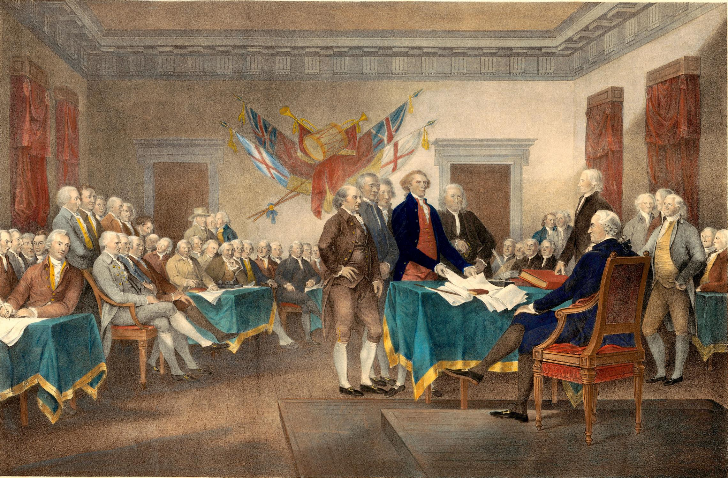
Agenda Item 4
A brief history lecture…(zzzz)

Slide 30
Agenda Item 4
May 2014 – April 2017
Seven Metro Counties, MetCouncil, MESB
Metro Regional Centerlines Collaborative
MRCC

Slide 31
Agenda Item 4
May 2014 – April 2017
Seven Metro Counties, MetCouncil, MESB
Metro Regional Centerlines Collaborative
MRCC
Documented primary business needs
Developed a prototype standard
First build and testing of data
Second build
More testing, testing and even more testing…

Slide 32
Agenda Item 4
May 2014 – April 2017
Seven Metro Counties, MetCouncil, MESB
Metro Regional Centerlines Collaborative
MRCC
Several revisions/versions of the MRCC:
2014-2015: 1.0, 1.1, 1.2, 1.3, 1.4
2016: 1.4.1, 1.4.2, 1.5, 1.5+
2017: 1.6, and finally 1.7

Slide 33
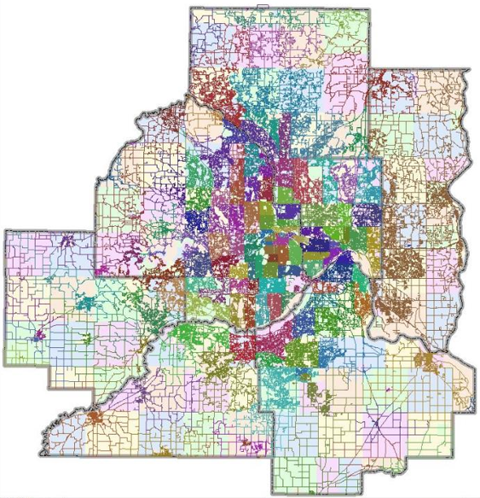
Agenda Item 4
Since April 2017…
Seven Metro Counties publishing centerlines in
MRCC v. 1.7 format to the Commons

Slide 34
Agenda Item 4
Since April 2017…
Seven Metro Counties publishing centerlines in
MRCC v. 1.7 format to the Commons
~19,000 miles of roads
~169,000 individual road segments

Slide 35
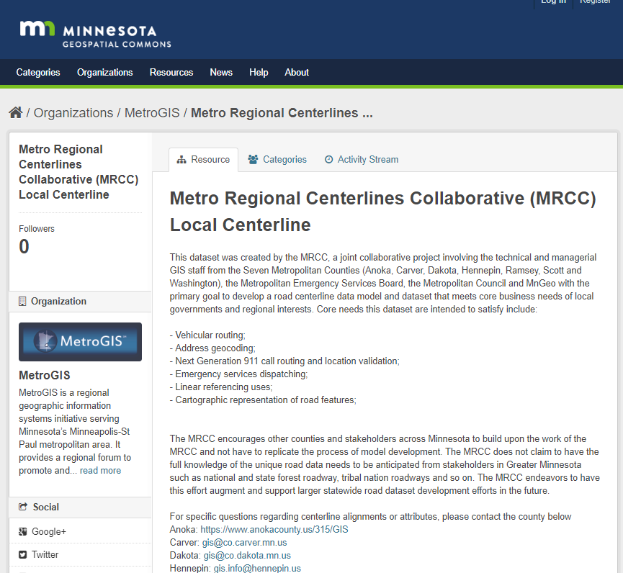
Agenda Item 4

Slide 36

Agenda Item 4
MRCC Best Practices Guide
>> Terminology
>> Definitions
>> Links to resources
>> Concepts (planarization,
managing boundary roads, etc.)

Slide 37
Agenda Item 4
Mid-2017
State 9-1-1 Standards Workgroup
Took the MRCC v. 1.7
Modified and tweaked it (five times internally) Resulted in the
Minnesota Road Centerline Standard
The “MRCS v. 0.5”

Slide 38
Agenda Item 4
Mid-2017
State 9-1-1 Standards Workgroup
Took the MRCC v. 1.7
Modified and tweaked it (five times internally)
Resulted in the MRCS v. 0.5
Brought the MRCS v. 0.5 to the Standards Committee
Standards Committee agreed to put it out for a
60-day public review as a candidate for a statewide standard

Slide 39
Agenda Item 4
MRCS v. 0.5
Publicly reviewed April – June 2018 (60-days)
Large number of comments and questions
Standards Committee:
July, September, October – reviewed comments
Adjusted the standard based on the public input
Strong need for a guidance document
Explaining each attribute, concepts and terminology
‘MRCS Guidance Document’ is in the works

Slide 40
Agenda Item 4
Standards Committee:
Revise the MRCS v. 0.5 to MRCS v. 0.6
To be published for another round of
public review: January – March 2019.
Alignment with NG9-1-1 needs
Alignment with other standards
What stays in, what gets removed
Guidance documentation to accompany the MRCS v. 0.6

Slide 41
Agenda Item 4
The forthcoming MRCS v. 0.6
Contains the hard work and deep technical dive of the
metro-level MRCC effort (2014-2017)
Contains the review and modification of the
9-1-1 Standards Workgroup (2017-present)
…and will benefit from the input, review and analysis of the
Standards Committee & statewide stakeholders (2018-present)

Slide 42
Agenda Item 4
MN Road Centerline Standard (MRCS)
Continued review and input by the stakeholder community;
Review and revision by the Standards Committee and others as necessary
Advanced to the GAC for review when it is ready

Slide 43
Agenda Item 4
MN Road Centerline Standard (MRCS)
Once approved by the GAC, it will then become the MRCS 1.0
0.5, 0.6, 0.7,etc. = drafts, not yet adopted
1.0 = when adopted by the GAC
1.1, 1.2, 1.3, etc. = revisions after adoption

Slide 44
Agenda Item 4
MN Road Centerline Standard (MRCS)
It is a resource and a tool to help our professional community work together.
Standards are not a mandate;
Once adopted they may be used/recommended by various interests and agencies to meet their needs;

Slide 45

Agenda Item 4
What can you do?
Review the standards and supporting documents
Provide comments, recommendations and
insights to the Standards Committee
Stay tuned…

Slide 46

Agenda Item 4
Timeline of
Upcoming Events

Slide 47

Agenda Item 4
Timeline of
Upcoming Events
Bonjour,
je m'appelle
Jean-Claude

Slide 48
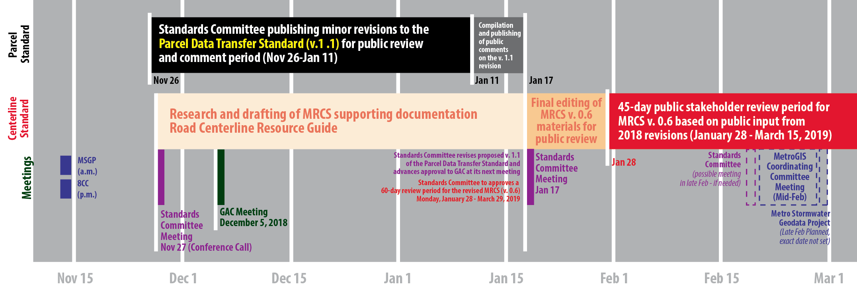
Agenda Item 4

Slide 49
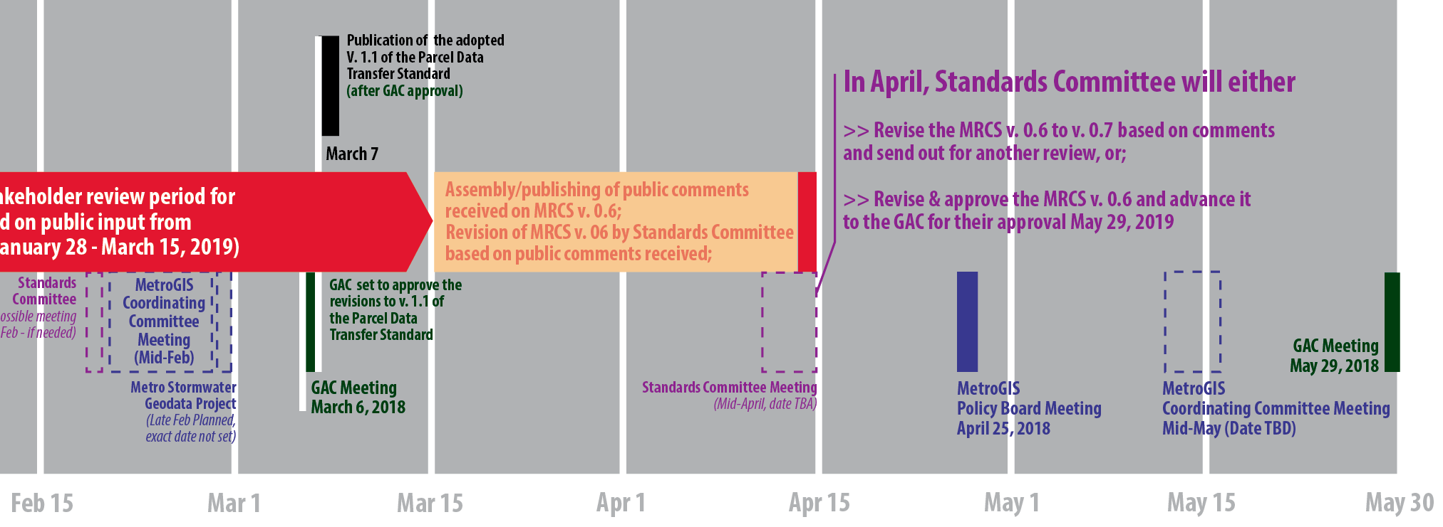
Agenda Item 4

Slide 50
Agenda Item 4
Questions?
Comments?
Thanks!
geoffrey.maas@metc.state.mn.us
amathews@mncenter.org
Jean-Claude dit “sacré bleu”!

Slide 51
Agenda Item 5
Filling vacant GAC seats - Dan Ross
2 positions open
  Regional Government, Greater MN
  Federal Government
GAC members assist with identifying potential members
Encourage signing up via the SOS process

Slide 52
Agenda Item 6
Surveyor seat on GAC
Ryan Stovern, Mark Kotz

Slide 53
Agenda Item 6
2014 Minnesota Statutes 16E.30, subd. 8. Geospatial Advisory Council created.
(a) The chief information officer must utilize a governance structure that includes an advisory council to provide recommendations for improving the operations and management of geospatial technology within state government and also on issues of importance to users of geospatial technology throughout the state.
(b) The Geospatial Advisory Council must advise the Minnesota Geospatial Information Office regarding the improvement of services statewide through the coordinated, affordable, reliable, and effective use of geospatial technology. The chief information officer must appoint the members of the council. The members must represent a cross-section of organizations including counties, cities, universities, business, nonprofit organizations, federal agencies, tribal governments, and state agencies. In addition, the chief geospatial information officer must be a nonvoting member.
(c) Members of the Geospatial Advisory Council must be recommended by a process that ensures that each member is designated to represent a clearly identified agency or interested party category. Members of the Geospatial Advisory Council must be selected in compliance with the state's open appointment process. Members shall serve a term of two years.
(d) The Minnesota Geospatial Information Office must provide administrative support for the Geospatial Advisory Council.

Slide 54
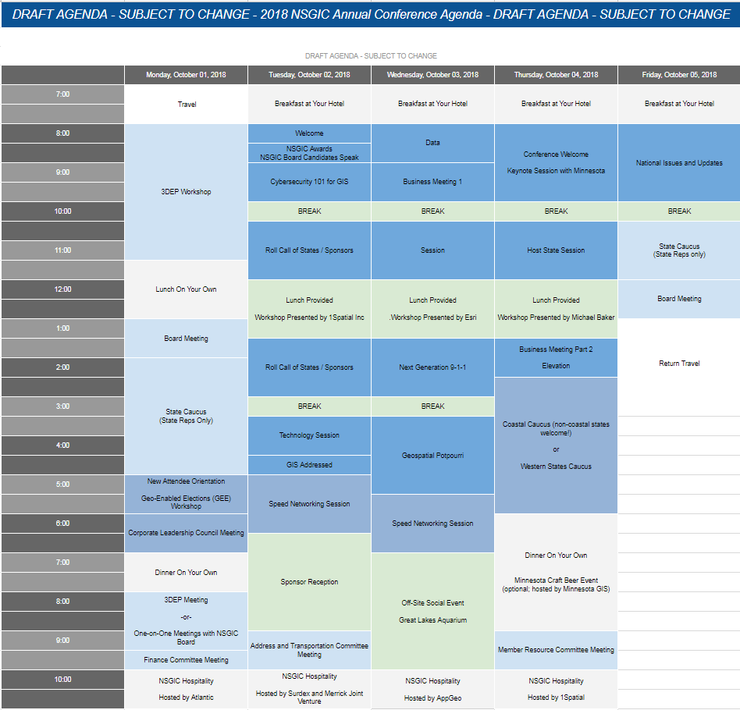
Agenda Item 7
GAC presentations at GIS/LIS and NSGIC
conferences - feedback

Slide 55

Break - Networking

Slide 56
Agenda Item 9
Geospatial Priorities Survey results and
2019 GAC priorities
Mark Kotz

Slide 57
Why Create Priorities?
To create a voice for the MN geospatial community
To direct work plans of the GAC and its committees
To recommend to MnGeo
To allow other organizations to compare priorities and align efforts
To inform outreach and policy related efforts
Having clear direction helps motivate people to participate

Slide 58
GAC Priorities Process
Create a list of proposed projects and initiatives
  From GAC members and committee chairs
  Announced at GIS/LIS conference
Assess the value of each – degree of business need
  MN Geospatial Priorities Survey
Assess likelihood of success of each - owner, team, champion, funding
Preliminary priority calculation
GAC discusses and adjusts

Slide 59
MN Geospatial Priorities Survey
407 survey responses
58% from two sectors

Slide 60
MN Geospatial Priorities Survey
Results scoring:
  Critical = 3
  Very Important = 2
  Nice to have = 1
  Not needed or not answered = 0
Scores shown weighted and unweighted
Weighting by GAC seats representing sectors (e.g. nonprofit weight of 1 (1 seat), state government weight of 2 (2 seats)).
Results are very similar weighted and unweighted.

Slide 61
MN Geospatial Priorities Survey
Project/Initiative Short Name | Project/Initiative Long Name | Weighted by Sector | Not Weighted
Free and Open Data | All public geospatial data in MN to be free and open to everyone | 2.191 | 2.108
Imagery Service Maintained | Assurance that the current MnGeo imagery service will be maintained and improved via a sustainable funding model, including policies on what layers are added and removed over time | 2.082 | 2.135
Updated & Aligned Boundary Data | Updated and aligned boundary data from authoritative sources | 1.943 | 1.985
LiDAR and Derived Products | New LiDAR data acquisition across Minnesota for use in developing new derived products guided by committee developed standards | 1.916 | 1.958
Hydro-DEMs | Accurate hydro-DEMs (hDEM) that serve modern flood modeling and hydro-terrain analysis tools, and the development of more accurate watercourses and watersheds | 1.907 | 1.926
Parcel Data | Statewide publicly available parcel data | 1.847 | 1.813
Archiving | A policy and procedures for archiving and preserving historical geospatial data | 1.609 | 1.543
Road Centerline Data | Statewide publicly available road centerline data (including a data standard) | 1.602 | 1.708
MN Basemap Service | MN focused basemap services | 1.598 | 1.663
Address Points Data | Statewide publicly available address points data | 1.407 | 1.477
EM Damage Assessment Standard | An emergency management damage assessment data standard to provide an accepted specification to support a request for State or Federal assistance after a disaster | 1.321 | 1.351
Geocoding Service | A statewide publicly available geocoding service | 1.296 | 1.378
Parks and Trails Standard | A parks and trails data standard | 1.265 | 1.287
Imagery Service Improvements | Improvements to the MnGeo imagery service capabilities, such as Web Mercator, tiling, downloading options, and increased refresh frequency | 0.845 | 0.814

Slide 62
MN Geospatial Priorities Survey
Project/Initiative Short Name | Weighted by Sector
Free and Open Data | 2.191
Imagery Service Maintained | 2.082
Updated & Aligned Boundary Data | 1.943
LiDAR and Derived Products | 1.916
Hydro-DEMs | 1.907
Parcel Data | 1.847
Archiving | 1.609
Road Centerline Data | 1.602
MN Basemap Service | 1.598
Address Points Data | 1.407
EM Damage Assessment Standard | 1.321
Geocoding Service | 1.296
Parks and Trails Standard | 1.265
Imagery Service Improvements | 0.845

Slide 63
Prioritization
Value Score = Weighted survey result x 10
Likelihood of Success Score
  Project owner = 3
  Project team = 2
  Champion = 2
  Funding = 2
  Effort: low = 3, medium = 2, high = 1

Slide 64
Time for Big Colorful Spreadsheet
Project or Initiative Name | Status | Do in '19 | GAC Rank | Priority Score | Value Score | Survey Score | Success Score | Owner Exists | Work Team Exists | Active Champ Exists | $$ Exists | Est $$ | Easy Score | Effort | Project Owner | Champ
Free and Open Data | Active |  |  | 241 | 22 | 2.1915 | 11 | 3 | 2 | 2 | 2 | $0 | 2 | Med | Len Kne | Ross
Imagery Service Maintained | Active |  |  | 208 | 21 | 2.0816 | 10 | 3 | 2 | 2 | 2 | $0 | 1 | High | Mike Dolbow | Ross
Archiving Policy/Procedure | Active |  |  | 177 | 16 | 1.6093 | 11 | 3 | 2 | 2 | 2 | $0 | 2 | Med | Ryan Mattke | many
Road Centerline Data & Standard | Active |  |  | 160 | 16 | 1.6017 | 10 | 3 | 2 | 2 | 2 | $0 | 1 | High | Norman Anderson | Ross
Address Points Data | Active |  |  | 141 | 14 | 1.4073 | 10 | 3 | 2 | 2 | 2 | $0 | 1 | High | Norman Anderson | Ross
Parcel Data | Active |  |  | 129 | 18 | 1.8472 | 7 |  | 2 | 2 | 2 | $0 | 1 | High |  | Kotz
MN Basemap Services | Active |  |  | 128 | 16 | 1.5977 | 8 | 3 | 2 | 2 |  | some | 1 | High | Sonia Dickerson | Ross
Parks and Trails Data Standard | Active |  |  | 127 | 13 | 1.2653 | 10 | 3 | 2 | 2 | 2 | $0 | 1 | High | Jim Bunning | Ross
EM Damage Assess Data Standard | Active |  |  | 119 | 13 | 1.3205 | 9 | 3 | 2 |  | 2 | $0 | 2 | Med | Anderson/Richter
Updated & Aligned Boundary Data | Active |  |  | 97 | 19 | 1.9435 | 5 | 3 |  |  |  |  | 2 | Med | Preston Dowell
Image Service Improvements | Active |  |  | 93 | 8 | 0.8453 | 11 | 3 | 2 | 2 | 2 | $0 | 2 | Med | Mike Dolbow | Ross
LiDAR Data and Derived Products | Proposed |  |  | 19 | 19 | 1.9161 | 1 |  |  |  |  |  | 1 | High
Hydro-DEMs | Proposed |  |  | 19 | 19 | 1.9073 | 1 |  |  |  |  |  | 1 | High
Geocoding Service (public) | Proposed |  |  | 13 | 13 | 1.296 | 1 |  |  |  |  | some | 1 | High

Slide 65
Agenda Item 10
Sector report
Business – Utilities
Gerry Sjerven, MN Power
Utilities Group or Committee
  GAC – past efforts
  MN GIS/LIS Consortium – various meetings at conference

Slide 66
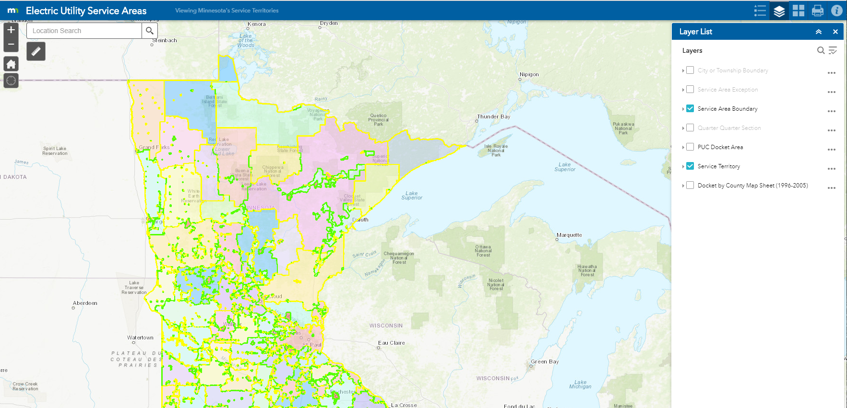
Agenda Item 10
Electric Utility Service Areas
MnGeo Website on Public Utilities Infrastructure
Municipal Electric Utilities – 124
Cooperatives – 47
Investor Owned – 4 (Xcel Energy,
Minnesota Power,
Northwestern Wisconsin Electric,
Otter Tail Power

Slide 67
Agenda Item 10
Contacts
Minnesota Municipal Utilities Association
Minnesota Rural Electric Association
MID – West Esri Utility Users Group
Contact list from the 2016 Mid-West Regional Esri Generation and Transmission Utility Users Group held at Minnesota Power in May of 2016.

Slide 68
Agenda Item 10
How is the GAC relevant to your sector / how can the GAC’s mission benefit your sector?
Communication Plan / Next Steps
  Introduce / Reintroduce GAC, current priorities, 3D Geomatics
  Is there a need to create a group/committee (GAC or Consortium)
  Potential Survey opportunity
  MN GIS/LIS Consortium Annual Conference Track

Slide 69
Agenda Item 11
Legislative updates
Dan Ross

Slide 70

Geospatial Data Act
Signed into law as a component of the FAA Reauthorization Act
(H.R. 302, P.L. 115-254)
Requires federal agencies to coordinate and work in partnership with other federal agencies, agencies of state, tribal and local governments, institutions of higher education, and the private sector to efficiently and cost-effectively collect, integrate, maintain, disseminate and preserve geospatial data
See bill text and resources: https://www.fgdc.gov/gda
Notes:
The bill establishes a clear vision, assigns responsibility, provides authority and ensures oversight of Federal activities by Congress.
Codify the existing executive orders and other guidance documents that direct work by the Federal Geographic Data Committee (FGDC) toward the NSDI.
Provide FGDC with the authority to make other agencies follow existing common sense rules
Provide Congressional oversight over geospatial activities of FGDC members and other agencies.
Require reporting that will allow Congress to track progress on the NSDI and ensure funding is spent wisely.
Provide a great deal more clout to input developed by the multi-sector membership of the National Geospatial Advisory Committee (NGAC) and require the FGDC to address NGAC’s concerns — not just dictate what NGAC should work on.
Require Federal agencies to coordinate and work in partnership with other Federal agencies, agencies of state, tribal and local governments, institutions of higher education, and the private sector to efficiently and cost-effectively collect, integrate, maintain, disseminate and preserve geospatial data.

Slide 71
Other Legislative Priorities
Digital Coast Act – S. 110/H.R. 4062
  Funds NOAA’s Digital Coast
  DCA has passed the Senate
  Currently not moving in the House
NG911 Act – S. 2061/H.R. 4672
  Program (ROI of 250%)
  Endorse nationwide deployment of NG911 over 10 years
  Provisions related to federal funding (but no specific amounts)

Slide 72
Minnesota 16E.30 Subd. 11
Subd. 11. Government sharing of electronic geospatial data. (a) The definitions in section 13.02 apply to this subdivision.
(b) Electronic geospatial government data must be shared at no cost with government entities, the notification center established under section 216D.03, and federal and tribal government agencies. Data received under this subdivision may be reproduced or shared with other government entities or agencies. A release of data under this subdivision must include metadata or other documentation that identifies the original authoritative data source. Government entities providing data under this subdivision are not required to provide data in an alternate format specified by the requestor. A government entity is not required to provide the same data to the same requestor more than four times per year, unless required by law or court order.

Slide 73
Agenda Item 12
Updates on MN GAC priority projects and initiatives
Mark Kotz

Slide 74
Agenda Item 12
GAC Rank | Project or Initiative Description | Status | Project Owner | Champion
1 | All Data Free and Open | Active | Len Kne | Dan Ross
2 | Image Service - Sustain | Active | Mike Dolbow | Dan Ross
3 | Address Points Data | Active | Norm Anderson | Dan Ross
4 | Road Centerline Data | Active | Norm Anderson | Dan Ross
5 | Image Service Enhancements | Active | Mike Dolbow | Dan Ross
6 | Archiving Policy/Procedure | Active | Ryan Mattke | many
7 | Parcel Data | Active | George Meyer
8 | Updated & Aligned Boundary Data | Proposed | Preston Dowell
9 | EM Damage Assess Data Standard | Active | Brad Anderson, Cory Richter
10 | LiDAR data and related standards | Active | Gerry Sjerven
11 | Basemap Services | Active | Sonia Dickerson | Dan Ross
12 | Parks and Trails Data Standard | Active | Jim Bunning | Dan Ross

Slide 75
Agenda Item 13
Announcements or other business

Slide 76
Adjourn
Thank you!
Next meeting is Wednesday, March 6, 2019

