Slide 1
Minnesota Geospatial Advisory Council
March 6, 2019

Slide 2
Welcome
Introductions
Approve agenda
Approve December minutes

Slide 3
Agenda
Time | Topic
11:15 | Committee and workgroup annual reports - Review and approve
11:20 | GAC accomplishments and work plan - Review and approve
11:30 | Image Service Sustainability Committee - Approve
11:40 | Parcel Data Standard revision - Approve
11:50 | Revised GCGI standards for state, county and CTU codes - Approve
12:00 | Break, networking
12:30 | Governor’s Geospatial Commendation Award language changes - Approve
12:40 | Parcels and Land Records/boundary alignment update
12:50 | Hazard mitigation and climate adaptation initiatives
1:10 | 3D Geomatics workgroup chairs updates
1:30 | Legislative updates
1:35 | GAC priority projects and initiatives updates
1:45 | Collaboration sites for committees and workgroups
1:50 | Announcements

Slide 4
Agenda Item 2
Committee and workgroup annual reports - Review and accept

Slide 5
Agenda Item 3
GAC overall accomplishments and work plan - Review and accept
Mark Kotz

Slide 6
Agenda Item 4
Image Service Sustainability Committee - Approve
Mike Dolbow, proposed committee vice-chair
(Matt McGuire will be committee chair)

Slide 7
MnGeo Image Service Sustainability Committee
Review:
Started with 6 layers
Now 77 layers
Adding layers every year
Concerned about sustainability without governance
Which layers to add? Which to “remove”?

Slide 8
Committee Charter - Responsibilities
Support a viable service with a governance framework that solicits feedback
Maintain a decision matrix on cycling older layers through stages
Communicate layer stage status
Review proposed additions to the service and/or inclusion in the Composite
Notify the GAC and MnGeo of recommendations
Evaluate potential enhancements/improvements
Make recommendations to MnGeo

Slide 9
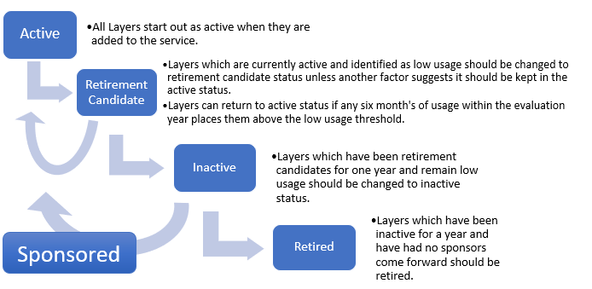
Review: Image Layer Life Cycle

Slide 10
Other Roles and Responsibilities
GAC
Create Committee
Ensure communication with Archiving Workgroup
Pass layer status changes to MnGeo
MnGeo
Keep list of layers and status
Execute layer status changes as communicated by GAC
Maintain usage statistics and other layer metadata

Slide 11
Next Steps / Work Plan
Form Committee (goal: by April 30, 2019)
Meet to discuss Sustainability Plan (goal: by June 30, 2019)
Review Layers for potential changes
Review any proposed layer additions
Review and recommend changes to Composite Imagery Service
Recommend status changes (goal: by September 30, 2019)
On request, review proposed layer additions outside of the meeting schedule

Slide 12
Committee Members
Confirmed Members:
Matt McGuire, Metropolitan Council (Chair)
Mike Dolbow, MnGeo (Vice-Chair)
Jennifer Corcoran, DNR
Steve Kloiber, MNIT DNR
Ryan Mattke, University of Minnesota
Joe Sapletal, Dakota County
Justin Roberts, DOT
Presumed Members:
Dennis Kepler, DNR
Chris Mavis, Hennepin County
Desired Member:
Another Representative from DOT, preferably non-metro

Slide 13
Agenda Item 5
Parcel Data Standard revision - Approve
Mark Kotz

Slide 14
Parcel Data Standard revision
Version 1.0 approved by GAC 3/28/18
Implementation by counties prompted suggested changes
45 day public review ending January 11
No comments on proposed changes
Several comments prompted new changes
Draft version 1.1 approved by Standards Committee January 17

Slide 15
Key Changes - Parcel Data Standard
Changes to introductory language to improve clarity
Adding a Non Standard Parcel Status field
Making some fields “conditional” – due to non-standard parcels
Other minor changes to improve clarity and consistency

Slide 16
Agenda Item 6
GCGI standards for state, county and CTU codes revisions - Approve
Mark Kotz

Slide 17
Approval of GCGI Standard
GCGI adopted 10 standards beginning in 1994
GAC approved idea of revisiting and updating format for approval by GAC
Starting with 3 standards
State ID
County ID
CTU ID
See separate handouts

Slide 18
Approval of GCGI Standard
State ID Standard
Updated to GAC standard intro language and format
No changes to specifications of the standard

Slide 19
Approval of GCGI Standard
CTU ID Standard
Updated to GAC standard intro language and format
No changes to specifications of the standard

Slide 20
Approval of GCGI Standard
County ID Standard
Updated to GAC standard intro language and format
Adding 5-digit code = Unique across state boundaries
5-digit code used in approved GAC standards (parcels, address points)
County Name | 5-Digit Code (Unique Across State Boundaries) | 3-Digit Code (Unique Only within State)
Aitkin | 27001 | 001
Anoka | 27003 | 003
Becker | 27005 | 005
Beltrami | 27007 | 007
Benton | 27009 | 009
Big Stone | 27011 | 011
Blue Earth | 27013 | 013

Slide 21
Break - Networking

Slide 22
Agenda Item 8
Governor’s Geospatial Commendation Award language changes
Cory Richter

Slide 23
Agenda Item 9
Parcels and Land Records/boundary alignment update
Preston Dowell

Slide 24
GAC Rank | Project or Initiative Description | Status | Project Owner | Champion
1 | All Data Free and Open | Active | Len Kne | Dan Ross
2 | Image Service - Sustain | Active | Mike Dolbow | Dan Ross
3 | Updated and Aligned Boundary Data | Active | Preston Dowell | Dan Ross
4 | Parcel Data | Active | Mike Dolbow | Mark Kotz
5 | Archiving Policy/Procedure | Active | Ryan Mattke | many
6 | Road Centerline Data | Active | Norm Anderson | Dan Ross
7 | New LiDAR Acquisition | Active | Gerry Sjerven | Dan Ross
8 | Address Points Data | Active | Norm Anderson | Dan Ross
9 | MN Focused Basemap Services | Active | Sonia Dickerson | Dan Ross
10 | Parks and Trails Data Standard | Active | Jim Bunning | Dan Ross
11 | EM Damage Assess Data Standard | Active | Brad Anderson, Cory Richter
12 | Accurate Hydro-DEMs | Active | Sean Vaughn

Slide 25
Boundary Alignment Project

Slide 26
Boundary Alignment Project

Slide 27
Boundary Alignment Project

Slide 28
Boundary Alignment Project

Slide 29
Boundary Alignment Project

Slide 30
Boundary Alignment Project

Slide 31
Boundary Alignment Project

Slide 32
Parcel and Land Records
Small group met to discuss taking this on
George Meyer, Ryan Stovern, Pat Veraguth, Robin T. Mathews, Curt Schley, Preston Dowell
Review Committee members
Review Charter

Slide 33
Parcel and Land Records Charter
Mission statement:
This Committee exists to develop and coordinate the statewide integration, standardization, and access to geospatial cadastral data.
The primary goals of the Committee are:
To foster communication and understanding among the geospatial professionals and other professions about the importance of digital cadastral data;
To champion the use, review and maintenance of the statewide Parcel Data Transfer Standard as a resource for the aggregation and usage of parcel data in Minnesota;
To develop and strengthen the ties to and relationships between the geospatial profession and the survey profession in Minnesota;
To establish a framework for standardizing and sharing geospatial data representing parcels and the Public Land Survey System (PLSS) in coordination with the agencies that both produce and consume this data.

Slide 34
Parcel and Land Records Charter
Objectives and Deliverables:
Parcel boundaries are the foundation of multiple land-based analyses, tax valuations, and administrative boundaries; but an accurate, continually updated statewide data resource of this information does not yet exist.
The Public Land Survey System (PLSS) is the foundation of all land records and property descriptions in the State of Minnesota, but an accurate, multi-purpose, consistently attributed, statewide geospatial dataset of the PLSS does also not yet exist.
The Parcels and Land Records Committee looks to build from the work of previous committees (such as the Digital Cadastral Data Committee [DCDC]) to document the various needs for standardized parcel data and PLSS information, and to work with the data producer and consumers to advance toward development and long-term maintenance of these importance data resources. To accomplish this, our purpose is to:
Support and maintain a statewide standard for sharing and aggregating parcel, data from all 87 counties, in a format that is easily understood and usable by multiple agencies.
Develop a process to collect, manage, and share the most accurate digital PLSS data possible, and to make that usable by multiple agencies.
As documents develop and approach working drafts, the Standards and Outreach committees will be involved to further refine and facilitate completion.

Slide 35
Boundary Alignment
Revise project summary
Focus on importance of PLSS restoration as the foundational data needed to properly move forward
Revamp Parcel and Land Records Committee
Get more surveyors involved and take the lead
Get more surveyors to certify their corners and publish geodetic coordinates
MACS PLSS Committee

Slide 36
Boundary Alignment
Preliminary Project Plan
Outreach
PLSS Inventory
Funding for restoration of PLSS along county boundaries and township corners
Best Practices for PLSS Corner Data management
Best Practices of GIS Data adjustment
Funding for statewide PLSS restoration fund
Talk about it and build awareness, restore the PLSS corners, adjust the data to the PLSS corners the boundaries will align themselves.

Slide 37
PLSS Inventory
PLSS Inventory Map
Once this map is populated we will be able to identify the areas where restoration is needed the most.
Communication tool to discuss the need with legislators, commissioners and the general public.

Slide 38
PLSS Inventory

Slide 39
PLSS Inventory

Slide 40
PLSS Inventory

Slide 41
Agenda Item 10
Hazard mitigation and climate adaptation initiatives
Stacey Stark, Brenda Hoppe

Slide 42
Hazard Mitigation and Climate Adaptation geospatial data gaps and opportunities
STACEY STARK, MS, GISP
GEOspatial Analysis Center
BRENDA HOPPE, PHD
MN CLIMATE AND HEALTH program

Slide 43
Introduction: who we are and why we are here
Hazard Risk and Vulnerability Assessment Data Needs
Essential and Critical Facilities Data
Climate Projection Data
Please think about
*What is the role of the GAC to ensure we have the best data available for Hazard Mitigation and Climate Adaptation needs?
*Do you have feedback for the EPC Tiger Team focused on Critical Facilities and State Asset Data?

Slide 44
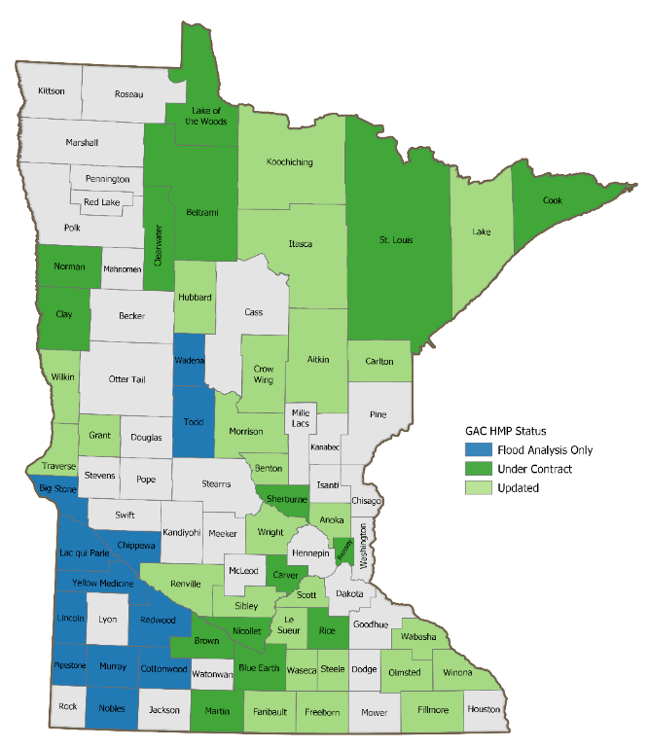
Presenters
Stacey Stark, Director
Geospatial Analysis Center
University of Minnesota Duluth
Dr. Brenda Hoppe,
Senior Research Scientist, MDH
MN Climate and Health Program

Slide 45
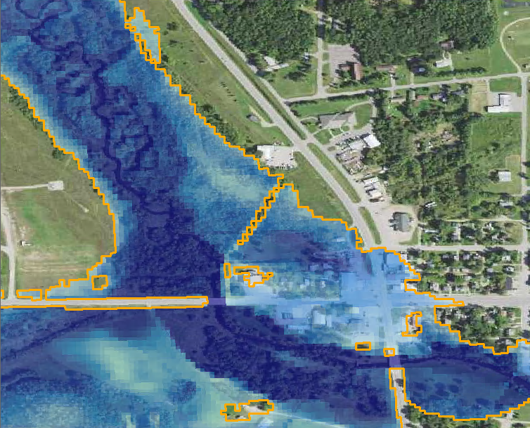
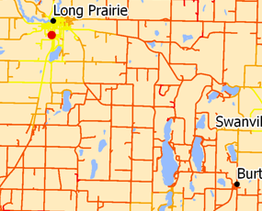
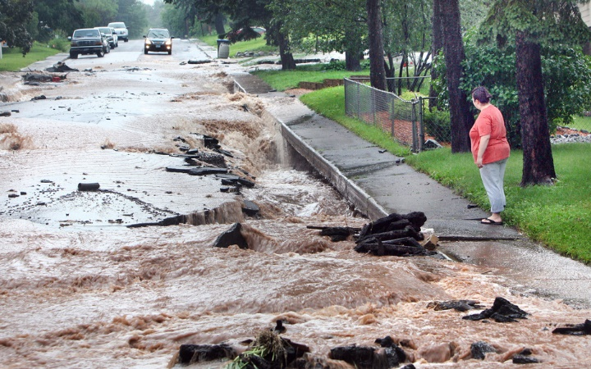
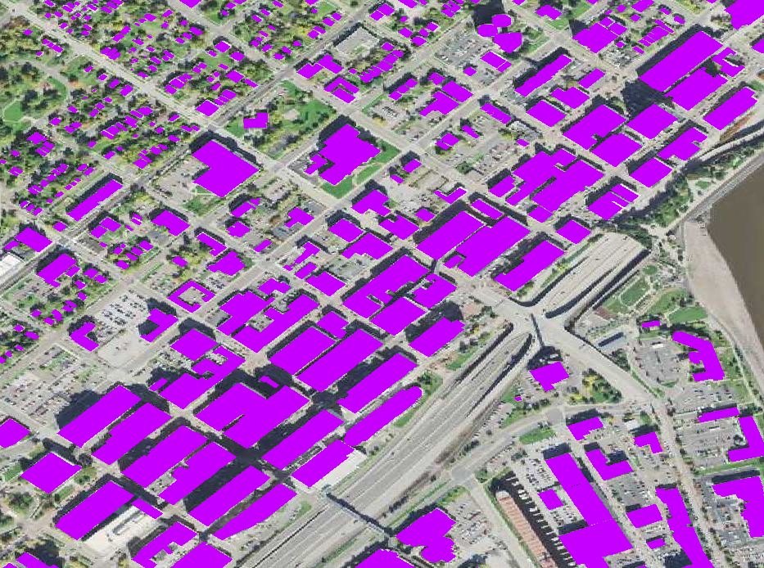
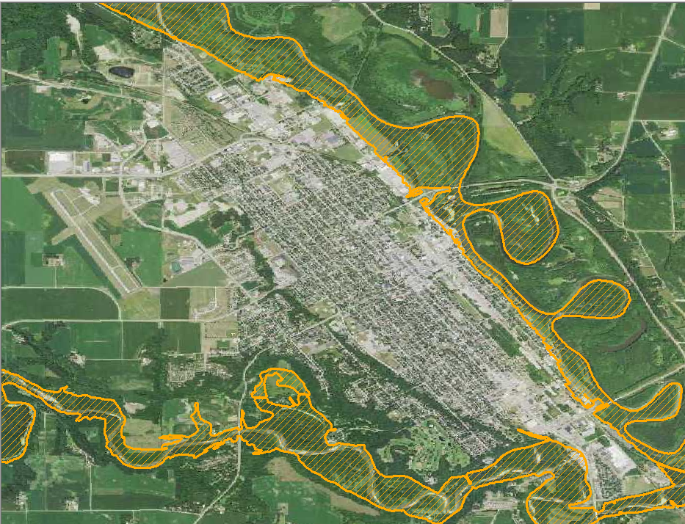
Hazard Risk and
Vulnerability Assessment
Must include: an Inventory of assets
estimation of potential human and economic losses based on the exposure and vulnerability of people, buildings, and infrastructure
Historical event data, physical data to demonstrate susceptibility or probability (e.g. Flood boundary data)
Parcel data and structure attributes
Essential and critical facilities
(incl. State Assets)

Slide 46
Essential Facilities Provide services and functions essential before, during and after a disaster
Facilities | Count | Source | Filter
Schools | 2396 | MN Department of Education | Extensive query required
Police Stations | 531 | Homeland Infrastructure Foundation Level Data (HIFLD) 2009 | All in Minnesota
Fire | 987 | Homeland Infrastructure Foundation Level Data (HIFLD) 2010 | All in Minnesota
Critical Care | 498 | MN Department of Health (2018) | Hospital, Nursing Homes, Boarding Care Home. Does not include Hospice, dialysis centers supervised living facilities

Slide 47
Critical Facilities
Vital to security, economic security, public health or safety
Critical Facility & Infrastructure Sectors | Available State-Wide Data | Source of Data
Chemical Facilities | EPA Tier II Facilities (restricted) MPCA potentially contaminated sites, permits, licenses, inspections, etc. MPCA Remediation Sites | MN Depart of Safety – HSEM MPCA (requires significant filtering)
Government Buildings and State-Owned Buildings | ARCHIBUS database COPE report (insured state-owned buildings) | Department of Administration (ADM) Department of Administration (ADM)
Communications | Applied Rapid Matrix for Emergency Response (ARMER) Communication & Radio Towers | Minnesota Department of Transportation (ARMER sites) Federal Communications Commission (antenna structure registration)
Correctional Facilities | Prisons | Minnesota Department of Corrections
Critical Manufacturing | No state-wide geospatial data available | No statewide source known
Dams and Levees | Inventory of Dams in Minnesota National Levee Database | Minnesota Department of Natural Resources U.S Army Corp of Engineers
Energy | Electric Transmission Lines & Substations | Minnesota Geospatial Information Office
Food & Agriculture | Food manufacturing, processing Livestock feedlots | No statewide source known MPCA (feedlots)
Transportation Systems | Airports, heliports, sea plane bases Roads, Passenger Rail, bridges | Federal Aviation Administration (airports) MN DOT (roads, rail)
Water (see Section 4.8.1) | Wastewater Facilities Wells | MPCA (wastewater facilities) MN Geological Survey (active public & municipal wells)

Slide 48
State Assets
May or may not be critical facilities
COPE report (ADM Risk Management) $25.3B
ARCHIBUS (ADM Enterprise Real Property) $8.8B
UMN and MNSCU
State-leased assets $1.3M
Agency Name | Number of Structures | CRV sum
Agriculture | 1 | $7,079,845
Amateur Sports Commission | 24 | $170,280,044
Department of Administration | 56 | $1,729,319,518
Department of Commerce | 1 | $793,588
Department of Corrections | 331 | $2,625,984,833
Department of Employment & Economic Development | 2 | $6,819,591
Department of Human Services | 169 | $831,325,918
Department of Natural Resources | 2881 | $623,882,633
Department of Transportation | 896 | $1,277,929,794
Historical Society | 154 | $318,226,310
Iron Range Resource | 65 | $48,509,696
Military Affairs | 1324 | $623,010,068
Minnesota State Academies (not assessed) | 19 | $0
Minnesota Veterans Affairs | 63 | $313,818,411
Minnesota Zoological Garden | 124 | $179,415,066
MN State Retirement Systems | 2 | $46,787,116
Perpich Center | 5 | $37,351,824
Pollution Control Agency | 18 | $10,523,744
Public Safety | 6 | $4,611,357
State Fair (not assessed) | 77 | $0

Slide 49
Next Steps
What is the role of the GAC to ensure we have the best data available for Hazard Mitigation, Emergency Management and other risk assessment needs?
EPC Tiger Team focused on Critical Facilities and State Asset Data?

Slide 50
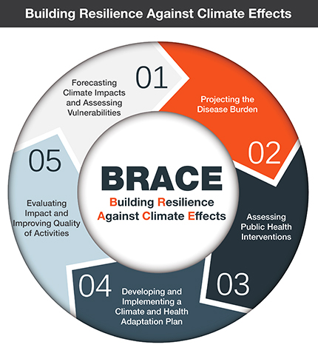
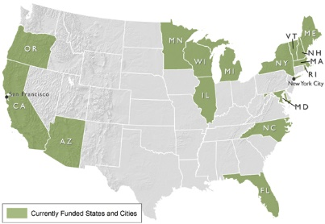
Minnesota Climate & Health Program
CDC’s Climate-Ready States & Cities Initiative Grantees

Slide 51
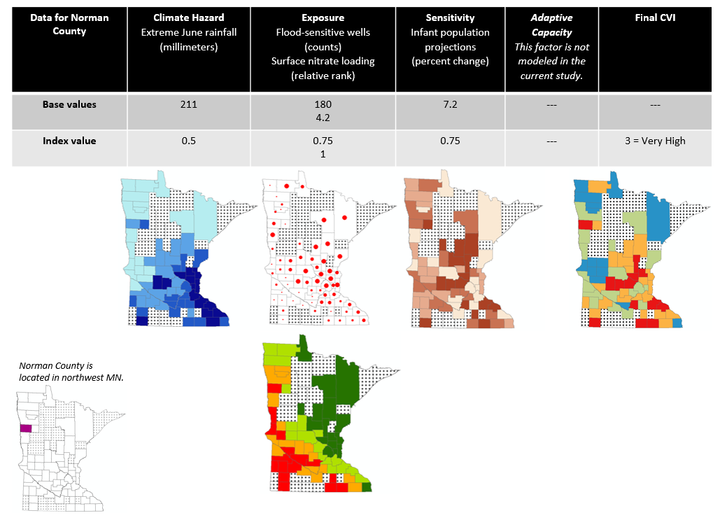
Climate projection data to assess future exposure burden to MN private well users

Slide 52
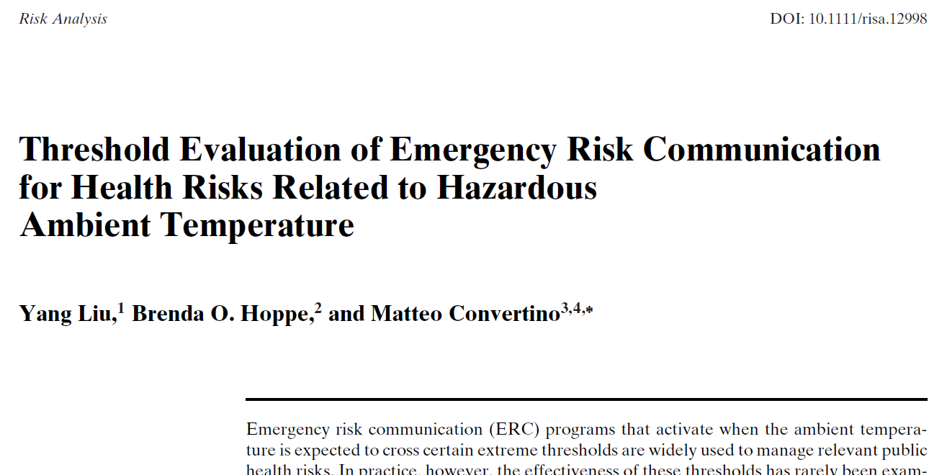
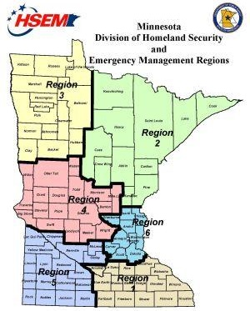
Climate projection data to assess future disease burden to MN from ambient temperatures
Climate projection data for emergency management and preparedness planning

Slide 53
The Past No Longer Predicts the Future

Slide 54
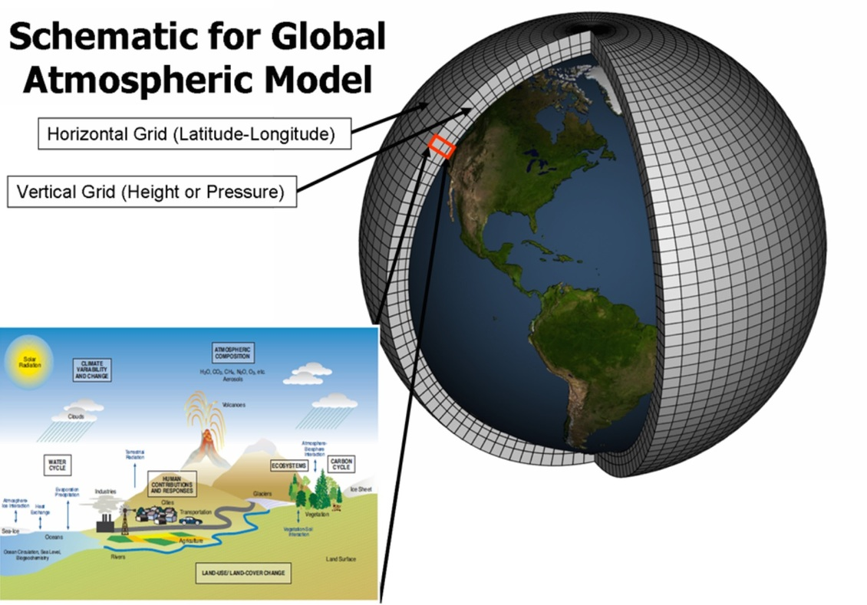
What’s the Big Deal with Climate Data?
Image courtesy of Geophysical Fluid Dynamics Laboratory, National Oceanic and Atmospheric Administration, USA

Slide 55
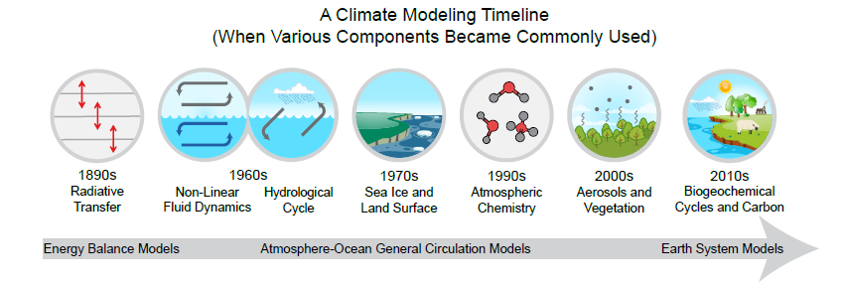
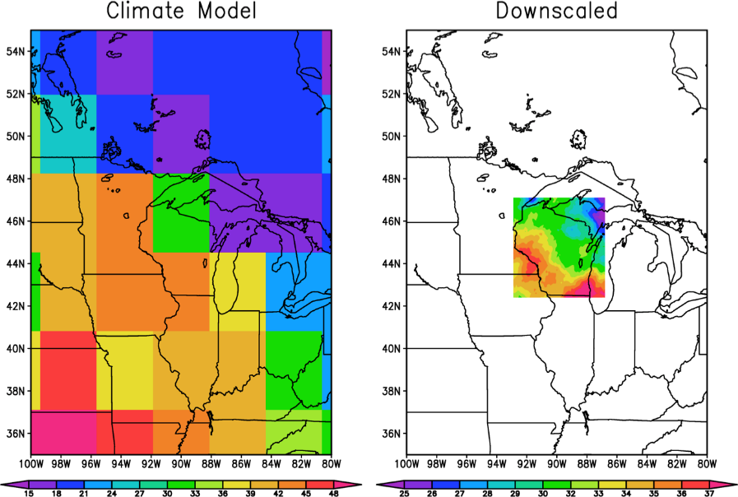
What’s the Big Deal with Climate Data?
Image from Fourth NCA, Vol 1.

Slide 56
“What gets measured gets managed.”
- Peter Drucker, management guru

Slide 60
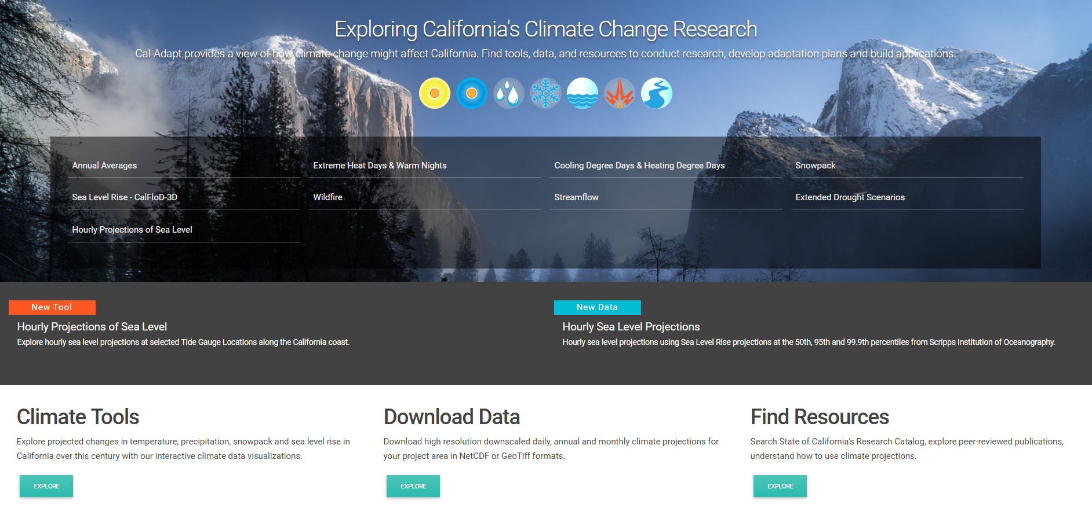
CAL-ADAPT

Slide 61
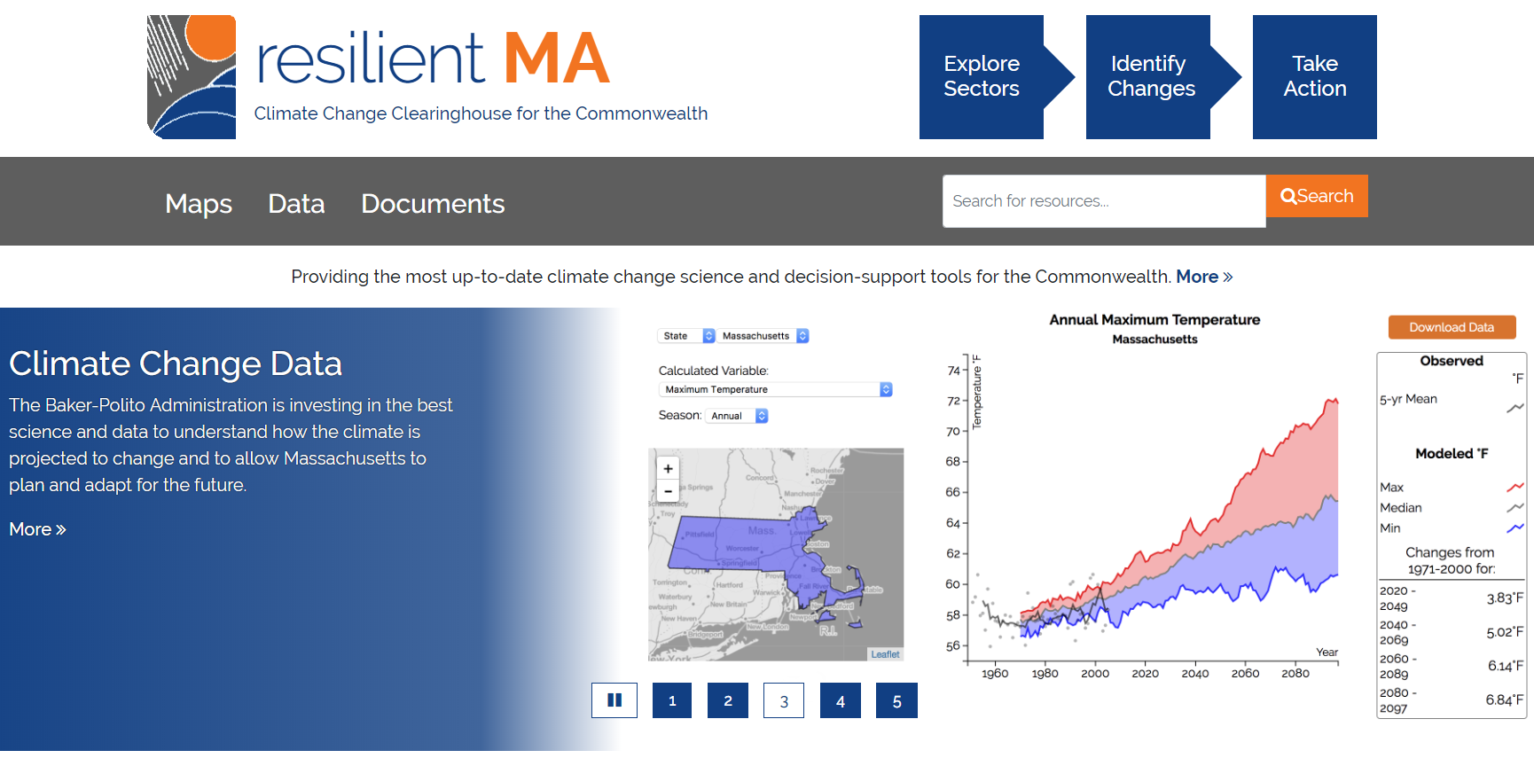
resilient MA

Slide 63
Stacey Stark, Director
Geospatial Analysis Center
University of Minnesota Duluth
slstark@d.umn.edu
Dr. Brenda Hoppe,
Senior Research Scientist, MDH
MN Climate and Health Program
brenda.hoppe@state.mn.us

Slide 64
Agenda Item 11
3D Geomatics workgroup chairs updates
Andrea Bergman, Rick Moore, Jamie Schulz

Slide 65
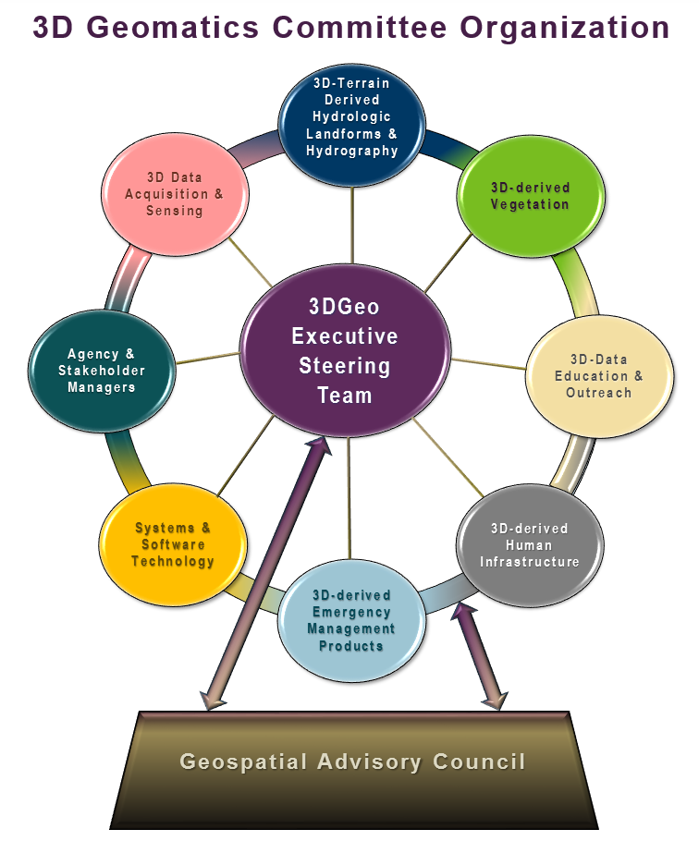
MN Geospatial Advisory Council 3D Geomatics Committee Update
3D Geomatics Committee Co-Chairs
Sean Vaughn, MNIT@DNR | Gerry Sjerven, Minnesota Power
Wednesday, March 6, 2019 11:00 PM
Blazing Star Room
Centennial Building, St. Paul
Hydrologic Landforms and Hydrography Workgroup Co-chairs
Andrea Bergman , MNIT@DNR | Rick Moore , MNIT@DNR | Jamie Schulz , MNIT@DNR

Slide 66
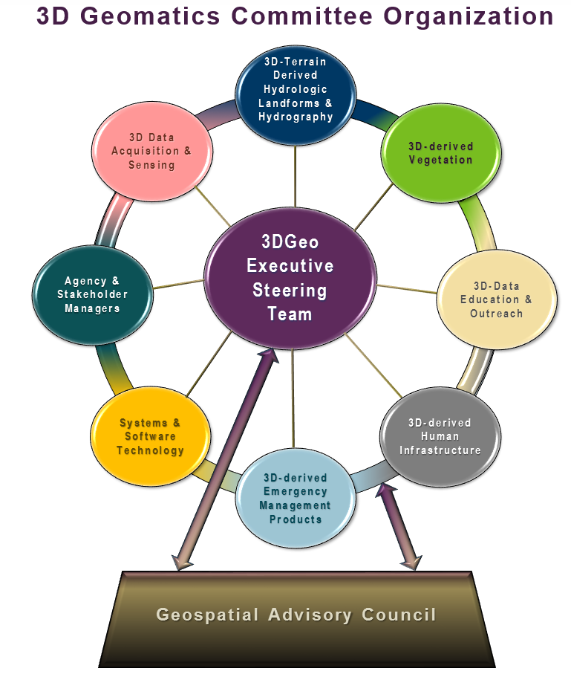
3D-Geo → Committee Organization
Sectors of Expertise
Multidiscipline committee organized by workgroups
Each discipline sector is comprised of subject matter experts
Five workgroup-sectors now established
Today is a focused update on recent activities on three workgroups
Education, Acquisition, and Hydro

Slide 67
3D-Geomatics → Education & Outreach Workgroup
“The Education Workgroup”
Established by champion Joel Nelson, U of MN, St. Paul
Draft work plan has been developed
Seeking membership
Mission Statement
“The Minnesota 3DGeo Education Workgroup identifies education and training needs for 3D Geomatics statewide to guide curriculum content development. The group will also serve a collaborative role among other 3DGeo workgroups and the Minnesota Geospatial Advisory Council to ensure LiDAR education funding is attached to any future Minnesota LiDAR proposal.”

Slide 68
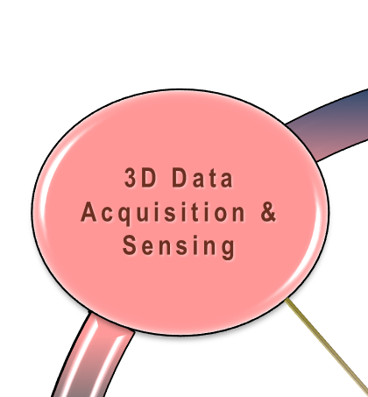
3D-Geomatics → Acquisition & Sensing Workgroup
“The LiDAR Acquisition Workgroup”
Committee guided LiDAR acquisition for Minnesota
Building diverse needs, one collective voice
Guiding Minnesota’s Statewide LiDAR Acquisition Plan
Alison Slaats, MnGeo is coordinating the plan
Draft Work Plan
Draft Mission Statement
“The 3D Data Acquisition and Sensing Workgroup serves as the data acquisition steering panel of the 3D Geomatics Committee bringing committee guided 3D data (i.e. LiDAR) to Minnesota. The group promotes LiDAR acquisition by engaging stakeholders; providing guidance and writing standards; defining value and benefits of the data; defining management and dissemination needs; bridging disparate LiDAR procurements; and serving as liaisons to USGS 3D Nation and UGSG 3DEP programs..”

Slide 69
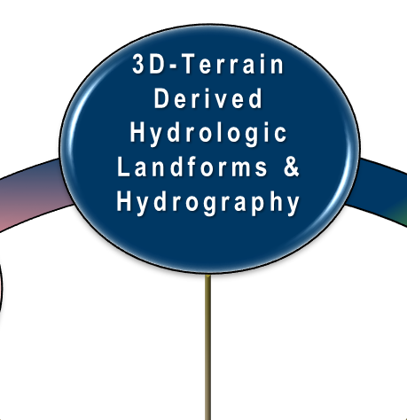
3D-Geomatics → Hydrologic Landforms and Hydrography Workgroup
“Hydro Workgroup”
Officially formed March of 2018
Managed by three co-chairs
Rick, Jamie and Andrea are here to present next
Under their leadership the Hydro Workgroup has made great progress

Slide 70
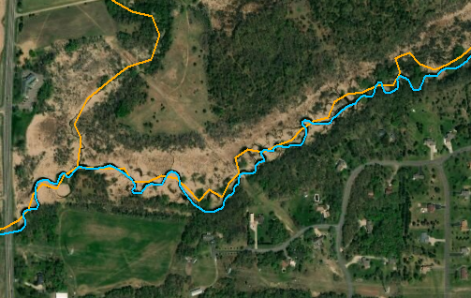
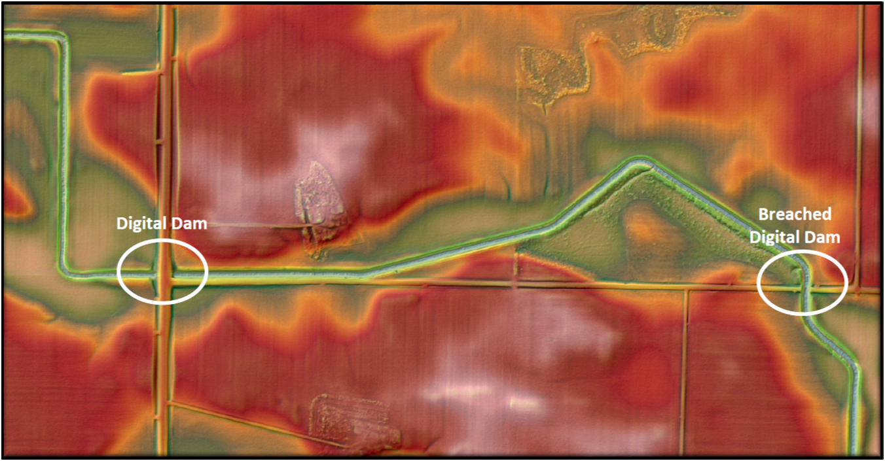
3D Geomatics Hydrologic Landforms and Hydrography Workgroup
Andrea Bergman | Rick Moore | Jamie Schulz | Sean Vaughn

Slide 71
3D-Geomatics → Hydrologic Landforms and Hydrography Workgroup
“Hydro Workgroup”
Building on the past, moving to the future
Dedicated individuals representing government, academia, and private sector interests
Diverse needs, one collective voice
Mission Statement
“The 3DGeo Hydrologic Landforms and Hydrography Workgroup of the 3D Geomatics Committee exists to promote the consistent development of Minnesota's hydrography data and to enable data exchange through coordination, cooperation and standards development.”

Slide 72
3D-Geomatics → Hydro Workgroup
Diverse membership of subject matter experts
Currently 12 Responsible-Accountable Members
State
Federal
Name | Organization
Andrea Bergman | MNIT@DNR-EWR
Jen Crea | MNIT@MPCA
Matt Drewitz | BWSR
Rick Moore | MNIT@DNR-EWR
Jamie Schulz | MNIT@DNR-FSH
Sean Vaughn | MNIT@DNR-EWR
Name | Organization
Ann Banitt | USACE
Thomas Hollenhorst | EPA
Brandon Krumwiede | NOAA
Christiane Roy | USDA - NRCS
Academic and Private
Name | Organization
Tyler Grupa | Water Resource Center (MSU-Mankato)
Kiah Sagami | Houston Engineering, Inc

Slide 73
3D-Geomatics → Hydro Workgroup
Expanded network of 18 Consulted-Informed Members
State
Federal
Name | Organization
Lyn Bergquist | MNIT@DNR-FSH
Ben Gosack | DNR-EWR
Rick Lorenzen | MNIT@DNR-EWR
Doug Norris | DNR-EWR
Jill Pohjonen | DNR-EWR
Aaron Spence | MNIT@BWSR
Casey Scott | MPCA
Angus Vaughan | MPCA
Barbara Weisman | DNR-EWR
Andy Williquett | MNIT@DNR-FSH
Name | Organization
Joe Brennan | USDA - NRCS
Kevin Hanson | USACE
Kari Hedin | Fond du Lac
Brian Huberty | USFWS
Local
Name | Organization
Alan Laumeyer | Goodhue County
Academic and Private
Name | Organization
Whitney DeLong | University of Minnesota
Chuck Fritz | International Water Institute
Grit May | International Water Institute

Slide 74
3D-Geomatics → Hydro Workgroup
We are putting together pieces of the hydrography data steward and data users puzzle
Workgroup has highlighted work of members and how they use hydrography data to understand:
How people currently use and interact with data
Limitations people face with current data
Opportunities created with LiDAR-derived hydrography data

Slide 75
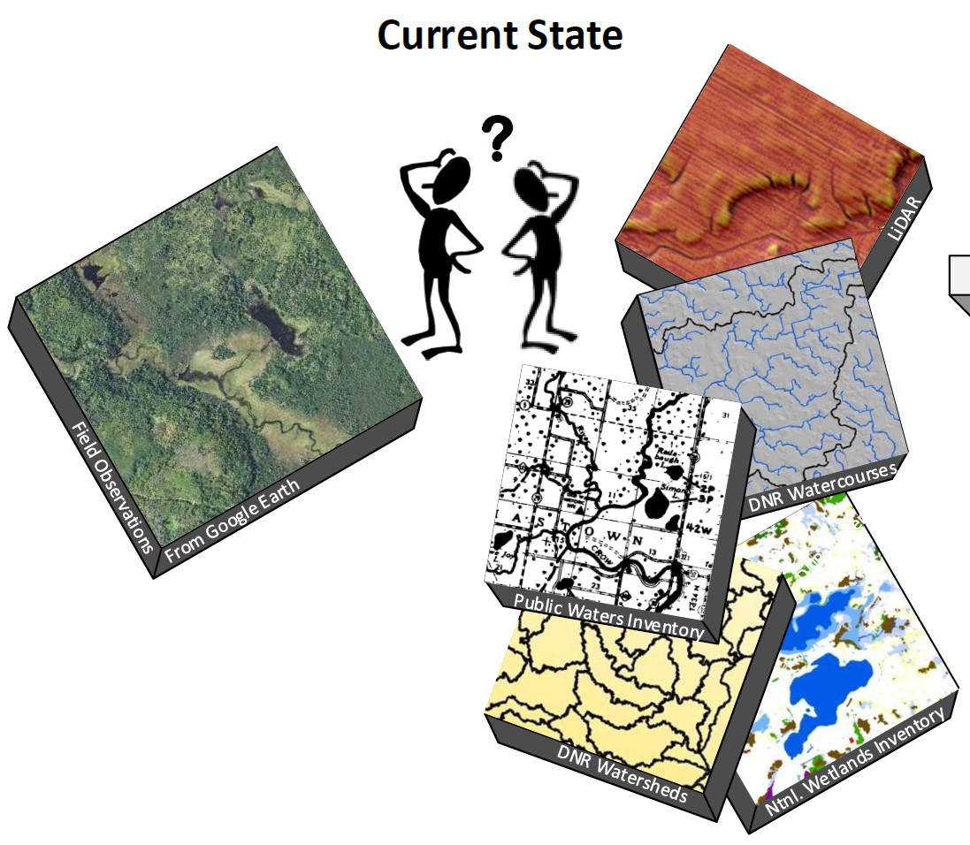
3D-Geomatics → Hydro Workgroup → Where is hydrography data today?
Today we have:
Multiple, out-of-sync copies of hydrography data
Locations of stream centerlines based on historic maps
Inefficient processes for creating derived data products
Costly field site verifications
Missing data lowers public trust
Current Status

Slide 76
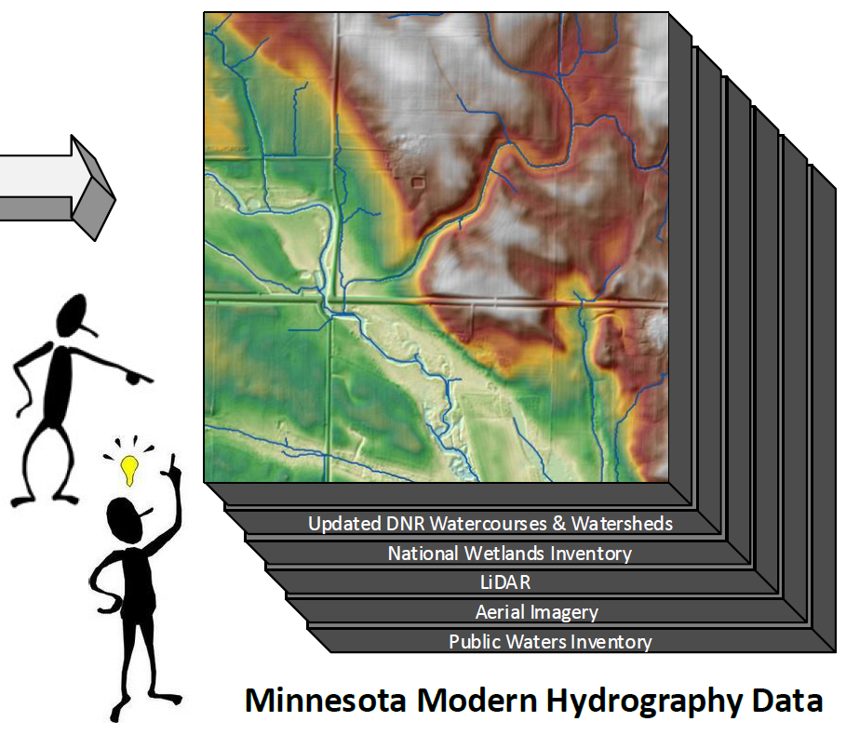
3D-Geomatics → Hydro Workgroup → The future?
What we could have:
Single, authoritative data source
Harmonized data that leverages recent state investments
Automated processes identify changes on the landscape
High-resolution data that minimizes field site verifications
Enhanced public trust in watershed management decisions

Slide 77
3D-Geomatics → Hydro Workgroup → Subgroups
Two subgroups are diving deeper into topics identified by the work group
These topics will position Minnesota to develop modern LiDAR-derived hydrography products
Data Catalog
Breachline

Slide 78
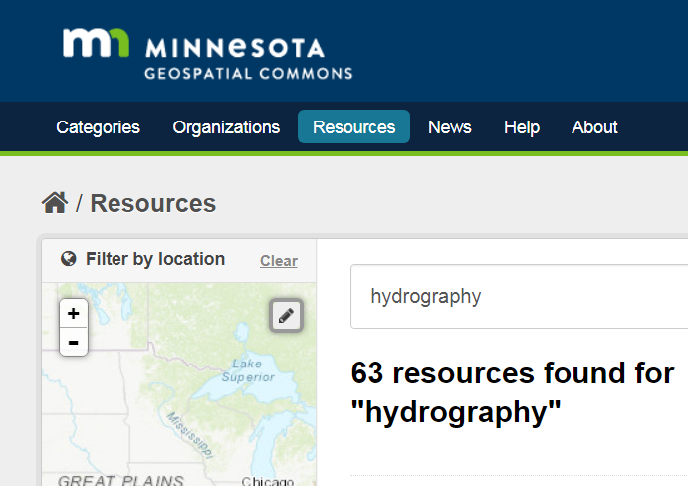
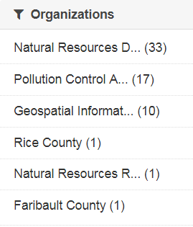
3D-Geomatics → Hydro Workgroup → Data Catalog Subgroup
Mission Statement
“To create an inventory of existing geospatial hydrography data used across Minnesota to help guide the development of new LiDAR-derived hydrography to better serve modern business needs.”

Slide 79
3D-Geomatics → Hydro Workgroup → Data Catalog Subgroup
Purpose of the Data Catalog Subgroup
Understand the wide scope of hydrography data needs in the state
Identify limitations of current data
Identify missing datasets that users need
Define requirements of a new LiDAR collect for development of derived hydrography products

Slide 80
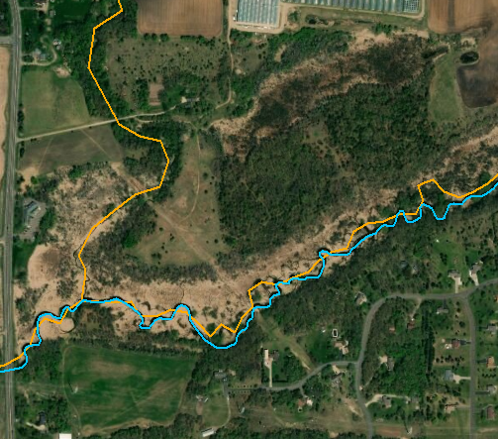
3D-Geomatics → Hydro Workgroup → Data Catalog Subgroup
Key Points
Hydrologic features are dynamic – they change over time
LiDAR captures these changes which is important for data integrity
Current data is not meeting user needs
Users are creating their own data to fulfill business needs
Duplicating work leads to loss of staff time and money
The attributes of existing data are essential, and will need to be transferred to new hydrography products

Slide 81
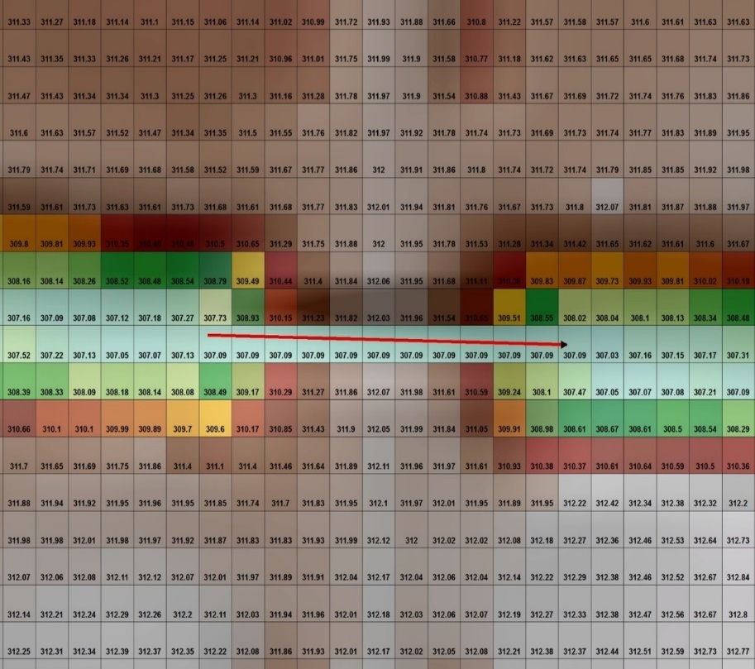
3D-Geomatics → Hydro Workgroup → Breachline Subgroup
Mission Statement
To develop the foundation for a single, authoritative, digital dam breachline dataset for Minnesota utilizing standards and methodology through collaboration with breachline subject matter experts.

Slide 82
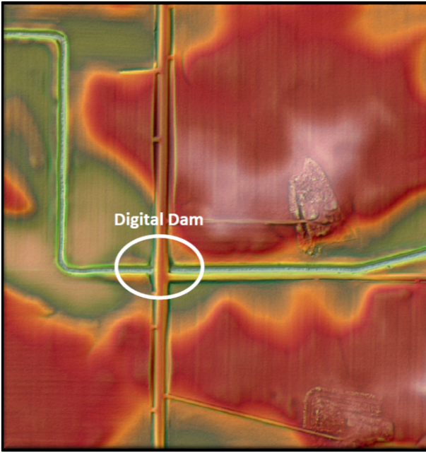
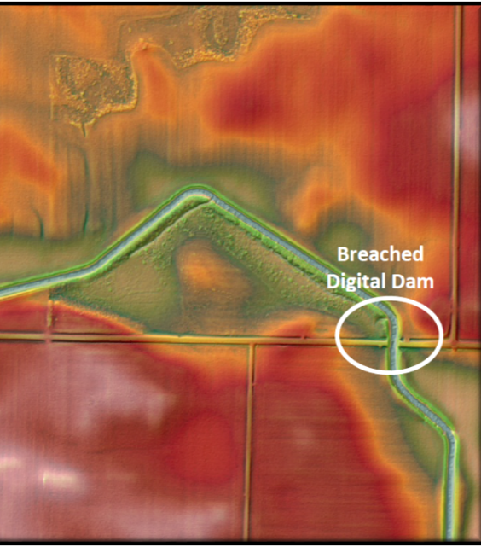
3D-Geomatics → Hydro Workgroup → Breachline Subgroup
Purpose of the Breachline Subgroup
Capitalize on knowledge of subject matter experts who have built their own individual digital dam breachline datasets.
Develop Standards, Methodology, and QA/QC Protocol to support the breachline dataset.
Publish these features into one authoritative breachline dataset for use in developing hydro-modified digital elevation models (hDEMs).
Support public and private business needs associated with hydrologic modeling of the landscape using hydro-terrain analysis tools (e.g., PTMApp and ACPF).

Slide 83
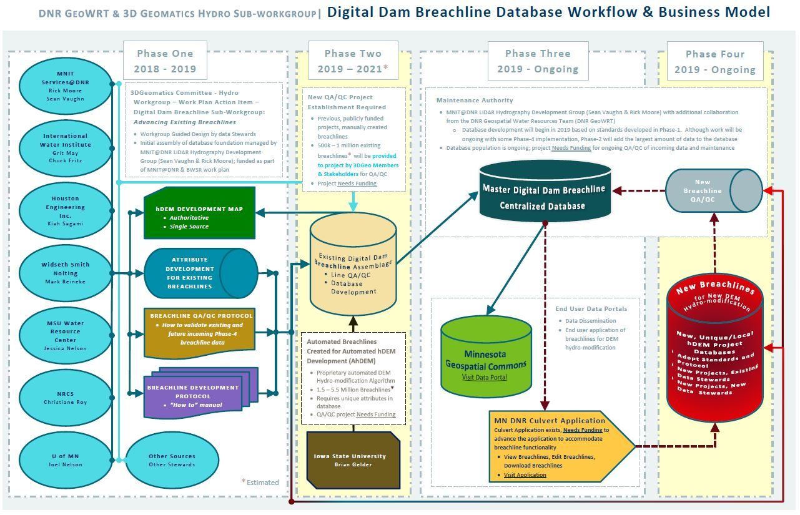
3D-Geomatics → Hydro Workgroup → Breachline Subgroup

Slide 84
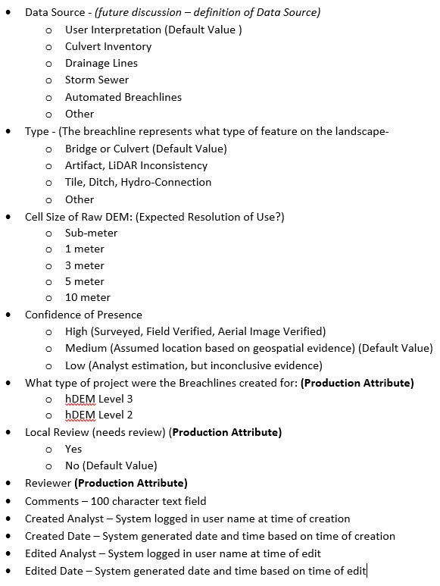
3D-Geomatics → Hydro Workgroup → Breachline Subgroup
Developments of the Breachline Subgroup
Standardized Attributes
Methodology and Protocol
Pilot of Breachline Data and Work Area Identification

Slide 85
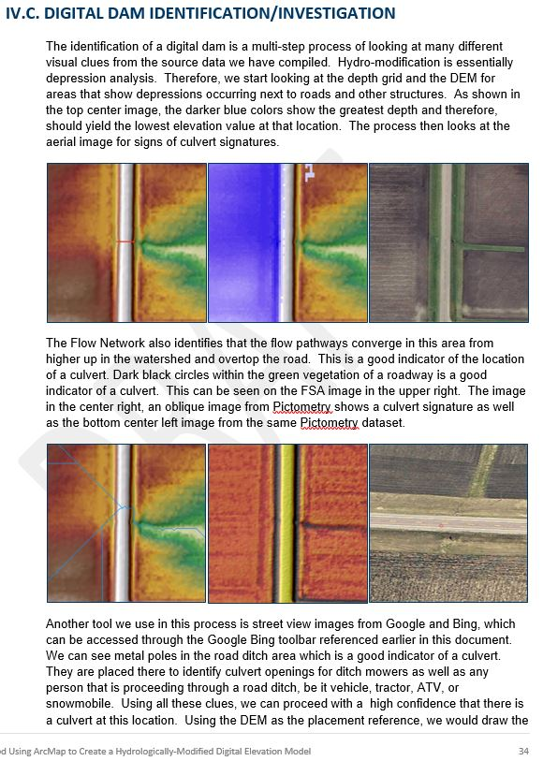
3D-Geomatics → Hydro Workgroup → Breachline Subgroup
Developments of the Breachline Subgroup
Standardized Attributes
Methodology and Protocol
Pilot of Breachline Data and Work Area Identification

Slide 86
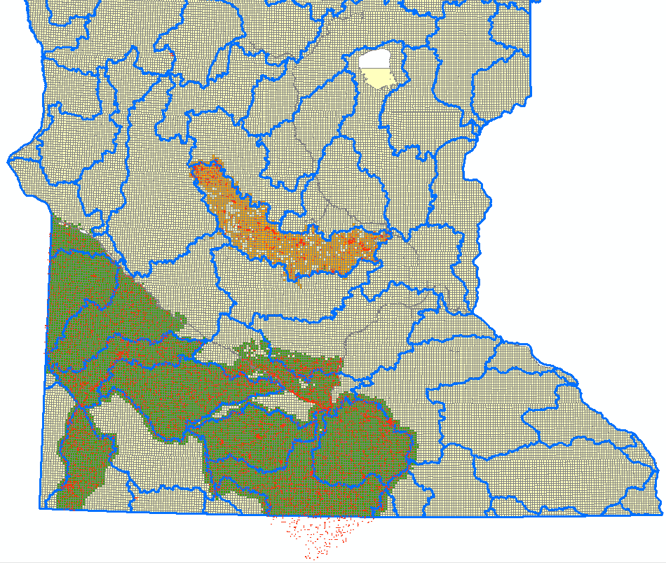
3D-Geomatics → Hydro Workgroup → Breachline Subgroup
Developments of the Breachline Subgroup
Standardized Attributes
Methodology and Protocol
Pilot of Breachline Data and Work Area Identification

Slide 87
Thank You!
Andrea Bergman | Rick Moore | Jamie Schulz | Sean Vaughn | Gerry Sjerven
3D Geomatics Committee
www.mngeo.state.mn.us/committee/3dgeo
3D Geomatics Hydrologic Landforms and Hydrography Workgroup www.mngeo.state.mn.us/committee/3dgeo/hydro

Slide 88
Agenda Item 12
Legislative updates
Mark Kotz

Slide 89
Agenda Item 13
Updates on GAC priority projects and initiatives
Mark Kotz

Slide 90
Agenda Item 13
GAC Rank | Project or Initiative Description | Status | Project Owner | Champion
1 | All Data Free and Open | Active | Len Kne | Dan Ross
2 | Image Service - Sustain | Active | Mike Dolbow | Dan Ross
3 | Updated and Aligned Boundary Data | Active | Preston Dowell | Dan Ross
4 | Parcel Data | Active | Mike Dolbow | Mark Kotz
5 | Archiving Policy/Procedure | Active | Ryan Mattke | many
6 | Road Centerline Data | Active | Norm Anderson | Dan Ross
7 | New LiDAR Acquisition | Active | Gerry Sjerven | Dan Ross
8 | Address Points Data | Active | Norm Anderson | Dan Ross
9 | MN Focused Basemap Services | Active | Sonia Dickerson | Dan Ross
10 | Parks and Trails Data Standard | Active | Jim Bunning | Dan Ross
11 | EM Damage Assess Data Standard | Active | Brad Anderson, Cory Richter
12 | Accurate Hydro-DEMs | Active | Sean Vaughn

Slide 91
Agenda Item 14
Collaboration sites for committees and workgroups
Alison Slaats

Slide 92
Overview
MnGeo set up a GAC SharePoint site to provide a collaboration workspace
Any committee or workgroup can request a “sub-site” for their work (but not a sub-sub-site)
Committee responsibilities | MnGeo responsibilities
Content management | Create sites Maintain user permissions Help with content management

Slide 93
Guidelines & Best practices
SharePoint site should be used for:
Document creation and editing
Working together
SharePoint site should not be used for
Sharing of official documents, communications, and publications
Public access to GAC or Committee/Workgroup information
A permanent archive of Committee/Workgroup​ efforts

Slide 94
Collaboration Parent Site
SharePoint blah blah blah

Slide 95
3D Geomatics Committee Subsite

Slide 96
Agenda Item 15
Announcements or other business

Slide 97
Adjourn
Thank you!
Next meeting is Wednesday, May 29, 2019

