Slide 1



Minnesota Geospatial Advisory Council
May 29, 2019

Slide 2
Welcome
Introductions
Approve agenda
Approve March minutes

Slide 3
Agenda
Time | Topic
11:15 | Committee and workgroup summaries - Review and accept
11:20 | Road Centerline Data Standard - Approve
11:30 | Positional Accuracy and U.S. National Grid Standards - Approve
11:35 | Standards approval process document - Approve
11:40 | Archiving Workgroup update
11:55 | Awards group status
12:00 | Break, networking
12:30 | GAC appointment process
12:35 | Metro Stormwater Data project
12:55 | Sector reports (Richason and Anderson)
1:15 | Legislative updates
1:25 | GAC priority projects and initiatives updates
1:45 | Announcements

Slide 4
Agenda Item 2
Committee and workgroup summaries - Review and accept

Slide 5
Agenda Item 3
Road Centerline Data Standard - Approve
Mark Kotz

Slide 6
Road Centerline Data Standard
Proposed by state NG 9-1-1 Standards Workgroup
Integrates Metro Regional Centerline Collaborative (MRCC) specifications
Additional key attributes identified by NG 9-1-1 Standards Workgroup
Two rounds of public review
  January 28 - March 13, 2019
  April 9 - June 8, 2018
Approved by Standards Committee May 2, 2019.

Slide 7
Road Centerline Data Standard
Standards Committee requests approval by GAC
But wait…. Late breaking news…
Change field order in Section 7 to match Address Points Data Standard

Slide 8
Agenda Item 4
GCGI Standards - Approve
Positional Accuracy Measuring and Reporting
United States National Grid
Mark Kotz

Slide 9
Approval of GCGI Standards
GCGI adopted 10 standards beginning in 1994
GAC approved idea of revisiting and updating format for approval by GAC
Approved 3 standards in March
  State ID
  County ID
  CTU ID

Slide 10
Approval of GCGI Standards
Positional Accuracy Measuring and Reporting
United States National Grid
See separate handouts
Updated to GAC standard intro language and format
No changes to specifications of the standard
Approved by Standards Committee April 11, 2019

Slide 11
Agenda Item 5
GAC Standards Approval Process - Approve
Mark Kotz

Slide 12
Standards Approval Process
Purpose:
Formalize process for proposing, approving & revising standards
Have process sanctioned (approved) by GAC

Slide 13
Standards Approval Process
Documents roles of Proposers & Standards Committee
Defines the public review process
Explains the process for changing a standard
Describes supporting materials for standards
Approved by Standards Committee April 11, 2019

Slide 14
Agenda Item 6
Archiving Workgroup update
Ryan Mattke

Slide 15
Archiving Workgroup
Mission statement:
Define policies, best practices, and procedures for archiving geospatial data in Minnesota, so that a wealth of valuable geospatial data can be preserved and available for future use.
Deliverables:
Policies
Best Practices
Procedures
Report
Presentation at 2019 MN GIS/LIS Conference

Slide 16
Archiving Workgroup
Members:
David Bendickson
Art Botello
Len Kne
Mark Kotz
Mike Koutnik
Karen Majewicz (Vice Chair)
Andra Mathews
Ryan Mattke (Chair)
Colleen Paavola
Dan Ross
Ben Timerson
Denise Tingstad
Brandon Tourtelotte
Hal Watson
Activity:
Nine subgroups working on various aspects of the deliverables and objectives
Work to be completed by August 2019

Slide 17
Archiving Workgroup
Objectives:
Engage with data stewards and relevant stakeholders
Create a priorities list of data sets
Collaborate with MnGeo on a strategy for archiving imagery layers
Explore ways to streamline or eliminate license agreements
Explore what an archiving agreement would look like
Create an archiving strategy
Educate the geospatial community about archiving

Slide 18
Archiving Workgroup
August - December 2018:
Group formed
Distributed a stakeholder survey to:
  obtain feedback regarding the possible archiving of geospatial data
  provide a framework for compiling a more comprehensive questionnaire for data stewards and stakeholders
  capture the relevant topics of interest toward data archiving methods, prioritization of archival dataset pilot projects, and related data archiving concerns
Created a priorities list of data sets to focus on for archiving purposes

Slide 19
Archiving Workgroup
January - May 2019:
Completed the 2018 Public Geospatial Data Archive Survey Report
Drafted a Priority Datasets Report
Working with MnGeo on a pilot for archiving imagery data
Developed template license language for data to be archived
Developing a draft Archiving Agreement (to include data collection policy, end-user access policy, preservation policy, license language, terms of use, content guidelines, and support levels for various files types)

Slide 20
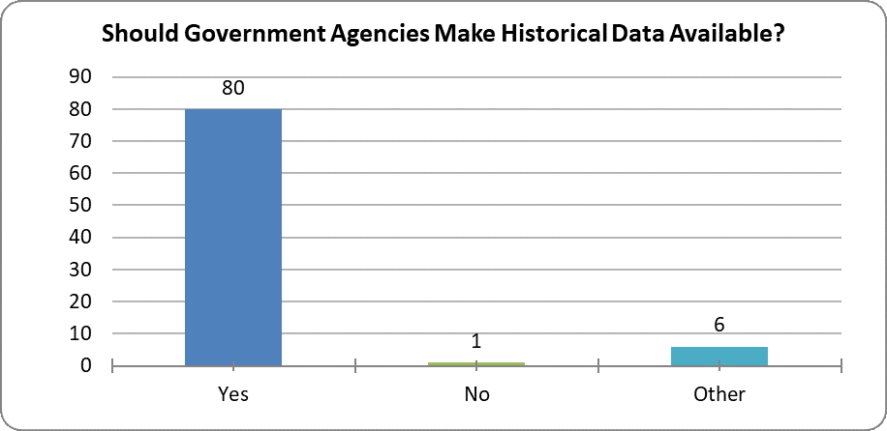
Archiving Workgroup

Slide 21
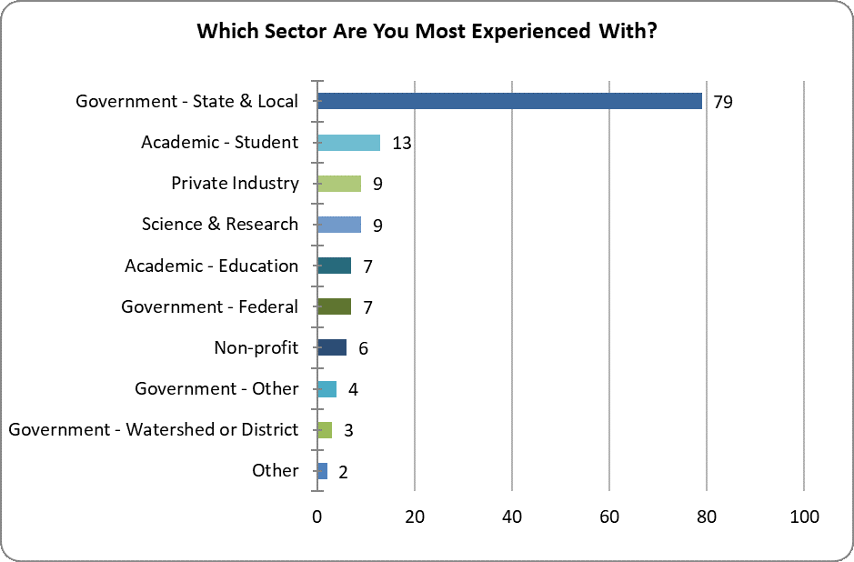
Archiving Workgroup

Slide 22
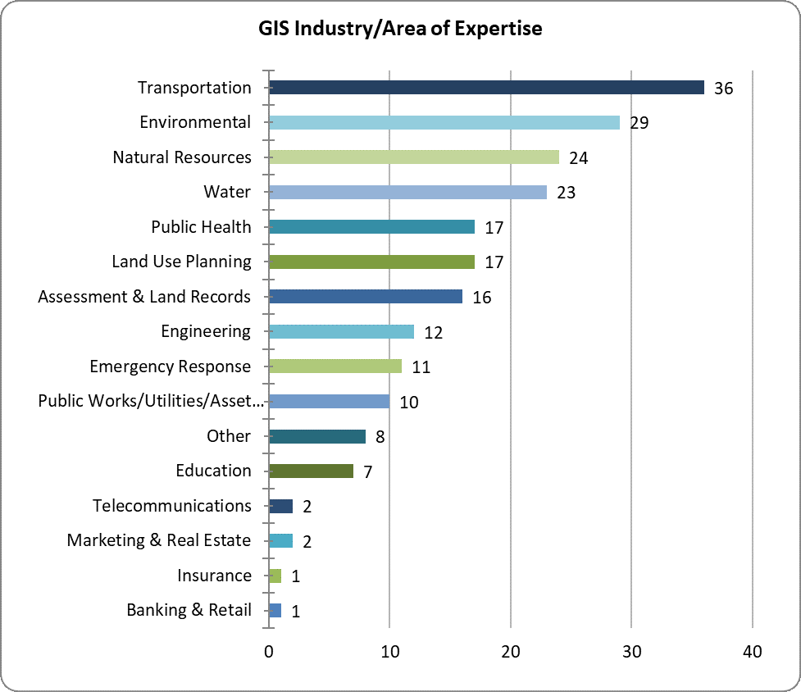
Archiving Workgroup

Slide 23
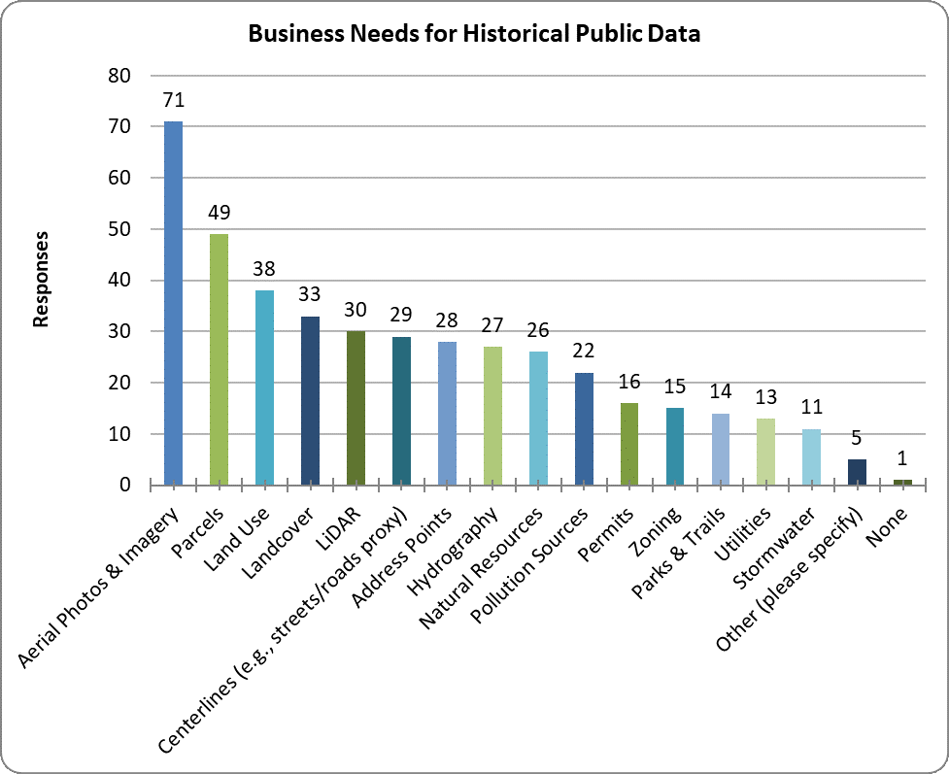
Archiving Workgroup

Slide 24
Archiving Workgroup
Next Steps (June - October 2019):
Complete a draft Archiving Agreement
Create an Archiving Strategy document to identify:
  Data transfer workflow options
  Repositories and discovery platforms
  Estimated costs
Complete Final Report (for September GAC meeting)
Present at GIS/LIS (October)
  Poster (Survey)
  Lightning Talk (Progress)
  Panel (GAC activities)

Slide 25
Archiving Workgroup
Questions?

Slide 26
Agenda Item 7
Awards group status
Cory Richter

Slide 27

Break - Networking

Slide 28
Agenda Item 9
GAC appointment process
Nancy Rader

Slide 29
Agenda Item 10
Metro Stormwater Data Project
Geoff Maas

Slide 30



Metro Stormwater Geodata Project:
Overview and Update
Geoff Maas
MetroGIS Coordinator

Slide 31
Metro Stormwater Geodata Project:
Overview and Update
>> Purpose
>> Overview of the project
>> Current status
>> Upcoming work

Slide 32

Metro Stormwater Geodata Project:
Purpose of the project

Slide 33

Metro Stormwater Geodata Project:
Purpose of the project
Define the business needs for a
stormwater transfer standard;
Develop a prototype standard
Publish prototype standard and sample data for testing and review by the stakeholder community

Slide 34
Metro Stormwater Geodata Project:
Purpose of the project
Define the business needs for a
stormwater transfer standard;
Develop a prototype standard
Publish prototype standard and sample data for testing and review by the stakeholder community

Slide 35
Metro Stormwater Geodata Project:
Purpose of the project
Define the business needs for a
stormwater transfer standard;
Develop a prototype standard
Publish prototype standard and sample data for testing and review by the stakeholder community

Slide 36
Metro Stormwater Geodata Project:
Purpose of the project
Long-Term Goals:
Creation of a transfer standard and supporting documentation that supports the work of engineering, municipal, county, regional, state, federal and other interests in creating, maintaining, federating and sharing geospatial data representing stormwater system features.

Slide 37
Metro Stormwater Geodata Project:
Purpose of the project
Why do this?
Functional needs:
Data creation, maintenance, sharing & federation;
“Philosophical” needs:
Water is a shared inter-jurisdictional resource
Complex topic
Wide inter-disciplinary interaction

Slide 38
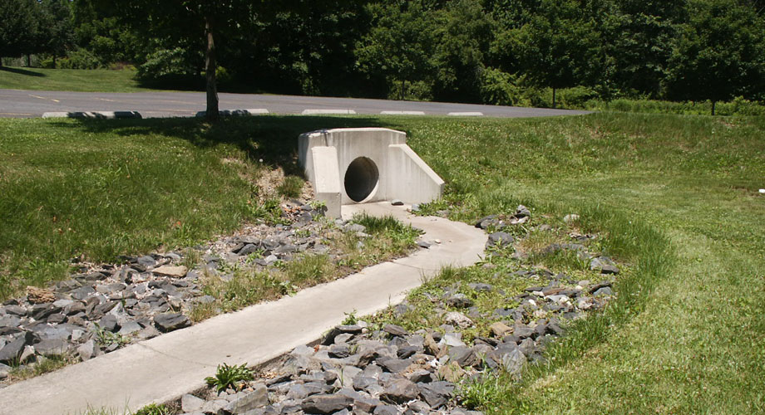
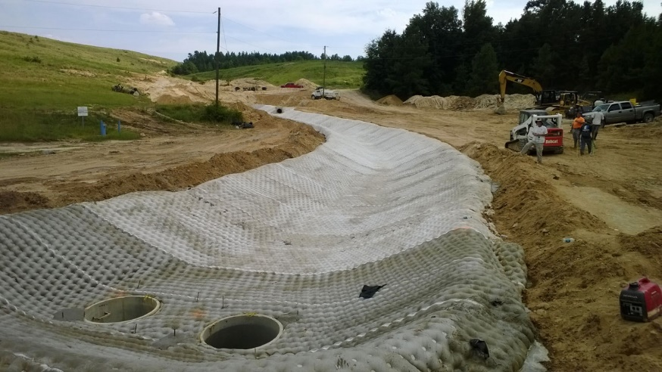

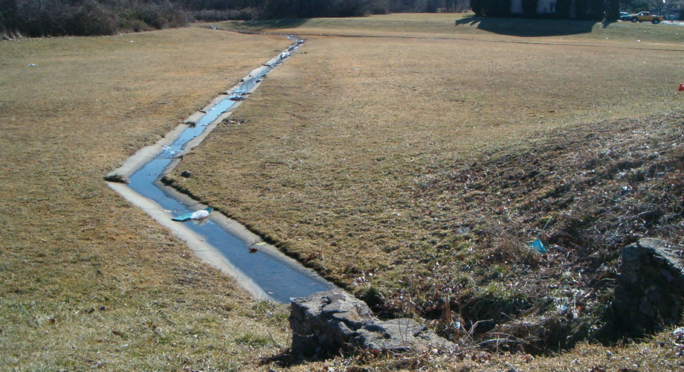
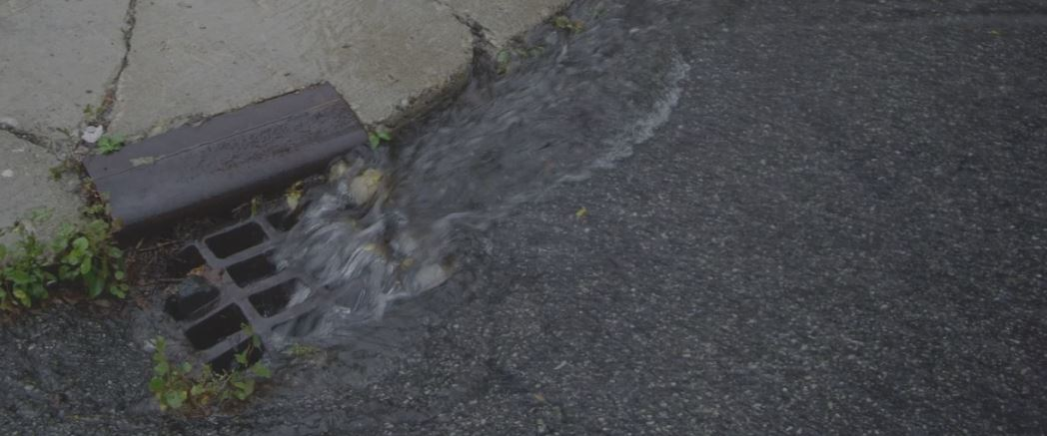


Slide 39
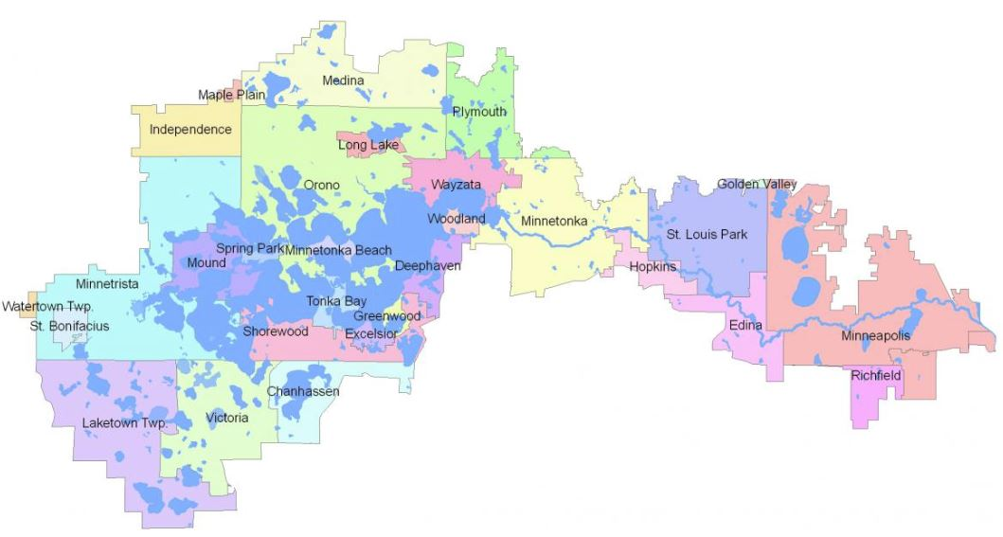
Minnehaha Creek Watershed District

Slide 40
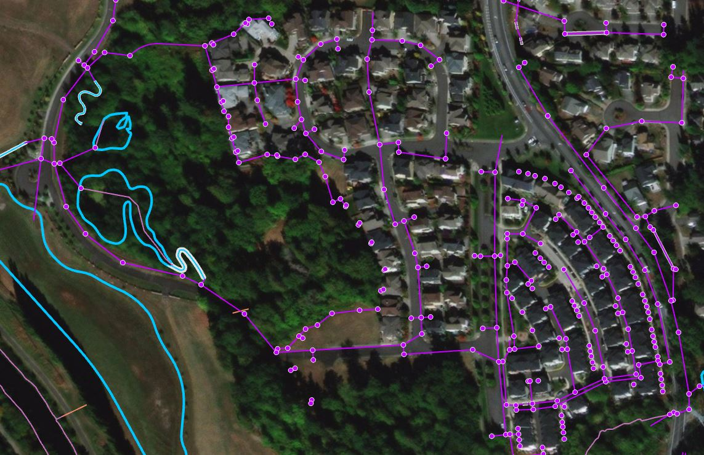

Points, lines, polygons, oh my!

Slide 41
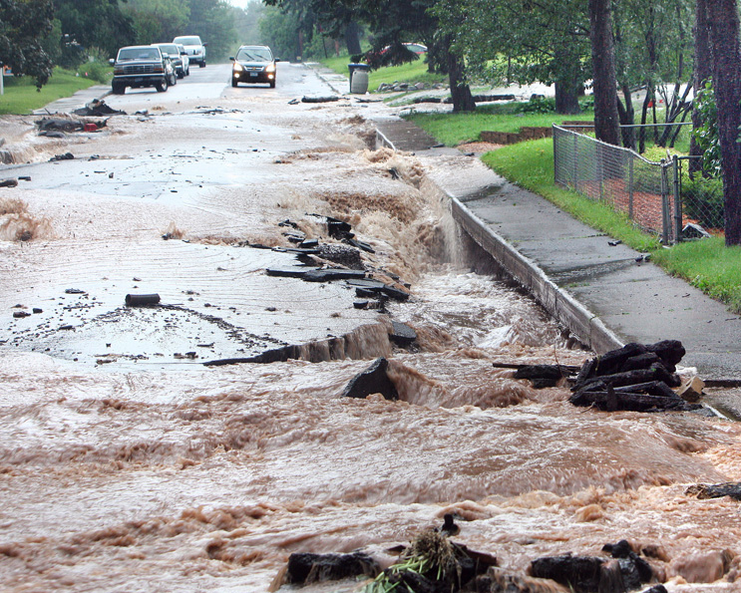
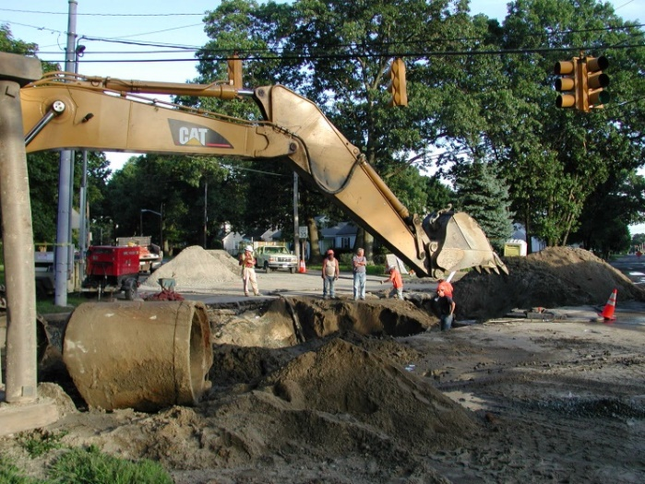
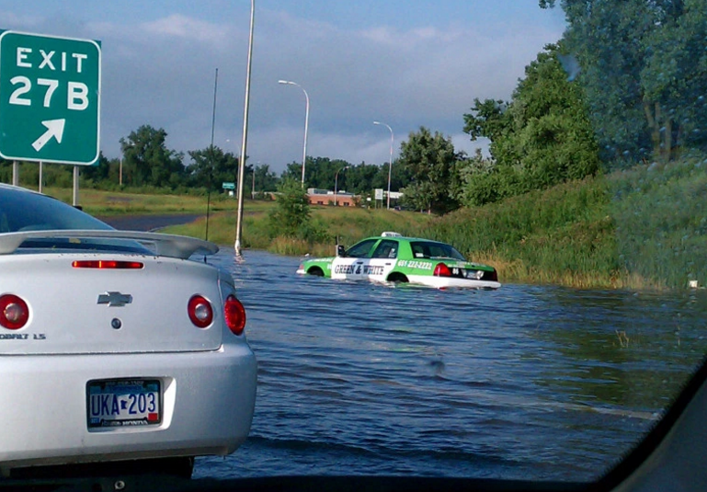

Multiple needs on same system…
Infrastructure capacity
Maintenance & tracking
Hazard mitigation
Environment & health

Slide 42
Metro Stormwater Geodata Project:
Overview of project

Slide 43
Metro Stormwater Geodata Project:
Overview of the project
April – June 2018:
>> Establishment of project
>> Business needs documentation
>> Drafting a project charter
>> Initial scope of work
June 2018 – present
>> Steering Committee
>> Creation of prototype standard

Slide 44
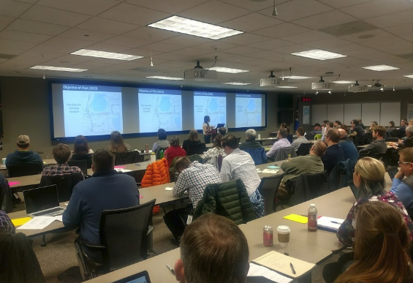
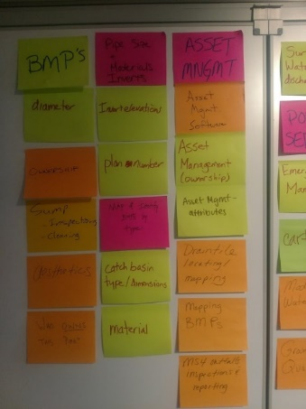
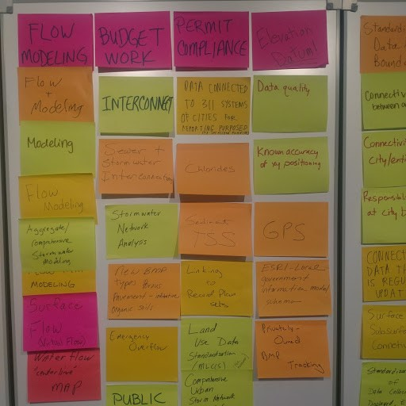
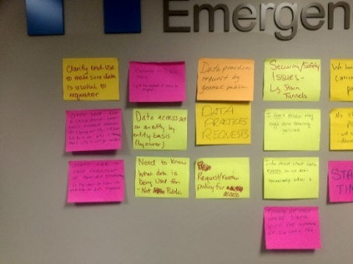
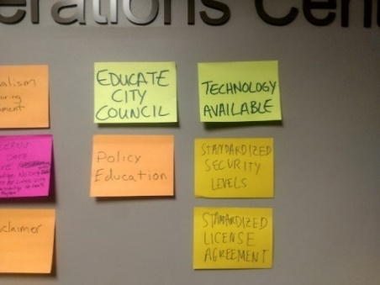

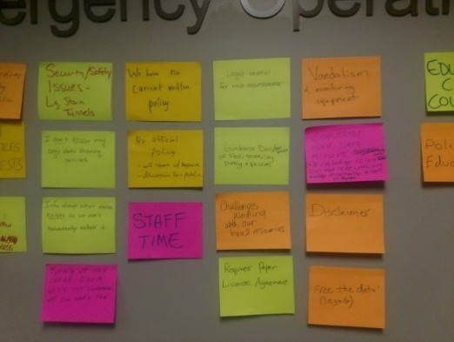
Business needs determination:

Slide 45
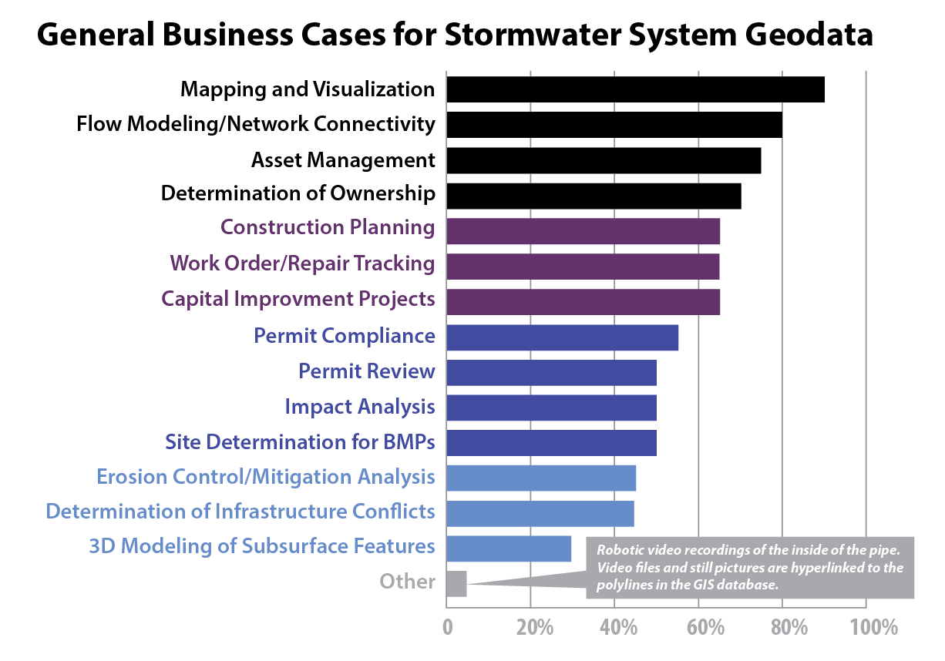
Broad category business needs:

Slide 46
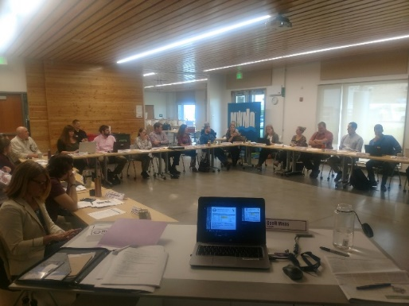
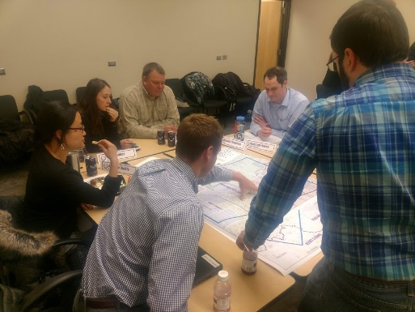
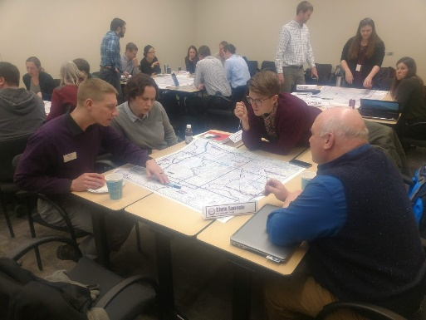
Effort and results to date:
4/17/18: Kickoff/Geodata Summit, Medina
6/12/18: CSWEA, Input Session, St. Paul
6/28/18: Steering Team 1, Minneapolis
8/26/18: Steering Team 2, Chaska
11/14/18: Steering Team 3, Blaine
2/26/19: Steering Team 4, Maple Grove
4/30/19: Steering Team 5, Eagan
+ Small technical sub-group sessions
+ Presentations at conferences & interest groups

Slide 47
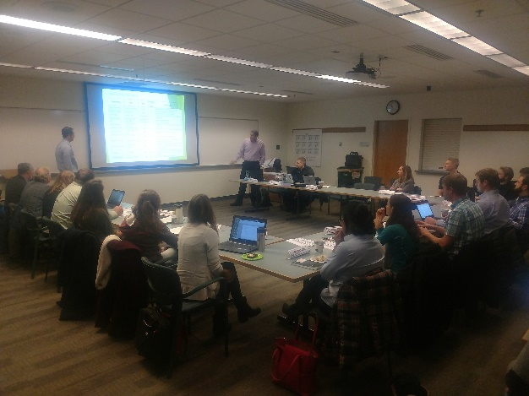
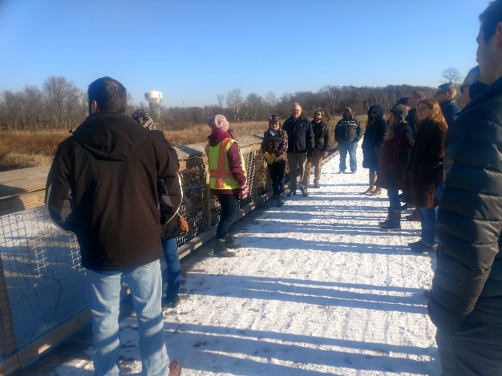
MSWGP Steering Team:
Cities
County (GIS, Public Works, Asset Management)
Private Engineering Firms
WSD/WMOs
Regional, State & Federal
esri

Slide 48

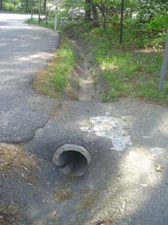
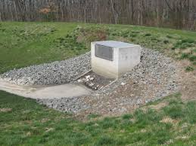
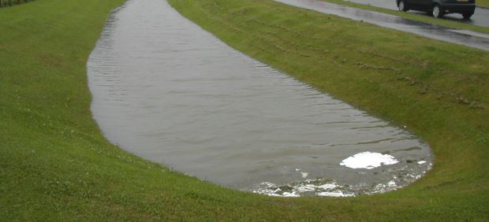
Our prototype standard (in development)
LINES: PIPES
CHANNELS
ARTIFICIAL PATHS
POINTS: BASINS
STRUCTURES
INLET/OUTLET/OUTFALL
BMPs
MONITORING DEVICES
MS4 INLET-OUTFALL SPECIFICATION
MS4 BASIN INSPECTION SPECIFICATION
POLYGONS: POLY_BASINS
POLY_BMPs

Slide 49
Our prototype standard (in development)
LINES: PIPES
CHANNELS
ARTIFICIAL PATHS
POINTS: BASINS
STRUCTURES
INLET/OUTLET/OUTFALL
BMPs
MONITORING DEVICES
MS4 INLET-OUTFALL SPECIFICATION
MS4 BASIN INSPECTION SPECIFICATION
POLYGONS: POLY_BASINS
POLY_BMPs

Slide 50
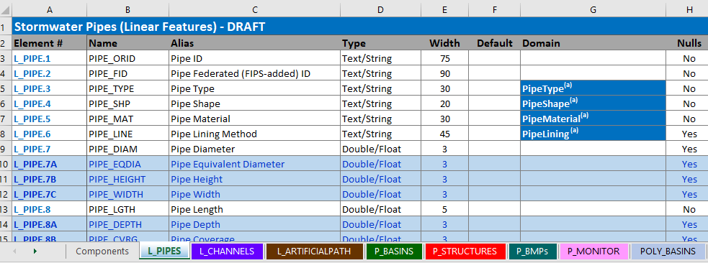
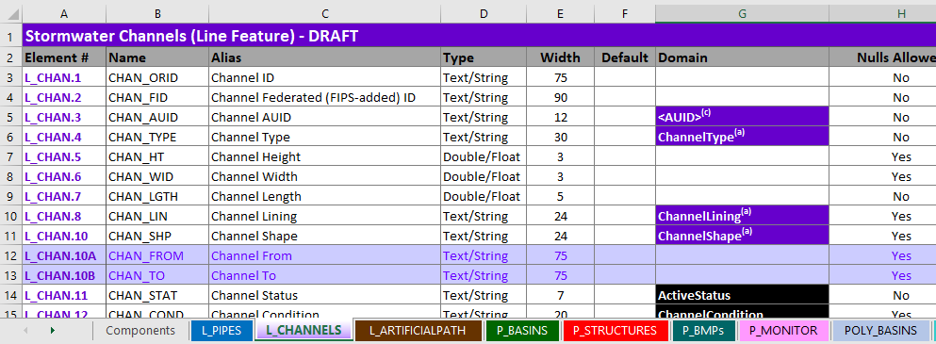
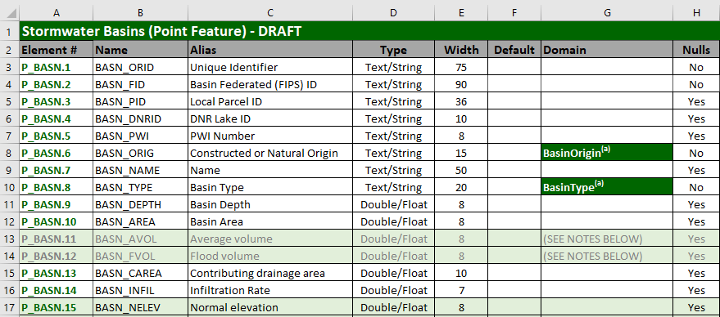
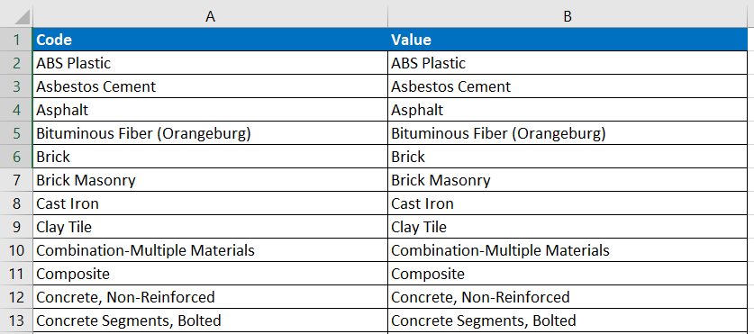
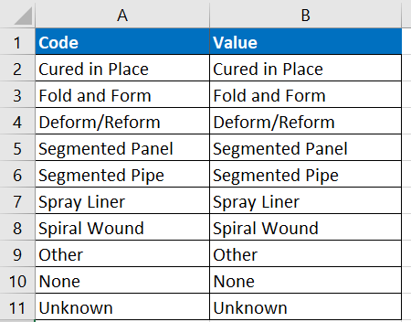
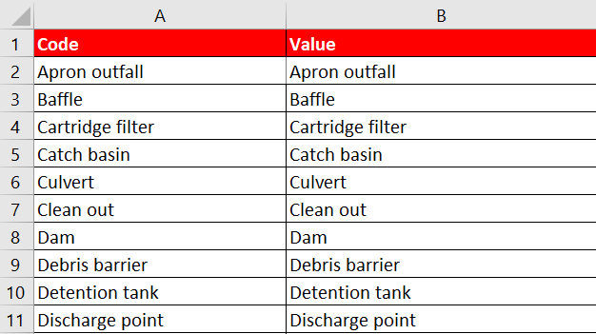
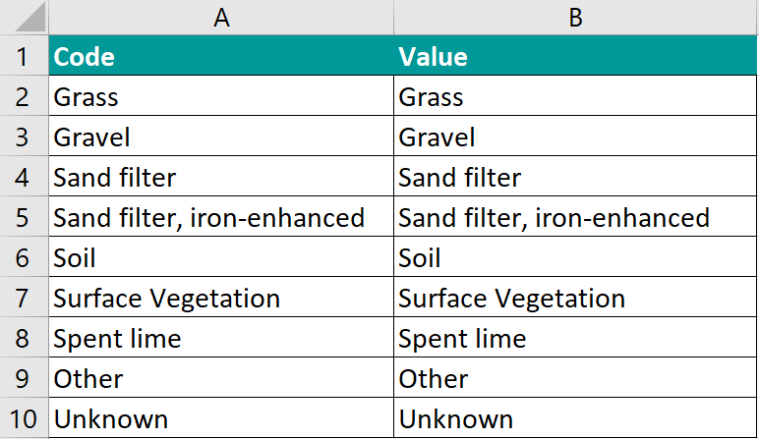
Our prototype standard
Components
Domain Values

Slide 51
Our prototype standard (in development)
LINES: PIPES
CHANNELS
ARTIFICIAL PATHS
POINTS: BASINS
STRUCTURES
INLET/OUTLET/OUTFALL
BMPs
MONITORING DEVICES
MS4 INLET-OUTFALL SPECIFICATION
MS4 BASIN INSPECTION SPECIFICATION
POLYGONS: POLY_BASINS
POLY_BMPs

Slide 52

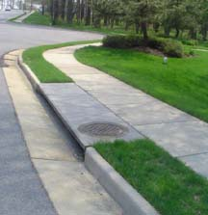
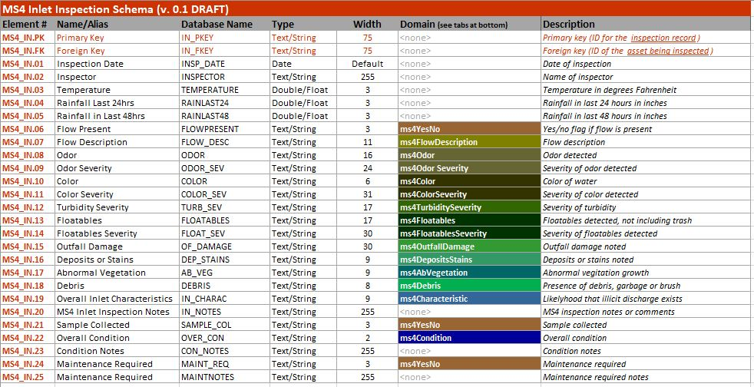
MS4 field inspection template schemas
Inlets:
(Draft) inlets schema

Slide 53
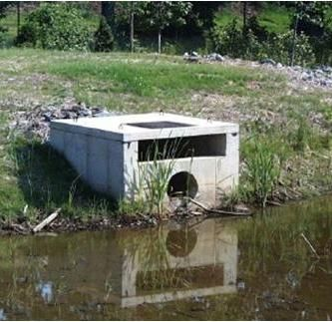
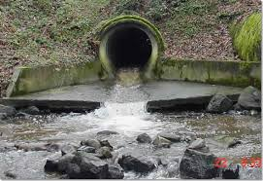
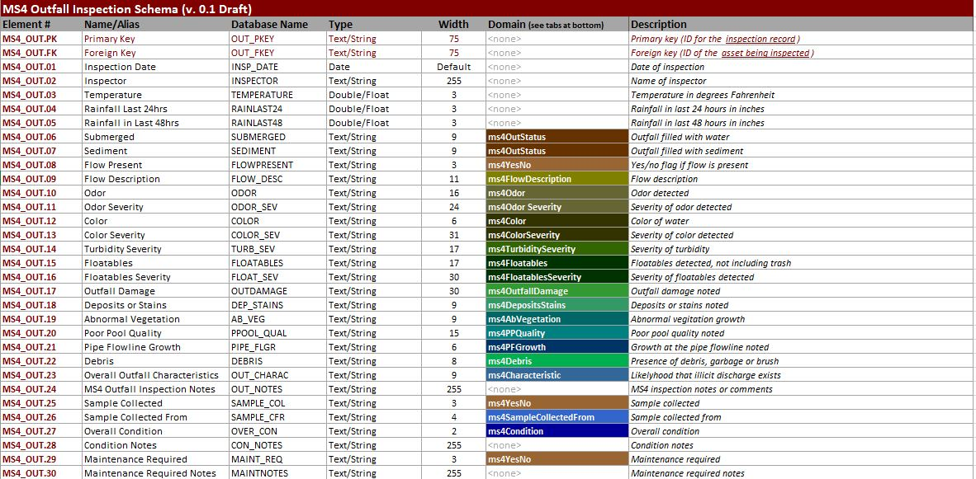
MS4 field inspection template schemas
Outlets
Outfalls:
(Draft) outfall schema

Slide 54
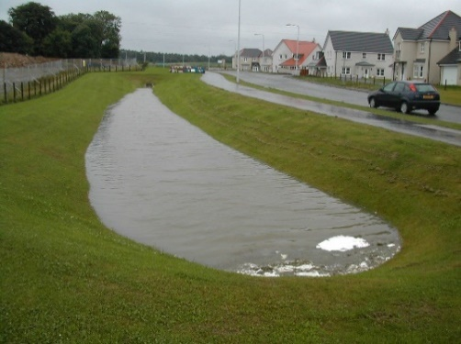
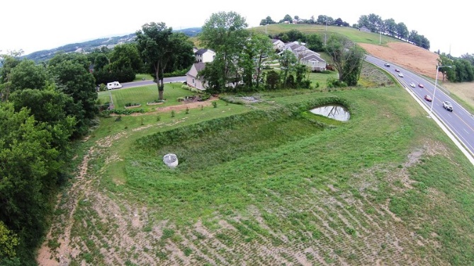
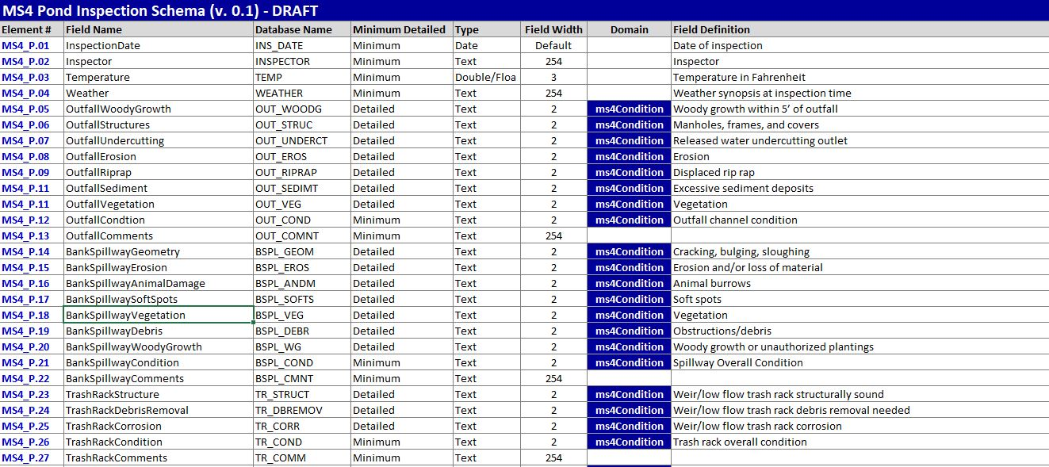
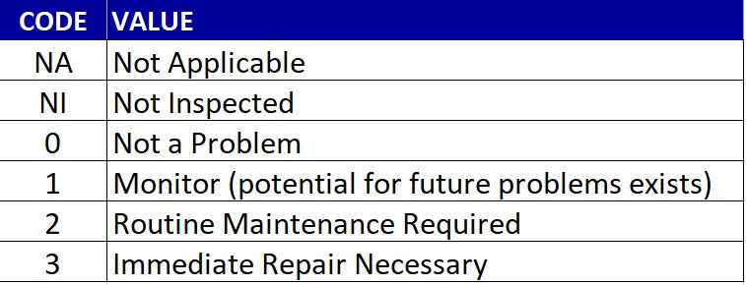
MS4 field inspection template schemas
Basins
& Ponds:
(Draft) basin inspection schema

Slide 55
Metro Stormwater Geodata Project:
Current Status

Slide 56
Metro Stormwater Geodata Project:
Current status
MPCA has completed review of
proposed inspection schemas
Prototype standard development
>> ‘Structures’ team meeting in June
>> Goal: ‘Approval for testing’ in late July
Pilot project
Test the ‘prototype standard’
Invitation for comment by stakeholder community

Slide 57
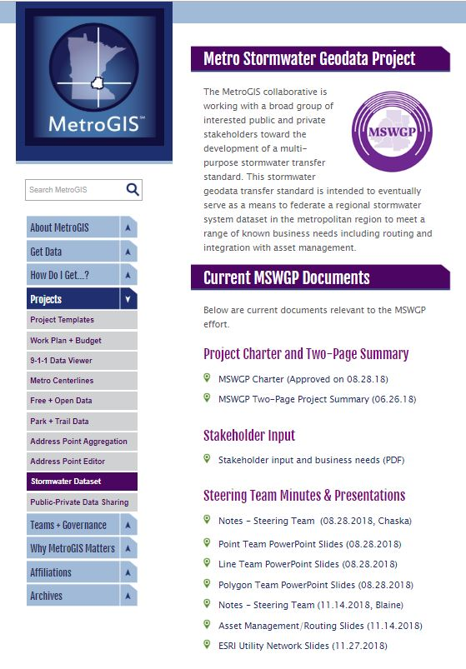
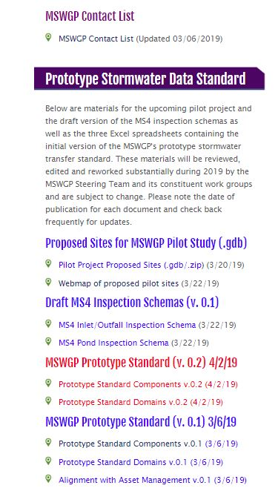
MSWGP Project Resources
metrogis.org > Projects > Stormwater Dataset
>> Overview & information
>> Project charter
>> 2-page FAQ document

Slide 58
MSWGP Project Resources
metrogis.org > Projects > Stormwater Dataset
>> Overview & information
>> Project charter
>> 2-page FAQ document
>> Stakeholder input
>> Steering Team work/notes
>> Steering Team contact info

Slide 59
MSWGP Project Resources
metrogis.org > Projects > Stormwater Dataset
>> Overview & information
>> Project charter
>> 2-page FAQ document
>> Stakeholder input
>> Steering Team work/notes
>> Steering Team contact info
>> Proposed pilot sites (.gdb & web map)
>> Draft MS4 inspection schemas
>> Draft Prototype Standard

Slide 60
Metro Stormwater Geodata Project:
Upcoming Work

Slide 61
Metro Stormwater Geodata Project:
Upcoming work – Pilot project
Select a set of possible pilot sites around the metro region;
Acquire data within the pilot sites;
Translate data from those areas into our prototype standard;
Publish data in prototype standard out to the entire stakeholder community for testing

Slide 62
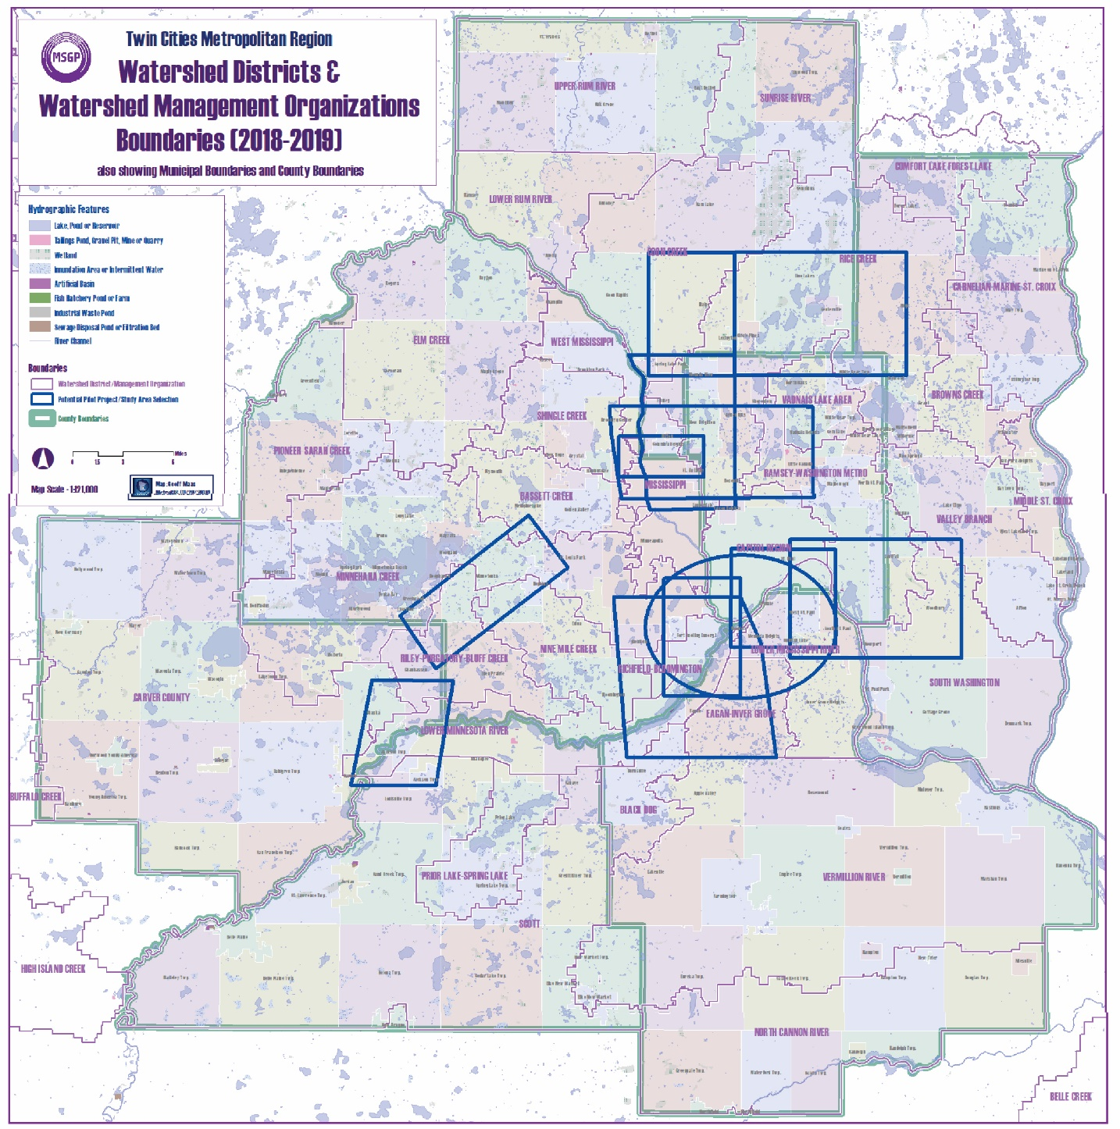
11/14/2018: “Initial area” selection exercise

Slide 63
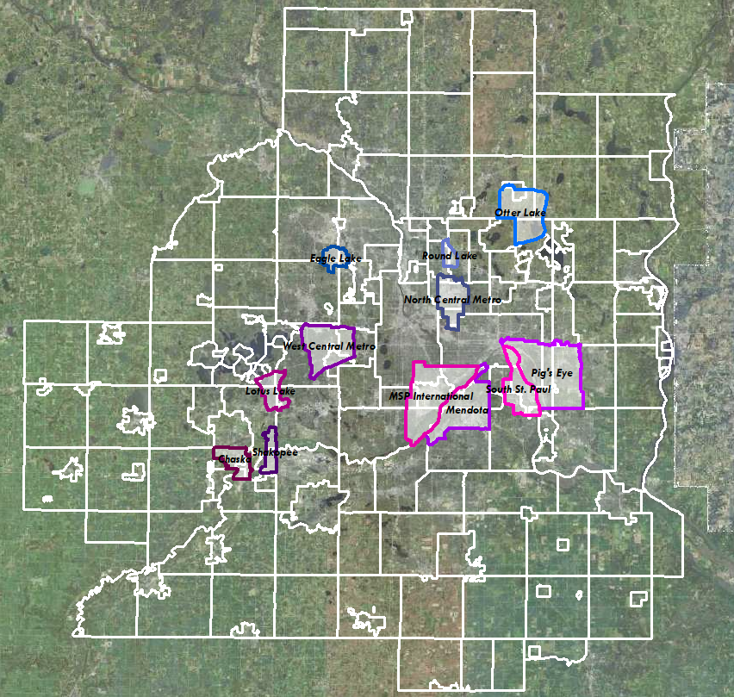


Slide 64
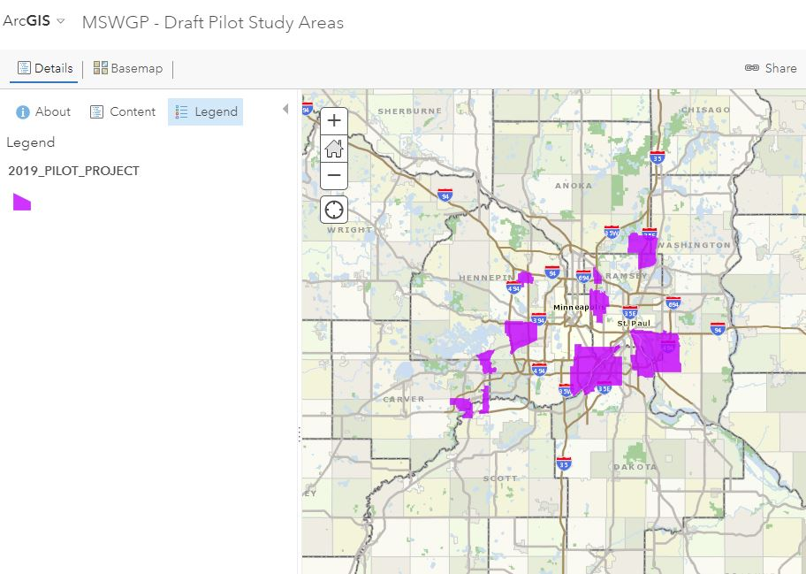
May & June (Collect)
Reaching out to agencies maintaining stormwater fixtures within our selected sites;
Late Summer/Fall (Translate & Outreach)
Translating data received into our prototype standard for testing, review and comment by
the stakeholder community;

Slide 65
Sample data in our draft standard;
Outreach to the stakeholder community
for testing, review and comment.
Receive comments and refine the
Prototype accordingly….

Slide 66


Metro Stormwater Geodata Project
Peter L. Croswell
The GIS Management Handbook
Forthcoming
2nd Edition to cite
and utilize our
MSWGP Project Charter
as an good example of
inter-agency project scoping and documentation

Slide 67
Interested?
>> Please get in touch via email
>> Check out our website
>> Provide feedback and input
>> Let us know who else you think needs to be involved

Slide 68

Thank you!
Questions?
Geoff Maas
MetroGIS Coordinator
    geoffrey.maas@metc.state.mn.us
651.602.1638

Slide 69
Agenda Item 11
Sector reports
Ben Richason, Brad Anderson

Slide 70
Agenda Item 11
Sector Report
Minnesota State University System (MnSCU)
  Benjamin F. Richason III
  Department of Geography and Planning
  St Cloud State University

Slide 71
Higher Education Sector Report
Topics
  Statewide Geospatial Courses
  National Center for Autonomous Technologies (NCAT)

Slide 72
Higher Education Sector Report
  Statewide Geospatial Courses
  Course inventories for the University of Minnesota system, the Minnesota State University system, a number of private college and universities was done in 2015, 2017, and 2019.
  Preliminary review indicates that overall the course types remained relatively stable.
    This is also true with the diversity of departments and programs where geospatial courses are offered.
  This is not to say that there have not been changes. Some departments have added a number of classes, while others have either renamed or dropped some titles.

Slide 73
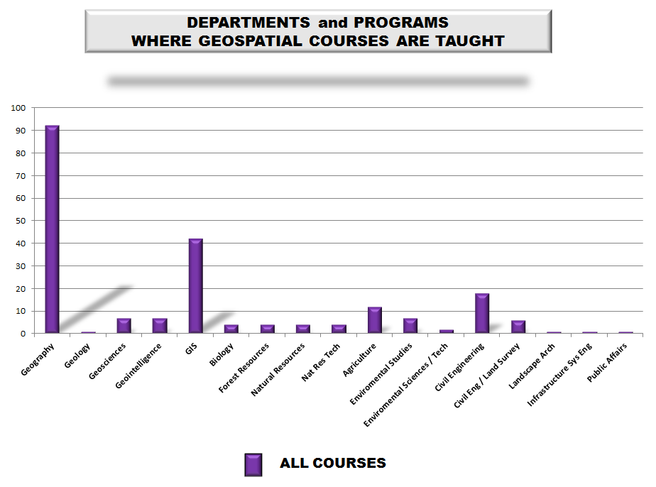

Higher Education Sector Report

Slide 74

Higher Education Sector Report

Slide 75
Higher Education Sector Report
National Center for Autonomous Technologies (NCAT)
  The ability of autonomous vehicles, on land, beneath the water, and in the air, to carry sophisticated sensors for the gathering of locational data of the earth’s environment and for the integration of geolocational routing tools and expertise has now been realized.
  Geospatial Science techniques have become ubiquitous over the past few decades. This science encompasses the acquisition of data, the exact and detailed location of geographic features, the spatial analysis of quantitative data, and the creation of information graphics.
  It was only a matter of time before these spatial methodologies would be merged with autonomous techniques.

Slide 76



Higher Education Sector Report
UAV’s or UAS’s
(Unmanned Aerial Vehicles or Unmanned Aerial Systems)

Slide 77

Higher Education Sector Report
UUV’s or AUV’s
(Underwater Unmanned Vehicles or Autonomous Underwater Vehicles)

Slide 78


Higher Education Sector Report
CAV’s
Connected and Automated Vehicle (CAV)

Slide 79
Higher Education Sector Report
National Center for Autonomous Technologies (NCAT)
  NCAT will focus on three areas of Autonomous Technologies: unmanned aircraft systems (UAS),connected automated vehicles (CAV), and unmanned underwater vehicles (UUV)--all of which require highly skilled, agile technicians who can design, monitor, utilize, repair, and control the technologies.
  As the first national ATE Center in Autonomous Technologies, NCAT will lead the crafting, adapting, and implementing of educational resources and be a resource hub for evidence-based research on the knowledge and skills needed for careers in autonomous technologies.
    NCAT will provide mentoring, leadership, and resources for degree development, articulation agreements, increased communication among stakeholders, systems reform, and standardizations of regulations.

Slide 80


Greater Minnesota Cities
Sector Report
Greater (Outstate) Minnesota Cities
Brad Anderson, City of Moorhead
853 Cities in Minnesota
715 in Greater (Outstate) Minnesota
(*League of Minnesota Cities)
Brief overview of sector
How is GAC relevant to your sector?
How can the GAC mission benefit your sector?
What is your strategy for communicating with your sector?

Slide 81


Greater Minnesota Cities
Greater Minnesota Cities that are on the MnGeo City GIS Contacts list (22)
Department:
6 Engineering
5 Goodhue County GIS
4 Public Works\Utilities
4 IT\GIS\Admin
2 Planning
1 Survey

Slide 82

Greater Minnesota Cities
Minnesota Cities Outreach Committee
2018 Survey – Open Data (43 Responses)
Is your data free and open?
Cities Counties
Yes 52% 36%
No 20% 53%
Not Sure 28% 12%
How long have you created or
maintained your geospatial data?
1 – 5 Years 16%
5 – 10 Years 16%
10 – 15 Years 28%
15 – 20 Years 18%
Over 20 Years 23%
Steward of your GIS data?
Engineering\PW 34%
Planning\Zoning 26%
IT 14%
GIS 9%
Public Safety 3%
All Other 12%
** County does GIS, though
maps in Clerk’s Office **

Slide 83


Greater Minnesota Cities
715 Variations of GIS
Some maintain their own parcels
Some provide open data
Some maintain their own address
points and Street CL
Some contract 100% with vendor
Some contract with their County

Slide 84


Greater Minnesota Cities
23 personalized e-mails sent out to City contacts on MnGeo’s list for the 2018 GAC Geospatial Priorities Survey
After some investigation, multiple e-mails were sent out to City GIS staff that were not on list – did not receive responses back from three

Slide 85


Greater Minnesota Cities
Results from the 2018 Minnesota Geospatial Priorities Survey
(*for 2019)

Slide 86
Agenda Item 12
Legislative updates
Dan Ross

Slide 87

Geospatial Data Act
FGDC Implementation Activities

Slide 88
Geospatial Data Act – In summary
Enacted by Congress Oct. 2018 as part of H.R. 302
Provides statutory authorization for FGDC and NGAC
  Gives more influence to NGAC
Codifies guidance to federal agencies on implementing the NSDI from OMB Circular A-16
Directs FGDC and federal agencies to partner with state, local and tribal governments, higher education and private sector to build the NSDI

Slide 89
Tiger Team
FGDC established a special team
  Evaluate impacts and requirements of FGDC and partners to implement GDA
  Develop a GDA implementation strategy for approval by FGDC
Tiger Team members are from FGDC covered agencies
FGDC Executive Team members serve as leads for GDA subsection reviews

Slide 90
Timeframe
Tiger Team formed late October 2018
First meeting November 14-15
Have completed some initial analysis but more to come
Draft GDA Implementation Strategy was to be due by end of March

Slide 91
Initial Analysis
Identified key differences/changes between GDA and earlier authorization
Significant detail included in initial analysis
Tiger Team is taking a much deeper dive and have created some workgroups
NGAC work group established to provide initial advice to FGDC on implementation
  NGAC work group met once before shutdown
  Key elements are agency reporting to Congress and FGDC, and stakeholder engagement

Slide 92
Geospatial Data Act of 2018
Update on Implementation
Coalition of Geospatial Organizations
May 2, 2019

Slide 93

Geospatial Data Act of 2018
Context–
The GDA is one of several new data initiatives aimed at:
Federal Data Strategy
Geospatial Data Act
Promoting and improving access to data for public health, economic growth, environment and other purposes
Promoting use of quality scientific and other data to improve policymaking
Sparking public private partnerships, new innovative start-ups & services
Foundations for Evidence-Based Policymaking Act
  - TITLE I: Federal Evidence-Building Activities
  - TITLE II: Open Government Data Act
  - TITLE III: Confidential Information Protection And Statistical Efficiency
Notes:
3 recent actions by the administration and congress codify and promote the strategic importance of open data for public good
Paying close attention to these activities.
Participating in the FDS action plan, - use of geospatial data can enhance and improve decision making
Put forth platform, NGDA’s and standards to support the newly established US data federation use case pilots – planned meeting date ??
Attending Data.gov calls to stay in form
For the purposes of this meeting I will focus on the GDA

Slide 94

Geospatial Data Act of 2018
The GDA reflects growing recognition of the essential role of geospatial data and technology and highlights the need to support their continuing development as critical infrastructure for the Nation.
The GDA formalizes Federal government structures related to geospatial data
The GDA provides policy and guidance to empower the use of geospatial data and technology
Facilitates broad cooperation between the public and private sector
Positions the U.S. to be a global leader in utilization of geospatial technology
Notes:
The GDA reflects growing recognition of the essential role of geospatial data and technology and highlights the need to support their continuing development as critical infrastructure for the Nation.
- Largely codifies A-16 and adds additional oversight and reporting requirements

Slide 95




Geospatial Data Act of 2018
Executive Summary
Codifies the role and authorities of the FGDC
Establishes the NGAC as a statutory advisory committee
Establishes stewardship of geospatial assets
Policy and guidance to empower the use of geospatial data and technology
National Spatial Data Infrastructure
Establishes agency responsibilities
Budgeting and reporting requirements
Notes:
Key
Authorities of FGDC
NGAC as a statutory advisory committee

Slide 96

Geospatial Data Act of 2018
Implementation Approach
Coordination with FGDC Leadership/OMB
GDA Workshops/Establishment Tiger Teams
Initial assessment of GDA
Stakeholder engagement
High-level implementation roadmap
Updated OMB guidance (Circular A-16)
GDA Implementation Strategy / NSDI Strategic Plan
Notes:
Implementation Strategy

Slide 97
Geospatial Data Act of 2018
GDA Tiger Team/Work Groups
Analysis of the GDA––identify impacts, requirements and recommendations that will result in the development of an implementation strategy.
Governance & Organization
Data, Standards and Delivery
Covered Agencies & Reporting
Communications & Outreach

Slide 98
Geospatial Data Act of 2018
GDA Implementation Roadmap
KEY TASKS
OMB Circular A-11 Language Revision
Federal Data Strategy (FDS) Action Plan Update
Ongoing Stakeholder Engagement
GDA Interagency Budget Initiative
GDA Work Groups – Critical Issues
GDA Communication Strategy
Development of OMB Guidance

Slide 99
Geospatial Data Act of 2018
Conclusion
The GDA reflects growing recognition of the essential role of geospatial data and technology and highlights the need to support their continuing development as critical infrastructure for the Nation.
Positions the U.S. to be a global leader in utilization of geospatial technology
Thank You
Fgdc@fgdc.gov
The GDA formalizes Federal government structures related to geospatial data
The GDA provides policy and guidance to empower the use of geospatial data and technology
Facilitates broad cooperation between the public and private sector
Positions the U.S. to be a global leader in utilization of geospatial technology
Notes:
The GDA reflects growing recognition of the essential role of geospatial data and technology and highlights the need to support their continuing development as critical infrastructure for the Nation.
- Largely codifies A-16 and adds additional oversight and reporting requirements

Slide 100
Geospatial Data Act of 2018
Discussion Topics:
What are other organizations priorities or suggestions for GDA implementation?
How can we best engage with other member organizations?
The GDA includes requirements for engaging and partnering with non-federal partners – what suggestions would your organization have on meeting these requirements?
What will successful implementation look like and how will we measure it?
Notes:
3 recent actions by the administration and congress codify and promote the strategic importance of open data for public good
Paying close attention to these activities.
Participating in the FDS action plan, - use of geospatial data can enhance and improve decision making
Put forth platform, NGDA’s and standards to support the newly established US data federation use case pilots – planned meeting date ??
Attending Data.gov calls to stay in form
For the purposes of this meeting I will focus on the GDA

Slide 101

Questions?
Dan Ross
dan.ross@state.mn.us
651-201-2460

Slide 102
Agenda Item 13
Updates on GAC priority projects and initiatives
Mark Kotz

Slide 103
Agenda Item 13
GAC Rank | Project or Initiative Description | Status | Project Owner | Champion
1 | All Data Free and Open | Active | Kari Geurts | Dan Ross
2 | Image Service - Sustain | Active | Mike Dolbow | Dan Ross
3 | Updated and Aligned Boundary Data | Active | Preston Dowell | Dan Ross
4 | Parcel Data | Active | Mike Dolbow | Mark Kotz
5 | Archiving Policy/Procedure | Active | Ryan Mattke | many
6 | Road Centerline Data | Active | Norm Anderson | Dan Ross
7 | New LiDAR Acquisition | Active | Gerry Sjerven | Dan Ross
8 | Address Points Data | Active | Norm Anderson | Dan Ross
9 | MN Focused Basemap Services | Active | Sonia Dickerson | Dan Ross
10 | Parks and Trails Data Standard | Active | Jim Bunning | Dan Ross
11 | EM Damage Assess Data Standard | Active | Brad Anderson, Cory Richter
12 | Accurate Hydro-DEMs | Active | Sean Vaughn

Slide 104
Agenda Item 14
Announcements or other business

Slide 105
Adjourn
Happy Summer!
Next meeting is Wednesday, September 4, 2019

