Slide 1



Minnesota Geospatial Advisory Council
September 4, 2019

Slide 2
Welcome
Welcome new members
Introductions
Approve agenda
Approve May minutes

Slide 3
Agenda
Time | Topic
11:20 | Committee and workgroup summaries - Review and accept
11:25 | GAC annual process and logistics
11:35 | Awards Committee charter and work plan - Approve
11:40 | Archiving Workgroup recommendations
noon | Break, networking
12:30 | Remove coordinate exchange standard from GAC website
12:35 | Image Service Sustainability Committee recommendations
12:40 | Minnesota state LiDAR plan
1:00 | MNIT Commissioner request
1:20 | Legislative updates
1:25 | GAC priority projects and initiatives updates
1:45 | Announcements

Slide 4
Agenda Item 2
Committee and workgroup summaries - Review and accept

Slide 5
Agenda Item 3
GAC annual process and logistics
Mark Kotz and Nancy Rader

Slide 6
Committees and Workgroups
3D Geomatics
Archiving (workgroup)
Awards Committee
Emergency Preparedness
Image Service Sustainability
Outreach
Parcels and Land Records
Standards

Slide 7
Annual Process
Identify statewide projects and initiatives
Survey geospatial community for importance
Prioritize
Annual reports - accomplishments and work plans
Repeat

Slide 8
2019 GAC Priorities
GAC Rank | Project or Initiative Description | Status | Project Owner | Champion
1 | All Data Free and Open | Active | Kari Geurts | Dan Ross
2 | Image Service - Sustain | Active | Mike Dolbow | Dan Ross
3 | Updated and Aligned Boundary Data | Active | Preston Dowell | Dan Ross
4 | Parcel Data | Active | Mike Dolbow | Mark Kotz
5 | Archiving Policy/Procedure | Active | Ryan Mattke | many
6 | Road Centerline Data | Active | Norm Anderson | Dan Ross
7 | New LiDAR Acquisition | Active | Gerry Sjerven | Dan Ross
8 | Address Points Data | Active | Norm Anderson | Dan Ross
9 | MN Focused Basemap Services | Active | Sonia Dickerson | Dan Ross
10 | Parks and Trails Data Standard | Active | Jim Bunning | Dan Ross
11 | EM Damage Assess Data Standard | Active | Brad Anderson, Cory Richter
12 | Accurate Hydro-DEMs | Active | Sean Vaughn

Slide 9
GAC Priorities Process
Create a list of proposed projects and initiatives
  Existing and new
Assess the value of each
  GAC members advocate for sectors
  Results by GAC sector
Assess likelihood of success
Preliminary priority calculation
GAC discusses and adjusts

Slide 10
Why Create Priorities?
To create a voice for the MN geospatial community
To direct work plans of the GAC and its committees
To recommend to MnGeo
To allow other organizations to compare priorities and align efforts
To inform outreach and policy related efforts
Having clear direction helps motivate people to participate

Slide 11
Logistics
Representing your “Sector”
Sector reports at meetings
NSGIC membership

Slide 12
GAC Leadership
Chair
  Leads GAC and Leadership Team
  Chairs meetings
  Works with members and committee and workgroup chairs to collaboratively set, direction and priorities for GAC
  Coordinates with committee chairs
Vice Chair
  Assists with chair responsibilities and fills in for chair as needed
  Provides input to help set direction of GAC

Slide 13
GAC Leadership
Leadership Team
  Chair, Vice Chair, State CGIO, 3 to 4 other members
  Quarterly call-in meeting between GAC meetings
  Set agenda for GAC meetings
  E-discussions of GAC pressing issues
GAC will choose leaders at December GAC meeting

Slide 14
GAC Process and Logistics
Questions?

Slide 15
Agenda Item 4
Approve Awards Committee charter and workplan
Cory Richter

Slide 16
Agenda Item 5
Archiving Workgroup recommendations
Ryan Mattke

Slide 17
Archiving Workgroup
Mission statement:
Define policies guidelines, best practices, and procedures for archiving geospatial data in Minnesota, so that a wealth of valuable geospatial data can be preserved and available for future use.
Deliverables:
Policies Guidelines
Best Practices
Procedures
Report
Presentation at 2019 MN GIS/LIS Conference

Slide 18
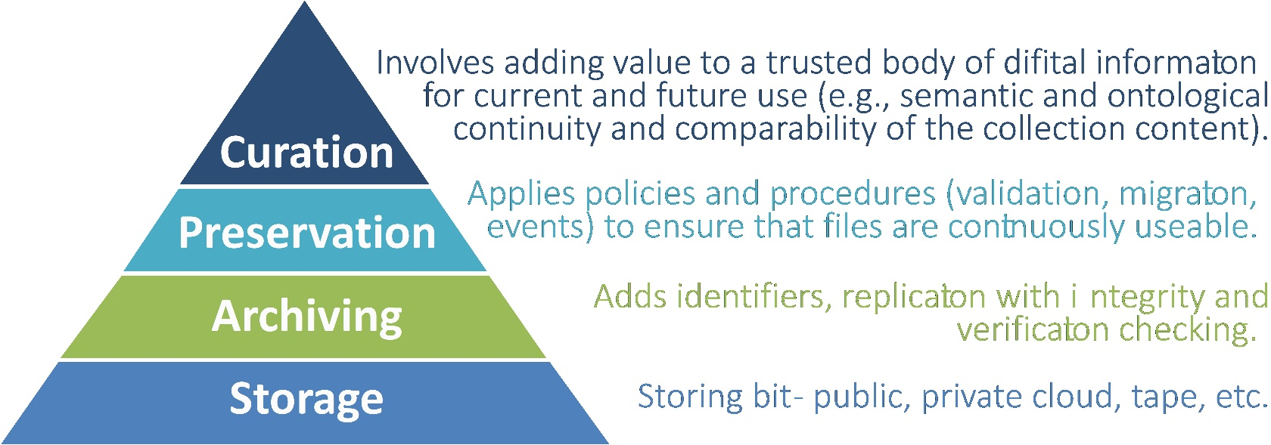
Archiving Workgroup
Members:
David Bendickson
Art Botello
Len Kne
Melinda Kernik
Mark Kotz
Mike Koutnik
Karen Majewicz (Vice Chair)
Andra Mathews
Ryan Mattke (Chair)
Colleen Paavola
Dan Ross
Ben Timerson
Denise Tingstad
Brandon Tourtelotte
Hal Watson
Activity:
Nine subgroups working on various aspects of the deliverables and objectives
Work to be completed by August 2019

Slide 19
Archiving Workgroup
Accomplishments:
Described the need for geospatial data archiving
Collected initial findings about the level of interest in archiving
Identified datasets to target
Outlined the available technology
Clarified data archiving concepts
Developed approximations and estimates of data sizes, data sources, staffing models, and costs
Defined many potential policies, guidelines, and procedures

Slide 20
Archiving Workgroup
Subgroup Outcomes & Reports:
Public Geospatial Data Archive Survey
Priority Datasets Report
Archiving Strategy Report
Archiving Agreement
Worked with MnGeo to determine areas of further exploration around archiving aerial imagery layers
Began a series of outreach communications to educate the geospatial community around the idea of archiving
Presenting at MN GIS/LIS Conference
  Poster (data survey)
  Panel (GAC activities)
  Lighting Talk (Archiving)

Slide 21
Archiving Workgroup
Selected Key Findings:
Geospatial Data Archive Survey:
  Support for data archiving is strong across the Minnesota geospatial community
  Identified top candidates for archiving among Minnesota stakeholders:
    Aerial photography and Imagery
    LiDAR
    Land use & Landcover
Priority Datasets
  Weighed the survey results with other factors, particularly layer and metadata availability
  Recommended prioritizing:
    Aerial Photography and Imagery
    Parcels
    Address points
    Road centerlines
  LiDAR and Land use & Landcover data will also be priorities, but will require further research to determine the availability and storage space needed for archiving

Slide 22
Archiving Workgroup
Selected Key Findings:
Archiving Strategy
  Build a sustainable spatial data infrastructure that includes stored archival files and access copies
  Place the data repository portion of the archive under the stewardship of an existing infrastructure initially
  Integrate the archive’s metadata records into the MN Geospatial Commons for discoverability
  Hire a curator to coordinate ingest and preservation activities
  Designate agencies as being responsible for submitting data to the archive
Archiving Agreement
  Accept geospatial data that includes all or a portion of Minnesota
  Data will be non-restricted, deposited for open access use, and should be in a final publishable state
  Data for deposit should be accompanied by metadata records that adhere to the Minnesota Geographic Metadata Standard
  Data producers will need to agree to standard language for the Access Constraints, Use Constraints, and Distribution Liability fields in the metadata
  Content submission to the archive should be considered permanent

Slide 23
Archiving Workgroup
Next Steps:
Continue outreach & education efforts (through October 2019)
Present at GIS/LIS (October)
  Poster (Survey)
  Lightning Talk (Archiving)
  Panel (GAC activities)
Create an Archiving Implementation Workgroup to:
  Define and facilitate the implementation of an archive for Minnesota geospatial data
    Program: Develop a detailed program for archiving geospatial data, including governance, guidelines, procedures, and the necessary social infrastructure
    Technology: Develop detailed technical infrastructure plans and workflows for archiving geospatial data
    Outreach & Education: Continue to build support for the archiving effort
    Funding: Research and secure funding for the archiving effort

Slide 24
Archiving Workgroup
Future Plans:
Establish an Archiving Committee to coordinate strategies for archiving geospatial data
  Advise the state geospatial community about relevant archiving issues
  Make recommendations about policies and procedures related to archiving
Establishment of this committee would occur once there is a firm timeline for implementation of an archive

Slide 25
Archiving Workgroup
Thoughts?
Reactions?
Questions?

Slide 26

Break - Networking

Slide 27
Agenda Item 7
Remove coordinate exchange standard from GAC website
Mark Kotz

Slide 28
Coordinate Exchange Standard
“Coordinate Specifications for Spatial Data Exchange Between Minnesota State Agencies”
Approved by the Governor’s Council on Geographic Information in 1998
Never adopted by the GAC
Developed prior to common use of projection files, transformation technology
Applies only to state agencies (could be retained by that sector)
Standards Committee requests removal from GAC web site

Slide 29
Agenda Item 8
Minnesota Geospatial Image Service Layer Status Change Recommendation
Matt McGuire
Notes:
At the GAC meeting last May,
Mike Dolbow raised sustainability issues for the Minnesota Geospatial Image Service,
He requested that the GAC guide MnGeo on how to determine which layers it could remove.
The GAC agreed to this, and I volunteered to lead the effort.
Included in your agenda packet,
starting on page 14, is the result of that effort -
The Minnesota Geospatial Image Service Sustainability Plan Proposal.
...a few slides that
summarize the key elements of the proposal
and request further action from the GAC.

Slide 30
Image Service Sustainability Committee
GAC Committee created in March at MnGeo’s Request
Make recommendations to MnGeo on layer changes to Image Service
9 members:
  Counties, State Agencies, The University of Minnesota and The Metropolitan Council
Today is our first recommendation

Slide 31
Steps since last status update
Identified 48 candidate low-usage layers
Short-list of very low usage layers to review for other criteria
Recommend status change on 12 layers
Sent recommendation to MnGeo

Slide 32
Status Change Decision Criteria
Usage –This is the prime factor. Low usage is defined as less than 1/10th of 1% of total usage.
Other factors
  Coverage
  Resolution
  Time of year (leaf on/off)
  Historical Significance

Slide 33
Recommended Status Change to “Retirement Candidate”
Layer Name | Geographic Area | Season | Type | Resolution | 12-Month Usage (% of total)
2013 Scott | Scott Co. | spring | Color Infrared | 0.15 meter (6-inch) | 0.002%
2013 Dakota | Dakota Co. | spring | Color Infrared | 0.15 meter (6-inch) | 0.004%
2013 Carver | Carver Co. | spring | Color Infrared | 0.15 meter (6-inch) | 0.004%
2011 Rice | Rice Co. | spring | Color Infrared | 1-foot | 0.001%
2010 Scott | Scott Co. | spring | Color Infrared | 0.15 meter (6-inch) | 0.001%
2010 Dakota | Dakota Co. | spring | Color Infrared | 0.15 meter (6-inch) | 0.001%
2008 Twin Cities | Twin Cities | spring | Natural Color | 0.3-meter | 0.002%
2014 McLeod | McLeod Co. | spring | Color Infrared | 0.15-meter (6-inch) | 0.001%
2013 Meeker | Meeker Co. | spring | Color Infrared | 0.5-meter | 0.001%
2011 Murray | Murray Co. | spring | Color Infrared | 1-foot | 0.001%
2009 south shore (WI) | Wisconsin lakeshore | summer | Color Infrared | 0.3-meter | 0.002%
2009 nw border | Northern border | summer | Natural Color | 0.3-meter | 0.003%

Slide 34
Communication Notes
Notify the Archive Workgroup
Public outreach is not part of the committee’s workplan
*Nothing is being “permanently deleted” from this process*
It is just being removed from the service
This round of status changes does not affect the service itself

Slide 35
Next Steps
Solicit counties for new imagery
Meet again to evaluate layer status in January
Expect to meet once yearly in January

Slide 36
Agenda Item 9
Update and preview of MN State Lidar Plan
Sean Vaughn, GIS Hydrologist | Lidar Data Steward, MNIT DNR, Co-Chair 3D Geomatics Committee, Acquisition Workgroup Champion
Gerry Sjerven, Senior GIS Analyst, Minnesota Power, Co-Chair 3D Geomatics Committee, Acquisition Workgroup Champion
Alison Slaats, Program Manager, MnGeo, Acquisition Workgroup Champion
Notes:
Gerry - Intro

Slide 37
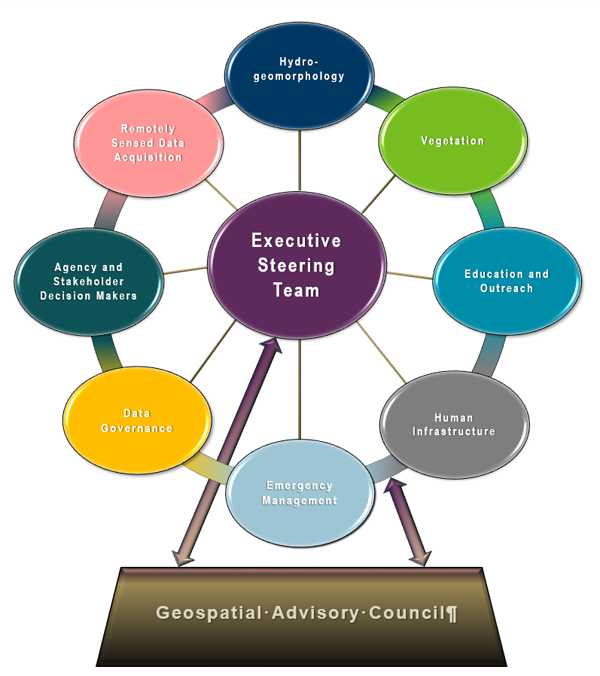
3DGeo Background/Update
What is the 3D Geomatics Committee
  The committee engages multiple geospatial disciplines across Minnesota to identify and promote the need for planning, funding, acquisition, and management of three-dimensional geomatic data and derived products.
  One of the committee missions is to bring new high-density lidar to Minnesota
    Striving for Quality Level 1 High Density Lidar
Committee Structure Diagram
    Executive Steering Team
    Workgroups (Remotely Sensed Data Acquisition Workgroup
    Subgroups
    Minnesota State Lidar Plan​ Subgroup
Notes:
Sean – 3DGeo Background

Slide 38
3DGeo Background/Update
Minnesota State Lidar Plan​ Subgroup formed
  Alison Slaats, Dan Ross, Jennifer Corcoran, Colin Lee, Sean Vaughn, Gerry Sjerven, Matt Baltes, Brandon Krumwiede, Harvey Thorleifson
    Members have Sector representation and subject matter expertise
GAC Project Priority #7
  Sponsored by the 3D Geomatics Steering Committee
    New Lidar data acquisition across Minnesota for use in developing new derived products guided by committee developed standards
Notes:
Gerry -

Slide 39
Lessons Learned
Northeast Minnesota Lidar Acquisition Opportunity [Winter 2019]
  Early Opportunity Outcomes (a learning process)
    Confirmed the need for a State Lidar Plan
      Build stakeholder support
      Acquisition standards
    Started to build the foundation of the State Plan
    NSGIC pilot projects as a template
    Exposure to 3DEP and BAA processes
  Vendor Outreach
Notes:
Gerry – NE Opportunity

Slide 40
Accomplishments Minnesota State Lidar Plan​ Subgroup
Vendors Who Participated
Aerial Services
Quantum
Ayres
Continental Mapping
Sanborn
Fugro
Surdex
KBM GeoSpatial (WSN)
Woolpert
Lidar Vendor Meetings
  Acquisition workgroup extended invitations to vendors
    12 vendors invited; 9 participated
    1-hour in-person and/or online meeting opportunities; 7 came to St. Paul
  Meetings were a learning session
    Built a knowledge base with information from all nationally recognized and local lidar acquisition vendors before we enter RFP processes
    Meetings resulted in valuable information to inform plan (including quality level, costs, distribution, tips for USGS BAA applications)
Notes:
Alison and/or Sean -

Slide 41
Obstacles Ahead
Lidar Data Hosting
Making data publicly available
Hosting meetings with DNR, MnGeo, MNIT Central, and vendors
Identifying costs for the State Lidar Plan and future budgeting
  Preparing for when we have the data by identifying costs and considerations now
No current solution for Lidar acquisition
Outreach and Education
Marketing this new lidar collect is different than our first project a decade ago
We have statewide lidar, must educate what is different and why costs have increased.
Notes:
Identify 2 other obstacles
What different about new LiDAR compared to old/existing LiDAR – Not just about the DEM
Stakeholder Knowledge
Funding

Slide 42
Introduction to the State Lidar Plan
Purpose of the Plan
  Educate stakeholders and decision makers
    Organizes acquisition partners
    Builds support for funding
  Set acquisition specifications
Multiyear Plan
Regional Areas of Acquisition
  Build stakeholder support, involvement, and funding throughout the state

Slide 43
Next steps
State Lidar Plan Timeline
  Finalize draft plan (End of September)
  Draft document – out for review by stakeholders (October)
  Panel at GIS/LIS Conference (October)
  Continue to manage outreach across the state (October – 2025/ongoing)
USGS Funding Timeline
  Submit 3DEP BAA application (Fall 2019)
  Outreach to NE Minnesota regional stakeholders and funding partners for data acquisition (Fall 2019 – Winter 2020)

Slide 44
Closing Remarks
The Minnesota State Lidar Plan will:
  Serve as a foundation of information that will represent geospatial community needs and educate stakeholders
  Build support for high quality, high density lidar data.
  Guide the development of an enhanced, seamless, Lidar 3D point cloud statewide with derived products publicly available by the end of 2025.
  Be inclusive and will identify opportunities for data users, practitioners, and data developers to work together to bring the benefits of lidar to the state of Minnesota.
    Get in touch to be involved!
Notes:
Gerry / Sean

Slide 45
Agenda Item 10
Discussion of request from MNIT Commissioner
Dan Ross

Slide 46
Agenda Item 11
Legislative updates
Dan Ross

Slide 47
Agenda Item 12
Updates on GAC priority projects and initiatives
Mark Kotz

Slide 48
Agenda Item 12
GAC Rank | Project or Initiative Description | Status | Project Owner | Champion
1 | All Data Free and Open | Active | Kari Geurts | Dan Ross
2 | Image Service - Sustain | Active | Mike Dolbow | Dan Ross
3 | Updated and Aligned Boundary Data | Active | Preston Dowell | Dan Ross
4 | Parcel Data | Active | Mike Dolbow | Mark Kotz
5 | Archiving Policy/Procedure | Active | Ryan Mattke | many
6 | Road Centerline Data | Active | Norm Anderson | Dan Ross
7 | New LiDAR Acquisition | Active | Gerry Sjerven | Dan Ross
8 | Address Points Data | Active | Norm Anderson | Dan Ross
9 | MN Focused Basemap Services | Active | Sonia Dickerson | Dan Ross
10 | Parks and Trails Data Standard | Active | Jim Bunning | Dan Ross
11 | EM Damage Assess Data Standard | Active | Brad Anderson, Cory Richter
12 | Accurate Hydro-DEMs | Active | Sean Vaughn

Slide 49
Agenda Item 13
Announcements or other business

Slide 50
Adjourn
Thank you!
Next meeting is Wednesday, December 11, 2019

