Slide 1



Minnesota Geospatial Advisory Council
March 11, 2020

Slide 2
Welcome
Introductions
Approve agenda
Approve December minutes

Slide 3
Agenda
Time | Topic
11:15 | Committee annual reports - Review and accept
11:20 | GAC accomplishments and work plan – Review and approve
11:30 | GAC chair and vice chair duties update
11:35 | GIS/LIS Consortium salary survey
11:40 | GIS-T conference
11:45 | Initiative for Climate Action Transparency
11:55 | One Minnesota Plan Response working group update
12:05 | Break, networking
12:35 | Sector report: Watershed Districts
12:45 | GAC priority projects and initiatives updates
1:25 | Legislative updates
1:35 | Announcements

Slide 4
Agenda Item 2
Committee Annual Reports - Review and accept

Slide 5
Agenda Item 3
GAC Accomplishments and Work Plan – Review and approve
Mark Kotz

Slide 6
GAC Accomplishments
Created Image Service Sustainability Committee
Created Awards Committee
Clarified language for the Governor’s Geospatial Commendation Award
Swapped Archiving Workgroup for Archiving Implementation Workgroup
Formed ad-hoc group about One Minnesota Plan

Slide 7
GAC Accomplishments
Approved Road Centerline Data Standard
Approved revision to the Parcel Data Standard
Approved formal process for creating, approving and revising standards
Approved old Governor’s Council on Geographic Information standards”
  state, county and CTU codes
  positional accuracy reporting
  US National Grid

Slide 8
GAC 2020 Work Plan
Approve damage assessment data standard
Ratify remaining older GCGI standards
Promote & facilitate progress on priority geospatial projects and initiatives
Begin measuring progress on GAC priorities
Continue to increase outreach to the geospatial and related communities.
  Formal efforts of the Outreach Committee
  Less formally by GAC members and their sectors and stakeholders
Conduct annual geospatial community priorities survey

Slide 9
Agenda Item 4
GAC Chair and Vice Chair Duties Update
Cory Richter, Mark Kotz

Slide 10
Vice Chair Duties Update
GAC Calendar
GAC Committees and priority projects
  Metrics and goal setting
  Web presence
  Important dates published
Priority Survey
  Broad promotion
  Engage stakeholder groups

Slide 11
Agenda Item 5
GIS/LIS Consortium Salary Survey
Ryan Stovern

Slide 12
Agenda Item 6
GIS-T Conference
Ben Timerson

Slide 13


Slide 14
GIS for Transportation Overview
  https://gis-t.transportation.org/Program/
  Tuesday, April 14 are workshops, ½ day morning and ½ day afternoon
  Wednesday, April 15 to Friday, April 17
  Early-Bird cost is $550, One-Day is $325, and Student is $385
  All go up $100 after March 13
  Map Gallery still accepting posters until March 27
  Special Interest Groups (SIGs) - Women in GIS
  Exhibit Hall with vendors
  Esri Hands-on learning lab

Slide 15
Session Topics: 28 Sessions and 84 Presentations
Asset Management
Data Governance
Data Management
Data Management & LRS
Emerging Technology
Energy and the Environment
Enterprise LRS & Business Integration
Federal Topics
Geospatial Collaboration
LRS Implementation
Mobile Data
Process Improvement
Solving Geospatial Issues
Traffic Data
Traffic and Safety
Transport Canada
Work Zone Initiatives

Slide 16
Sessions and Presenters
  Round Table Discussions
  Getting Current, Authoritative Data in the Hands of GPS Users – Dan Ross, moderating
  Presentations
  Statewide Multisector Geospatial collaboration – Mark Kotz
  Improving Traffic Safety Outcomes by Bringing People and Systems Together
  – Dan Ross

Slide 17
Agenda Item 7
Initiative for Climate Action Transparency (ICAT)
Gerry Sjerven

Slide 18
Agenda Item #7
Initiative for Climate Action Transparency (ICAT)
Interagency Climate Adaptation Team, formed in 2009, to explore climate change in Minnesota and how to adapt.
Includes representatives from:
  Pollution Control Agency (Lead agency)
  Department of Natural Resources
  Department of Health
  Department of Agriculture
  Department of Transportation
  Department of Commerce (Office of Energy Security)
  Department of Public Safety (Division of Homeland Security and Emergency Management)
  Board of Water and Soil Resources
  Metropolitan Council
Notes:
Formed in 2009
Includes many state agencies
How many have heard of ICAT

Slide 19
ICAT
Five statewide indicators to help track climate change impacts and Minnesota’s progress in climate adaption
  Climate adaptation planning among state agencies, tribes and local units
  Disruptions to the power grid
  Heat-related health impacts
  Damages from extreme weather
  Urban and community forest canopy cover
2019 Climate Adaptation Planning Survey Report
    MPCA and Management Analysis and Development (MAD) developed survey
Notes:
Completed survey for counties, cities, agencies, tribes, etc.. in 2016 and 2019.
Has data been discussed.

Slide 20
ICAT - GAC & Committee Roles
What is current role of GAC members with ICAT membership?
How do we communicate with ICAT?
Next Steps?
Notes:
Who on the GAC has heard about it and been involved.
Should committees work through their members to contact the lead members of the ICAT.
Should it be a coordinated effort from the GAC with ICAT?

Slide 21
Agenda Item 8
One Minnesota Plan Response Working Group update
Victoria Reinhardt, Renee Huset

Slide 22

Break - Networking

Slide 23
Agenda Item 10
Sector Report
Watershed Districts: Alex Steele
Notes:
To cover:
Update on the plan
What is GAC role

Slide 24
Minnesota Geospatial Advisory Council
Sector Report

Slide 25
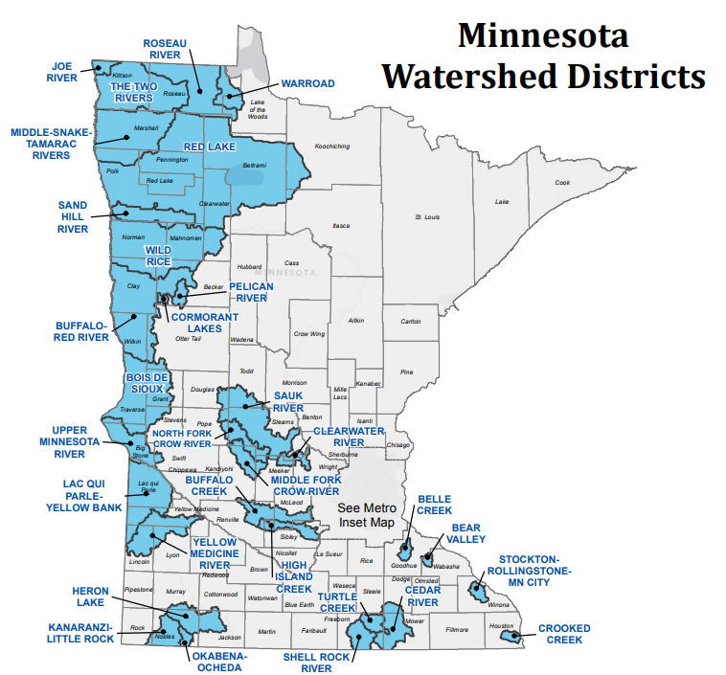
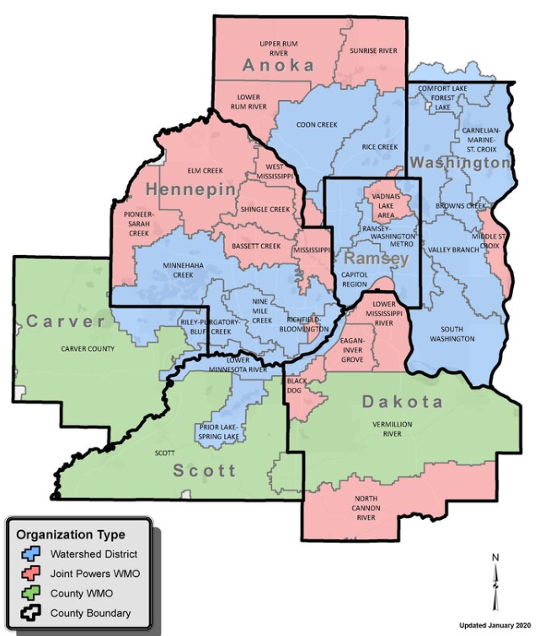

Slide 26
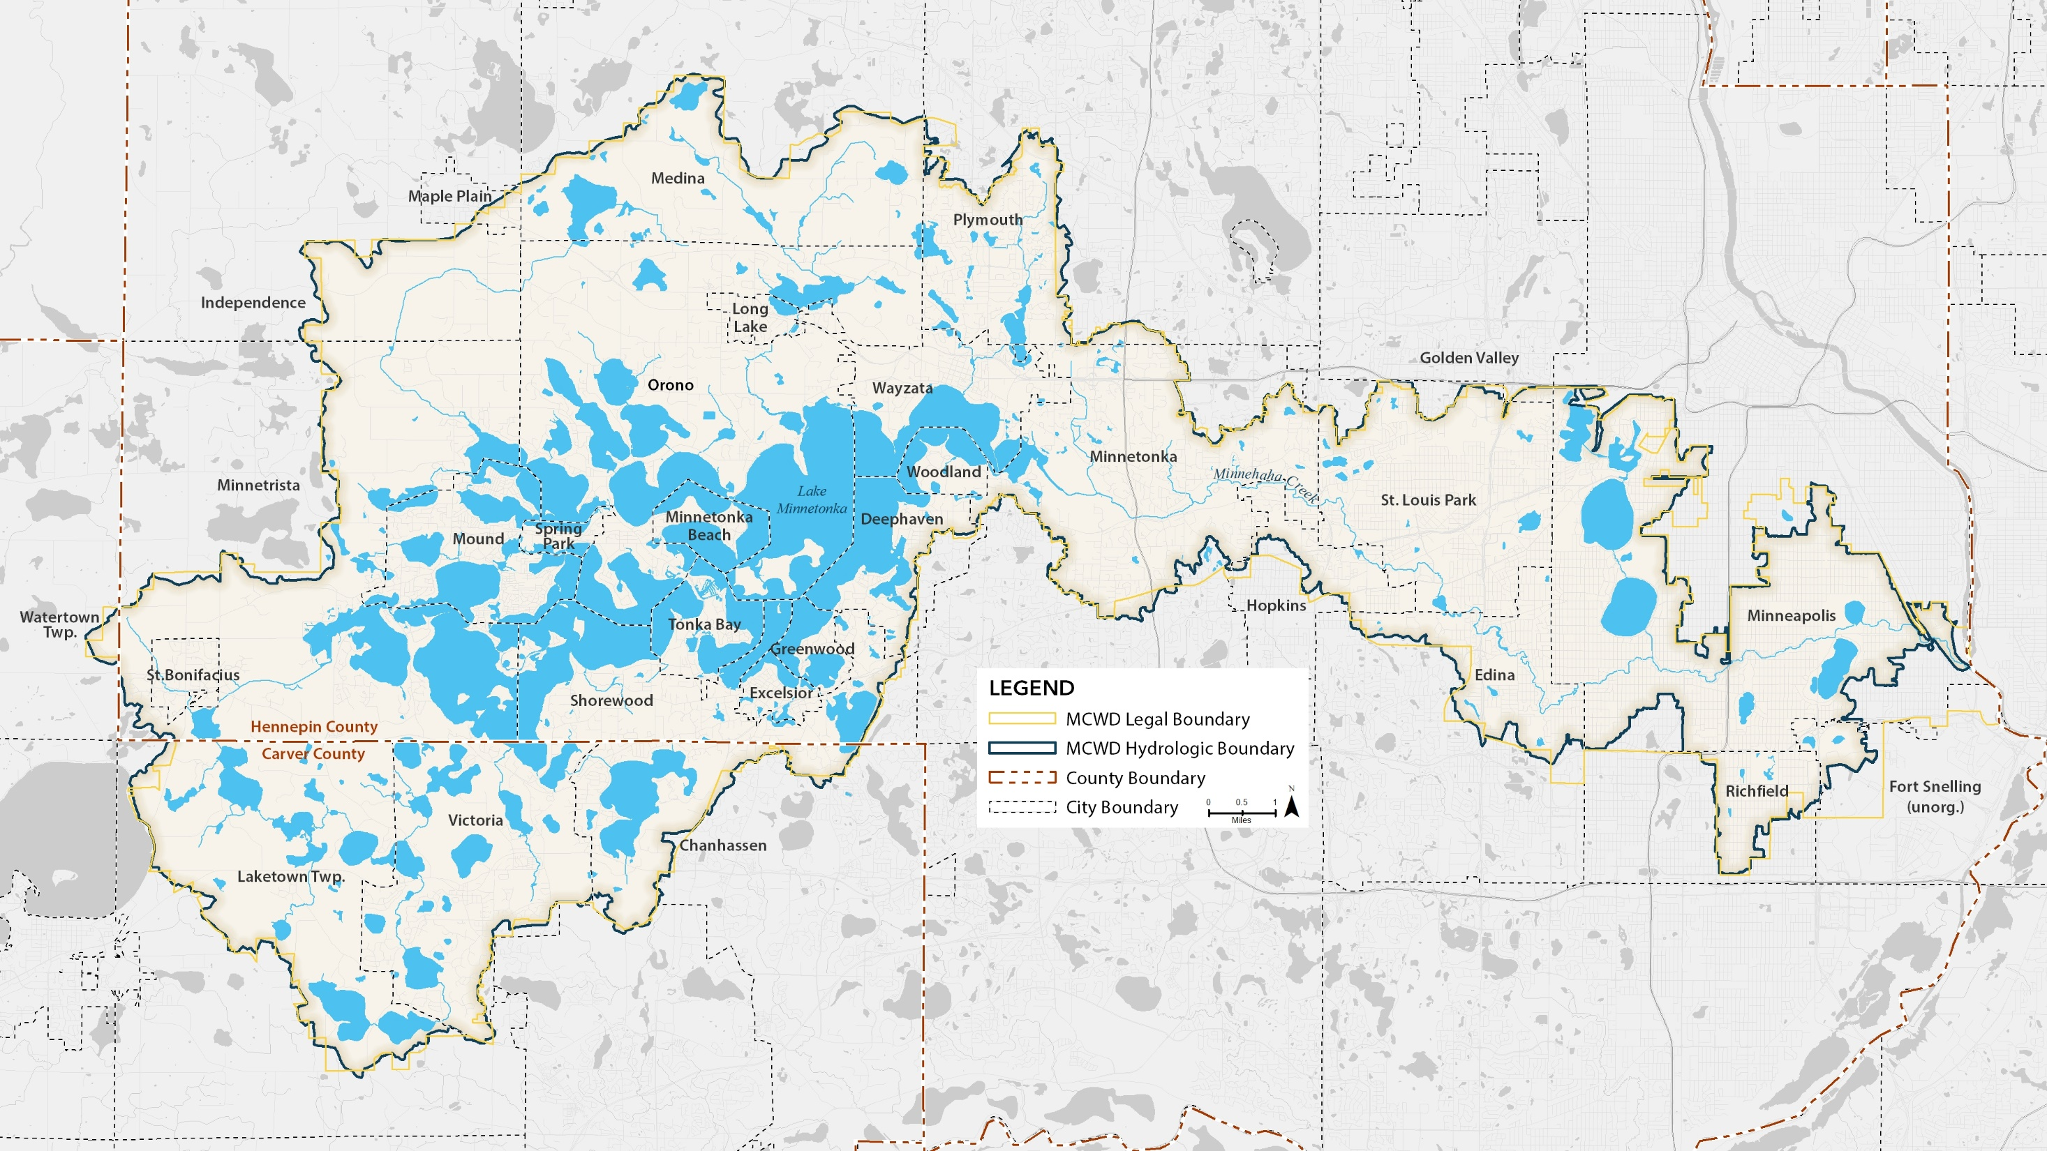

Slide 27
Minnesota Geospatial Advisory Council
Data standards
Statewide datasets
State/regional imagery services
LiDAR and derived products (DEM, HydroDEM)

Slide 28
Sector Engagement
Minnesota Association of Watershed Districts (MAWD)
  Metro MAWD
Regional GIS user & collaboration groups
  MetroGIS
Local and county governments within Minnehaha Creek Watershed District

Slide 29
Questions?

Slide 30
Agenda Item 11
Updates on GAC priority projects and initiatives
Cory Richter

Slide 31
GAC Priorities
Champion
Upper management, policymaker
Big Picture
Remove Barriers
Procure Resources
Promotion
Owner
Define scope and dependencies
Responsible for success
Day to day work
Communication with Champion
Report to GAC
Promotion

Slide 32
GAC Priorities
GAC Rank | Project or Initiative Description | Status | Project Owner | Champion
1 | All Data Free and Open | Active | Kari Geurts | many
2 | Updated and Aligned Boundary Data | Active | Preston Dowell | Dan Ross
3 | Archiving Implementation | Active | Ryan Mattke | many
4 | Parcel Data | Active | Alison Slaats | Mark Kotz
5 | Image Service Improvements | Active | Alison Slaats | Dan Ross
6 | Accurate Hydro-DEMs | Active | Sean Vaughn | many
7 | Road Centerline Data | Active | Sandi Stroud | Dan Ross
8 | New LiDAR Acquisition | Active | Gerry Sjerven | Dan Ross
9 | EM Damage Assess Data Standard | Active | Brad Anderson, Cory Richter
10 | Address Points Data | Active | Sandi Stroud | Dan Ross
11 | U.S. National Grid Materials | Active | Randy Knippel | Randy Knippel
12 | Parks and Trails Data Standard | Active
13 | NG9-1-1 Forum | Inactive

Slide 33
GAC Inactive Priorities
GAC Rank | Project or Initiative Description | Status | Project Owner | Champion
14 | Underground Utilities Forum | Inactive
15 | Basemap Services | Active
16 | Unmanned Vehicle Metadata Guide | Inactive
17 | Geospatial Data Asset Inventory | Inactive
18 | Critical Infrastructure Custodian | Inactive
19 | Culvert Data Standard | Inactive

Slide 34
Agenda Item 12
Legislative Updates
Dan Ross

Slide 35
Legislative Update
LiDAR budget request
  Could be other sources as well or instead
  Putting in for LCCMR this spring
Survey Coordinator Position at MnGeo
  Will be asking for a legislative change to support the position in terms of ongoing funding
  This would be for July 1, 2021

Slide 36
Legislative Update
SF 3696
  Minnesota Statutes 2018, section 394.25, subdivision 7, is amended to read…
  o) Counties are prohibited from imposing a fee on an applicant for geographic information systems data on dwellings or homes.

Slide 37
Agenda Item 13
Announcements or other business

Slide 38
Adjourn
Next meeting is Wednesday, May 27, 2020

