Slide 1



Minnesota Geospatial Advisory Council
May 27, 2020

Slide 2
Welcome
Introductions
Approve agenda
Approve March minutes

Slide 3
Agenda
Time | Topic
11:15 | Committee summaries - Review and accept
11:20 | Standards update
11:25 | GAC SharePoint site
11:30 | Geospatial Commons advisory group
11:40 | GIS/LIS Consortium salary survey update
11:45 | COVID-19 impacts to Minnesota travel patterns
11:55 | Break, networking
12:25 | Sector reports: Business; Nonprofits
12:45 | GAC priority projects and initiatives updates
1:05 | Legislative updates
1:15 | Announcements
2:00 | Adjourn

Slide 4
Agenda Item 2
Committee Summaries - Review and accept

Slide 5
Agenda Item 3
Standards Update
Mark Kotz

Slide 6
Agenda Item 4
GAC SharePoint Site
Alison Slaats

Slide 7
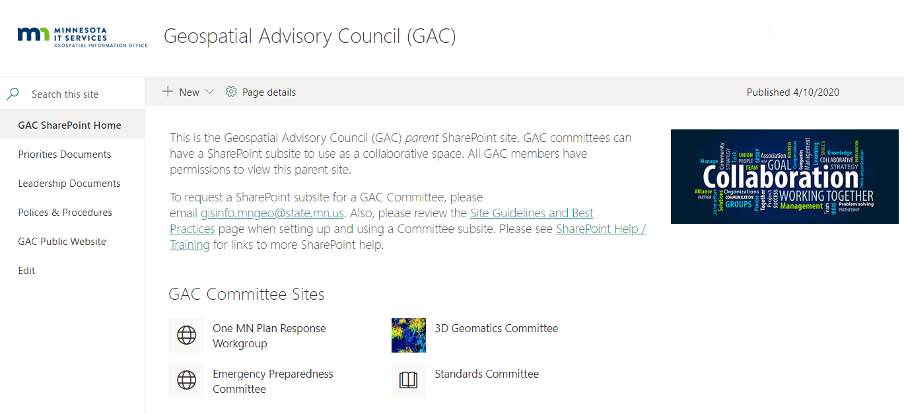

Slide 8
Agenda Item 5
Geospatial Commons Advisory Group
Mark Kotz

Slide 9
Agenda Item 6
GIS/LIS Consortium Salary Survey Update
Ryan Stovern

Slide 10
Agenda Item 7
COVID-19 Impacts to Minnesota Travel Patterns
Ben Timerson

Slide 11

COVID-19 IMPACTS TO MINNESOTA TRAVEL PATTERNS
Ben Timerson and Paul Czech
05/01/2020

Slide 12
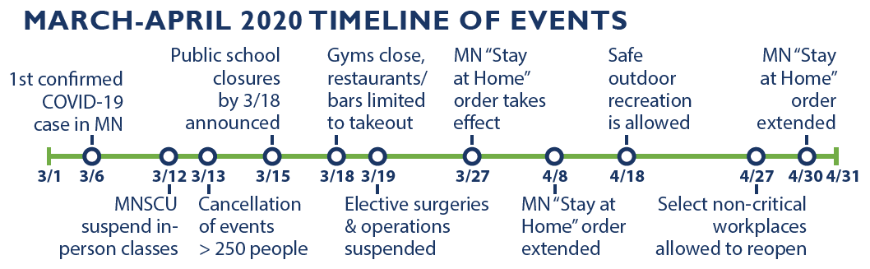
Timeline of COVID-19 Events in Minnesota

Slide 13
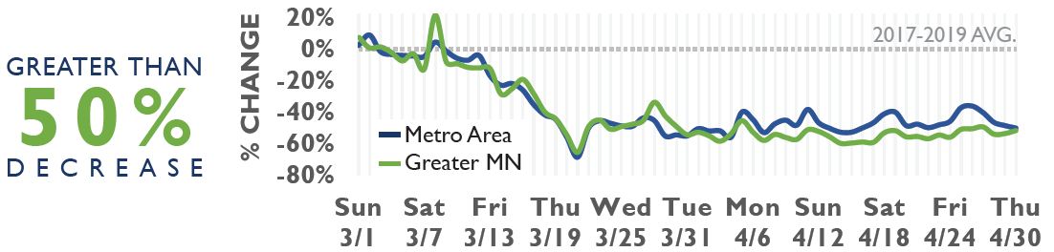
Hospital Traffic Volumes
Traffic volumes to hospitals decreased beginning around March 11th, and started to fall drastically around March 13th after the first executive action eliminating gatherings of >250 people was announced.
Notes:
Speculation:
March 11th, possibly due to the fact that testing was limited
The first confirmed COVID-19 death on March 21st, might have contributed to an increase in hospital traffic.

Slide 14
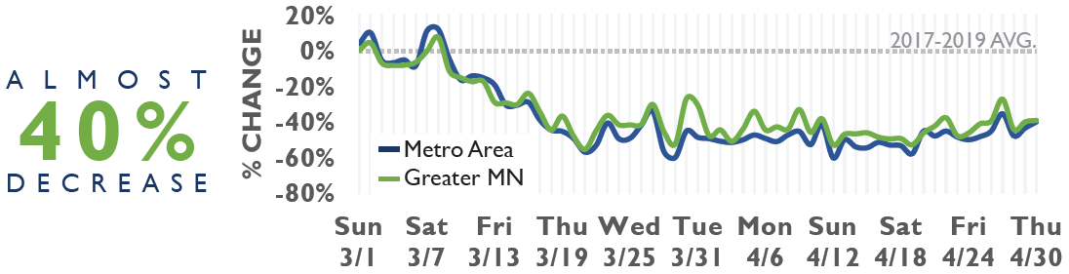
Nursing and Boarding Care Home Traffic Volumes
Traffic volumes to nursing and boarding care homes started to decrease around March 8th. The second half of the month shows a leveling out of traffic volumes. April traffic volumes in greater Minnesota are almost at a 40% decrease in Greater MN and the Metro.
Notes:
Speculation
beginning of March, there was an increase in traffic volume on the weekends when family and friends tend to visit more frequently
1st COVID-19 dead on March 21st produced a change in vehicle traffic activity at nursing and boarding care homes as well
slight increase in the last days of march, possibly due to increase in COVID-19 related hospitalizations

Slide 15
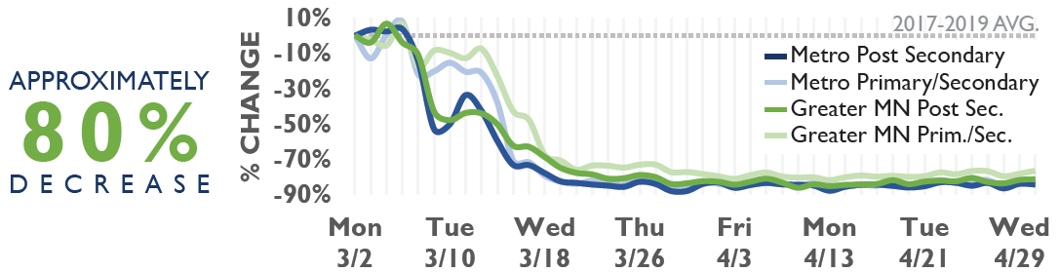
School Traffic Volumes
Traffic volumes at post-secondary schools decreased during the second week of March. After Governor Walz authorized a temporary closure of K-12 public schools on March 15th, traffic volume at primary and secondary schools quickly decreased.
Notes:
Speculation:
While schools are closed, food distribution services could be one of the reasons for remaining traffic activity at schools.

Slide 16
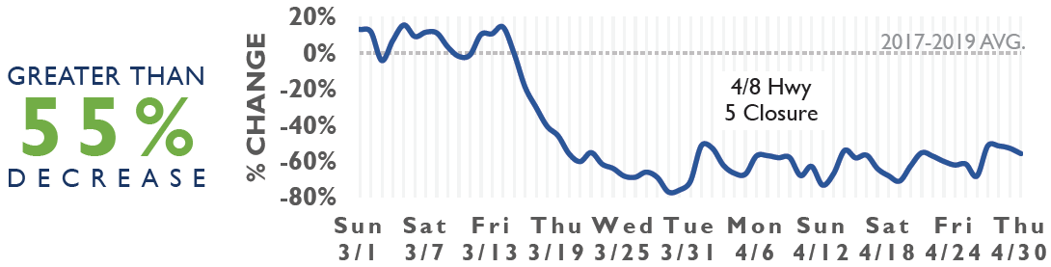
MSP Airport Traffic Volumes
There was a significant decrease in vehicle traffic volume beginning on March 14th, as people realized the risks of COVID-19 and the severity of the spread. The vehicle traffic volume continued to decrease until March 30th, but then increased slightly and leveled off in April.
Notes:
Speculation:

Slide 17
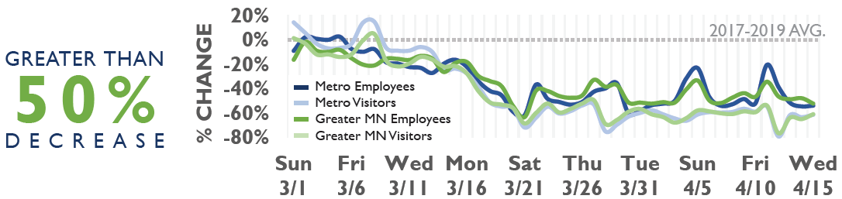
Commercial Center Traffic Volumes
Greater Minnesota shows a very similar trend to the metro. After March 15th, both visitors and employees greatly reduced their trips. Over the next month, visits were even more reduced than work trips, suggesting that people are following social distancing guidelines.
Notes:
Speculation:
week of March 9th, some employees may already have been staying home while the many members of the general public were attempting to run errands.
A spike in job zone visitors over the weekend of the 7th and the 8th may again indicate a surge in shopping for Stay-at-Home preparation
After the 27th, visits tended to be even more reduced than work trips, suggesting that potential customers are following social distancing guidelines, while a reduced number of essential workers still travel to job zones.

Slide 18
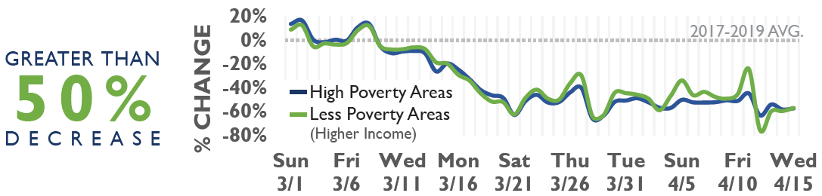
Traffic Volumes by Income
Both the less poverty and high poverty tracts showed similar patterns over time. However, by the end of March, residents of less poverty tracts were traveling slightly more, with a decline of around 40% as compared with 50% in the higher poverty tracts.
Notes:
Speculation:
Travel from high income, and especially low income tracts, spiked on Friday the 27th, perhaps in anticipation of Governor Walz’s Stay at Home executive order on Saturday, March 28th
The increased number of trips over the two weekends in the study period may speak to the efforts of tract residents to stock up for anticipated shut downs
Low poverty tracts travelling less may reflect the decreased ability of lower income residents to travel recreationally in light of reductions in public transportation service.

Slide 19
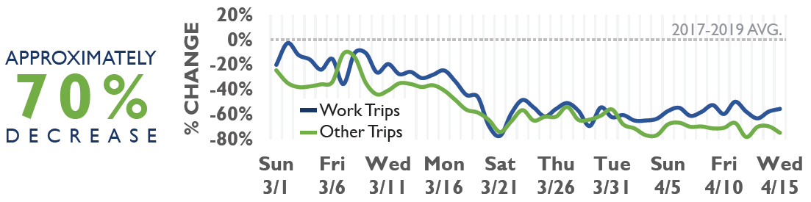
Tribal Nations Traffic Volumes
The decline in trips accelerated across the third week of March, with trips reduced by 80% on the 21st. Then, trips showed a small rebound, with overall travel reduced around 60% at the end of March. By mid-April non-work trips declined 70 to 80%.
Notes:
Speculation:
Shows a great deal of variability, which may speak to the difficulty of collecting mobile phone data in isolated rural areas that lack complete network coverage.

Slide 20
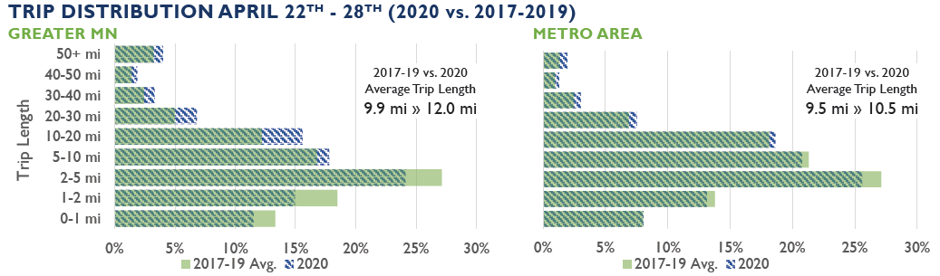
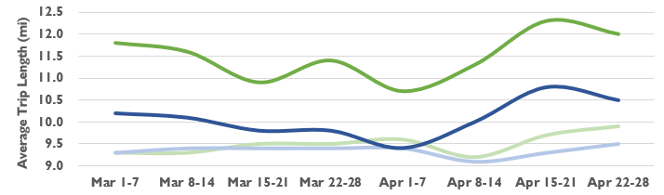
Trip Distribution and Average Trip Length (2020 vs. 2017-2019)
Average trip length in March and April 2020 was longer than in previous years for both greater Minnesota and metro counties. Overall, the trip distribution in March and April for the metro counties did not change as drastically as it has for Greater MN when compared to trip lengths of similar weeks in 2017-2019. For the Greater Minnesota counties, there was more of a change in the trip distribution (i.e., greater proportion of longer trips).
Notes:
Speculation:
Trips may be skewing longer because people are also making less spontaneous or extraneous trips (to get coffee, to run to Target quick) etc.
Trips may be longer because people were having to drive further for items or services that currently are not available closer to them.

Slide 21
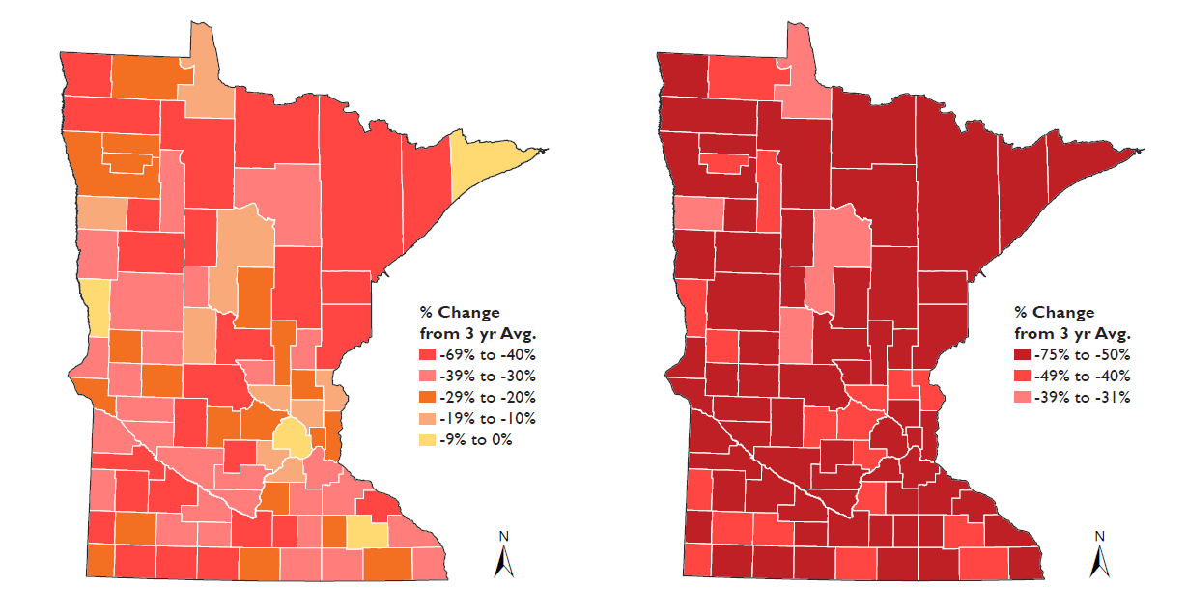
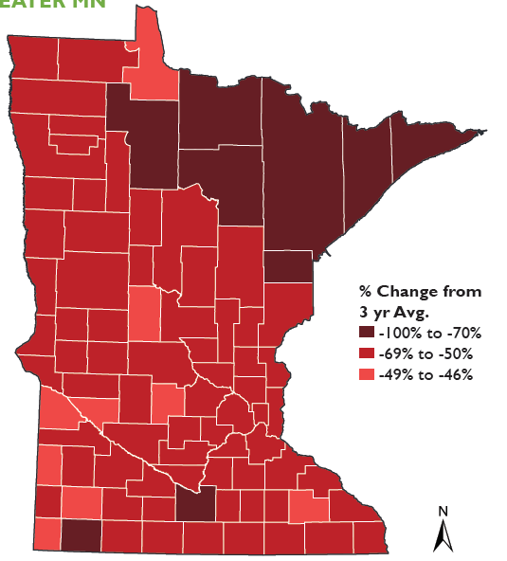
Greater MN Change in Average Daily Trips in the 2nd and 4th Weeks of March and April 1-14th (2020 vs. 2017-2019)
2nd Week of March
4th Week of March
April 1st - 14th
Notes:
State Map: nearly every part of the state was reducing travel

Slide 22
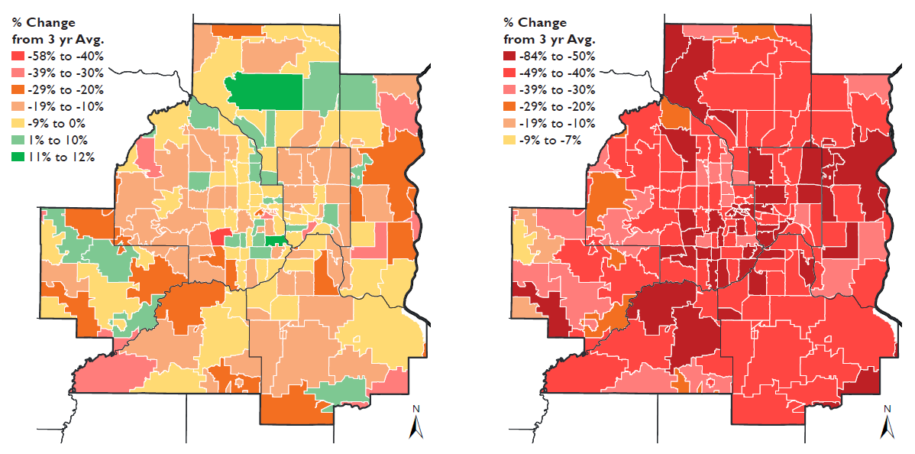
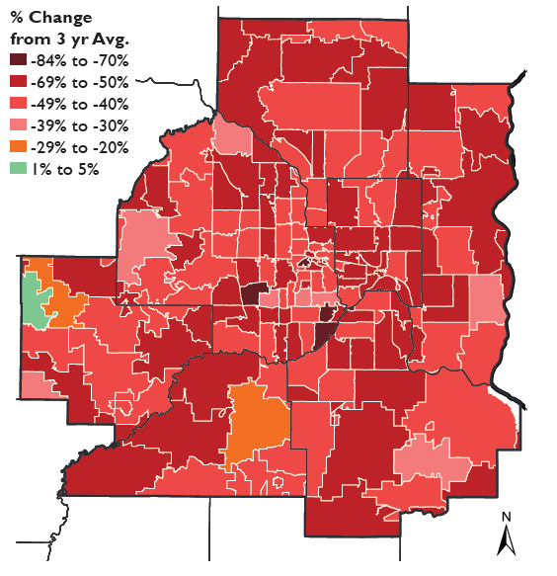
Metro Area Change in Average Daily Trips in the 2nd and 4th Weeks of March and April 1st – 14th (2020 vs. 2017-2019)
2nd Week of March
4th Week of March
April 1st - 14th
Notes:
Zip Map: 4th week display steeper declines with increased areas showing declines of more than 50%. Once again, only areas of western Carver County did not show the same level of decline

Slide 23
Thank you!
Ben Timerson and Paul Czech
http://www.dot.state.mn.us/tda/tardis.html

Slide 24

Break - Networking

Slide 25
Agenda Item 9
Sector Report
Business: Brandon Tourtelotte
Notes:
To cover:
Update on the plan
What is GAC role

Slide 26

BUSINESS SECTOR REPORT
Brandon Tourtelotte
State & Local Business Development Manager
Pro-West & Associates
Btourtelotte@prowestgis.com
320-207-6875 ph
612-916-0519 c

Slide 27

PRIVATE SECTOR GEOSPATIAL FIRMS IN MN
Content providers – sensors; imagery, lidar, weather, captured from UAV, fixed wing, vehicles, satellites
Content providers – derived data products, like terrain products (DEM/TIN, contours), feature mapping (ROW, road centerlines), NG911 datasets, parcel development and parcel fabric
Equipment providers – UAV, GPS/GNSS equipment, service and training packages to support these
Software vendors – desktop, web, server, mobile
Implementation consultants for said software vendors – recommendations, configuration, install, ongoing support
GIS-based business systems – CAD/Dispatch, CAMA, Asset Management, Tax Systems, Permitting, others coming online

Slide 28

SO WHO ARE THESE FOLKS?

Slide 29


CONTENT PROVIDERS - Sensors
EagleView Tech
Quantum
Ayres
Fugro
Surdex
Woolpert

Slide 30
CONTENT PROVIDERS - Data Products
Houston Engineering
Pro-West
Panda Consulting
Quantum
Ayres
Fugro
Surdex
EagleView Tech
Moore Eng
Woolpert

Slide 31
EQUIPMENT PROVIDERS
Trimble/Frontier Precision
EOS
TopCon
Leica/Hexagon
Laser Technology
CES Imaging

Slide 32
SOFTWARE VENDORS
Esri
Schneider Geospatial
GeoMoose
QGIS/other FOSS
Latitude Geographics
Hexagon Geospatial
SAFE Software
Bentley
MapInfo
Manifold

Slide 33
IMPLEMENTATION CONSULTANTS
Houston Eng
Pro-West
Northpoint
WSB Eng
Graef

Slide 34
GIS-BASED BUSINESS SYSTEMS
GeoComm
Michael Baker
Vanguard
Tyler Tech
DevNet
Xerox
Cartegraph
Lucity
Cityworks (Trimble)

Slide 35
STAYING IN TOUCH
Have created a simple email contact list
Have asked each entity who would be the best POC, confirmed they want to be involved in the conversation
Haven't contacted them much lately (please advise)

Slide 36
HOW CAN THE GAC SUPPORT?
Stay engaged in any venue that arises, ask questions
Take note of new vendors that arise, review their solutions
Take advantage of educational opportunities that vendors are offering during COVID
Any opportunities to unify shared interests around certain vendor(s) based on need for certain products (like 3D Geomatics has done, MCCC)
Don't be shy about asking vendors to talk to each other to ensure product compatibility

Slide 37
QUESTIONS?
Brandon Tourtelotte
State & Local Business Development Manager
Pro-West & Associates
Btourtelotte@prowestgis.com
320-207-6875 ph
612-916-0519 c

Slide 38
Agenda Item 9
Sector Report
Nonprofit: Soren Rundquist
Notes:
To cover:
Update on the plan
What is GAC role

Slide 39

Nonprofit Sector Report
Soren Rundquist
Director of Spatial Analysis
Environmental Working Group

Slide 40
Nonprofit Sector Report
GAC Priority: All public geospatial data in MN to be free and open to everyone
Making spatial data available for public health and environmental awareness and advocacy
Assist other nonprofits (MN Center for Environmental Advocacy, Friends of the Mississippi, Minnesota Environmental Partners, Land Stewardship Project) in Minnesota geospatially (analysis, web maps, visuals, communications)
The Groundwater Protection rule minimizes potential sources of nitrate pollution to the state’s groundwater and protects our drinking water.

Slide 41

Nonprofit Sector Report
Nitrate in MN Private Wells
– January 2020
Over 7,500 households may be drinking water from a private well with nitrate levels at or above 3 milligrams per liter

Slide 42

Nonprofit Sector Report
Nitrate in MN Drinking Water
– January 2020
Over 725 public water systems, serving 473,000 people recorded nitrate levels at or above 3 milligrams per liter.

Slide 43
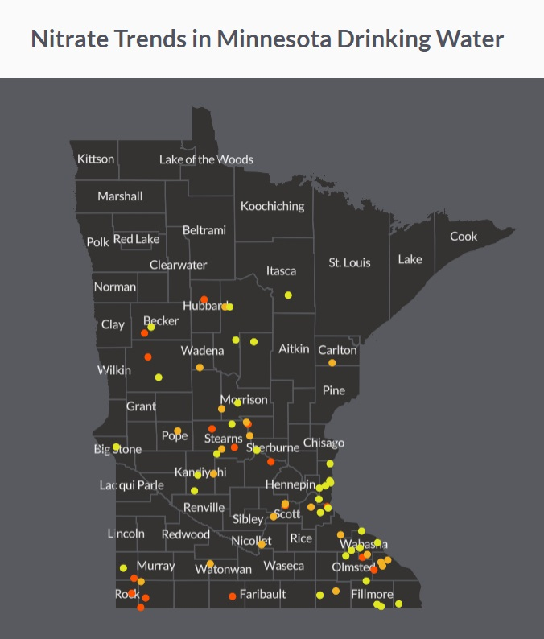
Nonprofit Sector Report
Nitrate in MN Drinking Water
– March 2020
Nitrate contamination is getting worse in 63% of public water systems serving over half a million people, primarily in rural areas.

Slide 44
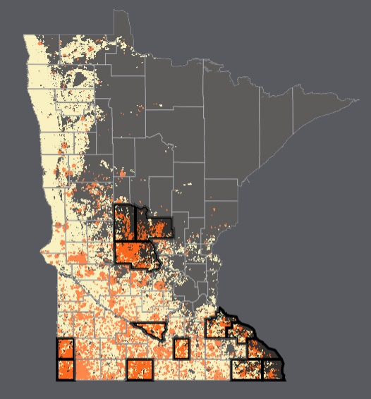
Nonprofit Sector Report
Manure Application Analysis
– Released tomorrow
Leverages Minnesota Pollution Control Agency feedlot data and peer reviewed analysis/model to generate manure outputs and field application for individual facility locations.

Slide 45
Agenda Item 11
Updates on GAC priority projects and initiatives
Cory Richter

Slide 46
GAC Priorities
GAC Rank | Project or Initiative Description | Status | Project Owner | Champion
1 | All Data Free and Open | Active | Kari Geurts | many
2 | Updated and Aligned Boundary Data | Active | Preston Dowell | Dan Ross
3 | Archiving Implementation | Active | Ryan Mattke | many
4 | Parcel Data | Active | Alison Slaats | Mark Kotz
5 | Image Service Improvements | Active | Alison Slaats | Dan Ross
6 | Accurate Hydro-DEMs | Active | Sean Vaughn | many
7 | Road Centerline Data | Active |  | Dan Ross
8 | New Lidar Acquisition | Active | Gerry Sjerven | Dan Ross
9 | EM Damage Assess Data Standard | Active | Brad Anderson, Cory Richter
10 | Address Points Data | Active |  | Dan Ross
11 | U.S. National Grid Materials | Active | Randy Knippel | Randy Knippel
12 | Parks and Trails Data Standard | Inactive*
13 | NG9-1-1 Forum | Inactive

Slide 47
GAC Priorities
GAC Rank | Project or Initiative Description | Status | Project Owner | Champion
14 | Underground Utilities Forum | Active | Steve Swazee
15 | Basemap Services | Inactive
16 | Unmanned Vehicle Metadata Guide | Inactive
17 | Geospatial Data Asset Inventory | Inactive
18 | Critical Infrastructure Custodian | Inactive
19 | Culvert Data Standard | Active | Rick Moore | Rick Lorenzen

Slide 48
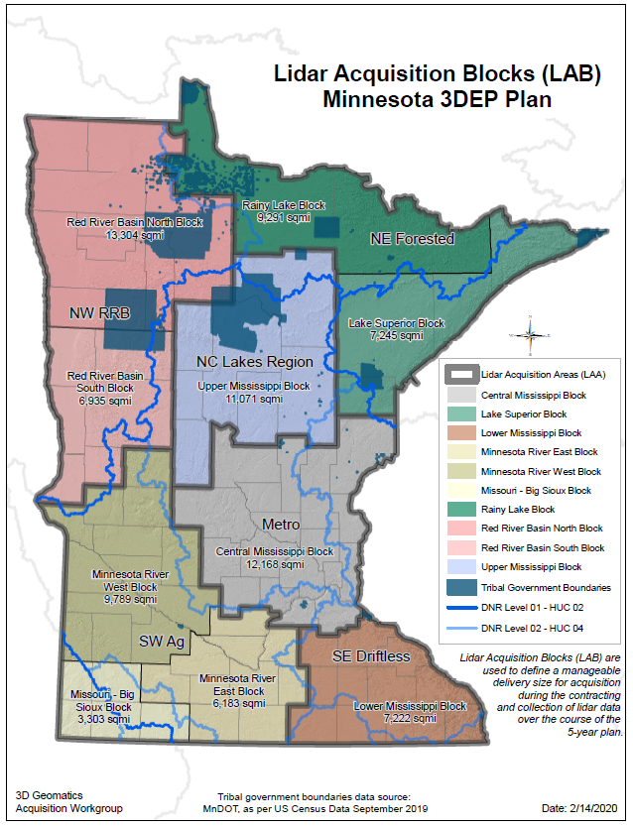
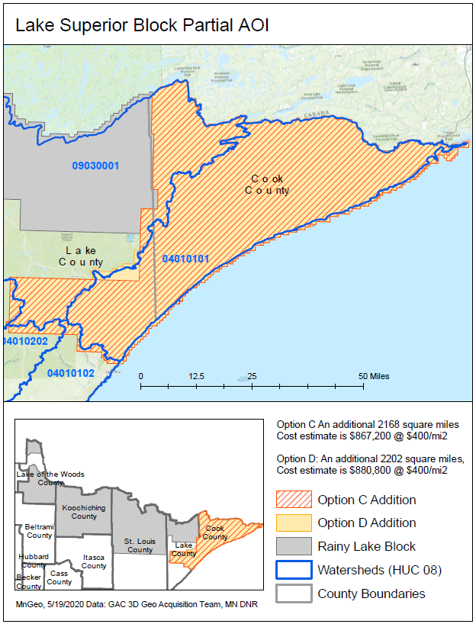

Lidar Update
Spring 2021
Rainy Lake Block
Recently added
Spring 2020
Fall 2020 BAA

Slide 49
Agenda Item 12
Legislative Updates
Dan Ross

Slide 50
Legislative Update
Lidar project request to LCCMR
  Hydro modified DEM, forest research and assessment, data storage and dissemination, education
Ligado Networks applied to the Federal Communications Commission for a license modification applications for use of 40 MHz of L-band spectrum to use for commercial wireless services.
  The 40 MHz of L-band spectrum is very close to the spectrum used by GPS receivers. That said there is much concern in the GPS, navigation, geospatial and survey sectors that use of the 40 MHz of L-band spectrum will cause interference and degradation of the signals a GPS receiver obtains from satellites moving across the sky.
  Many organization raising concerns
  Effort led by Senator Inhofe and Senator Reed – Committee on Armed Services

Slide 51
Agenda Item 13
Announcements or other business

Slide 52
Adjourn
Next meeting is Wednesday, September 9, 2020

