Slide 1
Minnesota Geospatial Advisory Council
December 9, 2020

Slide 2
Welcome
Introductions
Approve agenda
Approve September minutes

Slide 3
Agenda
Time | Topic
11:15 | Committee summaries - Review and accept
11:20 | Archiving Implementation Workgroup Update
11:35 | Approval of changes to address and road standards
11:45 | 3D Geomatics Committee update
12:00 | Break
12:10 | Statewide parcel map discussion
12:25 | GAC priority projects and initiatives updates
12:45 | Timing of future online GAC meetings
12:55 | Announcements
1:10 | Adjourn

Slide 4
Agenda Item 2
Committee Summaries - Review and accept

Slide 5
Agenda Item 3
Archiving Implementation Workgroup Update
Ryan Mattke

Slide 6
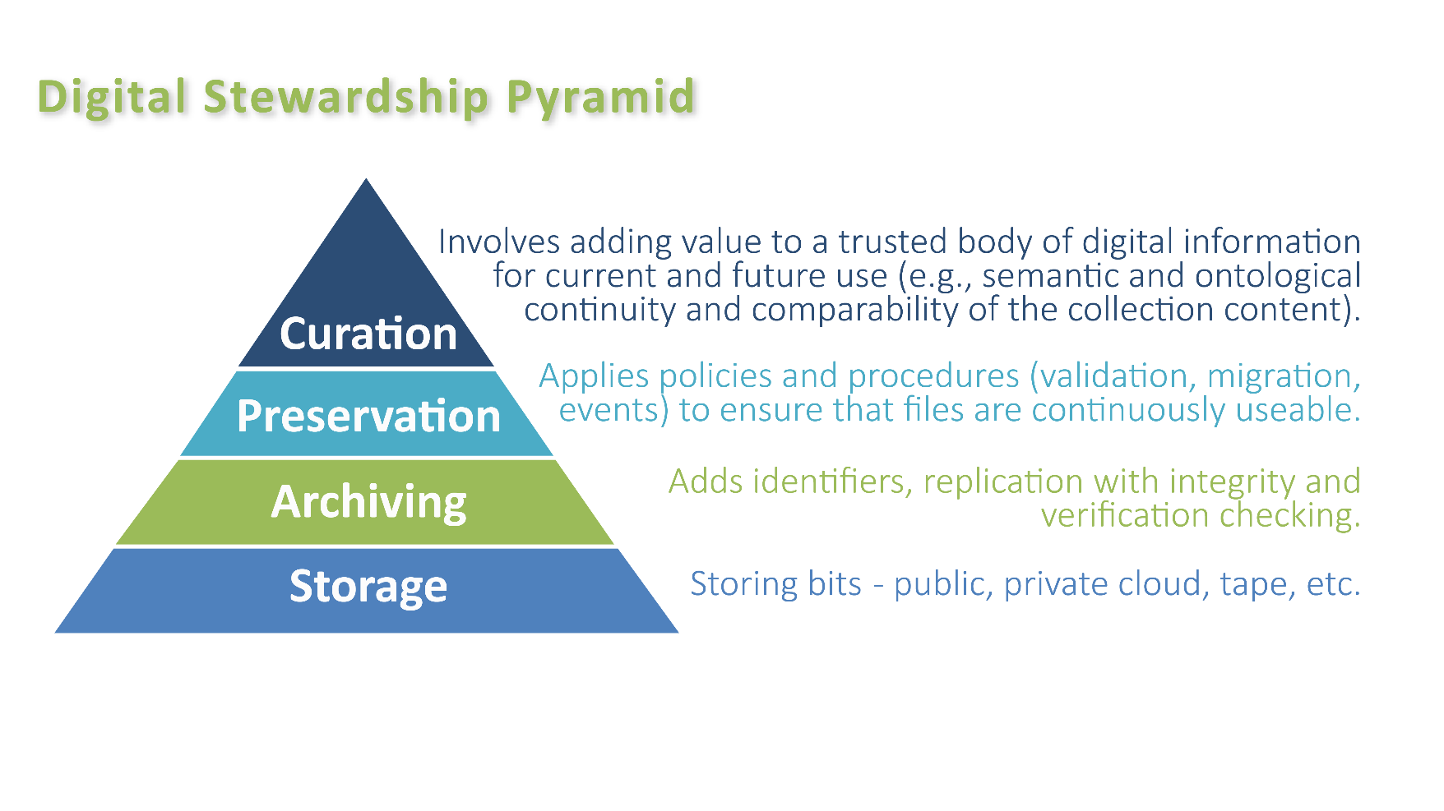
Archiving Implementation Workgroup
Mission statement:
Define and facilitate the implementation of an archive for Minnesota geospatial data by building on the work of the Archiving Workgroup

Slide 7
Archiving Implementation Workgroup
Members:
Sarah Barsness - Minnesota State Archives
David Brandt - Washington County
Jennifer Corcoran - MN DNR
Jon Hoekenga - Met Council
Melinda Kernik - UMN Libraries
Len Kne - UMN / U-Spatial
Leanne Knott - Goodhue County
Carol Kussmann - UMN Libraries
Brent Lund - MNIT / MnGeo
Karen Majewicz - UMN Libraries (Vice Chair)
Andra Mathews - MN DOT
Ryan Mattke - UMN Libraries (Chair)
Nancy Rader - MNIT / MnGeo
Soren Rundquist - EWG
Zeb Thomas - MNIT / MN DNR
Ben Timerson - MN DOT
Brandon Tourtelotte - Pro-West & Associates

Slide 8
Archiving Implementation Workgroup
Work Areas (from Archiving Workgroup Summary Report):
Program: Develop a detailed program for archiving geospatial data, including governance, guidelines, procedures, and the necessary social infrastructure
Technology: Develop detailed technical infrastructure plans and workflows for archiving geospatial data
Outreach & Education: Continue to build support for the archiving effort
Funding: Research and secure funding for the archiving effort
Deliverables (from January 2020):
Program recommendations
Technology plans and workflows
Outreach & Education plan
Funding recommendations
Pilot Project
Report
Present at 2020 MN GIS/LIS Conference

Slide 9
Archiving Implementation Workgroup
Accomplishments in 2020
Program – Developed a draft program for archiving geospatial data, including governance, staffing, coordination, workflows, discovery interface, maintenance options, and a glossary
Technology – Developed recommendations around data formats, data management, and data storage
Outreach & Education – Sent out informational and educational messages (more coming); collecting testimonials on the reasons for archiving geospatial data
Pilot Project – Devising a plan to experiment with MN Geospatial Commons data and MnGeo imagery
Funding – Devising a plan to pursue funding
Deliverables:
Program recommendations
Technology recommendations
Outreach & Education plan
Funding recommendations
Pilot Project plans
Report (March GAC meeting)

Slide 10
Archiving Implementation Workgroup
What should the next phase look like?

Slide 11
Archiving Implementation Workgroup
What should the next phase look like?
Continue sending out communications? Ideas for topics? Continue as part of GAC Outreach Committee?
Pilot project (spring/summer?) – need a formal (workgroup) for this or not?
Hold off on (another) formal workgroup until we have a more solid plan for implementation?

Slide 12
Archiving Implementation Workgroup
Questions?

Slide 13
Agenda Item 4
Approve Changes to Address and Road Standards
Mark Kotz

Slide 14
Address & Road Standard Changes
Background
GAC Standards alignment with NENA Standards (NextGen 9-1-1)
Standards Committee & MnGeo Review
Proposed 4 new elements – street name for legacy map displays & CAD
60-day public review
Responses to all comments – minor changes

Slide 15
Address & Road Standard Changes
Summary of changes
Minor wording edits for clarity
Removal of “If Available” inclusion category
Added Road Cartographic Class element in road standard
Optional
For cartographic symbology purposes
Removal of XML formatting template from address standard

Slide 16
Address & Road Standard Changes
Summary of changes
Legacy street name elements
backward compatibility with legacy map displays and Computer Aided Dispatch (CAD) systems
Conditional
Legacy Street Name Pre Directional
Legacy Street Name
Legacy Street Name Type
Legacy Street Name Post Directional

Slide 17
Address & Road Standard Changes
Action
The Standards Committee requests GAC approval of:
Draft version 1.3 of the Address Point Data Standard
Draft version 1.1 of the Road Centerline Data Standard

Slide 18
Agenda Item 5
3D Geomatics Committee Update
Sean Vaughn, Rick Moore

Slide 19
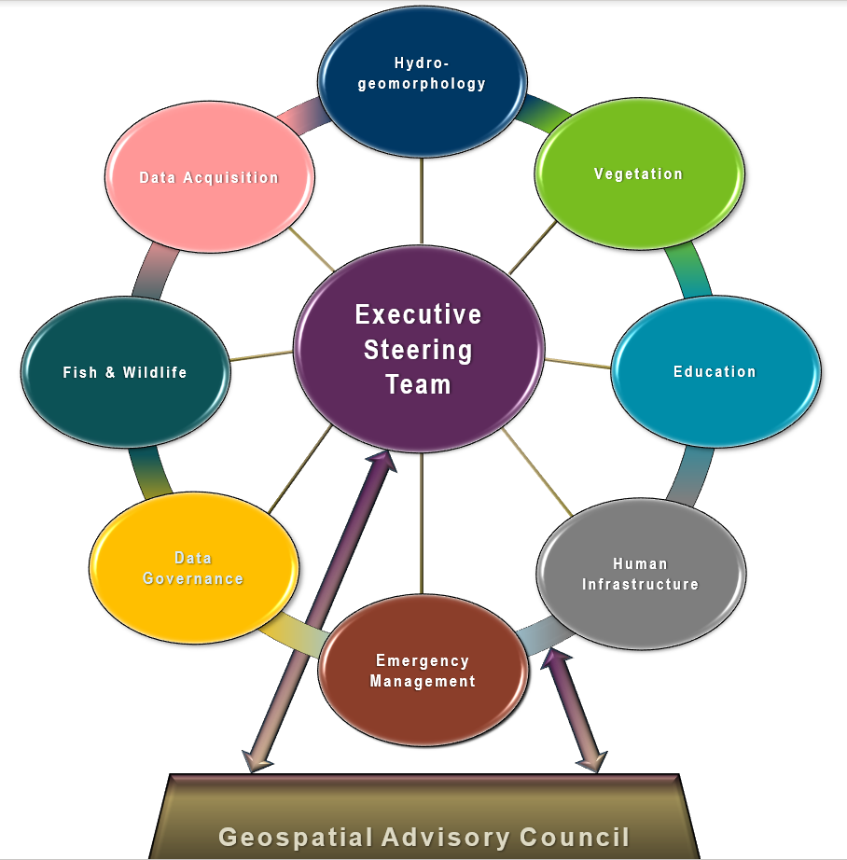
MN Geospatial Advisory Council 3D Geomatics Committee Update
3D Geomatics Committee Co-Chairs
Sean Vaughn, MNIT@DNR | Gerry Sjerven, Minnesota Power
Wednesday, December 9, 2020 11:00 PM
Online
Hydrogeomorphology Workgroup Co-chairs
Andrea Bergman , MNIT@DNR | Rick Moore , MNIT@DNR | Jamie Schulz , MNIT@DNR

Slide 20
Introduction

Slide 21
Introduction
What Brings Us Here Today …

Slide 22
Introduction
Introduction
Update: GAC Priorities and 3D Geomatics Committee (3DGeo)
3 GAC Priorities
Lidar Data
Hydro-modified DEMs (hDEM)
Culvert Data Standard
Priority #8 - Data Acquisition Workgroup:
New Lidar requires hDEM development for water route modeling and flood analysis
Priority #6 - DEM Hydro-modification Workgroup:
HDEM development requires knowledge of culvert locations to breach DEM digital dams
Priority #19:
Culvert data standard supports culvert inventory data sharing
Lidar data supports remote sensing of culvert locations and increases ability to identify culverts on the landscape
Notes:
Animation:
1st – Dem Hydro-modification fades in
2nd – Culvert Data Standard fades in
3rd – New Lidar green box fades in
4th – hDEM development green box fades in

Slide 23
Successful and Cost-Effective Lidar Acquisition and Derived Products

Slide 24
3DGeo Workgroups
Sectors of Expertise
Multidiscipline committee organized by workgroups
Each discipline sector is comprised of subject matter experts
Five workgroup-sectors now established with work plans
Today is an update on work relationships of two workgroups and GAC Priorities.
Acquisition, and Hydrogeomorphology
Notes:
Sean – 3DGeo Background
What is the GAC?
The Minnesota Geospatial Advisory Council is the coordinating body for the Minnesota geospatial community.
Cross-section of organizations that include counties, cities, universities, business, nonprofit organizations, federal and state agencies, tribal government, and other stakeholder groups.
What is the 3D Geomatics Committee?
The 3D Geomatics Committee (3DGeo) is a committee under GAC that works to identify and promote the need for planning, funding, acquisition, and management of three-dimensional geomatic data and derived products.
Sector Expertise
Lidar acquisition relies on subject matter expertise from different sectors in 3DGeo

Slide 25
3DGeo - Data Acquisition Workgroup
Mission:
Promotes procurement of foundational 3D data for Minnesota.
Co-Chairs
Sean Vaughn, Alison Slaats, and Gerry Sjerven
Lidar Acquisition Subgroup:
Alison Slaats (MnGeo), Dan Ross (MnGeo), Jennifer Corcoran (DNR), Colin Lee (MnDOT), Sean Vaughn (MNIT DNR), Gerry Sjerven (MN Power), Matt Baltes (NRCS), Joel Nelson (U of MN), Joe Sapletal (Dakota Co), Andra Mathews (MnDOT), and Brandon Krumwiede (NOAA)
Notes:
Committee guided LiDAR acquisition for Minnesota
Building diverse needs, one collective voice

Slide 26
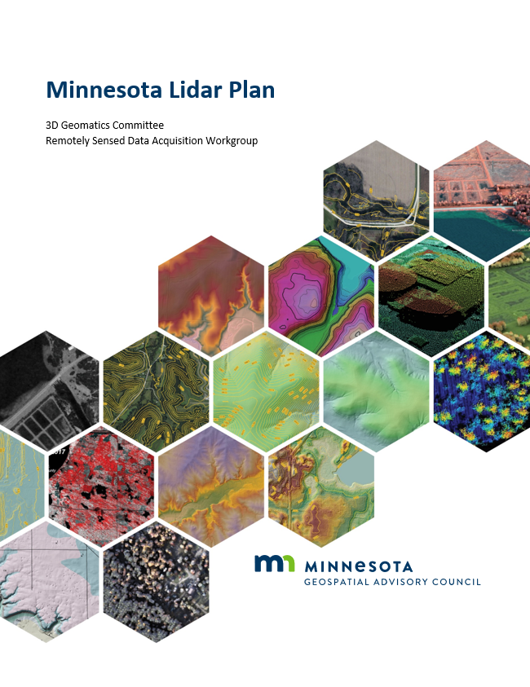
Overview of Plan
Executive Summary & Introduction
Background about Lidar
Value and Benefit of Lidar to Minnesota
Lidar Acquisition Areas of Interest
Lidar Acquisition Specifications
Elevation Products to be Derived from Lidar
Cost Estimates
Data management and Distribution
Outreach Plan
Educational Needs and Support
https://www.mngeo.state.mn.us/committee/3dgeo/acquisition/Minnesota_State_Lidar_Plan.pdf

Slide 27
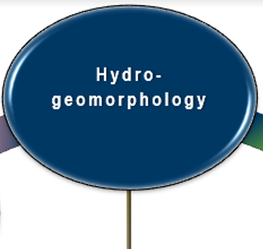
3DGeo – Hydrogeomorphology Workgroup
Mission
Promotes the consistent development of Minnesota's hydrography data and to enable data exchange through coordination, cooperation and standards development
Co-chairs
Rick Moore, Jamie Schulz and Andrea Bergman
Liaison
Sean Vaughn
Notes:
Committee guided LiDAR acquisition for Minnesota
Building diverse needs, one collective voice

Slide 28
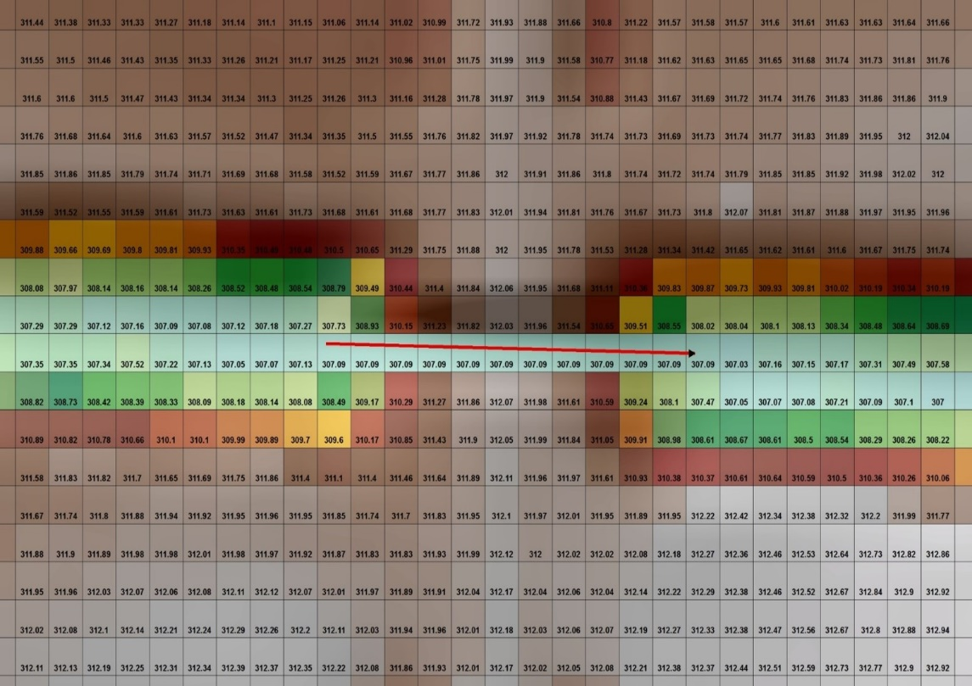
3DGeo – DEM Hydro-modification Subgroup
Mission:
Dedicated to developing the foundation for single, authoritative, digital dam breachline and hDEM datasets for Minnesota utilizing standards and methodology developed through collaboration with breachline subject matter experts
Workgroup
Co-chairs
Rick Moore
Liaison
Sean Vaughn
Notes:
Committee guided LiDAR acquisition for Minnesota
Building diverse needs, one collective voice

Slide 29
LiDAR & Digital Dams

Slide 30
Next
Priority #8 New Lidar Data
& DEM Digital Dams

Slide 31
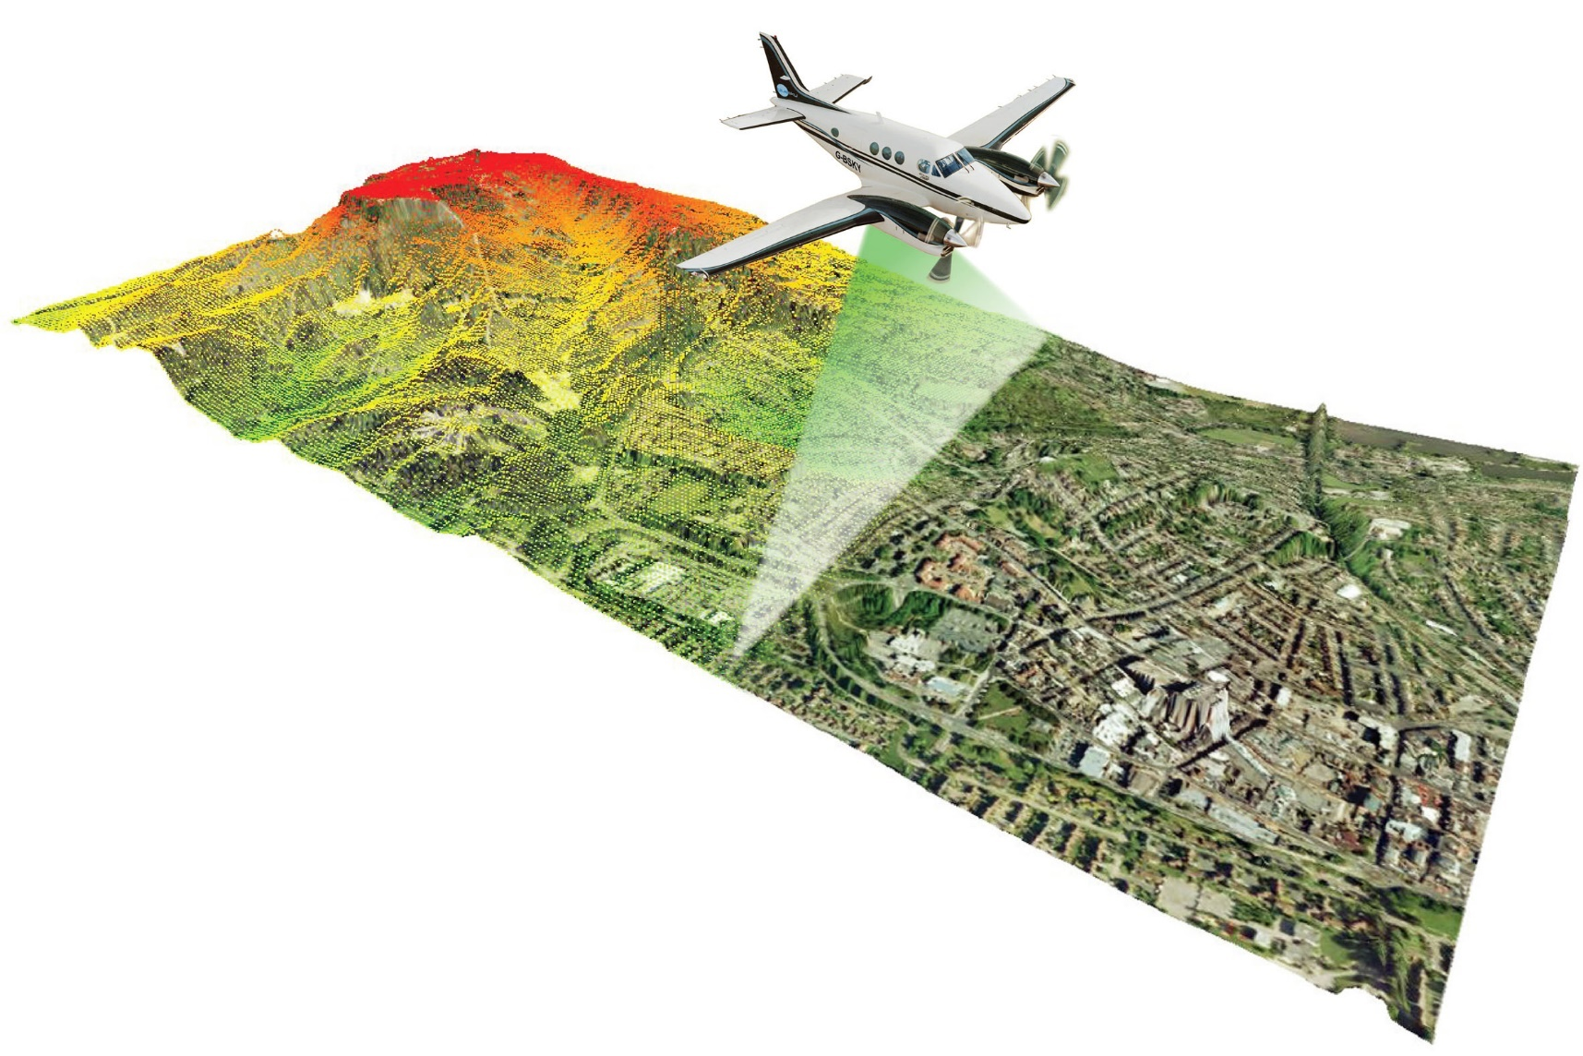
LiDAR → Point Cloud
LiDAR does its job
Millions of elevation data points
LiDAR captures terrain and features (roads, dams, bridges) without regard to pass through conveyance of water (e.g., culverts).
Creates Digital Dams in the DEM
Not unique to Minnesota

Slide 32
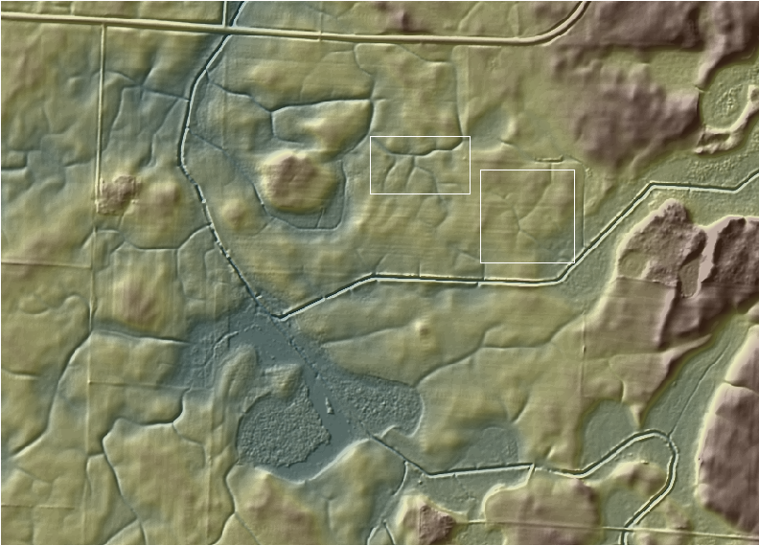
LiDAR → Point Cloud → DEM
Modeled water does not “flow” within the DEM without DEM Hydro-modification
LiDAR 3D Point Cloud
LiDAR-derived 3D Digital Elevation Model (DEM)

Slide 33
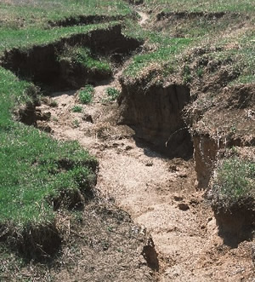
LiDAR → Point Cloud → DEM
Features of hydrologic Significance.
Nickpoint
Fluvial Processes
Soil Degradation
We Model this with DEMs
Where does the watercourse begin ?
Where concentrated flow begins.
LiDAR captures these landforms.

Slide 34
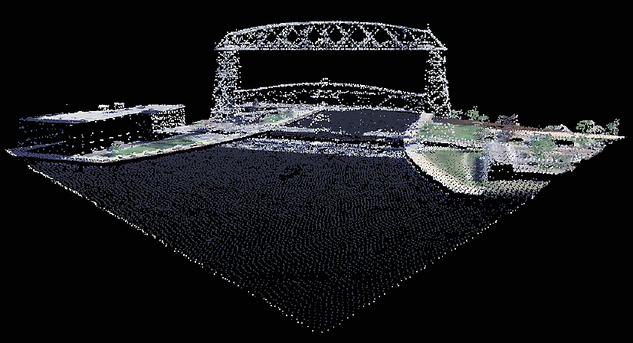
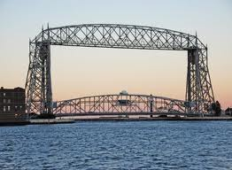
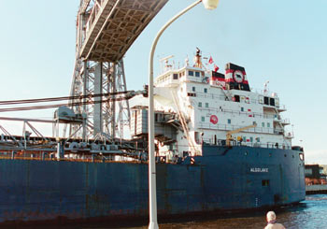
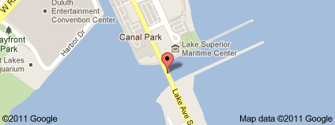
LiDAR → Point Cloud → DEM → Digital Dams
Bridges and culverts are digital dams
Point Cloud of the Aerial Lift Bridge - Duluth, MN
Notes:
Animation:
Lidar Point Cloud of Aerial Lift Bridge fades in

Slide 35
LiDAR → Point Cloud → DEM → Hydro-modification
Hydro-modified Digital Elevation Model (hDEM)
Digital Dams in this DEM have been breached to allow water to flow in the model
(A) - Roads
(B) - Railroad
(#1) - Watercourse
Receives water from these “breached” locations (A) and (B)
A
A
A
B
B
#1
#1

Slide 36
DEM Hydro-modification

Slide 37
Introduction
Priority #7 Hydro-DEMs
What is DEM Hydro-modification…

Slide 38
LiDAR → Point Cloud → DEM → Digital Dams → DEM Hydro-modification → hDEM
DEM
Hydro-modification
- is -
Digital Dam
Removal

Slide 39
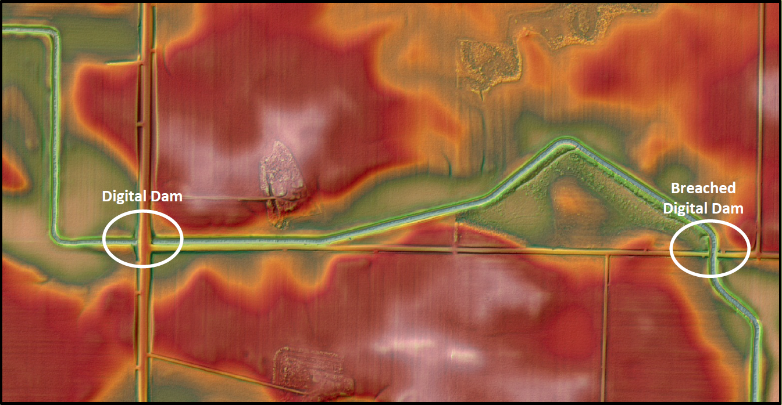
LiDAR → Point Cloud → DEM → Digital Dams

Slide 40
Next
DEM Hydro-modification Animation…

Slide 41
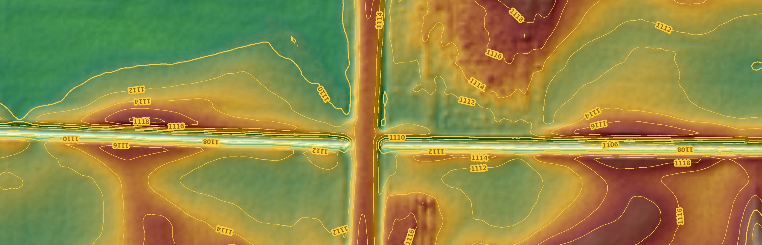
LiDAR → Point Cloud → DEM → Digital Dams
ROAD APRON
TOP OF BANK
TOP OF BANK
CULVERT
CHANNEL BED
CHANNEL BED
Notes:
Animation
First Click start the water drop to flow across the image from right to left

Slide 42
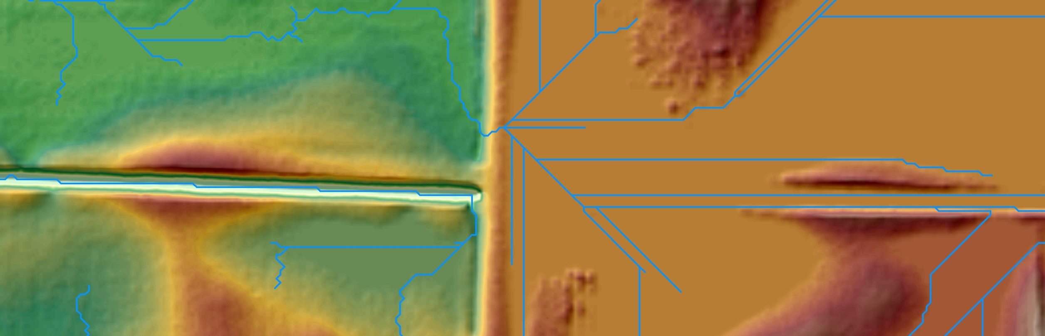
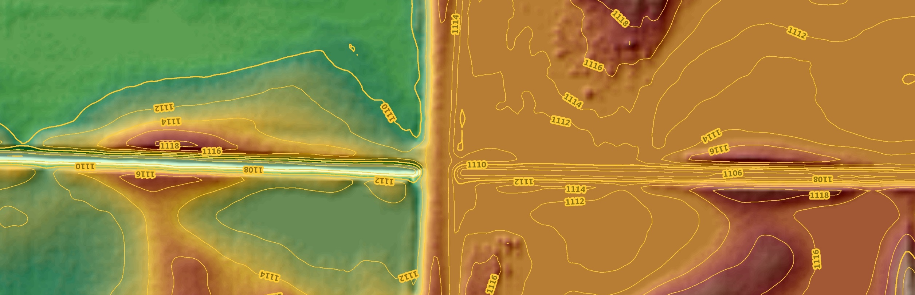
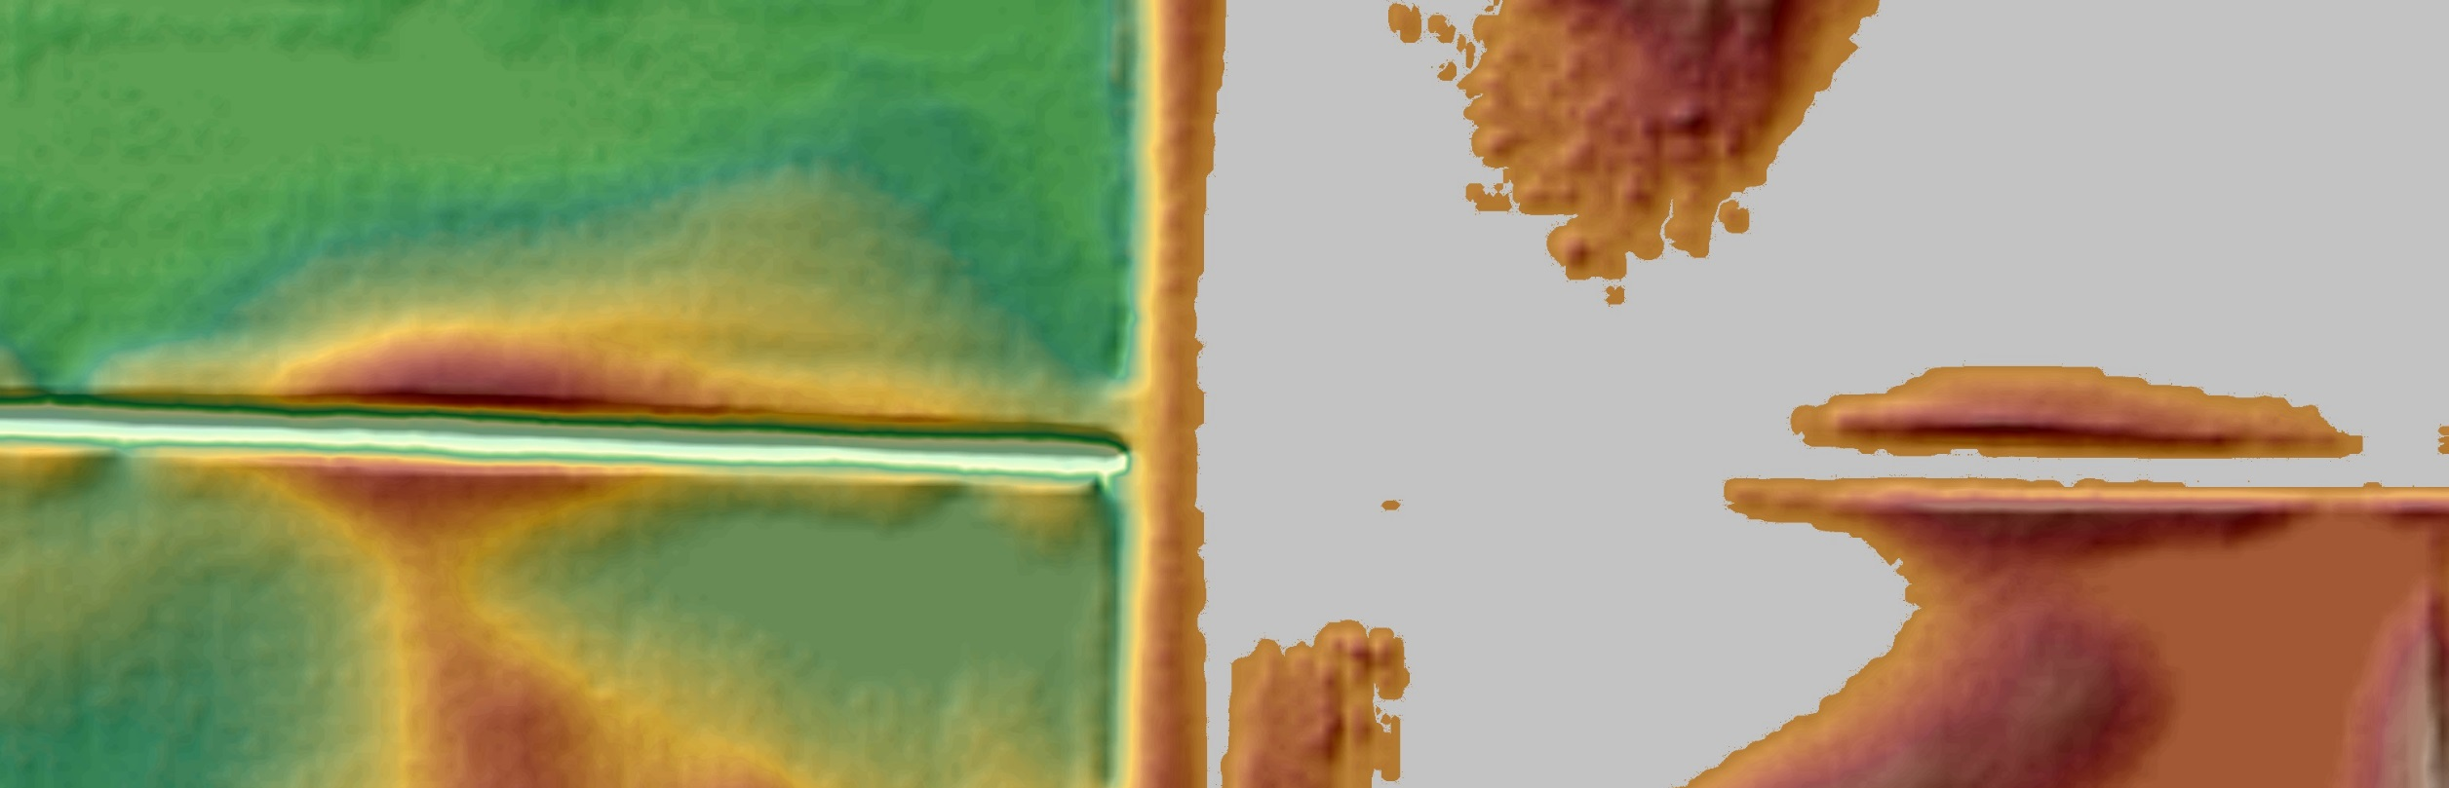
LiDAR → Point Cloud → DEM → Digital Dams
ROAD APRON
TOP OF BANK
CHANNEL BED
CHANNEL BED
Notes:
Animation
First Click fills in the area to the right of the road with white on top and bottom image – about 10 seconds to run
Second Click removes the white filled in area from the top picture and fades in a stream flow path
Third Click starts the water droplet to flow from left to right across the slide

Slide 43
LiDAR → Point Cloud → DEM → Digital Dams
ROAD APRON
TOP OF BANK
TOP OF BANK
CULVERT
CHANNEL BED
CHANNEL BED
Notes:
Animation:
First Click starts the red arrow to drop from its position to where the culvert is located in the lower image

Slide 44
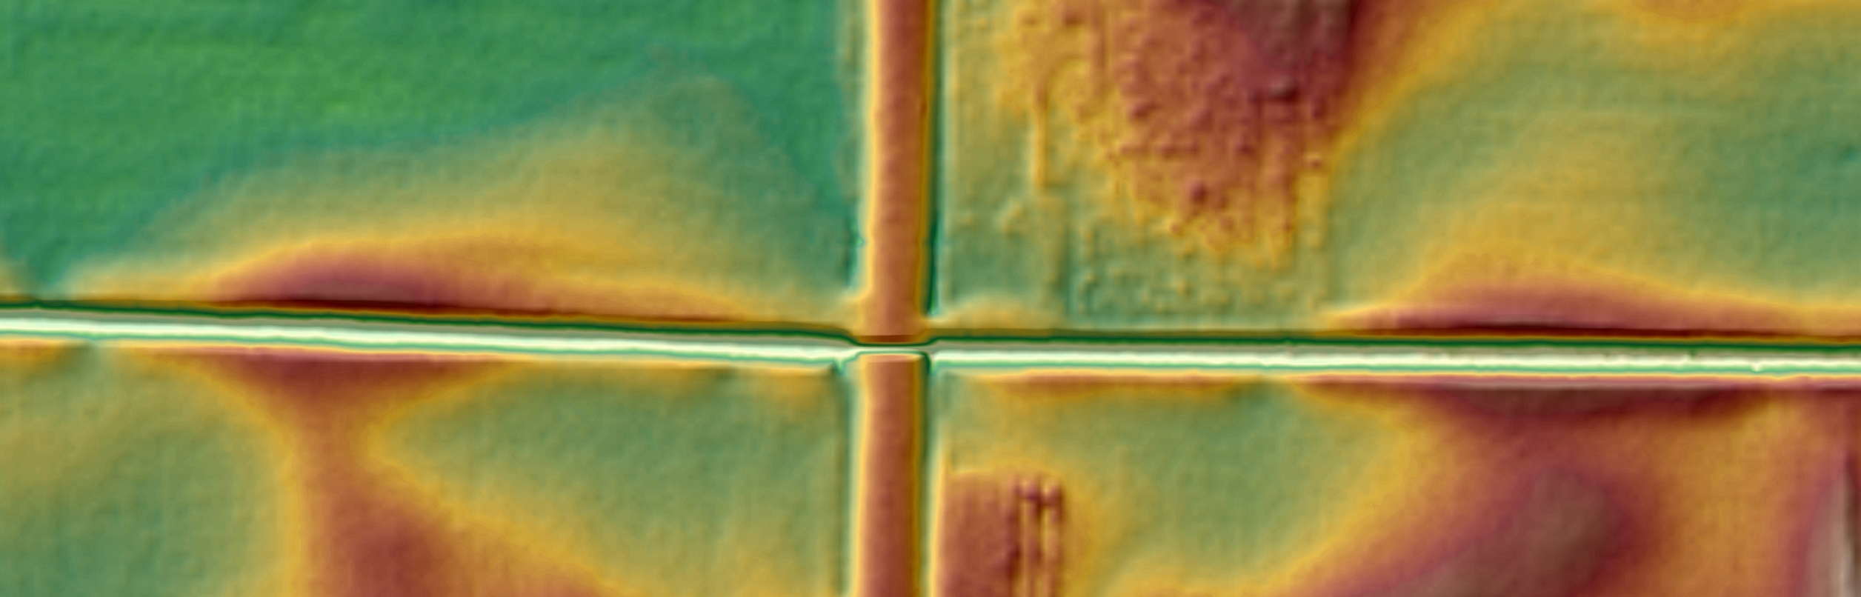
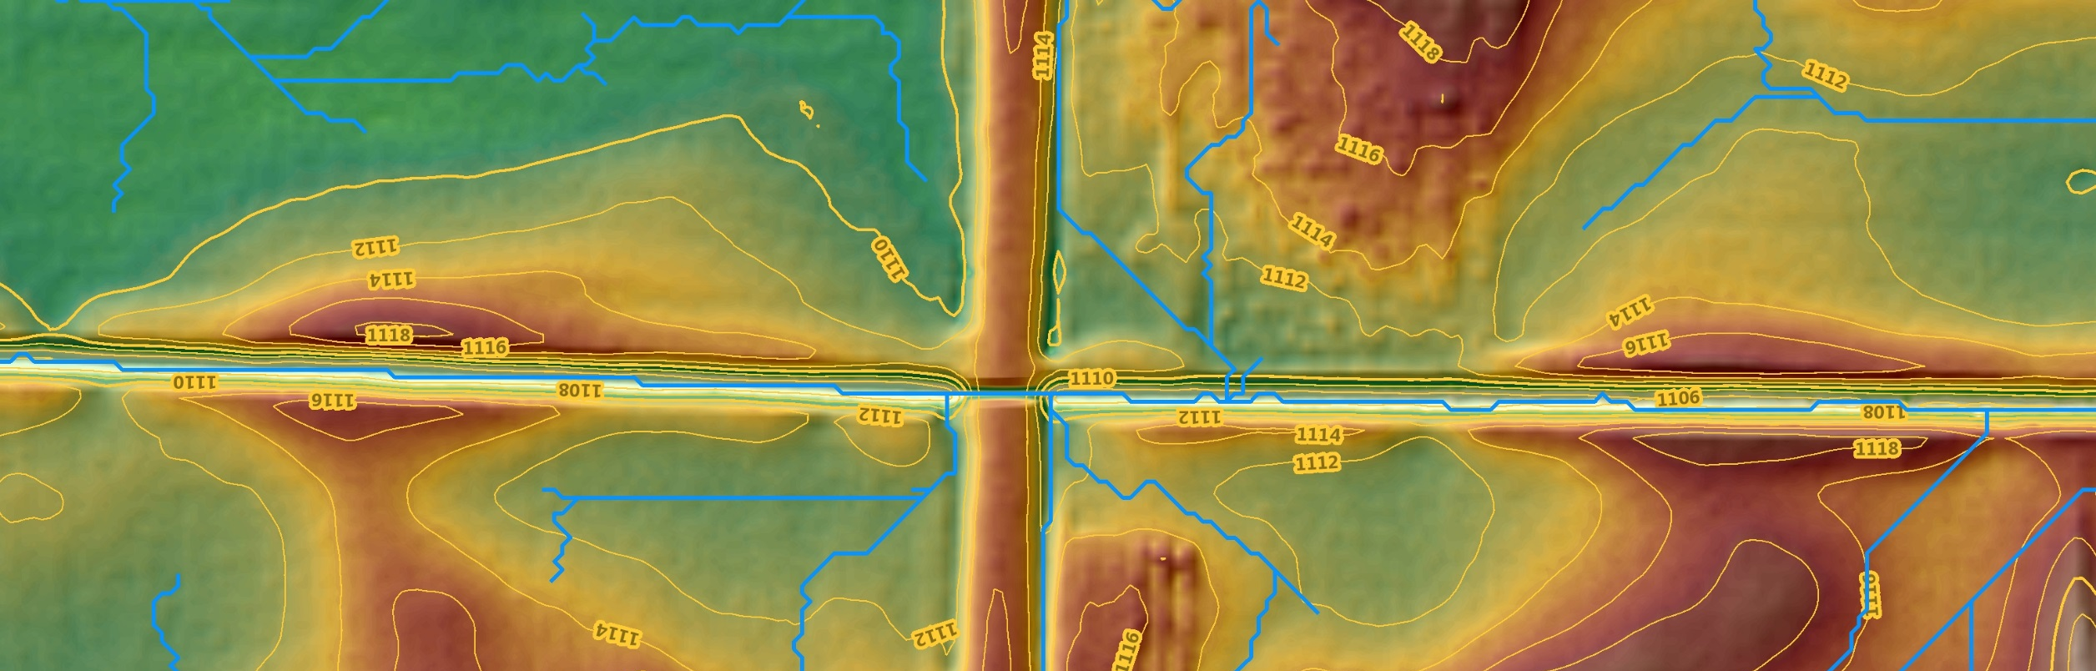
LiDAR → Point Cloud → DEM → Digital Dams
ROAD APRON
TOP OF BANK
TOP OF BANK
CULVERT
CHANNEL BED
CHANNEL BED
Notes:
Animation:
First Click removes the red arrow and the dotted culvert in the lower image.
Second Click fades in the DEM hydro-modified stream network (blue line) and fades in the contour lines
Third Click starts the water drop moving from right to left across the slide.

Slide 45
Next
3D Geomatics
DEM Hydro-modification Subgroup
Update:

Slide 46
3D-Geomatics → Hydro Workgroup → DEM Hydro-modification Subgroup
Purpose of the DEM Hydro-modification Subgroup
Capitalize on knowledge of subject matter experts who have built their own individual digital dam breachline datasets and perform hydro-modification.
Develop Standards, Methodology, and QA/QC Protocol to support DEM hydro-modification and development of the breachline dataset.
Publish these features into one authoritative breachline dataset for use in developing hydro-modified digital elevation models (hDEMs).
Support public and private business needs associated with hydrologic modeling of the landscape using hydro-terrain analysis tools (e.g., PTMApp and ACPF).

Slide 47
3D-Geomatics → Hydro Workgroup → DEM Hydro-modification Subgroup
Accomplishments
Finalized Standardized Attributes
Reviewed manuscript on impacts of hydro-modified DEMs on conservation practice placement by Rallipalli, Drewitz, and Magner
Discussed standard terminology on referencing legacy hDEM breachline datasets
Presentations by Kevin Stark of SMUMN and Brian Gelder of ISU on Automated hydro-modified DEMs

Slide 48
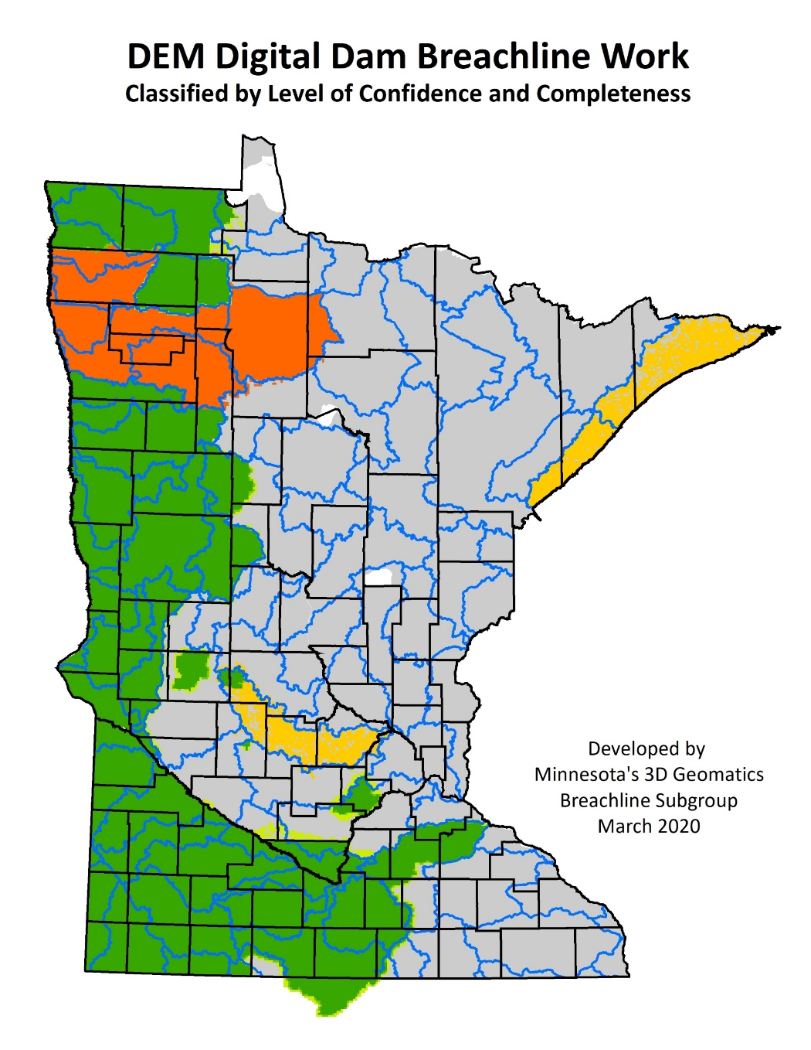
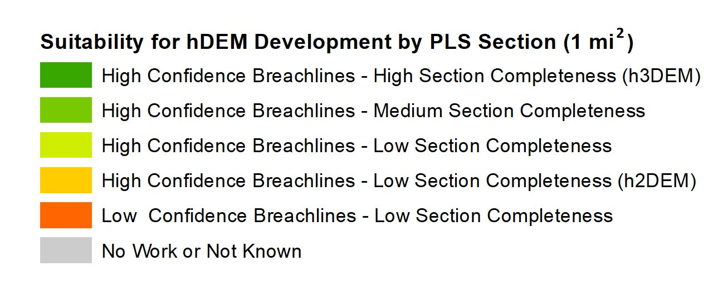
3D-Geomatics → Hydro Workgroup → DEM Hydro-modification Subgroup
DEM Digital Dam Breachline Work
Breachline datasets developed within Minnesota by subject matter experts.
Tracks the development of breachline datasets utilizing the tiling scheme of PLS sections
Identifies the confidence of breachline placement as well as the completeness of the PLS Section (1 mi²)

Slide 49
Introduction
GAC Priority #19:
Culvert Data Standard

Slide 50
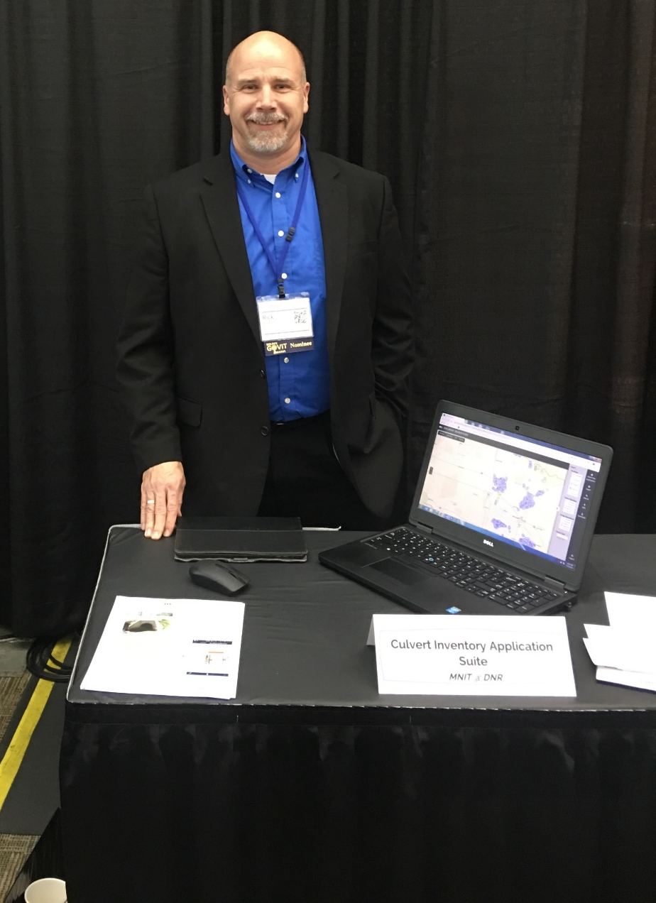
Culvert Data Standard
Accomplishments
Identification of Champions
Priority Owner: Rick Moore
Champion: Sean Vaughn
Executive Sponsor: Jonathan Lord

Slide 51
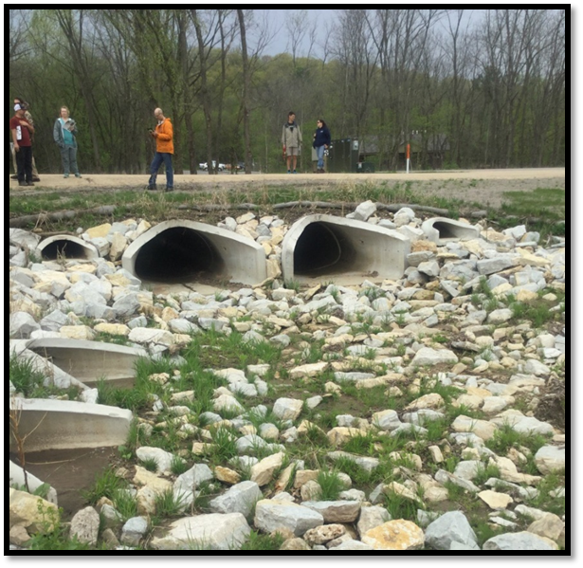
Culvert Data Standard
GAC Short Term vs. Long Term Vision
What vision does the GAC have for Culvert Data?
Culvert Data Standard?
Culvert Database that integrates multiple datasets from multiple organizations/entities into one standardized culvert inventory database?

Slide 52
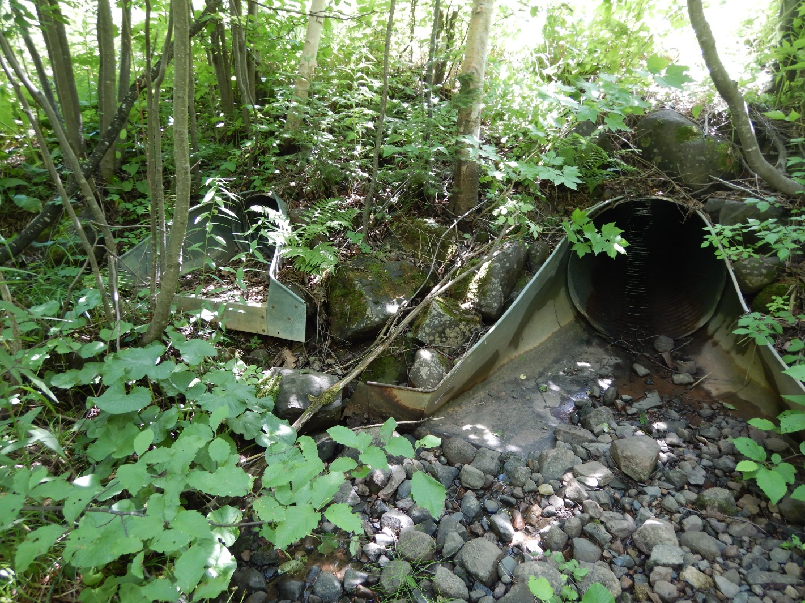
Culvert Data Standard
The collection of data in digital format and the standardization of attributes is paramount to creating a standardized database of features.
A Culvert Data Standard and tools can bring efficiencies into outdated processes by reducing data entry time, minimizing human error, and making data available in real-time.

Slide 53
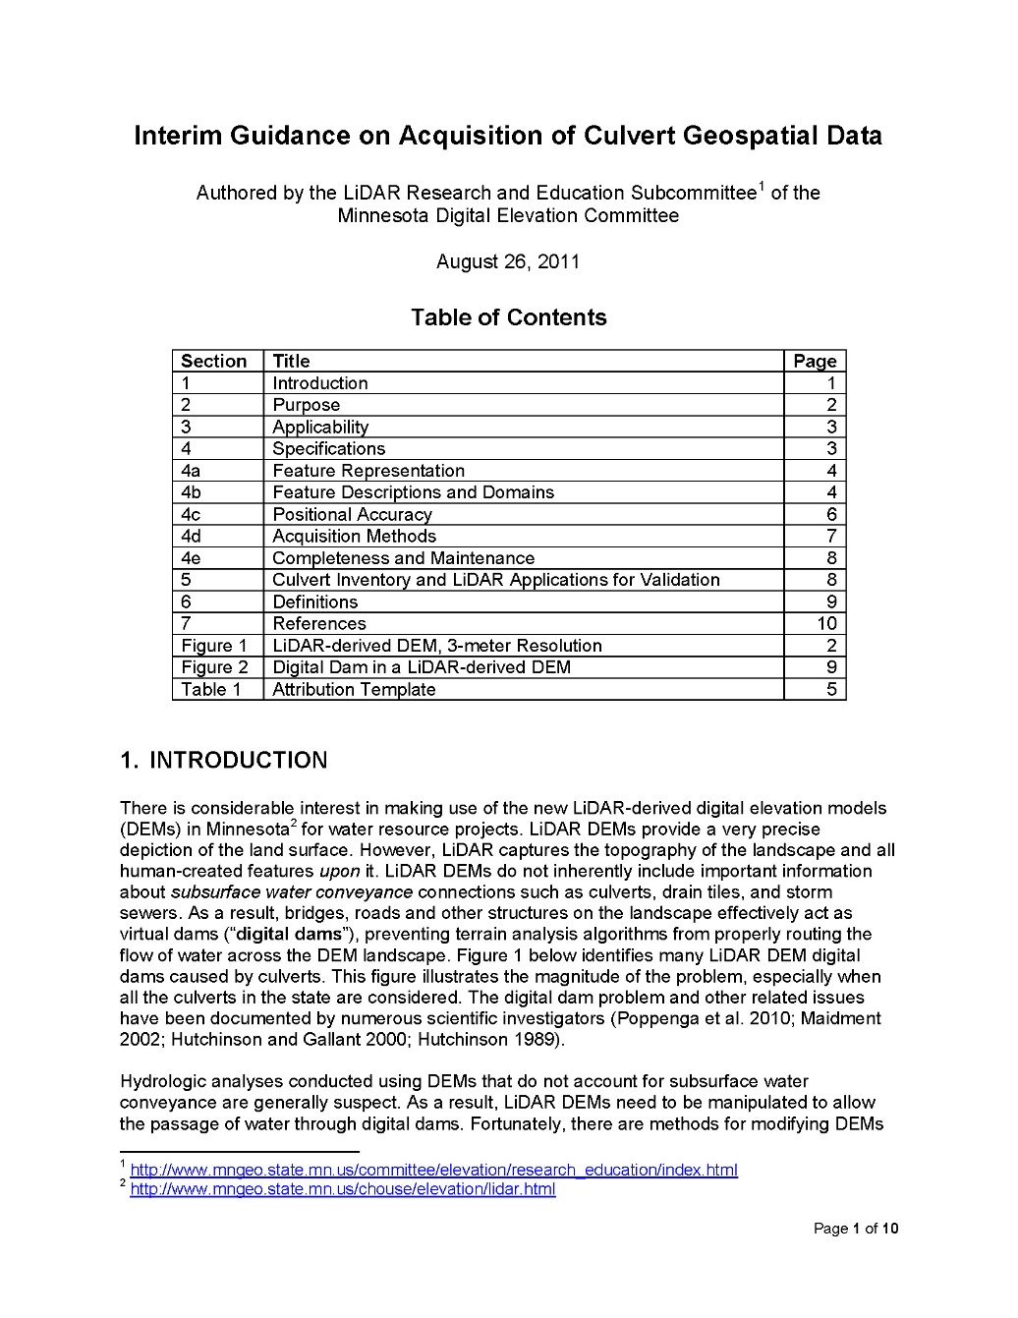
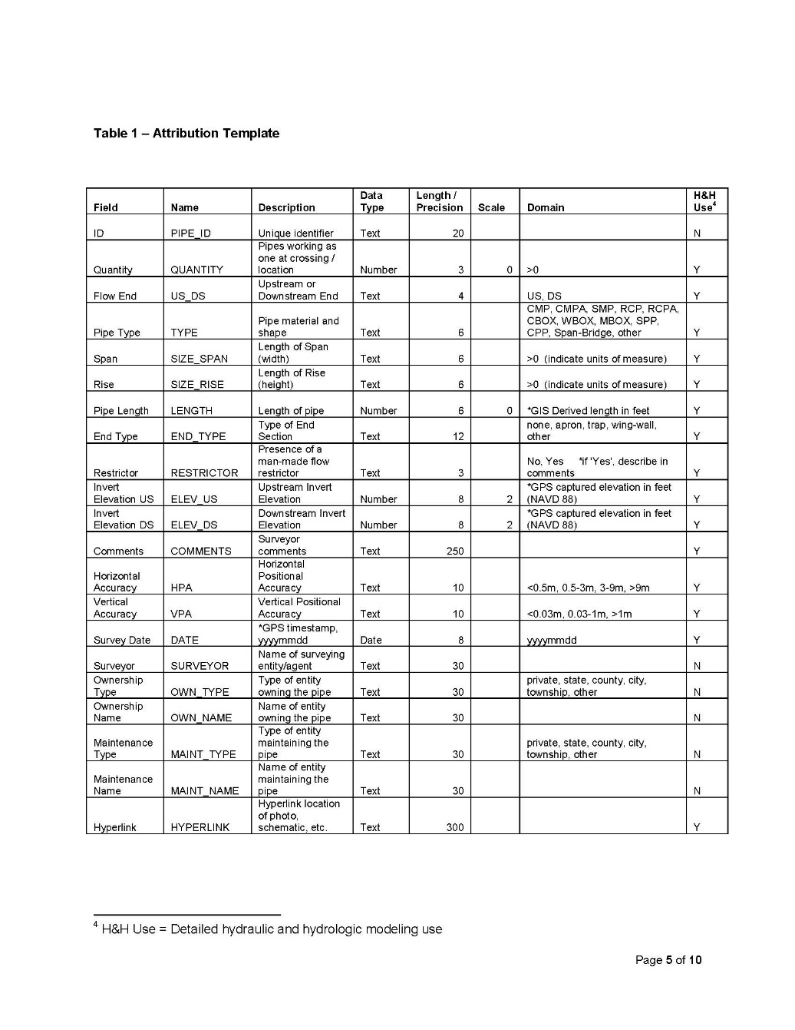
Interim Guidance – LiDAR R & E (2011)

Slide 54
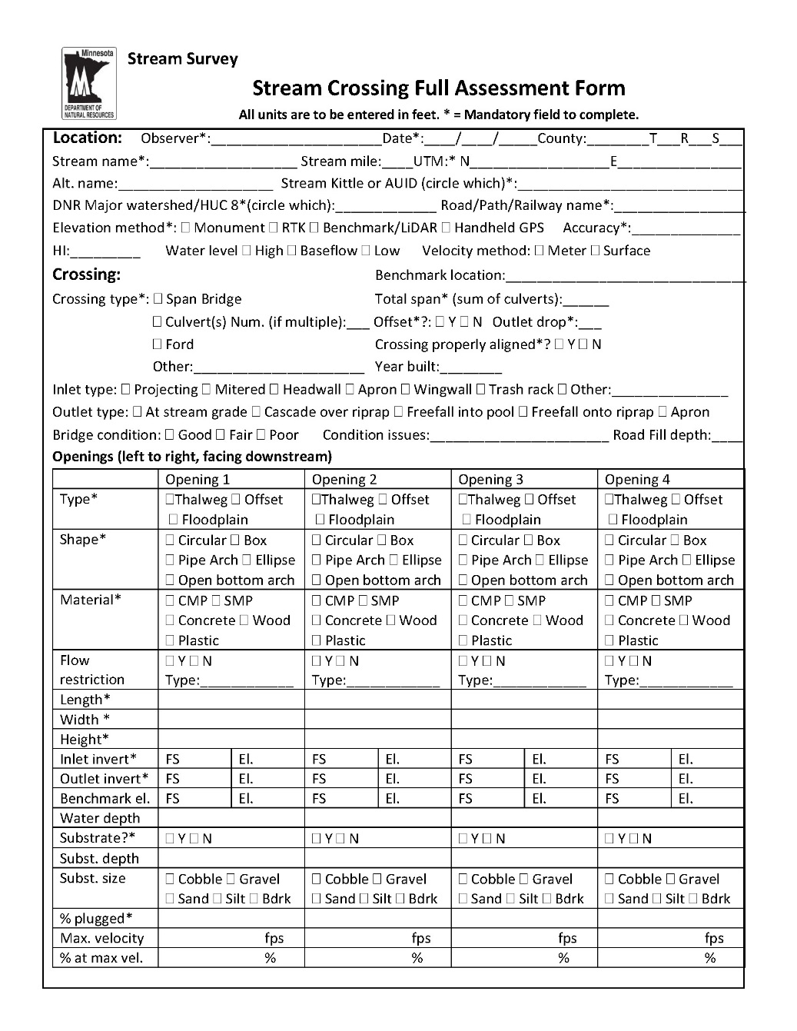
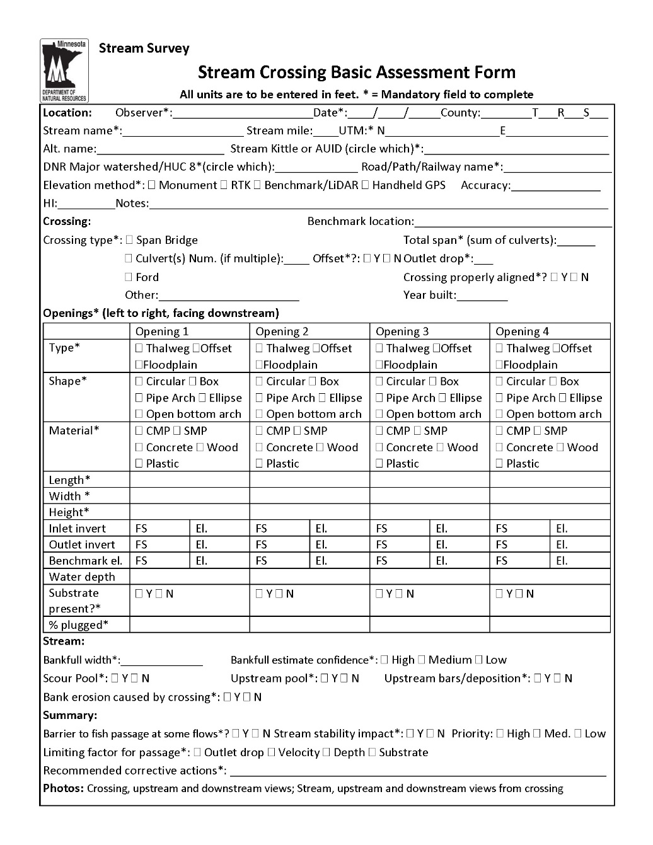
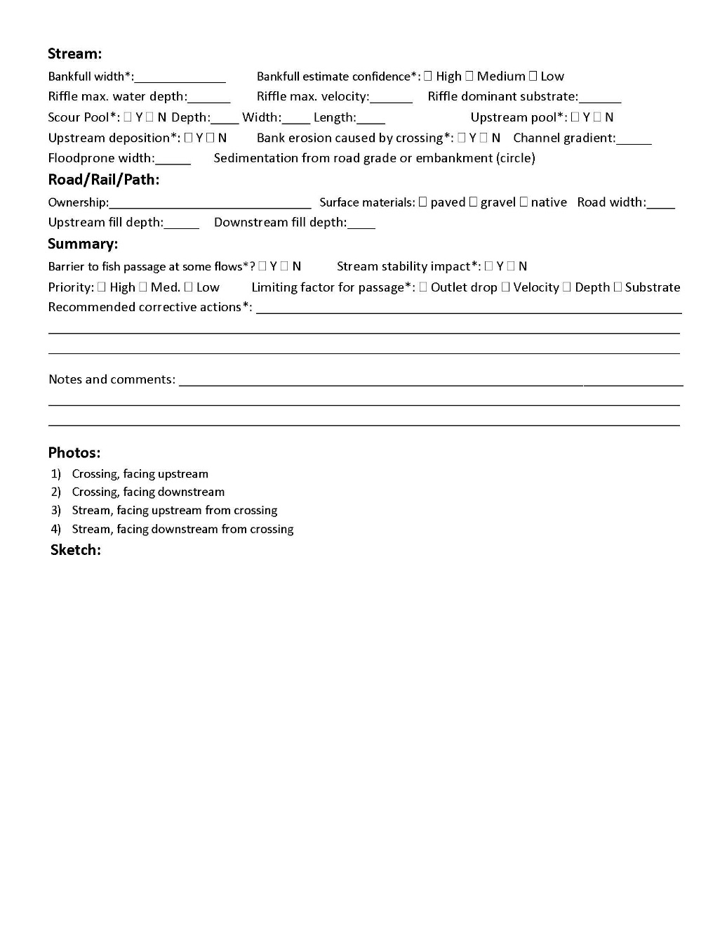
MN DNR Culvert Inventory Application

Slide 55
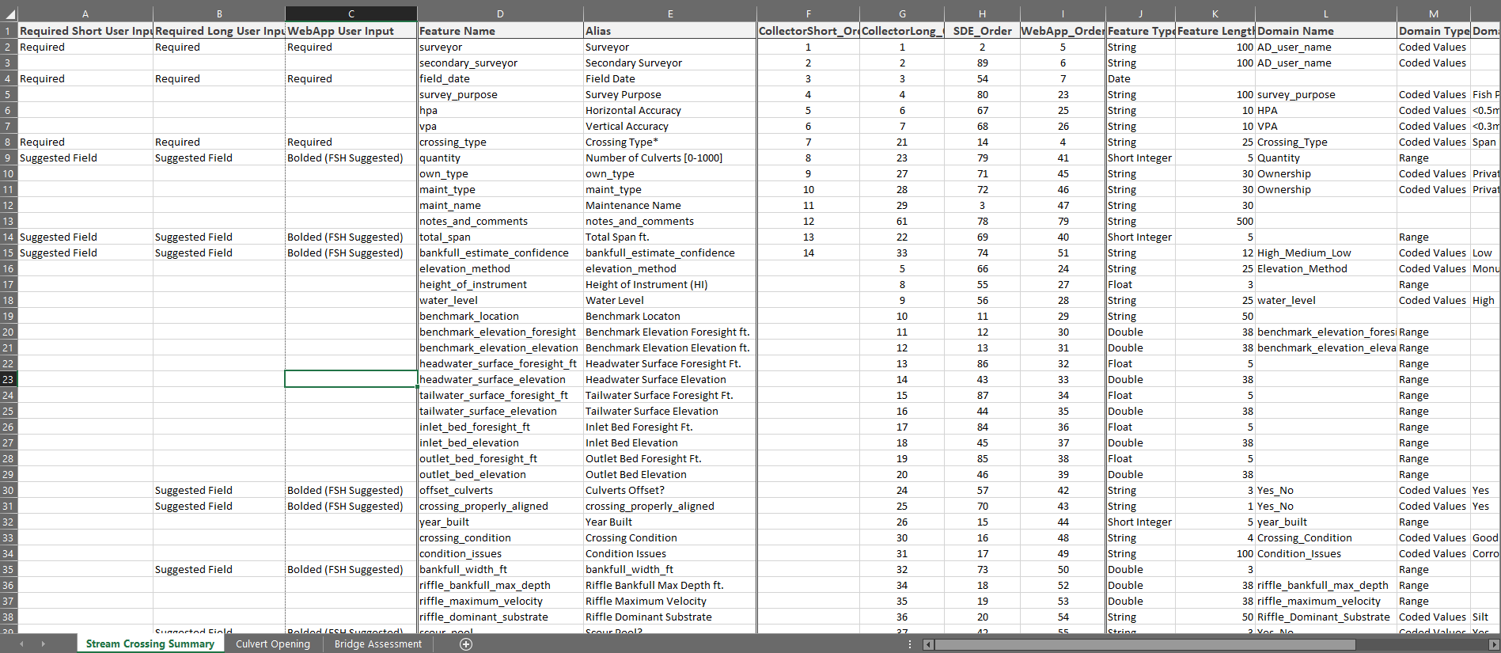
MN DNR Culvert Inventory Application

Slide 56
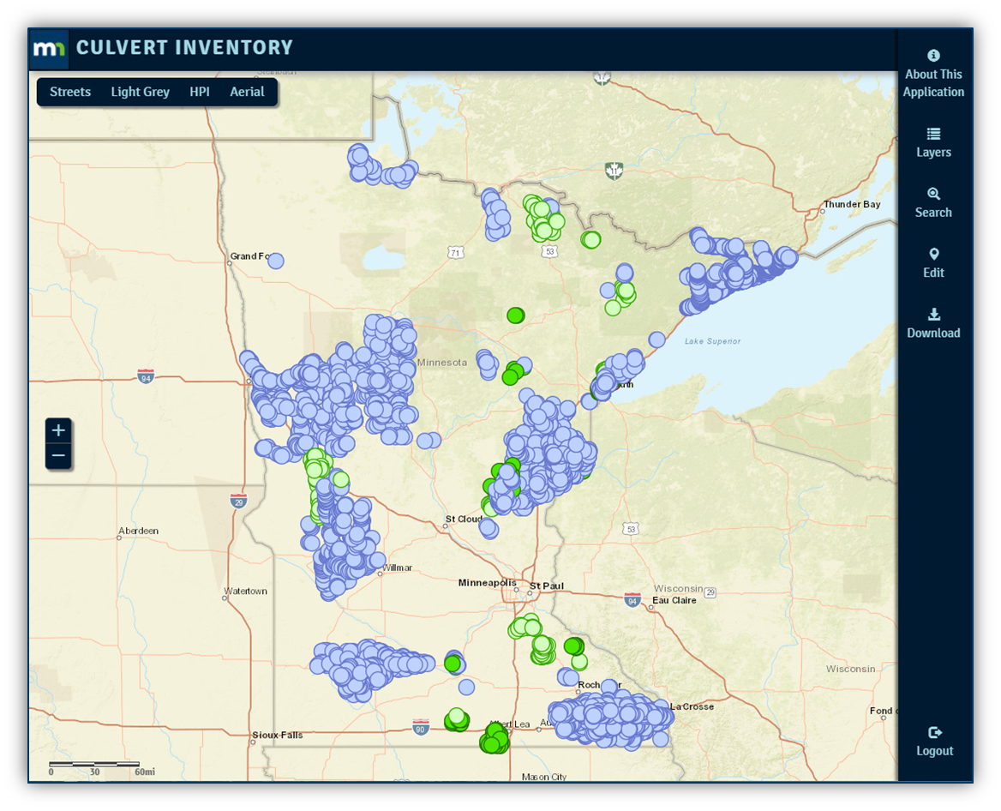
MN DNR Culvert Inventory Application
Developed by DNR, the Web Application allows data stewards to conduct in-office review, editing, and approval of their data locations and attributes created in the field using the ArcGIS Collector App.

Slide 57
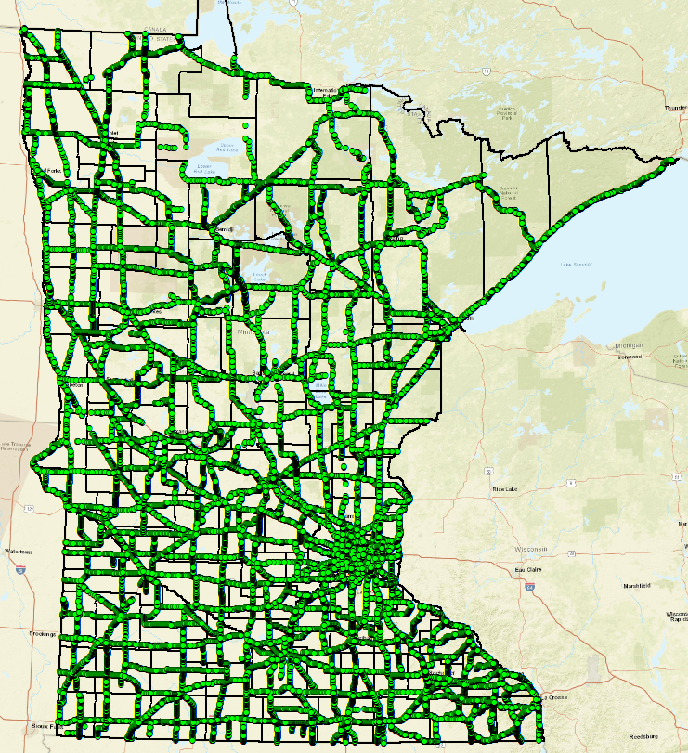
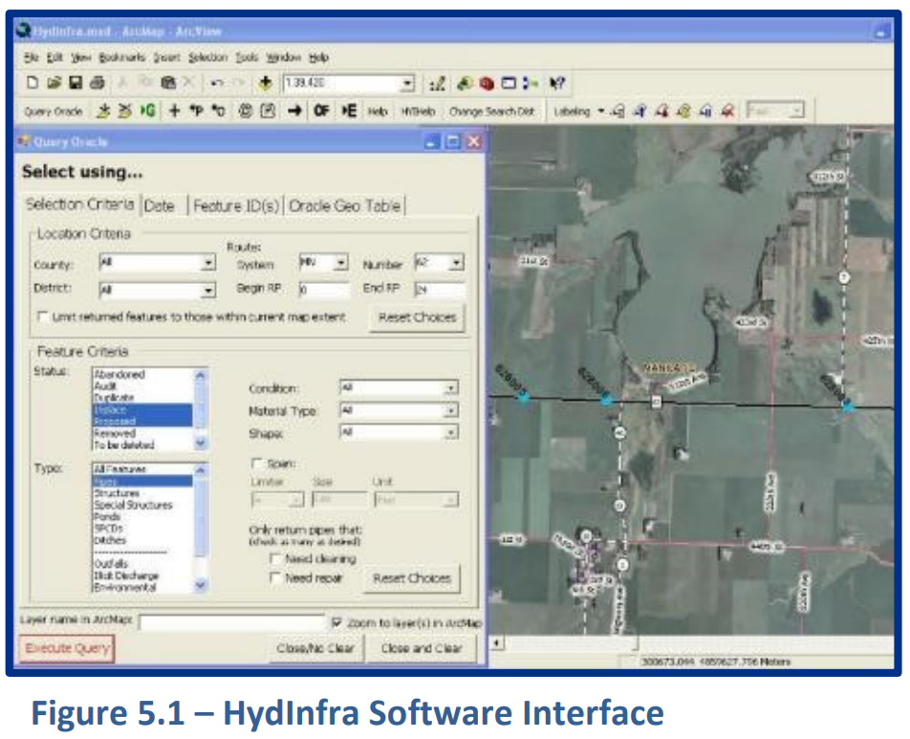
LiDAR → Point Cloud → DEM → Digital Dams → Culvert Data
HydInfra –
The Hydraulic Infrastructure Inspection Program (HydInfra) is MnDOT’s asset management system for culvert and storm drain infrastructure condition.
This asset management system is used to manage inspection and maintenance activities throughout the state.
HydInfra data documents physical attributes and condition ratings of existing culverts with the roadway around the culvert.

Slide 58
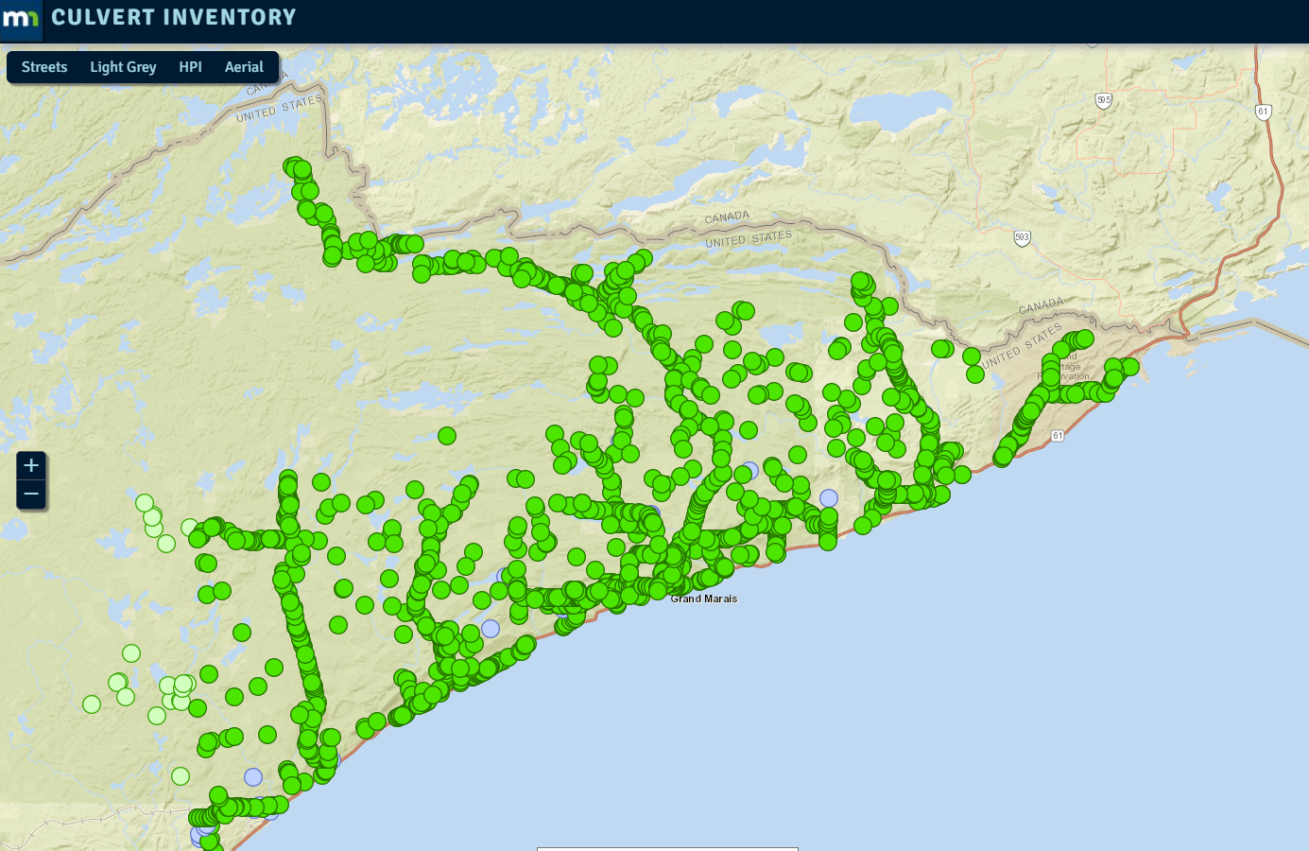
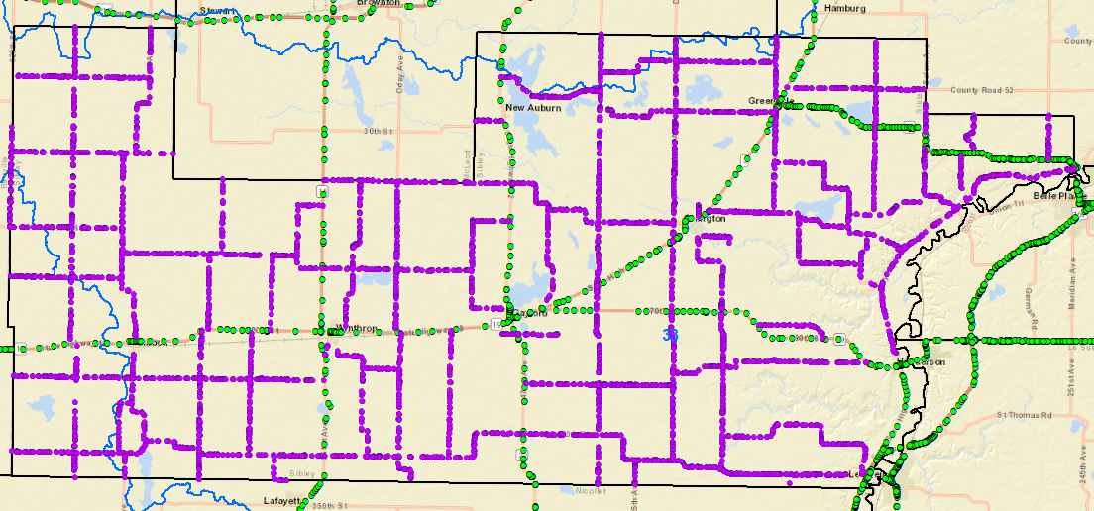
LiDAR → Point Cloud → DEM → Digital Dams → Culvert Data
County Culvert Inventories
DNR Culvert Inventory Application utilized for County Inventories
County Administered Inventories
Cook County
Sibley County

Slide 59
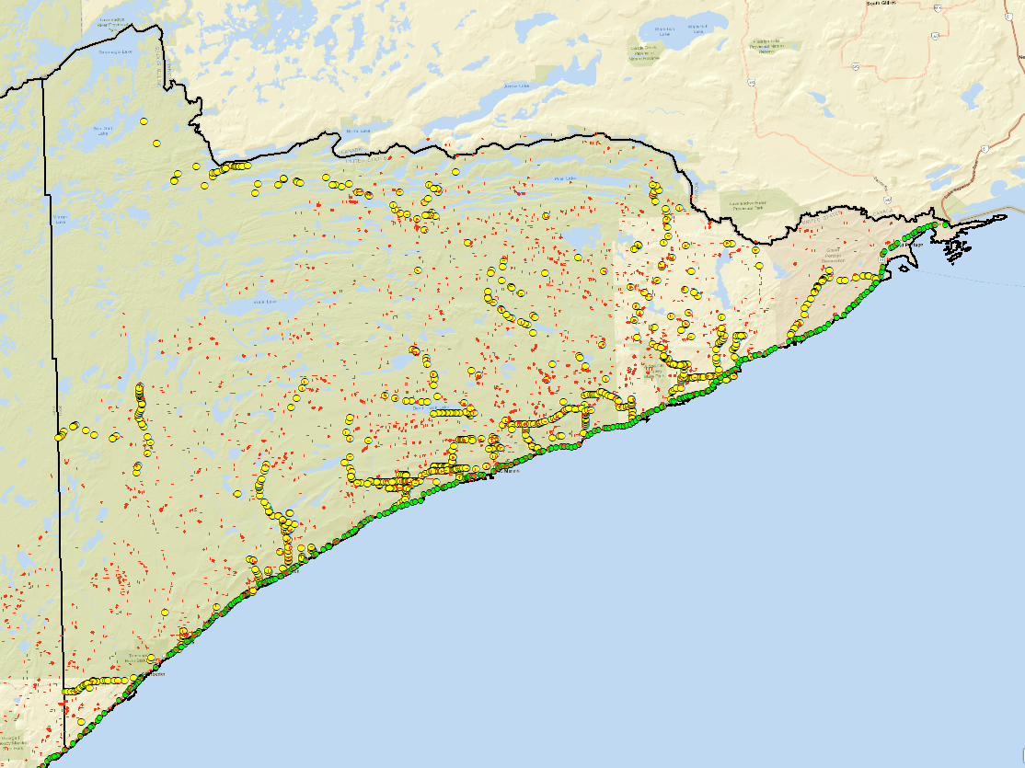
LiDAR → Point Cloud → DEM → Digital Dams → Culvert Data
Hydro-modified DEM’s use breachlines/culverts to breach digital dams and replicate landscape hydrology.
Culvert inventories inform technicians of locations of digital dams/breachline placement during the hydro-modification process.
Most of the time and effort in performing hydro-modification is reviewing various datasets and layers in a GIS to determine if there is a digital dam at a certain location
Cook County

Slide 60
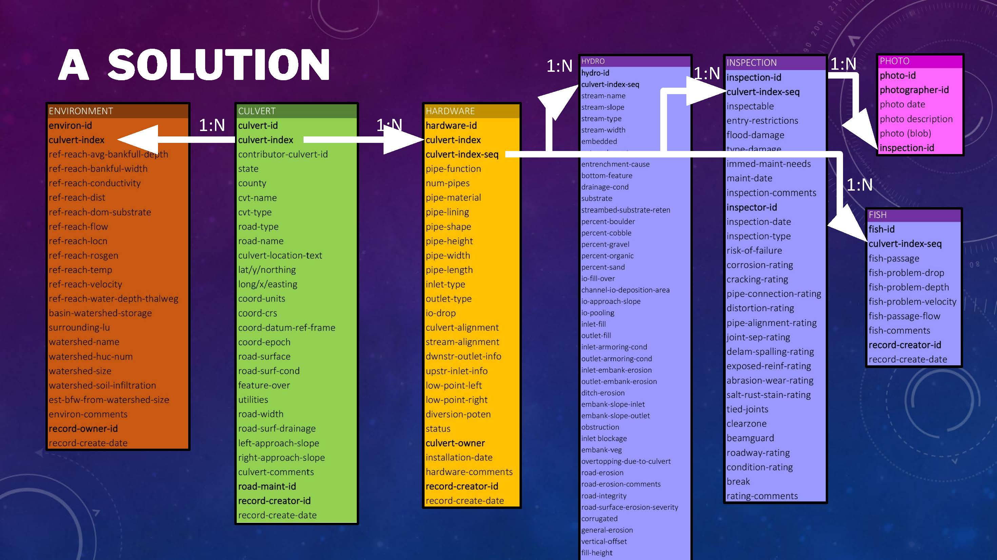
LiDAR → Point Cloud → DEM → Digital Dams → Culvert Data
Culvert Database Schema and Structure
Develop Standard similar to other GAC standards
Develop a Subgroup of subject matter experts in culvert collection and culvert databases to inform process
Identify a database schema and structure that is comprehensive.
Images courtesy of WICDI Spring 2020 Virtual Meeting
Notes:
WICDI – Wisconsin Coastal-Management Data Infrastructure - The Wisconsin Coastal Management Project of Special Merit is focused on providing data, tools, and training to coastal communities in Wisconsin. The project is starting by focusing on the Lake Superior region and tackling one of the key issues impacting communities in that region: culverts.

Slide 61
LiDAR → Point Cloud → DEM → Digital Dams → Culvert Data
Develop a process for integrating multiple datasets into one commonly accepted set of attributes.
The attributes will serve as a template for transferring data between organizations and as a template to guide development of a new culvert database.
Possible border state collaboration and coordination.
Images courtesy of WICDI Spring 2020 Virtual Meeting
Notes:
WICDI – Wisconsin Coastal-Management Data Infrastructure - The Wisconsin Coastal Management Project of Special Merit is focused on providing data, tools, and training to coastal communities in Wisconsin. The project is starting by focusing on the Lake Superior region and tackling one of the key issues impacting communities in that region: culverts.

Slide 62
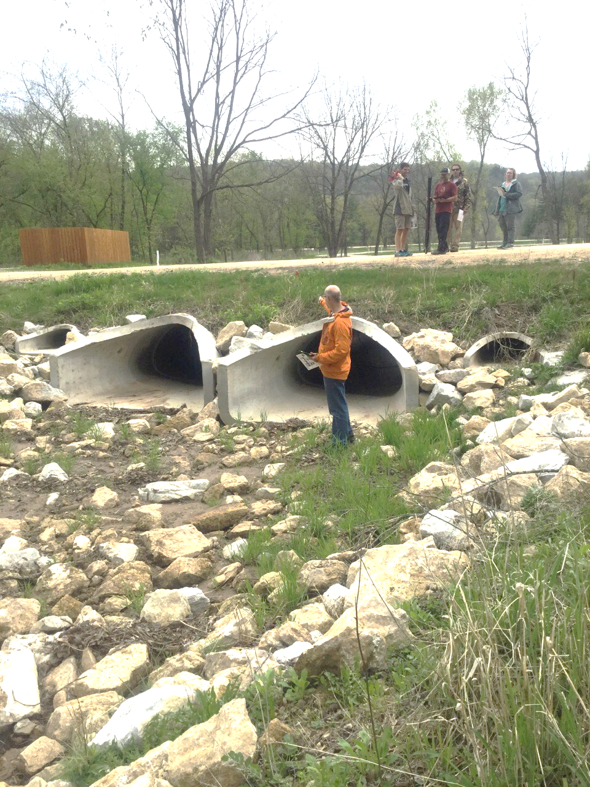
Culvert Data Standard Update
Challenges or Barriers
Defining Scope of the Project
Successes or Milestones
Collaboration with WICDI - Wisconsin Coastal-Management Data Infrastructure
Next Steps
With GAC guidance, establish Subgroup/Community of Practice
Identify and Recruit Membership
Kickoff Meeting in January/February
Notes:
WICDI – Wisconsin Coastal-Management Data Infrastructure - The Wisconsin Coastal Management Project of Special Merit is focused on providing data, tools, and training to coastal communities in Wisconsin. The project is starting by focusing on the Lake Superior region and tackling one of the key issues impacting communities in that region: culverts.

Slide 63
3 Takeaway Messages

Slide 64
Takeaway Messages
LiDAR does its job, DEMs are not a flaw of lidar
hDEMs are foundational data (Point Cloud, DEMs)
Proper replication of landscape hydrology in DEMs is required
Tools & Models have dependencies on hDEM.
Culvert Database supports culvert data sharing for DEM hydro-modification
Notes:
LiDAR did it’s job
hDEMs are foundational data
Proper replication of landscape hydrology in DEMs
Tools & Models have dependencies on foundational hydrography data.
Build awareness for disscussion - Continue to build recognition and support for statewide foundational NXG-Hydro.

Slide 65
Thank You!
Sean Vaughn | Rick Moore
3D Geomatics Committee
www.mngeo.state.mn.us/committee/3dgeo
3D Geomatics Hydrogeomorphology Workgroup – DEM Hydro-modification Subgroup www.mngeo.state.mn.us/committee/3dgeo/hydro

Slide 66
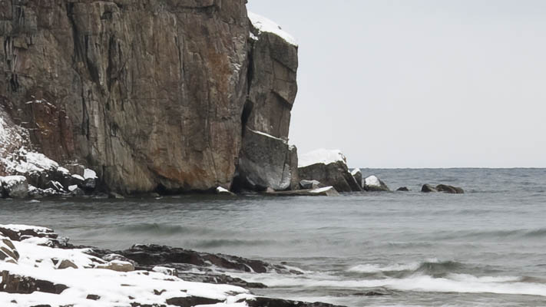
Break

Slide 67
Agenda Item 7
Statewide Parcel Map Discussion
Patrick Veraguth

Slide 68
Open Data for Public Statewide Parcel Map
Notes:
Falls on several committees.
Outreach, Standards and Parcel and Land Records Committees.

Slide 69
GAC Priorities List
Notes:
I have added one item for Statewide PLSS Remonumentation.

Slide 71
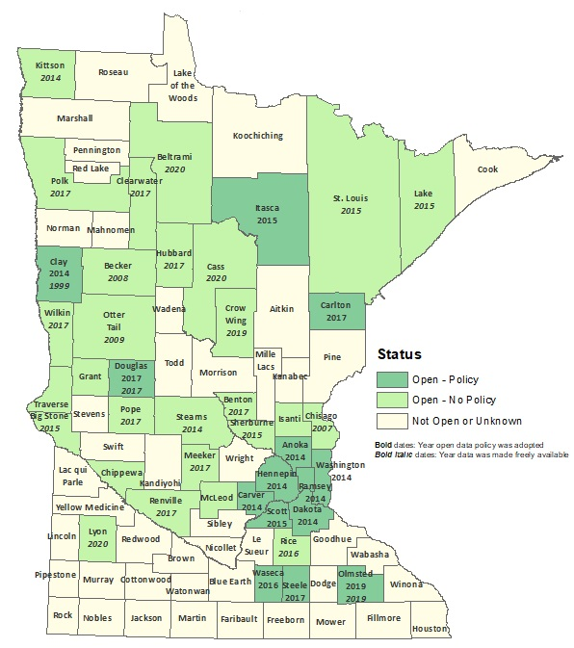

Slide 72
Status of Free and Open Data Public Geospatial Data from Minnesota Counties
Status | Number of Counties | Total
Open - Policy | 14 | 41
Open - No Policy | 27
Not Open or Unknown | 46 | 46
December 4, 2020
https://gisdata.mn.gov/dataset/bdry-mn-county-open-data-status
Notes:
13 counties require a signed License agreement with the state for parcel data

Slide 73
State Collected Parcel Data
State collects data Quarterly from all counties
Data is aggregated together with overlap and gaps in it
Do we need to aggregate it?
All data is projected to UTM Zone 15
State Use only!!

Slide 74
State Data Standards
Transfer Standard
Pilot project
How much does it cost and how long does it take?
GIS vendors take this on?
Derivative Parcel maps

Slide 75
How do we get permission for public to use?
Create a statewide parcel map from open data only
Reach out to two counties per month
We need County people to reach out to other counties
Outreach Committee
AMC District meetings (spring meetings end of May into July)
AMC’s Minnesota Counties quarterly publication
Recorder Meetings (PREP Meetings) Not sure if they are still meeting

Slide 76
Notes:
Two entities in the counties that have money and make decisions.

Slide 77
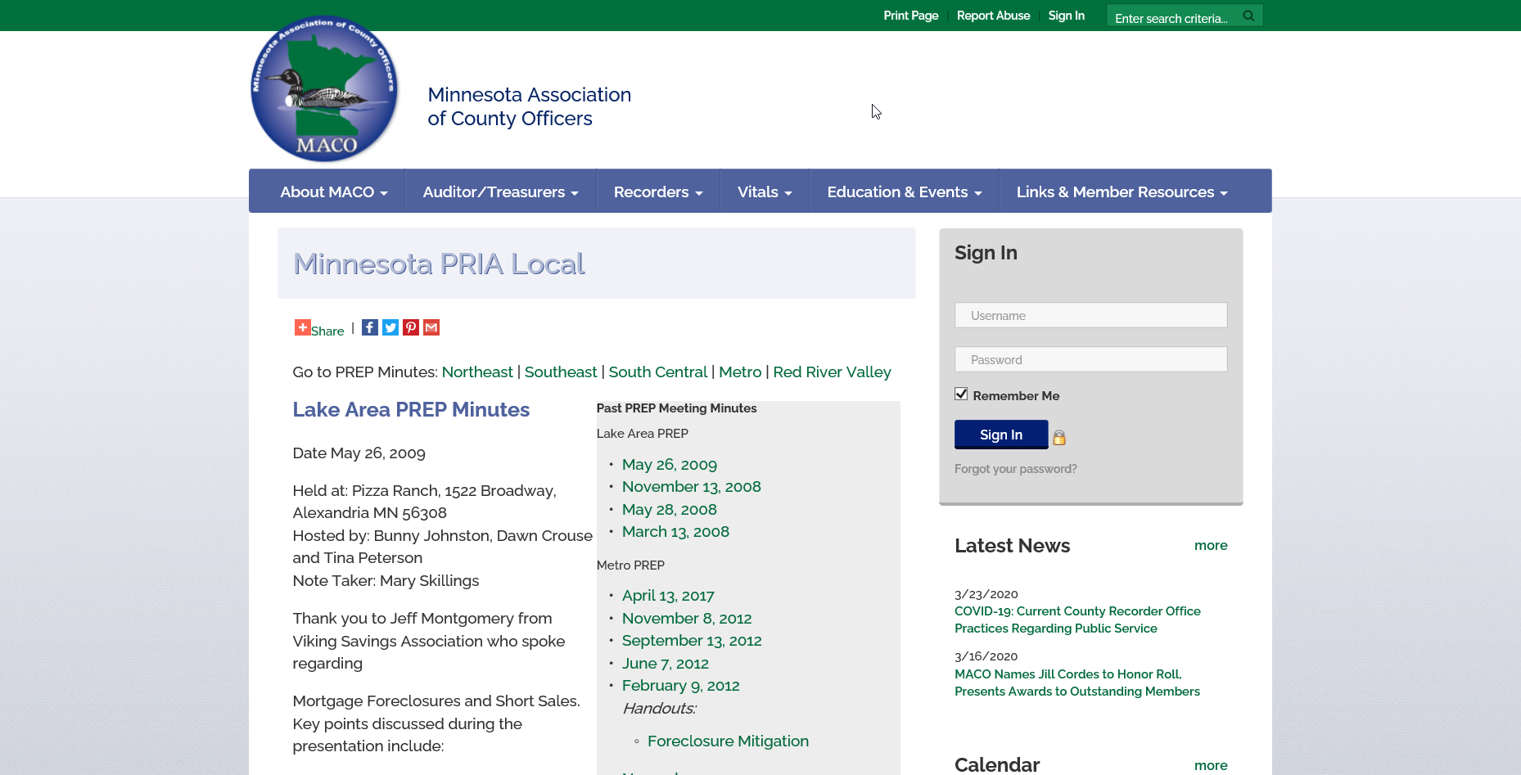
Notes:
7 Chapters
Recorders have a summer meeting?

Slide 78
Wisconsin
Working on a Statewide Digital Parcel Database.
Funding comes from an $8.00 per document recording fee.
$151,000 base budget to each county
Wisconsin has 4 benchmarks the county has to meet before they can use money for integration of PLSS.
Notes:
We may need to hang a carrot for all counties to go along with this.

Slide 79
Michigan
Established the Office of Land Survey State Survey and Remonumentation Program in 1990.
$4.00 per document.
http://www.michigan.gov/lara/0,4601,7-154-10575_17394_17565---,00.html
Notes:
Cadillac

Slide 80
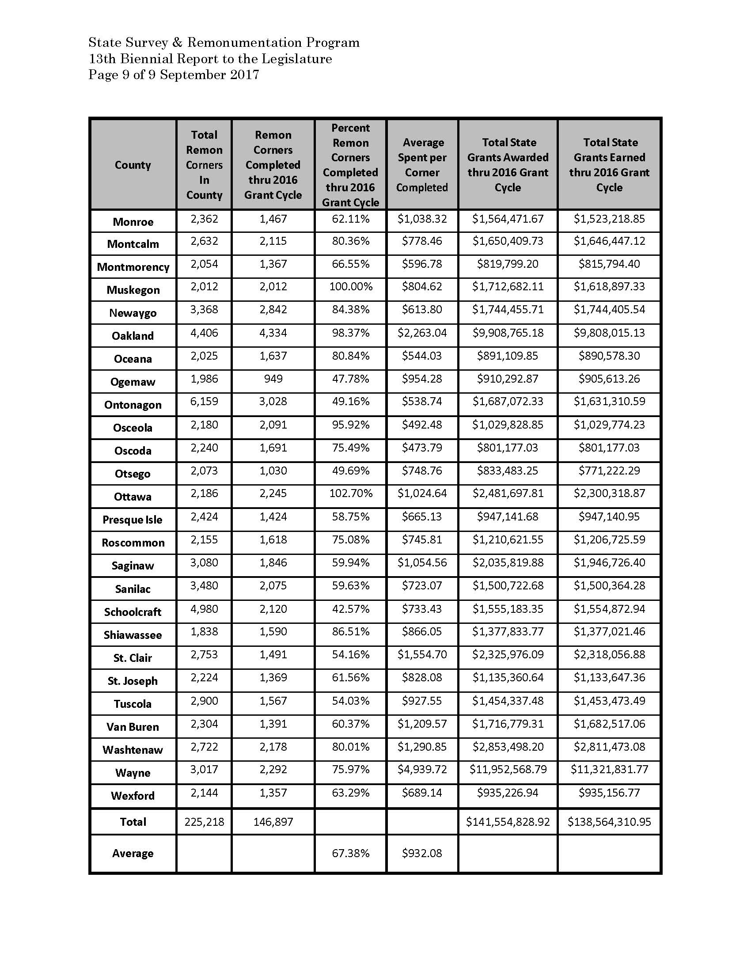
Notes:
83 counties
Act 345 of 1990
¾ the size of MN
Over 8000 corner remonumented from 2014 to 2016

Slide 81
Oregon
Public Land Corner Preservation Fund
Voluntary Recording fee up to $10 a document for remonumentation in that county.
Fees collected once a month.
Smaller counties have tough time generating funds for Remonumentation.
Notes:
Similar to California, Washington and Utah

Slide 82
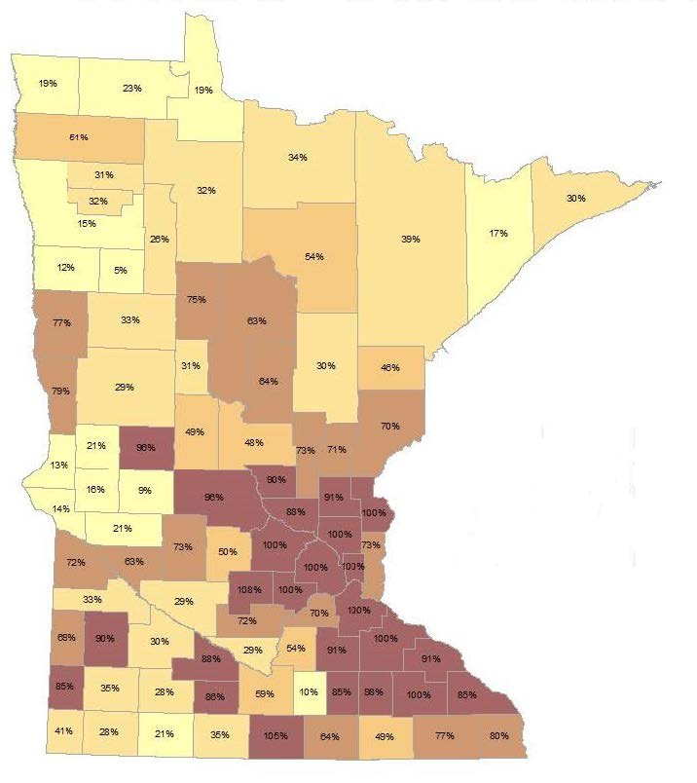
Percentage of corners certified in each county
Notes:
11 Counties at 100%
Pope County 11,000 People

Slide 83
Join the Joint Committee Endeavor!
Questions

Slide 84
Agenda Item 8
Updates on GAC priority projects and initiatives
Cory Richter

Slide 85
GAC Priorities
GAC Rank | Project or Initiative Description | Status | Project Owner | Champion
1 | All Data Free and Open | Active |  | many
2 | Updated and Aligned Boundary Data | Active | Preston Dowell | Dan Ross
3 | Archiving Implementation | Active | Ryan Mattke | many
4 | Parcel Data | Active | Alison Slaats | Mark Kotz
5 | Image Service Improvements | Active | Alison Slaats | Dan Ross
6 | Accurate Hydro-DEMs | Active | Sean Vaughn | many
7 | Road Centerline Data | Active |  | Dan Ross
8 | New Lidar Acquisition | Active | Gerry Sjerven | Dan Ross
9 | EM Damage Assess Data Standard | Active | Brad Anderson, Cory Richter
10 | Address Points Data | Active |  | Dan Ross
11 | U.S. National Grid Materials | Active | Randy Knippel | Randy Knippel
12 | Parks and Trails Data Standard | Active
13 | NG9-1-1 Forum | Inactive

Slide 86
GAC Priorities
GAC Rank | Project or Initiative Description | Status | Project Owner | Champion
14 | Underground Utilities Forum | Active | Steve Swazee
15 | Basemap Services | Inactive
16 | Unmanned Vehicle Metadata Guide | Inactive
17 | Geospatial Data Asset Inventory | Inactive
18 | Critical Infrastructure Custodian | Active | Stacey Stark
19 | Culvert Data Standard | Active | Rick Moore

Slide 87
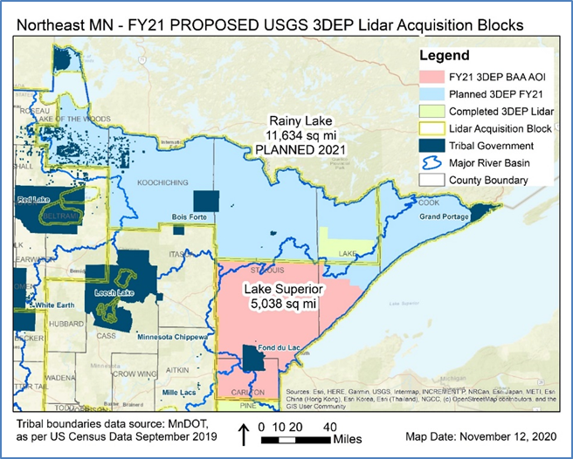
If this BAA grant proposal is successful it will complete the Northeast Lidar Acquisition Area (LAA) illustrated with peach shading in the image above.

Slide 88
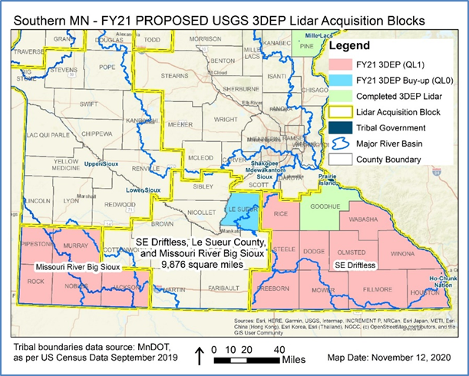
The Southern Minnesota BAA proposal is comprised of two full 3D Geomatics Committee - Lidar Plan Lidar Acquisition Blocks. The peach-shaded regions of the map above illustrate the Southeast Driftless LAB covering the entire southeast corner of Minnesota and the Missouri River Big Sioux LAB covering watersheds and counties in the southwest

Slide 89
Agenda Item 9
Timing of Future Online GAC Meetings

Slide 90
Agenda Item 10
Announcements or Other Business

Slide 91
Next Meetings
January 6, 2021 (11:00-noon): Special Discussion of 2021 GAC Priority Initiatives
March 3, 2021: Quarterly

