Slide 1
Minnesota Geospatial Advisory Council
September 29, 2021

Slide 2
Welcome
Commissioner Tomes
Introductions
Approve agenda
Approve May minutes

Slide 3
Introductions
City, Twin Cities metro
Cory Richter, City of Blaine
City, Greater Minnesota
Shawn Strong, City of Brainerd
County, Twin Cities metro
Victoria Reinhardt, Ramsey County
County, Greater Minnesota
Patrick Veraguth, Douglas County
Regional government, Twin Cities metro
Matt McGuire, Met Council
Regional government, Greater Minnesota
vacant
State agencies
Kari Geurts, DNR
Ben Timerson, MnDOT
Federal government
Jeff Bloomquist, Risk Management Agency, USDA
Tribal government
Ryan Bonney, Shakopee Mdewakanton Sioux Community
Non-profit organizations
Karen Tuerk, Monarch Joint Venture
Business
Kendis Scharenbroich, Pro-West & Associates
Gerry Sjerven, Minnesota Power
Higher Education
Len Kne, U-Spatial / UMN Twin Cities
Stacey Stark, U-Spatial / UMN Duluth
MetroGIS
David Brandt, Washington County
MN GIS/LIS Consortium
Leanne Knott, City of Red Wing
Surveyor
Chris Mavis, Hennepin County
At-large
Alex Steele, Minnehaha Creek Watershed District
Heather Bergen-Albrecht, Hennepin County
Britta Maddox, Anoka County
1 Chief Geospatial Information Officer (ex-officio)
Dan Ross, MnGeo
Vacancies
Federal, Greater MN Regional Gov't, K-12 Education

Slide 4
Agenda
Time | Topic |  | Time | Topic
10:00 | Introductions, approve agenda and previous minutes |  | 11:05 | Commons Discovery project
10:10 | Committee reports – Review and accept |  | 11:10 | Raster Data Discovery project
10:15 | GAC overview and welcome to new members |  | 11:15 | DNR public lands
10:25 | Bikeways Data Standard – Request for approval |  | 11:30 | Legislative update
10:30 | PLSS legislation support letter |  | 11:35 | GAC priority projects and initiatives updates
10:40 | Underground Utilities Mapping Project |  | 11:50 | Announcements
10:50 | Lidar update |  | noon
11:00 | Break

Slide 5
Agenda Item 2
Committee Reports – Review and Accept
All

Slide 6
Agenda Item 3
GAC Overview and Welcome to New Members
Dan Ross, Cory Richter

Slide 7
GAC Mission
The Council acts as a coordinating body for the Minnesota geospatial community and an advisory body for MnGeo. It represents a cross-section of organizations that include counties, cities, universities, business, nonprofit organizations, federal and state agencies, tribal government, surveyors and other stakeholder groups that benefit from geospatial technology.

Slide 8
Guiding Principles
Promote effective investments in geospatial information
Promote geospatial information as a shared public resource
Support the establishment and use of geospatial standards and best practices
Champion collaboration among geospatial practitioners and related stakeholders
Educate and inform policymakers about the value and use of geospatial technology
Provide a forum for ideas and issues to be shared and acted upon by the geospatial community
Encourage all council sectors to contribute to the state geospatial infrastructure
Encourage all council members to communicate outcomes with relevant stakeholders
Encourage geospatial education at all levels

Slide 9
Expectations
Support the Council's mission
Prepare for and be active in Council meetings. These quarterly meetings are typically scheduled on Wednesdays from 10 to noon.
Be an ambassador representing your sector stakeholders and other stakeholders with whom you are connected (e.g., professional groups)
Speak for stakeholders at Council meetings
Carry Council news and proposals back to stakeholders
Collect stakeholder views on complex issues, either from individuals or existing umbrella organizations

Slide 10
Opportunities for Engagement
Leadership team
Priority projects
GAC Hub
Committees
3D Geomatics
Archiving
Awards
Emergency Preparedness
Image Service Sustainability
Outreach
Parcels & Land Records
Standards

Slide 11
Agenda Item 4
Bikeways Data Standard – Request for Approval
Curt Carlson, Mark Kotz

Slide 12
Bikeways Data Standard
Purpose
a single, commonly accepted set of attribute specifications (field name, type, and length) for transferring and aggregating bikeways data
Sources
MetroGIS Collaborative Trails and Bikeways data specifications
National Recreation and Parks Association standard
MnDOT and DNR subject matter experts
Input from many others

Slide 13
Bikeways Data Standard
Workgroup
Michael Petesch, Pedestrian & Bicyclist Data Coordinator, MnDOT
Sandra Yassin, Research Analyst, Geographic Information Mapping, MnDOT
Mark Kotz, Standards Committee chair
Curt Carlson, Standards Committee vice chair
Standards Committee discussions and review of public review comments

Slide 14
Bikeways Data Standard
Public Review Process
90 days ending 12/23/2020
119 comments
Many useful improvements to standard
Revised scope to just bikeways instead of “trails and bikeways” (requested by many, including DNR)
50 days ending 5/15/2021
20 comments from 4 people
3 minor changes
August 2021 - Additional feedback on industry standard terms from MnDOT experts
Modifications to wording in some descriptions and domain values.

Slide 15
Bikeways Data Standard
Standards Committee requests approval of draft version 1.0

Slide 16
Agenda Item 5
PLSS Legislation Support Letter
Pat Veraguth, Chris Mavis

Slide 18
The PLSS

Slide 19
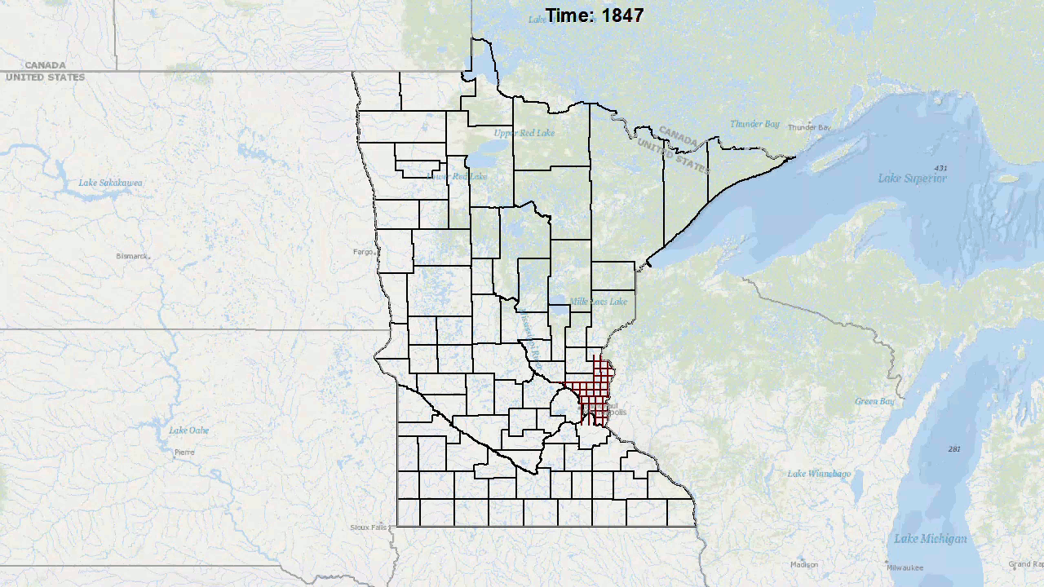
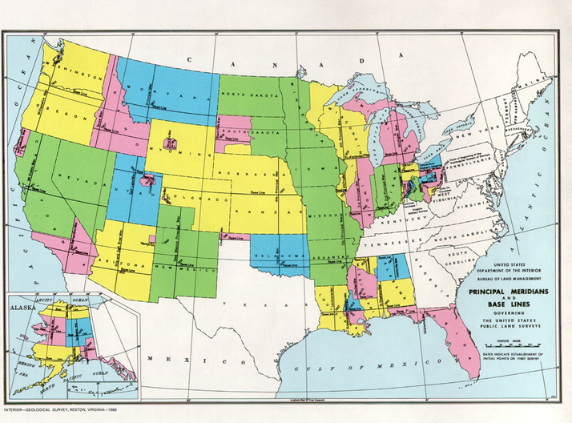
The PLSS in Minnesota
325,000 + PLSS Monuments set in MN (first infrastructure)
Notes:
The first infrastructure
Fun fact time – how many miles per township walked. At least 200,000 total miles walked
4th and 5th Principal Meridian.
Elements of the Sec, Twp, Range.
First GIS data layer

Slide 20
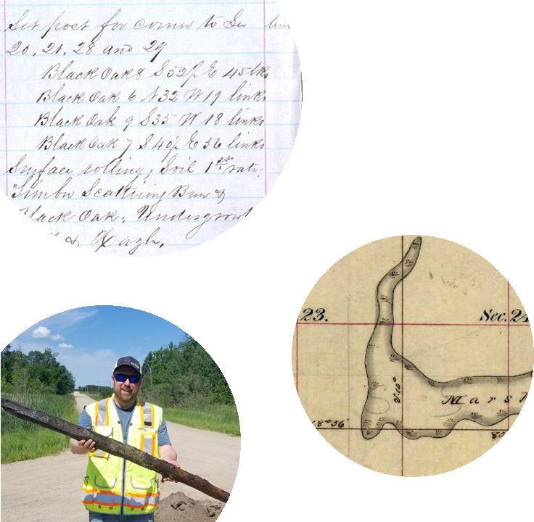
Following in the footsteps

Slide 21
The current state of PLSS monuments

Slide 22
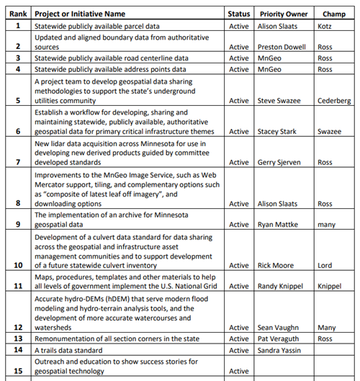
What the PLSS means to you

Slide 23
Benefits of preserving the PLSS

Slide 24
The Grant County pilot project

Slide 25
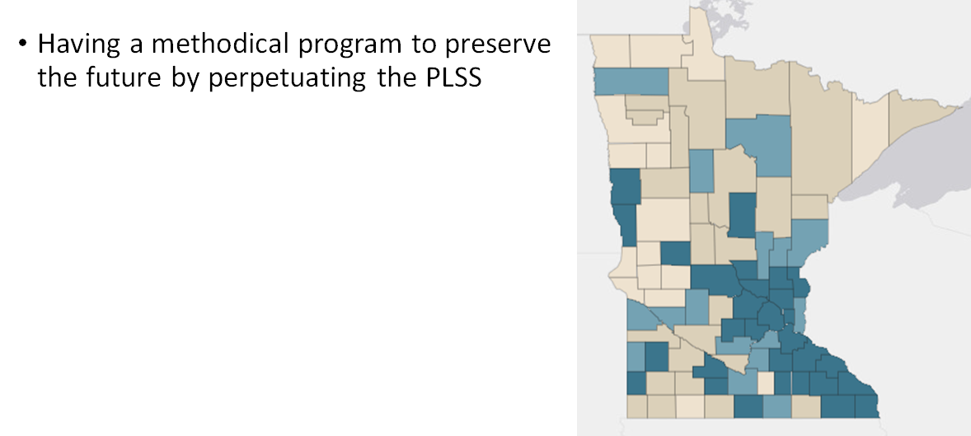
The solution

Slide 26
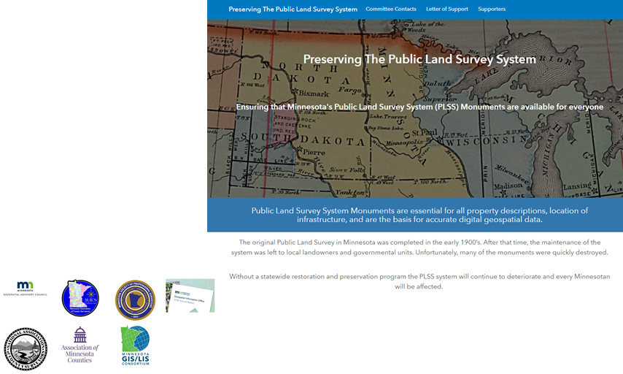
How can this be accomplished?
Introducing legislation to address functions and funding
Funding is still an open question, but looking at a general fund mechanism
We need your support
Please see our website at: https://mnplss-umn.hub.arcgis.com/
Read the proposed legislation
Adopt it as part of your platform/priority

Slide 27
Agenda Item 6
Underground Utilities Mapping Project
Steve Swazee, Barb Cederberg

Slide 28
Underground Utilities
Mapping
Project Team
Minnesota Geospatial Advisory Council Meeting Informational Brief
September 29, 2021

Slide 29
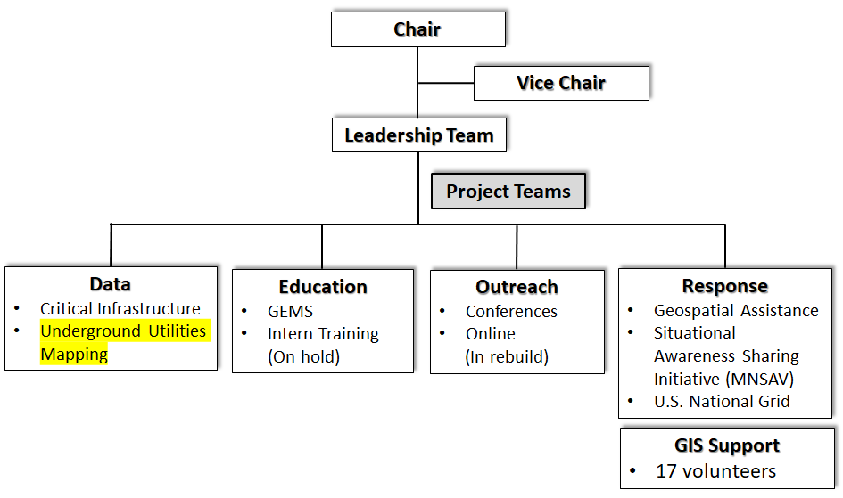
Emergency Preparedness Committee Structure

Slide 30
For your consideration

Slide 31
More and More Stuff is Underground

Slide 32
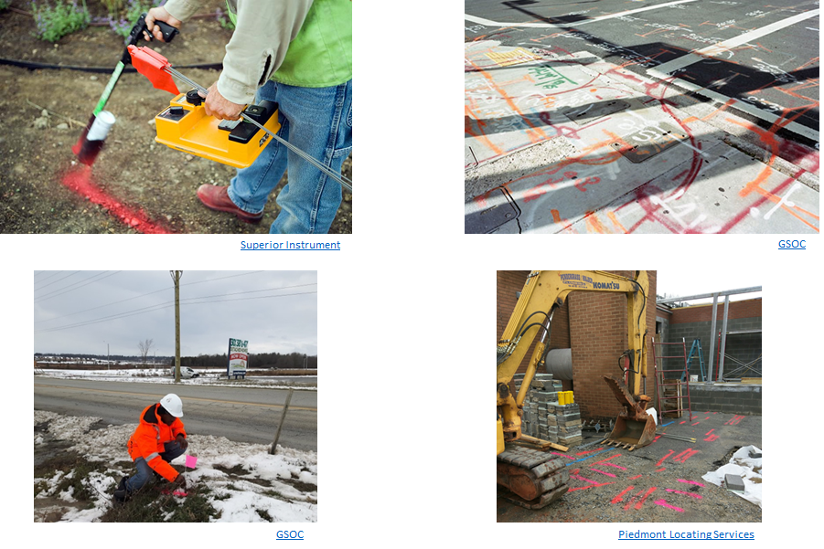
Finding what is there

Slide 33
We Want This Thinking – Gone For Good!

Slide 34
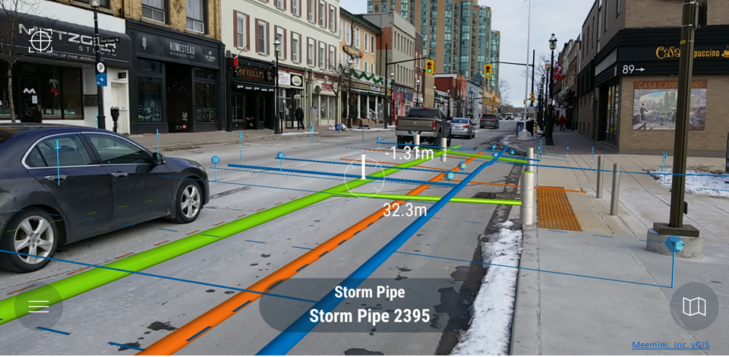
State of the art?

Slide 35
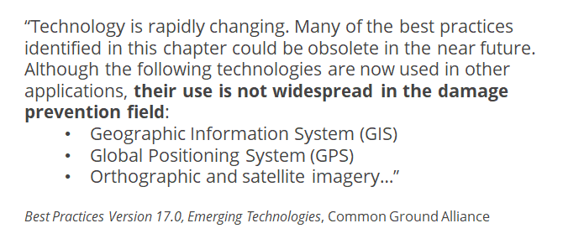
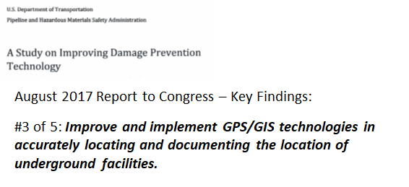
Recognized Problem – BUT What to Do?

Slide 36
Solutions – Not Problems!
Planning
Create access and share data for job planning and design
Managing
Plan for systems that will keep data current
Deploy technologies that facilitate data sharing, easy connections and translation of existing databases
Create standards for data accuracy and currency
Anticipate needing GIS cooperatives for smaller entities
Select a common base map
Create a repository of utility data for historic and defunct businesses
Locating
Enable universal view of data in the field
Leverage technologies which facilitate upload of collected data
Develop incentives for reporting unknown/abandoned lines
End the need for physical white-lining as an outcome of the total effort
Security/Legal
Ensure access is limited to only those with need and authorization
Work to achieve voluntary sharing of data
Develop the legal framework to codify and protect data sharing

Slide 37
Underground Utilities Mapping Project Team = Collaborative Effort

Slide 38
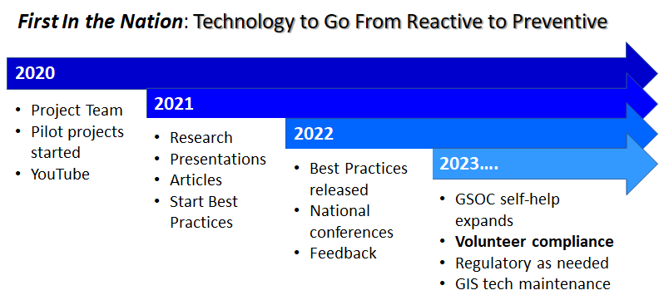
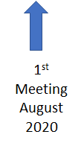
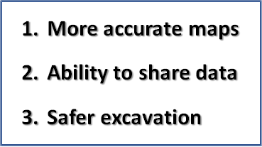
Underground Utilities Mapping Project Team = Collaborative Effort

Slide 39
The Plan: Research

Slide 40
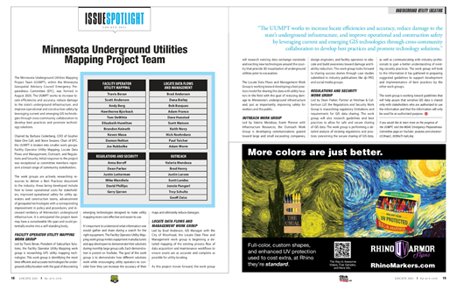
The Plan: Presentations/Articles
Clean Water Council Policy Committee: February 26
Common Ground Alliance Conference: Orlando, October 13
Clean Water Council: October 18/November 15?
MN GIS/LIS: October 24?
Global Excavation Safety Conference: Phoenix, March 1-3

Slide 41
The Plan: UUMPT Improvement Plan Framework
1. Cover
2. Administrative Handling
3. Table of Contents
4. List of Figures
5. Executive Summary
6. Background
Issue Overview
UUMPT
Other Efforts
Technologies Considered
7. Item Discussion Recommendations
Data Collection
Data Sharing
Data Display
Regulatory
8. Minnesota Improvement Plan
Area 1: Locate Community
Area 2: Utility Community
Area 3: Gopher State One Call
Area 4: Excavation Community
Area 5: Oversite
9. Conclusion
10. Index
Appendix A: Minnesota Improvement Plan
Appendix B: Technical Discussions
Appendix C: Self-assessment Safety Survey Form
Appendix D: Regulatory Review (Grid)
Appendix E: Acronyms
Appendix F: References

Slide 42
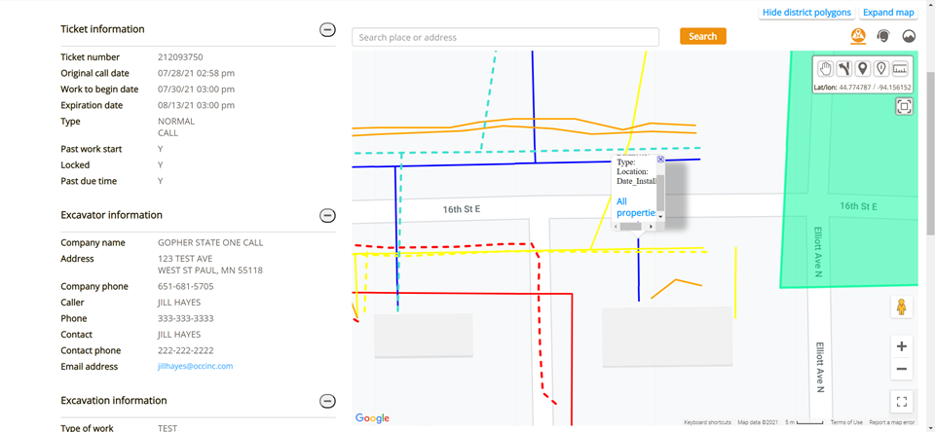
Baby Steps – UI Interface Prototype

Slide 43
Tech - Where We Can Go With Good Data
Leveraging emerging tech: AR, 3D, precision GPS
The technology is there, it’s a matter of will (and money)

Slide 44
Questions?
Learn More (mgacepc.net):
Next UUMPT – September 30, 1:00 pm
Next EPC – October 7, 3:00 pm
Steve Swazee
Chair
MGAC Emergency Preparedness Committee
chair@mgacepc.org

Slide 45
Additional Information
Nationwide We Do Not Comprehensively Know What’s Underground
Both the “What” and “Where” Element Are Lacking
Result: Nationwide construction damage to all types of utilities
2019 U.S. estimated damage was over $30 billion
Damage increased for 5th straight year
Gopher State One Call (GSOC)
Created 1987 after pipeline hit and explosion in Mounds View
811 or “Call Before You Dig” function for the entire state
Minnesota considered one of the best states for damage prevention
Best guess is there were 4,308 MN hits in 2019 (Dirt Report)
Top category was natural gas (apx. 2,000 hits)

Slide 46
Demand Versus Technology
Monday, June 22, 2020: GSOC handled 7,000 calls for locates
Must be marked within 48 hours
Good for only two weeks
GIS and GPS tech have been rapidly evolving since GSOC was created
U.S. is well behind Europe in mapping underground infrastructure
Although MN is rated as a top prevention state, the greater GSOC community knows they need to leverage GIS tech to improve efficiency and safety

Slide 47
Four Functional Area Working Groups
Facility Operator Utility Mapping (Travis Beran) - Locating, collecting and storing data – Where is that buried stuff?
Locate Data Flows & Mgt. (Brad Anderson) - Data maintenance and distribution – Telling others where the buried stuff is located
Outreach (Valerie Mendoza) - Finding the audience(s)/crafting the message – Creating engagement and improving safety awareness
Regulations/Security (Dean Parker) - Restrictions on availability and use of GIS data – Current situation and path forward
The Project Team (all members) and each working group meet once a month (2 meetings/month/each member)

Slide 48
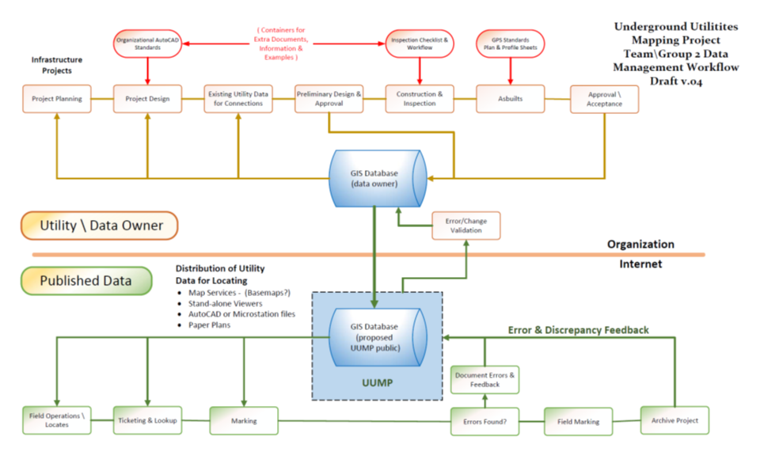
Defining Hurdles – Best Practices

Slide 49
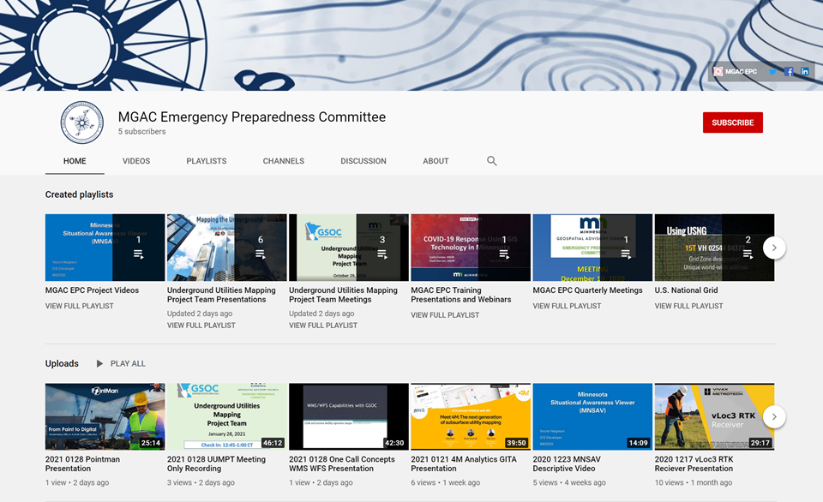
YouTube

Slide 50
Lidar Update – Agenda Item 7
Sean Vaughn, GIS Hydrologist | Lidar Data Steward, MNIT DNR, Co-Chair 3D Geomatics Committee, Acquisition Workgroup Champion
Gerry Sjerven, Senior GIS Analyst, Minnesota Power, Co-Chair 3D Geomatics Committee, Acquisition Workgroup Champion
Lidar Acquisition Subgroup:
Alison Slaats (MnGeo), Sean Vaughn (MNIT DNR), Gerry Sjerven (MN Power), Dan Ross (MnGeo), Jennifer Corcoran (DNR), Colin Lee (MnDOT), Matt Baltes (NRCS), Joel Nelson (U of MN), Joe Sapletal (Dakota Co), Mark Reineke (Widseth), Brandon Krumwiede (NOAA), Jeff Weiss (DNR), and Terry Zien (USACE).
Notes:
Gerry - Intro

Slide 51
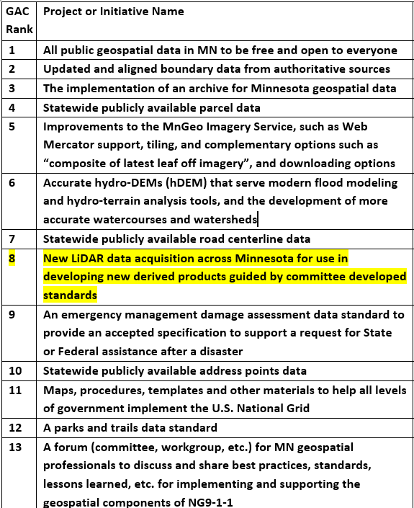
Geospatial Advisory Council (GAC) - 3D Geomatics Committee
Geospatial Advisory Council
The Minnesota Geospatial Advisory Council (GAC) is the coordinating body for the Minnesota geospatial community.
Cross-section of organizations that include counties, cities, universities, business, nonprofit organizations, federal and state agencies, tribal government, and other stakeholder groups.
3D Geomatics Committee?
The 3D Geomatics Committee (3DGeo) is a committee under GAC that works to identify and promote the need for planning, funding, acquisition, and management of three-dimensional geomatic data and derived products.
Notes:
3DGeo Background GAC priorities list, built by a robust survey. 3DGeo initiatives are recognized as high priorities (3 out of 20 geospatial challenges)

Slide 52
3DGeo - Data Acquisition Workgroup
Mission:
The Data Acquisition Workgroup promotes procurement of foundational 3D data for Minnesota.
Co-Chairs
Sean Vaughn, Alison Slaats, and Gerry Sjerven
Lidar Acquisition Subgroup:
Alison Slaats (MnGeo), Sean Vaughn (MNIT DNR), Gerry Sjerven (MN Power), Dan Ross (MnGeo), Jennifer Corcoran (DNR), Colin Lee (MnDOT), Matt Baltes (NRCS), Joel Nelson (U of MN), Joe Sapletal (Dakota Co), Mark Reineke (Widseth), Brandon Krumwiede (NOAA), Jeff Weiss (DNR), and Terry Zien (USACE).
Notes:
Sector Expertise
Lidar acquisition relies on subject matter expertise from different sectors in 3DGeo

Slide 53
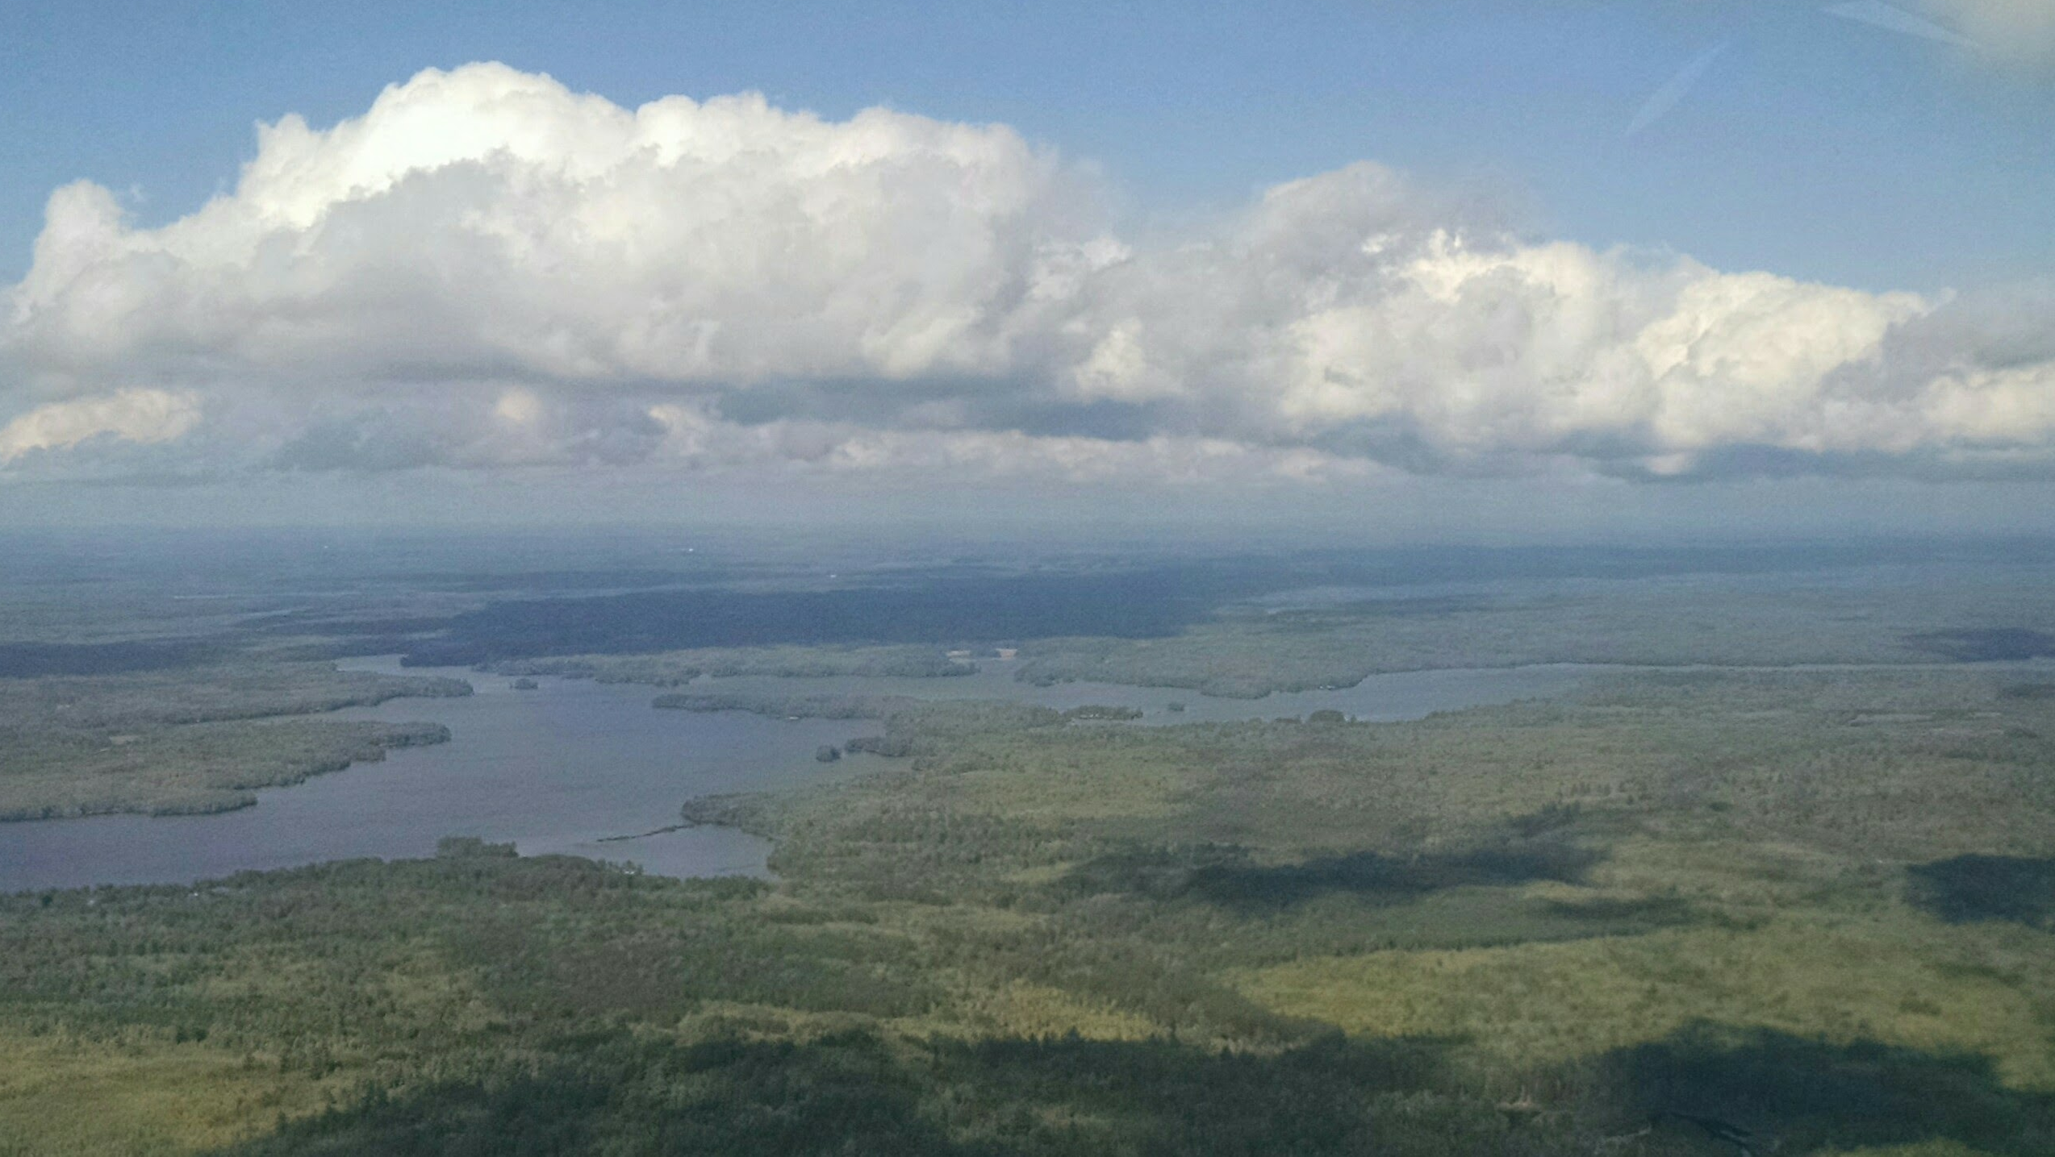
Lidar Collect
Notes:
THIS is where we are going next – or rather the aircraft collectiong high density lidar will be going. This picture was taken during a reconnaissance flight for acquisition planning for the high density lidar that was acquired in Lake County in 2018.

Slide 54
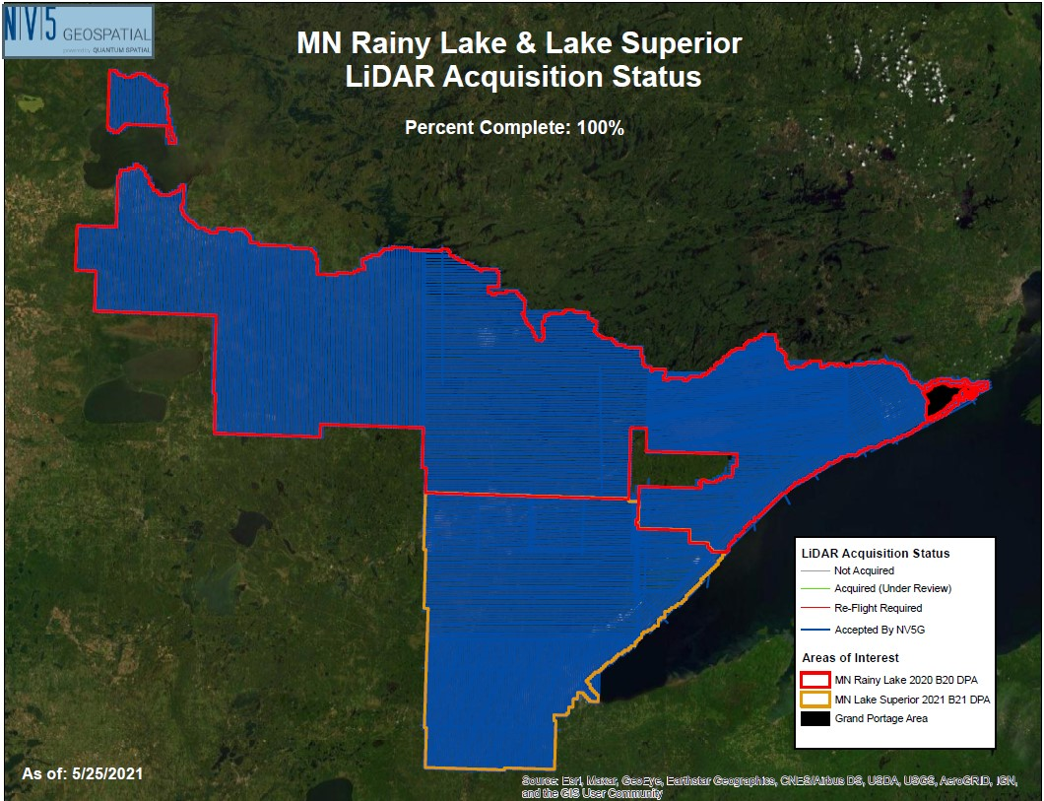
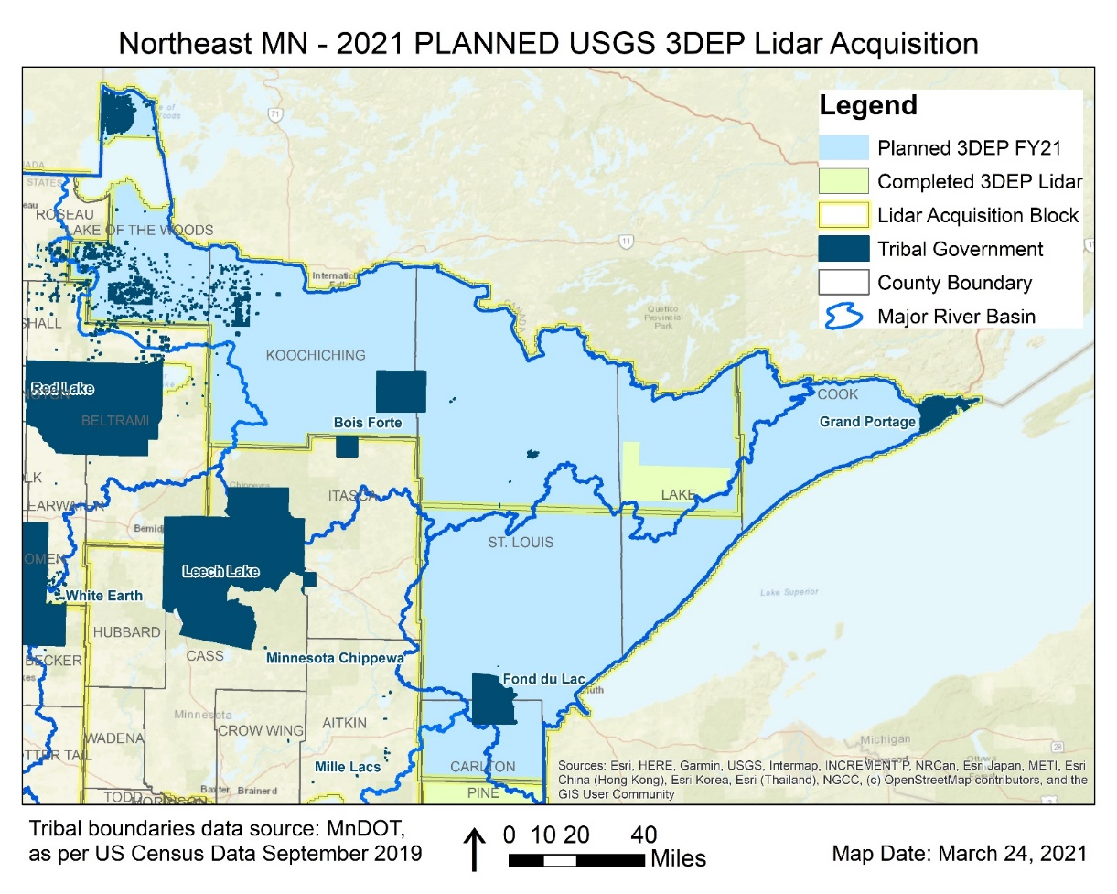
Lidar Acquisition: Northeast – Rainy Lake & Lake Superior Block
Rainy Lake and Lake Superior Block data collections are complete!
Notes:
Observations from the field are still useful. It has been very helpful to know the local condition leading up to and throughout the acquisition.

Slide 55
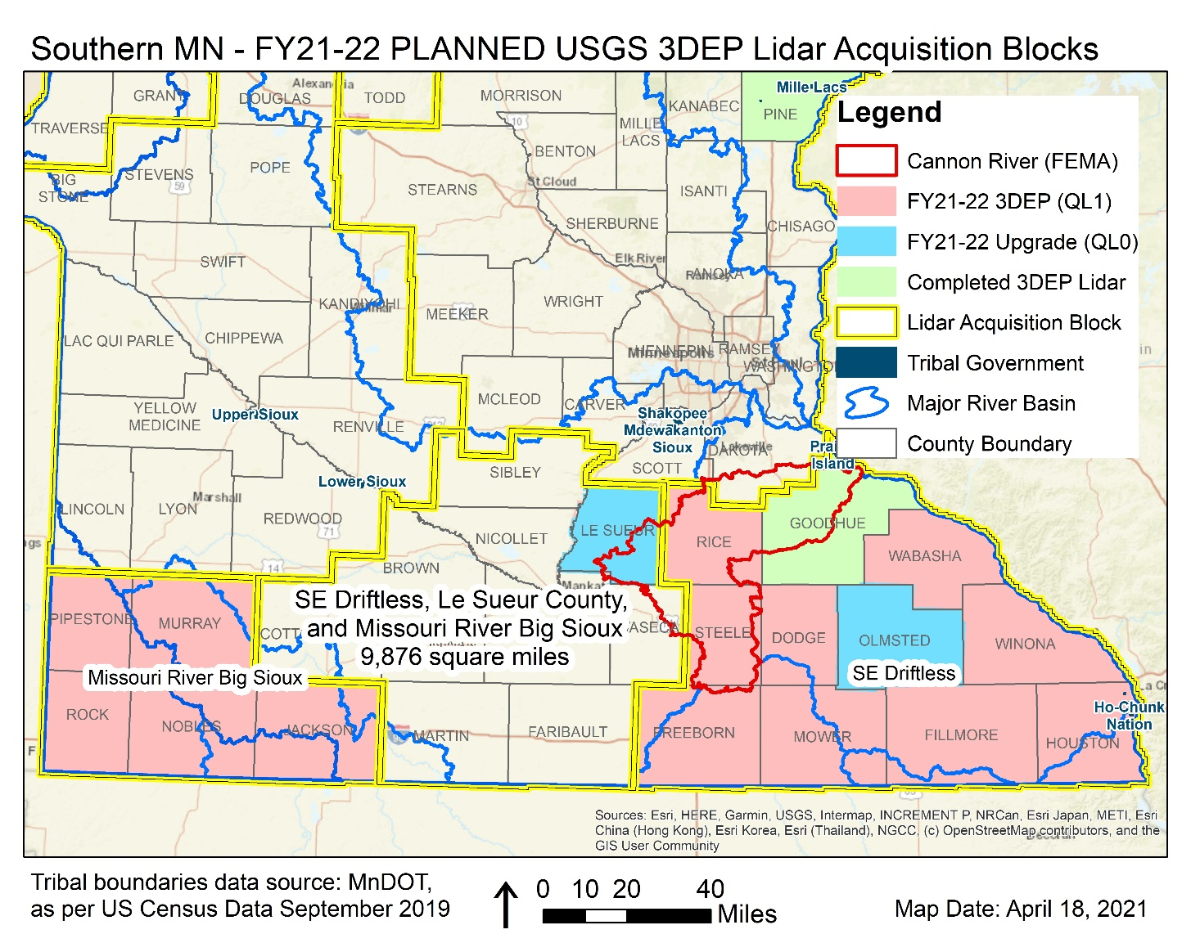
Lidar Acquisition: Southern BAA – Missouri Big Sioux & SE Driftless Blocks
BAA (west and east) split between two vendors and two JFA’s.
Partners: USGS, NRCS State and Federal Offices, MnDOT, MnGeo, and Nobles, Le Sueur, Olmsted (included City of Rochester), and Winona (included City of Winona) Counties
Much of the SE Driftless LAA was collected, data is under vendor review.
Missouri River Big Sioux block set for a Spring 2022 collection

Slide 56
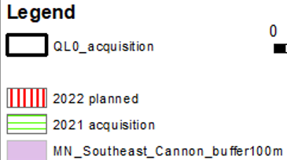
Lidar Acquisition: Southern BAA – Missouri Big Sioux & SE Driftless Blocks
Description
Vendor was able to put aircraft on this project following completion of a nearby job.
Collection was outside of contract, but vendor understands lidar base specification and the QC the data must met for certification
QL0 Counties
ASPRS Compliant QL0 Lidar
Will meet 1.67 cm RMSEz Non-veg accuracy for check points

Slide 57
3D Geomatics Funding Agreements
Contributions to Minnesota Lidar (millions)
Minnesota Partners: $3.15
USGS 3DEP: $6.18
Other Federal $0.448
Total: $9.77M
NRCS 2021 Contribution $1 Million
3DGeo Team member Matt Baltes
$10.77 Million
The State (MnGeo) Serves as the fiscal Agent with Minnesota Partners
MnGeo will establish funding agreements with funding partners
MnGeo will establish funding agreement(s) with USGS 3DEP
Notes:
Additional classes available for the point cloud: 3 - Low vegetation; 4 - Medium Vegetation (use for single vegetation class); 5 - High Vegetation; 6 - Buildings, other man-made structures; n - Additional classes or features as agreed upon in advance.

Slide 58
Lidar Quality Levels – Lidar Specifications
MnGeo Discovery Project
Storage Maintenance and Dissemination
Outcomes: Solutions, costs and likely a pilot, steering team
Exploration of vendor capabilities
Present it next legislative session
Set up a steering team going forward
Veronica Hiza (PM) and Usman Ahmad (BA) 3D Geo Stakeholder Matrix.docx
By end of December, the deliverable is a clear set of requirements and solutioning for data storage and distribution
We also need to decide if this includes tools for modelling and define what this means.
MnTOPO functionality needs to be replicated.

Slide 59
Planning in Progress

Slide 60
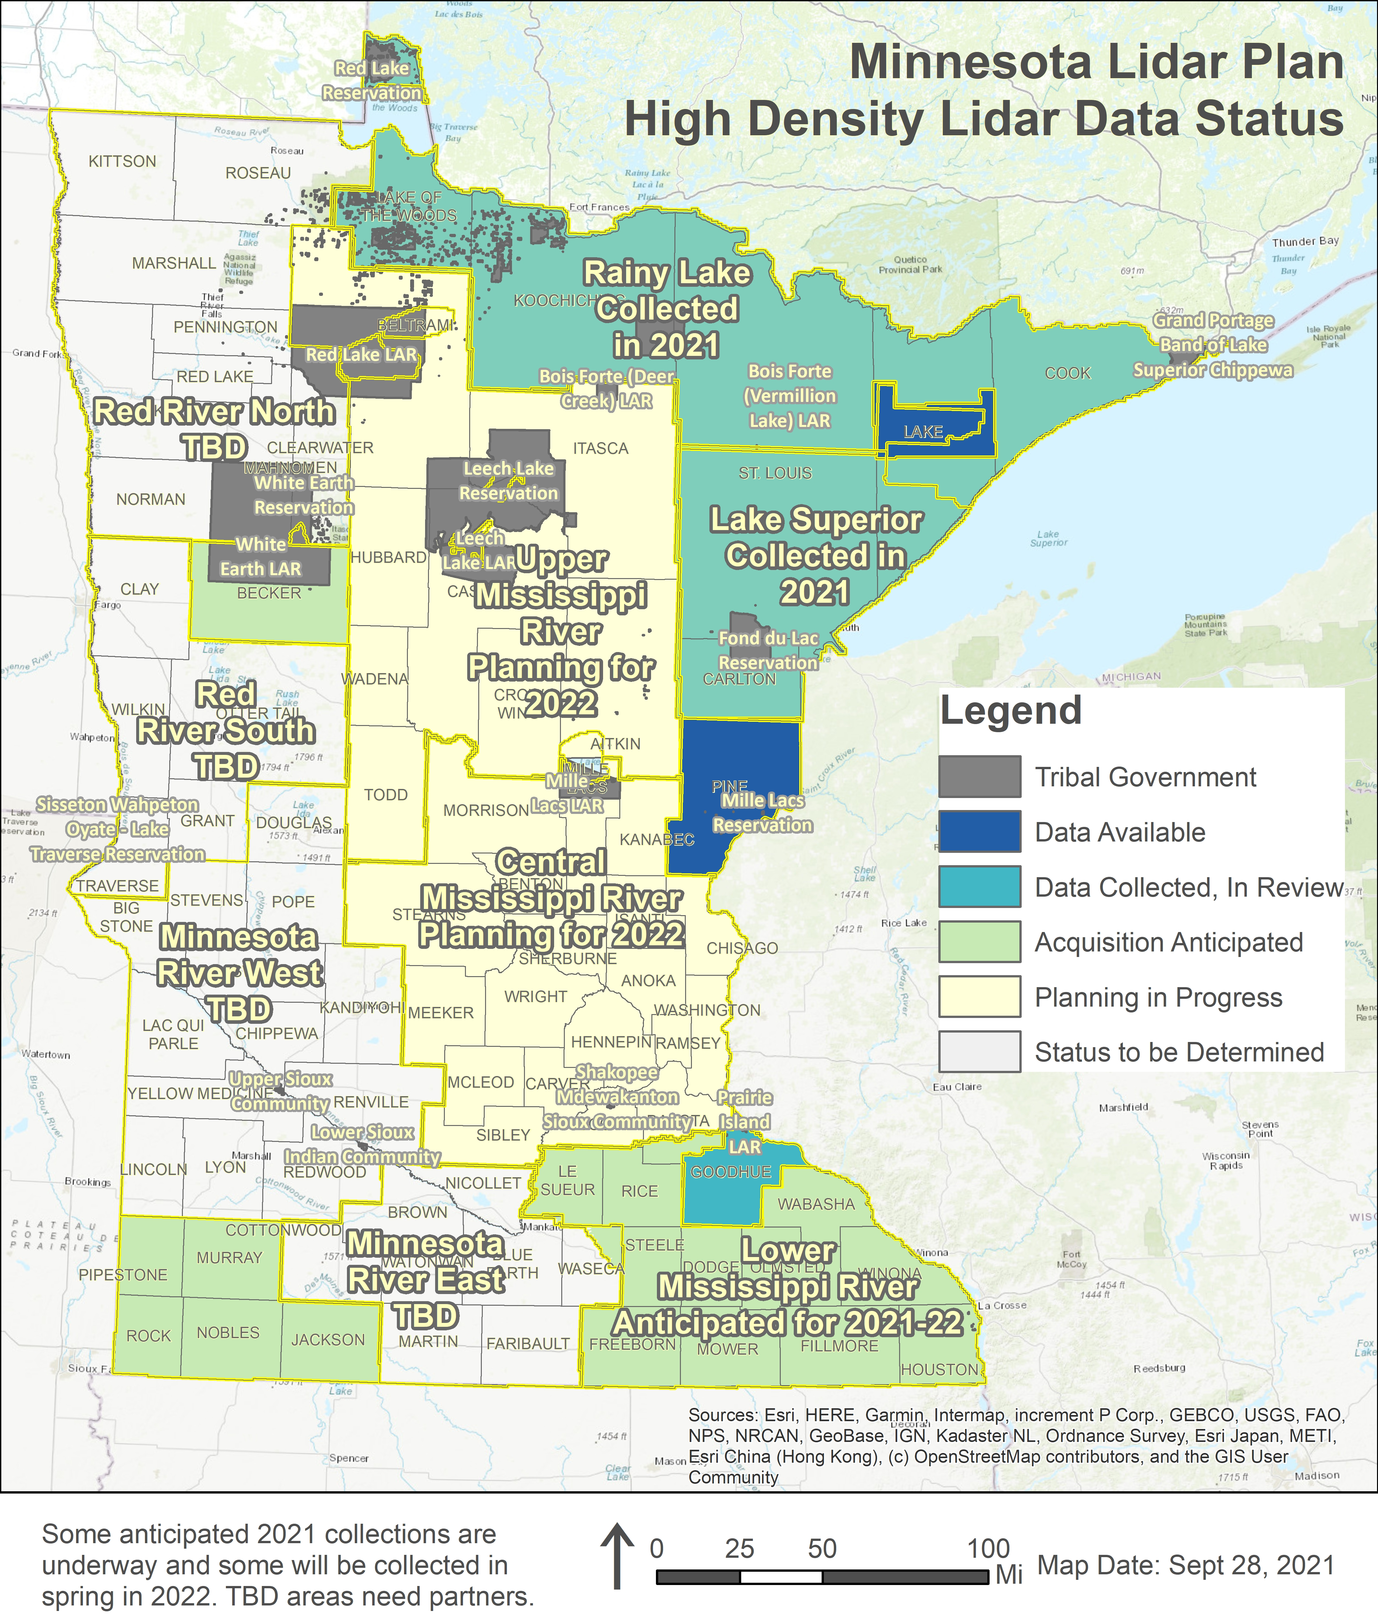
Lidar Acquisition Areas and Blocks of Interest

Slide 61
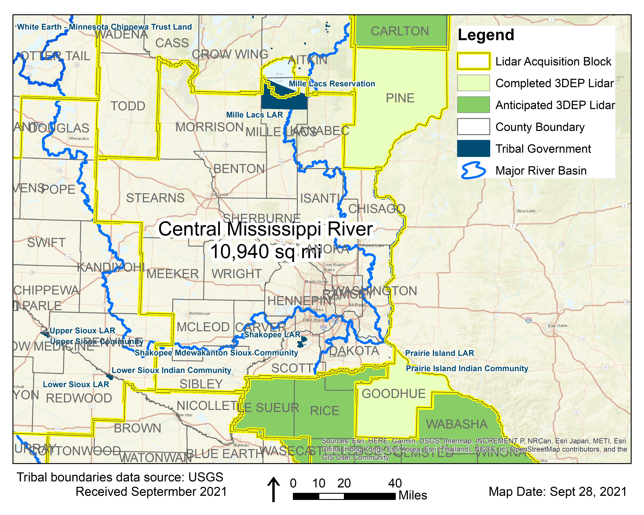
3DGeo Outreach: Central Mississippi River (Metro) Block
Contributing Partners
14 of the 19 counties
1 private company
NRCS
DNR, MnDOT, MNGeo
Estimated USGS 3DEP Contribution |  | Total Partner Contributions Needed
% | $ | % | $
40% | $1,425,320 | 60% | $2,137,980
10,940 square miles at $325.71 per square mile = $3,563,300 TOTAL
Notes:
TOTAL Est Funds Needed: $ 3,563,300
Estimated using $325.71 per square mile for QL1
19 Counties* - 10,940 square miles

Slide 62
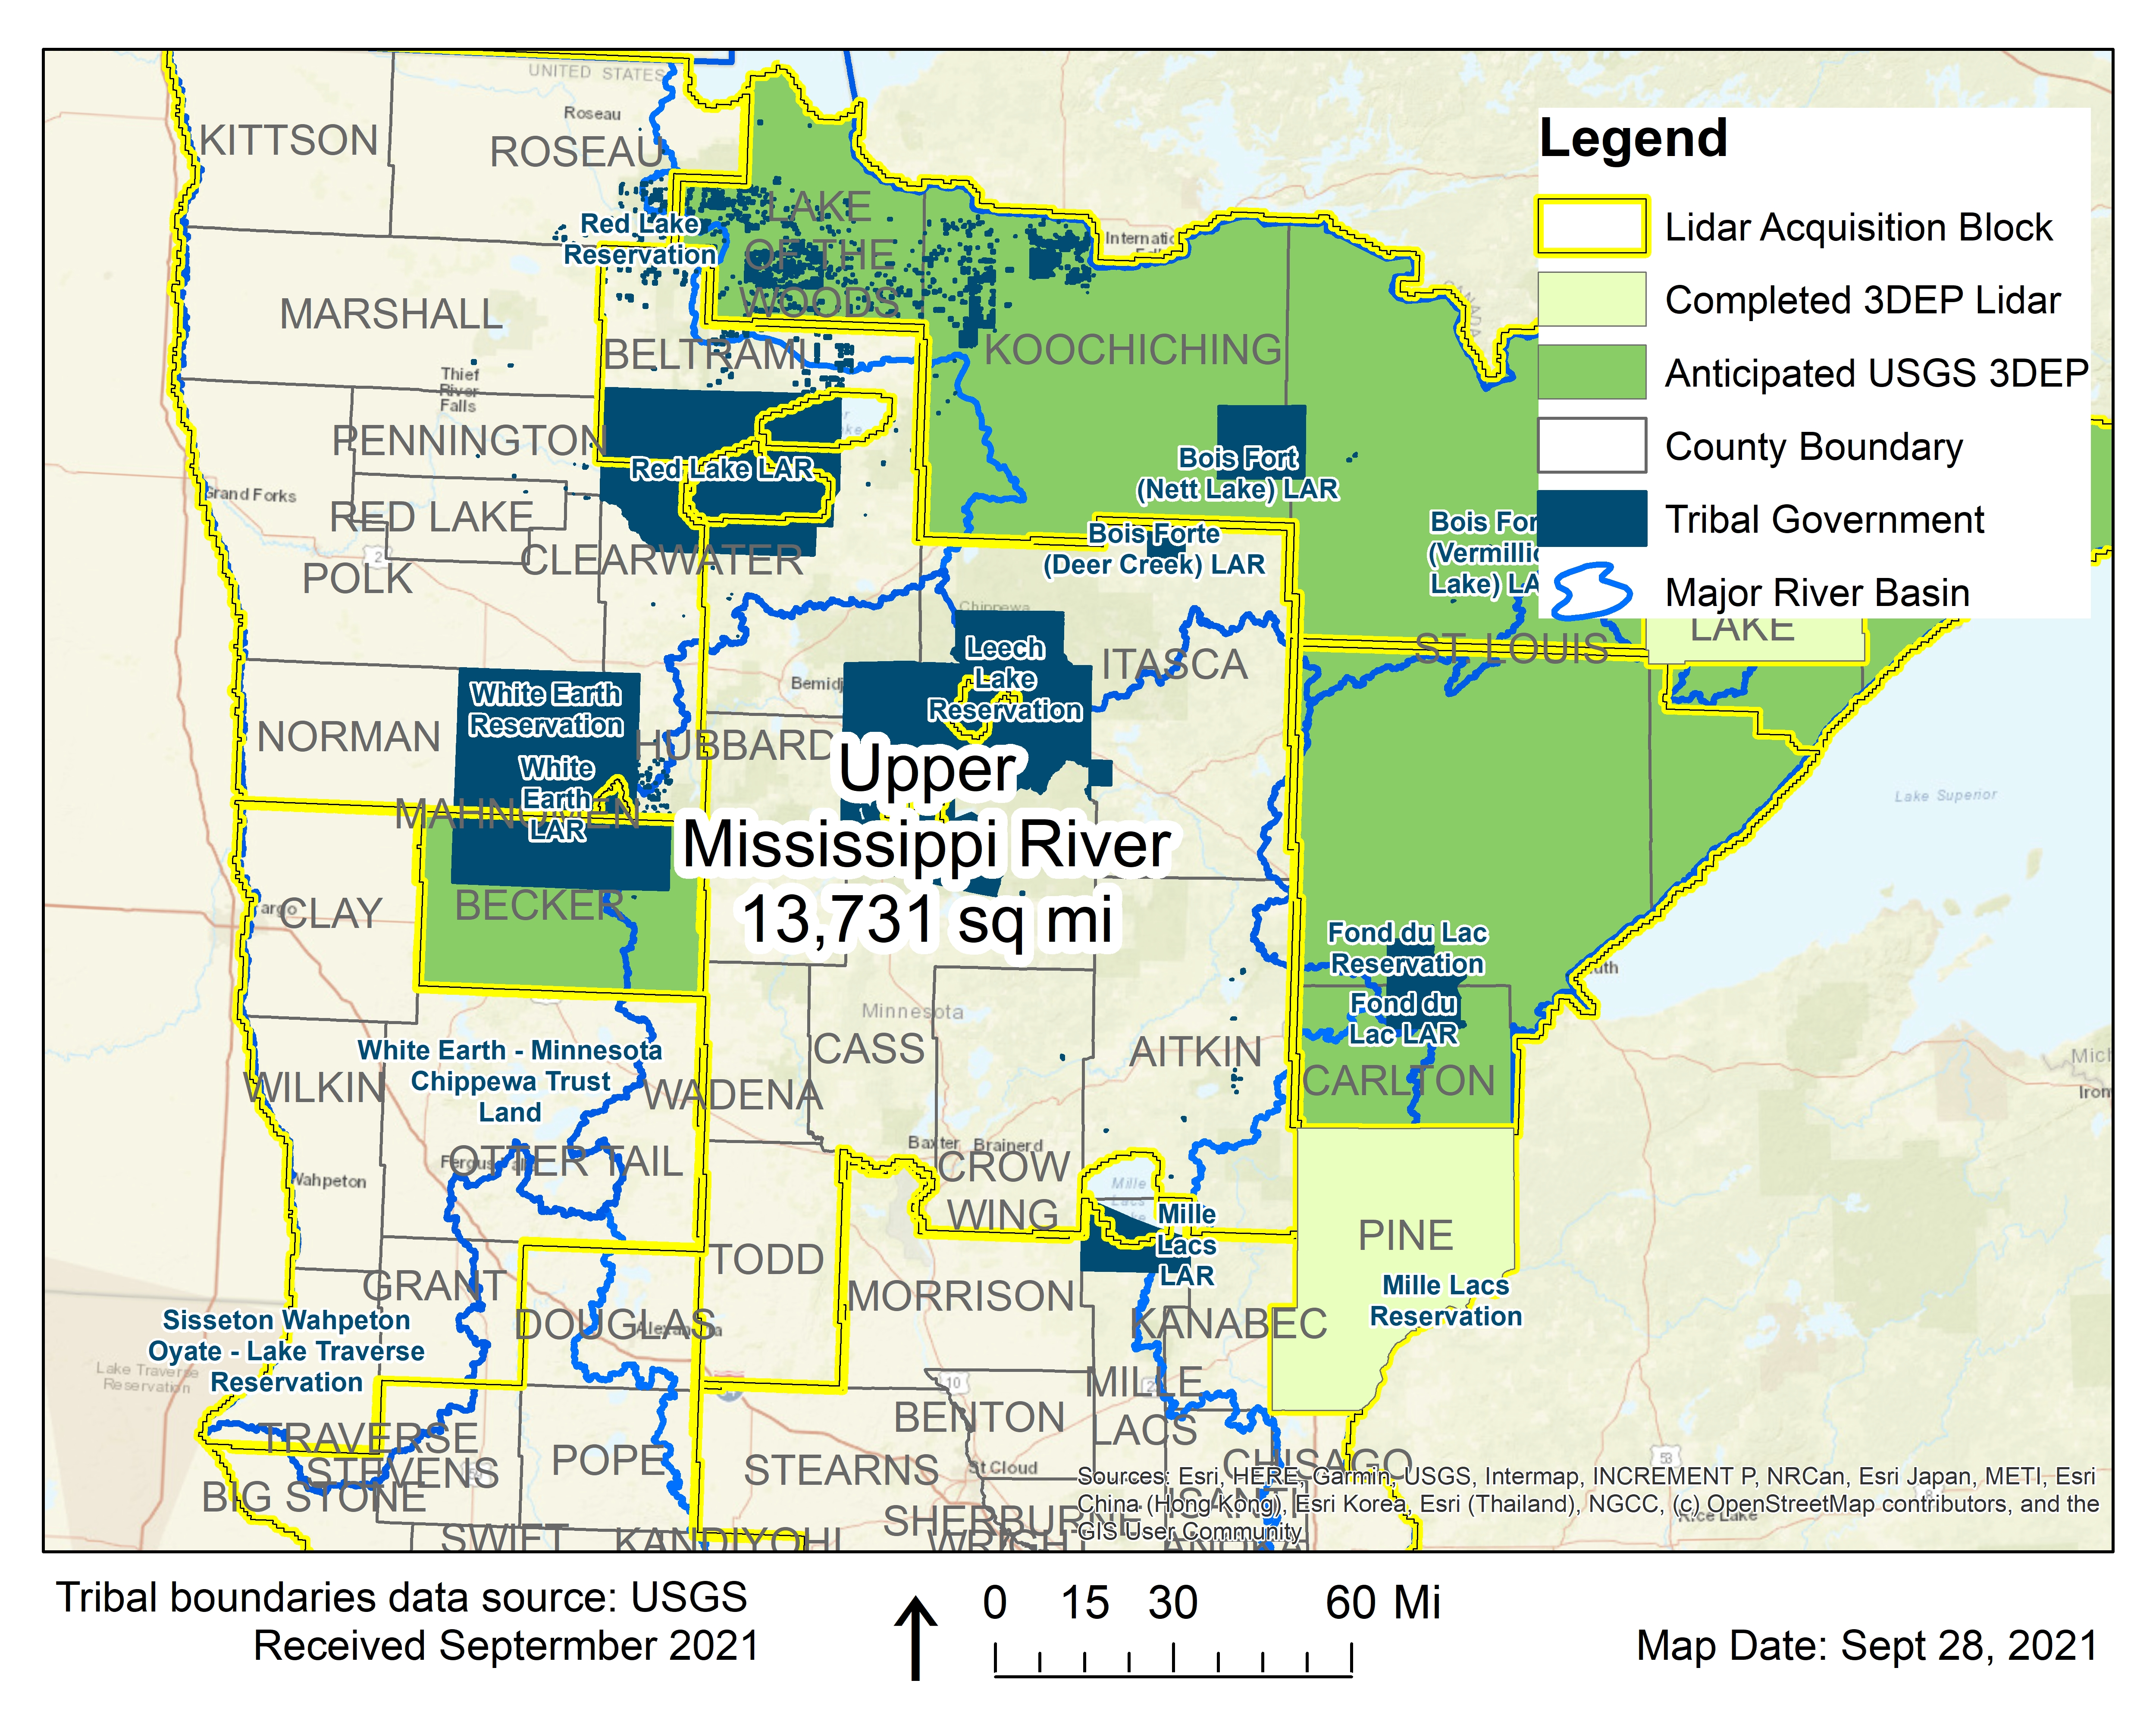
3DGeo Outreach: Upper Mississippi River (Central Lakes) Block
Contributing Partners
5 of the 8 counties
Leech Lake and Bureau of Indian Affairs
NRCS, Chippewa National Forest
DNR, MnDOT, MNGeo
Estimated USGS 3DEP Contribution |  | Total Partner Contributions Needed
% | $ | % | $
40% | $1,780,361 | 60% | $2,670,542
13,731 square miles Estimated at $324.15 per square mile = $4,450,903.65 TOTAL
Notes:
TOTAL Est Funds Needed: $ 4,450,903.65
Estimated using $324.15 per square mile for QL1
8 Counties* - 13,731 square miles

Slide 63
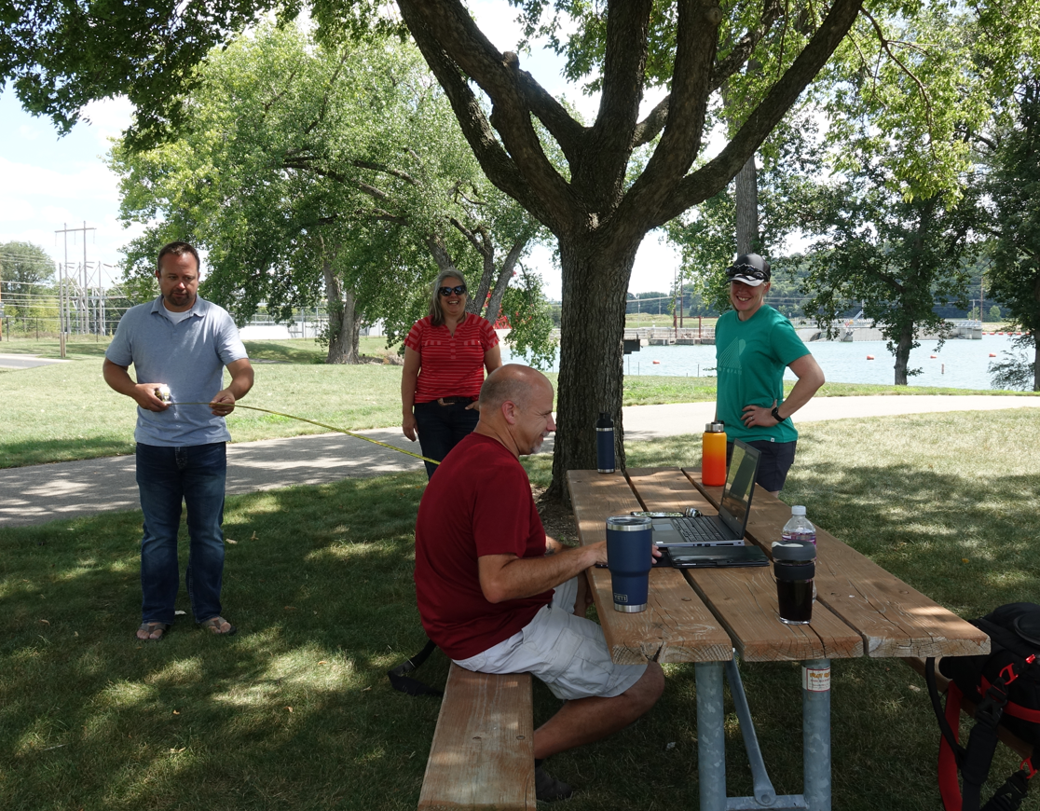
3DGeo Field Visit – Preparing for Data Validation
Hydromorphology Field Meeting
Co-chairs
Jamie Schultz (Meeting Coordinator)
Andrea Bergman (Measurement Instrumentation Assistant)
Rick Moore (Computer Technician)
HydroGeo liaisons
Sean Vaughn (Photographer)
Joel Nelson (Measurement Instrumentation Technician)
Joel Nelson measures to ensure social distancing is being met

Slide 64
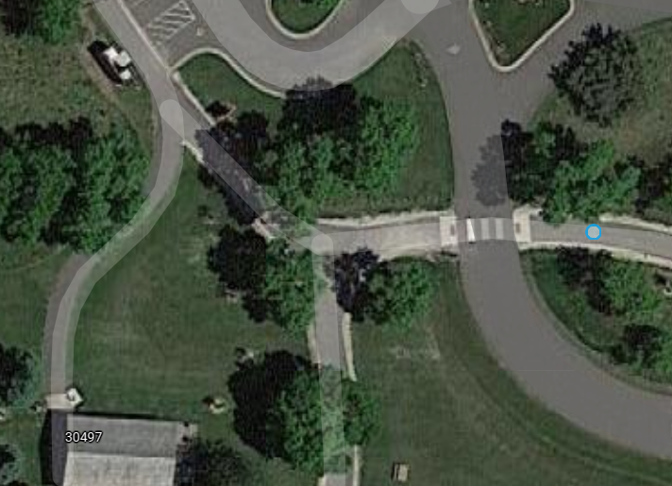
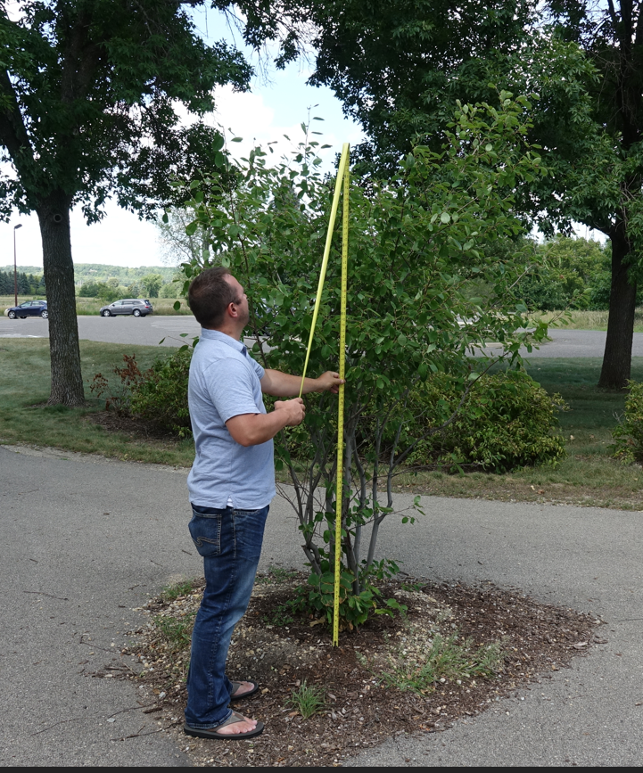
3DGeo Field Visit – Preparing for Data Validation
Bush in center of asphalt trail intersection surrounded by trees
Joel Nelson measures bush captured by HD Lidar

Slide 65
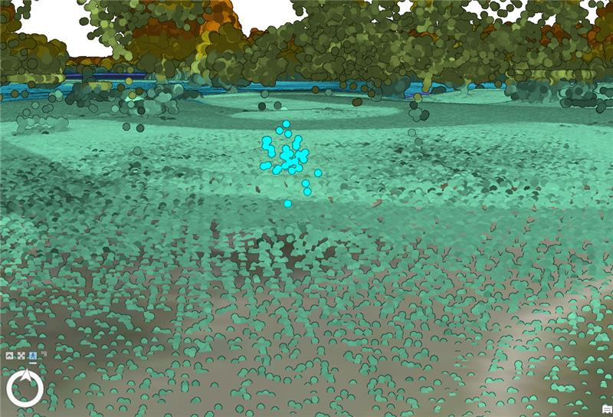
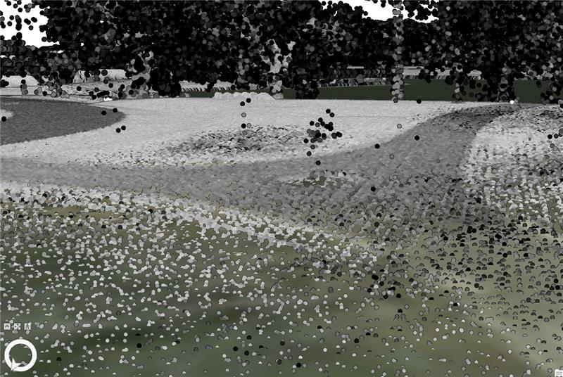
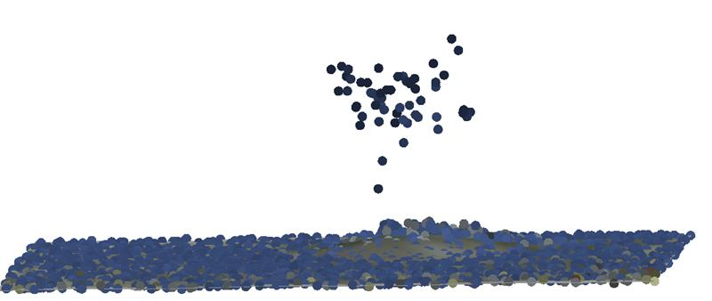
3DGeo Field Visit – Preparing for Data Validation
Bush and surrounding features captured by lidar intensity
Bush as represented in high-definition point cloud
Bush Point Cloud

Slide 66
Timeline - upcoming steps
Date | Task
August 27 | Optional: Partners provide notification to lidar@state.mn.us of any upgrade request(s)
September 3 | 3DGeo submits IGCE to obtain costs for final lidar acquisition areas, and upgrade areas
September 17-24 | USGS provides cost estimates to 3DGeo in response to IGCE 3DGeo passes shares upgrade costs with partners
September 24 | Partners provide completed “Attachment D” to lidar@state.mn.us
October 1 – Extended to October 8 | BAA application submitted by MNIT on behalf of 3DGeo partners
Winter | USGS provides approval of grant
January/February | MNIT executes Joint Powers Agreements (JPAs) with each local partner MNIT signs Joint Funding Agreement (JFA) with USGS on behalf of all local partners Statement of work (SOW) is agreed for work
March? | After JFA, SOW complete; USGS contracting moves forward; Vendor and partners work on detailed technical task order for lidar acquisition
March | Partners provide funds towards task order
March/April | Task order issued
April/May | Lidar Acquisition
https://www.mngeo.state.mn.us/committee/3dgeo/acquisition/status.html

Slide 67
Next steps
You don't have to have money or be a decision maker to be a stakeholder . . .
You can be a voice of support . . .
A collaborator
You
Transportation Engineer
Dam Engineer
Forester
Engineer
Surveyor
GIS Specialist
GIS Manager
Assessor
Natural Resource Specialist
3D Geo
Notes:
Sean’s email to Empower stakeholder who can’t bring money but can bring and promote a voice of support for why new HD lidar is needed.
Joes response - We (3DGeo) is the trunk of the tree (Joe’s analogy)

Slide 68
Closing Remarks
The Minnesota Lidar Plan guides the collection of enhanced, high density airborne Lidar for Minnesota.
Quality Level 1 High Density LiDAR (QL1), Aggregate Nominal Pulse Density (ANPD) ≥ 8.0 pulse/m2
The intent is to be inclusive and find opportunities for data users, practitioners and data collectors to work together to bring the benefits of Lidar to the state of Minnesota.
The goal is to have enhanced statewide, seamless, Lidar 3D point cloud and derived products publicly available by the end of 2025.
Notes:
Gerry / Sean

Slide 69
Break

Slide 70
Agenda Item 9
Commons Discovery Project - Dan Ross
Requirements gathering effort for the next version of the MN Geospatial Commons
Seeking broad input from across the community
Mission remains the same - collaborative public website where publishers can share geospatial data, metadata, maps, services and applications, and users can access these resources.

Slide 71
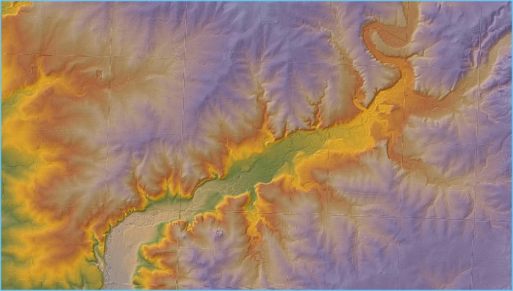
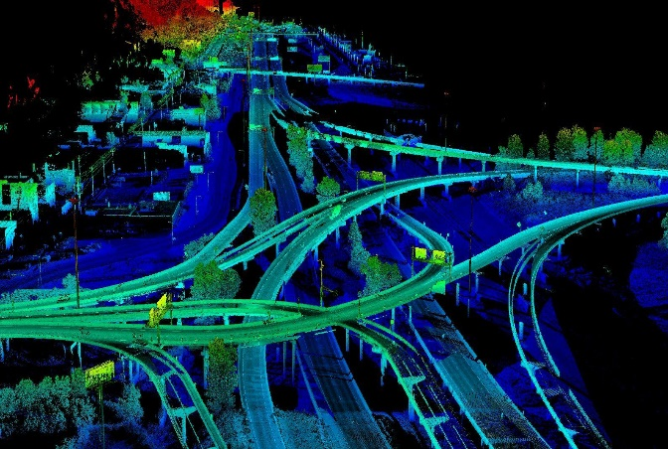
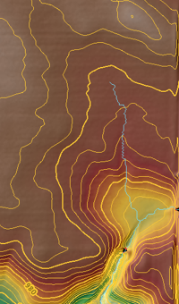
Agenda Item 10
Lidar and Aerial Imagery Data Discovery Project - Dan Ross
Requirements gathering for the storage, management and dissemination of aerial imagery, lidar and derived products from each
Perhaps some light analytic tools
Seeking broad input from across the community
Going on now through December with a pilot after that

Slide 72
Agenda Item 11
DNR Public Lands
Hal Watson, Trina Zieman

Slide 73
Public Lands of Minnesota Map and Dataset
Hal Watson | GIS Section Manager, MNIT DNR

Slide 74
Today’s Presentation
1 | Introduction
2 | The Need for This Data
3 | Creating This Dataset
4 | Public Lands by County
5 | Questions and Answers

Slide 75
Introduction
Minnesota's Diverse Landscape
Deep tradition of public land acquisition and management
Benefits to people, natural resources, local economies
Schoolcraft State Park
Notes:
Minnesota’s rich and diverse landscape is protected and maintained by a deep tradition of public land acquisition and management activities – all for the benefit of people, natural resources, and local economies.

Slide 76
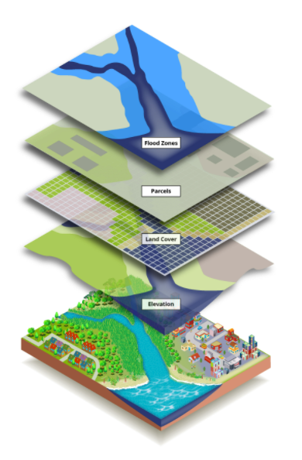
Introduction
Geospatial data development
Surveys, parcel maps and data at the project level and within the county context
Statewide integration of parcel data allows for broader questions to be answered
Recent completion of a statewide public lands dataset based on county parcel data
Green Infrastructure Mapping
Notes:
Through time, geospatial experts developed public lands maps and data resources for specific projects or research studies. Now, there’s an even more comprehensive map and dataset integrating parcel-level data for public lands across the entire state.

Slide 77
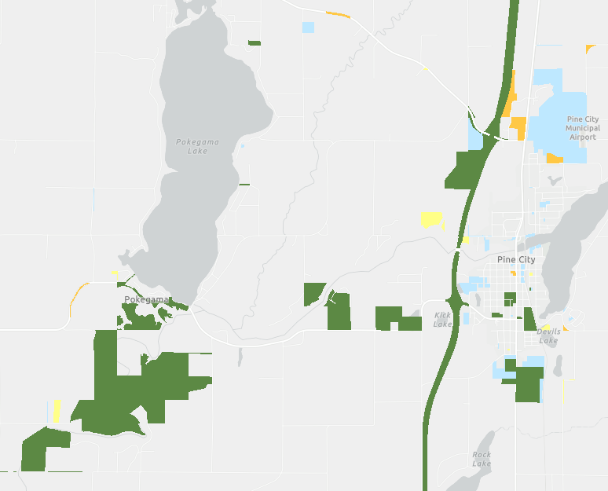
Introduction
Collaboration between different agencies and levels of government
Enhances ability to develop innovative strategies for Minnesota’s public lands
Public Lands near Pine City & Pokegama Lake
Notes:
Below Pokegema Lake: Conservation Officer Eugene H. Wynn Jr. Memorial WMA & Kraft WMA
Near Pine City: Pine City WMA, State DOT Lands along Hwy 35
The Minnesota Department of Natural Resources (DNR) has updated its Public Lands of Minnesota Map in partnership with Minnesota IT Services (MNIT) and Minnesota Geospatial Information Office (MnGeo). An update to the Public Lands of Minnesota Map provides high quality, consistent data that can add significant value to the development of innovative strategies and approaches for Minnesota's public lands.

Slide 78
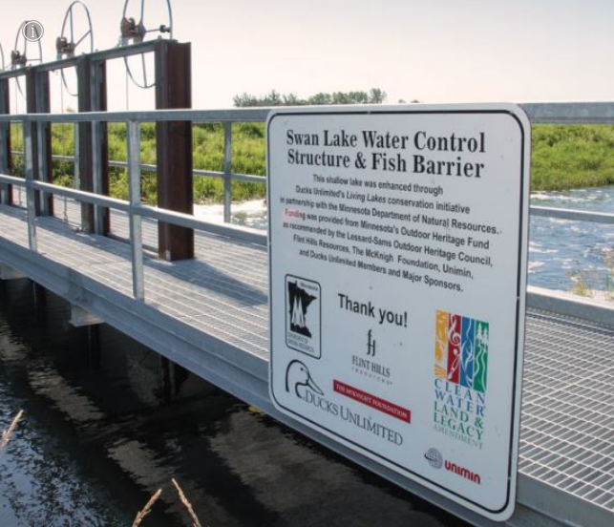
Conservation Planning to Improve the Public Land Portfolio
Natural resource managers, conservation leaders, government units, conservation groups, scientists, and public and private landowners.
Consistent, common data of public lands facilitates conversations between groups
Swan Lake, Near New Ulm
Notes:
Natural resource managers and conservation leaders need high quality, consistent data to help them make decisions about current and future uses for specific parcels of public land. The spatial data and map helps specialists analyze the geographic distribution of natural resources, monitor endangered or invasive species and wildlife habitation, and identify priorities for conservation management.
By clearly identifying public land ownership boundaries, the map and dataset also adds significant value to planning conversations between government units, conservation groups, and public and private landowners. Scientists, the GIS community, conservationists, and government leaders can utilize the same accurate and updated information to help balance the state’s outdoor recreation and economic needs, with critical wildlife and natural resources conservation priorities.

Slide 79
Collaborative Ecosystem Planning to Advance Common Goals
Statewide public lands data can guide collaborative ecosystem planning by increasing inter-agency knowledge of public land ownership and possible environmental, wildlife, and human interactions
This data helps establish conservation, restoration, and other management goals on public lands.
Bde Maka Ska, Minneapolis
Notes:
GIS spatial data in the public lands map helps identify and visualize ecological features across landscapes. The map and dataset effectively guide collaborative ecosystem planning by increasing inter-agency knowledge of public land ownership and possible environmental, wildlife, and human interactions that may alter natural terrains. The data helps establish conservation, restoration, and other management goals on public lands.

Slide 80
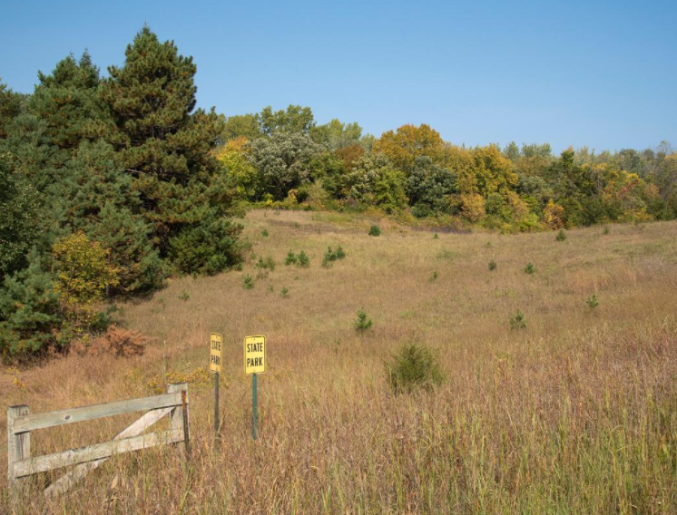
Public Lands Decision-Making and Policy Development
Consistent, local, regional, and state-level information essential for prioritizing public land policy, land management strategies, and related activities.
Relate detailed information about the state’s public lands with other resources, to make decisions about expanding access, infrastructure projects, land sales, acquisitions, and other issues.
Bde Maka Ska, Minneapolis
State Park Boundary
Notes:
The map and dataset provide consistent, local, regional, and state-level information essential for prioritizing public land policy, land management strategies, and related activities. Users of the map and dataset can relate detailed information about the state’s public lands, with other resources, to make decisions about expanding access, infrastructure projects, land sales, acquisitions, and other issues.

Slide 81
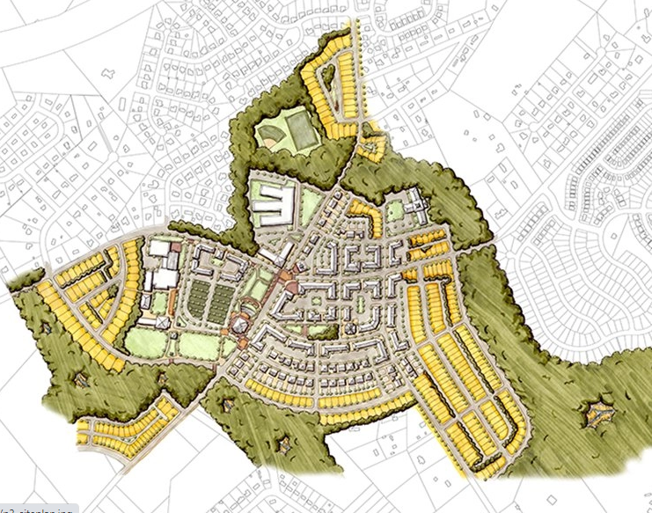
Survey Community Considerations
Using this dataset, county surveyors and engineers approach public land issues with the same underlying data assumptions as other partners, especially state agencies.
This dataset is not survey quality and is intended for mapping purposes only (as opposed to site-specific activity).
Land Use Planning
Notes:
The map and dataset provide consistent, local, regional, and state-level information essential for prioritizing public land policy, land management strategies, and related activities. Users of the map and dataset can relate detailed information about the state’s public lands, with other resources, to make decisions about expanding access, infrastructure projects, land sales, acquisitions, and other issues.

Slide 82
Creating This Dataset
All 87 counties share parcel data with MnGeo
County is transformed to meet the Geospatial Advisory Council’s parcel data standard
Standardized data is then aggregated into a statewide dataset
Data Aggregation
Notes:
All 87 counties in Minnesota share parcel data with MnGeo to assemble the data into a single statewide data layer, using the Minnesota Parcel Data Standard. State agencies, including the Minnesota DNR, use the aggregated parcel dataset to guide public land asset and management projects.

Slide 83
Creating This Dataset
MNIT and DNR Partnered to research and classify all of the public parcels in the aggregated dataset
Example: State of Minnesota
ST MN
State of Minnesota
Dept. of Natural Resources
DNR
State Forest
Dept. of Conservation
State of MN
Highway Dept.
School Trust Fund Land
Data Classification
Notes:
MNIT staff partnered with Minnesota DNR to research and classify all of the public parcels in the aggregated parcel dataset.
For example, lands owned by the State of Minnesota are represented by variety of names in county parcel data, including ST MN; State of Minnesota; Dept. of Natural Resources; DNR; State Forest; Dept. of Conservation; State of MN; Highway Dept.; School Trust Fund Land.
The process involved multi-step attribute and spatial analysis, and automation using Python scripts and manual quality control of the data.

Slide 84
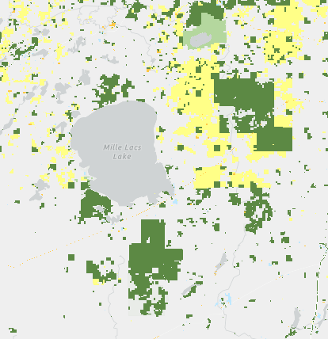
Creating This Dataset
Parcels are grouped by owner type: federal, state, county fee, tax forfeit land, and municipal ownership categories
Delineation below the 40 acre division and across all public types is a major step forward from existing statewide datasets
Data Classification
Notes:
The updated Public Lands of Minnesota Dataset groups parcels into federal, state, county fee, tax forfeit land, and municipal ownership categories. The resulting dataset is the most complete and consistently categorized statewide data for public land ownership across the state, available for an annual update. This allows users to quickly sort out federal lands from state lands and county lands with parcel-level spatial detail and display them on maps.

Slide 85
Creating This Dataset
Federal
State
County Fee
Tax Forfeit
Municipal
Tribal
Regional Government
Port Authority
Private
No Value
Unknown

Slide 86
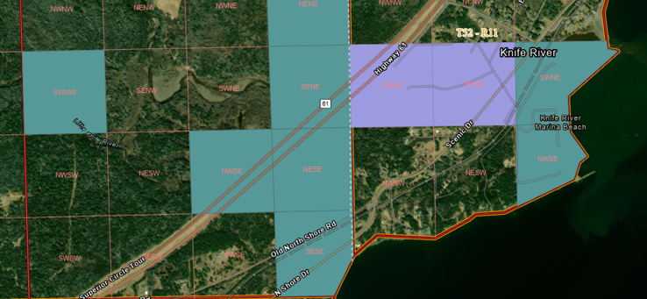
Problem: Most of Minnesota’s current public land records and supplemental data are only available for every 40 acres of landscape.

Slide 87
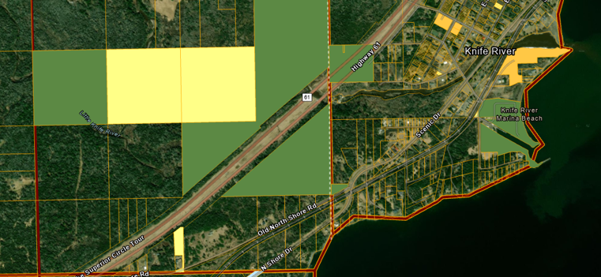
Solution: Parcel level detail in the new map and dataset to effectively support the state’s charge to responsibly manage Minnesota’s public lands for future generations.

Slide 88
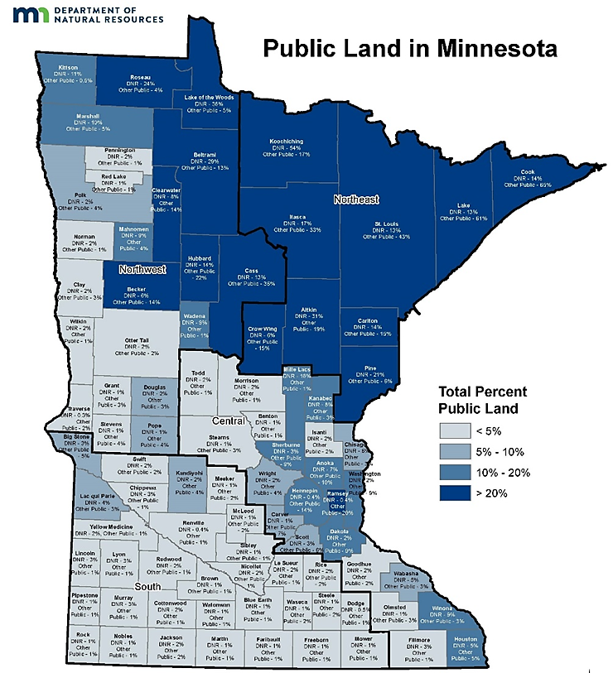
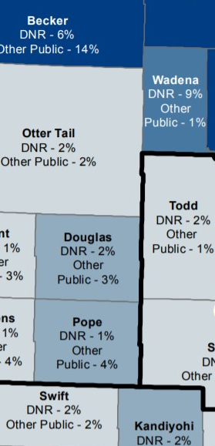
Public Lands of Minnesota by County
The Minnesota Department of Natural Resources is announcing an update to its Public Land in Minnesota Map and Dataset.
In partnership with Minnesota IT Services and Minnesota Geospatial Information Office, the map and dataset provides consistent data that can add significant value to the development of innovative strategies and approaches for Minnesota's public lands.
Notes:
The public lands dataset has also been summarized to display the percentage of public land for all 87 counties in Minnesota. The darker colors of blue indicate higher percentages of public land in a county. Explore the map for more information.
Spatial statistics were used to calculate the percentage of public ownership within each county. The analysis included dividing the acreage for each public ownership type by the acreage of the area of each county. The map provides greater knowledge of public land ownership percentage versus state-owned lands managed by the DNR.
For example, Cook County is 79% public land; however, only 14% of the total land is DNR managed and the majority is federally owned.
A critical component of successful public land conservation and management is immediate access to accurate data. This comprehensive dataset can be an important strategic planning tool for agencies.

Slide 89
Project Outcomes
Main Product: Integrated public lands, with parcel-level spatial detail, across all units of government (municipal, county, state, federal) into one single data layer, available for an annual update.
Other Products:
Public Lands of MN Map developed and maintained for staff, conservation partners, interested stakeholders, and government officials.
Public Lands of MN Dataset developed and maintained for staff, the GIS community, all state agencies, and government officials.
Metric: More accurate geometry – to the parcel level – on approximately 400,000 acres or 28,000 records of public land.
Notes:
The updated Public Lands of Minnesota Dataset groups parcels into federal, state, county fee, tax forfeit land, and municipal ownership categories. The resulting dataset is the most complete and consistently categorized statewide data for public land ownership across the state, available for an annual update. This allows users to quickly sort out federal lands from state lands and county lands with parcel-level spatial detail and display them on maps.

Slide 90
Questions, Answers, Conversation
The StoryMap is now publicly available can be accessed with this short URL: https://arcg.is/19b0Si

Slide 91
Thank You!
For more information contact:
Hal Watson, GIS Section Manager, Department of Natural Resources: 651-259-5508
Dan Ross, GIS Director, Minnesota Geospatial Information Office: 651-757-2550

Slide 92
Agenda Item 12
Legislative Update
Dan Ross

Slide 93
Agenda Item 13
Updates on GAC Priority Projects and Initiatives
Cory Richter

Slide 94
Updates on GAC Priority Projects and Initiatives
Most recent success
Experiencing a barrier?
Next task

Slide 95
GAC Priorities
Project or Initiative Description | Status | Project Owner | Champion
Parcel Data | Active | Alison Slaats | Mark Kotz
Updated and Aligned Boundary Data | Active | Preston Dowell | Dan Ross
Remonumentation of Section Corners | Active | Pat Veraguth | Dan Ross
New Lidar Acquisition | Active | Gerry Sjerven | Dan Ross
Accurate Hydro-DEMs | Active | Sean Vaughn | many
Culvert Data Standard | Active | Rick Moore | Jonathan Lord
Road Centerline Data | Active | MnGeo | Dan Ross
Address Points Data | Active | MnGeo | Dan Ross
Underground Utilities Data | Active | Steve Swazee | Barb Cederberg
Critical Infrastructure Data | Active | Stacey Stark | Steve Swazee
U.S. National Grid Materials | Active | Randy Knippel | Randy Knippel

Slide 96
GAC Priorities
Project or Initiative Description | Status | Project Owner | Champion
Image Service Improvements | Active | Alison Slaats | Dan Ross
Bikeways Data Standard | Active | Sandra Yassin
Archiving Implementation | Active | Ryan Mattke | many
Success Stories for Geospatial Technology | Active
Geospatial Commons Advisory Group | Inactive
NG911 Forum | Inactive
Basemap Services | Inactive
Parks Data Standard | Inactive
Optical, Lidar, Radar, Aerial and Satellite Imagery Strategy | Inactive
High-res Climate Projection Data | Inactive
Criminal Justice Info Best Practices | Inactive

Slide 97
GAC Priorities
Project or Initiative Description | Status | Project Owner | Champion
Licensed Businesses Data | Inactive
Snow Emergency Parking Restriction Data | Inactive
Geospatial Data Asset Inventory | Inactive
Property Crimes Data | Inactive
Street Parking Restrictions Data Standard | Inactive

Slide 98
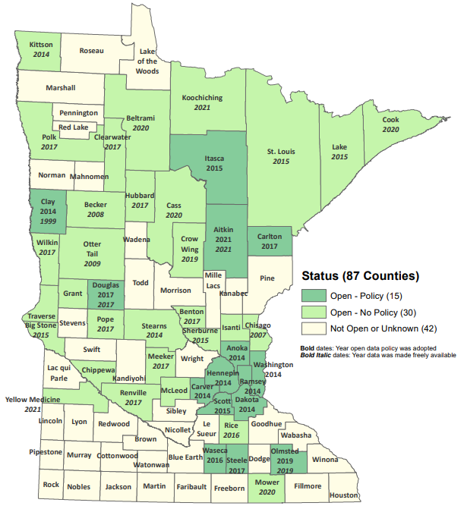
Status of Free and Open Data Public Geospatial Data
Status | Number of Counties | Total
Open - Policy | 15 | 45
Open - No Policy | 30
Not Open or Unknown | 42 | 42
Data current as of August 9, 2021
https://gisdata.mn.gov/dataset/bdry-mn-county-open-data-status

Slide 99
Statewide publicly available parcel data
Most recent success:
PLRC's open data sub-committee is actively working on many items related to parcel data and sharing
If you are experiencing a barrier:
none
Next task:
PLRC's open data sub-committee’s outreach team will be reaching out from county to county to talk about benefits of sharing data and learning more about barriers.

Slide 100
Updated and aligned boundary data
Most recent success:
Adopted definition of Boundary Alignment. Transferred data to MnGeo for the PLSS Status Map.
If you are experiencing a barrier:
Volunteer time
Next Task:
Participate and document boundary alignment in the Arrowhead in order to transition it to other areas of the state. Add more data to the PLSS Status Map.

Slide 101
Remonumentation of all section corners
Most recent success:
Working on a business case
Working on legislation
Working on letters of support (MSPS, MACS, GAC, MN GIS/LIS, County Recorders, County Engineers, AMC, MnDOT, DNR, Fish & Wildlife, Forest Service, Mn Farm Union, Corps of Engineers, MN Association of Townships, Realtors, Bar Association, Legislature)
Created a Hub for PLSS questions and answers (post link on several websites)
If you are experiencing a barrier:
Funding and Support!
Next task:
Finish business case
Finish legislation
Submit legislation for this session (find as many avenues as we can to submit legislation)
Find funding source

Slide 102
New Lidar Acquisition
See agenda item 7

Slide 103
Accurate hydro-DEMs (hDEM) that serve modern flood modeling and hydro-terrain analysis tools, and the development of more accurate watercourses and watersheds
Most recent success
If you are experiencing a barrier
Next task

Slide 104
Development of a culvert data standard for data sharing across the geospatial and infrastructure asset management communities
Most recent success
If you are experiencing a barrier
Next task

Slide 105
Road Centerline Data
Most recent success:
Internal statewide aggregation of road centerlines with address ranges to the NG911 data model
If you are experiencing a barrier:
Challenges but not barriers
Next task:
Snapping across county boundaries

Slide 106
Address Points Data
Most recent success:
Statewide aggregation of address points to the NG911 data model
If you are experiencing a barrier:
Challenges but not barriers – not currently available to provide to the public
Next task:
Statewide aggregation of updated data from authoritative sources to the GAC standard

Slide 107
A project team to develop geospatial data sharing methodologies to support the state’s underground utilities community
See agenda item 6

Slide 108
Establish a workflow for developing, sharing and maintaining statewide, publicly available, authoritative geospatial data for primary critical infrastructure themes
Most recent success
We have the fire stations ready to publish - should be up any day as a feature layer view
Alison drafted a 'resource page' on the GeoCommons for critical infrastructure
If you are experiencing a barrier
No
Next task
Communication plan for fire station layer
Consider attributes for police feature layer

Slide 109
Maps, procedures, templates and other materials to help all levels of government implement the U.S. National Grid
Most recent success
Developing a mechanism to allow anyone to register a map series and index polygons with map links for display in the SharedGeo map book application.
If you are experiencing a barrier
Time availability against other priorities is the biggest barrier
3. Next task
Next task is finishing up the one described in #1.

Slide 110
Improvements to the MnGeo Image Service, such as Web Mercator support, tiling, and complementary options such as “composite of latest leaf off imagery”, and downloading options
Most recent success:
Started work on image viewer recommended by Image Service Sustainability Committee
If you are experiencing a barrier:
Time constraints to work on recommendations of committee
Next task:
Adding county imagery from Steele, Rice and Carlton County to WMS
Follow up on recommendations of Image Service Sustainability Committee to add and retire some image layers.

Slide 111
Bikeway data standard
See agenda item 4

Slide 112
The implementation of an archive for Minnesota geospatial data
Outreach
Gathering stories for publication to MnGeo website
Presenting at GIS/LIS Conference 2021
Lightning Talk: Archiving Geospatial Data in Minnesota: Recommendations and Future Directions
Poster: The Future of Historical Data in Minnesota
Panel Discussion: What is geospatial data archiving and why is it important for Minnesota?
Pilot
Developing metadata crosswalk (MGMG to Dublin Core)
Experimenting with a test instance of a repository at the University of Minnesota
Determining how to organize and provide hierarchies for organizations, collections, and layers.

Slide 113
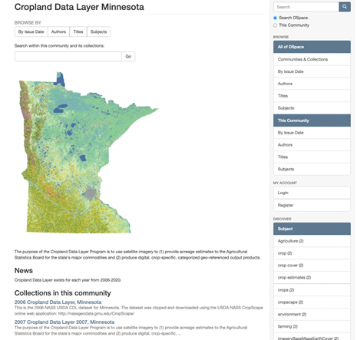
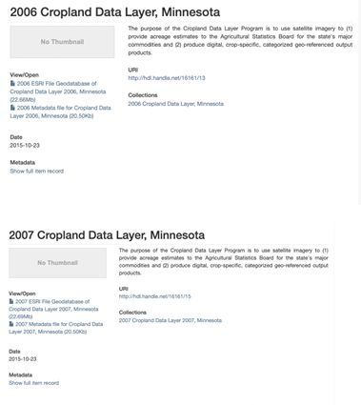
The implementation of an archive for Minnesota geospatial data

Slide 114
Agenda Item 14
Announcements

Slide 115
Next Meeting
December 15, 2021

