Slide 1



Minnesota Geospatial Advisory Council
January 19, 2022

Slide 2
Welcome and Agenda
Time | Topic
10:00 | Approve agenda Approve December 15, 2021 minutes
10:05 | MN Geospatial Priorities Survey and GAC Priorities for 2022
10:55 | Announcements
11:00 | Adjourn

Slide 3
Agenda Item 2
MN Geospatial Priorities Survey Results

Slide 4
Why Create Priorities?
To create a voice for the MN geospatial community
To direct work plans of the GAC and its committees
To advise MnGeo on needs of the community
To allow other organizations to compare priorities and align efforts
To inform outreach and policy related efforts
Having clear direction helps motivate people to participate

Slide 5
GAC Priorities Process
Create a list of proposed projects and initiatives
  From GAC members and committee chairs
  Outreach to sectors
Assess the value of each – degree of business need
  MN Geospatial Priorities Survey
Assess likelihood of success of each - owner, work team, champion, funding
Preliminary priority calculation
GAC discusses and adjusts

Slide 6
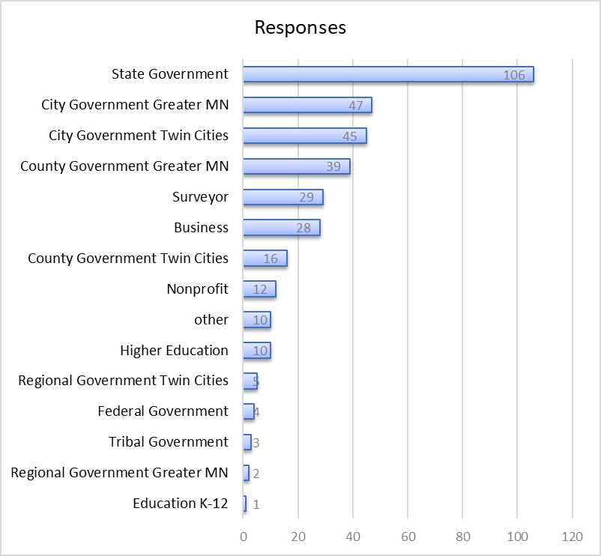
MN Geospatial Priorities Survey
357 survey responses
299 last year
+ 58 responses

Slide 7
MN Geospatial Priorities Survey
Results scoring:
  Critical = 3
  Very Important = 2
  Nice to have = 1
  Not needed or not answered = 0
Scores shown weighted and unweighted
Weighting by GAC seats representing sectors (e.g., nonprofit weight of 1 (1 seat), state government weight of 2 (2 seats))
Results are very similar weighted and unweighted

Slide 8
Project Short Name | Score Weighted by Sector | Score Not Weighted
Lidar Data | 2.095 | 1.99
Updated & Aligned Boundary Data | 2.093 | 2.03
Parcel Data | 1.959 | 1.80
Road Centerline Data | 1.870 | 1.81
Strategy Team for All Types of Imagery | 1.833 | 1.76
MnGeo Image Service Improvements | 1.790 | 1.70
Hydro-DEMs | 1.764 | 1.72
Basemap Services | 1.709 | 1.62
Critical Infrastructure Data Workflow | 1.690 | 1.67
Address Points Data | 1.681 | 1.57
Inventory of MN GeoData Assets | 1.674 | 1.55
Remonumentation of all Section Corners | 1.624 | 1.61
Geodata Archive Implementation | 1.590 | 1.55
Geospatial Commons Advisory Group | 1.559 | 1.43
NG9-1-1 Geospatial Forum | 1.500 | 1.39
Success Stories for Geospatial Technology | 1.481 | 1.34
Underground Utilities Data Sharing Team | 1.460 | 1.41
Climate Projection Data | 1.388 | 1.24
Parks Data Standard | 1.369 | 1.17
U.S. National Grid Materials | 1.356 | 1.32
State Business License Data | 1.332 | 1.21
Culvert Data Standard | 1.273 | 1.32
CJIS Data GIS Best Practices | 1.235 | 1.11
Summary Crime Data | 1.041 | 0.93
Snow Emergency Parking Data Practices | 0.938 | 0.87
Street Parking Restrictions Data Standard | 0.906 | 0.81

Slide 9
Prioritization
Value Score = Weighted survey result x 10
Likelihood of Success Score
  Project owner = 3
  Project team = 2
  Champion = 2
  Funding = 2
  Effort: low = 3, medium = 2, high = 1
Big, colorful spreadsheet

Slide 10
Project or Initiative Name | Status | Do in '22 | GAC Rank | Priority Score | Value Score | Survey Score | Success Score | Owner Exists | Work Team Exists | Active Champ Exists | $$ Exists | Est $$ | Easy Score | Effort | Priority Owner | Champ
Updated & Aligned Boundary Data | Active |  |  | 209 | 21 | 2.0935 | 10 | 3 | 2 | 2 | 2 | $0 | 1 | High | Preston Dowell | GIO
Parcel Data | Active |  |  | 196 | 20 | 1.9595 | 10 | 3 | 2 | 2 | 2 | $0 | 1 | High | Alison Slaats | Kotz
Lidar Data | Active |  |  | 189 | 21 | 2.095 | 9 | 3 | 2 | 2 | 1 |  | 1 | High | Gerry Sjerven | GIO
Road Centerline Data | Active |  |  | 187 | 19 | 1.8697 | 10 | 3 | 2 | 2 | 2 | $0 | 1 | High | MnGeo | GIO
MnGeo Image Service Improvements | Active |  |  | 179 | 18 | 1.7903 | 10 | 3 | 2 | 2 | 2 | $0 | 1 | High | Alison Slaats | GIO
Critical Infrastructure Data Workflow | Active |  |  | 169 | 17 | 1.6898 | 10 | 3 | 2 | 2 | 2 | ? | 1 | High | Stacey Stark | Swazee
Address Points Data | Active |  |  | 168 | 17 | 1.6812 | 10 | 3 | 2 | 2 | 2 | $0 | 1 | High | MnGeo | GIO
Underground Utilities Data Sharing Team | Active |  |  | 161 | 15 | 1.4602 | 11 | 3 | 2 | 2 | 2 | $0 | 2 | Med | Steve Swazee | Cederberg
U.S. National Grid Materials | Active |  |  | 149 | 14 | 1.356 | 11 | 3 | 2 | 2 | 2 | ? | 2 | Med | Randy Knippel | Knippel
Geodata Archive Implementation | Active |  |  | 143 | 16 | 1.5901 | 9 | 3 | 2 | 2 | 1 | some | 1 | High | Ryan Mattke | many
Hydro-DEMs | Active |  |  | 141 | 18 | 1.7641 | 8 | 3 | 2 | 2 |  | some | 1 | High | Sean Vaughn | Many
Culvert Data Standard | Active |  |  | 140 | 13 | 1.2725 | 11 | 3 | 2 | 2 | 2 | $0 | 2 | High | Rick Moore | Lord
Remonumentation of all Section Corners | Active |  |  | 130 | 16 | 1.6239 | 8 | 3 | 2 | 2 |  | some | 1 | High | Pat Veraguth | GIO
Success Stories for Geospatial Technology | Active |  |  | 89 | 15 | 1.4813 | 6 |  | 2 |  | 2 | $0 | 2 | Med
Geospatial Commons Advisory Group |  |  |  | 78 | 16 | 1.559 | 5 |  |  |  | 2 | $0 | 3 | Low
CJIS Data GIS Best Practices |  |  |  | 62 | 12 | 1.2354 | 5 | 3 |  |  |  | ? | 2 | Med | Britta Maddox
NG9-1-1 Geospatial Forum |  |  |  | 60 | 15 | 1.5 | 4 |  |  |  | 2 | $0 | 2 | Med
Parks Data Standard |  |  |  | 55 | 14 | 1.369 | 4 |  |  |  | 2 | $0 | 2 | Med
Summary Crime Data |  |  |  | 52 | 10 | 1.0414 | 5 | 3 |  |  |  | ? | 2 | Med | Britta Maddox
Basemap Services |  |  |  | 51 | 17 | 1.7087 | 3 |  | 2 |  |  | some | 1 | High
Strategy Team for All Types of Imagery |  |  |  | 37 | 18 | 1.8325 | 2 |  |  |  |  | $0 | 2 | Med
Climate Projection Data |  |  |  | 28 | 14 | 1.3875 | 2 |  |  |  |  | ? | 2 | Med
State Business License Data |  |  |  | 27 | 13 | 1.3317 | 2 |  |  |  |  | ? | 2 | Med
Snow Emergency Parking Data Practices |  |  |  | 19 | 9 | 0.9384 | 2 |  |  |  |  | ? | 2 | Med
Street Parking Restrictions Data Standard |  |  |  | 18 | 9 | 0.9058 | 2 |  |  |  |  | ? | 2 | Med
Inventory of MN GeoData Assets |  |  |  | 17 | 17 | 1.6737 | 1 |  |  |  |  | ? | 1 | High

Slide 11
Agenda Item 4
Announcements

Slide 12
Next Meeting
March 30, 2022

