Slide 1



Minnesota Geospatial Advisory Council
March 30, 2022

Slide 2
Welcome
Introductions
Approve agenda
Approve January minutes

Slide 3
Introductions
City, Twin Cities metro
  Cory Richter, City of Blaine
City, Greater Minnesota
  Shawn Strong, City of Brainerd
County, Twin Cities metro
  Victoria Reinhardt, Ramsey County
County, Greater Minnesota
  Patrick Veraguth, Douglas County
Regional government, Twin Cities metro
  Matt McGuire, Met Council
Regional government, Greater Minnesota
  vacant
State agencies
  Kari Geurts, DNR
  Ben Timerson, MnDOT
Federal government
  Mitch Bergeson, U.S. Geological Survey
  Jeff Bloomquist, Risk Management Agency, USDA
Tribal government
  Ryan Bonney, Shakopee Mdewakanton Sioux Community
Non-profit organizations
  Dale Watt, The Nature Conservancy
Business
  Kendis Scharenbroich, Pro-West & Associates
  Gerry Sjerven, Minnesota Power
Higher Education
  Len Kne, U-Spatial / UMN Twin Cities
  Stacey Stark, U-Spatial / UMN Duluth
K-12 Education
  vacant
MetroGIS
  David Brandt, Washington County
MN GIS/LIS Consortium
  Leanne Knott, City of Red Wing
Surveyor
  Chris Mavis, Hennepin County
At-large
  Alex Steele, Minnehaha Creek Watershed District
  Heather Bergen-Albrecht, Hennepin County
  Britta Maddox, Anoka County
1 Chief Geospatial Information Officer (ex-officio)
  TBD, MnGeo

Slide 4
Agenda
Time | Topic |  | Time | Topic
10:00 | Introductions, approve agenda and previous minutes |  | 11:05 | Lidar update
10:10 | Committee reports – Review and accept |  | 11:15 | Tribal sector report
10:20 | Award Committee update |  | 11:25 | Legislative update
10:25 | Archiving Workgroup final report |  | 11:30 | GAC priority projects and initiatives updates
10:40 | Open parcel data update |  | 11:50 | Announcements
10:50 | PLSS legislation and GAC role |  | noon | Adjourn
11:00 | Break

Slide 5
Agenda Item 2
Committee Reports – Review and Accept
All

Slide 6
Agenda Item 3
Award Committee update
Len Kne

Slide 7
Agenda Item 4
Archiving Workgroup final report
Ryan Mattke

Slide 8
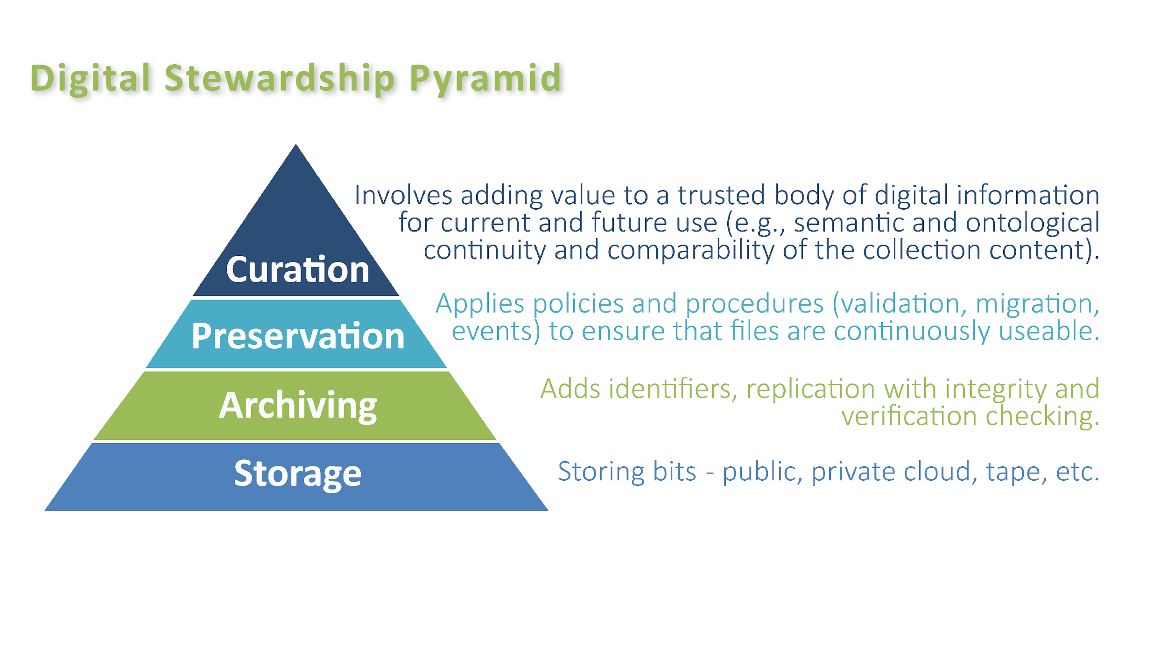
Archiving Pilot Workgroup
Mission statement:
Evaluate and test a range of potential archive technologies, create a proof of concept with sample sets of data, and continue to perform community outreach in order to build on the work of the Archiving Implementation Workgroup and the Archiving Workgroup.

Slide 9
Archiving Pilot Workgroup
Pilot Subgroup:
Sarah Barsness - Minnesota State Archives
Melinda Kernik - UMN Libraries
Carol Kussmann - UMN Libraries
Karen Majewicz - UMN Libraries (Subgroup Lead)
Zeb Thomas - MNIT / MN DNR
Outreach Subgroup:
Andra Mathews - MN DOT
Ryan Mattke - UMN Libraries (Subgroup Lead)
Nancy Rader - MNIT / MnGeo
Resource People (consulted as needed):
Jon Hoekenga - Met Council
Randy Knippel - Dakota County
Brent Lund - MNIT / MnGeo
Jesse Reinhardt - Hennepin County
Cory Richter - City of Blaine

Slide 10
Archiving Pilot Workgroup
Work Areas:
Pilot:
Evaluate and test potential archive technologies
Create a proof of concept with pilot data sets in a repository
Outreach:
Send appropriate communications in order to continue to build support for the archiving effort within these stakeholder communities: MnGeo, Government agencies at all levels, Academic researchers, Students/teachers/historians/etc through MNHS Library, All users of historic geospatial data, Higher Education, Non-profit organizations, Private sector, and Tribal nations
Deliverables (June 2021 – Jan 2022):
Technology recommendations
Ongoing Outreach & Education plan
Funding recommendations
Report
Present at 2021 MN GIS/LIS Conference

Slide 11
Archiving Pilot Workgroup
Accomplishments in 2021
Pilot – tested four software applications that could serve as discovery platforms for items in a geospatial archive: CKAN, Dspace, GeoBlacklight, Preservica

Slide 12
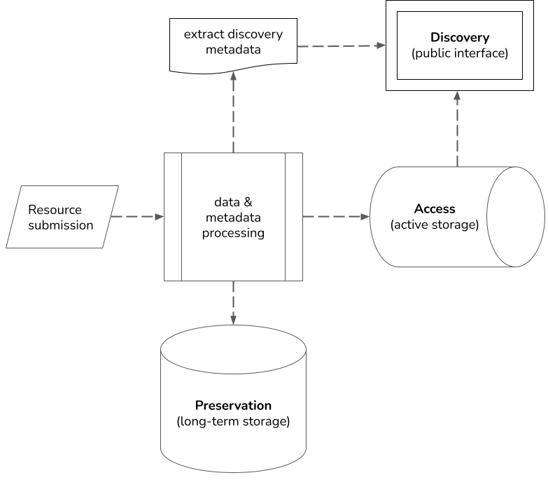
Archiving Pilot Workgroup
Repository Functions
An archive that supports both public access to spatial data resources and long-term preservation requires an infrastructure with three related but distinct functions: discovery, access, and preservation.
Chart 3. A comparison of repository functions for each application
Application | Discovery | Access | Preservation
CKAN | X | X
DSpace | X | X
Geoblacklight | X
Preservica | X | X | X
Notes:
Discovery refers to the way users find resources and know what exists. For geospatial data, this most commonly takes the form of a front-end search portal that users browse and search.
Access describes the infrastructure that provides active file storage and delivers copies of data and metadata to users. This function might be integrated into a repository application or set up separately with a file server. The server may be hosted locally or provided by a third-party using cloud storage.
Preservation includes the technology that manages multiple long-term storage copies of data and the processes needed for continual archival maintenance.

Slide 13
Archiving Pilot Workgroup
Chart 2. A comparison of selected attributes for each application
 | Geoblacklight | CKAN | Dspace | Preservica
Example installation | BTAA Geoportal | MN Geospatial Commons | UMN Digital Conservancy | MNHS Collections Online
Free, open-source tool | x | x | x
Hosted version managed as a paid service |  |  |  | x
Designed for geospatial data | x
Designed for any type of data |  | x | x
Requires in-house developers | x | x | x
High costs associated with large storage size |  |  |  | x
Easily customizable interface search options | x | x | x

Slide 14
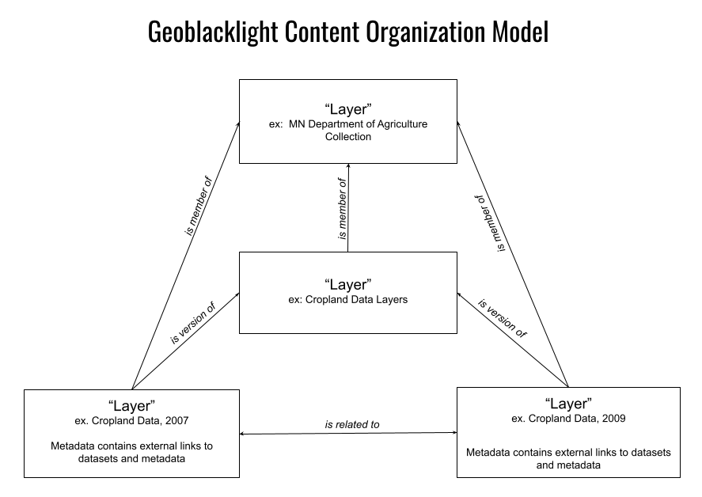
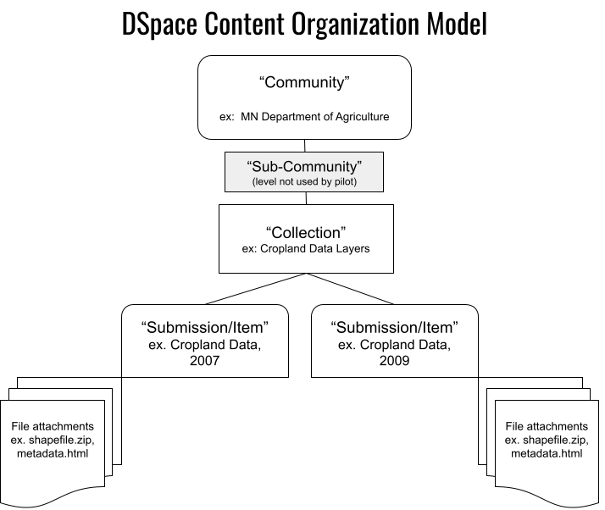
Archiving Pilot Workgroup
Content Organization
Each application we reviewed provided a slightly different way of organizing and presenting data resources.

Slide 15
Archiving Pilot Workgroup
Appendix 5. Metadata Crosswalk
This chart maps the Minnesota Geospatial Metadata Guidelines (MGMG) to Dublin Core, the metadata schema used by most discovery interfaces. Note: This is not all-inclusive, as each application may have custom fields not represented here.
Bold = mandatory; Bold Italics = Mandatory if applicable; Italics = Desirable; Plain = Optional
MGMG | Dublin Core
1.1-8.4 Title | dcterms:title
1.1-8.8.2 Publisher | dcterms:publisher
1.2.1 Abstract | dcterms:abstract
1.3 - 9.1.1 Time Period of Content Date | dcterms:temporal
Part of 1.2.3 Spatial Extent of Data | dcterms:spatial
1.3.1 Currentness Reference | dcterms:temporal
1.5.1.1 West Bounding Coordinate | dcterms:spatial
1.5.1.2 East Bounding Coordinate | dcterms:spatial
1.5.1.3 North Bounding Coordinate | dcterms:spatial
1.5.1.3 South Bounding Coordinate | dcterms:spatial
1.6.1 Theme Keywords | dcterms:subject
1.6.1.1 Theme Keyword Thesaurus | dcterms:subject
1.6.2 Place Keywords | dcterms:subject
1.7 Access Constraints | dcterms:rights
1.8 Use Constraints | dcterms:rights
2.4.1.1 Horizontal Positional Accuracy | dcterms:spatial
2.4.2.1 Vertical Positional Accuracy | dcterms:spatial
5.2.1 Entity and Attribute Overview | dcterms:description
5.2.2 Entity and Attribute Detailed Citation | dcterms:description
6.3 Distribution Liability | dcterms:rights
No equivalent | dcterms:identifier

Slide 16
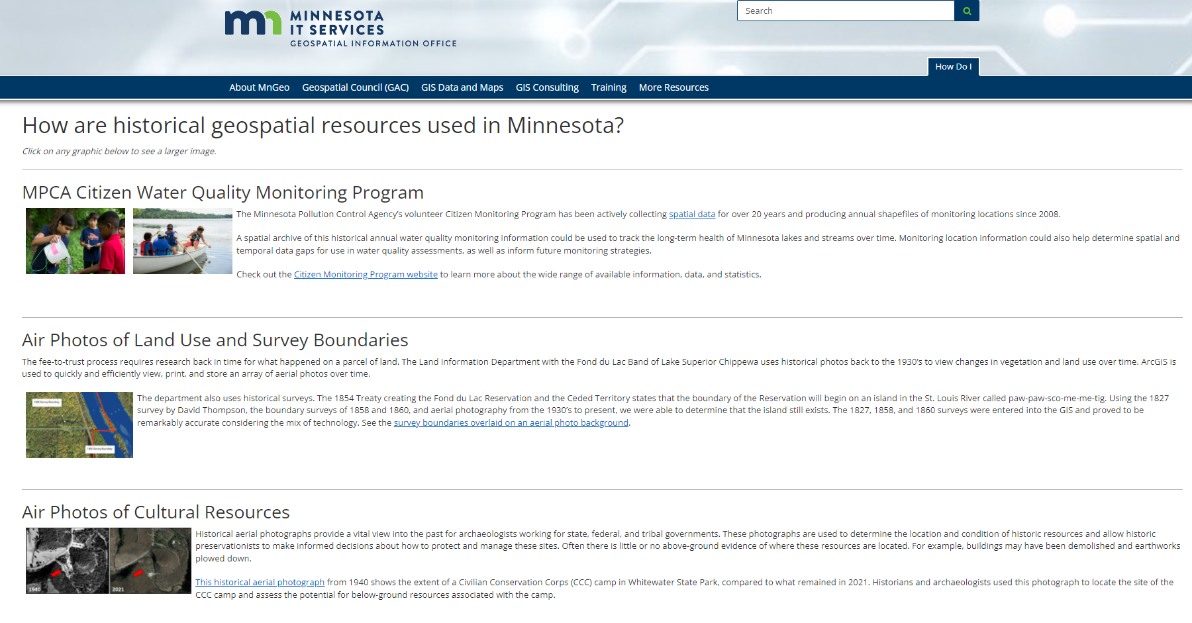
Archiving Pilot Workgroup
Accomplishments in 2021
Outreach – gathered user stories and created educational materials
Funding – Devising a plan to pursue funding

Slide 17
Archiving Pilot Workgroup
Aerial Imagery
This pilot focused on testing data pulled from the Minnesota Geospatial Commons
Aerial imagery is one of the highest priority types of data requested for the archive

Slide 18
Archiving Pilot Workgroup
Next Steps:
Convene another short-term workgroup to pilot the archiving of imagery
Determine any major differences in archiving imagery data, such as space considerations due to the size of the files
Continue to compile stories and use cases for the archive

Slide 19
Archiving Pilot Workgroup
Questions?

Slide 20
Agenda Item 5
Open parcel data subcommittee update
Ryan Stovern

Slide 21
Statewide Publicly Available Parcel Dataset Update and Proposal
Open Parcel Data Subcommittee
Parcels and Land Records Committee

Slide 22
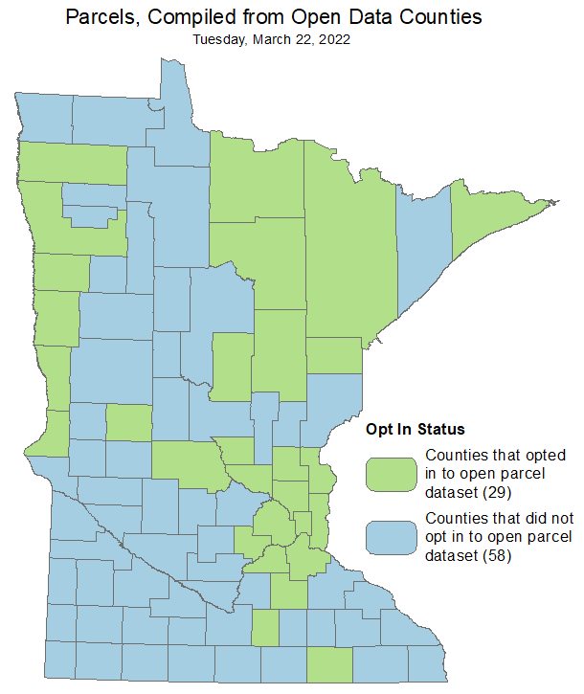
Open Parcel Data Subcommittee
Statewide Parcel Dataset currently contains 30 counties.
  Aitkin, Anoka, Benton, Carlton, Carver, Chisago, Clay, Cook, Crow Wing, Dakota, Douglas, Grant*, Hennepin, Isanti, Itasca, Koochiching, Marshall, Mower, Norman, Polk, Ramsey, Rice, Saint Louis, Scott, Sherburne, Stearns, Traverse, Waseca, Washington, Wilkin
  Grant County will be added in release next week
https://gisdata.mn.gov/dataset/plan-parcels-open
Over the course of the last few months, we have had additional counties reach out that want to be part of the statewide dataset. We knew the beginning stages of this process would be very fluid and we were needing a way to adapt to the change.
Next round of surveys have or will be going out soon.

Slide 23
Open Parcel Data Subcommittee Proposal
Motion:
The GAC will authorize the Open Data Parcel Subcommittee of the Parcels and Land Records Committee (PLRC) to provide updates to MnGeo, as needed, to add additional counties to the opt-in Statewide Compiled Public Parcel Dataset. The subcommittee will provide updates to the GAC at quarterly GAC meetings of the new counties participating in the opt-in Statewide Compiled Public Parcel Dataset.

Slide 24
Agenda Item 6
PLSS legislation
Preston Dowell, Parcels and Land Records Committee Chair
Notes:
Introductions

Slide 25
PLSS Legislation
2022 GAC Priority
Remonumentation of all Section Corners
Supports Boundary Alignment priority
Learn more at https://mnplss-umn.hub.arcgis.com/

Slide 26
PLSS Legislation
Introduced by Senator Johnson Stewart as SF 4037, Senator Bakk is also a co-author
  https://www.revisor.mn.gov/bills/bill.php?b=senate&ssn=0&y=2021&f=sf4037
Companion bill in the House was Authored by Representative Anderson as HF 4456
  https://www.revisor.mn.gov/bills/bill.php?f=HF4456&y=2022&ssn=0&b=house
Both referred to State Government Finance and Policy and Elections Committees

Slide 27
PLSS Legislation
Grant program managed by MNIT and the GAC
Requires remonumentation of the PLSS according to statute 381.12
Grant criteria must favor counties that demonstrate financial need
$10,000,000 per year for 34 years in dedicated funding to the remonumentation grant program
$1,000,000 per year for 34 years is dedicated for hiring of technical staff to help implement the program.

Slide 28
PLSS Legislation
March 25: Committees to act favorably on bills in the house of origin
April 1: Committees to act favorably on bills, or companions of bills, that met the first deadline in the other house
Alternative commission being considered
Unlikely to pass this year due to late introduction, but it is still possible to be brought into an omnibus bill
If it does not pass this year, we are ready to introduce it again next year

Slide 29
PLSS Legislation
Contact your local Senators and Representatives
Legislators respond more favorably to local constituents
Template Letter of Support can be found on
  https://mnplss-umn.hub.arcgis.com/
Register and promote the Meet Me at The Corner Event
  May 4th, Spicer, MN
  https://mnplss-umn.hub.arcgis.com/pages/mmatc

Slide 30
PLSS Legislation
If bill becomes law, GAC will need to establish a standing committee as specified in the bill
  “The chief geospatial information officer, through the Geospatial Advisory Council established under section 16E.30, subdivision 8, shall work with the stakeholders licensed as land surveyors under section 326.02, to develop a process for accepting applications from counties for funding for the perpetuation of monuments established by the United States in the public lands survey to mark public land survey corners, as provided in section 381.12, subdivision 2, clause (1).”
Existing Parcels and Land Records Remonumentation Subcommittee can be transitioned

Slide 31

Break

Slide 32
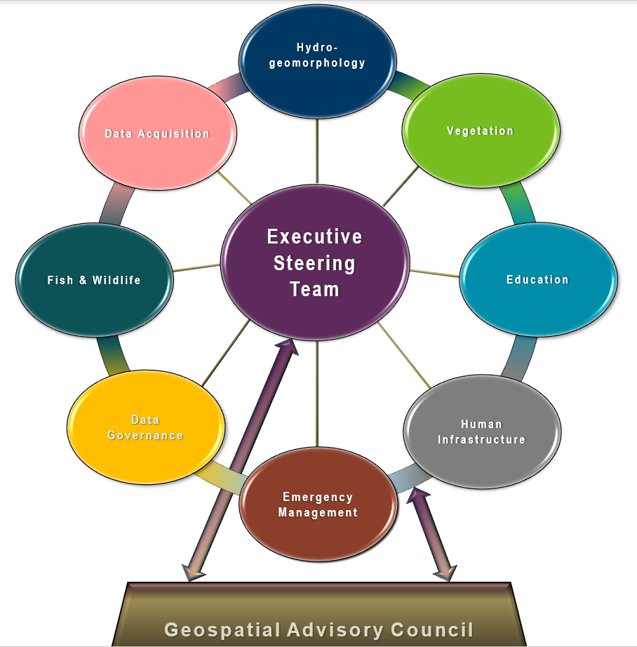
Lidar Update – Agenda Item 8
3DGeo Cochairs:
Sean Vaughn, GIS Hydrologist | Lidar Data Steward, MNIT DNR, Co-Chair 3D Geomatics Committee, Acquisition Workgroup Champion
Gerry Sjerven, Senior GIS Analyst, Minnesota Power, Co-Chair 3D Geomatics Committee, Acquisition Workgroup Champion
Notes:
Gerry - Intro

Slide 33

3DGeo - Data Acquisition Workgroup
Mission:
The Data Acquisition Workgroup promotes procurement of foundational 3D data for Minnesota.
Co-Chairs
Sean Vaughn, Alison Slaats, and Gerry Sjerven
Lidar Acquisition Subgroup:
Alison Slaats (MnGeo), Sean Vaughn (MNIT DNR), Gerry Sjerven (MN Power), Dan Ross, Jennifer Corcoran (DNR), Colin Lee (MnDOT), Matt Baltes (NRCS), Joel Nelson (U of MN), Joe Sapletal (Dakota Co), Mark Reineke (Widseth), Brandon Krumwiede (NOAA), Jeff Weiss (DNR), and Terry Zien (USACE).
Notes:
Sector Expertise
Lidar acquisition relies on subject matter expertise from different sectors in 3DGeo

Slide 34
3D Geomatics Data Acquisition Team - Coordinators
Established 3DGeo Data Acquisition Team - LAB Coordinators
  Help steer activities and responsibilities of their assigned LAB
MN 3DGeo LAA (Region of MN) | MN 3DGeo LAB (HUC4 Watersheds & Counties) | 3DGeo LAB Coordinator (USGS - 3DEP Technical Contact)
Northeast Forested | Rainy Lake | Jennifer Corcoran
Northeast Forested | Lake Superior | Jennifer Corcoran
North Central Lakes | Upper Mississippi | Gerry Sjerven
MN River West | Central Mississippi | Joe Sapletal
Southwest Ag | Douglas County | Mark Reineke
Northwest RRB | Becker County/Otter Tail | Sean Vaughn
Northwest RRB | Red River | Gerry Sjerven Mark Reineke Sean Vaughn
Southeast Driftless | Lower Mississippi | Sean Vaughn Secondary Contact: Jennifer Corcoran
Southwest Agriculture | Missouri-Big Sioux | Jennifer Corcoran Secondary Contact: Sean Vaughn
Southwest Agriculture | Minnesota River West | TBD
Southwest Agriculture | Minnesota River East | TBD
Notes:
Additional classes available for the point cloud: 3 - Low vegetation; 4 - Medium Vegetation (use for single vegetation class); 5 - High Vegetation; 6 - Buildings, other man-made structures; n - Additional classes or features as agreed upon in advance.

Slide 35




3D Geomatics Data Acquisition Team - Coordinators
2. Defined the 3DGeo Data Acquisition Team LAB Financial Coordinator
Alison Slaats - responsibilities encompass BAA application coordination and executive signature, establishment JPAs, IAAs, and JFAs and executive signature, as well as coordination with MNIT Procurement, MNIT Finance, funding partners contacts and their respective financial departments
Notes:
Additional classes available for the point cloud: 3 - Low vegetation; 4 - Medium Vegetation (use for single vegetation class); 5 - High Vegetation; 6 - Buildings, other man-made structures; n - Additional classes or features as agreed upon in advance.

Slide 36
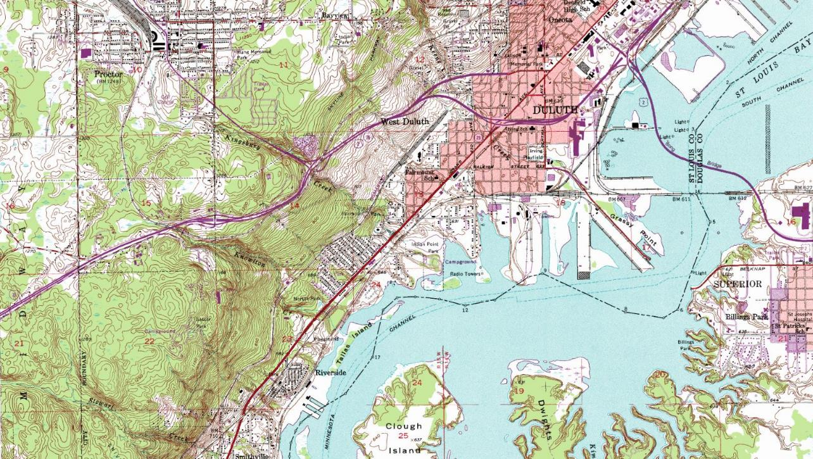
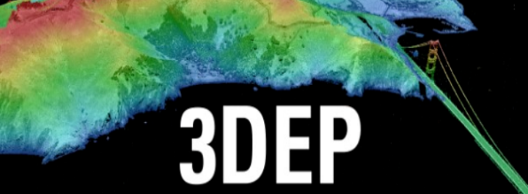
3DEP
(Federal Coordination and Grant)
Notes:
This background image depicts a standard USGS 24k Topograpic Map. The USGS has come a long way…

Slide 37
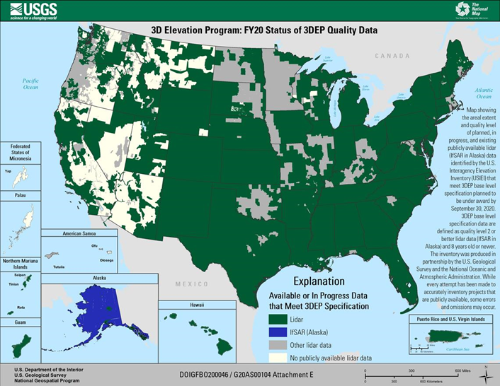
USGS 3D Elevation Program (3DEP)
3D Elevation Program (3DEP)
Systematically guiding the collection of 3D elevation data in the form of lidar data for the United States, and the U.S. territories
Broad Agency Announcement (BAA)
Grant coordinating mechanism 3DEP
Guides partnerships between the USGS and other Federal agencies with other public and private entities seeking high-quality 3D lidar elevation data acquisition.
2022 Submission Due October 1

Slide 38




3D Geomatics: Funding, Agreements, and Acquisition
Contributions to Minnesota Lidar ($millions)
Minnesota Partners: $ 6.05
USGS 3DEP: $11.60
Other Federal $ 0.45
Total: $18.09M
Minnesota Funding Partners
48 Funding Partners
51,405 Square Miles of New Lidar
$118* Cost/mi² For MN Partners
MNIT Services is the Fiscal Agent
  MnGeo is establishing funding agreements with all local funding partners
  MnGeo establishes individual funding agreements with USGS 3DEP for each of the 3DGeo lidar acquisition blocks
* Estimated cost per square mile paid by 48 unique Minnesota funding partners working collaboratively for consistent lidar data acquisition. Value: 1) is not specific to a 3DGeo Lidar Acquisition Block, 2) is based on total Minnesota partner contributions of $6,053,761.44 (03/28/2022), 3) does not include federal contributions.
Notes:
Additional classes available for the point cloud: 3 - Low vegetation; 4 - Medium Vegetation (use for single vegetation class); 5 - High Vegetation; 6 - Buildings, other man-made structures; n - Additional classes or features as agreed upon in advance.

Slide 39
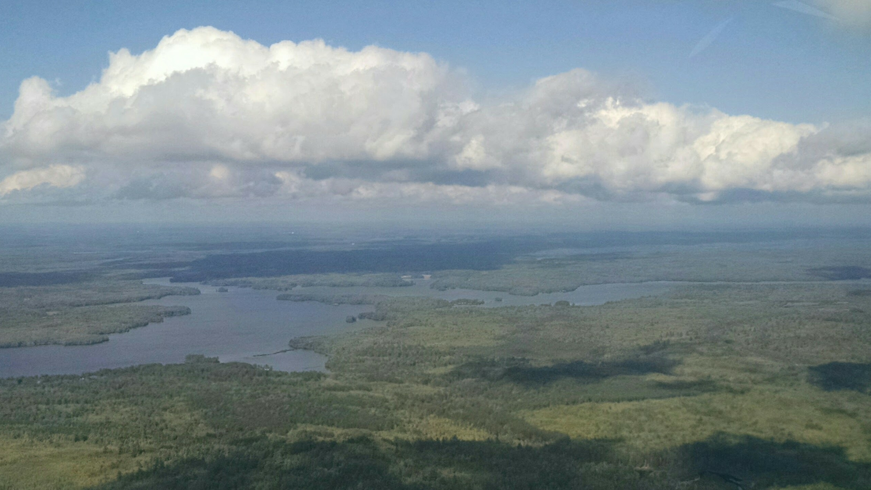
Lidar
Collect
Notes:
THIS is where we are going next – or rather the aircraft collectiong high density lidar will be going. This picture was taken during a reconnaissance flight for acquisition planning for the high density lidar that was acquired in Lake County in 2018.

Slide 40
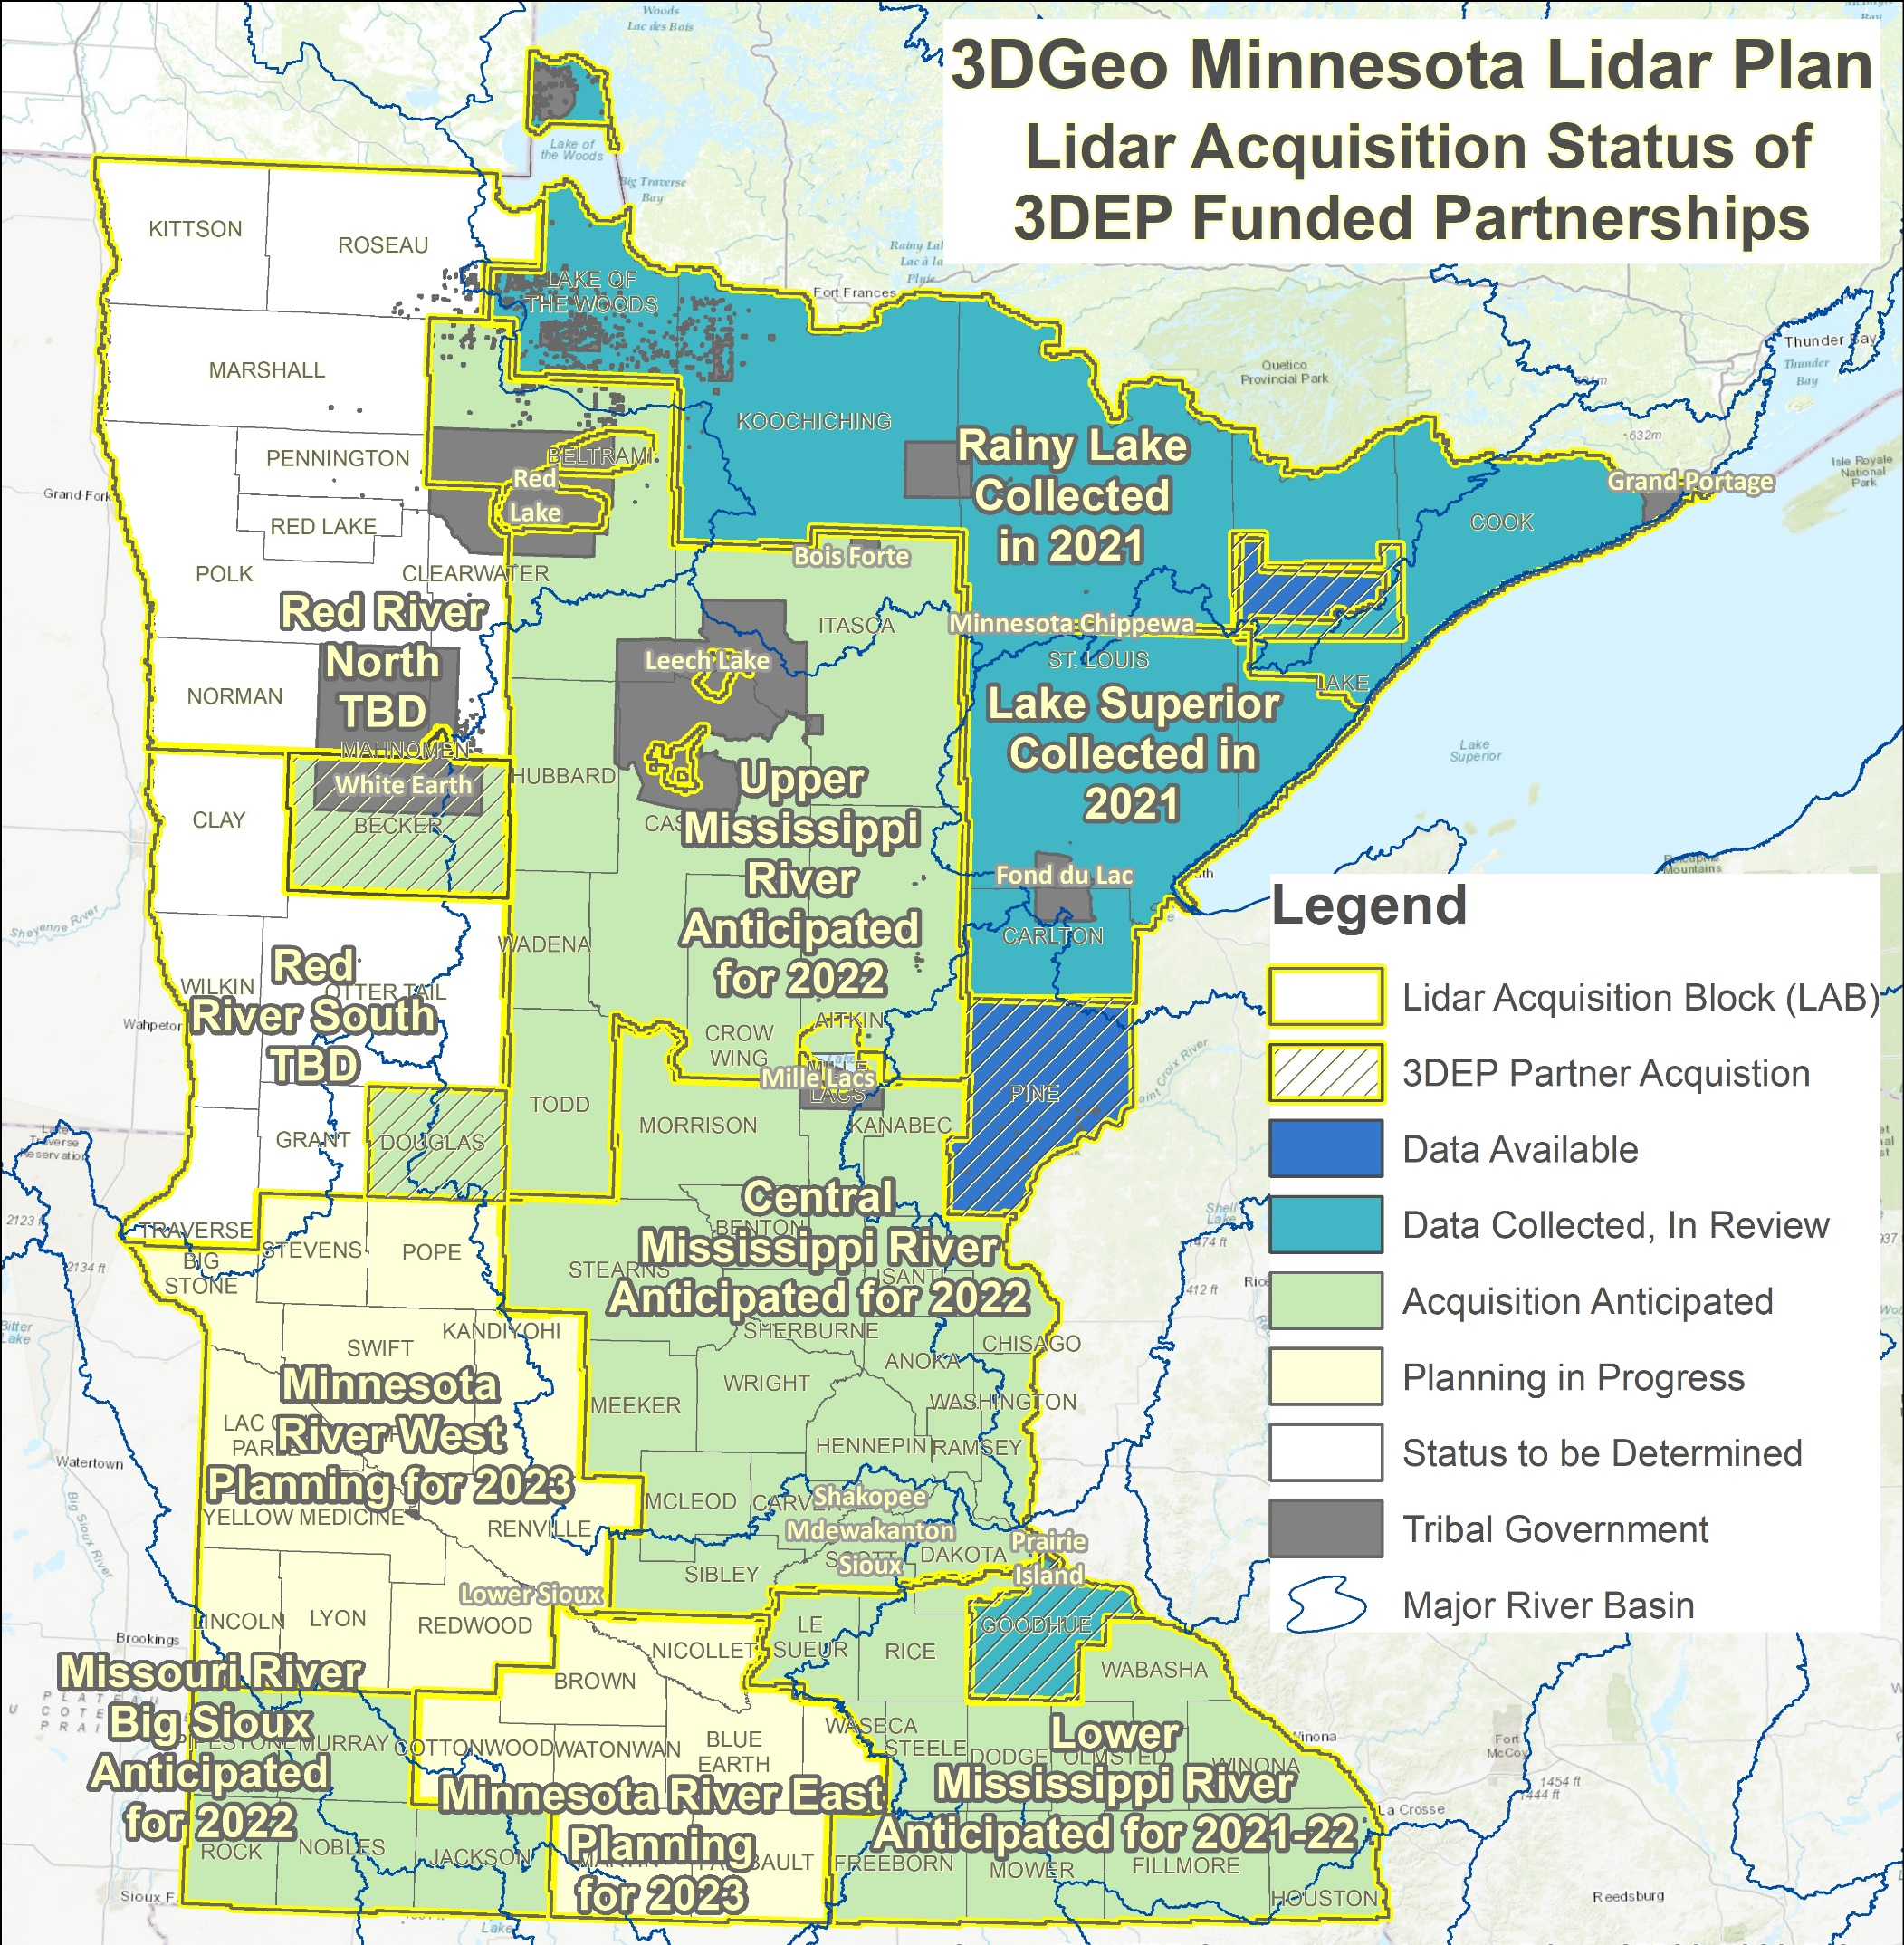
MN Lidar Status Map
Rainy Lake and Lake Superior data expected late spring 2022
  10 funding partners
  Data will be made available soon as possible, please withhold data requests until we announce its availability
Spring 2022 Acquisition – 6 Projects
  Lower Miss (SE) and Missouri/Big Sioux (SW)
    14 funding partners
    Partial 2021 data acquisition in SE
  Upper Mississippi and Central Mississippi
    35 funding partners
  Becker County/Otter Tail
  Douglas County

Slide 41
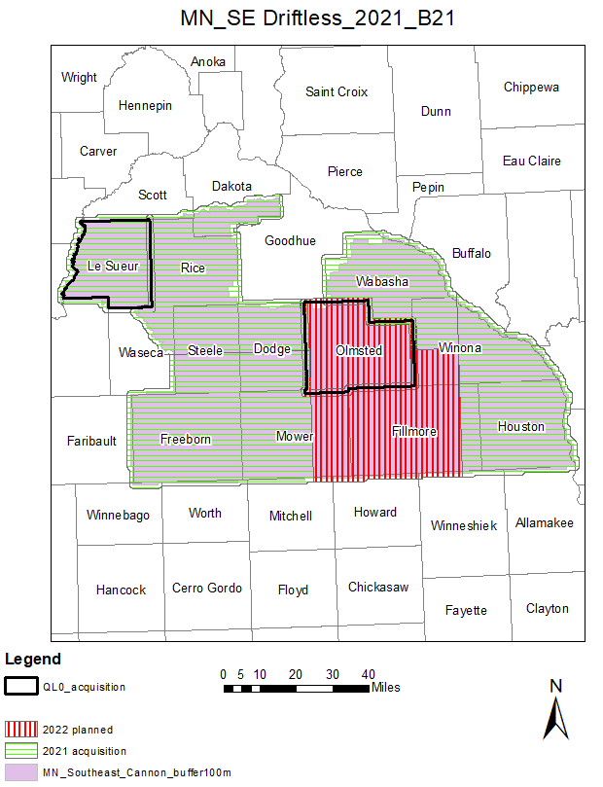
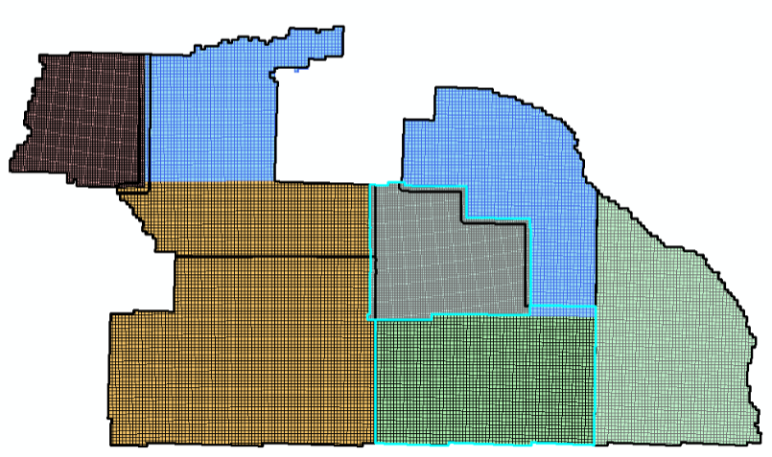
Lidar Acquisition: Southern BAA – Missouri Big Sioux & SE Driftless Blocks
Description
Two areas of Pilot Data have been received for review.
Collection was outside of contract, but vendor understands lidar base specification and the QC the data must meet for certification
QL0 Counties
  ASPRS Compliant QL0 Lidar
  Will meet 1.67 cm RMSEz Non-veg accuracy for check points
Le Sueur
Olmsted

Slide 42
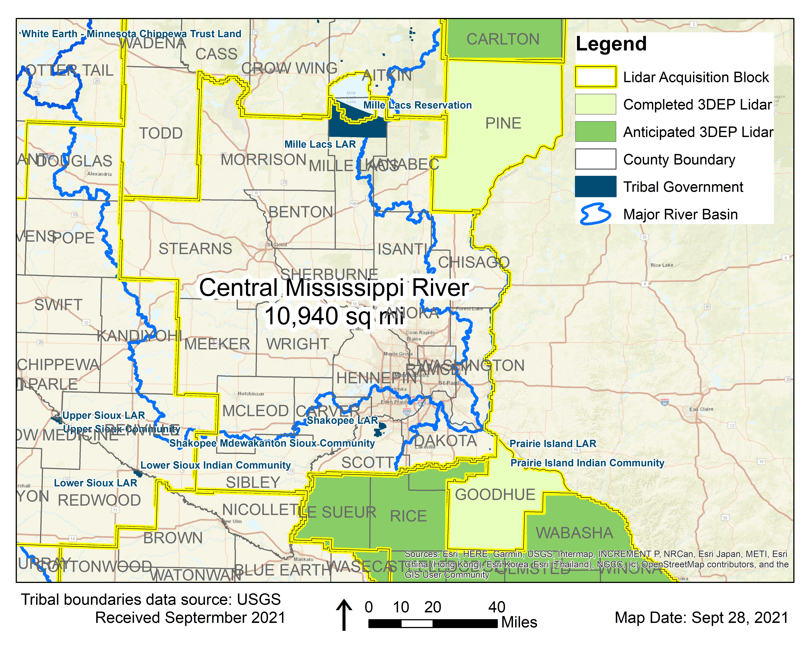
3DGeo Outreach: Central Mississippi River (Metro) Block
Contributing Partners
14 of the 19 counties
1 private company
NRCS
DNR, MnDOT, MnGeo
Estimated USGS 3DEP Contribution |  | Total Partner Contributions Needed
% | $ | % | $
40% | $1,425,320 | 60% | $2,137,980
10,940 square miles at $325.71 per square mile = $3,563,300 TOTAL
Notes:
TOTAL Est Funds Needed: $ 3,563,300
Estimated using $325.71 per square mile for QL1
19 Counties* - 10,940 square miles

Slide 43
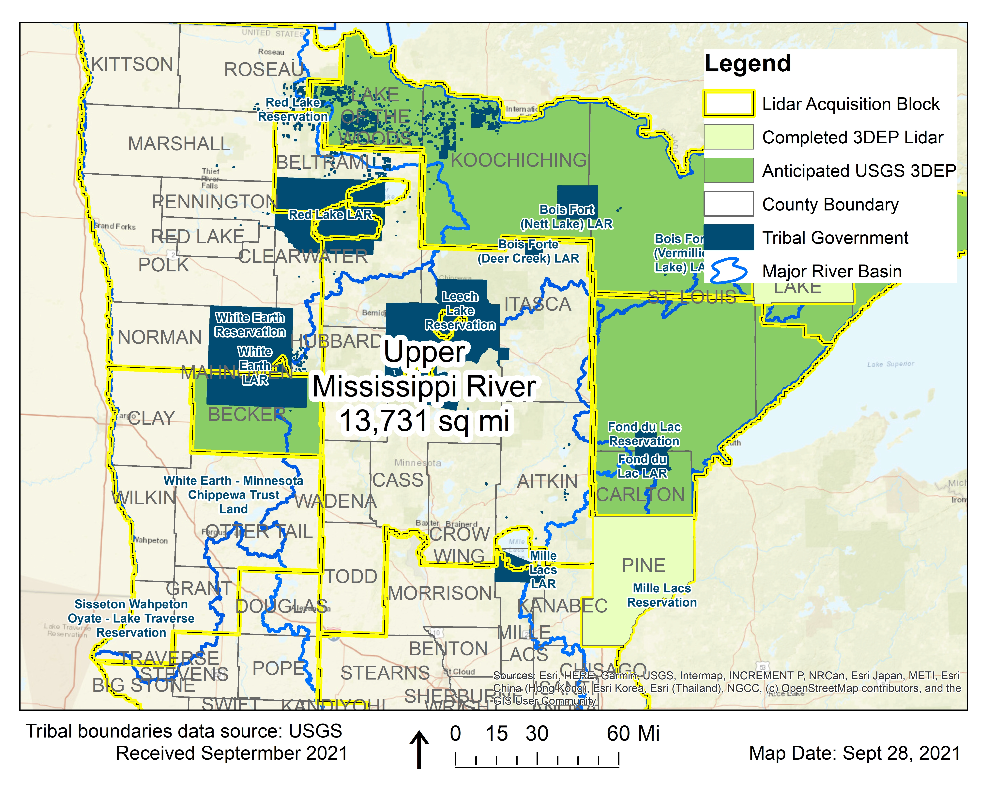
3DGeo Outreach: Upper Mississippi River (Central Lakes) Block
Contributing Partners
5 of the 8 counties
Leech Lake and Bureau of Indian Affairs
NRCS, Chippewa National Forest
DNR, MnDOT, MnGeo
Estimated USGS 3DEP Contribution |  | Total Partner Contributions Needed
% | $ | % | $
40% | $1,780,361 | 60% | $2,670,542
13,731 square miles Estimated at $324.15 per square mile = $4,450,903.65 TOTAL
Notes:
TOTAL Est Funds Needed: $ 4,450,903.65
Estimated using $324.15 per square mile for QL1
8 Counties* - 13,731 square miles

Slide 44
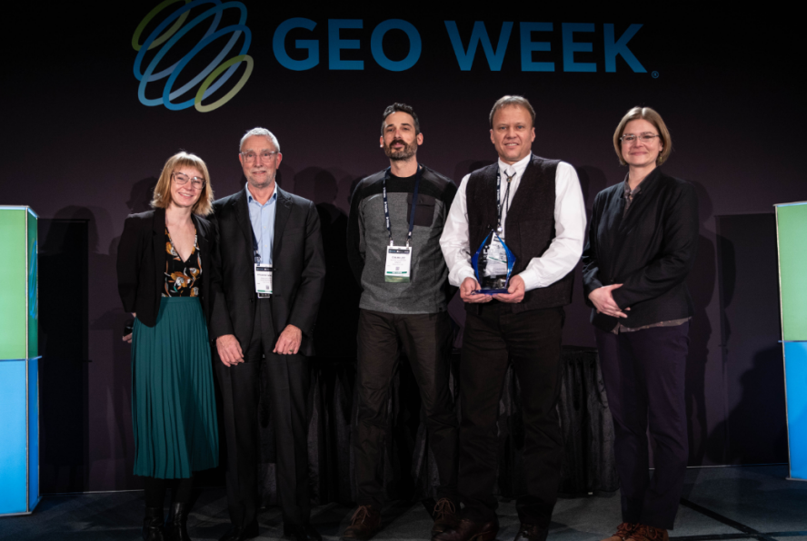

3D Geomatics Geo Week Award - Outstanding Team Achievement in Lidar
Award recognized by a partnership between LIDAR Magazine, Lidar News, and ASPRS, the Geo Week Awards honor the achievements of individuals and teams working in the geospatial technology industry.
Outstanding Team Achievement in Lidar award is given to teams who have demonstrated a unique achievement in the area of service, project management, product development or other specialty.
  Award states: The 3D Geomatics Committee of the Minnesota Geospatial Advisory Council works to identify and promote the need for planning, funding, acquisition, and management of three-dimensional geomatic data and derived products. The success of 3DGeo is built on a collaborative community, working together to coordinate fundraising and education to achieve the common goal of acquiring high-density lidar statewide.
Minnesota 3D Geomatics Committee recognized for team-managed, partner-based lidar acquisition. Award Presentation: Lora Burns - Geo Week, Stewart Walker – Lidar Magazine | Award Recipients: Colin Lee, Sean Vaughn, Jennifer Corcoran – 3D Geomatics Committee (left to right)

Slide 45

3D Geomatics Geo Week Award - Outstanding Team Achievement in Lidar
Outstanding Team Achievement in Lidar
Geo Week - February 6 – 8, 2022 - Denver, Colorado
Intersection of 3D technologies representing the geospatial and built worlds came together for one conference representing:
  AEC Next - Architecture, Engineering, and Construction (AEC) Next Technology Expo & Conference
  ILMF - International Lidar Mapping Forum
  SPAR 3D - Expo & Conference
    ASPRS Annual Conference
    MAPPS Annual Winter Conference
    USIBD Annual Symposium

Slide 46
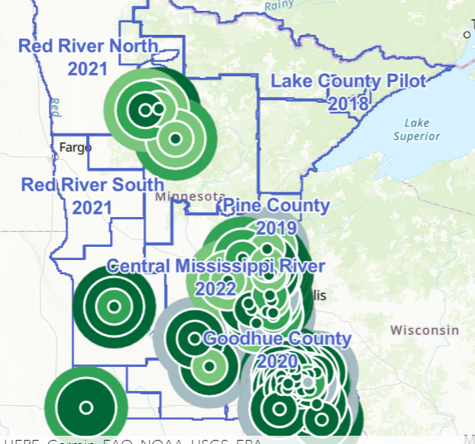

3DGeo - CONDITIONS REPORTING TOOL
3DGeo created a crowdsourcing tool that uses ArcGIS Survey123 to track conditions of ice, vegetation, and the ground in support of timing and coordinating lidar data procurement throughout 3DGeo lidar acquisition blocks (LAB).
App
  Conditions entry
  Install the app on a mobile device by clicking on this link https://arcg.is/1KDOyP or scanning the QR Code:
Dashboard
  Information collected is shared in a dashboard that allows cooperators to monitor changing conditions.
  https://smarturl.it/3DGeoLidarDashboard

Slide 47
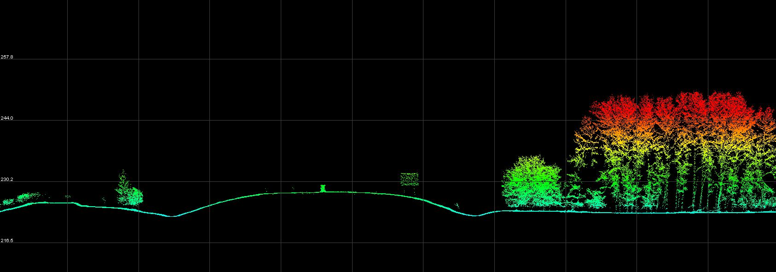
HD Lidar Examples: Hydrography & Infrastructure
Feature Extraction | High Density Lidar ≥30-point/m² | Le Sueur County Lidar Data Collection 2021
Notes:
GIS results provided by Rick Moore
MnDOT Accuracy Test Results
Evaluation of High-Density Quality Level – 0 (HD QL0)
2020 Goodhue County Lidar Procurement Project
3DGeomatics Lidar Acquisition Team Member Colin Lee (MnDOT Photogrammetrist) and MnDOT surveyors from the District-6 office analyzed a sample of high-density quality level-0 (HD QL0), lidar point cloud data (~30 point per square meter) from the 2020 Goodhue County lidar data acquisition.
HD QL0 Criteria
Standard QL0 ≥ 8.0 Pulse Density (ANPD) [pulse/m²]
High Density QL0 ≥ 30+ Points/ m² (exceeds minimum base spec for QL0 with a work order defined additional amount of points equal to or greater than 30 points per sq meter [suggested description described as HD QL0 or HD QL0-30])
Results
Test points represent open, hard, smooth surfaces.
The test results are showing that 90% of the lidar points evaluated have elevation values within 0.033 (ft) to 0.066 (ft) of actual, onsite, vertical survey results.
As expected, a few outliers are falling up to 0.30 (ft) outside of the 90% distribution
Unit Conversion
Converting these results to centimeters, we see that the vertical accuracy of this HD QL0-30 lidar data is within 1.0 (cm) to 2.0 (cm) of onsite, vertical survey results.
These values are better than the minimum lidar base specification of ≤ 0.03 m (≤ 3.0 cm / 1.181 in).
0.033 ft = 0.396 inches = 1.00584 cm
0.066 ft = 0.792 inches = 2.01168 cm
Disclaimer
All publicly funded QL-0 lidar acquisitions must adhere to the USGS Lidar Base Specification vertical accuracy, pulse spacing and density criteria. Although the 2020 Goodhue County QL0 lidar data procurement project collected Quality Level 0 (QL0), Non-vegetated vertical accuracy RMSEz = 5.0 cm as defined by USGS Lidar Base Specifications, the statement of work (SOW) was unique, it specified the acquisition collect lidar points at 30 points per square meter nominal pulsed density.
The Goodhue SOW stated:
Aggregate Nominal Pulse Spacing (ANPS) (m) ≤0.35
Aggregate Nominal Pulse Density (NPD) (pls/m2) ≥ 8.0
DEM cell size (minimum) = 1.5m /1 foot
Point cloud deliverable must ≥30

Slide 48
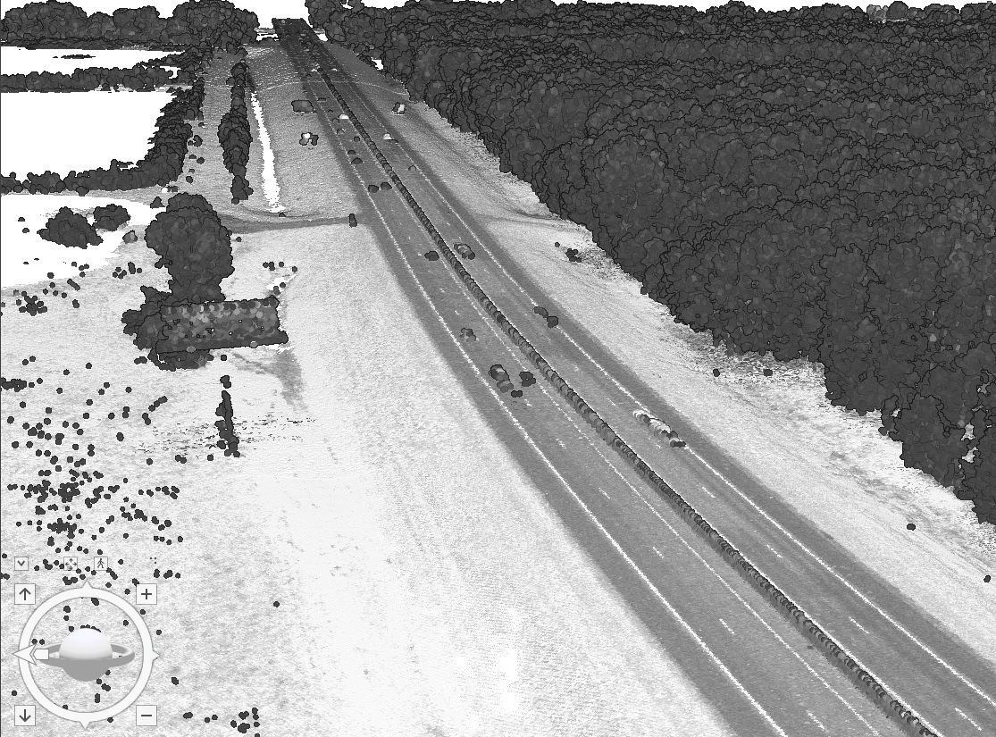
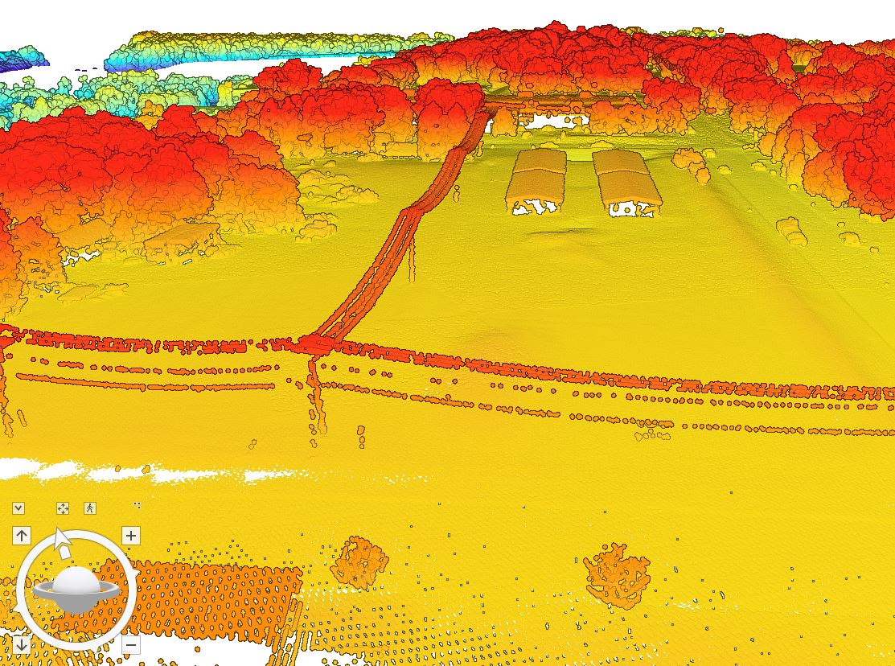
HD Lidar Examples: Hydrography & Infrastructure
Infrastructure | High Density Lidar ≥30-point/m² | Le Sueur County Lidar Data Collection 2021
Lidar Point Cloud Intensity Classification
Lidar Point Cloud Elevation Classification
Notes:
GIS results provided by Rick Moore
MnDOT Accuracy Test Results
Evaluation of High-Density Quality Level – 0 (HD QL0)
2020 Goodhue County Lidar Procurement Project
3DGeomatics Lidar Acquisition Team Member Colin Lee (MnDOT Photogrammetrist) and MnDOT surveyors from the District-6 office analyzed a sample of high-density quality level-0 (HD QL0), lidar point cloud data (~30 point per square meter) from the 2020 Goodhue County lidar data acquisition.
HD QL0 Criteria
Standard QL0 ≥ 8.0 Pulse Density (ANPD) [pulse/m²]
High Density QL0 ≥ 30+ Points/ m² (exceeds minimum base spec for QL0 with a work order defined additional amount of points equal to or greater than 30 points per sq meter [suggested description described as HD QL0 or HD QL0-30])
Results
Test points represent open, hard, smooth surfaces.
The test results are showing that 90% of the lidar points evaluated have elevation values within 0.033 (ft) to 0.066 (ft) of actual, onsite, vertical survey results.
As expected, a few outliers are falling up to 0.30 (ft) outside of the 90% distribution
Unit Conversion
Converting these results to centimeters, we see that the vertical accuracy of this HD QL0-30 lidar data is within 1.0 (cm) to 2.0 (cm) of onsite, vertical survey results.
These values are better than the minimum lidar base specification of ≤ 0.03 m (≤ 3.0 cm / 1.181 in).
0.033 ft = 0.396 inches = 1.00584 cm
0.066 ft = 0.792 inches = 2.01168 cm
Disclaimer
All publicly funded QL-0 lidar acquisitions must adhere to the USGS Lidar Base Specification vertical accuracy, pulse spacing and density criteria. Although the 2020 Goodhue County QL0 lidar data procurement project collected Quality Level 0 (QL0), Non-vegetated vertical accuracy RMSEz = 5.0 cm as defined by USGS Lidar Base Specifications, the statement of work (SOW) was unique, it specified the acquisition collect lidar points at 30 points per square meter nominal pulsed density.
The Goodhue SOW stated:
Aggregate Nominal Pulse Spacing (ANPS) (m) ≤0.35
Aggregate Nominal Pulse Density (NPD) (pls/m2) ≥ 8.0
DEM cell size (minimum) = 1.5m /1 foot
Point cloud deliverable must ≥30

Slide 49
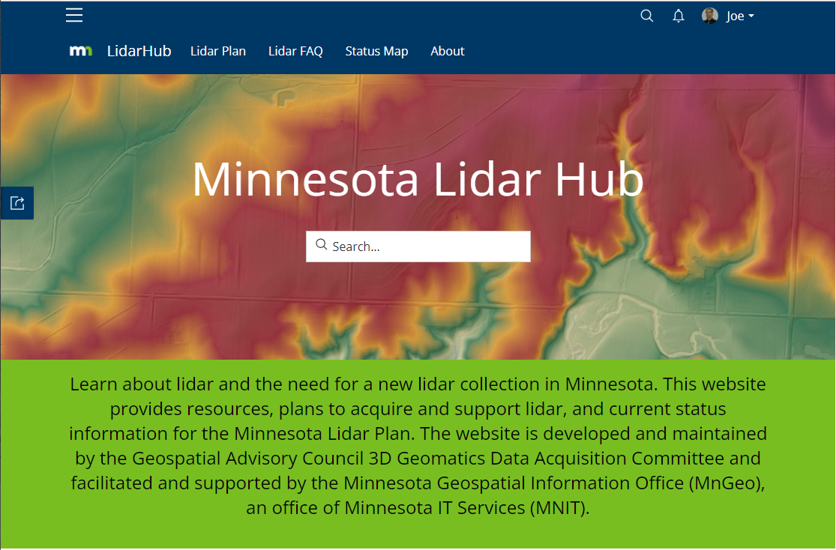
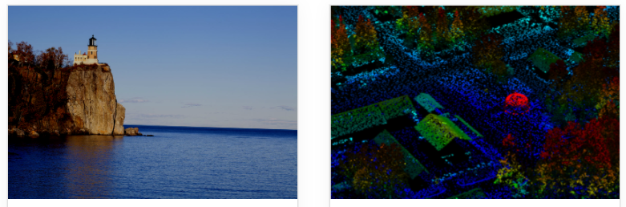
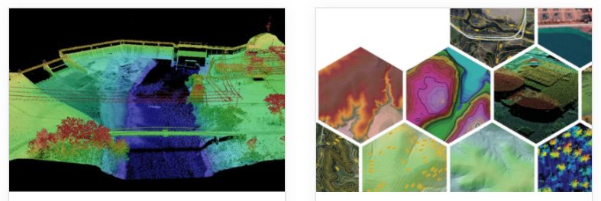
Minnesota Lidar Hub
Lidar Hub
Serves as our lidar information portal
Visit often for updates
https://lidarhub-minnesota.hub.arcgis.com/

Slide 50

How:
You can Help

Slide 51


Next steps
You don't have to have money or be a decision maker to be a stakeholder . . .
You can be a voice of support . . .
A collaborator
You
Transportation Engineer
Dam Engineer
Forester
Engineer
Surveyor
GIS Specialist
GIS Manager
Assessor
Natural Resource Specialist
3D Geo
Partners are NEEDED to help fund lidar acquisition!!
Notes:
Sean’s email to Empower stakeholder who can’t bring money but can bring and promote a voice of support for why new HD lidar is needed.
Joes response - We (3DGeo) is the trunk of the tree (Joe’s analogy)

Slide 52
Agenda Item 9
Tribal Sector Report
Ryan Bonney

Slide 53
Where do Minnesota Tribes Sit with GIS?
Geospatial Advisory Council Tribal Sector Update
Ryan Bonney – Tribal Representative

Slide 54

HELLO!
I am Ryan Bonney
Here to give a brief update on how Minnesota Tribes are doing in GIS and what it means for GAC

Slide 55

Getting a read on MN tribes
Trying to get a read on all MN tribes is hard…
Each is dealing with different challenges
I sent out a Poll
if and how your tribe is currently utilizing GIS?
What are your biggest GIS concerns
what are your biggest GIS needs
Are you familiar with any of the GIS offerings (such as open data, or web applications) from MnGeo?
If so ^^, do you have any criticism or kudo’s you’d like me to share?
More info on how to use this template at www.slidescarnival.com/help-use-presentation-template
This template is free to use under Creative Commons Attribution license. You can keep the Credits slide or mention SlidesCarnival and other resources used in a slide footer.

Slide 56

1. So what did they say?
Let’s look at the results

Slide 57
Responses

Slide 58
Responses

Slide 59

My biggest GIS concern is being able to keep up with the technology and know that I'm utilizing what's available to us in the best ways possible.
I'm not an IT person, and our IT department isn't always super helpful, so sometimes I feel a little lost on that end of it. For example, I know we have Enterprise available to us through BOGS, but I don't utilize it because I lack the IT knowledge to get it set up. And I don't even know if it's something that would benefit us.

Slide 60
Responses

Slide 61
One of the biggest needs here in NW/NC MN would be new high res imagery similar to the High Resolution Orthoimagery, 1/2 meter resolution, flown in EC and SE MN couple years ago.
I think tribes in NW/N/NE MN could greatly benefit in having new peak fall high resolution imagery like the above datasets on the MN Geo Commons website. [We] had to pay for the 2010 peak fall infrared imagery collected from the MN DNR Forestry Office several years ago....

Slide 62
Responses

Slide 63
I use the geospatial commons frequently to download data, and the WMS services for imagery.
Lately, I find myself going to the MN Natural Resources Atlas before the Commons. I like the way you can visualize the data on a map first to see if it's actually what you need before downloading it. It's also nice to be able to do some quick analyses on it.

Slide 64

What is SMSC doing?
State of GIS at SMSC

Slide 65
Staffing / GIS users
GIS Admin – Ryan Bonney
GIS Dept – 1 just me ☺
~5 staff utilizing ArcPro casually
Numerous people using AGOL

Slide 66
Cartography / Normal GIS
Mapping
Real Estate
Natural Resources
Cultural
Infrastructure

Slide 67

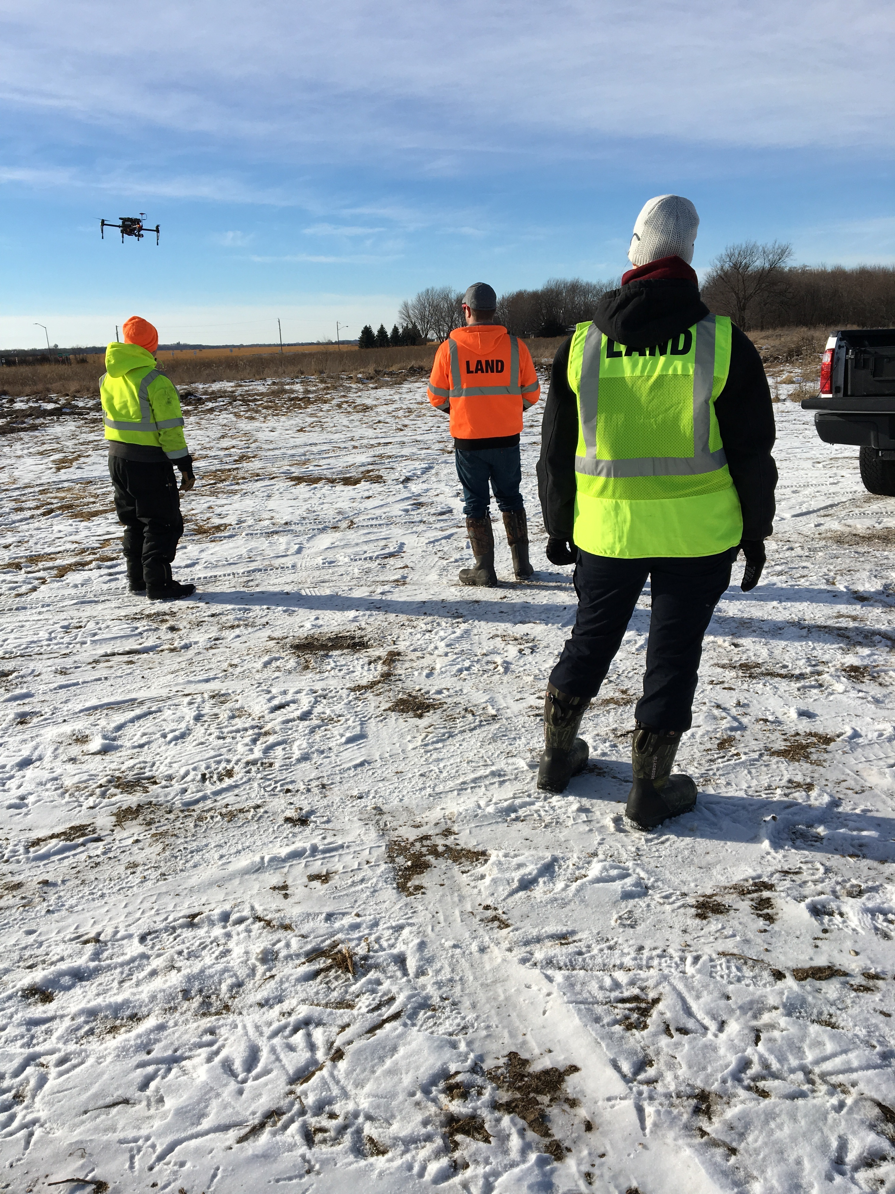
Remote Sensing
  Extensive UAV program
  LiDAR
  Multispectral
  Optical
  Thermal

Slide 68
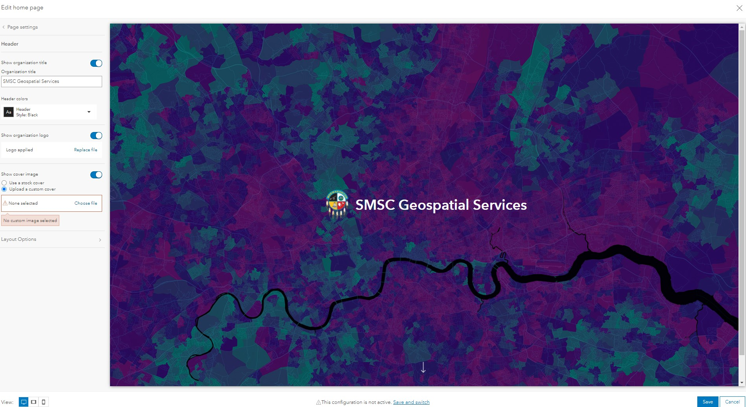
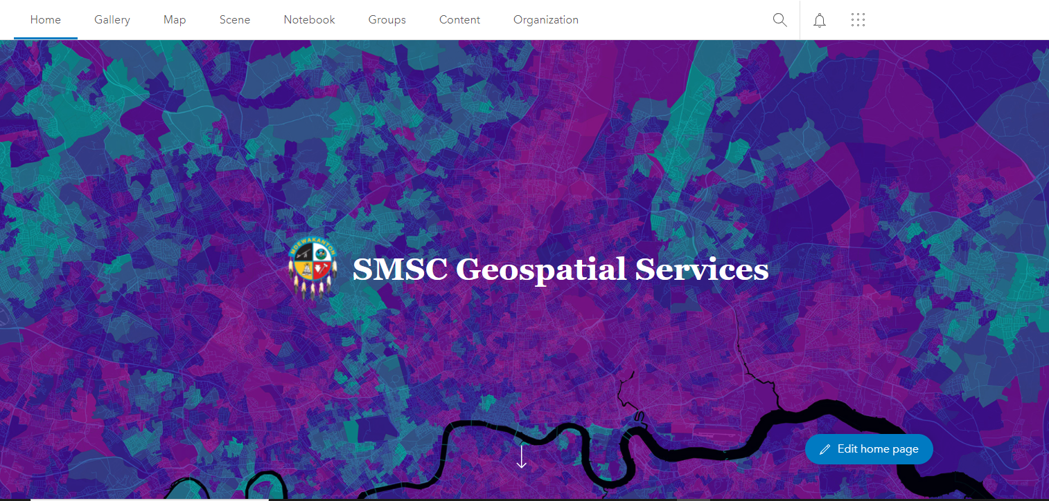
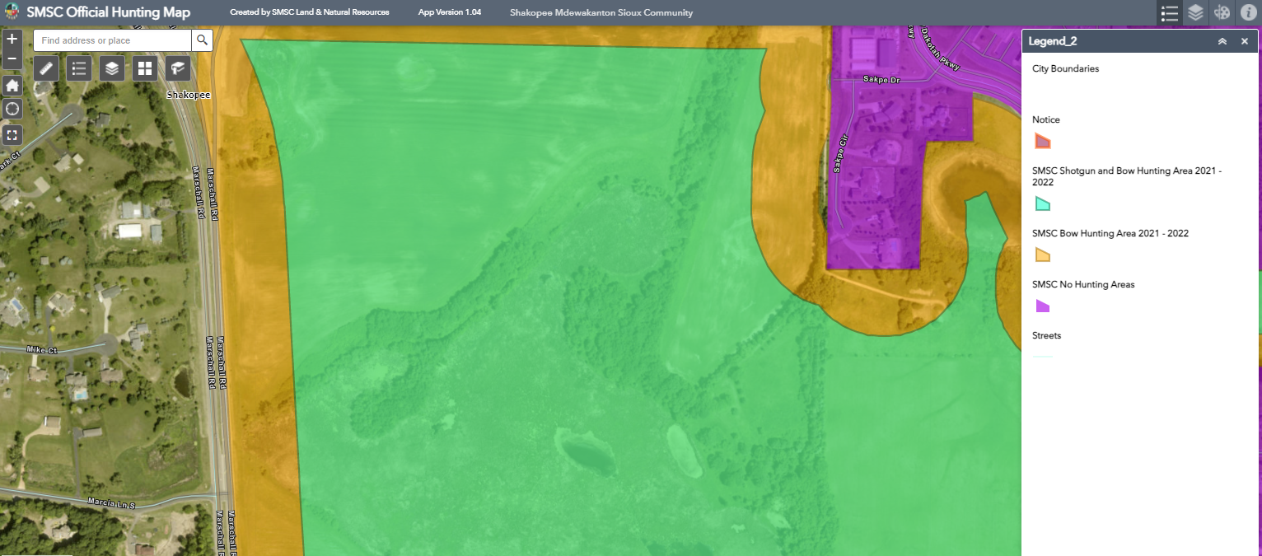
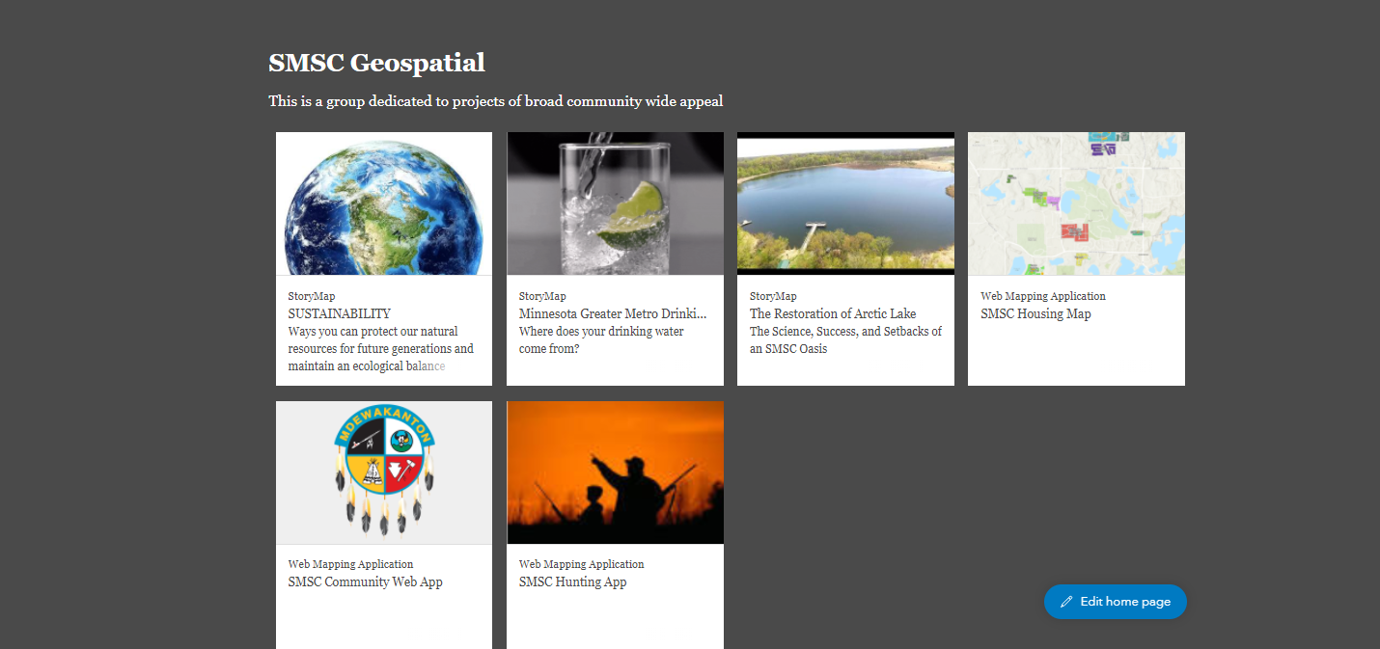
Web Mapping
Currently Maintaining 12 active web mapping apps with a Community Member facing approach

Slide 69
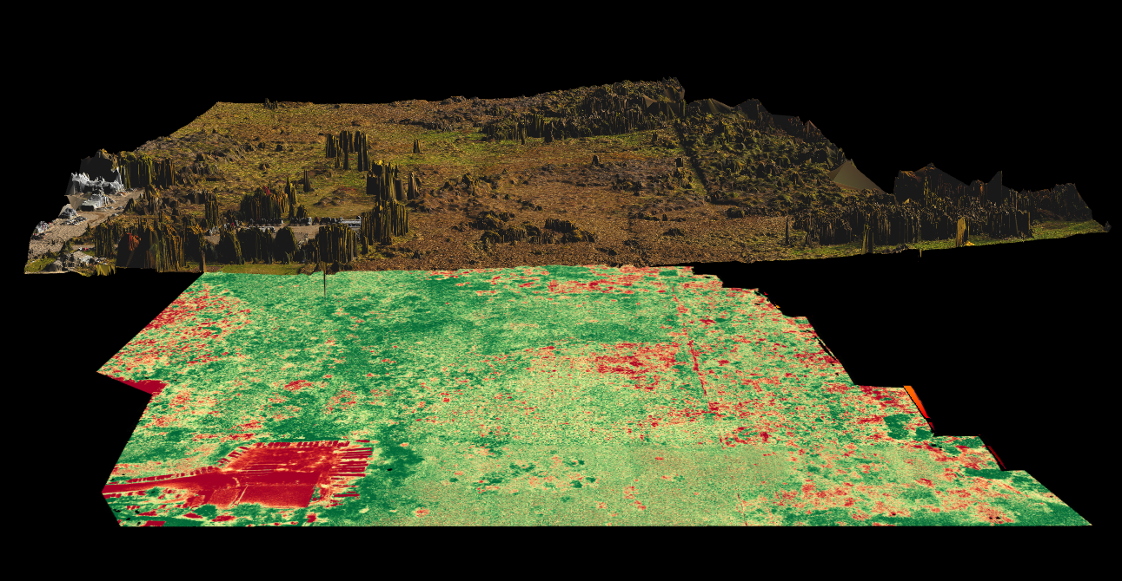
Thank you!
Questions?
Ryan.Bonney@shakopeedakota.org

Slide 70
Agenda Item 10
Legislative Update
Conversations are continuing about the topics of policy, and funding of geospatial program needs
PLSS bill is scheduled HF4456 (Anderson) for hearing on Friday

Slide 71
Agenda Item 11
Updates on GAC Priority Projects and Initiatives
David Brandt

Slide 72
Updates on GAC Priority Projects and Initiatives
Most recent success
Experiencing a barrier?
Next task

Slide 73
GAC Priorities
Project or Initiative Description | Status | Project Owner | Champion
New Lidar Acquisition | Active | Gerry Sjerven | GIO
Updated and Aligned Boundary Data | Active | Preston Dowell | GIO
Parcel Data | Active | Alison Slaats | Mark Kotz
Road Centerline Data | Active | MnGeo | GIO
Image Service Improvements | Active | Alison Slaats | GIO
Critical Infrastructure Data | Active | Stacey Stark | Steve Swazee
Address Points Data | Active | MnGeo | GIO
Underground Utilities Data | Active | Steve Swazee | Barb Cederberg
U.S. National Grid Materials | Active | Randy Knippel | Randy Knippel
Archiving Implementation | Active | Ryan Mattke | many
Accurate Hydro-DEMs | Active | Sean Vaughn | many
Culvert Data Standard | Active | Rick Moore | Jonathan Lord

Slide 74
GAC Priorities
Project or Initiative Description | Status | Project Owner | Champion
Remonumentation of Section Corners | Active | Pat Veraguth | GIO
Success Stories for Geospatial Technology | Recruitment
Geospatial Commons Advisory Group | Recruitment
Criminal Justice Info Best Practices | Recruitment | Britta Maddox
NG911 Forum | Recruitment
Parks Data Standard | Inactive
Summary Crime Data | Inactive | Britta Maddox
Basemap Services | Inactive
Strategy Team for All Types of Imagery | Inactive
State Business License Data | Inactive
Snow Emergency Parking Restriction Data | Inactive
Street Parking Restrictions Data Standard | Inactive
Geospatial Data Asset Inventory | Inactive

Slide 75
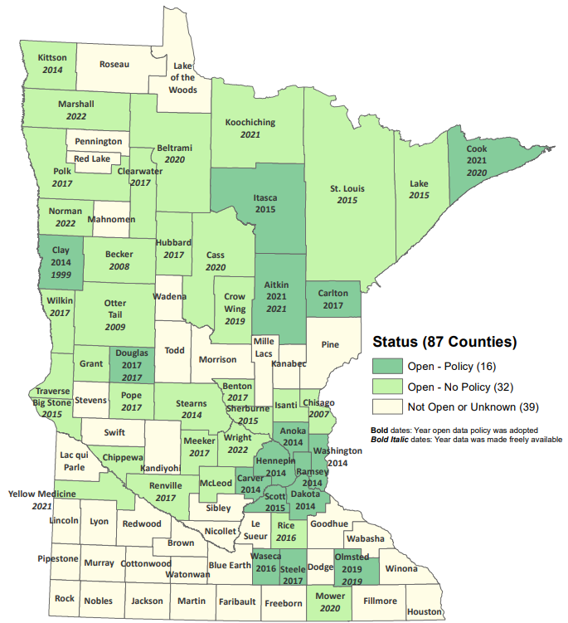
Status of Free and Open Data Public Geospatial Data
Status | Number of Counties | Total
Open - Policy | 16 | 48
Open - No Policy | 32
Not Open or Unknown | 39 | 39
Data current as of March 10, 2022
https://gisdata.mn.gov/dataset/bdry-mn-county-open-data-status

Slide 76
New Lidar Acquisition
Most recent success:
  Created LAB Coordinators
  Statement of Work and Task Orders approved for Upper and Central Mississippi LAB, awaiting vendor selection
  Spring Flights planned for SE and SW Minnesota
  Awaiting data for NE Minnesota this spring or early summer
If you are experiencing a barrier:
  Coordinating delivery of data and storage
Next task:
  Outreach for Minnesota River East & West LAB’s for potential 2023 collect
  Coordinate communication with the LAB partners

Slide 77
Updated and aligned boundary data
Most recent success:
  Committee discussed difficult parcel mapping issues along county boundaries. Hopefully this will turn into a process for proper handling and mapping of boundaries.
  PLSS Status Map transitioned to MnGeo
  Supporting Remonumentation Subcommittee which is working on Priority 14
  Supporting/documenting Arrowhead Alignment Project
If you are experiencing a barrier:
  Committee member time
Next Task:
  Update PLSS Status Map
  Review PLSS Data Standard
  Continue supporting/documenting Arrowhead Alignment Project

Slide 78
Statewide publicly available parcel data
Most recent success:
  Published a public GAC-standard compiled dataset including 29 opt-in counties in January 2022
  Streamline process with GAC for including additional counties in opt-in dataset
If you are experiencing a barrier:
  none
Next task:
  PLRC's open data sub-committee’s outreach team will continue reaching out from county to county to talk about benefits of sharing data and learning more about barriers and follow up on survey results.
  Send GovDelivery newsletter to community to share success

Slide 79
Road Centerline Data
Most recent success:
  Data submission and validation routines moved to a new portal
If you are experiencing a barrier:
  Work on validation process is still taking precedence over sharing data
Next task:
  Build and automate the ETL process for aggregating data to the GAC standard
  Publish to the Geospatial Commons

Slide 80
Improvements to the MnGeo Image Service, such as Web Mercator support, tiling, and complementary options such as “composite of latest leaf off imagery”, and downloading options
Most recent success:
  Worked on image viewer recommended by Image Service Sustainability Committee
  Added county imagery from Rice, Steele, and Carlton County to WMS
  Added NAIP 2021 Color imagery
If you are experiencing a barrier:
  Time constraints to work on recommendations of committee, and did not accomplish removal of suggested retirement image layers
  Issue with Koochiching imagery borders
Next task:
  Adding county imagery from Koochiching and Dakota
  In discussion: Le Sueur, Lyon, Lincoln, and Aitkin Counties

Slide 81
Critical Infrastructure Assessment
Most recent success:
  Published fire station dataset to GeoCommons with app for verification
If you are experiencing a barrier:
  Hoping to pique the interest of the Fire Marshal and/or other authorities of these data! Finding avenues to publicize beyond GIS community.
Next task:
  Publish “C.I. resource site” on MnGeo website
  Publish law enforcement dataset, similar to fire station dataset

Slide 82
Address Points Data
Most recent success:
  Data submission and validation routines moved to a new portal
If you are experiencing a barrier:
  Work on validation process is still taking precedence over sharing data
Next task:
  Build and automate the ETL process for aggregating data to the GAC standard
  Publish to the Geospatial Commons

Slide 83
A project team to develop geospatial data sharing methodologies to support the state’s underground utilities community
Most recent success:
Multiple – See quarterly report
2. If you are experiencing a barrier:
Working through a highly technical geospatial implementation for the first time on the planet - but making progress
3. Next task:
    Currently 5 different work groups simultaneously working over 50 spreadsheet-defined tasks spanning data, legal, security, prototype build, standards, and policy

Slide 84
Maps, procedures, templates and other materials to help all levels of government implement the U.S. National Grid
Most recent success:
  Developed interface to allow map publishers to contribute to an application that provides access to USNG maps series and map books published anywhere on the Internet
If you are experiencing a barrier:
  Time
Next task:
  Complete the above interface
  Migrate existing documentation from ArcMap to ArcGIS Pro

Slide 85
Archiving Minnesota geospatial data
Most recent success:
  Created a test repository with sample datasets from the Commons as a proof of concept.
If you are experiencing a barrier:
  Working on getting a firm commitment from hosting entity (hopefully UMN)
Next task:
  Writing report describing pilot details
  Figuring out funding

Slide 86
Accurate hydro-DEMs (hDEM) that serve modern flood modeling and hydro-terrain analysis tools, and the development of more accurate watercourses and watersheds
Most recent success:
  No success to report related to progress
  3D Geomatics is starting to receive more questions about the new high-density lidar coming and the need for DEM Hydro-modification
    New Lidar will require DEM Hydro-modification
    Previous state investments in DEM hydro-modification and resulting datasets will support new DEM Hydro-modification
If you are experiencing a barrier:
  Funding
Next task:
  Continue to build awareness that new Lidar will require DEM hydro-modification and funding
    Identification of culverts in new lidar will facilitate DEM hydro-modification

Slide 87
Development of a culvert data standard for data sharing across the geospatial and infrastructure asset management communities
Most recent success:
  Identifying resources and interested parties to become partners/members in the committee. Researching Culvert Data practices of other states to identify best practices
If you are experiencing a barrier:
  Identifying time to coordinate meetings for the standard. Culvert Data Standard will become high priority in 2022 in tandem with DEM Hydro-modification Subgroup
Next task:
  Meeting will be set in January to bring together interested parties for the Culvert Data Standard. Meeting with MnDOT representatives forthcoming

Slide 88
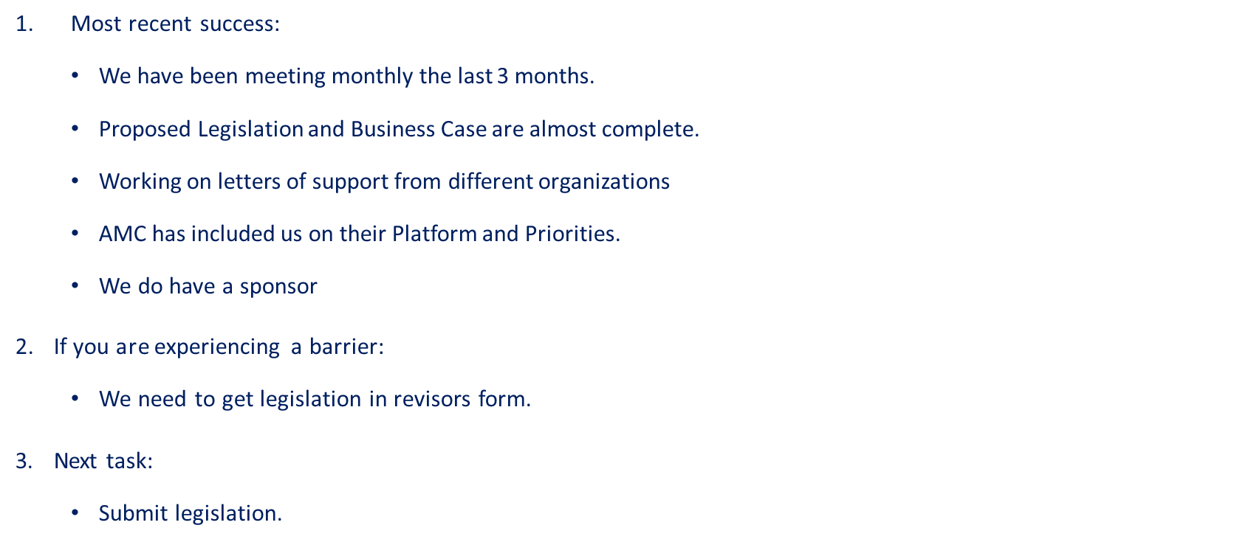
Remonumentation of all section corners

Slide 89
CJIS Data GIS Best Practices
Most recent success:​
  The Charter for this group will be shared at the meeting
If you are experiencing a barrier:​
Actively recruiting team members should anyone wish to join!
Next task:​
  Schedule a meeting with SME's to begin work.
  Summary Crime Data - pending the completion of CJIS Data GIS Best Practices as that will be key to what we share for this.

Slide 90
Agenda Item 12
Announcements

Slide 91
Next Meeting
May 25, 10:00 – 1:00

