Slide 1
Statewide
Geospatial Advisory council
January 10, 2014

Slide 2
AGENDA
1. Call to order and introductions 5 min
2. Approval of September 24, 2013 meeting minutes 5 min
3. Legislative hearing update 5 min
4. Approved standards update 5 min
5. Review council’s mission, roles, responsibilities, and expectations 30 min
6. Committee and workgroup update 10 min
7. Break – Networking 30 min
8. Data sharing initiatives – Geoff Maas, MetroGIS, and Mark Kotz, 30 min
Metropolitan Council
9. Member sector reports: Jeff Bloomquist, Farm Service Agency 30 min
John Mackiewicz, WSB & Associates - Trisha Nelson, Minnesota
Department of Transportation - Kody Thurnau, Minnesota Center for
Environmental Advocacy
10. MnGeo priority efforts updates 20 min
11. NSGIC annual meeting highlights 5 min
12. Adjourn

Slide 3
September 24, 2013 Meeting Minutes http://www.mngeo.state.mn.us/councils/statewide/SWGAC_minutes_2013Sept24.pdf

Slide 4
Legislative Commission on Planning and Fiscal Policy
Sept 30
To what extent has the mission of the Council/Committee been satisfied?
You indicated the budget for the Geospatial Information Advisory Council is .25 FTE and the budget for the Technology Advisory Committee is $0. Does the lack of funding inhibit the ability of the Council/Committee to complete its mission in any way, or have alternative sources of funding been sought to provide the resources needed to support the work of the Committee?

Slide 5
Legislative Hearing Update – Sept 30
Are there more efficient and effective methods of accomplishing the mission of the Council/Committee?
Has the Council/Committee provided the agency with an efficient and effective means of obtaining expert advice and opinions? Are there individuals, groups or other stakeholders whose voice would be valuable but who have not participated through the Council/Committee?
How has the Council/Committee impacted the agency’s implementation and operations of the program?

Slide 6
Legislative Hearing Update – Sept 30
In the absence of the Council/Committee, how would the viewpoints and opinions of stakeholders be obtained by the agency and reflected in the program?
Are there specific additional tasks that the Council/Committee could perform effectively for the legislature or your agency?
Does the work of the Council/Committee in any way overlap or duplicate the work of other groups?

Slide 7
Legislative Hearing Update – Sept 30
Do you believe the Geospatial Information Advisory Council and the Technology Advisory Committee should be continued? If so, do you recommend any changes in law that would improve the Council/Committee's efficiency and effectiveness?

Slide 8
Approved Standards Update
Standard | Type | Source
Codes for Minnesota Counties | Code | ANSI
Codes for City, Township and Unorganized Territory | Code | ANSI
State Agency Coordinate Interchange | Coordinate | Various
Geographic Metadata | Content | FGDC
Positional Accuracy | Quality | FGDC
Codes for the Identification of States | Code | ANSI
Codes for Lake and Wetland Basins | Code | MN DNR
Codes for Watersheds | Code | MN DNR
Codes for River Reach/Water Course | Code | FGDC/DNR
U.S. National Grid | Coordinate | FGDC
Stormwater System Data Exchange | Data
Thoroughfare, Landmark, and Postal Address Data Standard | Data | URISA
Parcel Attribute Data Exchange | Data

Slide 9
Council mission
Roles, responsibilities, and expectations

Slide 10
Mission
The mission of the council is to promote efficient and effective use of resources by providing leadership and direction in the development, management and use of geographic information in Minnesota. The council makes recommendations in areas including, but not limited to: policies, institutional arrangements, standards, education and stewardship.
Does this still fit?

Slide 11

GUIDING PRINCIPLES
The following guiding principles form the foundation for the council's activities and priorities.
Promote efficient investments in geographic information.
Promote geographic information as a public resource that should be widely shared with and available to interested parties.
Support the establishment and use of geographic data standards and guidelines to better exchange and share information resources.
Are these still correct?

Slide 12

GUIDING PRINCIPLES
Promote education and training in GIS.
Promote the beneficial uses of geographic information in the development of policy and the management of public resources.
Provide a major forum where ideas and issues of the GIS community in Minnesota can be brought forward, discussed and acted upon, as appropriate.
Are these still correct?

Slide 13
Roles and responsibilities as a member…
You are willing to be active in meetings and provide input, advice and guidance to MnGeo regarding issues and information of importance to your sector and the council regarding activities, governance, needs, and opportunities related to geospatial.
You currently have or are willing to obtain and engage contacts in the broad sector you represent.
You are willing to reach out to organizations and individuals in the sector you represent to obtain input and information regarding geospatial activities and opportunities and are also willing to provide information back to that sector to share activities from the meeting and information shared from other sectors.

Slide 14
Council Member Roles and Expectations
Proactively advise and assist MnGeo to:
Coordinate or improve geospatial technology, data and services statewide
Establish priorities
Understand needs and issues of geospatial community
Communicate with the community sectors
Identify opportunities and develop partnerships and collaboration
Create and use committees and workgroups
Develop council meeting agendas and participate at meetings

Slide 15
Communication – your most important role…
Keep stakeholders informed about Council activities.
  Provide ongoing project updates.
  Distribute major reports and findings.
Solicit and acquire input relating to Council activities.
Assist in converting GIS users to approved standards.
Educate people about the benefits of GIS.
Make people aware of the Council and the impact it is having.
Understand the needs of the Minnesota GIS community.
Provide sound policy advice to state and federal government.
Promote programs that the Council thinks are critical to sound GIS development.
Promote the use of GIS in meeting objectives of key stakeholders in local and State government.

Slide 16
Committee Update
Charter and Work Plan Review and Discussion
Input from the Council

Slide 17

BREAK
+

Slide 18

Free & Open Geospatial Data
Realizing the Benefits to Governments, Businesses and
Citizens in Expanding Data Availability
Presentation to Statewide Geospatial Advisory Council
Geoff Maas, MetroGIS Coordinator
January 10, 2014

Slide 19
Three Things:
What is MetroGIS?
What does “free and open” data mean?
Examples and benefits

Slide 20


What Is MetroGIS?
A voluntary collaborative of interests…
Governments at all levels
Academia
Non-Profits
Private Sector (utilities, real estate, etc.)
…who produce, consume and share GIS data in the metro;
Since 1996, the Metropolitan Council has provided:
Financial backing for the collaborative;
Administrative oversight of its operation;
Stability and guidance;

Slide 21
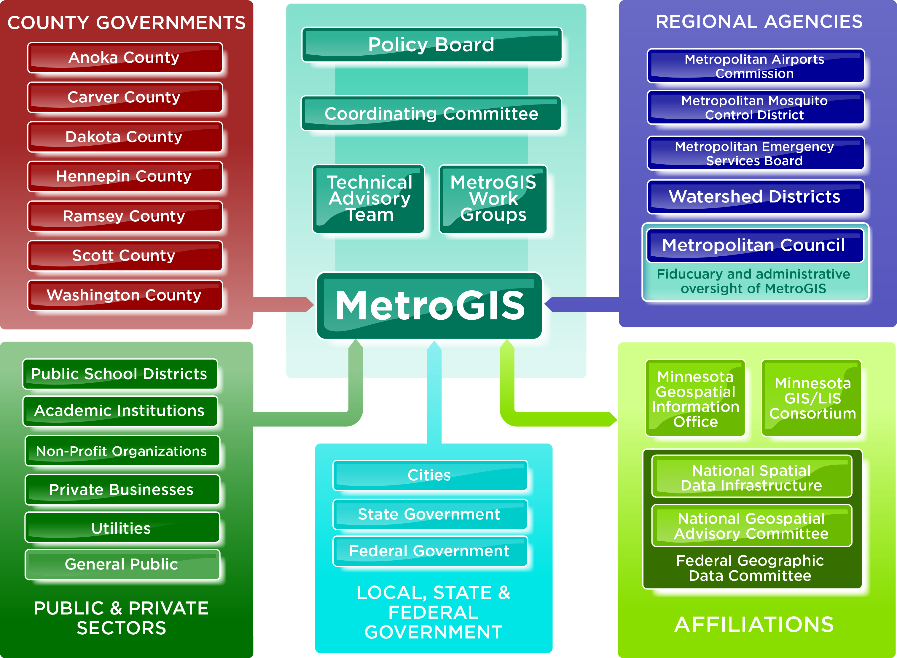

Slide 22



What Does MetroGIS do?
Core Maintenance Functions
Maintain the datafinder.org clearinghouse;
Manage the Regional Parcel Dataset
Manage the NCompass Road Data licensing and distribution;
Maintain the metrogis.org website (being re-designed);
On-going governance;
Projects & Research
Development of data and data standards
Research into issues of importance to the stakeholders;
Advocacy & Outreach
Promotion and facilitation of data sharing in the region;
Support of legislation that promotes GIS, data availability;
Advocate for the importance of GIS/geospatial work;
Liaison between agencies engaged in GIS in the region;

Slide 23


Current MetroGIS Work:
Free & Open Data Research/Advocacy
Support for Statewide Centerlines Initiative
Regional Address Point Development & Aggregation
New MetroGIS Website (Planned Launch in April 2014 )
Expanding Private/Public Data Partnerships
Increase GIS collaboration beyond the Metro
Regional Stormsewer Dataset Research & Development
Support for the Minnesota Geospatial Commons

Slide 24

Foundational Statements
Open sharing of data between interests and agencies…
…reduces their operating costs;
…identifies and eliminates redundant effort;
…saves tax payer money;
…ensures that data comes from the authoritative source;

Slide 25


Free & Open Data Context:
GIS isn’t just data, maps, apps, etc.
There are:
Laws and Statutes…
Agency Policies & Practices…
Business Needs and…
Funding Considerations…
…which govern our work

Slide 26
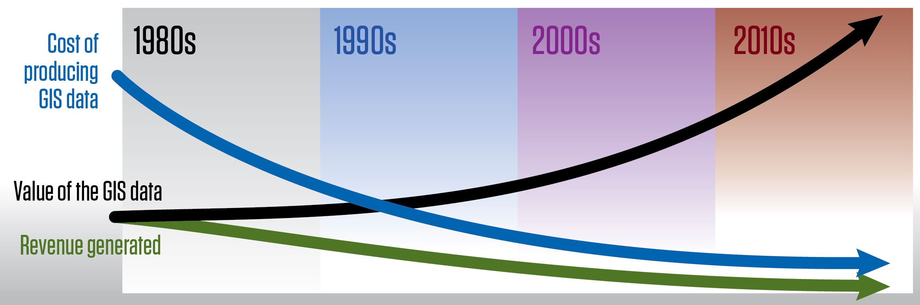
Brief “Evolution of GIS Policy”
1980s: Development Costs
Emergence of GIS in government; Offset costs with licensing/fees
1990s: Growth of GIS & Recognition of Value to External Partners
Establishment of MetroGIS, parcel data license
2000s: Maturity and Expansion
Internet mapping, smart phones, significant decrease in costs, rise in computing power
2010s: Continued Expansion & Public Expectations for Data
Ever-increasing ‘public appetite’ for data, “explosion” of uses/computing power;

Slide 27
What does “free and open” data mean?

Slide 28

Terminology: “Free”
No charges or fees would be assessed to data consumers for public geospatial data in its native electronic format;
“Public Geospatial Data”
Electronic geospatial data: MN Stat. Chapter 16E, Section 30, Subd. 10
Public data: MN Stat. Chapter 13, Section 2
MN Stat. Chapter 13, Section 3, Subd. 3(d)
City or county data producers retain the ability to charge for the cost of making and certifying copies or for providing custom work (requested maps, custom ‘cuts’ of the data, etc.)
MN Stat. Chapter 13, a.k.a. Data Practices Act
Legal language hasn’t fully ‘kept pace’ with the technology that it governs;

Slide 29

Terminology: “Open”
Data consumers would not be required to sign a
license agreement to access and use the data;
Data consumers would be able to share the data with other parties; notify of authoritative source
No restrictions on the use of the data;
A disclaimer describing the accuracy and original initial intended use would run with the data;
MN Stat. Chapter 466, Section 3, Subd. 21 exempts municipalities from tort liability for GIS data they produce and release;

Slide 30
Terminology: “Open”
‘Open’ refers to public data only, it does
not include data produced or maintained
by government agencies that are:
Not Public
Confidential
Private
Nonpublic
Protected Nonpublic
…as defined in MN Stat. Chapter 13, Section 2

Slide 31

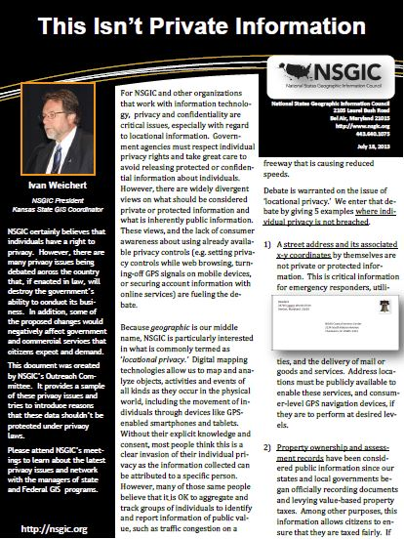
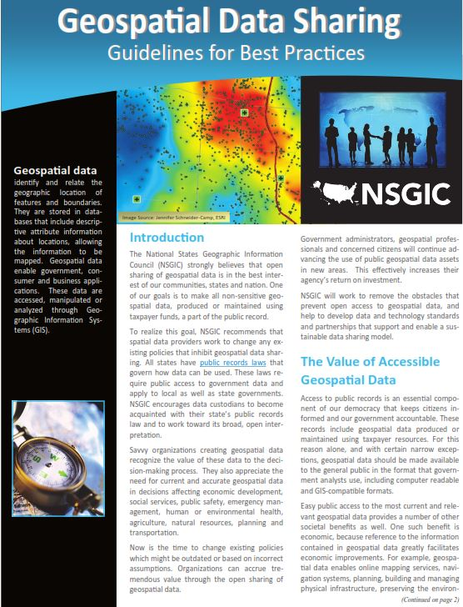
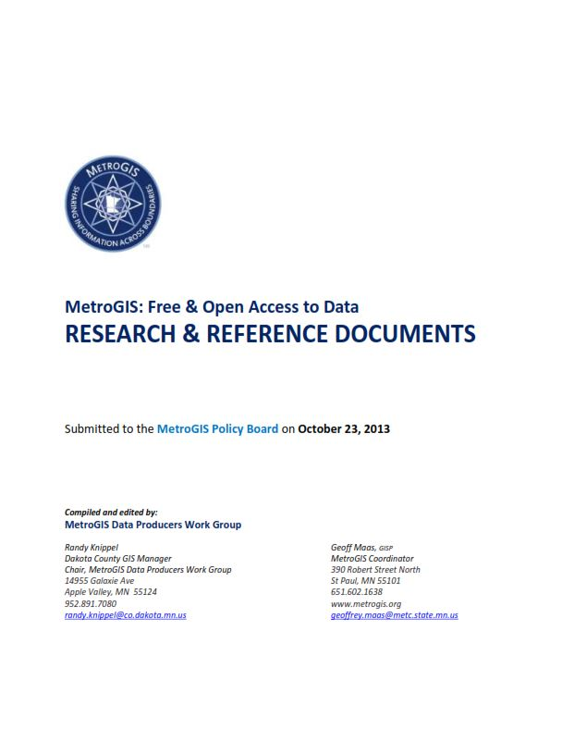
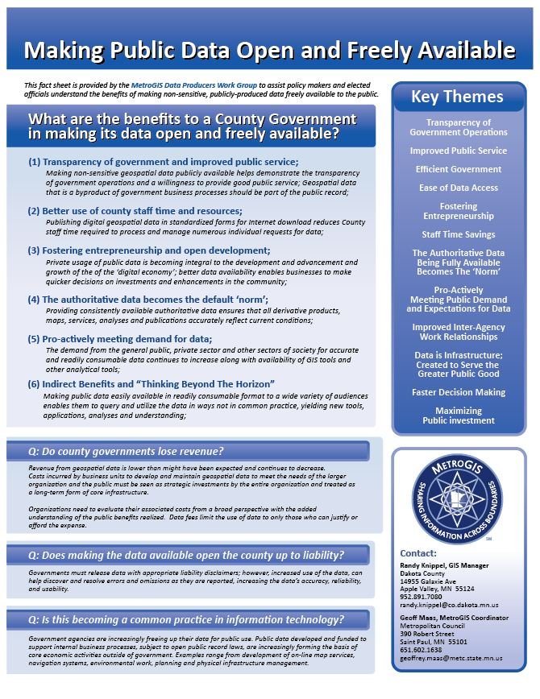
Free & Open Data: Four Tasks
#1 - Demonstrate the
Benefits Of Making
Data Freely Available
MetroGIS has assembled a body of research and resources demonstrating the benefits;
Working to communicate the value of free and open data to our senior management and elected officials;
http://www.metrogis.org/teams/workgroups/free_open_data/index.shtml

Slide 32
Free & Open Data
#2 - Understanding the Legal Framework Governing
Data Availability;
Case law examples;
Lack of applicable state-level case law examples in MN;
Examining case law examples from other states.
Existing statute language governing data access:
Chapter 13 (Data Practices Act);
Chapter 16E, Section 30, Subd. 11 (Gov-To-Gov);
Trying to avoid…
Numerous different (possibly conflicting) interpretations of state statues to apply locally; wide variation in practices and data availability;

Slide 33

Free & Open Data
#3 - Covering the Issues of Liability to Data Producers;
Clarity for Data Producers
Ensure that data producers are covered from liability when responding to requests, voluntary publishing of the data, etc.;
Specific exemption from liability for GIS data in statute:
Chapter 466, Section 3, Subd. 21(a)
Exempts a municipality from claims to the alleged or actual
inaccuracies in its data;
Chapter 466, Section 3, Subd. 21(b)
GIS data is subject to the presumption of Chapter 13, Section 1, Subd. 3
Government data are public data;

Slide 34

Free & Open Data
#4 - Change to Existing Policies;
Trend is moving away from the sale and licensing of GIS data
If a county or municipality wishes to pro-actively and voluntarily make its data freely available…
Chapter 13, Section 1, Subd. 3; ‘Gov data are public and accessible…’
Chapter 13, Section 3, Subd 1; ‘All data shall be public…’
Chapter 13, Section 3, Subd 2(a); ‘Establish procedures…’
Chapter 16E, Section 30, Subd 11 ‘Government to government…’
Chapter 466, Section 3, Subd. 21(a) ‘GIS data exempt from tort liability…’
Chapter 466, Section 3, Subd. 21(b) ‘GIS data subject to ‘13.01.Subd 3’…

Slide 35
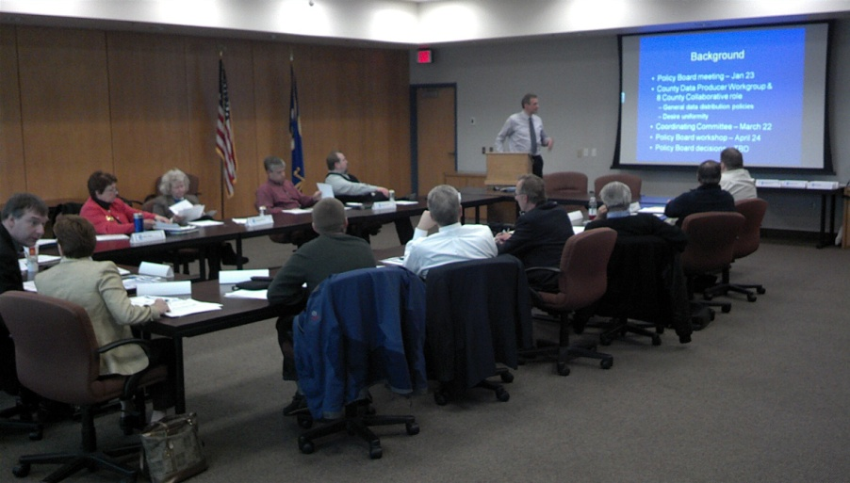
MetroGIS Policy Board
Comprised of:
6 County Commissioners
1 County IT Director
1 Metropolitan Council representative
2 Metro City mayors
1 Watershed District Board Chair
October 23, 2013
Adopted a Resolution of Support for free and open public geospatial data;
Directed a Letter of Support and research materials to each County Board Chair and County Administrator of the Seven Metropolitan Counties

Slide 36
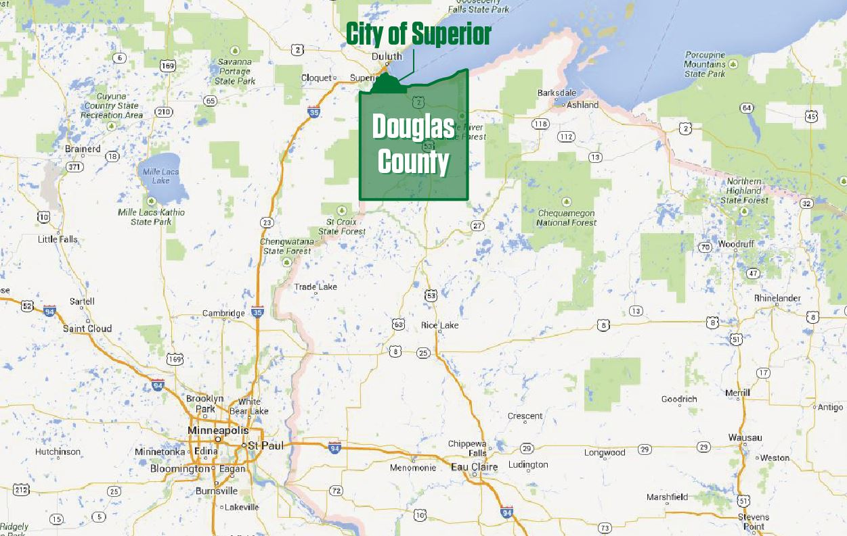
So what does ‘Free & Open Data’ look like?
Case Example:
City of Superior/Douglas County, Wisconsin

Slide 37
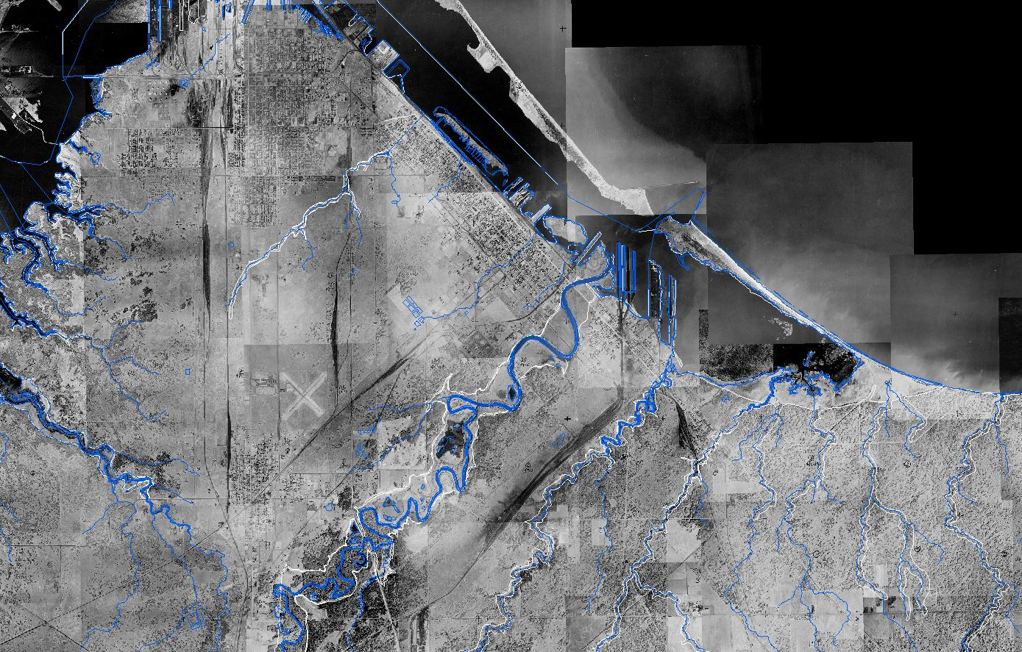
Hydrography
Aerial Imagery: 1948 to 2013
City of Superior & Northern Douglas County, Wisconsin

Slide 38
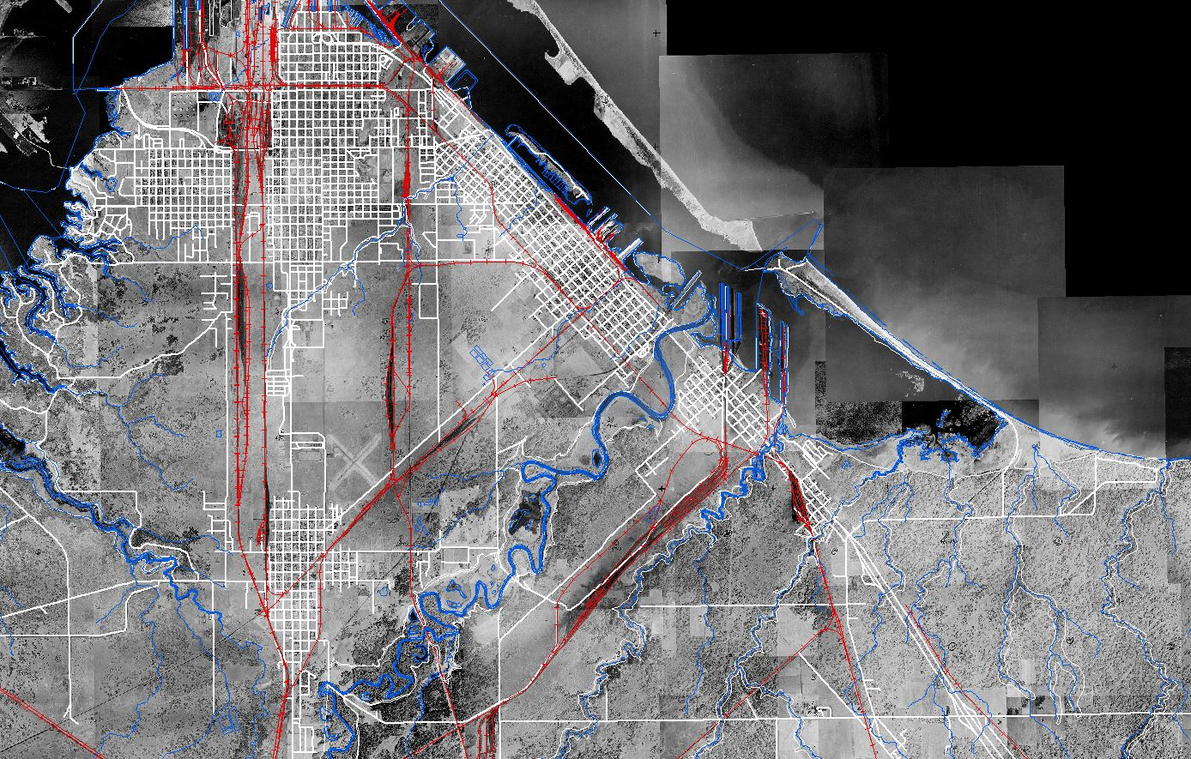
Hydrography
Aerial Imagery: 1948 to 2013
Railroads
Road Network
City of Superior & Northern Douglas County, Wisconsin

Slide 39
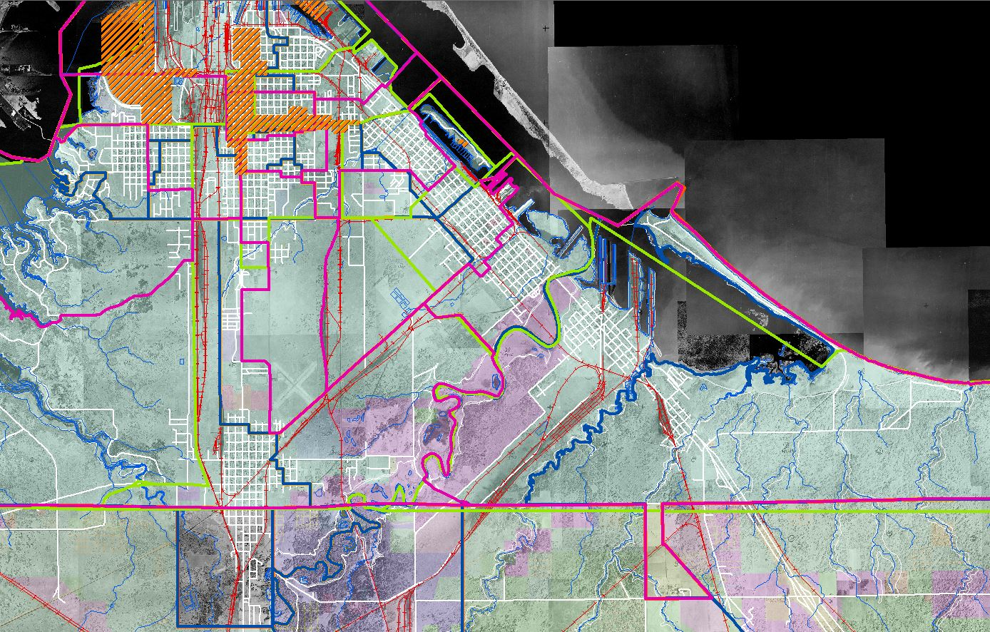
Hydrography
Aerial Imagery: 1948 to 2013
Railroads
Road Network
Municipal Boundaries
Administrative Districts
Special (TIF, etc.) Districts
Planning & Zoning
City of Superior & Northern Douglas County, Wisconsin

Slide 40
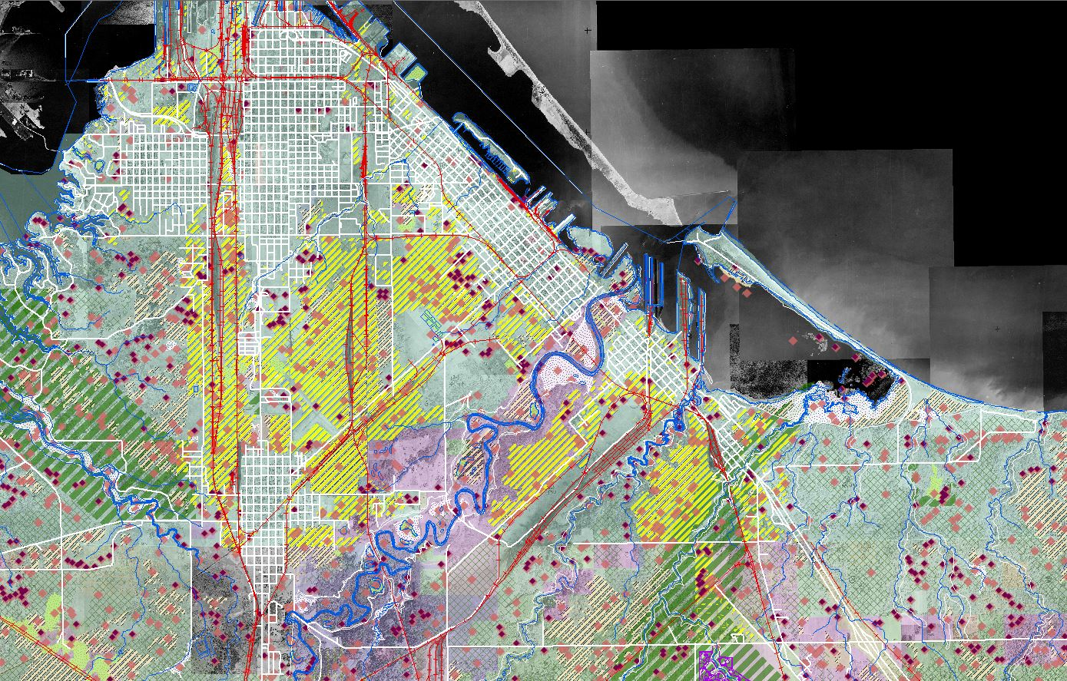
Hydrography
Aerial Imagery: 1948 to 2013
Railroads
Road Network
Municipal Boundaries
Administrative Districts
Special (TIF, etc.) Districts
Planning & Zoning
Environmental Data
Special Protection Areas
City of Superior & Northern Douglas County, Wisconsin

Slide 41
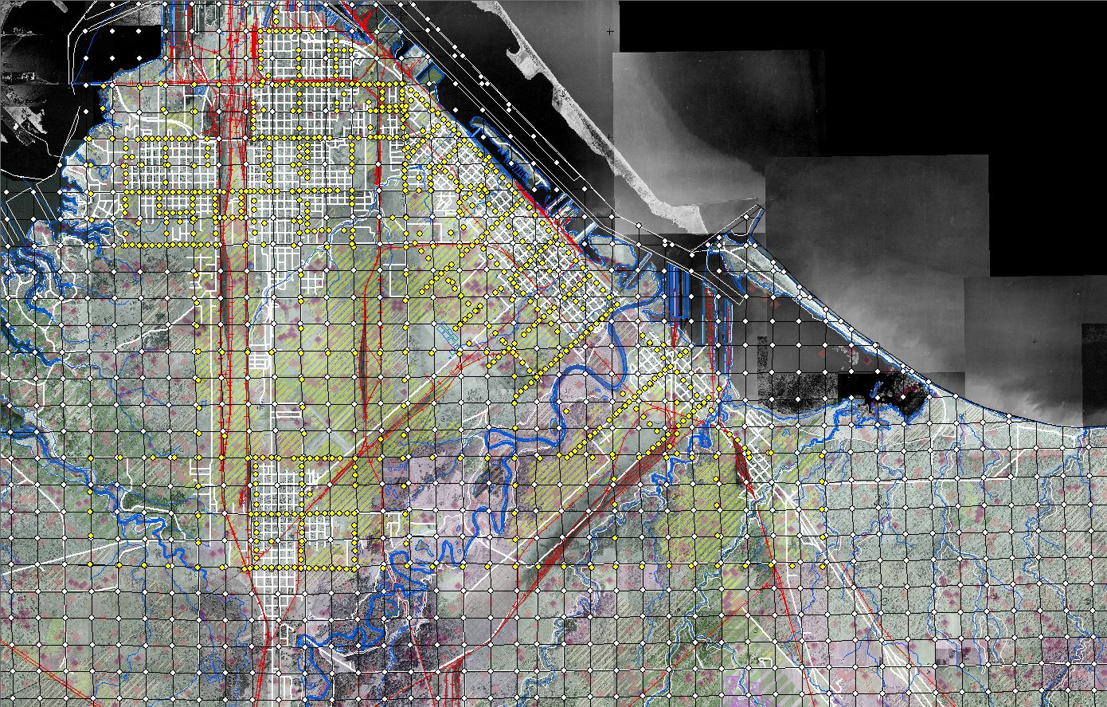
Hydrography
Aerial Imagery: 1948 to 2013
Railroads
Road Network
Municipal Boundaries
Administrative Districts
Special (TIF, etc.) Districts
Planning & Zoning
Environmental Data
Special Protection Areas
PLSS & Survey Data
City of Superior & Northern Douglas County, Wisconsin

Slide 42
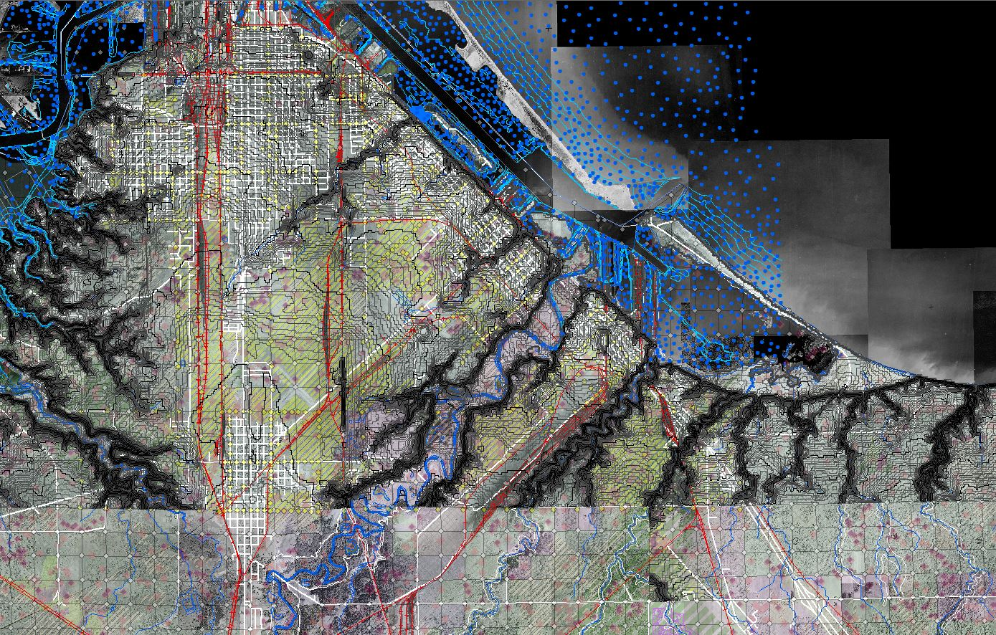
Hydrography
Aerial Imagery: 1948 to 2013
Railroads
Road Network
Municipal Boundaries
Administrative Districts
Special (TIF, etc.) Districts
Planning & Zoning
Environmental Data
Special Protection Areas
PLSS & Survey Data
1’, 5’ & 10’ Contours
Bathymetric Soundings
City of Superior & Northern Douglas County, Wisconsin

Slide 43
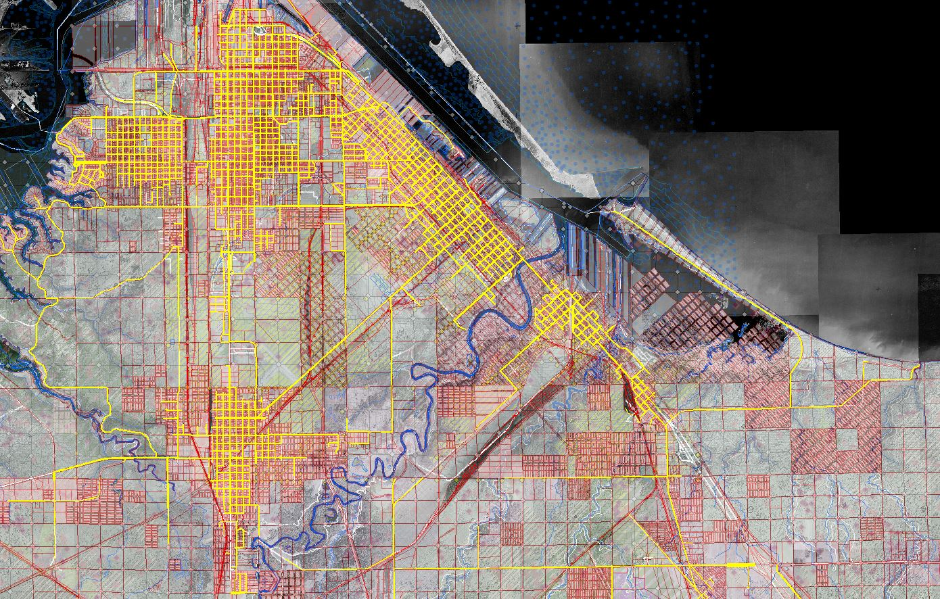
Hydrography
Aerial Imagery: 1948 to 2013
Railroads
Road Network
Municipal Boundaries
Administrative Districts
Special (TIF, etc.) Districts
Planning & Zoning
Environmental Data
Special Protection Areas
PLSS & Survey Data
1’, 5’ & 10’ Contours
Bathymetric Soundings
Tax Parcels
Right of Way
City of Superior & Northern Douglas County, Wisconsin

Slide 44
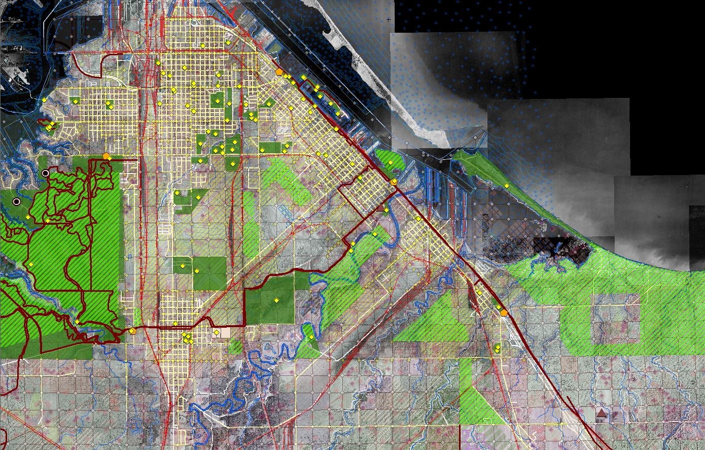
Hydrography
Aerial Imagery: 1948 to 2013
Railroads
Road Network
Municipal Boundaries
Administrative Districts
Special (TIF, etc.) Districts
Planning & Zoning
Environmental Data
Special Protection Areas
PLSS & Survey Data
1’, 5’ & 10’ Contours
Bathymetric Soundings
Tax Parcels
Right of Way
Park and Recreation Data
Trail Networks
Historic Sites
Cultural Points of Interest
Natural Points of Interest
City of Superior & Northern Douglas County, Wisconsin

Slide 45
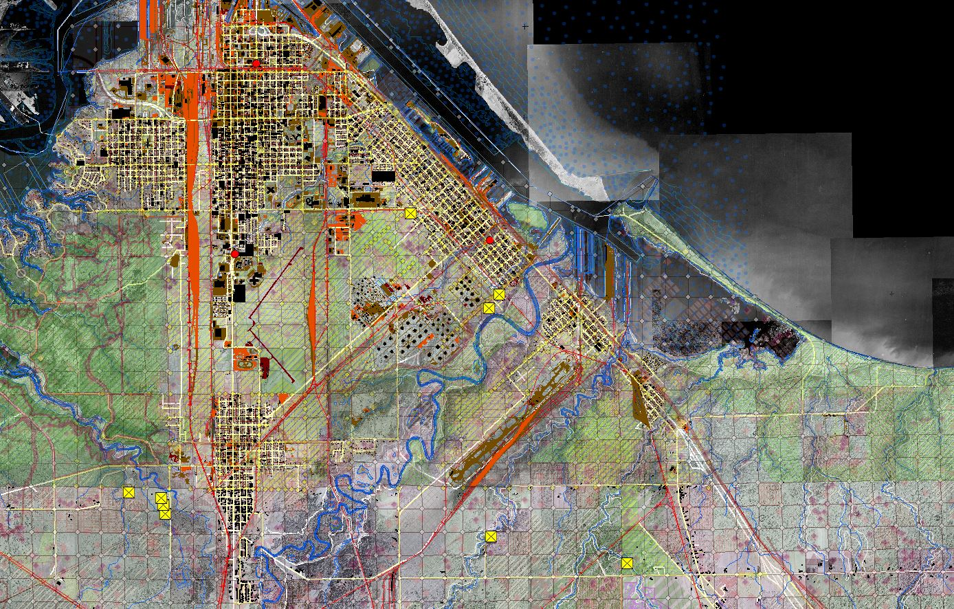
Hydrography
Aerial Imagery: 1948 to 2013
Railroads
Road Network
Municipal Boundaries
Administrative Districts
Special (TIF, etc.) Districts
Planning & Zoning
Environmental Data
Special Protection Areas
PLSS & Survey Data
1’, 5’ & 10’ Contours
Bathymetric Soundings
Tax Parcels
Right of Way
Park and Recreation Data
Trail Networks
Historic Sites
Cultural Points of Interest
Natural Points of Interest
Impervious Surfaces
All Building Footprints
Cemeteries
Public Buildings
City of Superior & Northern Douglas County, Wisconsin

Slide 46
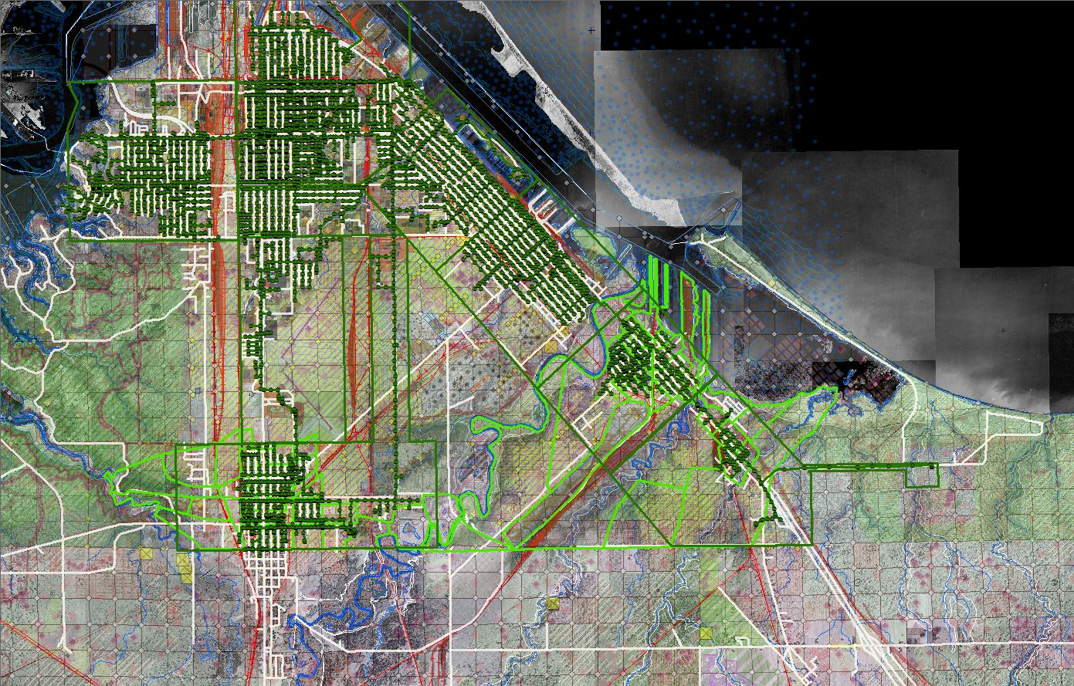
Hydrography
Aerial Imagery: 1948 to 2013
Railroads
Road Network
Municipal Boundaries
Administrative Districts
Special (TIF, etc.) Districts
Planning & Zoning
Environmental Data
Special Protection Areas
PLSS & Survey Data
1’, 5’ & 10’ Contours
Bathymetric Soundings
Tax Parcels
Right of Way
Park and Recreation Data
Trail Networks
Historic Sites
Cultural Points of Interest
Natural Points of Interest
Impervious Surfaces
All Building Footprints
Cemeteries
Public Buildings
Sanitary Sewer
Sewersheds + Service Districts
City of Superior & Northern Douglas County, Wisconsin

Slide 47
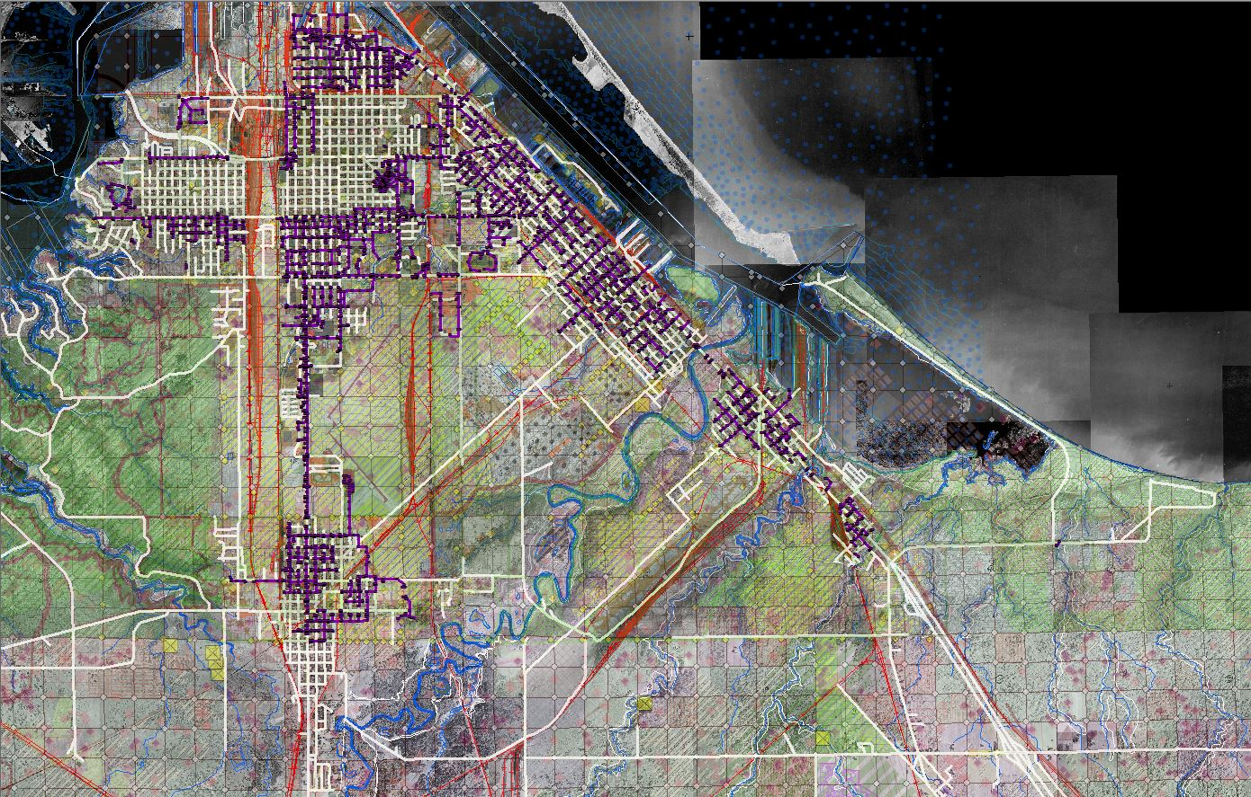
Hydrography
Aerial Imagery: 1948 to 2013
Railroads
Road Network
Municipal Boundaries
Administrative Districts
Special (TIF, etc.) Districts
Planning & Zoning
Environmental Data
Special Protection Areas
PLSS & Survey Data
1’, 5’ & 10’ Contours
Bathymetric Soundings
Tax Parcels
Right of Way
Park and Recreation Data
Trail Networks
Historic Sites
Cultural Points of Interest
Natural Points of Interest
Impervious Surfaces
All Building Footprints
Cemeteries
Public Buildings
Sanitary Sewer
Sewersheds + Service Districts
Stormsewer Network
Stormwater Outfalls
City of Superior & Northern Douglas County, Wisconsin

Slide 48
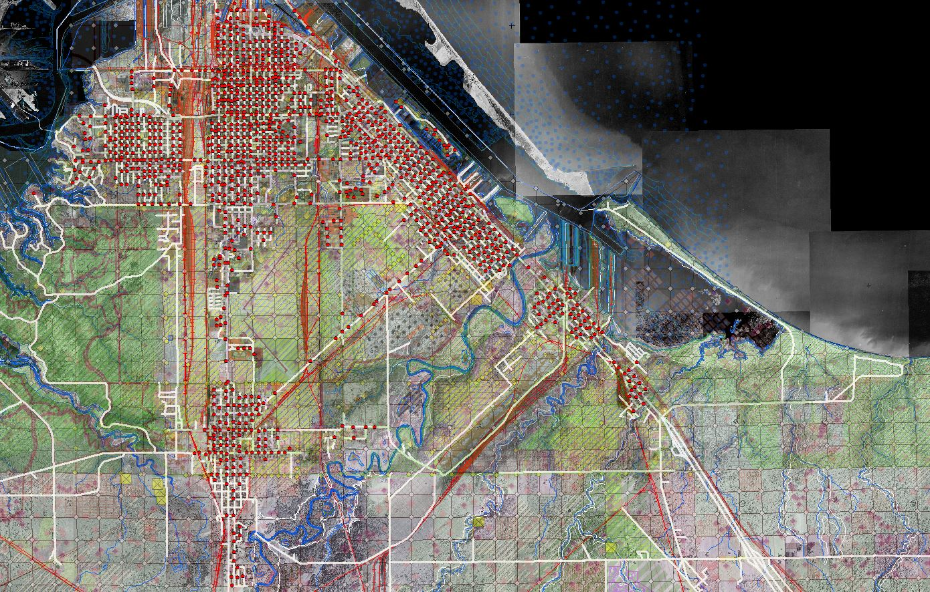
Hydrography
Aerial Imagery: 1948 to 2013
Railroads
Road Network
Municipal Boundaries
Administrative Districts
Special (TIF, etc.) Districts
Planning & Zoning
Environmental Data
Special Protection Areas
PLSS & Survey Data
1’, 5’ & 10’ Contours
Bathymetric Soundings
Tax Parcels
Right of Way
Park and Recreation Data
Trail Networks
Historic Sites
Cultural Points of Interest
Natural Points of Interest
Impervious Surfaces
All Building Footprints
Cemeteries
Public Buildings
Sanitary Sewer
Sewersheds + Service Districts
Stormsewer Network
Stormwater Outfalls
Fire Hydrants
City of Superior & Northern Douglas County, Wisconsin

Slide 49
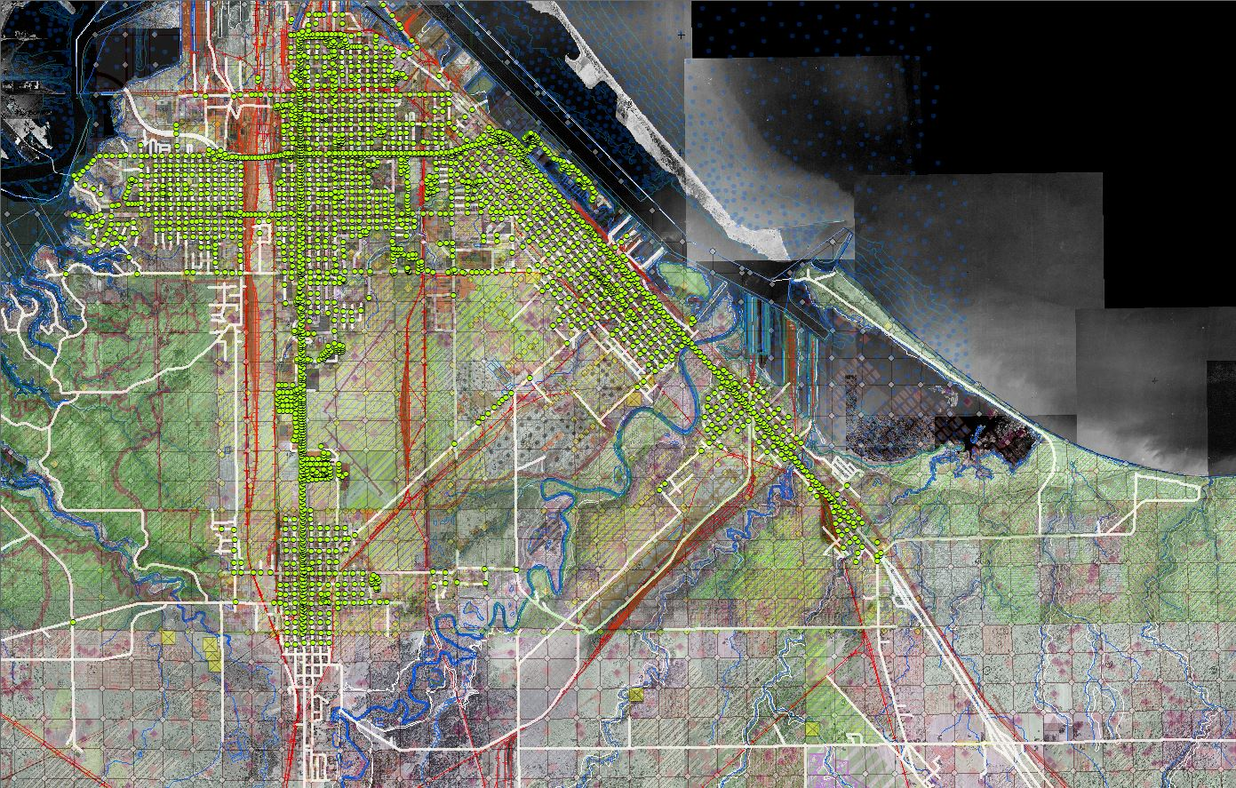
Hydrography
Aerial Imagery: 1948 to 2013
Railroads
Road Network
Municipal Boundaries
Administrative Districts
Special (TIF, etc.) Districts
Planning & Zoning
Environmental Data
Special Protection Areas
PLSS & Survey Data
1’, 5’ & 10’ Contours
Bathymetric Soundings
Tax Parcels
Right of Way
Park and Recreation Data
Trail Networks
Historic Sites
Cultural Points of Interest
Natural Points of Interest
Impervious Surfaces
All Building Footprints
Cemeteries
Public Buildings
Sanitary Sewer
Sewersheds + Service Districts
Stormsewer Network
Stormwater Outfalls
Fire Hydrants
Streetlights
City of Superior & Northern Douglas County, Wisconsin

Slide 50
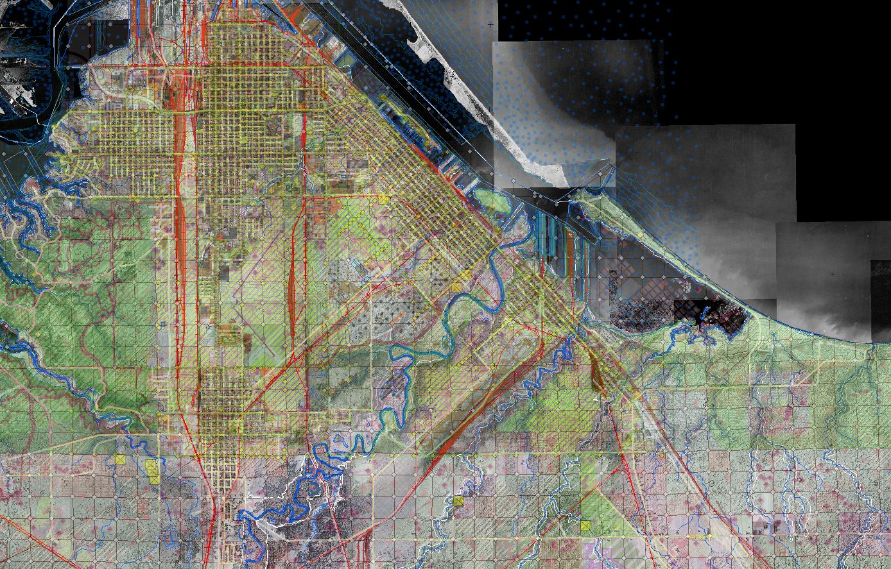


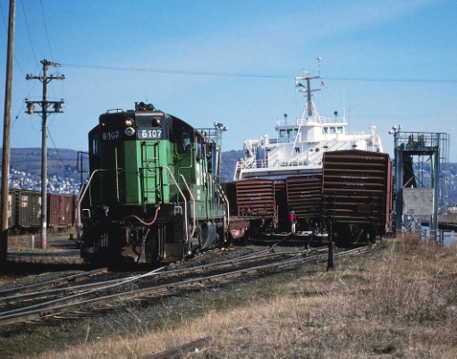

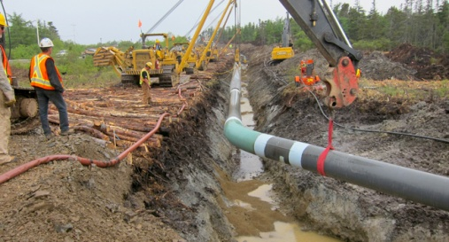

Free & Open Data practices encouraged and supported by the legal counsel of both the
City of Superior and Douglas County, Wisconsin
Significant benefits to a wide consumer base:
Railroads
Telecommunications
Pipelines
Real Estate and Development
Electric and Gas Utilities
Insurance/Risk Assessment
Duluth Seaway Port Authority
Port Authority of Superior
U. S. Army Corps of Engineers (Vessel Yard)
U. S. Coast Guard (Duluth Marine Safety Unit)
Historical Societies
Colleges & Universities
Commercial & Industrial Forest businesses
Federal, state and regional governments
City of Superior & Northern Douglas County, Wisconsin

Slide 51
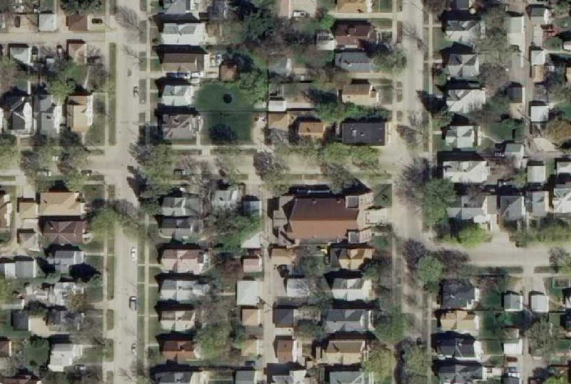
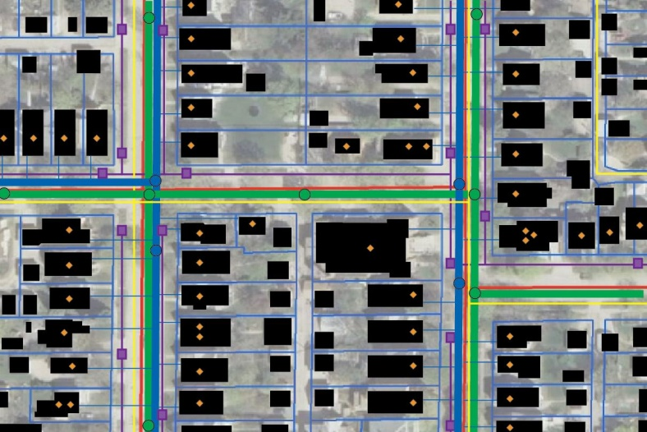
“Data Is Infrastructure”
Real World Features
Virtual Representations
Roads, pipes, buildings, parcels, manholes, sidewalks, hydrants, etc.
All the physical assets of a the city, county, agency or jurisdiction;
The virtual representations (and the data that accompanies them) are a form of infrastructure themselves used for tracking, mapping, modeling, applications development, routing, analysis, mapping, etc.

Slide 52
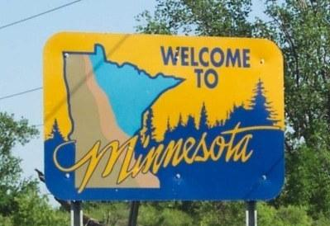
Creating a “Data Rich Minnesota”
Benefits to Government:
Transparency of operations;
Increased level of public service;
Pro-actively (vs. reactively) meeting
the demand for data;
The authoritative data being available is the norm;
Less staff time handling licenses,
fees, data transfer, etc.;
“Return” value

Slide 53
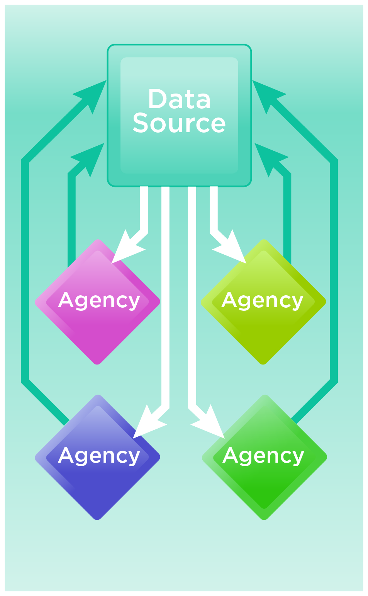
Creating a “Data Rich Minnesota”
Benefits to Government:
Transparency of operations;
Increased level of public service;
Pro-actively (vs. reactively) meeting
the demand for data;
The authoritative data being available is the norm;
Less staff time handling licenses,
fees, data transfer, etc.;
“Return” value

Slide 54

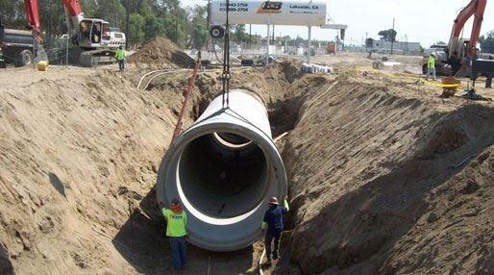

Creating a “Data Rich Minnesota”
Benefits to the Business Community:
Facilitates and stimulates the
“Information economy”/ “App economy”
Data consuming industries can operate more reliably, efficiently and cost-effectively when they can immediately acquire data and services they need;
Insurance, real estate, telecom, utilities, pipelines, railroads, etc.
A data-rich environment enables our region and our state to be more economically competitive;

Slide 55



Final Thoughts:
GIS data is a public investment for the benefit of all; enhancing access maximizes that investment.
The on-going investment in developing and maintaining GIS data is justified by government business processes;
Government entities can proactively collaborate to distribute the costs of
GIS data; (e.g. data development, maintenance of data clearinghouses)

Slide 56
Thank you!
Questions? Comments?
Geoff Maas, GISP
MetroGIS Coordinator
651.602.1638
geoffrey.maas@metc.state.mn.us

Slide 57
Member sector reports:
Jeff Bloomquist, Farm Service Agency
John Mackiewicz, WSB & Associates
Trisha Nelson, Minnesota Department of Transportation
Kody Thurnau, Minnesota Center for Environmental Advocacy

Slide 58
Minnesota Farm Service Agency
Information Section
January 14, 2014
– Minnesota State Office – Farm Service Agency -
GIS/LIS

Slide 59
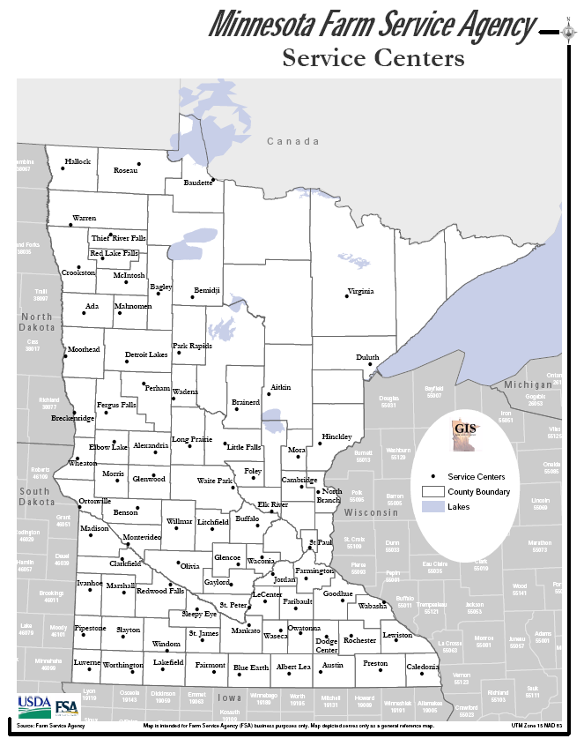
Service Center Locations throughout Minnesota

Slide 60
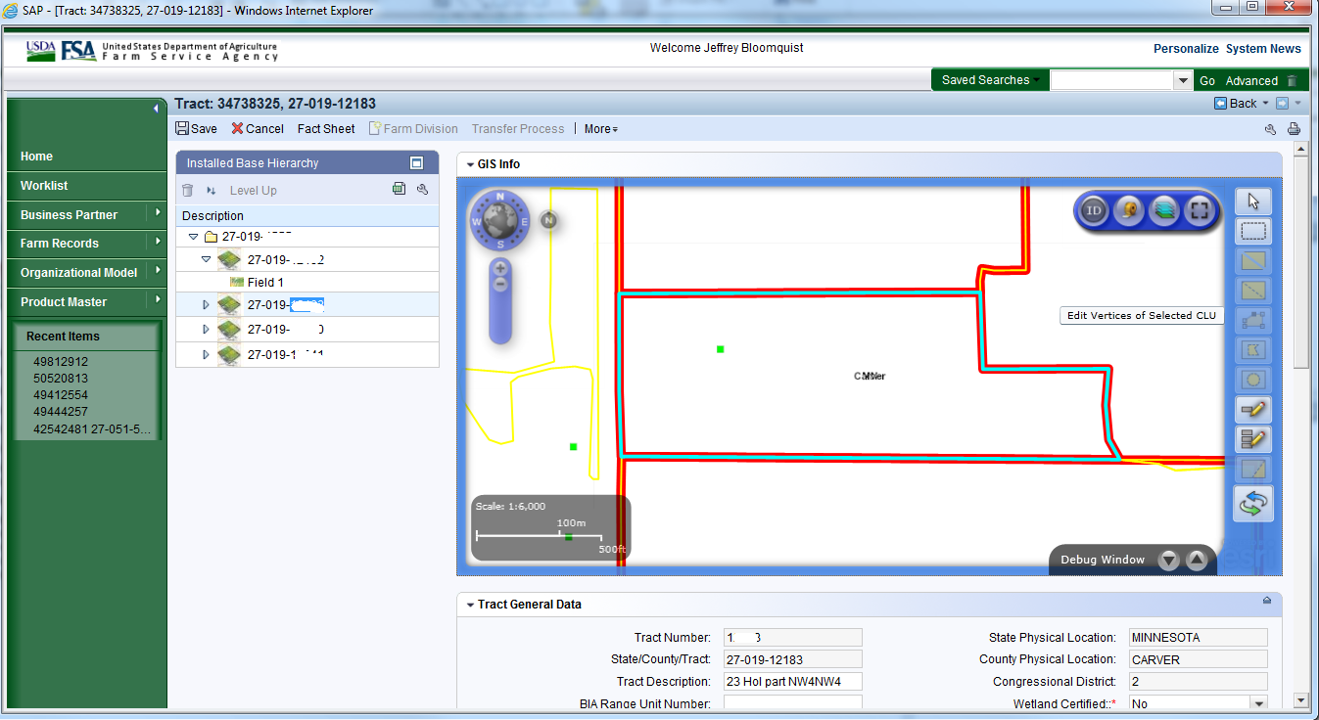
MIDAS
Tools used to maintain CLU nationwide manages all aspects of USDA FSA Farm Records

Slide 61
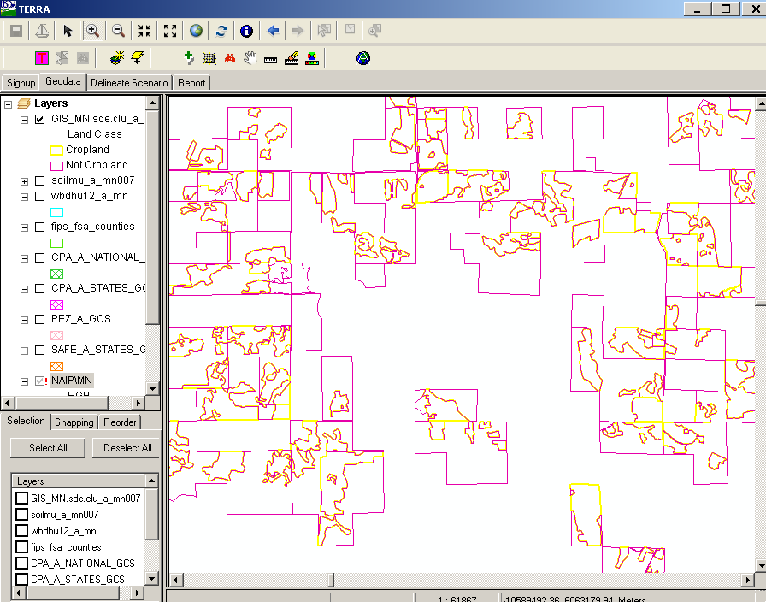

TERRA
The Tool for Environmental Resource Results Assessment (TERRA) enables FSA county office employees to determine the environmental and wildlife benefits of a contract scenario.

Slide 62
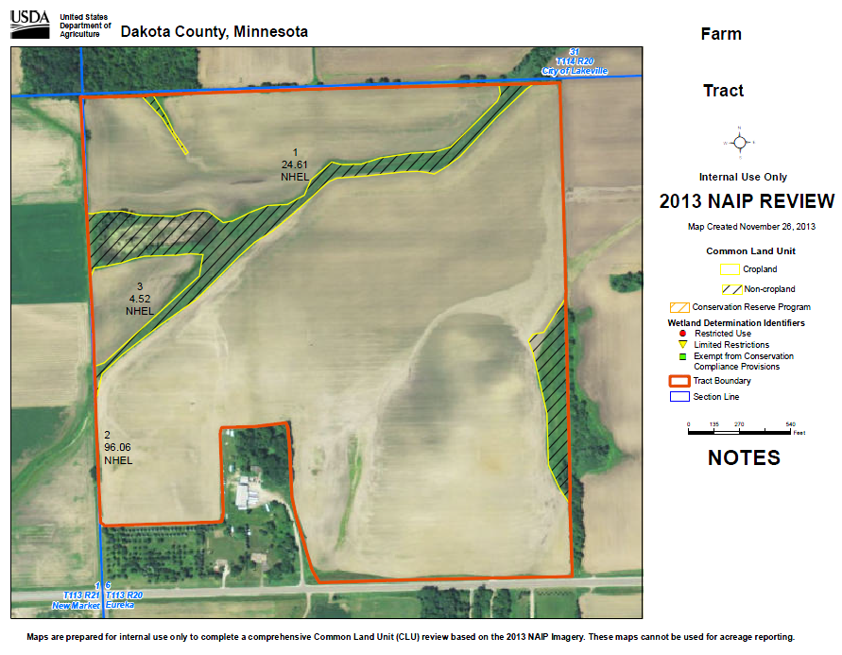
Acreage Maps
Tract Based
Producer Maps
2013 NAIP Imagery
Typical County Takes 3 Hours to create
1.6 Million maps created in MN Farmers

Slide 63
Minnesota Farm Service Agency
Information Section
Jeff Bloomquist
GIS Coordinator & EM Coordinator
USDA Farm Service Agency
Minnesota State Office
375 Jackson Street, Suite 400
St. Paul, MN 55101-1852
651-602-7728

Slide 64
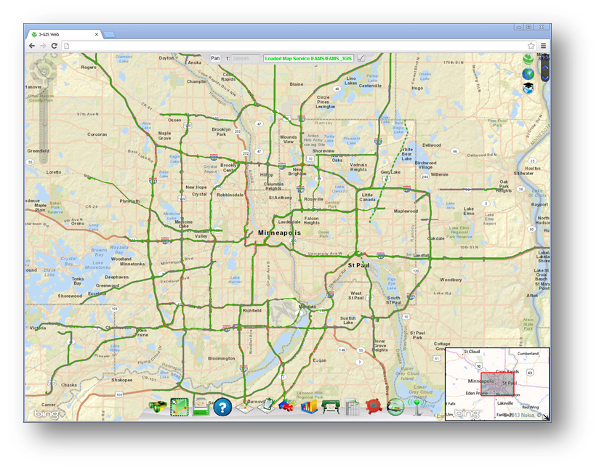
Intelligent Fiber Asset Management System (IFAMS)
Gathered detailed business requirements
Created custom data model
Cleaned/created data
Implemented web/mobile 3-GIS

Slide 65
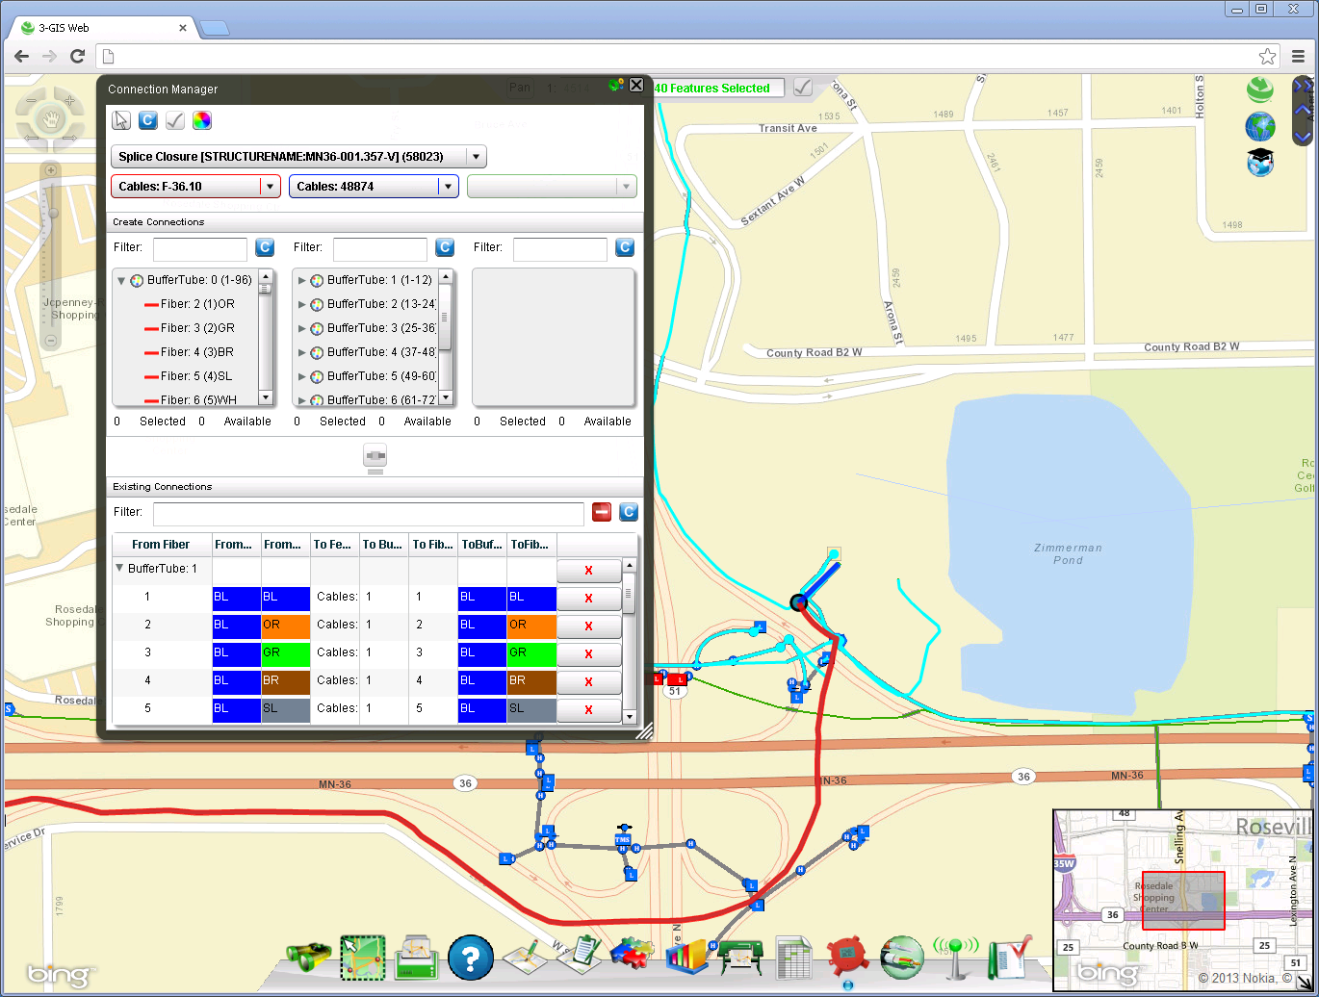

Slide 66
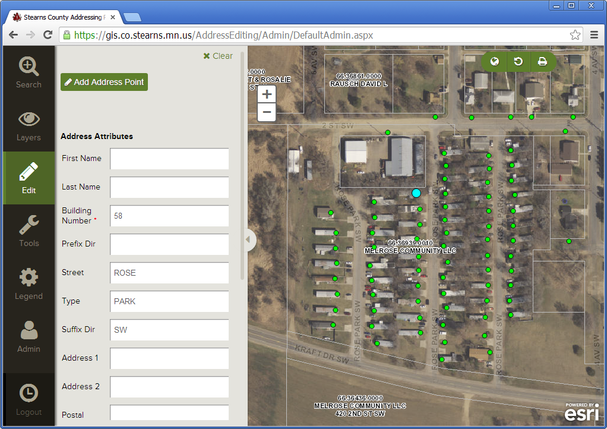
Stearns County Addressing App
Easy to use interface
Secure access
  Users can edit addresses only in their jurisdiction
  Edit tracking
Email alerts on updates

Slide 67
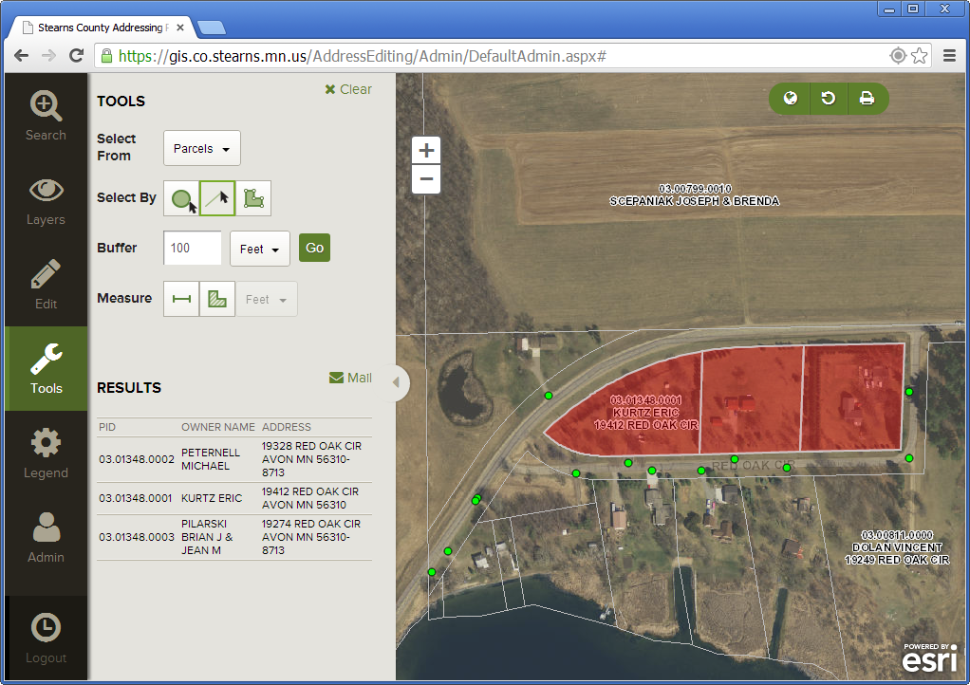
Stearns County Addressing App
Provides GIS Outreach to communities
  Mail labels
  Print basic maps
  View data
  Expandability

Slide 68
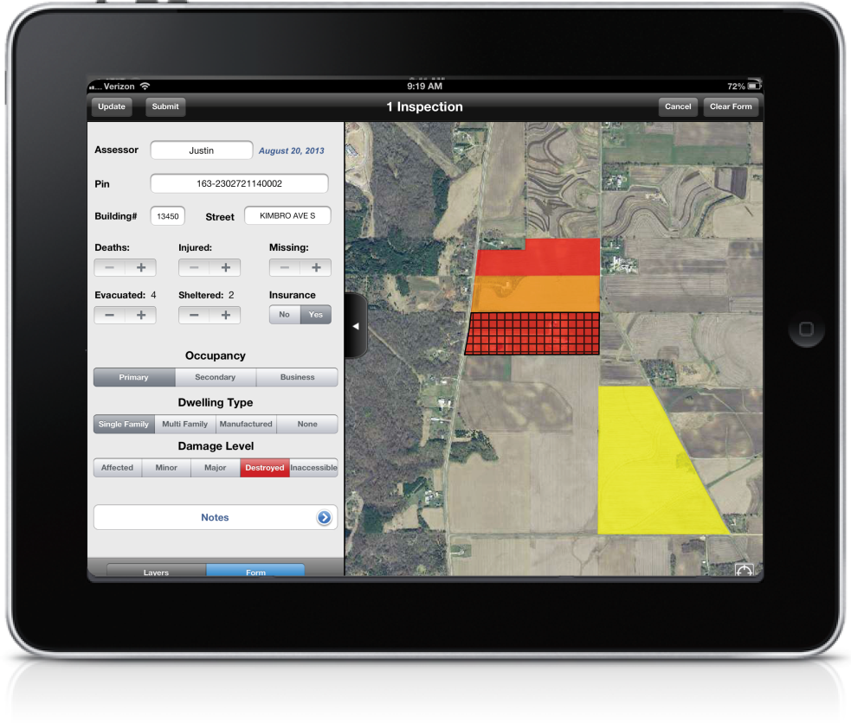
Rapid Damaged Assessment (RDA)
Custom iOS client for field data collection
JavaScript Dashboard to view real time data
Generates standard FEMA reports
Shares data between the Red Cross, Counties, Cities, HSEM

Slide 69
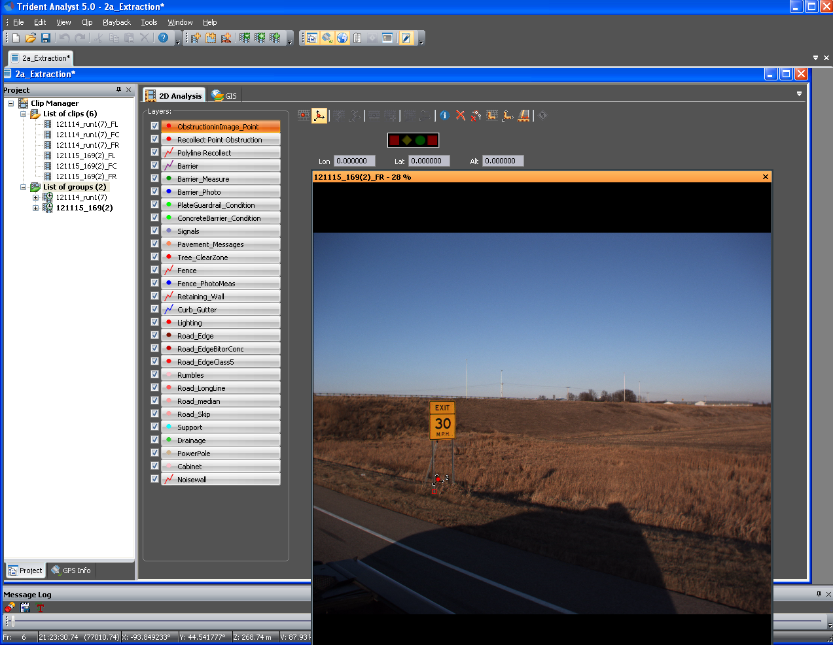
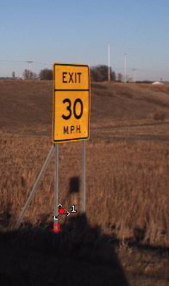
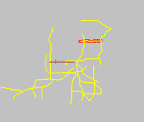
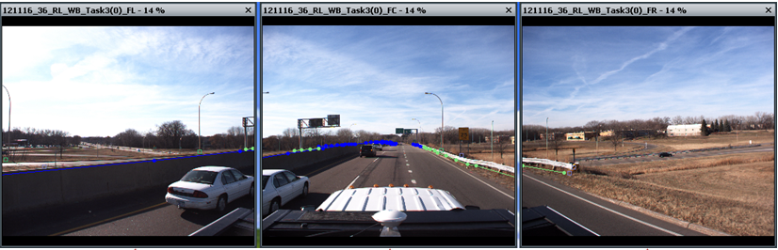
Trisha Nelson - GIS Extraction Project
Inventory for Barriers
High Resolution Camera’s
12.5’ Interval Photo
High Accuracy GPS
Desktop Mining – Safe & Efficient
Accuracy ~1’
Future As-built?

Slide 70
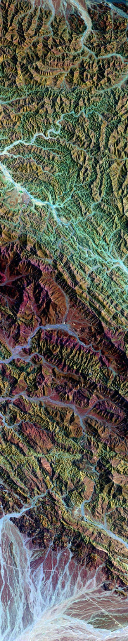










Non-Profit & GIS
Kody Thurnau, GIS Specialist
Minnesota Center for Environmental Advocacy
26 East Exchange Street, Suite 206
St Paul, Minnesota, 55101
www.mncenter.org

Slide 71

Mission
…using law, science, and research to protect Minnesota's natural resources, wildlife and the health of its people.
How we do it
…work at the legislature, in the courts, and with public agencies to enact, strengthen, and enforce smart environmental laws.
Who are we
-Attorneys (Environmental law experts)
-Scientist, planners, and issue experts
-Legislative experts

Slide 72



Natural Resources
Water Quality
Land Use and Transportation
Public Health
Energy Policy
Environmental Review
Litigation
Partnerships
Mining

Slide 73
Natural Resources
Water Quality
Land Use and Transportation
Public Health
Energy Policy
Environmental Review
Litigation
Partnerships
30%
40%
30%
Mining

Slide 74
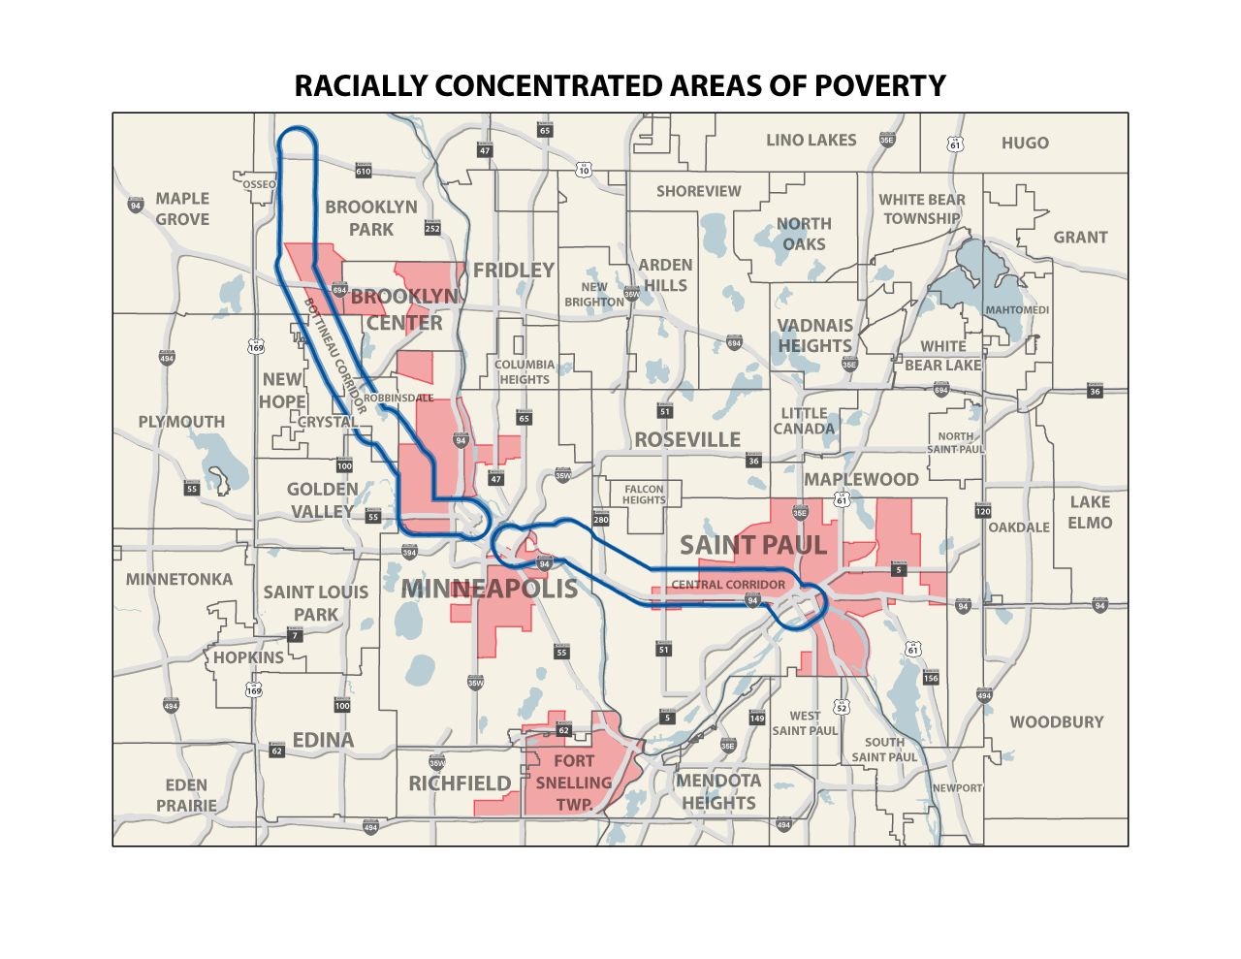
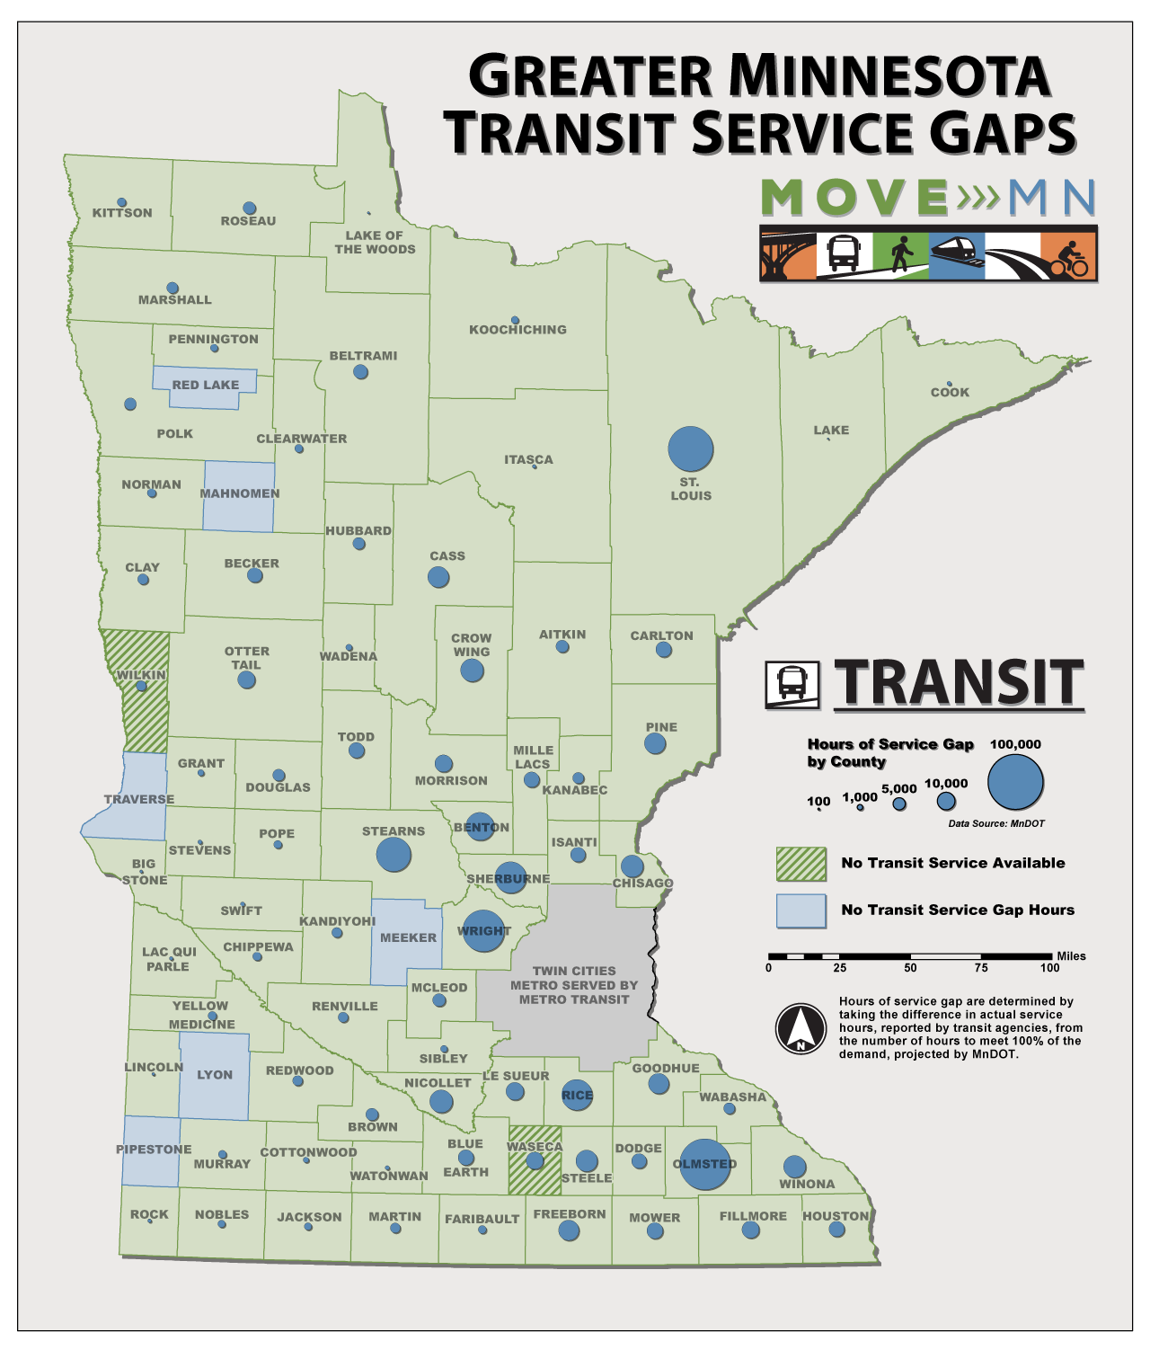
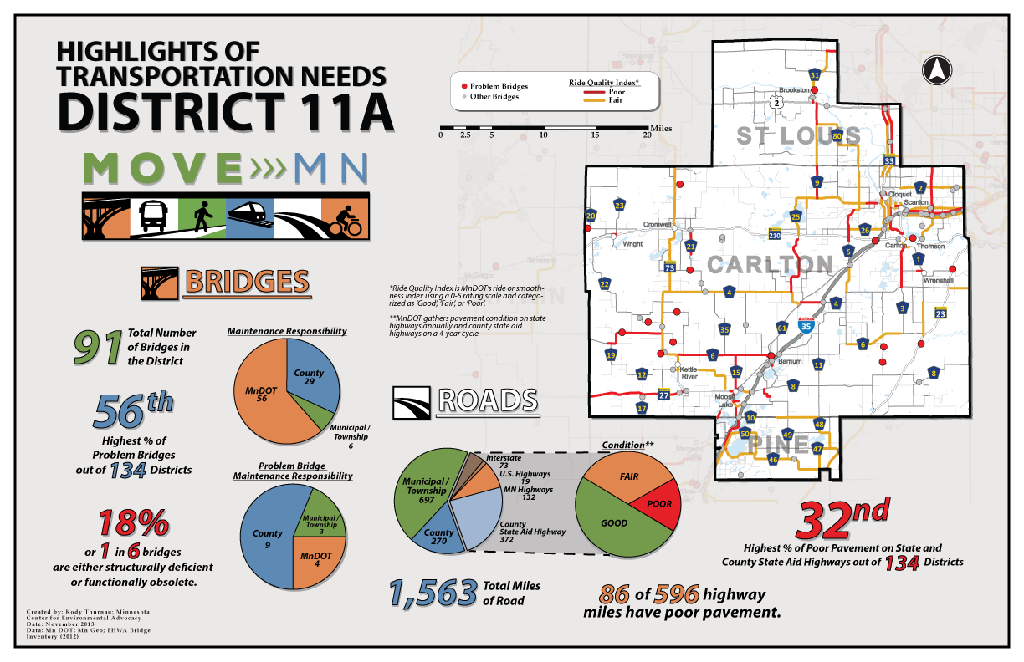
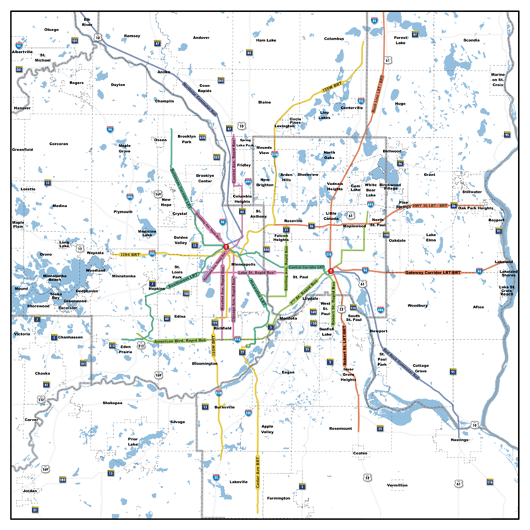

Slide 75
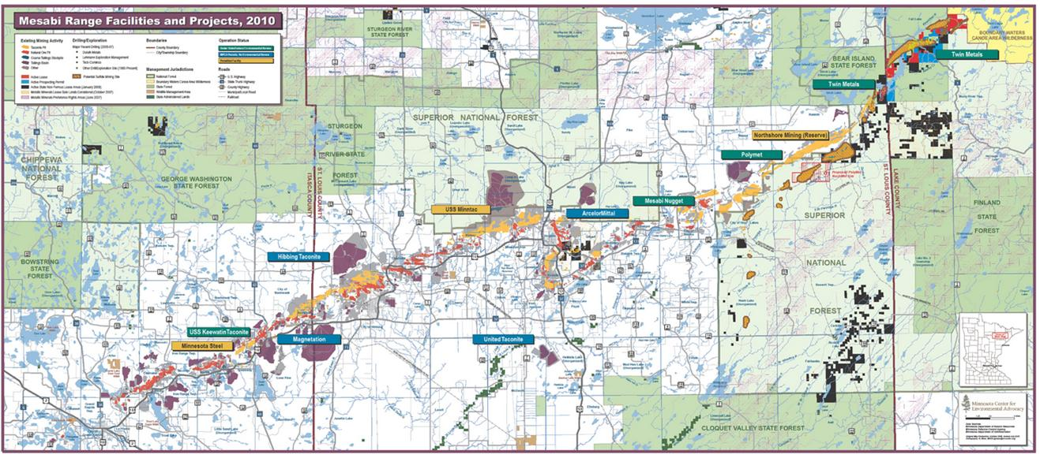
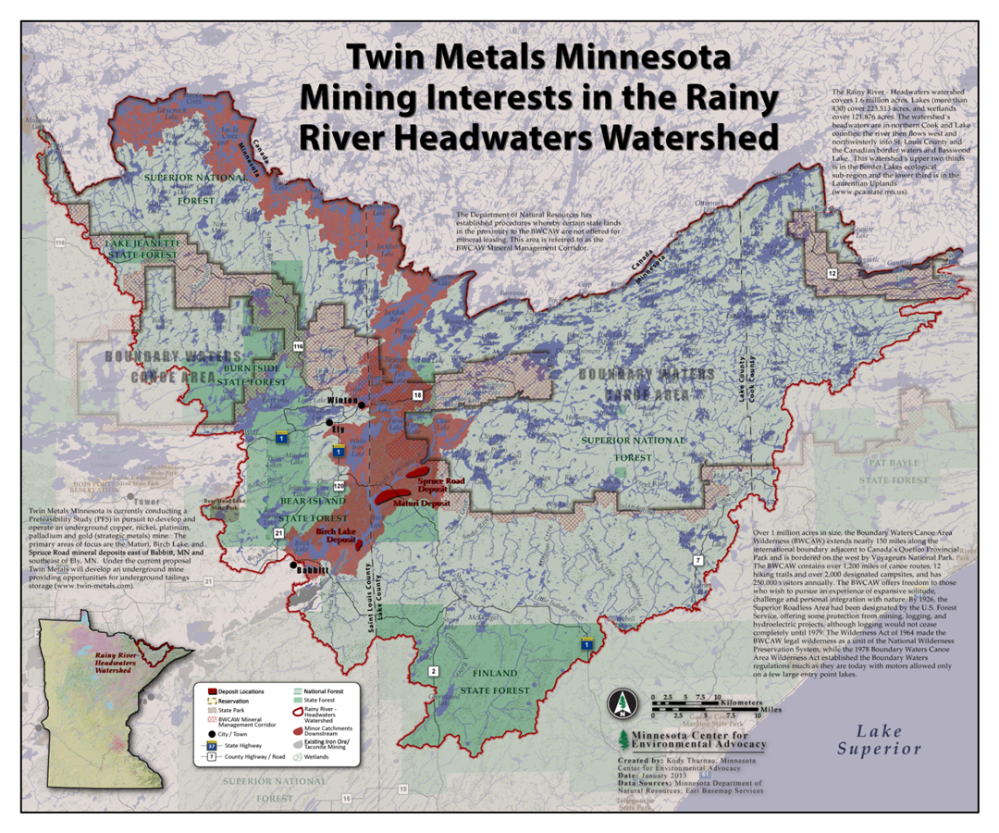

Slide 76
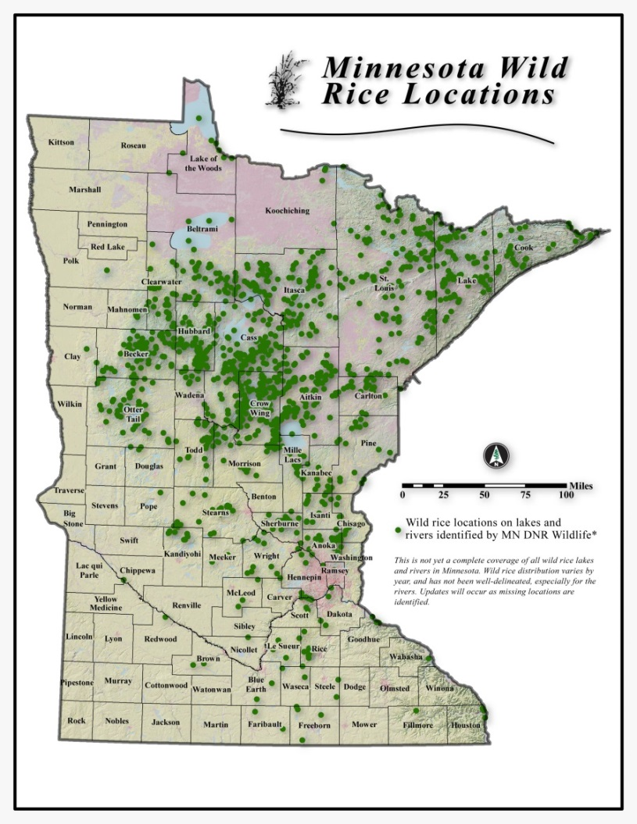




Slide 77


Slide 78

General Non-profit Uses of GIS
Program and Service Delivery
  NGOs that provide some sort of service
  Locating needs, routing, etc.
Research and Analysis
  Modelling efforts, analysis, etc.
Fundraising and Development
  Mapping donor locations (missing a geographic donor pool)
  Connecting donors with issues in their geographic location
Advocacy / Storytelling
Community Resource Mapping
  Gathering community input from the affected community
  PPGIS

Slide 79





Opportunities Exist
Funding / Grant opportunities are out there
  $100/year Arc Advanced
  ArcGIS Online Discounts
  Google Maps Engine
  Open Source
Map requests continue to rise from partners / stakeholders
  Demand is there

Slide 80
What I have been doing as the Non-profit Rep
Only been in non-profit work for a year
Met with MN Council for Nonprofits
Continuing to push public agencies to make data more readily accessible and thorough documentation
Showing the power of geographic information to advocate and message

Slide 82
Update - MnGeo Priority Projects
  Addresses
  Aerial Imagery
  Altered Watercourse
  Geospatial Commons
  LiDAR/Elevation
  Hydrography
  Parcels
  Street Centerlines

Slide 83

Addresses
Future Project

Slide 84


Statewide Aerial Imagery Partnerships
Project Overview:
Complete statewide 4-band, leaf-off aerial imagery (ortho and stereo) at ½-meter resolution over 5-seasons
For DNR’s National Wetlands Inventory (NWI) update efforts; support provided through the Environment and Natural Resources Trust Fund
Buy-up opportunities offered where feasible: 12 & 6-inch resolution
22 Buy-up Partnerships:
Federal (2) f State (2) f County (14) Tribal (2) f Regional (1)
Financial Support
State Funds: $1,100,000
Partner buy-ups: $ 900,000

Slide 85

2013 Statewide Aerial Imagery Progress
Project Description:
$750K project coordinated between DNR, MnGeo, MnDOT, 11 local partners, 34 cos
2013 Progress:
9 partner buy-up JPAs executed
Vendor selected; contract let
High res collected: Carlton, Clay, Itasca, Mille Lacs, Wilkin Counties; White Earth & Fond du Lac Reservations; Camp Ripley
Medium res collected: Three E/W bands
26,000 square miles of data acquired in 2013 has been accepted
2014 Plans:
Complete balance of 39,000-sq mi area
3 partner buy-ups: Beltrami, Polk, McLeod

Slide 86

MnGeo Image Service Activity - 2013
Project Overview:
A Web Mapping Service publishing 61 raster data sets, including:
Aerial imagery
Hillshade elevation
USGS topographic maps
In 2013, more than 48-million image view requests were made. Top 5 data sets make up 80% of those requests:
2010 NAIP leaf-on Statewide 1-meter
2011 DNR leaf-off Southern MN ½-meter
2012 NGA leaf-off Metro 1-foot
2010 DNR leaf-off Metro 1-foot
Best Image Service Statewide composite
New Additions:
2013 DNR leaf-off Central & NW MN ½-meter & 1-foot
Notes:
Image Caption: An example of Spring 2013 one-foot resolution color infrared imagery from Clay County, showing the confluence of the Red and Buffalo Rivers near Georgetown, MN.

Slide 87


COMPLETED!! Altered Waters
Susanne, Jim K., Stephen, Jim D. and Whole Bunch of Students!
The Altered Watercourse Project Expedition
April 2011 – June 2013

Slide 88
MN Geospatial Commons – June 30, 2014
A single place we all go to find and share geospatial resources
Where are we?
  Release 1 complete
    Demo usability
  Align infrastructure and data
    Assessment of existing agency infrastructure
Evaluate
Share
Administer
Find

Slide 89


LiDAR Elevation – Winter 2014
Partnership with MN DNR to:
  Provide FTP site
  Improve data download
  Develop browser viewer

Slide 90

MnTOPO

Slide 91

Hydrography – In progress
  Hydrographic features for making maps
  A national stream addressing system
  A modeling network for navigating upstream/downstream
  A maintenance infrastructure
  Additional tools to enhance use of data
  Move toward a single geo-representation for surface water
Notes:
Graphic – St. Louis River Basin is the central basin – emptying into Lake Superior. Hydro features include lakes, rivers for mapping (1-d, 2-d), rivers for networking (1-d); A system of Watershed Boundaries (WBD) is also included. Those are the red lines on this graphic.
Flow volume and velocity within catchments

Slide 92

Statewide Parcel Integration Project – aligning with Revenue efforts
Legislation
License Agreement
Exchange Guideline
Regional Collaborations
MN Dept. of Revenue Project

Slide 93



STATEWIDE PARCEL PROJECT
Alignment with Revenue’s
PRISM Project
Revenue considering adopting draft parcel attribute standard
First data to come in 2016
MnGeo to do parcel collect 2014
Notes:
Prior surveys and strategic plans identified the need for a statewide parcel data layer.
This project is developing a business plan. The business plan can be thought of as a tactical plan or map to guide us to our vision. It identifies current capacities, policies, obstacles, and opportunities and provides tactics to address the issues identified. The business plan establishes a business case for moving forward.
We anticipate that we will want to develop business plans to help guide us in building other critical data sets.

Slide 94










Defining business rules for the data and the system
MnGeo of Esri Roads and Highways for the partners
Statewide Centerline Initiative
Minnesota Geospatial Information Office Minnesota Department of Transportation
Metropolitan Council MetroGIS
To develop, test, refine, publish and perpetuate a single state- wide roadway dataset that meets the needs of a diverse user community…

Slide 95
NSGIC Update

Slide 96
NSGIC
Annual Conference October 27-31
    2013 Annual Google Drive Folder
    Sunday Google Doc
    Monday Google Doc
    Tuesday Google Doc
    Wednesday Google Doc
    Thursday Google Doc
Mid Year Conference
February 23 - 26
Transportation – Business Planning, Data Modelling, How should a national file be built and by whom
Addresses – How are we going to create a national Address/Point database working local > Fed
FirstNet/Broadband – How do we build on the success of this model and what still needs to be done
NSDI – EFFECTIVE mechanisms for Fed/State/Local coordination, national data sharing – what will enable us
Emergency Management Systems/Activities/Response
Coastal Issues – flooding, coastal management
Privacy Issues – What are the emerging issues and Legislative efforts surrounding privacy, UASs, geolocational tracking, etc.

Slide 97
Future Meetings – Suggested dates
March 12th, 2014
June 18th, 2014

Slide 98
Thank you!

