Slide 1
Statewide Geospatial Advisory Committee
June 2014

Slide 2
AGENDA
Call to order and introductions
Approval of March 12, 2014 meeting minutes
ArcGIS Online Minnesota Storefront
Member sector report
Updates to Minnesota’s land cover data
Break – Networking 12:15 PM
Recorders fee proposal update
MnGeo priority efforts updates
Data sharing initiatives update
Committee and workgroup update
Governor’s Commendation
Adjourn

Slide 3
Introductions

Slide 4
Approval of March 12 Minutes
Nancy Rader

Slide 5
ArcGIS Online
Minnesota Storefront
MnGeo Statewide Geospatial Advisory Council Meeting
Norman Anderson, MnGeo
June 18, 2014

Slide 6
AGENDA
What is ArcGIS Online?
ArcGIS Online Workgroup
Minnesota Storefront
Whitepaper / Governance
Collaboration Example
Geospatial Commons
ArcGIS App

Slide 7


ArcGIS Online
What is it?
  Content Management System
  Collaboration Tool
Where is it?
  Software as a Service
  Browser / Smart Device
Notes:
Focus on mapping

Slide 8
ArcGIS Online
Who sees it?
  User account: Login & Password
    Assigned a Role
  Share: Group (project), Organization, Public
  Based on Roles and Sharing

Slide 9
AGOL Workgroup
Multi-Agency Membership
Explore the Capabilities
Create the Governance Document
Build the Minnesota Storefront
Geospatial Commons
Training
Miscellaneous

Slide 10
Minnesota Storefront
Minnesota Maps
Storefront
  Featured Content
    12 Featured Items
  Gallery Content
    Agencies can ‘Share’ Content
  Public Viewable Content (most)
My Content
Notes:
USA Counties
Public items can generally be saved to your ‘My Content’

Slide 11
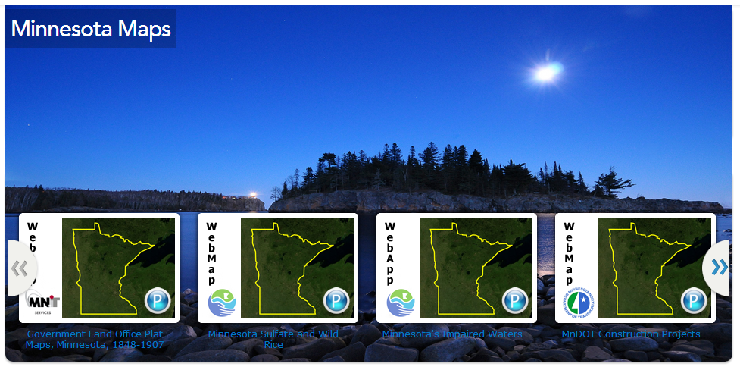
Featured Content

Slide 12
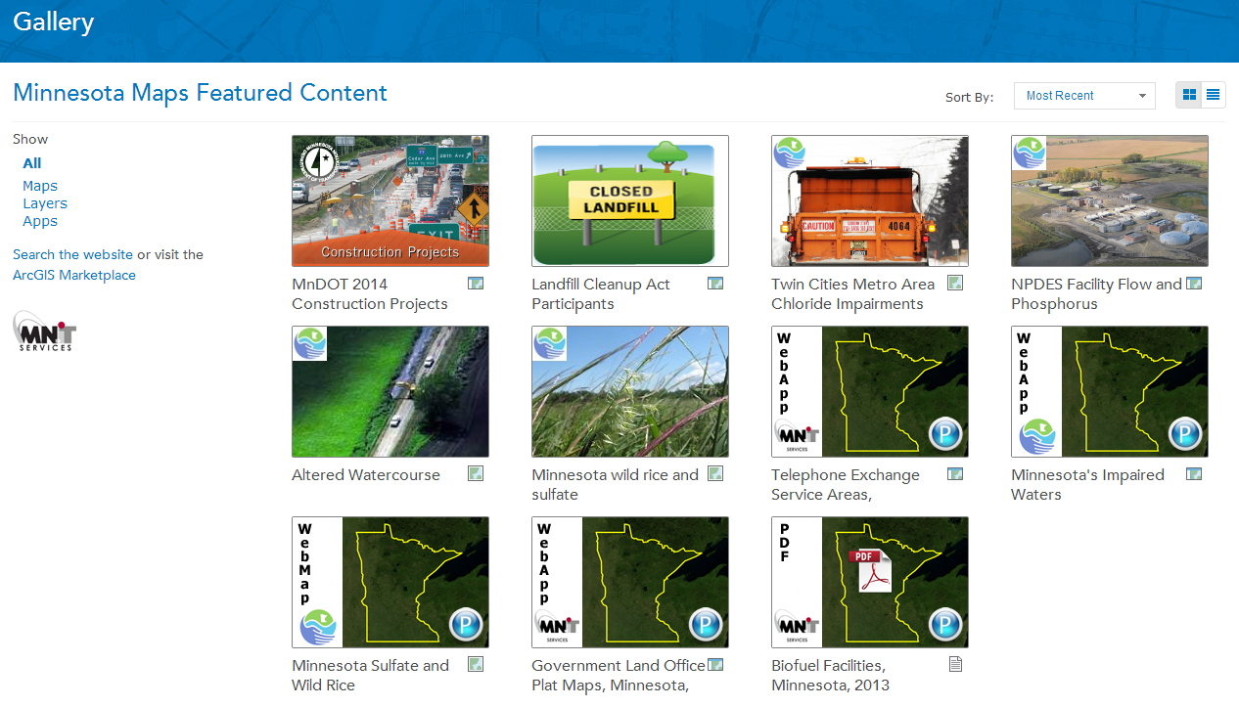
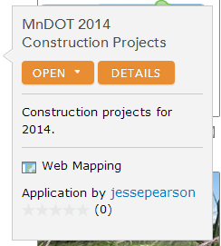
Gallery

Slide 13
White Paper
Governance for Agencies
Information for Agencies Starting
Any Question?

Slide 14
An Example - Telephone Exchange Boundaries
Background
FCC Order 11/6/12 with data due 6/28/13
  Eight months from zero to complete
Partners
  90+ Service Providers
  Minnesota Telecom Alliance
  Department of Commerce
  MnGeo
  FCC

Slide 15
Telephone Exchange - Results
ArcGIS Online had the Tools
  Edit with a Browser
We met the Deadline
Significant Savings
High Participation
Happy Users
Public Viewable Map

Slide 16
Geospatial Commons
Close Integration
Both Workgroups Ready

Slide 17
ArcGIS App
Apps for Smartphones and Tablets
  Apple App Store
  Google Play
  Windows Phone Marketplace
GPS on Device
Wireless Internet Connection
  Cellular
  Wi-Fi (disconnected editing)

Slide 18
Questions

Slide 19
Member sector report…
Cory Richter, City of St. Paul

Slide 20

Cory Richter
SWGAC June 18, 2014
Metro City representative

Slide 21
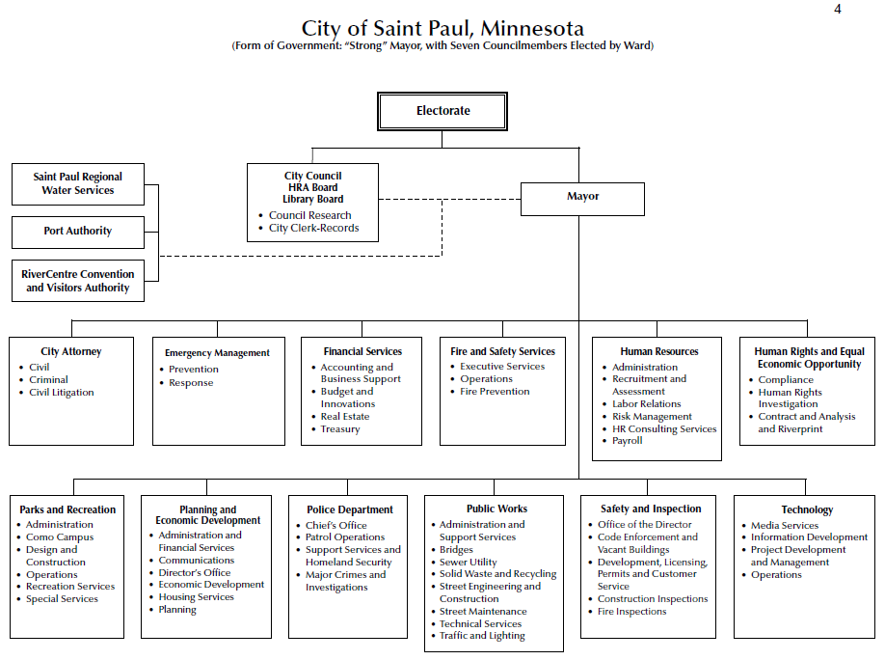
Fast Facts
Population 287,151 – 2nd most populous City in Minnesota
More city shoreline on the Mississippi River than any other city
More than 80 languages are spoken in Saint Paul public schools
Over 850 miles of streets
Infrastructure valued $2.9 billion
2700+ employees

Slide 22
Diverse Services = Diverse GIS needs
esri
AutoDesk
Open Source

Slide 23
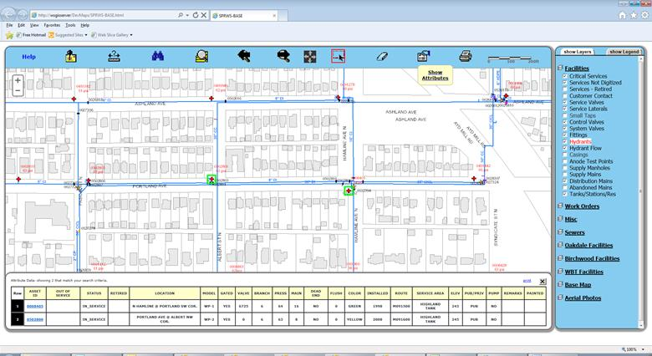
Saint Paul Regional Water Services

Slide 24
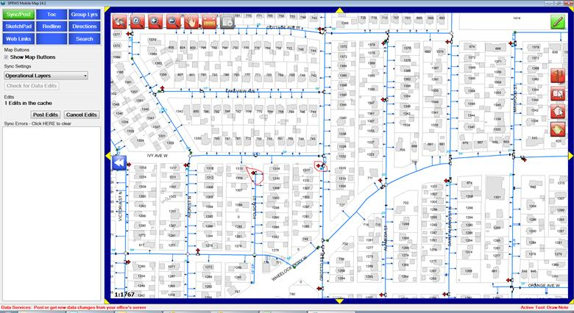
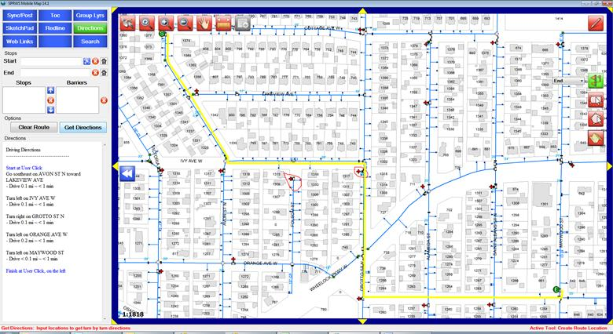
Saint Paul Regional Water Services

Slide 25
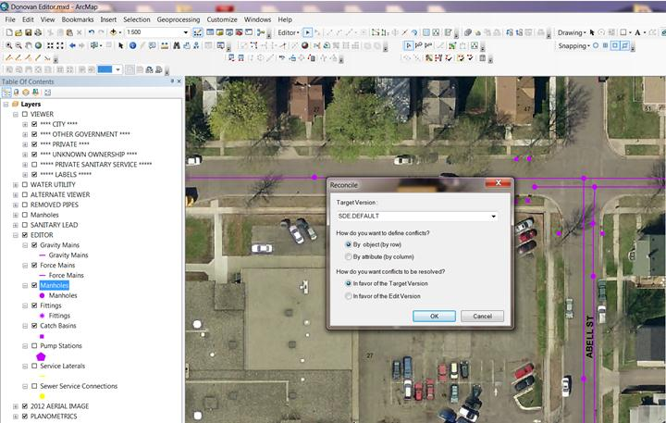
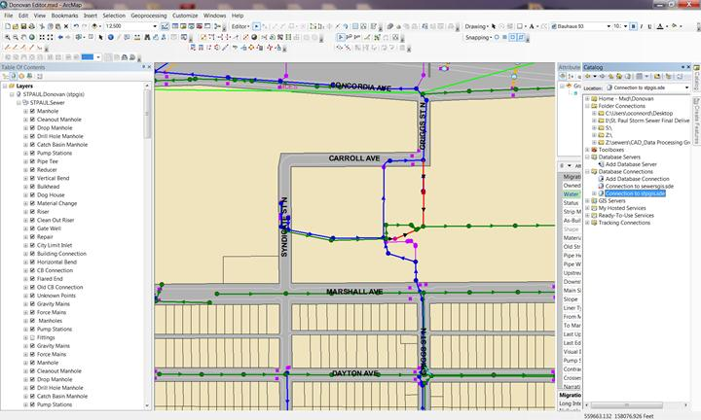
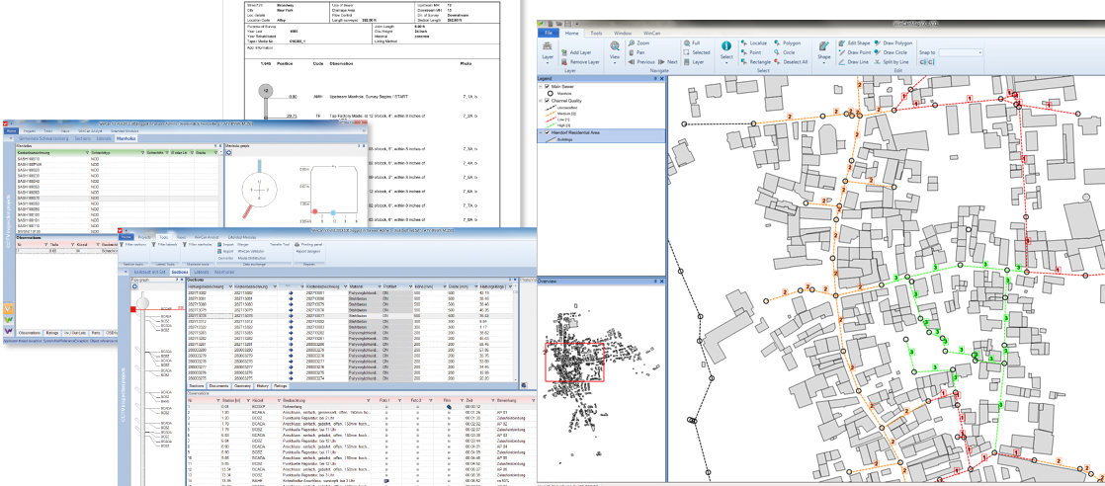
Public Works Sewer Division

Slide 26
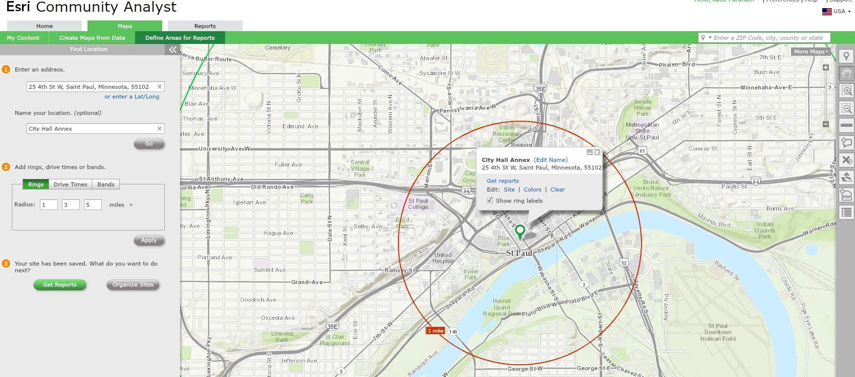
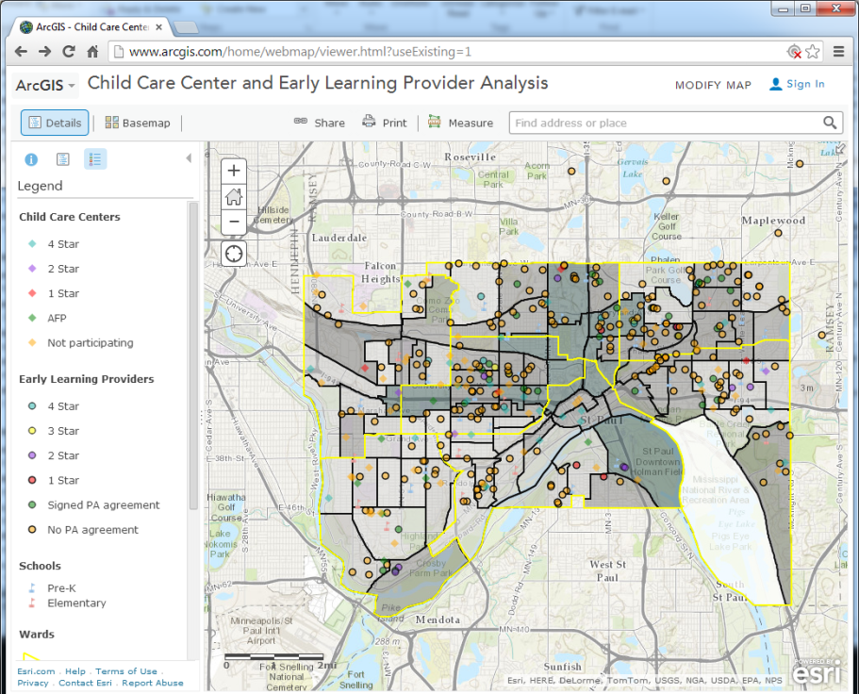
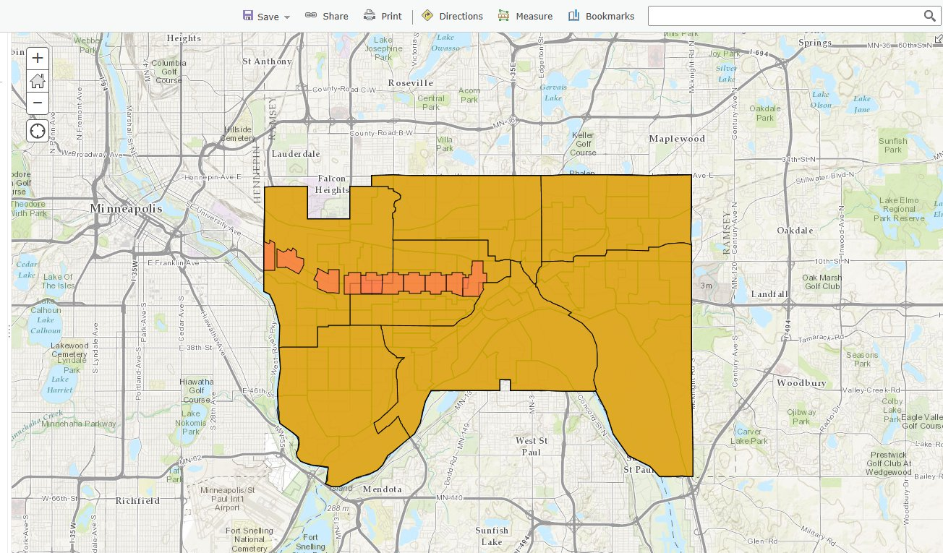
Public & Economic Development

Slide 27
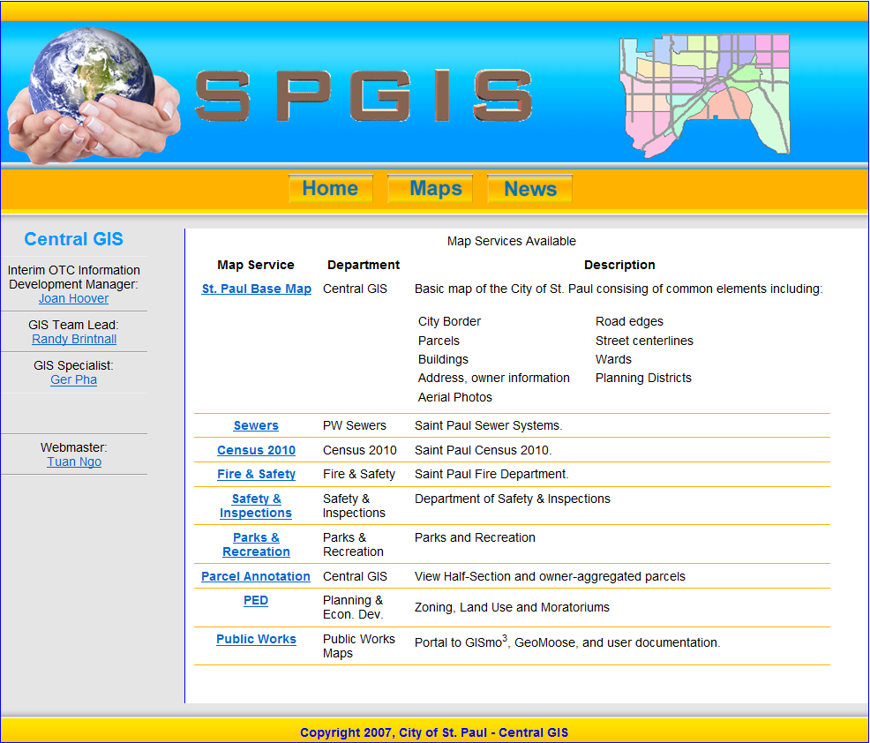
Central GIS

Slide 28
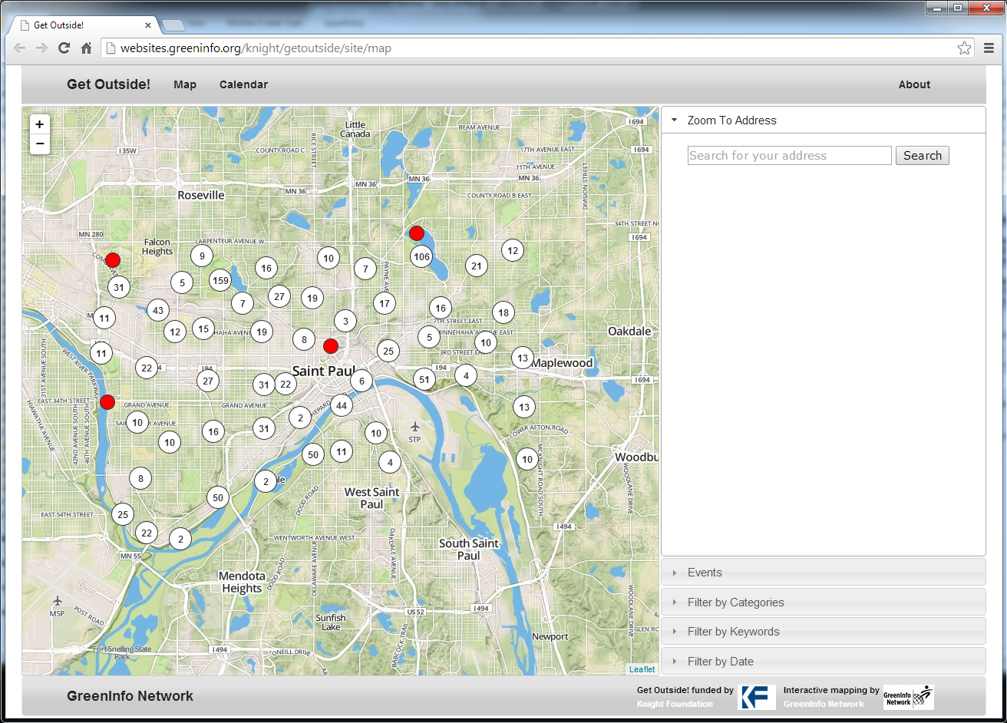
Parks & Recreation

Slide 29
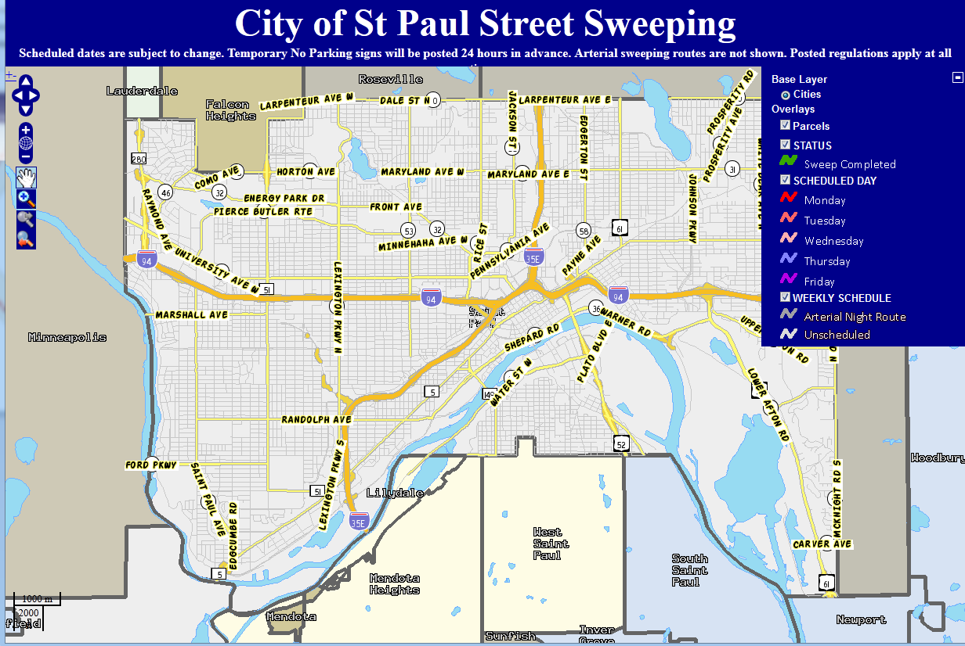
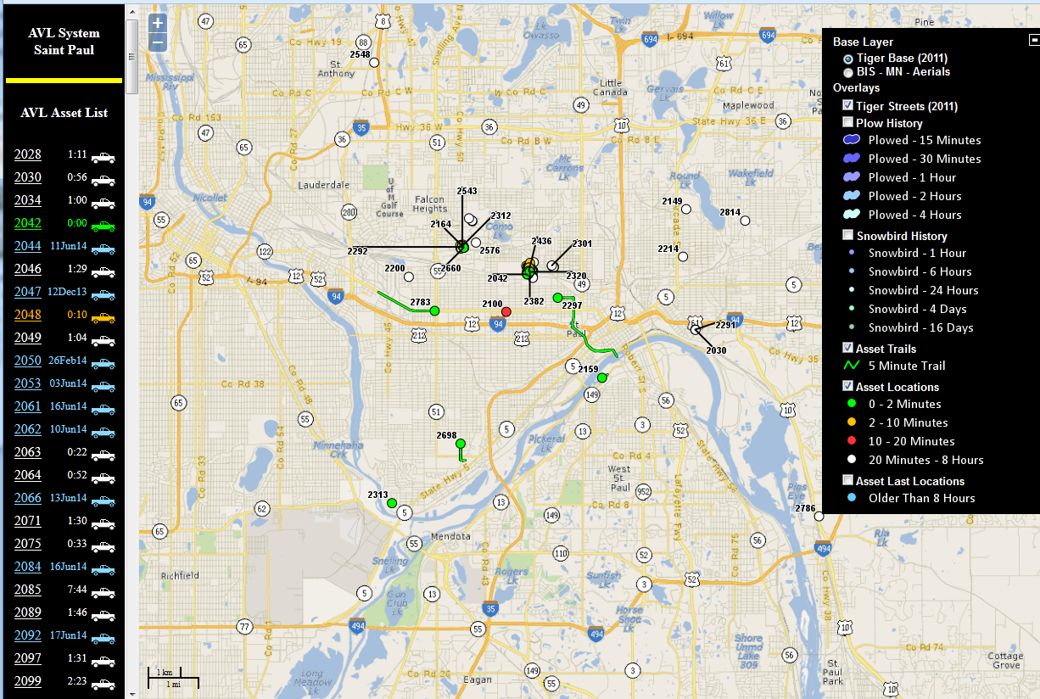
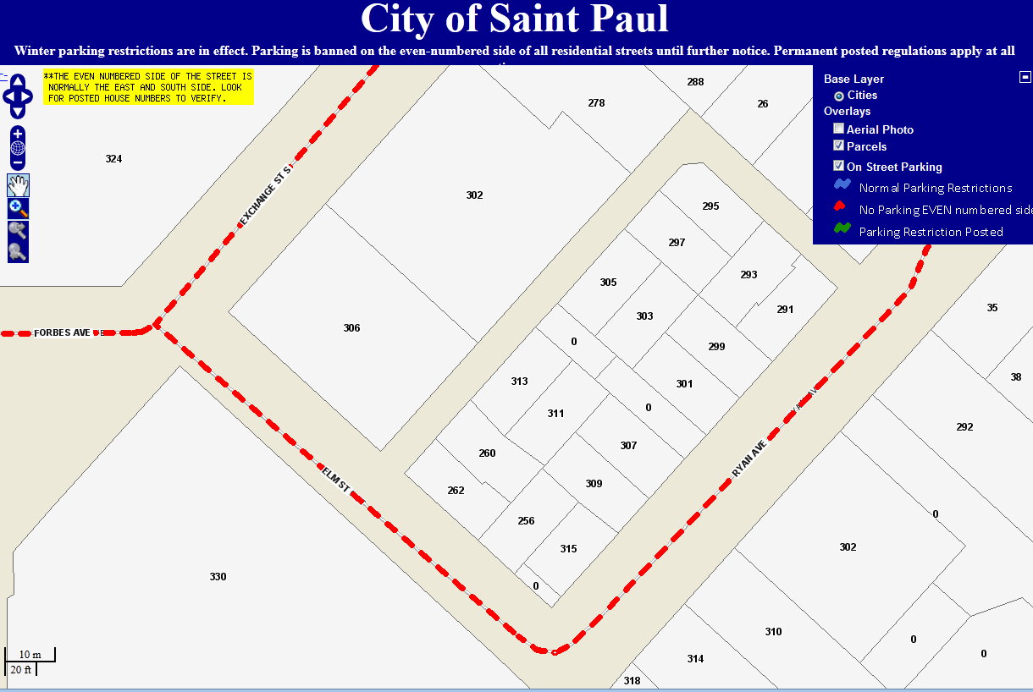
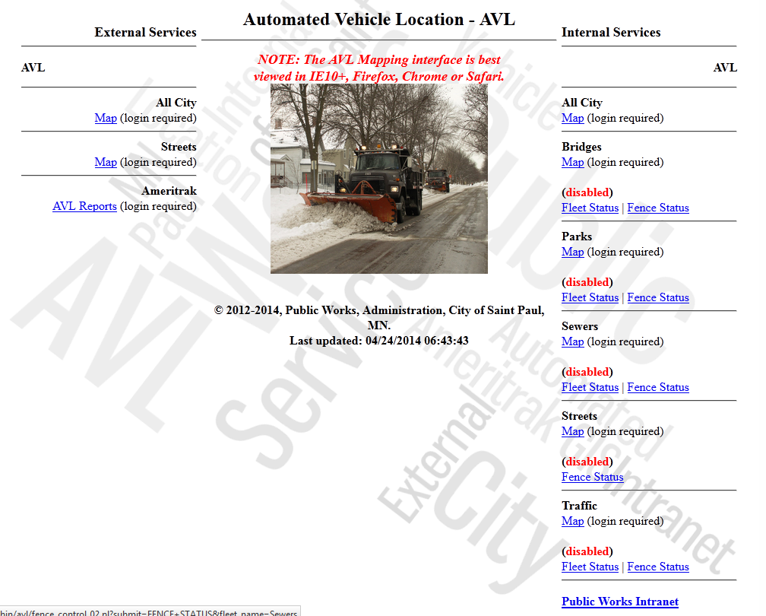
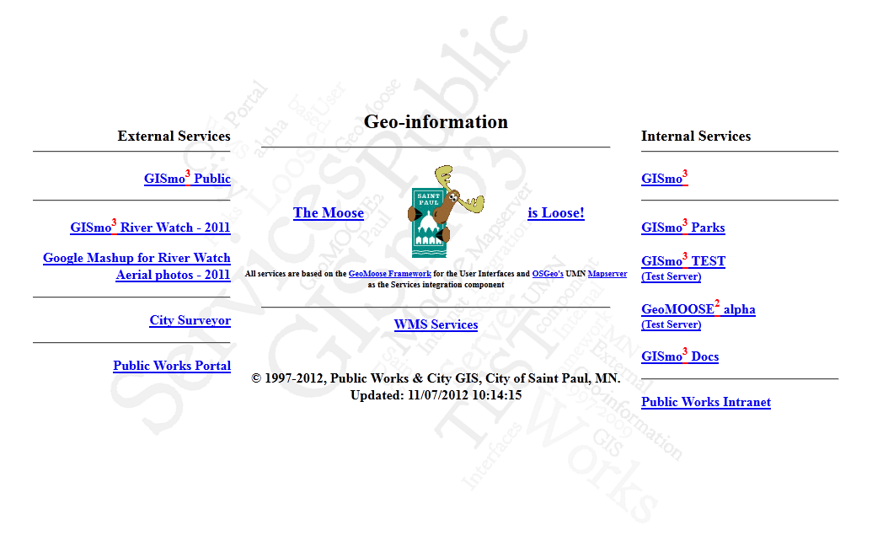
Public Works

Slide 30

Mobile Saint Paul

Slide 31
Cory Richter
Saint Paul Public Works
cory.richter@ci.stpaul.mn.us
651-266-6156

Slide 32
Updates to Minnesota’s Land Cover Data a LCCMR project
Discussion: How to fund future land cover updates and change maps
Joe Knight, University of Minnesota

Slide 33

Update on 2014 Statewide
Land Cover Project
Joe Knight & Marv Bauer
Remote Sensing and Geospatial Analysis Laboratory
University of Minnesota

Slide 34
Outline
Overview of LCCMR project
Recap of existing MN land cover products
Mechanisms for updates beyond 2014

Slide 35
Overview of Project
Create updated land cover layer for the state
Based on 2012-2014 image data w/ statewide lidar
30 m (~100 ft) statewide,
2 - 4 m (~7 - 13 ft) Metro and selected areas
Products and statistics will be freely available online.

Slide 36
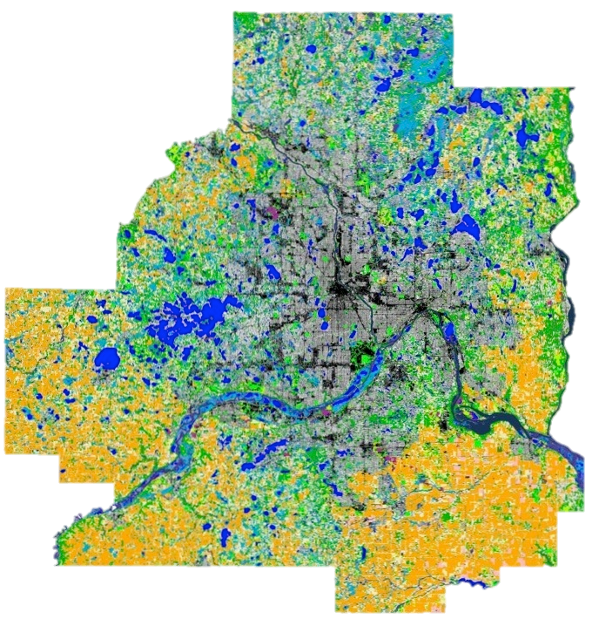
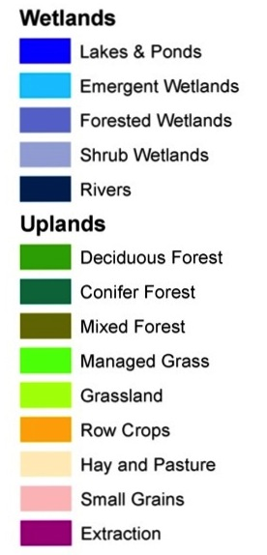

2011 TCMA Land Cover
Level 2
Overall Accuracy
Level 1 92%
Level 2 91%
Urban/Developed
Funded by Metropolitan Council

Slide 37
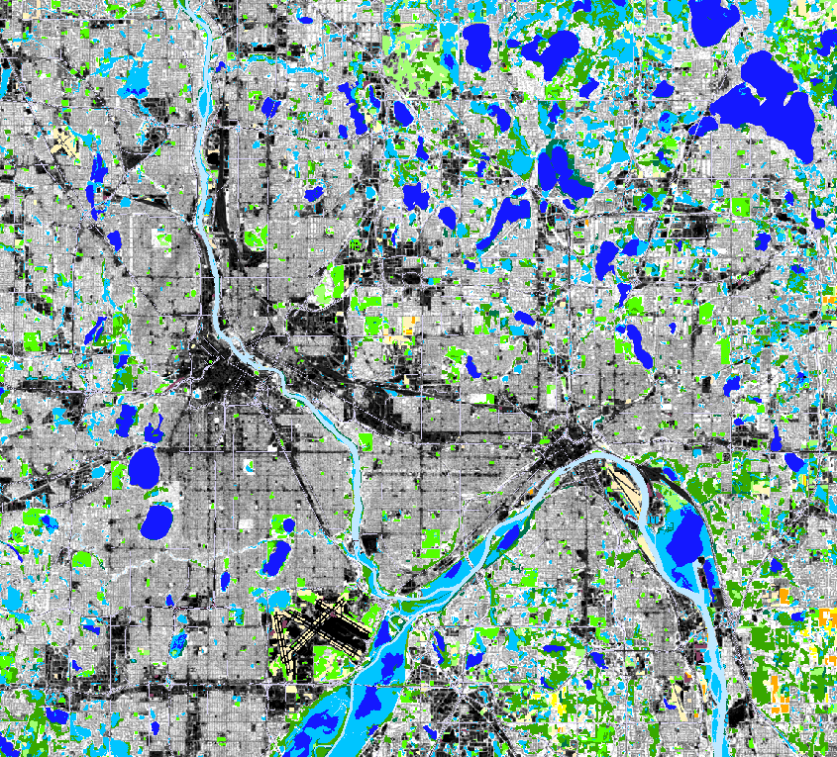
TCMA 30 m Examples
Downtowns

Slide 38
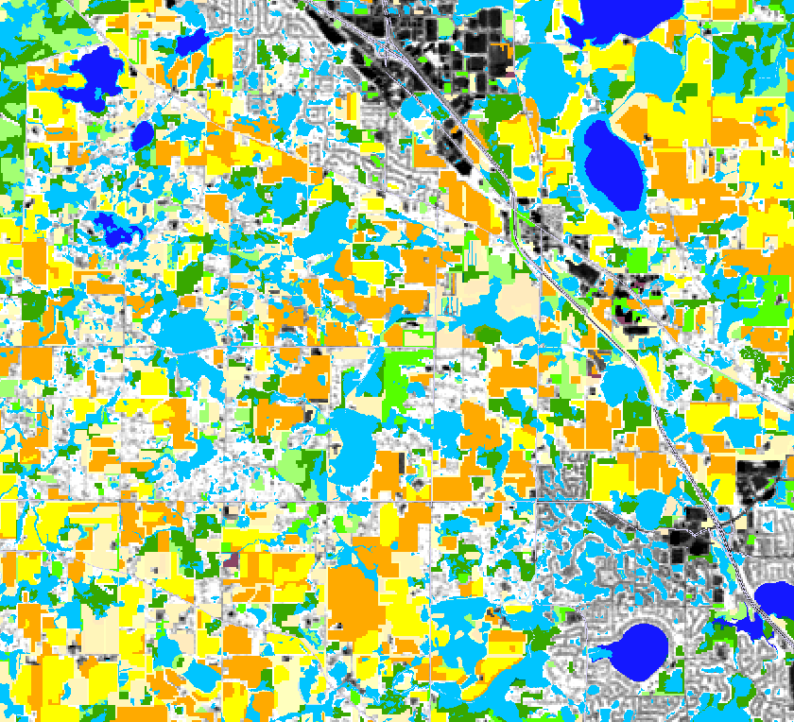
TCMA 30 m Examples
Agriculture area b/w Rogers and Maple Grove

Slide 39
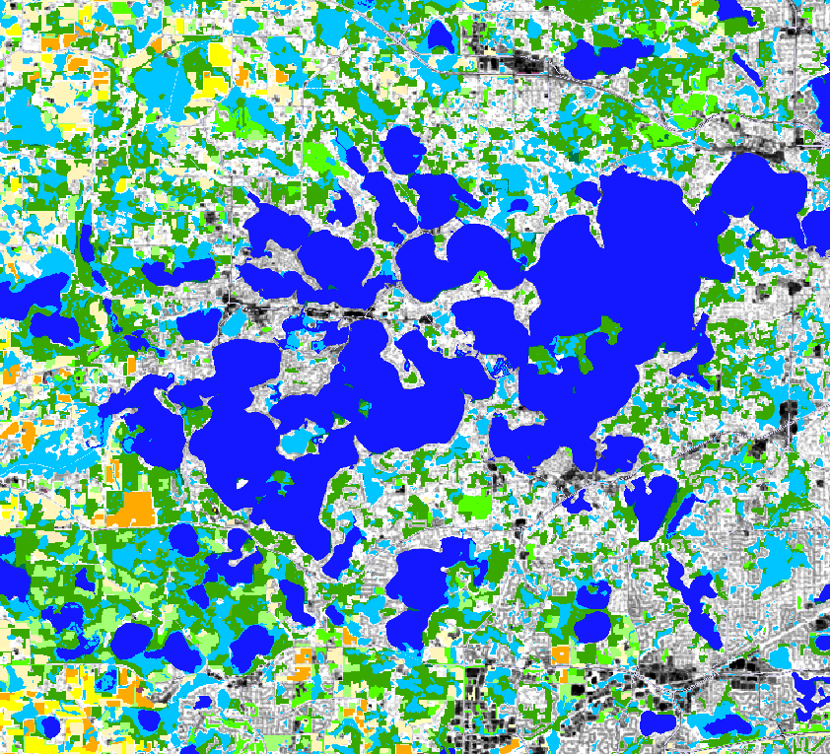
TCMA 30 m Examples
Lake Minnetonka area

Slide 40
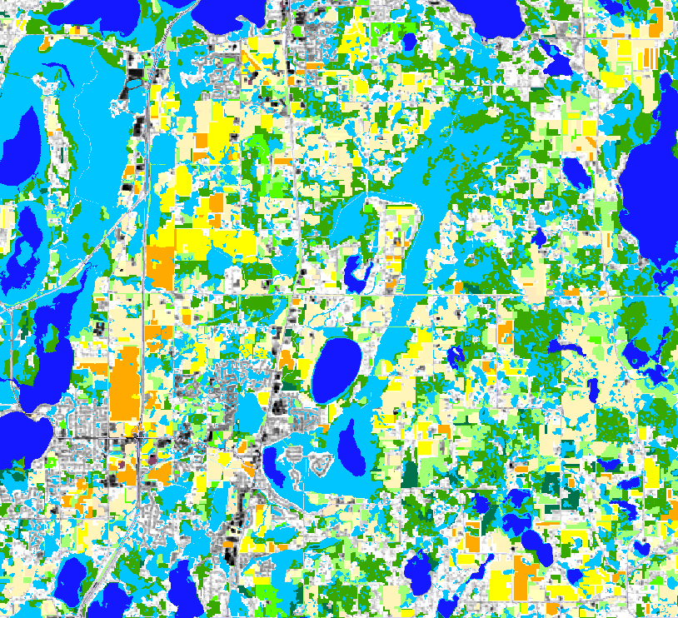
TCMA 30 m Examples
Wetlands SE of Forest Lake

Slide 41
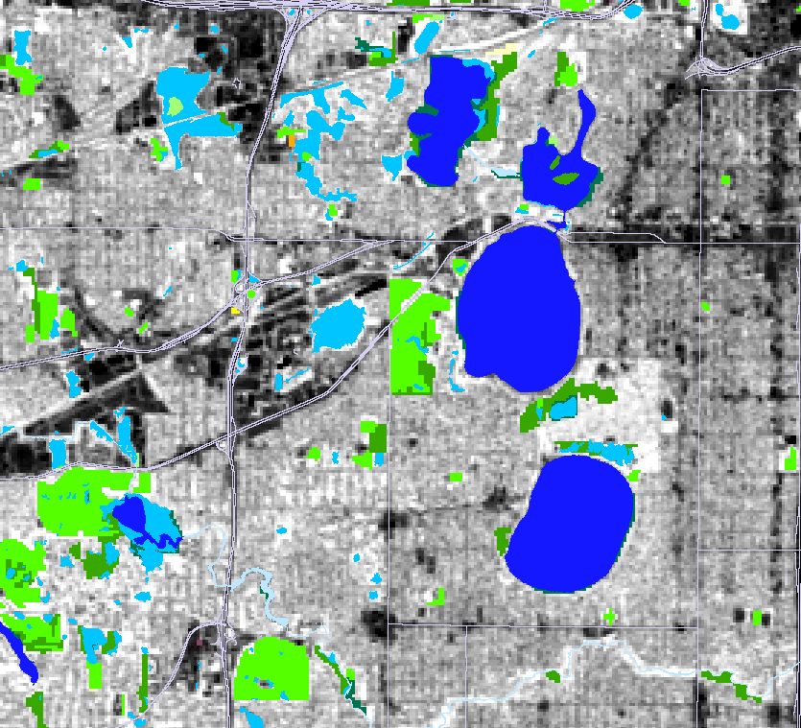
TCMA 30 m Examples
Lake Calhoun / Harriet area

Slide 42
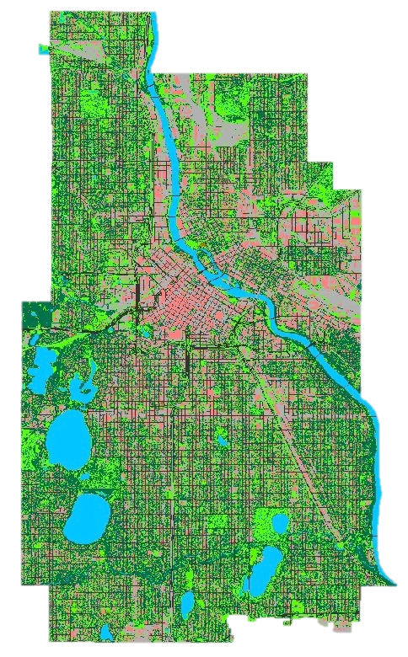
High Spatial Resolution Mapping
Urban Tree Cover in
Minneapolis
Class Percent
Tree Canopy
31.5
Grass/Shrub
19.7
Bare Soil
0.2
Water
6.2
Buildings
15.5
Streets
9.5
Impervious
17.5
Funded by cities of Minneapolis, St. Paul, and Woodbury

Slide 43
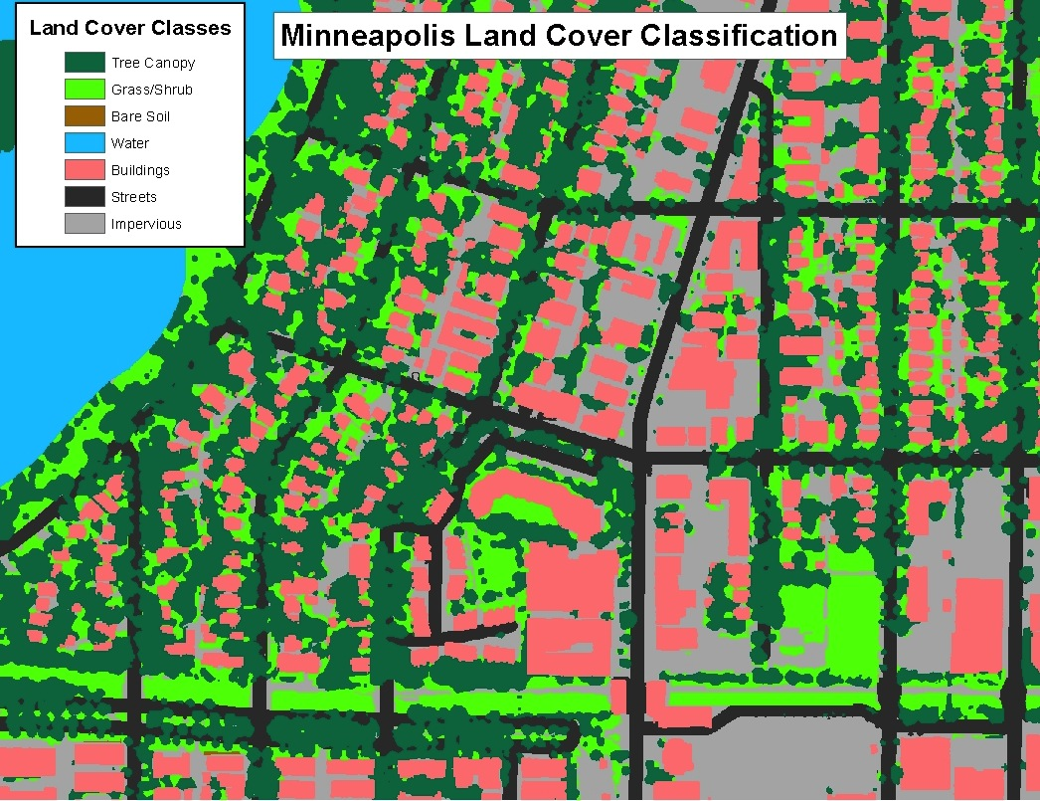
Detailed View of Minneapolis Classification

Slide 44
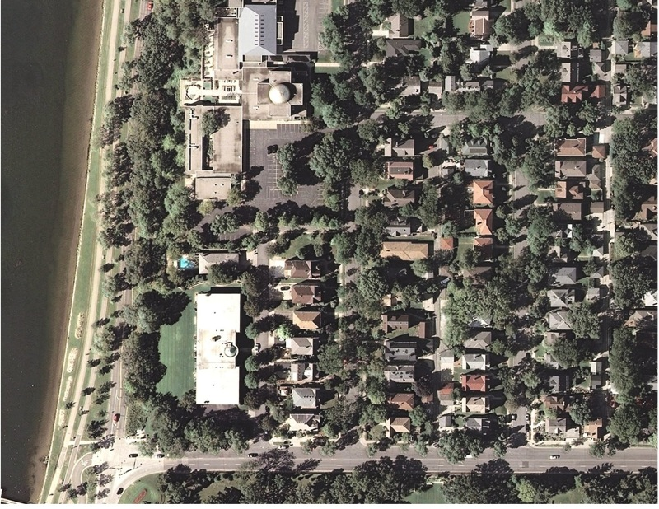
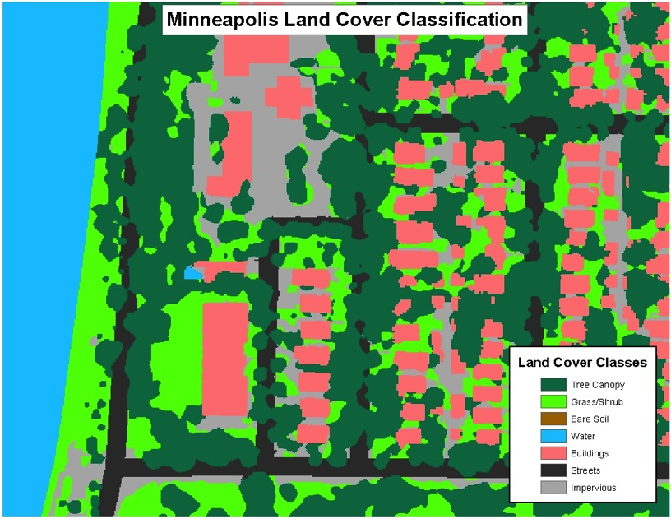
Comparison of High Resolution Aerial Photo and Land Cover Classification
Overall accuracy: 91%

Slide 45
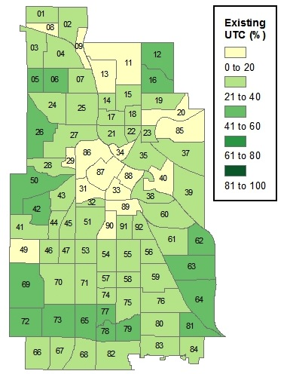
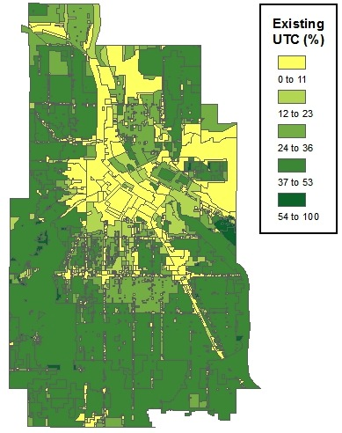
Existing Tree Canopy as Percent of Land Area for Minneapolis Neighborhoods and Zoning Districts

Slide 46
Existing Land Cover Products
Statewide
  UMN: 1990, 2000
  NLCD: 2001, 2006, 2011
  CDL: Annual, for crops only
TCMA
  UMN: 1986, 1991, 1998, 2002, 2007, 2008*, 2011
  * Minneapolis, St. Paul, and Woodbury only
NLCD: Not customized to Minnesota, has significant accuracy issues with some classes and in some parts of the state, and is infrequently updated.
We need more frequent, high quality, Minnesota-specific land cover data.

Slide 47
Uses for Land Cover Products
MN DNR hydrologic modeling
MN DNR habitat mapping/monitoring (e.g. moose)
MN DNR urban tree cover mapping
MN PCA basin-wide monitoring, modeling
MN PCA lake clarity maps
Met Council infrastructure planning
Municipal: urban tree canopy, storm water flow
Corporate: Xcel Energy, real estate, project siting
Agriculture: cropland extent, impacts on ag lands
Researchers (e.g. climate change impacts)

Slide 48
Funding Sources
Past funding
NASA: Long ago, no longer an option
Metropolitan Council: Metro only
LCCMR: Challenging, political, not a reliable source, future funding for land cover uncertain/unlikely
We have no “go-to” source to fund these important land cover updates.
We currently have to “reinvent the wheel” every time an update is needed: funding, personnel, data, methods, delivery, etc.

Slide 49
Discussion Question
Can we create a partnership between UMN and Minnesota stakeholders (agencies and others) to provide regular funding for maps and change products?
An example: A three-year update cycle at $120k per year could yield:
Year 1: Statewide land cover
Year 2: High resolution land cover for selected areas
Year 3: Statewide lake clarity maps (e.g. water.umn.edu)
… start over with Year 1…

Slide 50


30 minutes…
+

Slide 51
Recorders fee update and discussion…
David Brandt

Slide 52
MnGeo priority efforts and updates…
Dan Ross

Slide 53
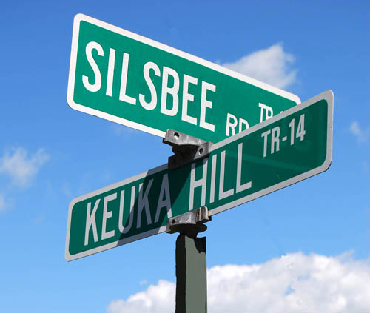
Statewide Addresses
Developed as part of NG9-1-1
Shaping the project now
Collaboration with DPS, State Patrol, MnDOT, local partners
AIigned with Street Centerlines

Slide 54
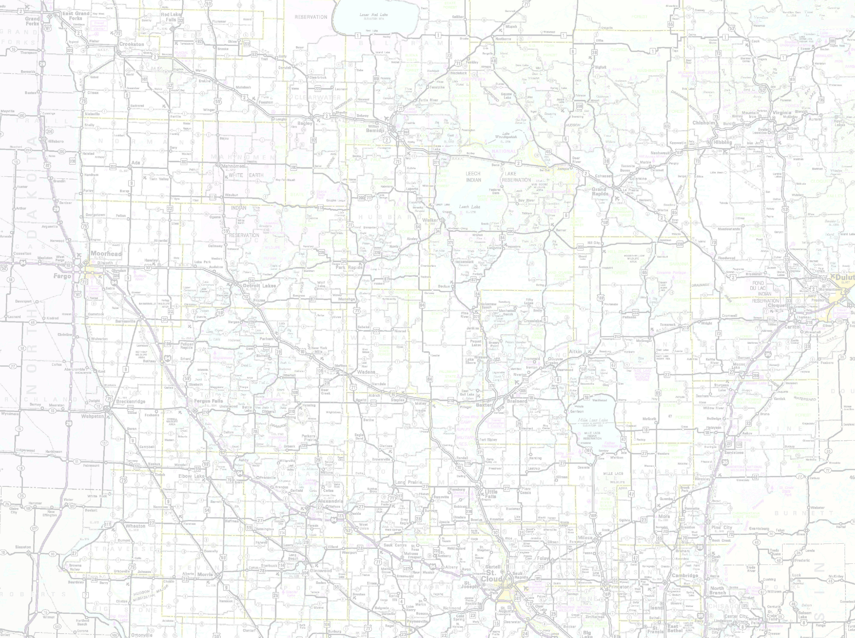







Defining business rules for the data and the system – every two weeks - August 1st
Set up - MnGeo instance of Esri Roads and Highways for the partners
Conflation of non-state data
Align with Metro counties GIS Centerlines
Statewide Centerline Initiative
Minnesota Geospatial Information Office Minnesota Department of Transportation
Metropolitan Council MetroGIS
To develop, test, refine, publish and perpetuate a single state- wide roadway dataset that meets the needs of a diverse user community…

Slide 55
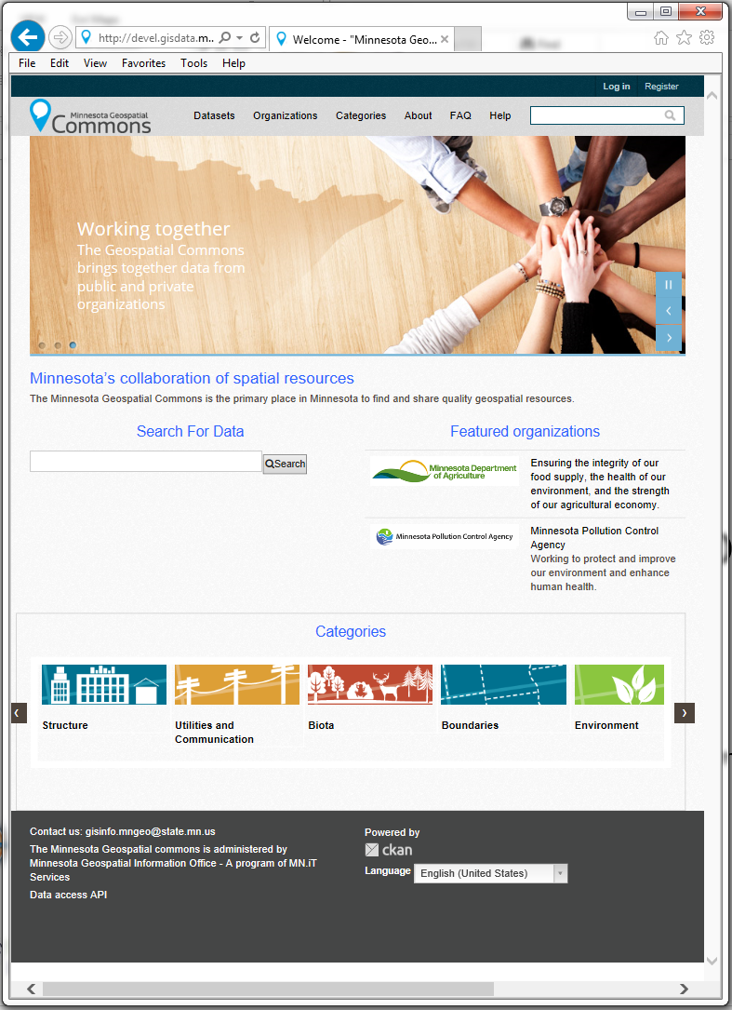
MN Geospatial Commons
A single place we all go to find and share geospatial resources
Where are we?
  Release complete - June 30, 2014
    Store will be open but shelves not completely stocked
  Align infrastructure and data
    Starting with MDH

Slide 56
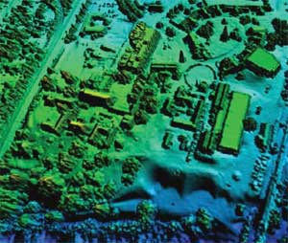
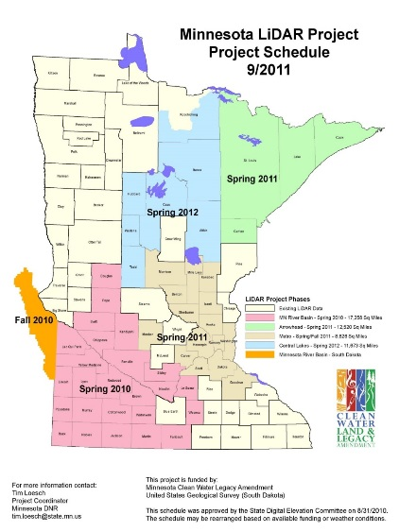
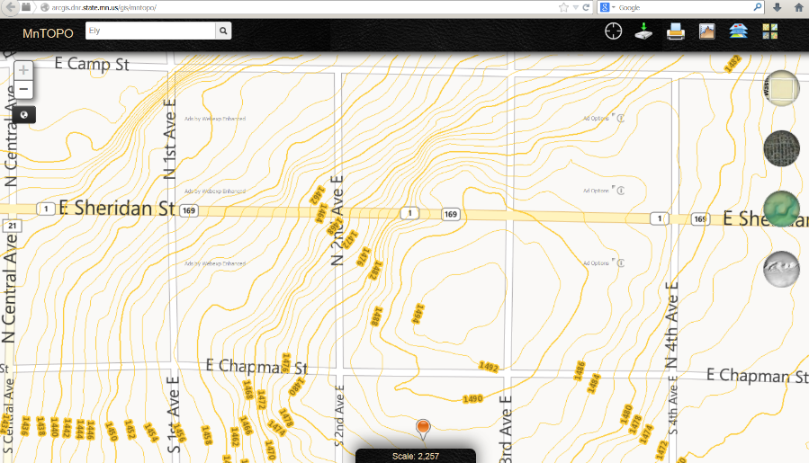
LiDAR Elevation
Nearly ready to promote more widely:
  FTP site ready
  Data download ready
  MnTOPO web application released
  Finishing implementing standard naming conventions

Slide 57
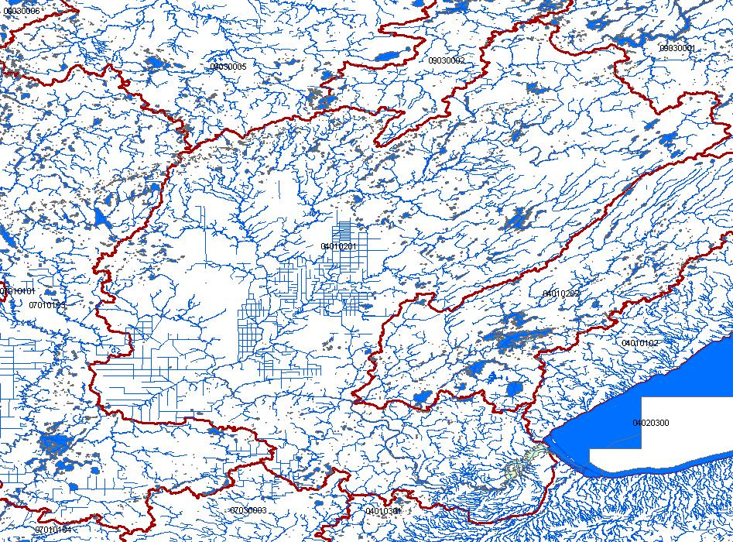
Hydrography – June 30th
  Multi agency project to try to work toward a single geographic representation of surface water for Minnesota…
  A national stream addressing system
  A modeling network for navigating upstream/downstream
  A maintenance infrastructure
  Additional tools to enhance use of data
Notes:
Graphic – St. Louis River Basin is the central basin – emptying into Lake Superior. Hydro features include lakes, rivers for mapping (1-d, 2-d), rivers for networking (1-d); A system of Watershed Boundaries (WBD) is also included. Those are the red lines on this graphic.
Flow volume and velocity within catchments

Slide 58

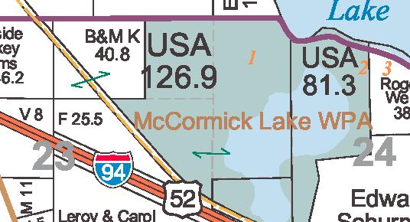

Statewide Parcels
Align with Revenue efforts
Exchange Guideline - shared
Regional Collaborations - happening
MnGeo to do parcel collect 2014
  Will obtain, aggregate, standardize, make available to state agencies
What is the best way to engage local partners?

Slide 59
Changing the approach…
MnGeo Organization, Workplan, and Priorities for FY15

Slide 60
Changing the approach…
Focus on the enterprise
Continue focus on foundational data
Stocking the shelves - MN Geospatial Commons
Move toward shared service delivery
Geocoding service
More imagery – Metro Counties 2016?
Geospatial Managed Hosting
Data (e.g. agreements and services)
Others?
Funding and Legislation

Slide 61
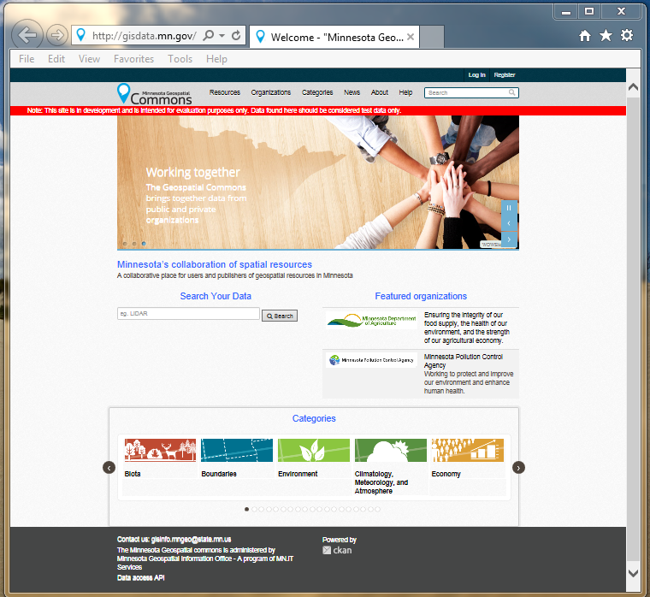
Focus on priorities…
Data Access and Coordination
MN Geospatial Commons
  Migration
  Open the store to others
Data Sharing Agreements
  MN.IT obtains, aggregates and shares

Slide 62
Priorities - Data Access and Coordination
Acquire/Building/Publishing foundational data
Addresses – NG9-1-1
Street Centerlines
Imagery
LiDAR – MnTOPO
Parcels
All via collaboration…

Slide 63
Organize to deliver the service…
Reorganization
Align the team
  Geospatial Commons
  Geospatial Managed Hosting
  Primary and back-up for each position
  Provide the right skills – hire/develop/train
  Look at what agencies need and build for that - MDH

Slide 64
MnGeo Organization

Slide 65
Data sharing Initiatives
Dan Ross with info from Geoff Maas

Slide 66
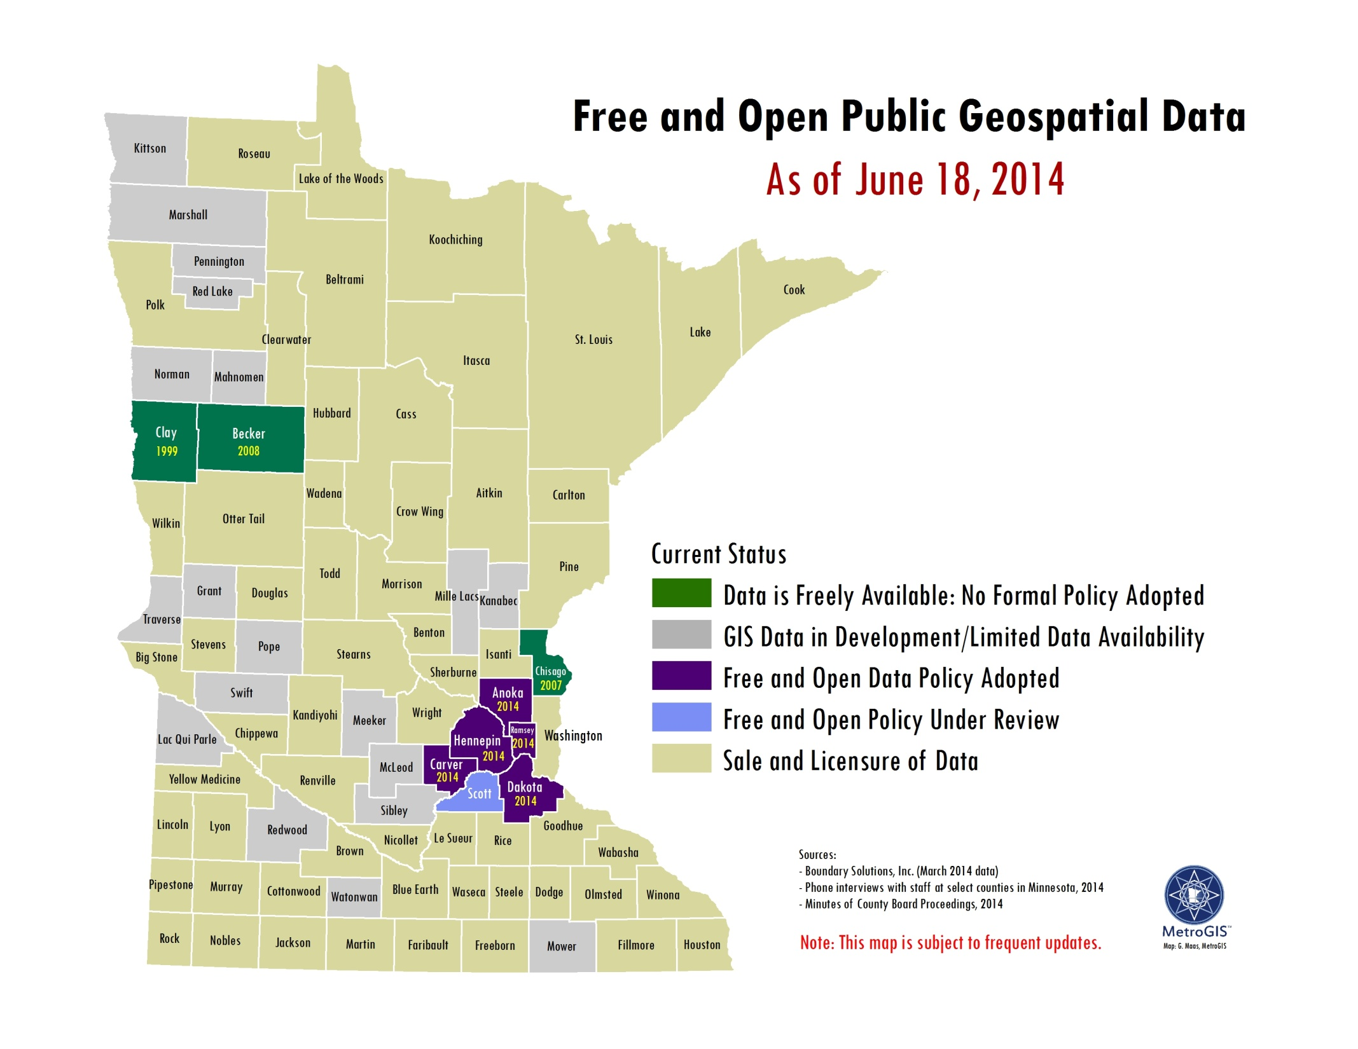

Slide 67

Data Sharing Agreements
Goal – single agreement with partners
Approach
  MnGeo makes agreement, obtains and aggregates
  Publishes, shares as needed
    GeoCommons?, GDRS, Service
MN.IT makes agreements with individual agencies
  Why is that needed?

Slide 68
Committee Updates

Slide 69
Governor’s Commendation
Nancy Rader

Slide 70
Adjourn…
See you September 24th

