Slide 1
Statewide
Geospatial Advisory council
March 12, 2014

Slide 2
AGENDA
Call to order and introductions 11:00 5 min
Approval of January 10, 2014 meeting minutes 11:05 5 min
Council member responsibilities and expectations 11:10 10 min
Legislative update 11:20 20 min
Committee and workgroup update 11:40 10 min
Data sharing initiatives update 11:50 10 min
Minnesota Geospatial Commons governance 12:00 15 min
Break – Networking 12:15 30 min
Two LCCMR recommended projects: 12:45 20 min
- public drainage system
- landcover
Member sector reports: 1:05 30 min
- Gerry Sjerven, Minnesota GIS/LIS Consortium
- Will Craig, U of M, Center for Urban and Rural Affairs: Community GIS Program
- Chad Martini, Stearns County: land use application
MnGeo priority efforts updates 1:35 20 min
Governor’s Commendation awards committee 1:55 5 min
Adjourn

Slide 3
January 10, 2014 Meeting Minutes http://www.mngeo.state.mn.us/councils/statewide/SWGAC_minutes_2014Jan10.pdf

Slide 4
Council Members
Roles, responsibilities, and expectations

Slide 5
Mission
Advise, support and make recommendations to MnGeo for improving services statewide through the coordinated, affordable, reliable, and effective use of geospatial technology

Slide 6

GUIDING PRINCIPLES
Promote effective investments in geographic information
Promote geographic information as a shared public resource
Support the establishment and use of geospatial standards and guidelines
Champion collaboration among geospatial practitioners and related stakeholders
Educate and inform policymakers related to the value and use of geospatial technology
Provide a forum for ideas and issues to be shared and acted upon by the geospatial community
Encourage all SWGAC sectors to contribute to the state geospatial infrastructure
Encourage all SWGAC members to communicate outcomes with relevant stakeholders
Encourage geospatial education at all levels

Slide 7
Draft - Roles and responsibilities …
Support the Council's mission
Prepare for and be active in Council meetings
Be an ambassador representing your sector stakeholders and other stakeholders with whom you are connected (e.g. professional groups)
  Speak for stakeholders at Council meetings
  Carry Council news and proposals back to stakeholders
  Collect stakeholder views on complex issues, either from individuals or existing umbrella organizations

Slide 8
Legislative Update

Slide 9
Legislative Update
Suggestion:
Redirect a portion of the Recorders Fee the State receives from the general fund to a state fund set up for the advancement of geospatial data, technology, and activities to improve services to the broader geospatial community…
What kind of money are we talking about?
  $46 Fee $10.50 State General Fund
  $10.00 County Technology Fund
  $ 25.50 County General Fund
  Approximately $12-13M per year

Slide 10
Legislative Update Discussion…
What should it be used for?
Develop and sustain programs for foundational standardized statewide layers
  Statewide Street Centerlines and Address Ranges (2 year program)
  Statewide Aerial Imagery collect 1/5th of the state (ongoing)
  Statewide Addresses - initial collect/standardization
  Hydrography (surface water) - 2 year effort to standardize and align agency data
  Elevation/LiDAR
    Additional collect (e.g. areas of older data)
    Statewide hydro-conditioning (2 year)
  Statewide parcel data (2 years)
  Municipal boundaries from parcels
  Statewide geodetic layer – control point inventory (2 years)
  Statewide Public Land Survey update
  Data Access Tools and Services
  Complete the build-out of the MN Geospatial Commons, a single place (currently many agencies have their own) for all to go to find, evaluate and share geospatial data, services and tools
  Open up to partners (training and access)

Slide 11
How can this Council get behind this effort?
Help shape the programs that will benefit from this investment?
Gather input from the sector you represent
Letters of support?

Slide 12
Committee and Workgroup Update
Charter and Work Plan Review and Discussion
Input from the Council

Slide 13
Committees and Workgroups
Committees and Subcommittees
Parcels and Land Records (Active)
Digital Elevation (Active – no charter or workplan received yet)
  LiDAR Research and Education
Emergency Preparedness (Active)
Hydrography (Inactive)
Outreach (Inactive)
Standards (Active – looking for a new chair)
Workgroups
Geocoding (Inactive)
Geospatial Commons (Team composition has changed)
Metadata (Active on MN Geospatial Commons, Team composition change)

Slide 14
Update on the
Open Data Sharing Initiative
Geoff Maas

Slide 15
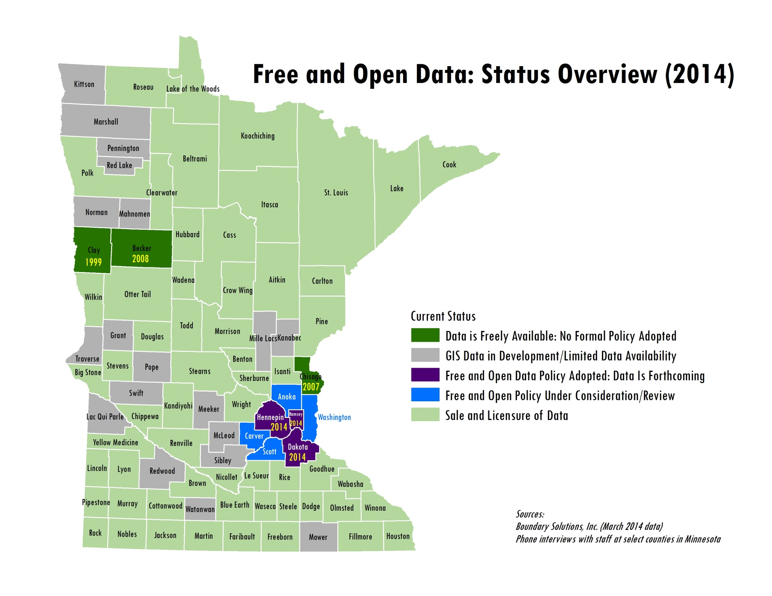

Slide 16
Geospatial Commons Governance

Slide 17
Open Questions
Level of curation? = staff resources
Cost to participate?

Slide 18
Guiding/Operating Principles
Covers all resources (data, services, apps, etc.)
Enough documentation to determine fit for use
Professional site – no anonymous content
Assumes “published” resources are free and open

Slide 19
Users
Anonymous: view & download
Registered: real name & organization
Publisher: organization w/ registered user(s)
Commenter: register on Disqus
Administrator can approve & revoke

Slide 20
Commenting
Uses Disqus
Publishers encouraged to respond
Process to remove comments if needed

Slide 21
Metadata
Requirements
  Minimum level of detail (tbd)
  MGMG and FGDC formats
  XML & HTML files
Curator reviews periodically

Slide 22
Disclaimers
In metadata
“click to agree” - tbd
  Logistically undesirable
  Awaiting legal & local partner input

Slide 23
Publishing Resources
Data, services, apps, maps
Geographically must involve MN
Must be free and open
Non-geospatial data must have a geo connection
State agencies – state standards
Admin can remove if inappropriate

Slide 24
Publishing with a GDRS
Technical requirements
Agree to governance policies
Performance expectations & SLA??? tbd

Slide 25
Authoritative Source
Publish your own stuff
Publish hybrid data – clearly document
“Sponsor” other orgs who don’t publish
  Notify and ask permission
If duplicates, admin will investigate

Slide 26
Governance Process
System design and human involvement
Administrator, curator, community
Governance board to advise quickly

Slide 27
Questions?
Comments?

Slide 28


+

Slide 29
LCCMR recommended projects….

Slide 30
Drainage Records Modernization and Statewide GIS Database
Al Kean

Slide 31
Drainage Records Modernization and Statewide GIS Database
MN Geospatial Council Meeting
3-12-14
Al Kean, Chief Engineer, BWSR

Slide 32
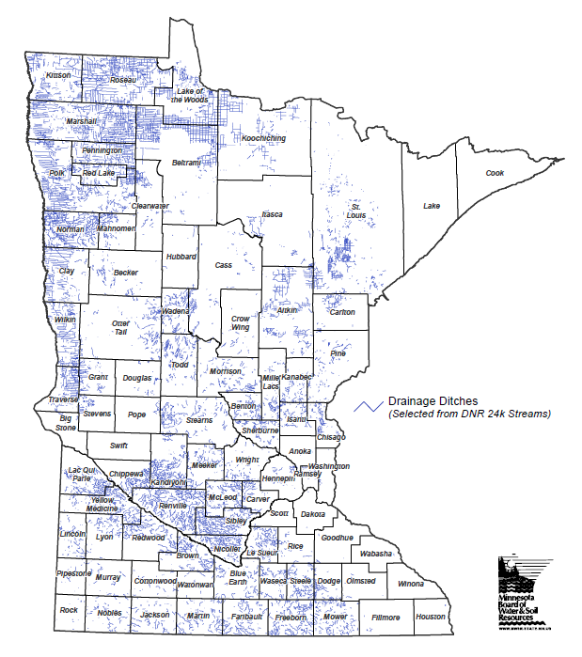
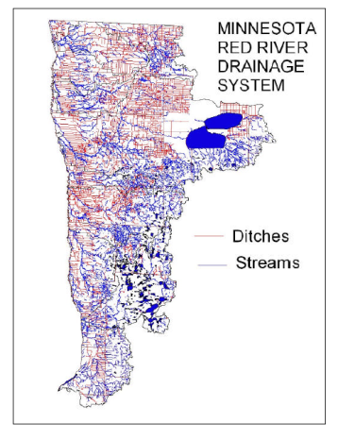
Drainage Ditches in MN
(Estimated
21,000 miles Chapter 103E ditches)
Source – MN DNR from USGS Maps, circa 1980.
Source – Red River Basin Board, Inventory Team Report on Drainage, September 2000.

Slide 33
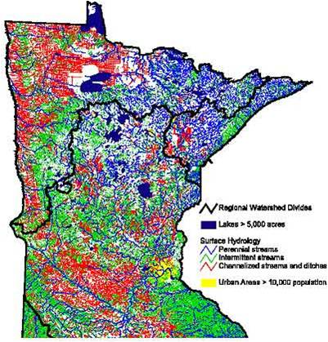
Drainage Ditches in MN
Source – MN DNR from USGS Maps, circa 1980.
Red = Channelized Streams and Ditches

Slide 34
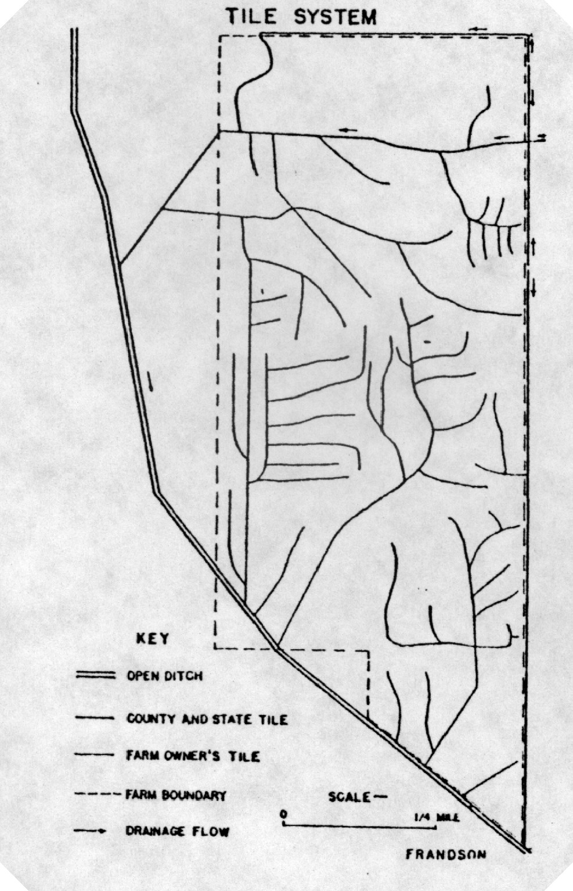
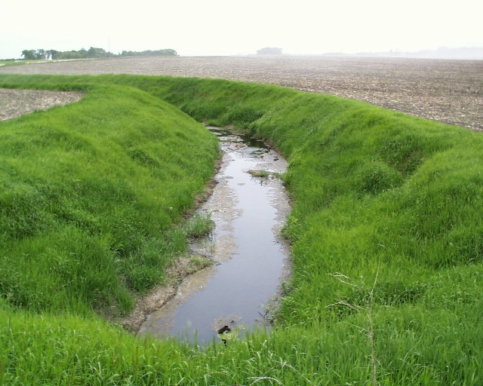
Example Drainage Ditch & Tile Systems

Slide 35
Chapter 103E – Drainage Law
Drainage Authorities
Over the years included Townships, Counties and State (the latter via a state commission and/or district courts)
CD = County Ditch, SD = State Ditch, JD = Judicial Ditch
Now: Counties, Joint County Authorities, Watershed Districts (can include Metro Water Mgmt. Orgs.)
Drainage authorities administer “public” or “legal” drainage systems in accordance with Chapter 103E Drainage Law (best described as publicly administered private drainage systems)

Slide 36
Why Drainage Records Modernization and GIS Database are Important
The vast majority of Chapter 103E drainage systems were installed in the late 1800s and early 1900s.
Drainage system records historically have been kept in hard copy on various types of materials of the day, many of which are substantially deteriorating.
Electronic data records can greatly increase use efficiency and effectiveness –
  Drainage system management, including inspection , repair, buffer strip enforcement
  Multipurpose water management (e.g. ag production, flood control, WQ, habitat), including modeling for water planning

Slide 37
Drainage Records Modernization – Brief History for Context
BWSR cost-shared some work via Local Water Planning Challenge Grants
Stakeholder Drainage Work Group (DWG) recommendations – 2006
BWSR funded for Drainage Records Modernization Guidelines – FY 2008
BWSR funded $500K for DRM cost-share FY 2009 (22 drainage authorities funded, min. 1:1 match)
BWSR funded $100K for DRM cost-share FY 2011
BWSR LCCMR app. FY 2012 – GIS database and cost-share (not selected)
BWSR LCCMR app. FY 2014 – GIS database and cost-share (recommended and in process for partial funding)

Slide 38
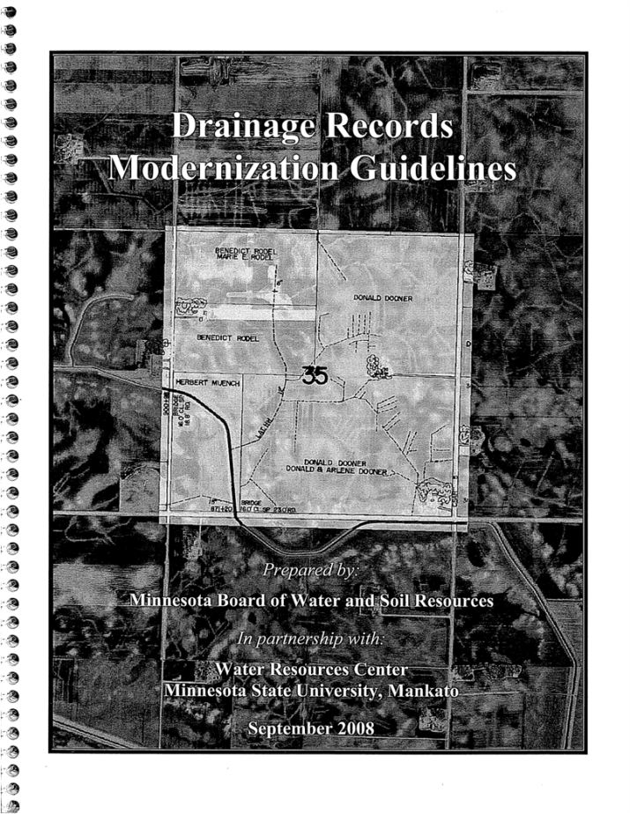
Drainage Records Modernization Guidelines,
Sep. 2008
(MSU-Mankato WRC contractor, BWSR editor)

Slide 39

LCCMR Project Funding and Components
$230,000 for database, portal, guidelines; $0 for DRM cost-share
Create GIS database template & data stds. for drainage authority use
  focus on hydrographic information: drainage system type, location and alignment, dimensions, profile, road crossings
  draw on experience from prior Drainage Records Modernization work
Create a web-based data portal at MnGeo for Chapter 103E drainage system record data (Geo-Commons approach)
Update the Drainage Records Modernization Guidelines
Utilize a stakeholder advisory committee, including members of the Drainage Work Group and drainage authority database users

Slide 40
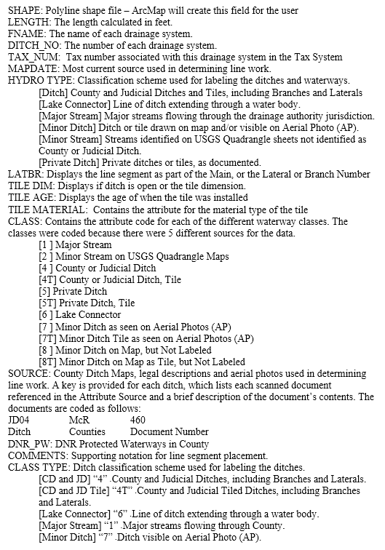
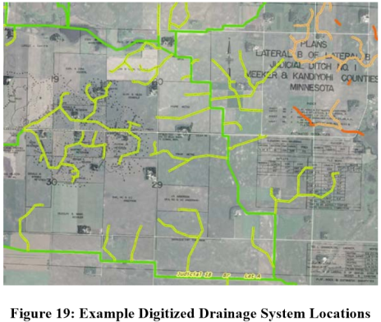
Create GIS Database Template and Stds.

Slide 41
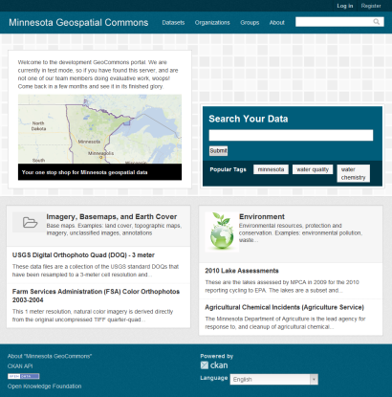
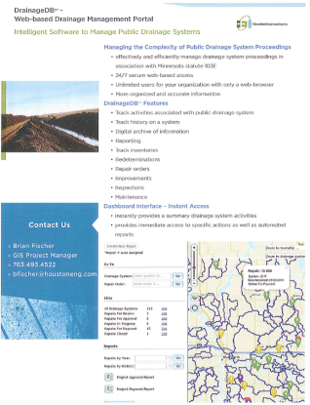
Create Portal for Sharing Data

Slide 42
Project Outcomes and Benefits
Improved access to data on public drainage systems:
  shared data standards for drainage authorities using it
  coordinated access through a web portal
  use of authoritative data sources to avoid duplication of data management
Updated Drainage Records Modernization Guidelines
Enhanced water management for water quality outcomes due to better information on public drainage systems for modeling and planning

Slide 43
Questions?

Slide 44
Mapping Landscapes for Better Land and Water Management
Joe Knight and Marv Bauer

Slide 45
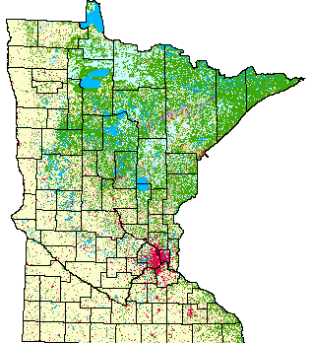
Updating Minnesota’s Land Cover
Proposed Project:
Update the statewide geospatial land cover data and freely distribute it to all land and water conservation entities

Slide 46
Method
Integrate the existing LiDAR elevation data with state-of-the-art remote sensing data and methods to develop the ‘next generation’ of Minnesota-specific land cover datasets that are needed statewide. Selected areas will be mapped at much higher spatial resolution
  Statewide 1/4-acre (30-meter)
  Higher resolution (1-2 meter) geospatial data products developed for selected urban areas (e.g., the TCMA, Duluth, Rochester, St. Cloud, Alexandria and Detroit Lakes) as well as additional areas of the state deemed especially sensitive
Identify changes from 2000 to today that are applicable to diverse conservation goals

Slide 47
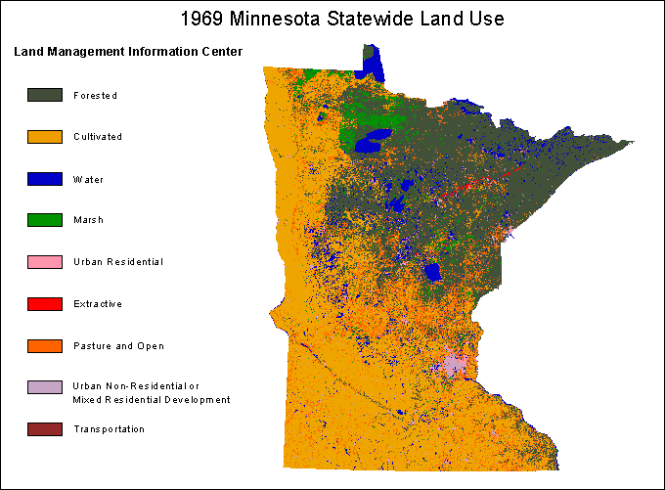
Outcomes
Better resolution updated data for Minnesota available in easily displayed GIS-compatible format through existing information websites
Workshops and Training - Three data use workshops will be conducted for project stakeholders at appropriate locations

Slide 48



Member sector reports:
Gerry Sjerven, Minnesota GIS/LIS Consortium
Will Craig, U of M, Center for Urban and Rural Affairs: Community GIS Program
Chad Martini, Stearns County: land use application

Slide 49

To develop and support the GIS professional in Minnesota for the benefit of our state and its citizens.

Slide 50
GIS/LIS Consortium Activities
Annual Conference
Spring Workshops
Networking Events
Lifetime, Polaris and Scholarship Awards
Event Grants
Career Center
Outreach & Social Media

Slide 51
GIS/LIS Consortium Events 2013
Spring Workshops
  132 Attendees | 15 Workshops
23rd Annual Conference & Workshops
  425 Attendees | 27 Exhibitors | 12 Workshops
  31 Technical Presentations | 52 General Presentations
  8 Student Presentations | 211 Workshops Attendees
  13 Lightning Presentations | 15 Posters
  10 Mentor/Mentee pairs participated in the Young Professionals Mentorship Program

Slide 52
GIS/LIS Consortium 2013 Networking Events
2nd Annual Summit Event at Summit Brewery
  December 12, 2013, approximately 100 attendees
Tailgating at a St. Paul Saints Game
  July 30, 2013, approximately 30 attendees
Town Hall Event after Spring Workshops
  May 21, 2013, 60-80 attendees
All proceeds from the networking events go to the Scholarship Fund. In 2013, that amount was $671.40.

Slide 53

October 1-3

Slide 54
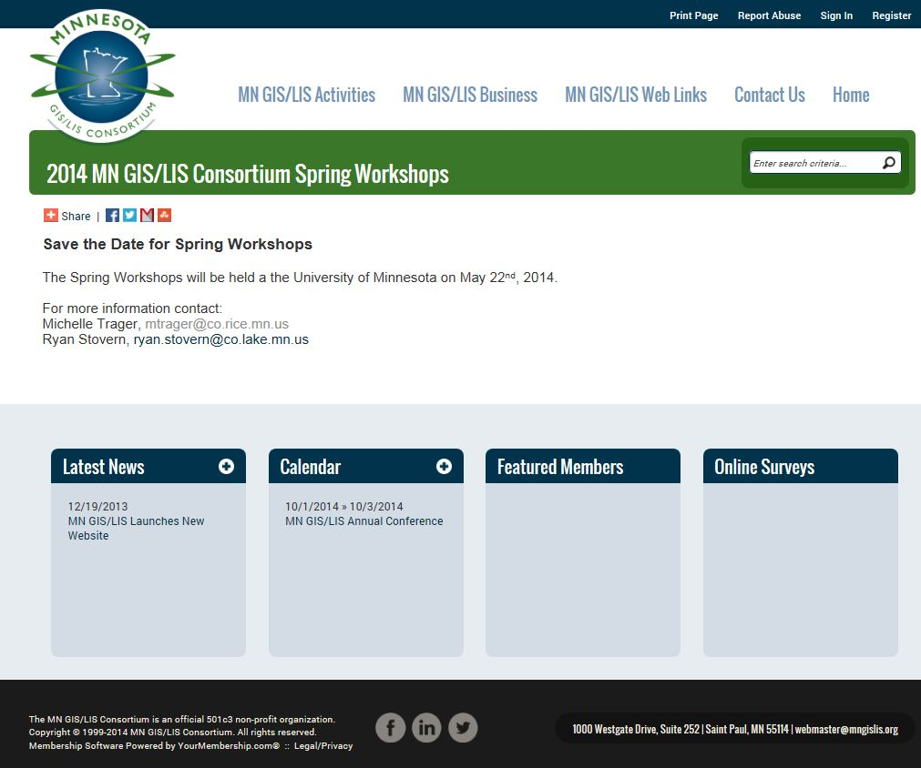
May 22

Slide 55
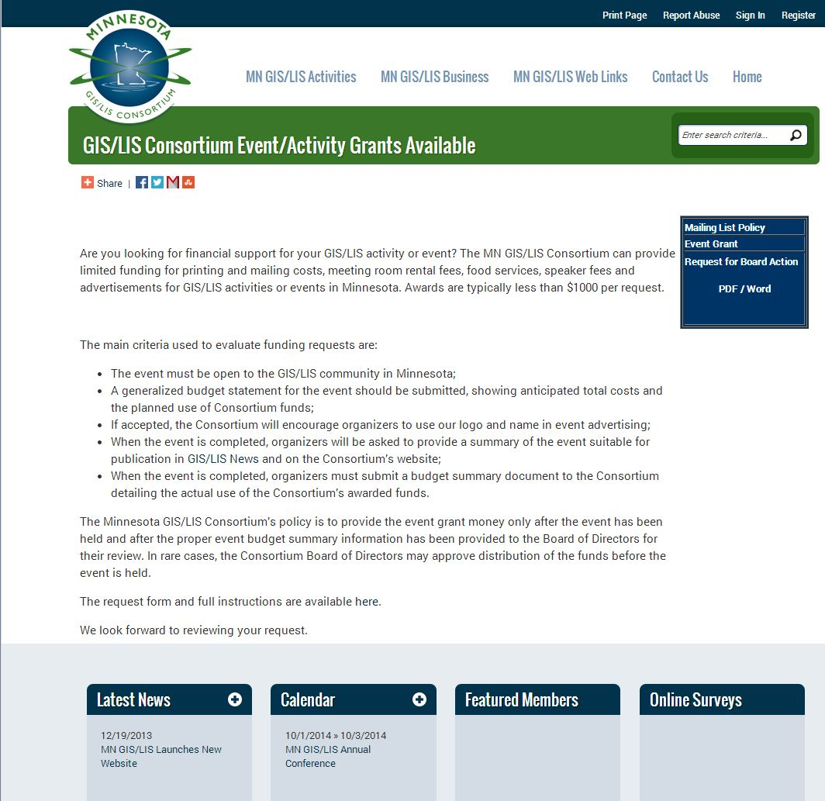
GIS/LIS Consortium Event Grant

Slide 56

GIS/LIS Consortium Committees

Slide 57
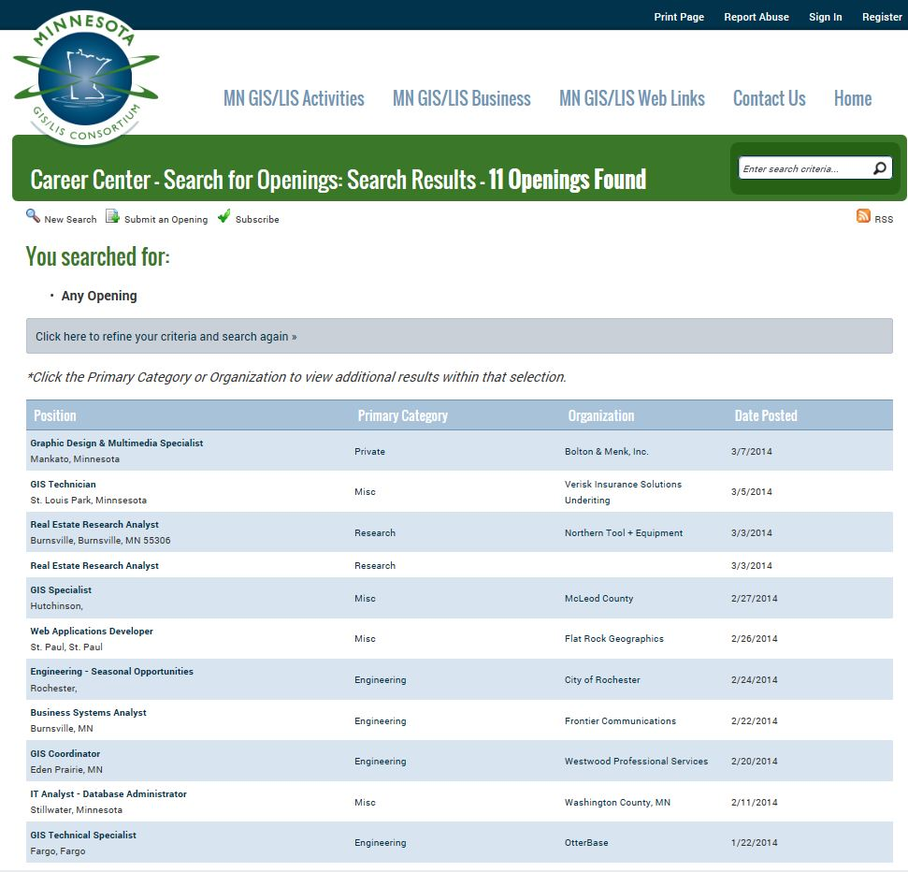
GIS/LIS Consortium Career Center
2618 Views since January 1

Slide 58

GIS/LIS Consortium Outreach and Social Media
E-Announcements sent to Membership Bi-Weekly
MN GIS/LIS News is in the works and will return as a blog Spring 2014
Facebook - https://www.facebook.com/MNGISLIS

Slide 59
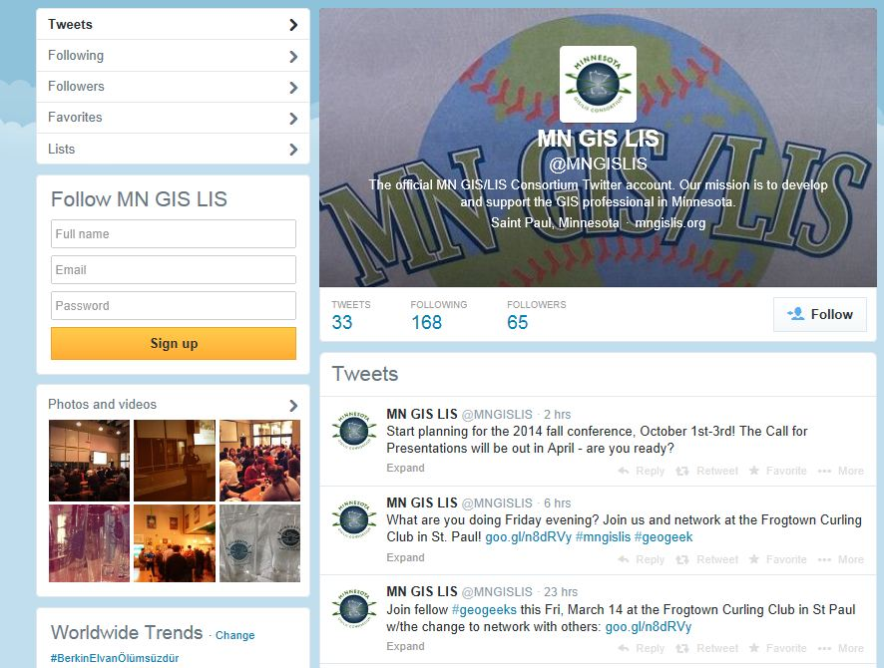
GIS/LIS Consortium Outreach and Social Media
Twitter - https://twitter.com/MNGISLIS

Slide 60
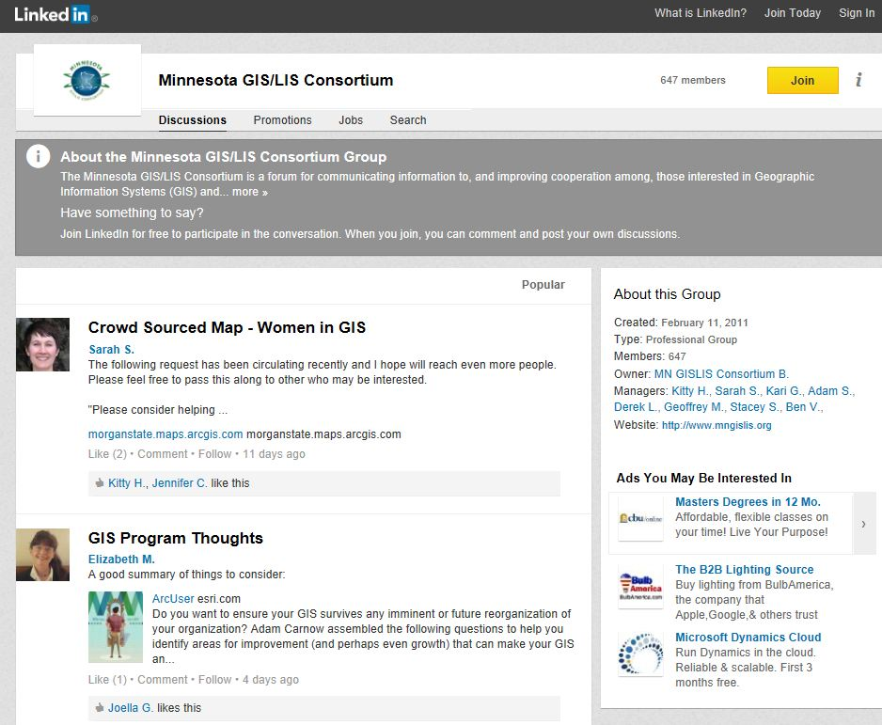
GIS/LIS Consortium Outreach and Social Media
Linkedn - http://www.linkedin.com/groups/Minnesota-GIS-LIS-Consortium-3784690?mostPopular=&gid=3784690

Slide 61
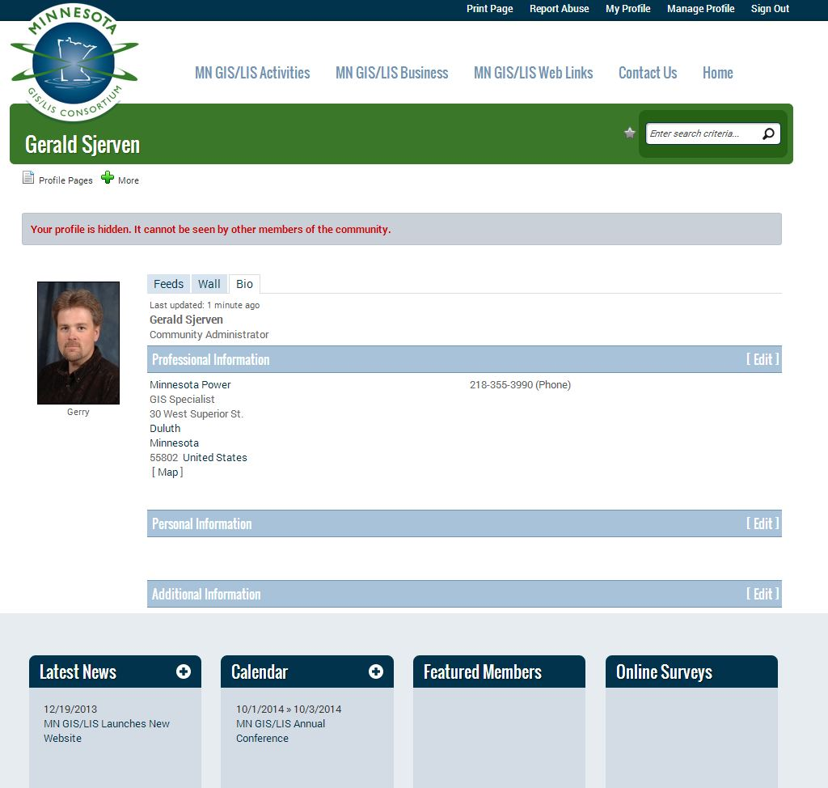
GIS/LIS Consortium Membership
Membership is Free
Profile pages arc customizable
Database will track future
attendance
Working on importing past
involvement
Customizable to users needs

Slide 62
GIS at the UofM
Overview with focus on
Community GIS

Slide 63









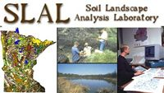


















Rationale
Cartography Lab
Notes:
For over fifty years, the UMN has been a national and international leader in spatial-related scholarship and applications. Among many contributions, the UMN helped create one of the first geographic information systems, the Land Management Information System in the 1960s; we created the first professional degree program in GIS in the United States; and was where one of the key open-software packages for displaying spatial information was developed (MapServer) . The University has many internationally known spatial research centers, including the Center of Urban and Regional Affairs, the Remote Sensing and Geospatial Analysis Laboratory, the Spatial Database and Spatial Data Mining Research Group, the Minnesota Population Center the Geographic Information Sciences Laboratory and the Polar Geospatial Center. A more comprehensive list of the units and people involved with spatial research can be found on the U-Spatial web site. Along with a long esteemed history in cartography, geodesign, and geography, we have a solid intellectual foundation in core disciplines ranging from computer science to remote sensing.

Slide 64
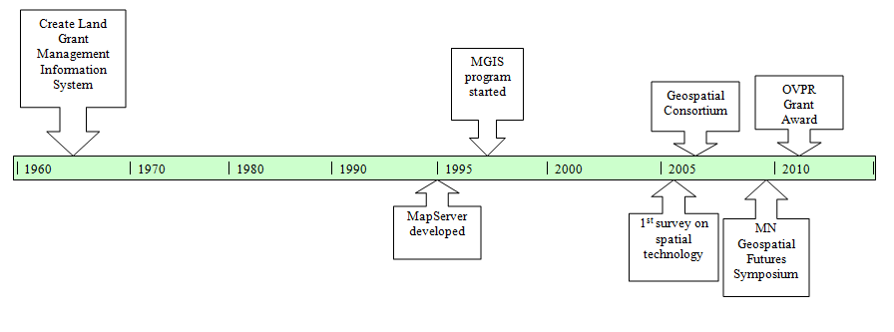
A long time in the works
Notes:
For over fifty years, the UMN has been a national and international leader in spatial-related scholarship and applications. Among many contributions, the UMN helped create one of the first geographic information systems, the Land Management Information System in the 1960s; we created the first professional degree program in GIS in the United States; and was where one of the key open-software packages for displaying spatial information was developed (MapServer) . The University has many internationally known spatial research centers, including the Center of Urban and Regional Affairs, the Remote Sensing and Geospatial Analysis Laboratory, the Spatial Database and Spatial Data Mining Research Group, the Minnesota Population Center the Geographic Information Sciences Laboratory and the Polar Geospatial Center. A more comprehensive list of the units and people involved with spatial research can be found on the U-Spatial web site. Along with a long esteemed history in cartography, geodesign, and geography, we have a solid intellectual foundation in core disciplines ranging from computer science to remote sensing.

Slide 65

U-Spatial
College of Design
College of Food, Agricultural and Natural Resource Sciences
College of Liberal Arts
College of Science and Engineering
Center for Urban and Regional Affairs
School of Public Health
University of Minnesota Extension Service
Enterprise GIS
Office of Information Technology
University of Minnesota Libraries
Hubert H. Humphrey School of Public Affairs
Institute on the Environment
Minnesota Population Center

Slide 66
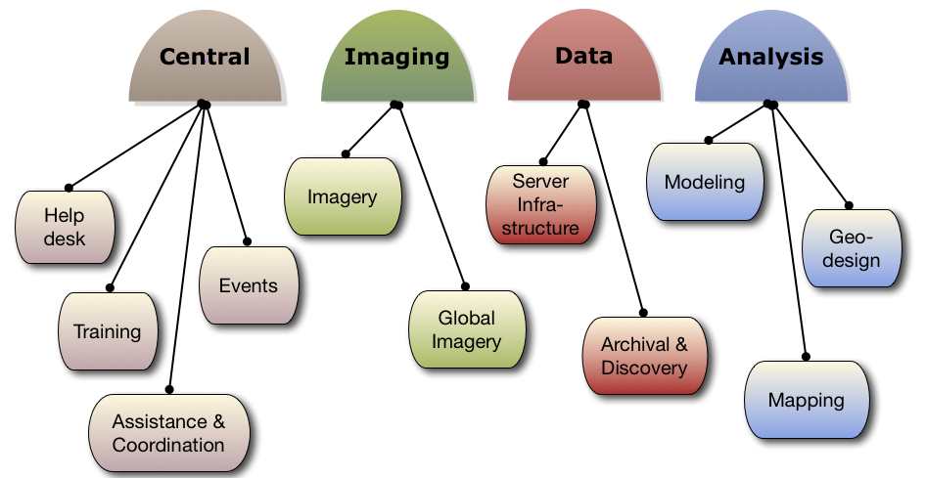
Cores

Slide 67
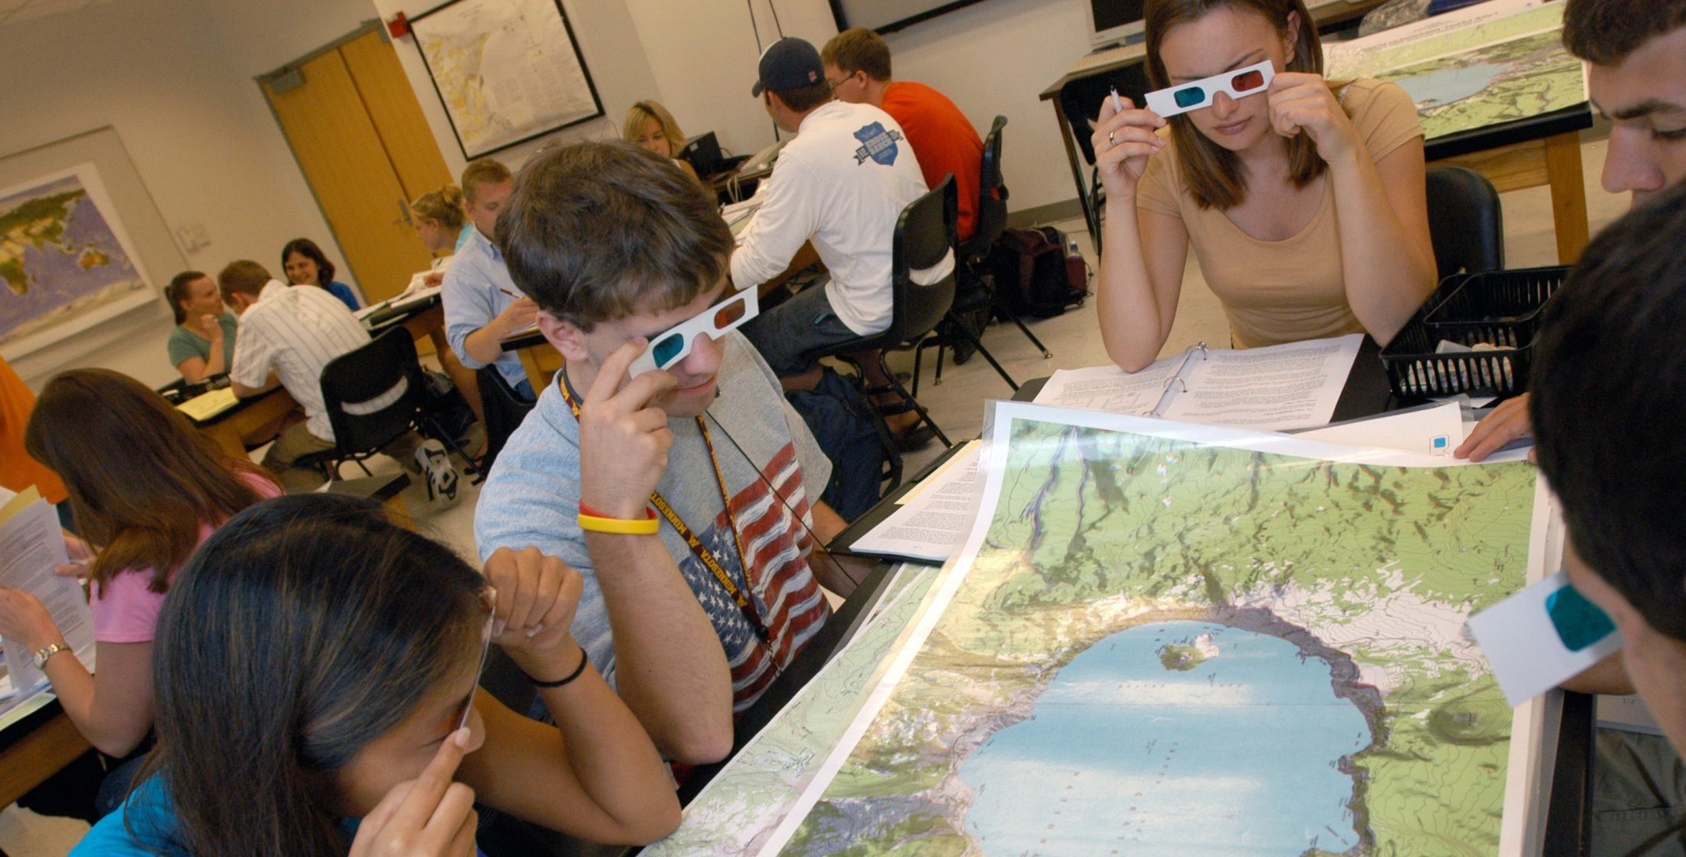
Central Core
The visible core
Help desk
Training
Activities
“Consulting”
Coordination

Slide 68
Relevant to Outside World
UofM Libraries
  Databases – e.g. Social Explorer, GeoLytics
  Aerial photography
Minnesota Population Center
  IPUMS (Integrated Public Use Microdata Series
  National Historic GIS
CURA’s Community GIS

Slide 69
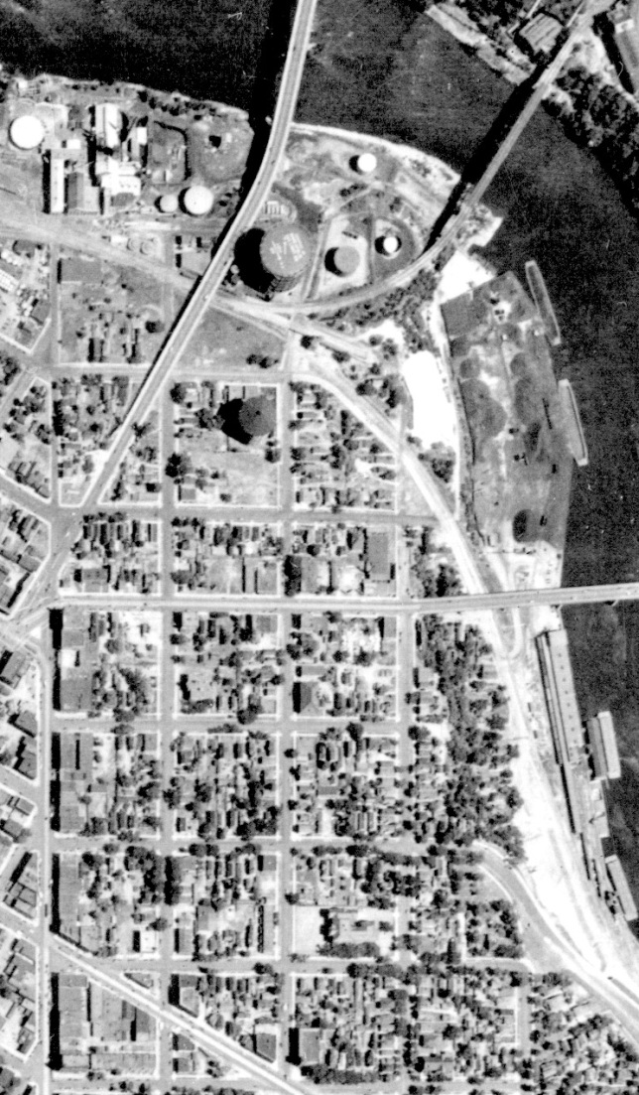
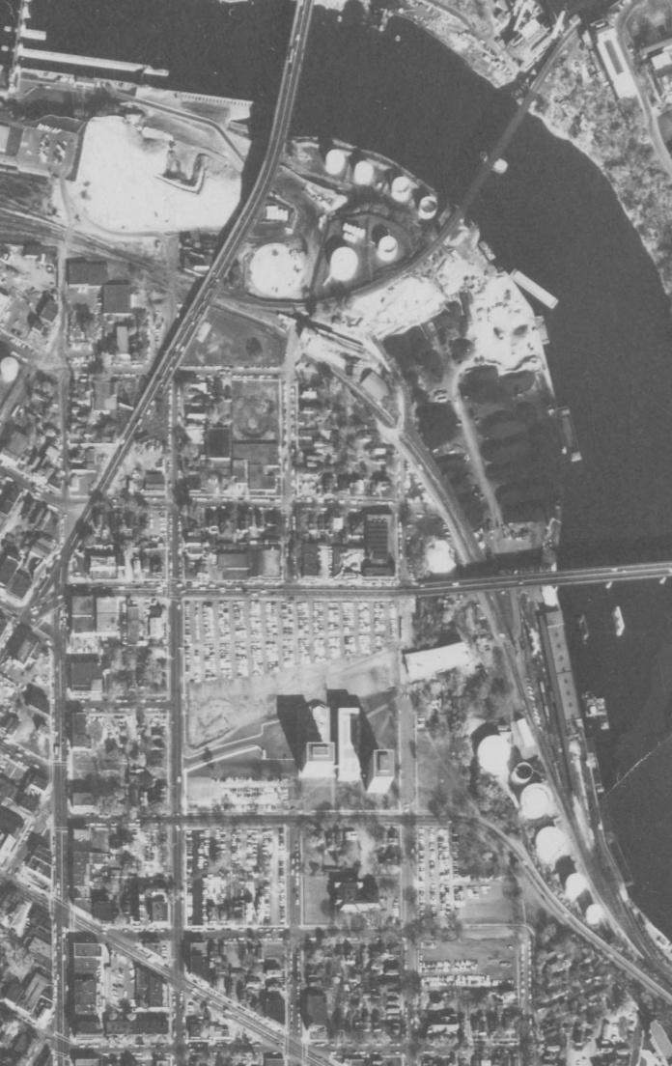
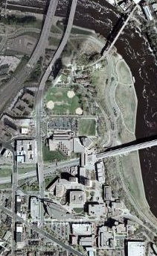
Minneapolis Historic Aerial Photograph Comparison
1940
1963
Current Google Map

Slide 70
NHGIS
National Historical Geographic Information System
  Project started in 2001
  Created historical census tract boundaries back to 1940
  Create historical county boundaries back to 1790
  Provide access to aggregate census data

Slide 71
Education Programs
MGIS - Professional Masters in GIS
Graduate and UG Minors available
Dozens of courses across many depts.
  Geography
  Forest Resources
  Computer Science
  more

Slide 72
CURA
Center for Urban and Regional Affairs
Faculty-initiated research
Community-initiated research (students)
Technical Assistance
  Community GIS
  Community organizing
  Small partnership grants
  CURA Tech

Slide 73
Community GIS
“Walk-in” technical assistance center
No fees for service
Our projects
  50-75 per year > 5hrs
  50-100 more < 5hrs
All projects community initiated
Commonly available data
Community-generated data
Products
  Mapping
  Data analysis
  Poster printing

Slide 74
Project Examples
Foreclosure & Housing Recovery
Economic Development
Asset Mapping
Outreach
Environmental Justice

Slide 75
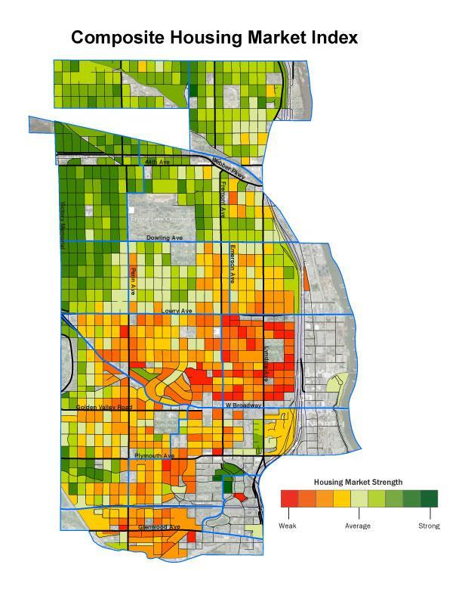
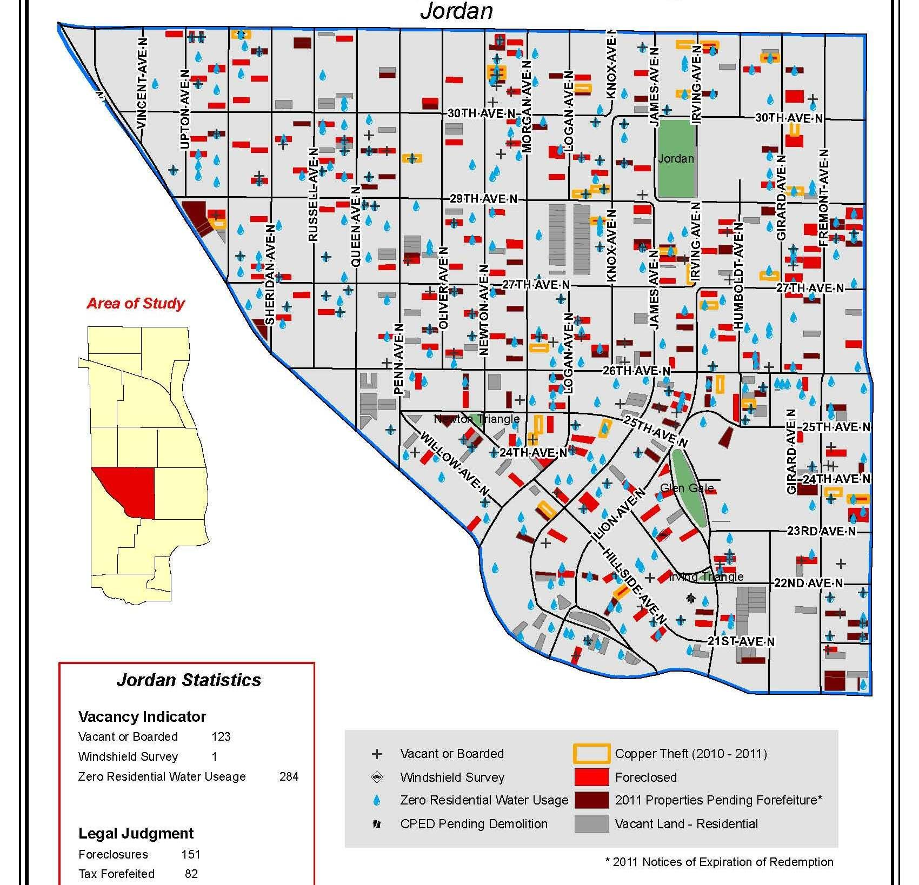
Inventory & Neighborhood Analysis
Notes:
Client: various north Minneapolis neighborhoods including Jordan Area Community Council and Folwell Neighborhood Association
Foreclosure / vacancy crisis and a potential tool for response – the Housing Market Index – can’t help every house and different strategies should be employed depending on where you fall on this spectrum.

Slide 76
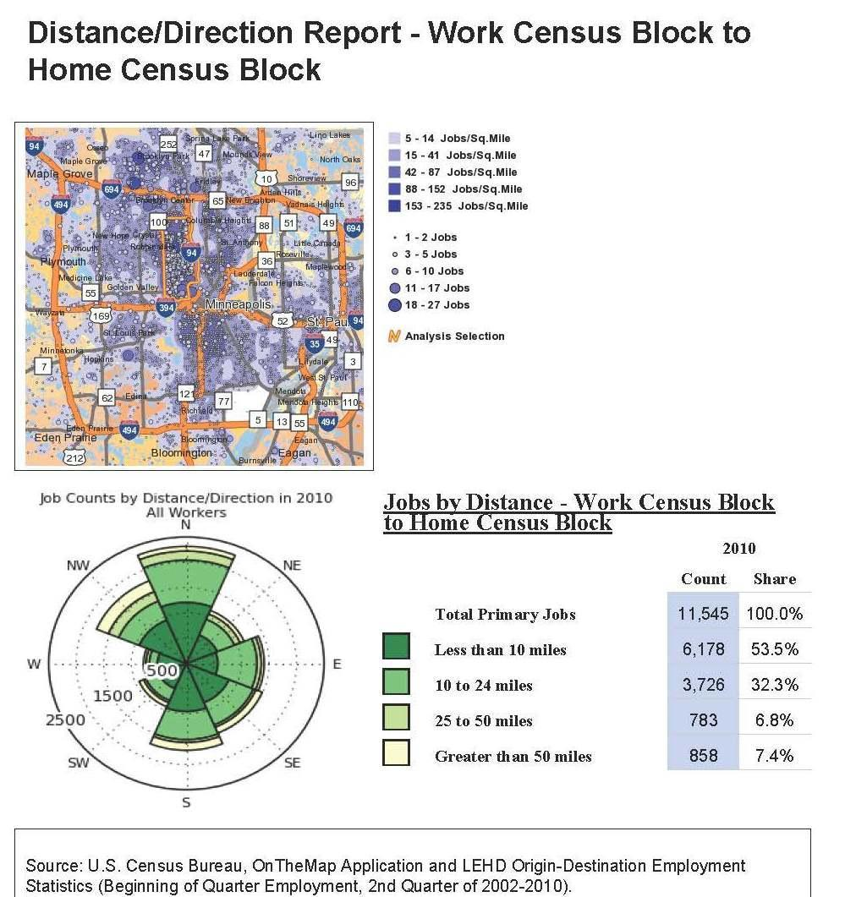
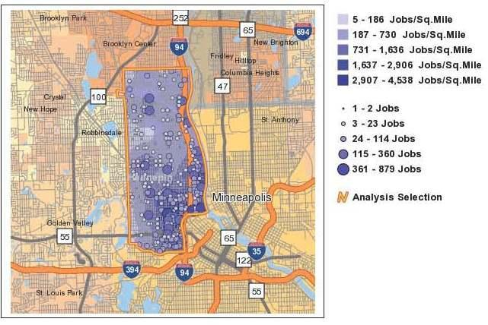
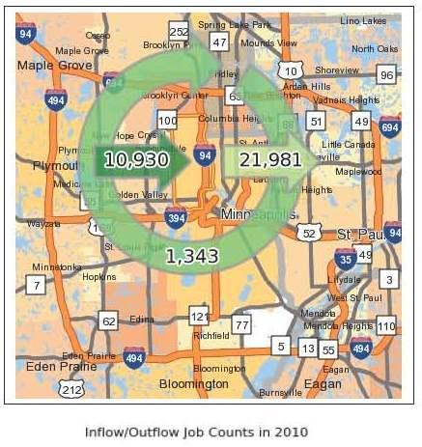
Economic Development
Notes:
Client: Northside Job Creation Team (UROC w/ various Northside orgs.) & Northside Funders Group (foundations including McKnight, Pohlad)
Upper left – home locations of workers commuting to North Mpls
Upper right – where jobs are concentrated in North Mpls
Lower Left – radar graph (distance/direction) of where people come from that work in North Mpls
Lower right – Inflow / Outflow (how many people come in/out of North Mpls to work, How many live/work in same area: 1,343)

Slide 77
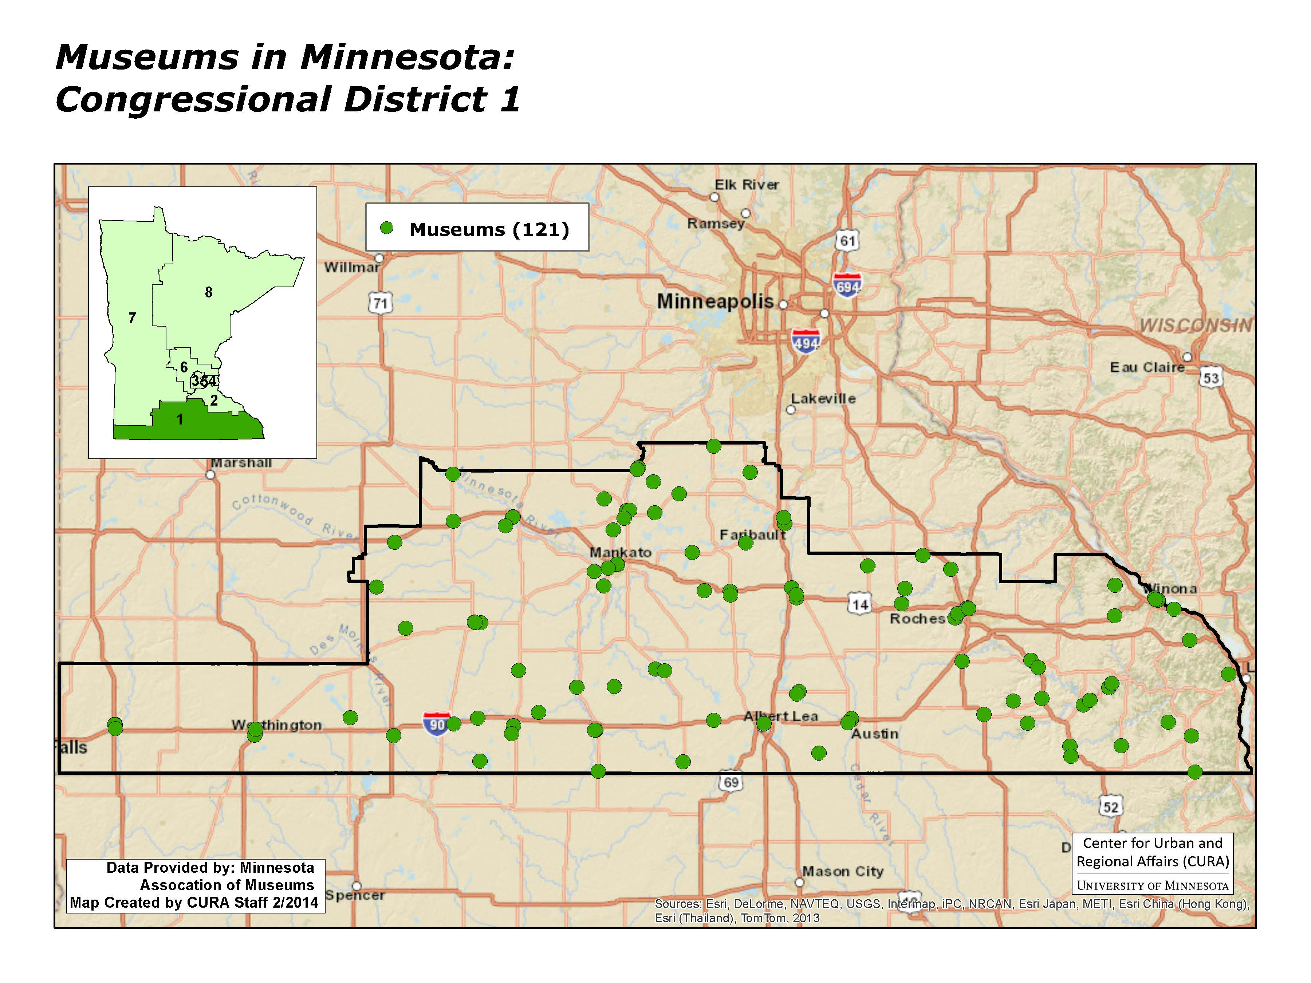
Asset Mapping
Notes:
Client: MN Association of Museums
Over 500 museums in MN. Members of Congress are being informed as to their importance in their district.

Slide 78
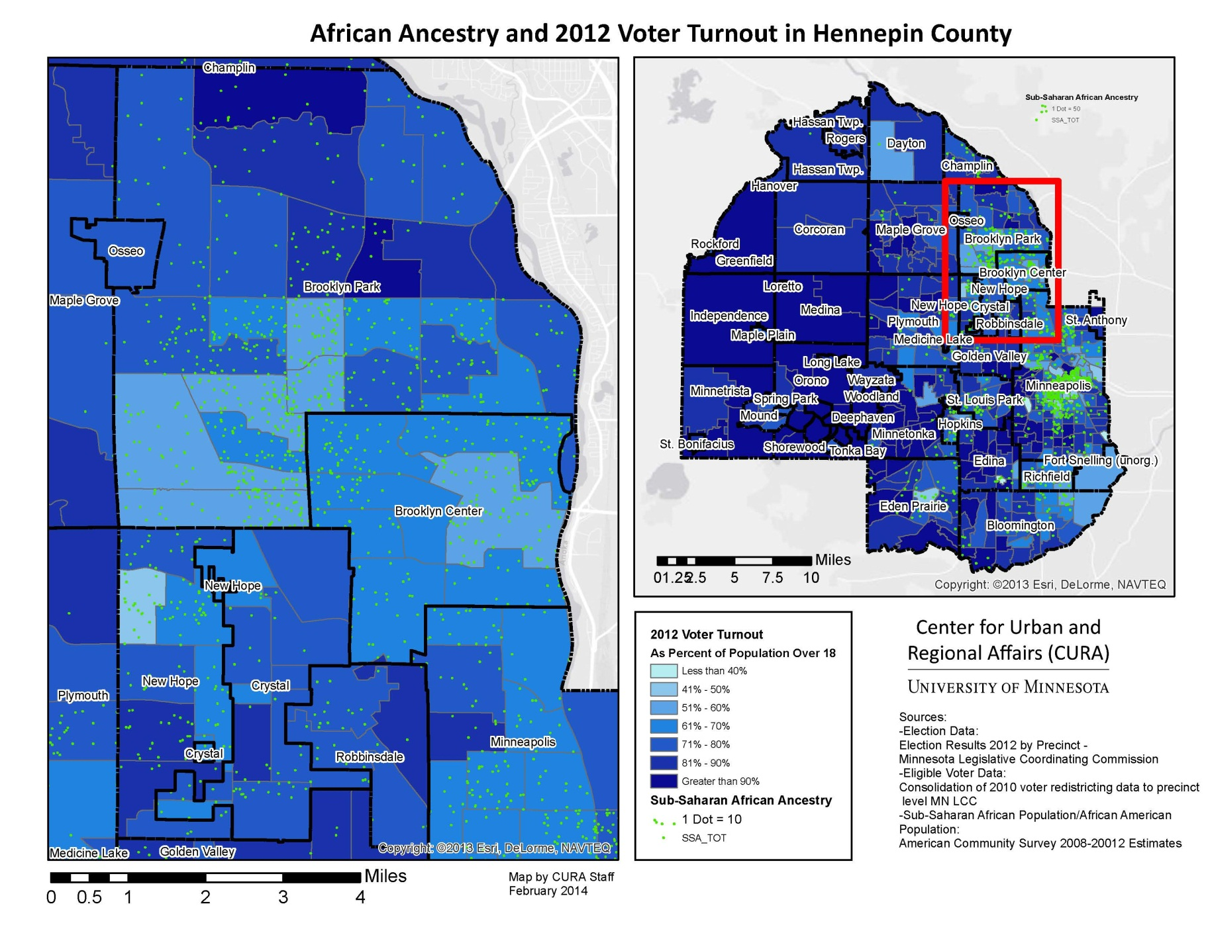
Immigrant Community Outreach
Notes:
Client: African Immigrant Services (non-profit resource center located in Brooklyn Park mainly working with the West African population)

Slide 79
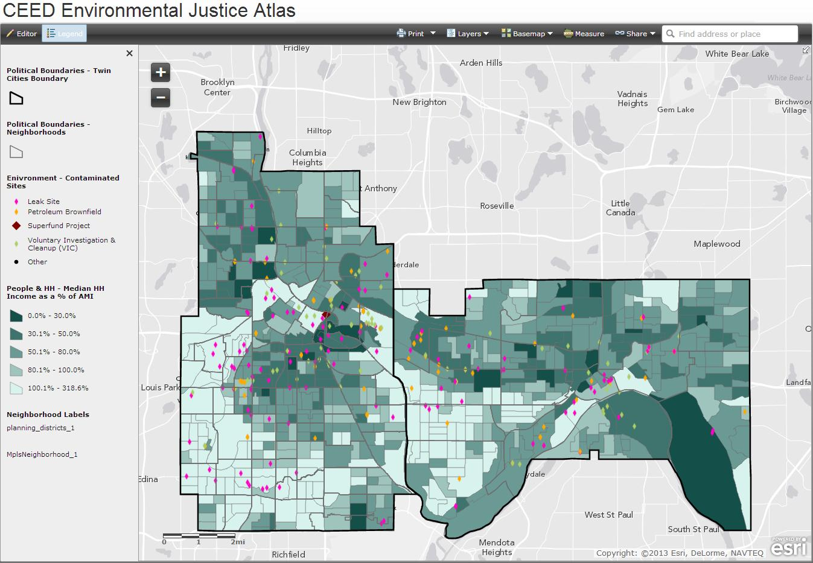
Environmental Justice
Notes:
Client: Center for Earth, Energy and Democracy working with WSCO (Westside St. Paul)
On line tools being created for access to a wider audience

Slide 80
STEARNS COUNTY LAND USE
BUILDING RESTRICTIONS AND PARCEL HISTORY

Slide 81
BUSINESS NEED
External partners need to see what parcels have building restrictions
Internal staff wanted a visual history of restrictions
Although parcel history is tracked in a tabular format, staff wanted a visual history
User interface to deal with many to one relationships

Slide 82
Project Plan
Project partner in WSB
Data creation
Data clean up
Parcel maintenance process review
  Multiple departments
  LEAN review

Slide 83
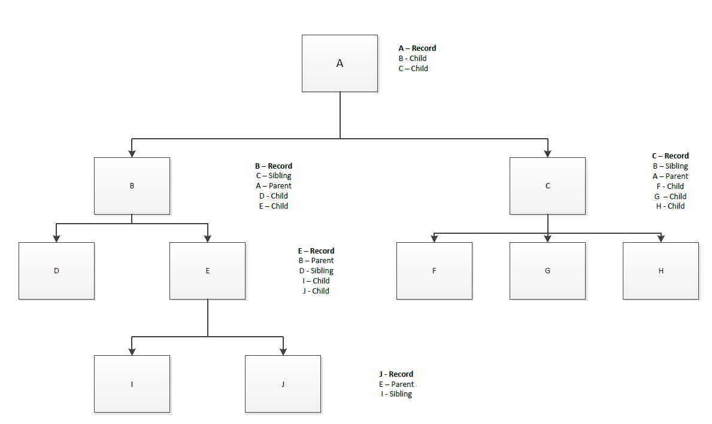
Parent / Child

Slide 84
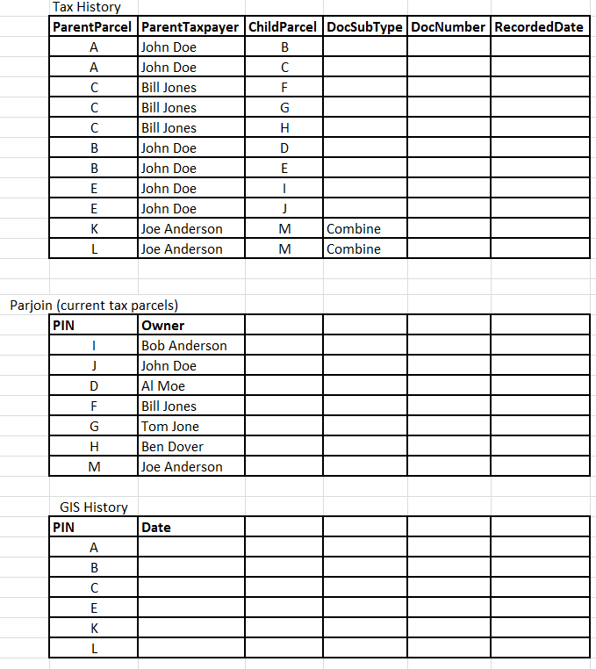

Slide 85
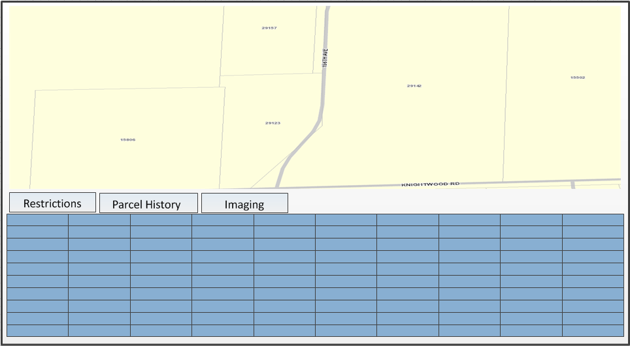
User Interface

Slide 86
Future
Replace county public viewer
Add additional tax information
Additional reports

Slide 87
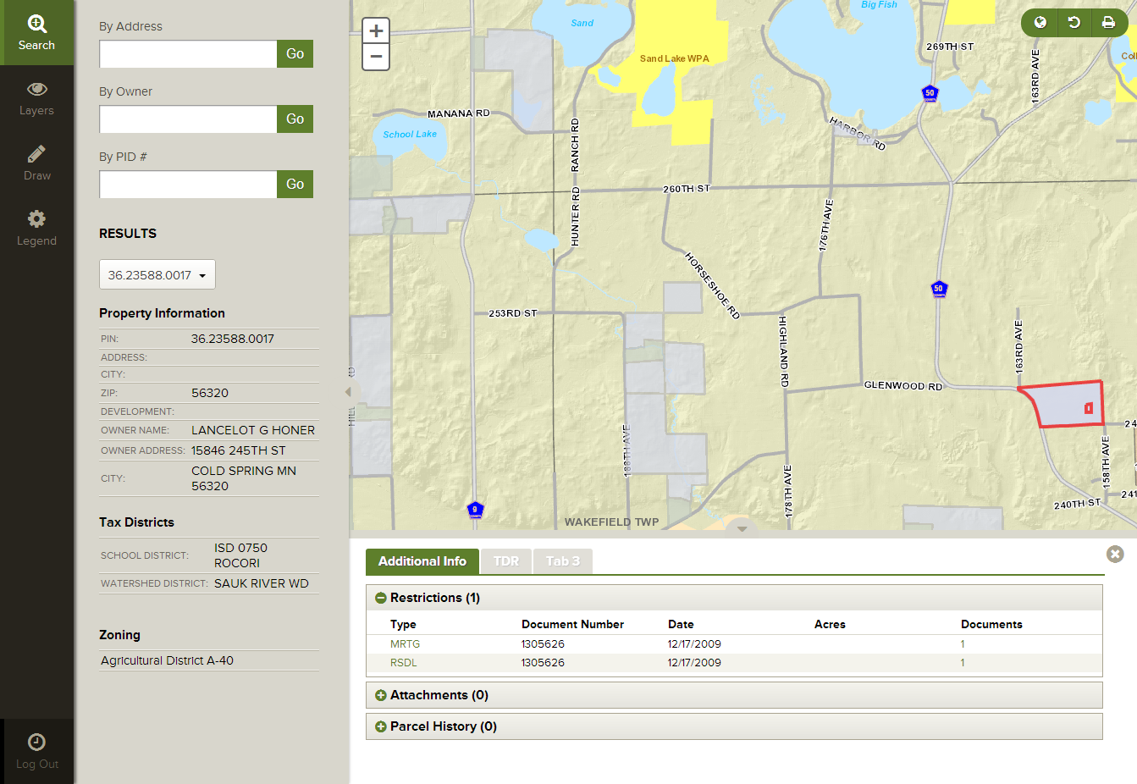
https://gis.co.stearns.mn.us/Landuse-Restriction/#

Slide 88
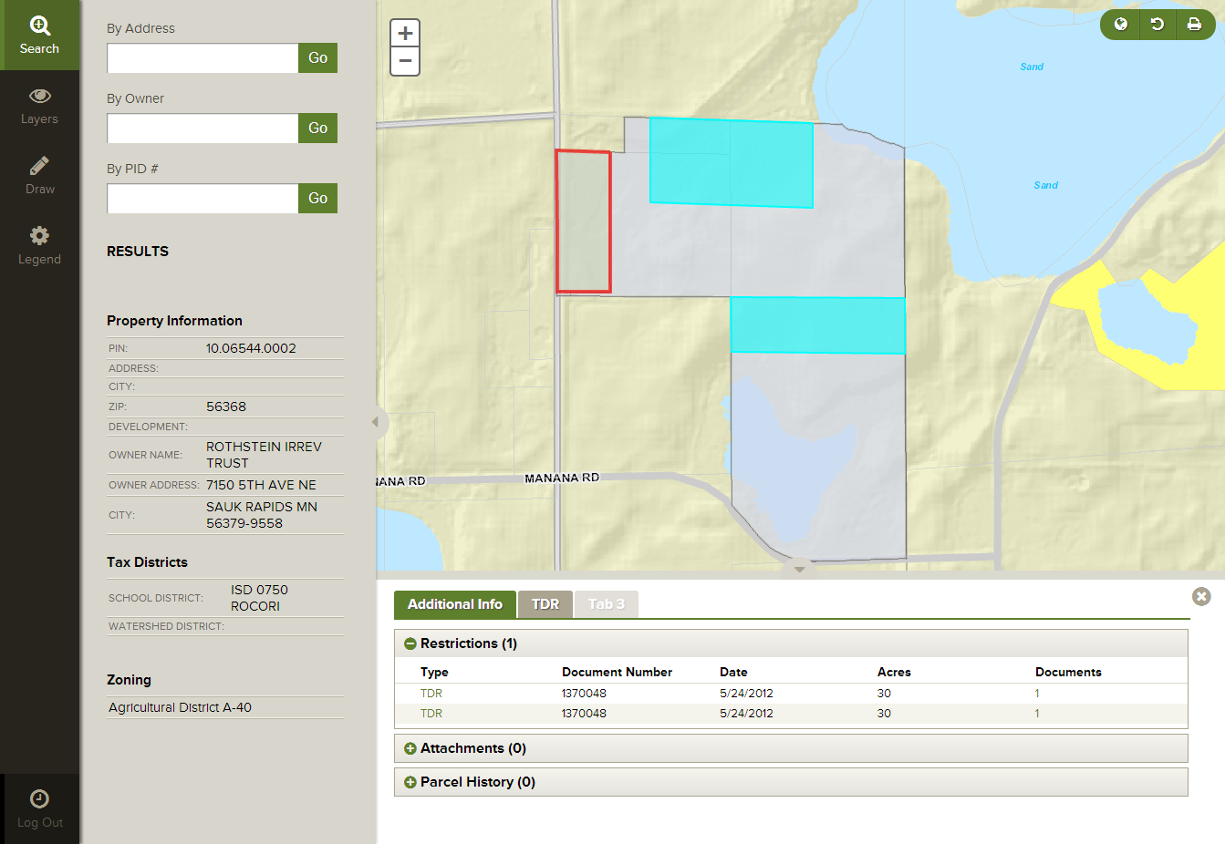
Grantee / Grantor

Slide 89
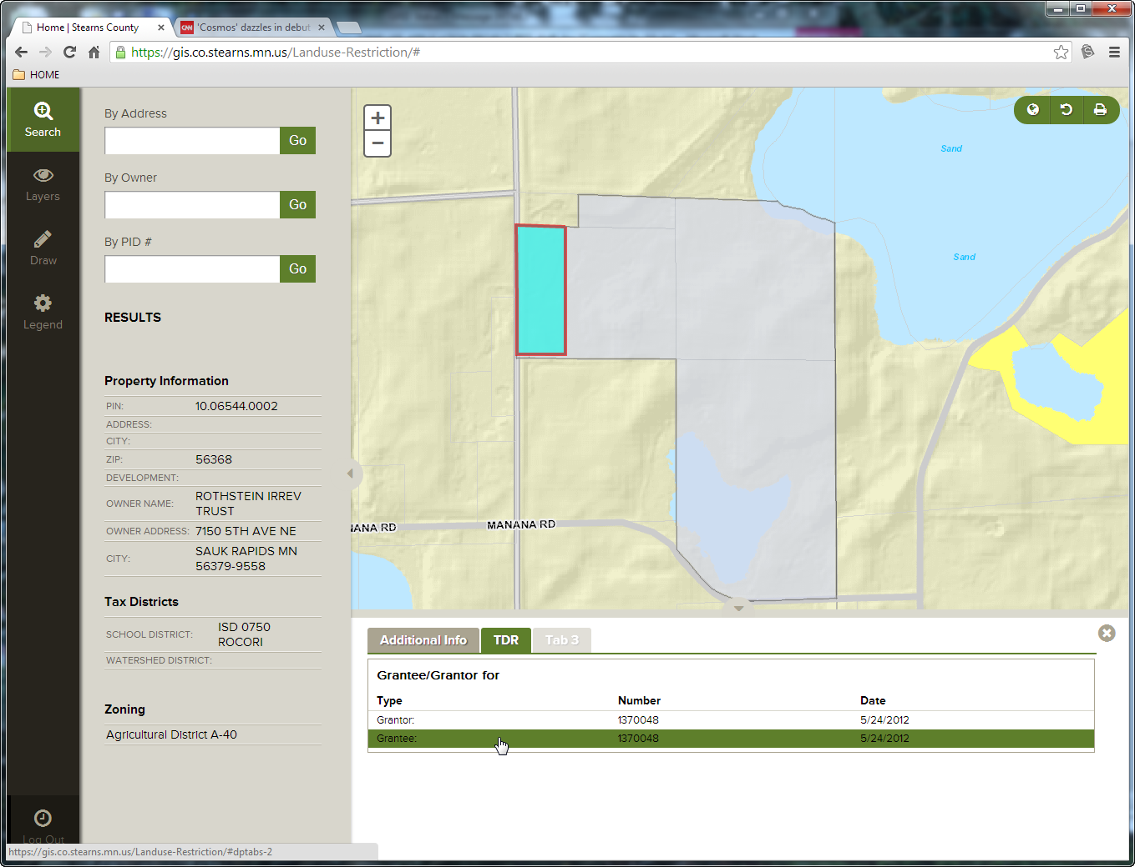
Who, what, where

Slide 90
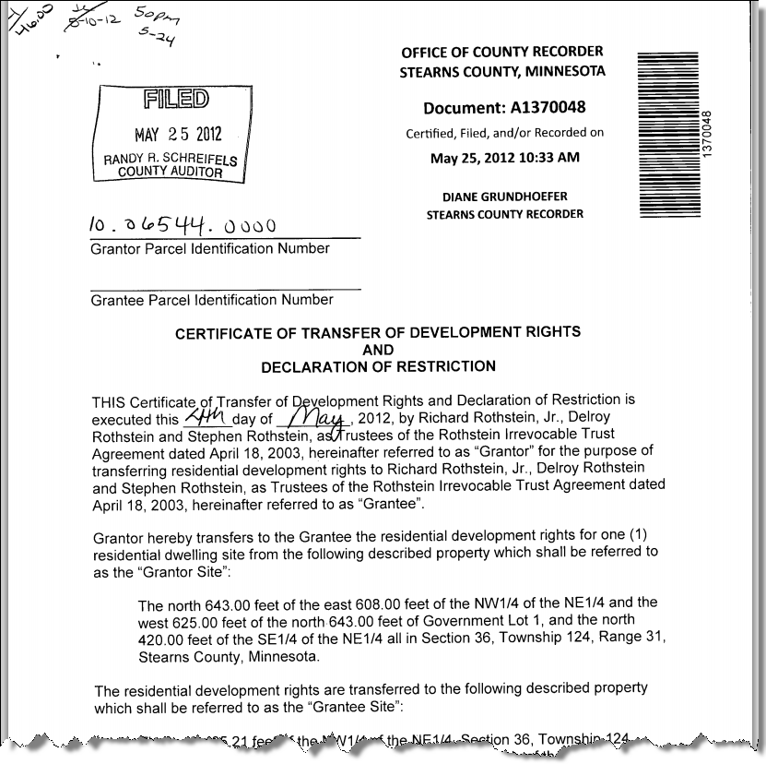
Scanned images

Slide 91
Update - MnGeo Priority Projects

Slide 92
MnGeo Priority Projects
  Addresses
  Aerial Imagery
  Altered Watercourse
  Geospatial Commons
  LiDAR/Elevation
  Hydrography
  Parcels
  Street Centerlines
  ArcGIS Online

Slide 93
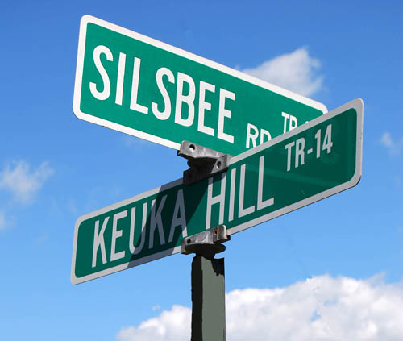
Addresses
Future Project

Slide 94
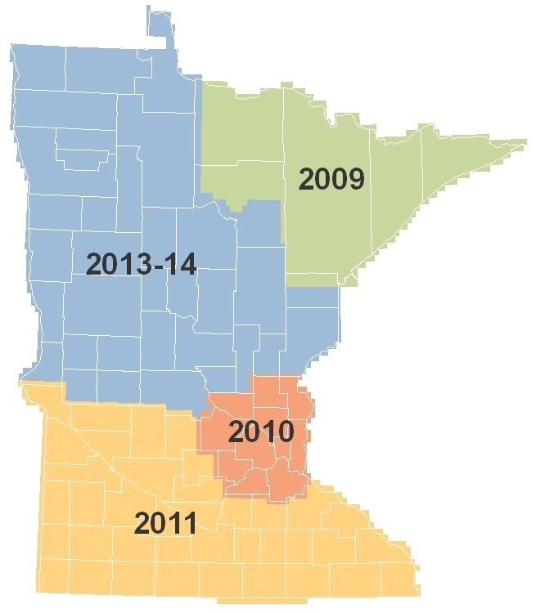
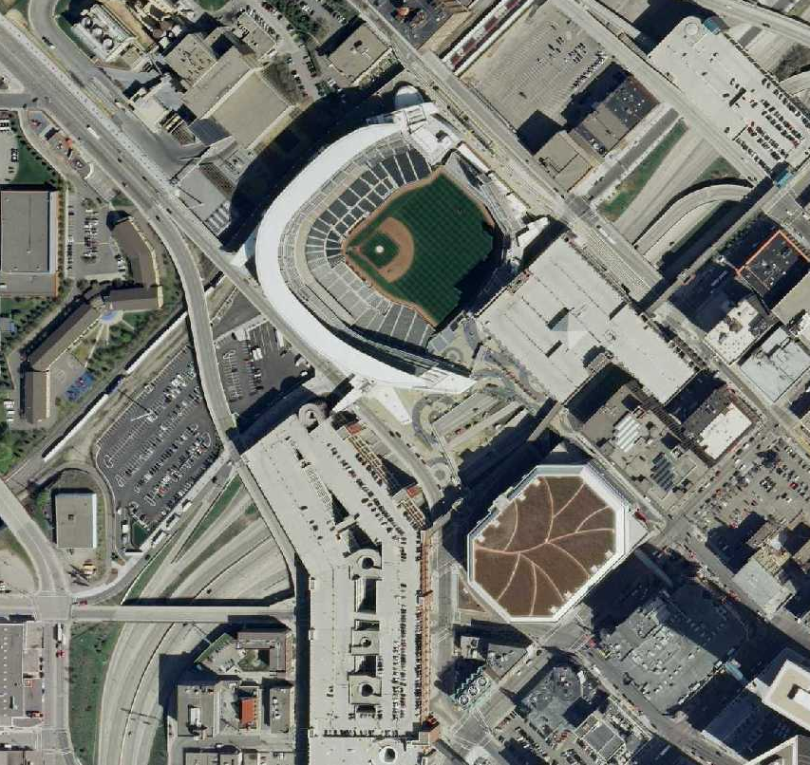
Statewide Aerial Imagery Partnerships
Project Overview:
Statewide 4-band, leaf-off aerial imagery
(ortho and stereo) at ½-meter resolution over 5-seasons
Sponsored by DNR for National Wetlands Inventory (NWI) update efforts; support provided through the Environment and Natural Resources Trust Fund
Buy-up opportunities offered where feasible: 12 & 6-inch resolution
22 Buy-up Partnerships:
Federal (2) f State (2) f County (15) Tribal (2) f Regional (1)
Financial Support
State Funds: $1,100,000
Partner buy-ups: $1,000,000

Slide 95
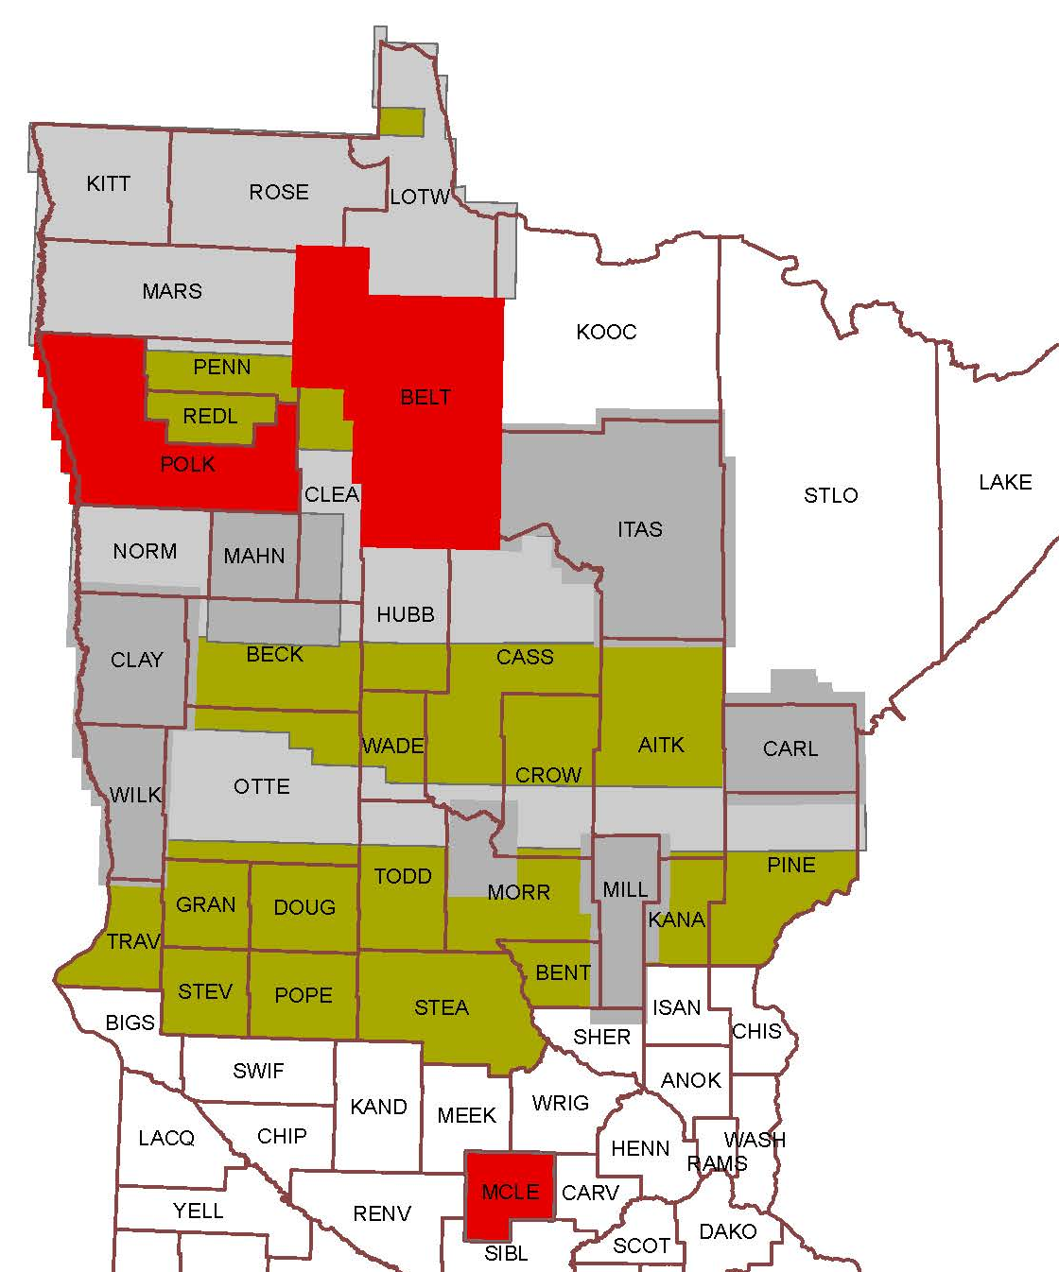
2013/2014: Final Phase of SAIP
Project Description:
$750K project coordinated between DNR, MnGeo, MnDOT, 11 local partners, 34 cos
2013:
8 buy-up partners: Carlton, Clay, Itasca, Mille Lacs, Wilkin Counties; White Earth & Fond du Lac Reservations; Camp Ripley
Medium res collected: Three E/W bands
26,000 square miles of data acquired
2014:
Complete balance of 39,000-sq mi area
3 buy-up partners: Beltrami, Polk, McLeod
Project ends this year
Efforts will continue to encourage partnerships

Slide 96
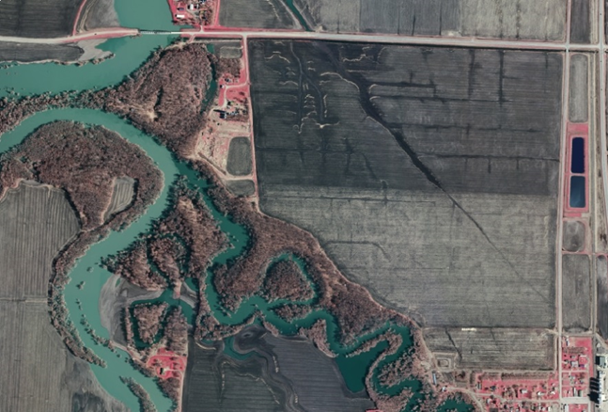
MnGeo Image Service Activity - 2013
Project Overview:
A Web Mapping Service publishing 61 raster data sets, including:
Aerial imagery
Hillshade elevation
USGS topographic maps
In 2013, more than 48-million image view requests were made. Top 5 data sets make up 80% of those requests.
New Additions:
2013 DNR leaf-off Central & NW MN
2013 FSA NAIP Imagery – Statewide
Notes:
Image Caption: An example of Spring 2013 one-foot resolution color infrared imagery from Clay County, showing the confluence of the Red and Buffalo Rivers near Georgetown, MN.

Slide 97
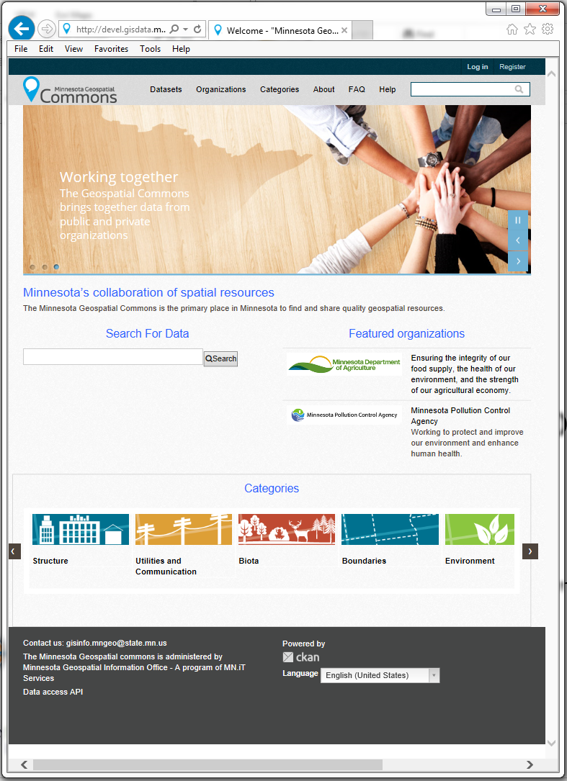
MN Geospatial Commons – June 30, 2014
A single place we all go to find and share geospatial resources
Where are we?
  Release complete
    Demo usability
  Align infrastructure and data
    Assessment of existing agency infrastructure

Slide 98
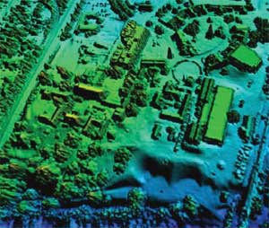
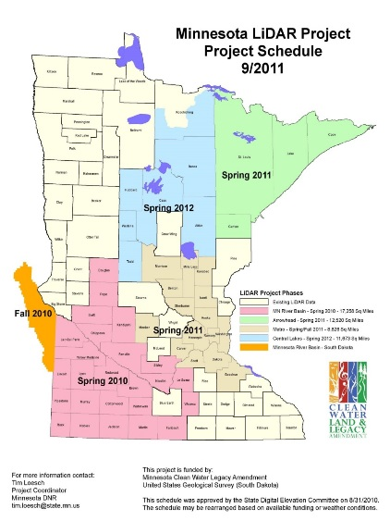
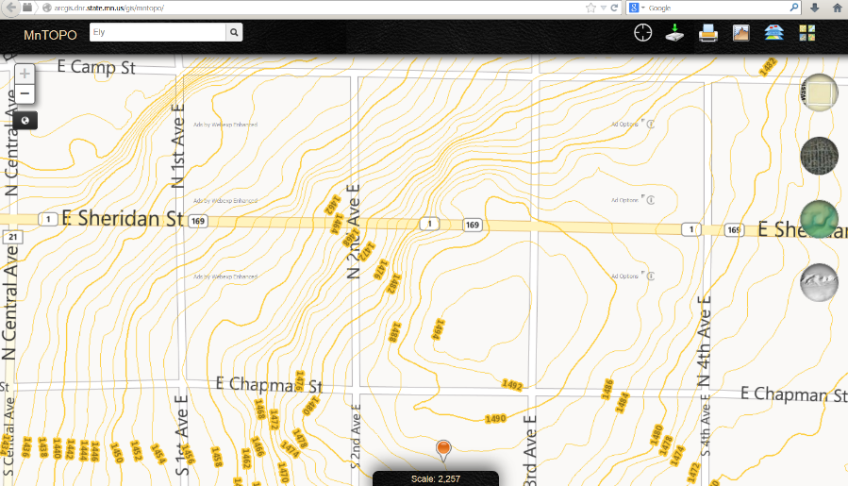
LiDAR Elevation – Winter 2014
Nearly ready to go public:
  FTP site ready
  Data download ready
  Web page updated
  Working on standardizing naming conventions

Slide 99

Hydrography – In progress
  Multi agency project to try to work toward a single geographic representation of surface water for Minnesota…
  A national stream addressing system
  A modeling network for navigating upstream/downstream
  A maintenance infrastructure
  Additional tools to enhance use of data
Notes:
Graphic – St. Louis River Basin is the central basin – emptying into Lake Superior. Hydro features include lakes, rivers for mapping (1-d, 2-d), rivers for networking (1-d); A system of Watershed Boundaries (WBD) is also included. Those are the red lines on this graphic.
Flow volume and velocity within catchments

Slide 100



Statewide Parcel Integration Project – aligning with Revenue efforts
Legislation – passed
License Agreement - in progress
Exchange Guideline - shared
Regional Collaborations - happening
MN Dept. of Revenue Project – in progress
MnGeo to do parcel collect 2014

Slide 101










Defining business rules for the data and the system
MnGeo instance of Esri Roads and Highways for the partners
R&H Training for pilot partners coming soon
Statewide Centerline Initiative
Minnesota Geospatial Information Office Minnesota Department of Transportation
Metropolitan Council MetroGIS
To develop, test, refine, publish and perpetuate a single state- wide roadway dataset that meets the needs of a diverse user community…

Slide 102




State of Minnesota ArcGIS Online Site
A single place for all executive branch agencies to publish their maps and web applications
Metadata for maps and web apps will be in the Minnesota Geospatial Commons

Slide 103
Governor’s Commendation Award Committee

Slide 104
Governor’s Commendation Award Committee
Award is for activities that exemplify a commitment to "coordinated, affordable, reliable and effective" use of GIS to improve services within Minnesota.
Criteria and past winners are listed on the award webpage:
http://www.mngeo.state.mn.us/awards/gov_commendations/
Deadline for nominations: June 30, 2014
Need 4-5 volunteers to serve on the award committee to:
  review nominations
  recommend nominations that meet the criteria to the CGIO. Nominations then need CIO and Governor’s Office review and approval. Award(s) are presented at the Mn GIS/LIS Consortium conference in October.

Slide 105

Questions?

Slide 106
Thank you!
See you
June 18th, 2014

