Slide 1
Statewide Geospatial Advisory Committee
April 1, 2015

Slide 2
AGENDA
Call to order and introductions
Approval of Jan. 28 meeting minutes
Parks and trails of regional significance website projects
Update on legislative session
NSGIC highlights
Next Generation 9-1-1 update
Break – Networking
Mn GIS/LIS conference
Governor’s Commendation award
Call for members - the next 2 year term
MN Geospatial Commons – release to others
Data sharing discussion – government to government
MnGeo priority projects update
Adjourn

Slide 3
Introductions

Slide 4
Approval of January 28 minutes
Nancy Rader, MnGeo

Slide 5
Minnesota Parks and Trails of Regional Significance
Data Integration and Website Project
Hal Watson - Minnesota DNR

Slide 6
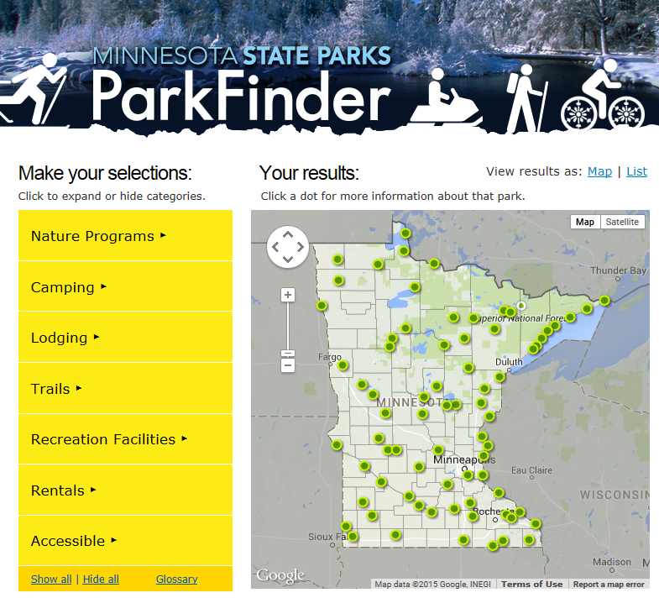
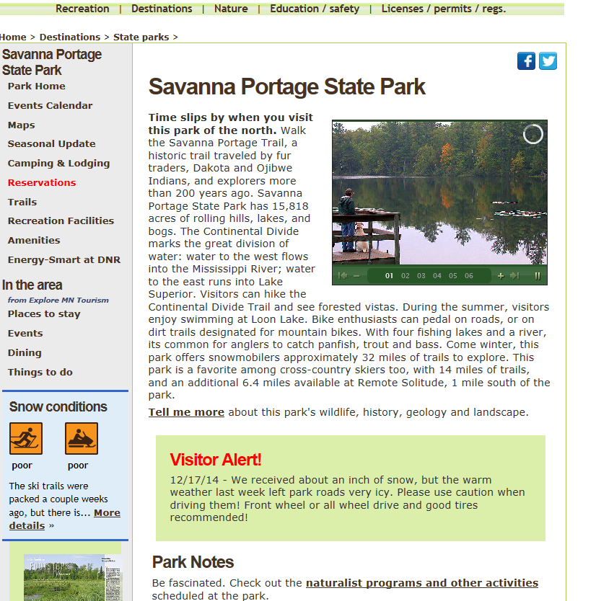
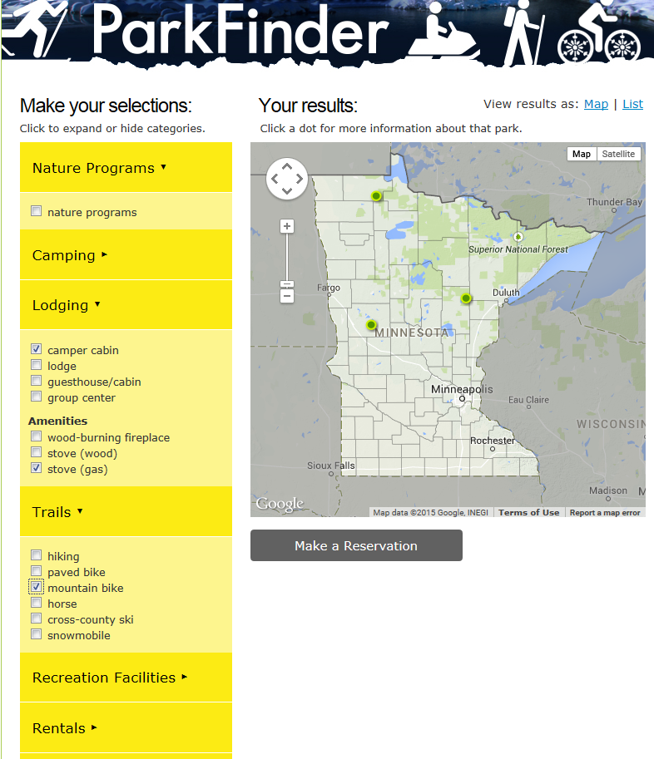
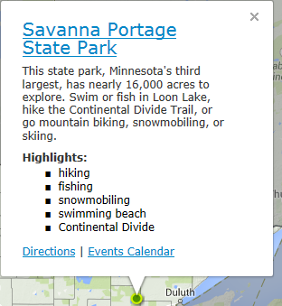
Purpose & Need

Slide 7
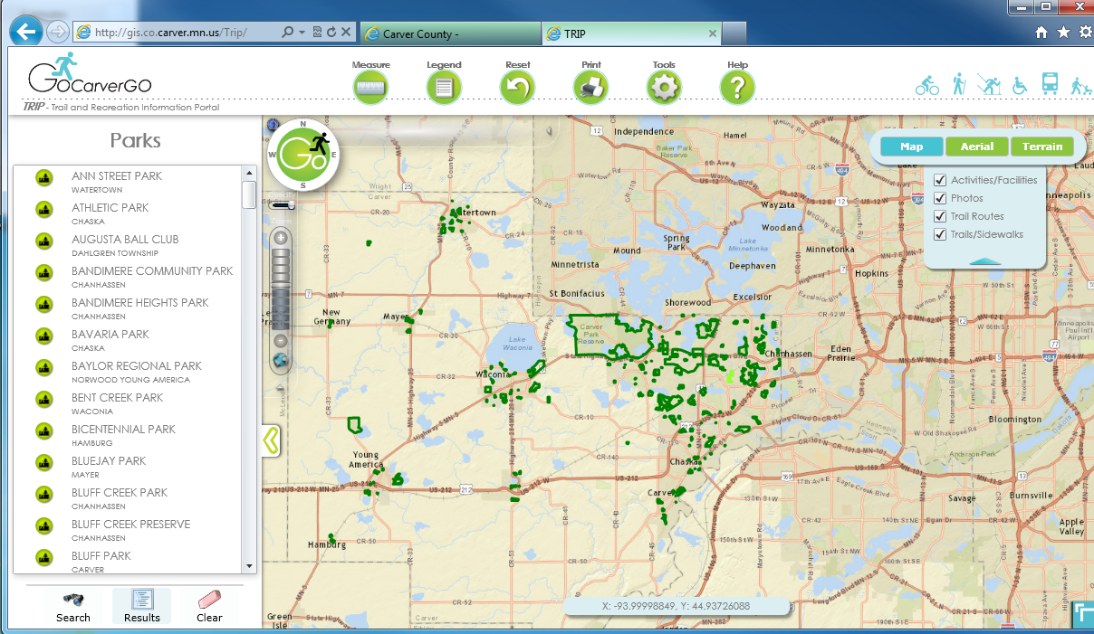
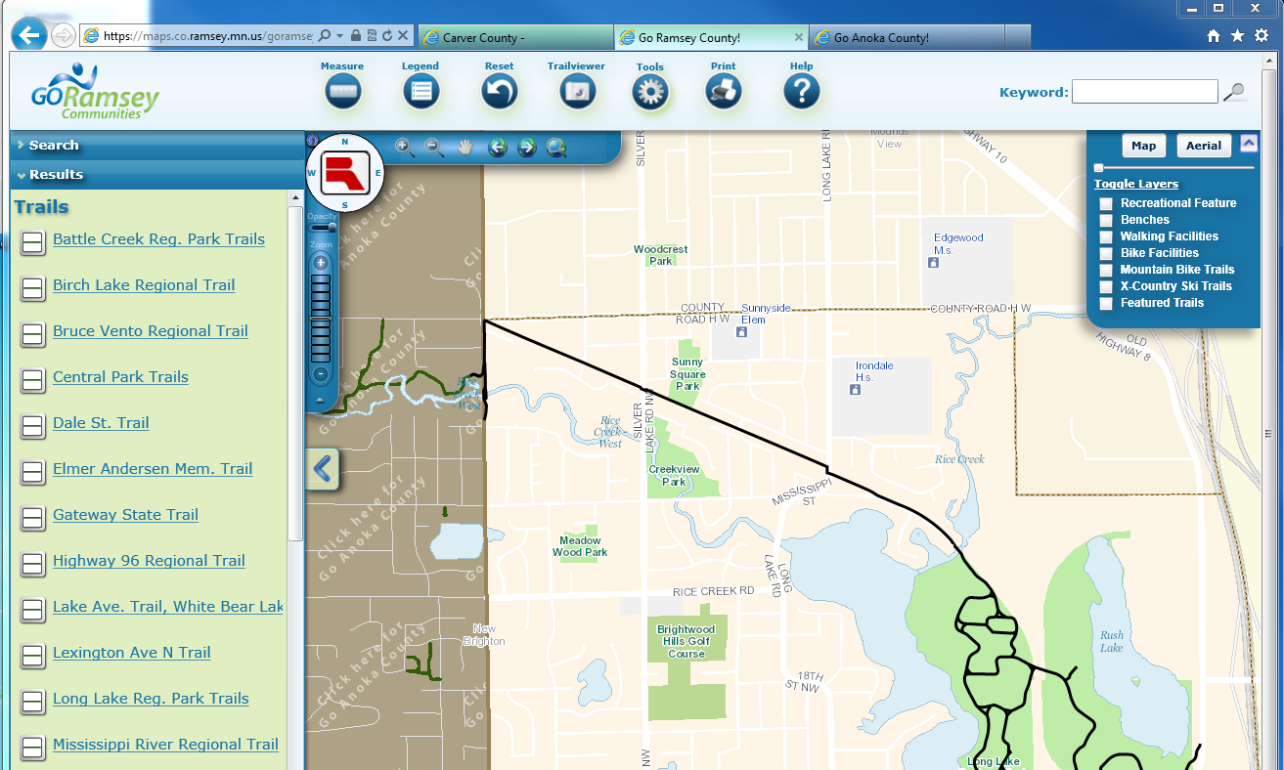
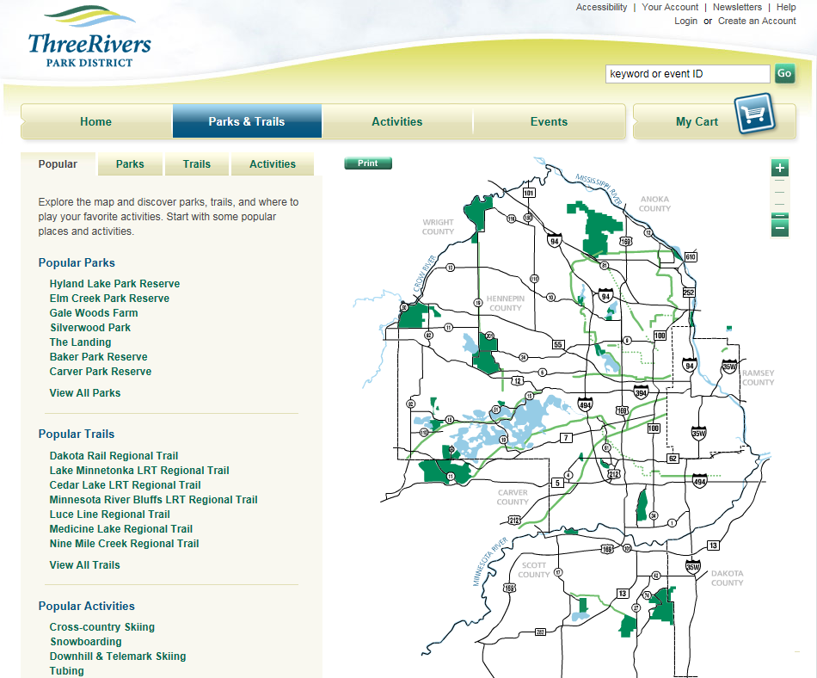
Purpose & Need

Slide 8
Legislation
Minnesota Session Laws, Chapter 137 directs the DNR to: create enhanced, integrated, and accessible Web-based information for park and trail users; joint marketing and promotional efforts for all parks and trails of regional or statewide significance; and support of activities of a parks and trails legacy advisory committee

Slide 9






Partners

Slide 10
Goals
Short term:
  Park and Trail End User Website
  Development of a Recreation Data Standard
  Partner with MetroGIS in the Standard Development Process
Long Term
  Consistently Structured Recreation Data and Services
  Consumable by wide variety of public and private apps.

Slide 11

Questions and Comments

Slide 12

Legacy Fund Parks and Trails
Create common definitions for parks and trails data in Minnesota.
Common terms, database, tools and methods for obtaining/maintaining the data
Accomplished through a series of stakeholder meetings

Slide 13
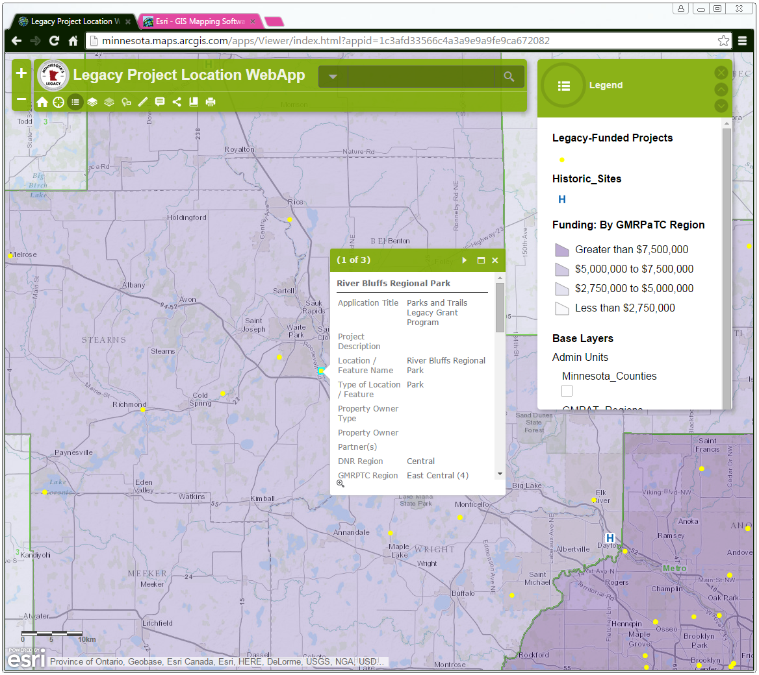
Legacy Fund Parks and Trails
Provide a mechanism to geographically locate and visually share the location and some information about each of the projects that have received funding from the Legacy Fund
Online web application that will allow multiple organizations and users to view and enter the data into a single hosted site
  Include geospatial data for existing trails, bikeways, parks from multiple jurisdictions (state, county, local)
  Align with other projects and authoritative data (e.g. DNR, GMPTC)

Slide 14
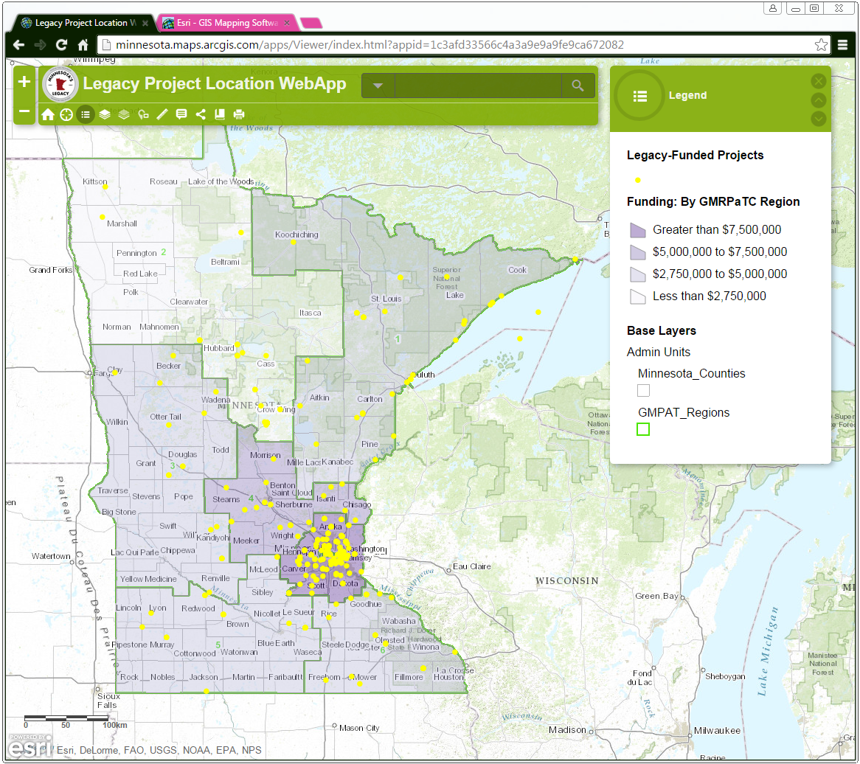
Legacy Fund Parks and Trails
Provide the ability to perform analysis on parks and trails data
Who has received funding – several different summaries
What types of strategic directives are being met with the funding
For planning - Where are there gaps and or needs for projects or connections in trails
Change in the system over time

Slide 15
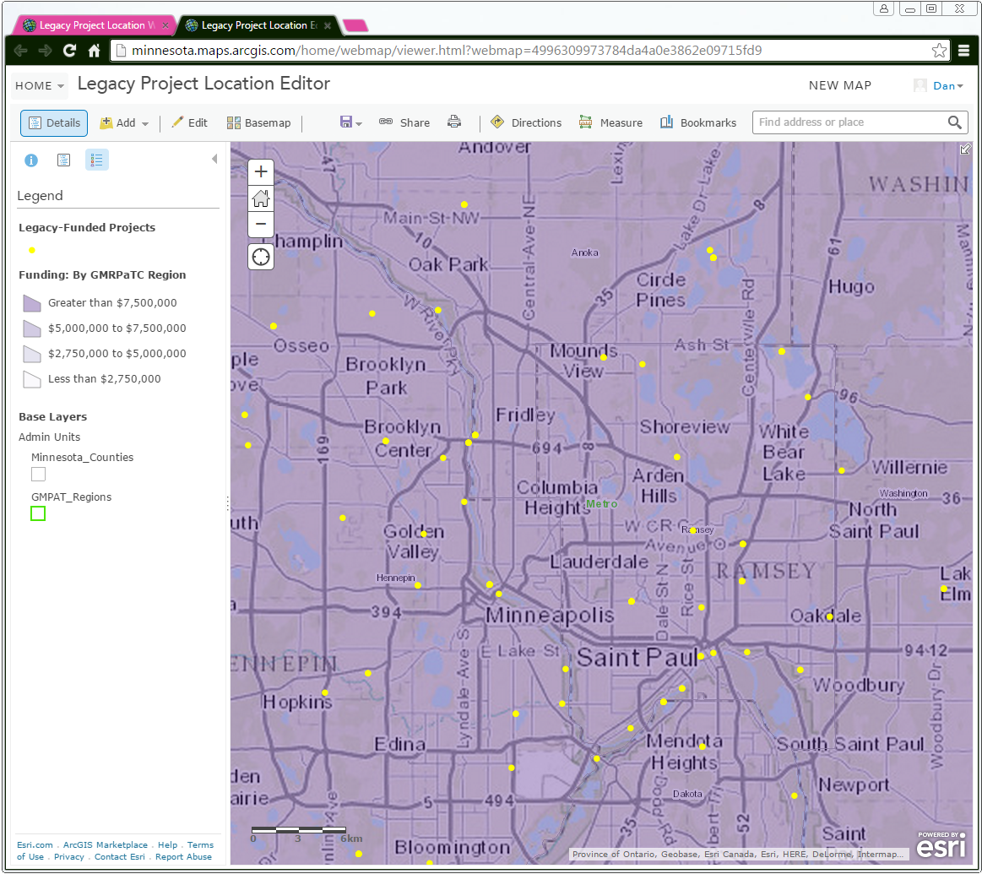
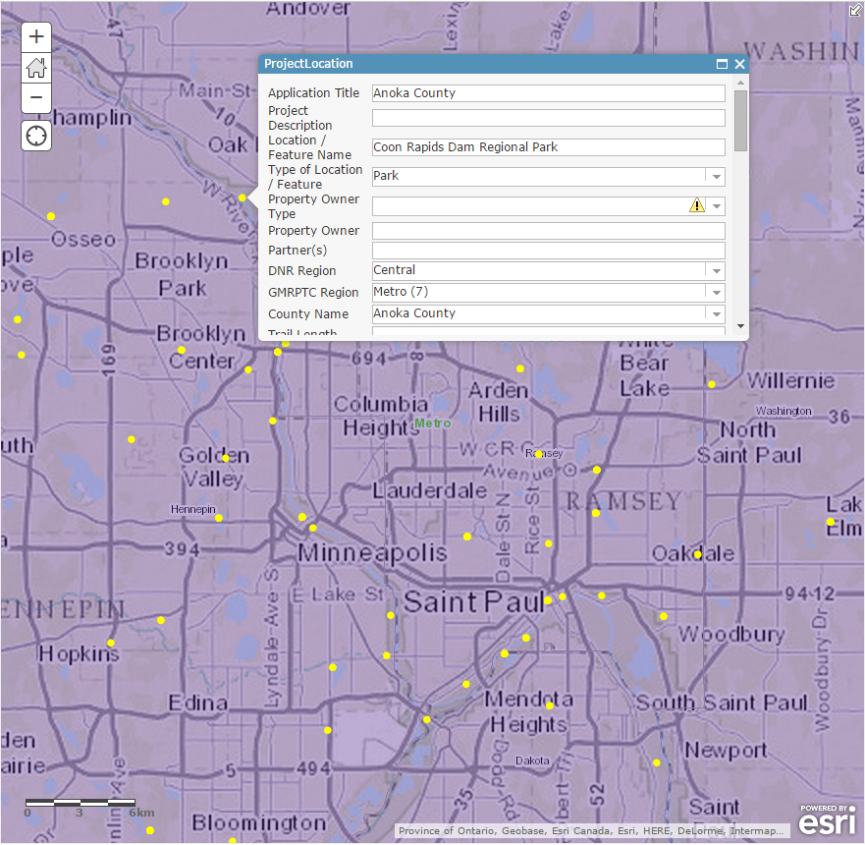
Legacy Fund Parks and Trails
Provide a sustainable approach for obtaining and keeping the data up to date.

Slide 16
Update on legislative session
Dan Ross, MnGeo
Hal Watson DNR

Slide 17
Legislative happenings related to GIS
A few of legislative actions…
9-1-1 – Increase in fees to support the build out of Next Generation 911
Buffer strips along waterways
U of M Parks and Trails effort

Slide 18
On the National scene…

Slide 19
NSGIC highlights
Recent Midyear meeting – Annapolis, MD
Federal Programs – Census, USGS, NOAA, FHWA
Collaboration
  All levels
  Street centerlines, addresses, parcels, imagery, 911
Strategic Planning
Open Data
Report Card on the U.S. National Spatial Data Infrastructure (NSDI)
Emergency Response
  FirstNet
  Next Generation 9-1-1
http://www.nsgic.org/index.php?page_id=1070

Slide 20
On the National scene - GAO Report
Geospatial Data—Progress Needed on Identifying Expenditures, Building and Utilizing a Data Infrastructure, and Reducing Duplicative Efforts.” http://www.gao.gov/products/GAO-15-193
GAO's objectives were to:
Describe the geospatial data that selected federal agencies and states use and how much is spent on geospatial data;
Assess progress in establishing the National Spatial Data Infrastructure; and
Determine whether selected federal agencies and states invest in duplicative geospatial data. To do so, GAO identified federal and state uses of geospatial data; evaluated available cost data from 2013 to 2015; assessed FGDC's and selected agencies' efforts to establish the infrastructure; and analyzed federal and state datasets to identify duplication.
What GAO Recommends
GAO suggests that Congress consider assessing statutory limitations on address data to foster progress toward a national address database.
OMB improve its oversight of FGDC and federal agency initiatives, and that FGDC and selected agencies fully implement initiatives.
The agencies generally agreed with the recommendations and identified plans to implement them.

Slide 21
On the National scene…
Hatch, Warner Introduce Bipartisan Geospatial Data Act
The Geospatial Data Act will:
Codify and strengthen OMB Circular A-16
Require federal agencies to implement international consensus standards,
Assist in eliminating duplication,
Avoid redundant expenditures,
Accelerate the development of electronic government to meet the needs and expectations of citizens and agency programmatic mandates,
Improve the efficiency and effectiveness of public management,
Provide a clear definition for geospatial data and metadata,
Require an accounting of the costs associated with the acquisition or creation of geospatial data,
Improve government transparency and availability to public information.

Slide 22
Addresses for the Nation
National Address Summit – April 8-9th
Hosted by Federal Highways
Diverse participation
  Federal, State, Local, Tribal, Private, Non-profit
Goal
To identify the possible alternatives for developing a NAD with the pros and cons of each alternative based on real case examples that are currently in-place

Slide 23
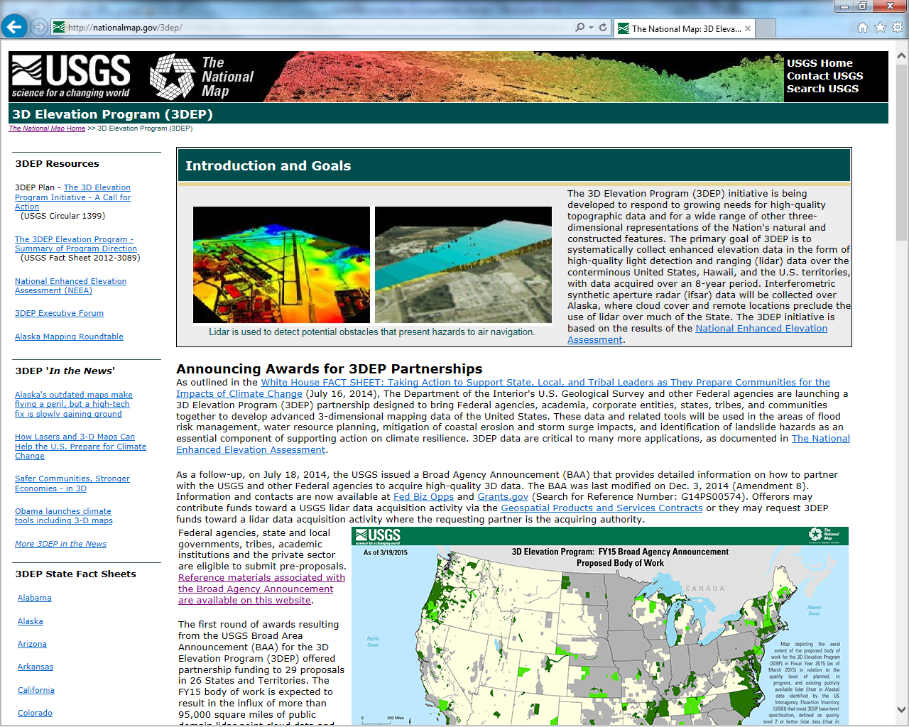
Notes:
3D Elevation Program (3DEP) was implemented in FY15 and included a Broad Agency Announcement (BAA) for partnership funding proposals. This is Quality Level 2 (QL2) or better Elevation data (multiple points per square meter w/ vertical accuracy < 10 cm). BAA announcement for FY16 planned for July w/ public meeting at USGS scheduled on May 28 to provide overview and facilitate discussion for potential projects. Federal agencies are currently submitting their requirements.

Slide 24
National Hydrography Requirements and Benefits Study
Document major uses of geospatial water information by Federal, State, and local government; water utilities and other private sector industries; tribal; not for profit; and the academic research community.
Document benefits that will be realized from a Hydrographic Analysis Framework – not just a dataset, but a system.
Identify the data types, quality, organization, and delivery mechanisms required to achieve those benefits.
Develop a menu of proposed program approaches with associated costs and benefits.
Notes:
The Hydrography Requirements and Benefits Study (HRBS) is a national effort (USGS, USDA co-lead) modeled after the NEEA (National Enhanced Elevation Assessment) study to gather user requirements / needs and prepare “cost benefit” of developing a national program (not just dataset). National survey included over 530 responses from 23 Federal agencies and all 50 states to document nearly 600 “mission critical activities” or business uses. Minnesota had input from 9 (out of 10) organizations including State agencies, Met Council and watershed district. Participants to meet in May (?) to review a “state summary” of survey results.

Slide 25


The Next Generation 9-1-1 Update
John Hoshal, MnGeo

Slide 26
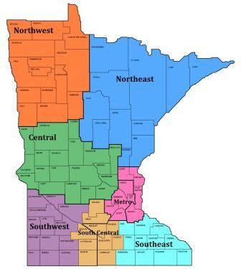
Current Project Tasks
  Project Scope and Work Plan – complete early March 2015
  Regional Kickoff Meetings – begin April 2015
    NE region: April 9
    Metro region: April 16
    Other regions: TBD

Slide 27
Current Project Tasks
  PSAP GIS Survey – begin distribution in April 2015
  Outreach to PSAPs and GIS Sources – ongoing
  Initial GIS Data Assessment – begin summer 2015
  MN NG9-1-1 GIS Standards – complete October 2015

Slide 28
PSAP GIS Survey
  Purpose:
  To assess status of GIS data and software at every PSAP
  Vetted by:
    Statewide Emergency Communications Board (SECB) - reviewed and approved on 3/26
      NG9-1-1 Committee - reviewed and approved on 3/18
      GIS Subcommittee - reviewed and approved on 3/13
    MESB
    MnDOT
    NSGIC
    FirstNet – Televate

Slide 29


30 minutes…
+

Slide 30
Mn GIS/LIS conference
Gerry Sjerven, Conference Chair

Slide 31
Governor’s Commendation award
Nancy Rader, MnGeo

Slide 32
Governor’s Commendation Award
Awards from the Governor’s office for activities that exemplify the use of GIS to improve services within Minnesota.
Criteria:
Promote effective investments in geospatial information
Promote geospatial information as a shared public resource
Support the establishment and use of geospatial standards and guidelines
Champion collaboration among geospatial practitioners and related stakeholders
Educate and inform policymakers related to the value
and use of geospatial technology
Provide a forum for ideas and issues to be shared
and acted upon by the geospatial community
Encourage geospatial education at all levels

Slide 33
Governor’s Commendation Award
Standards are high; award is not always given
Deadline for nominations: June 30, 2015
Council awards committee evaluates the nominations and makes recommendations to advise the CGIO, the CIO, and the Governor’s Office
  Volunteers needed for this year’s committee
  Work done in July, mostly by email
More information on the award webpage: www.mngeo.state.mn.us/awards/gov_commendations/
  How to nominate a project
  Past winners

Slide 34
Preparing for the Next Council Term
Nancy Rader, MnGeo

Slide 35
Open Appointments Process
All council member terms expire June 30, 2015
Next member terms run two years, through June 30, 2017
All members are appointed through the Open Appointments process administered by the Office of the Minnesota Secretary of State (SOS)
Steps and timeline
SOS press release on May 4
Other publicity follows (GIS/LIS e-announcement, others)
Application deadline: May 26
(applications can be accepted until positions are filled)
CGIO, in consultation with others, makes recommendations to the CIO
CIO makes the appointments and notifies SOS
Applications and additional information on the SOS website:
www.sos.state.mn.us/index.aspx?page=5

Slide 36
MN Geospatial Commons – Release to others
Dan Ross and Nancy Rader

Slide 37












Status
Focus - Migration of all significant state geospatial resources currently provided in the Data Deli, Minnesota Geographic Data Clearinghouse, Data Finder and other independent state agencies;
Published resources accessible
  11 Organizations
  220 Resources
The site is now open to broader participation
  Multiple ways to participate
  Looking for candidate partners who want to represent their data via the Geospatial Commons
    Hennepin – Esri Geoportal connection
    Dakota – expressed interest
Metadata Training being shaped and will be provided

Slide 38
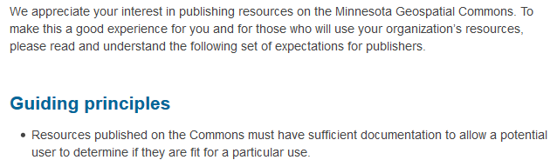
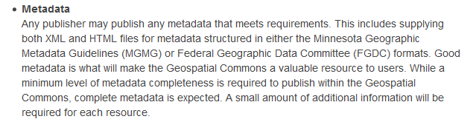

Slide 39
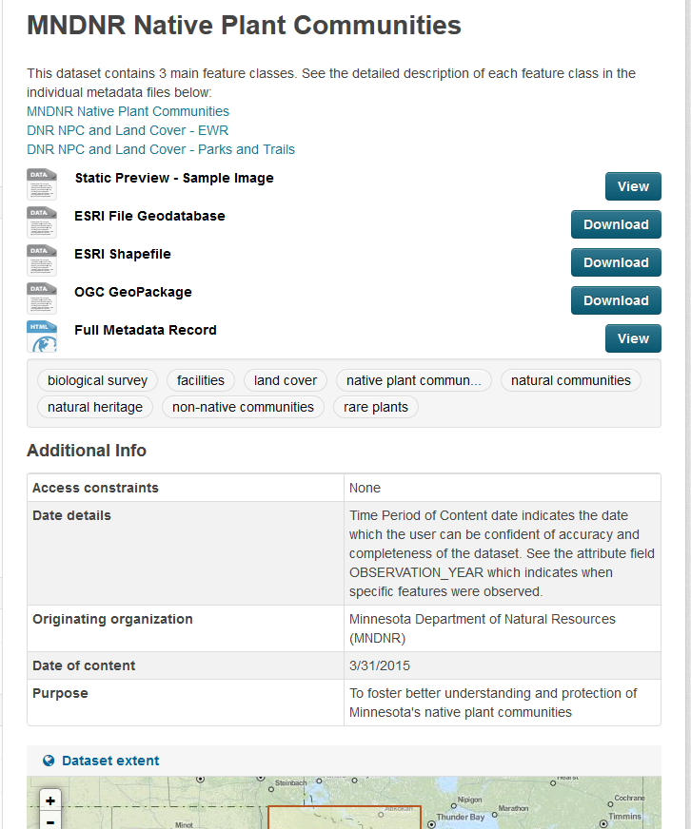
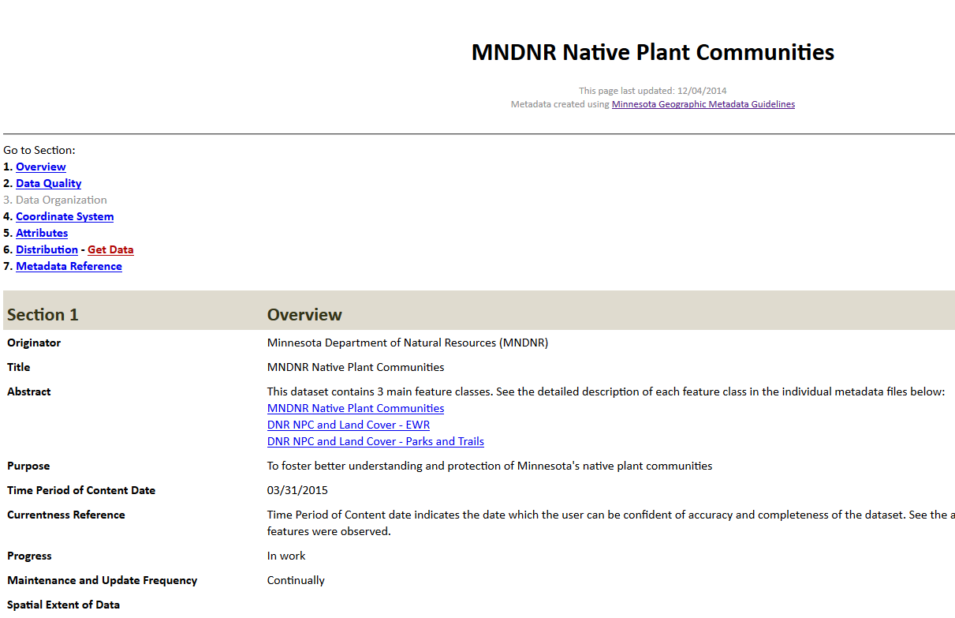
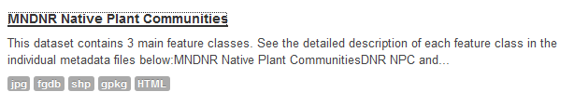


Slide 40
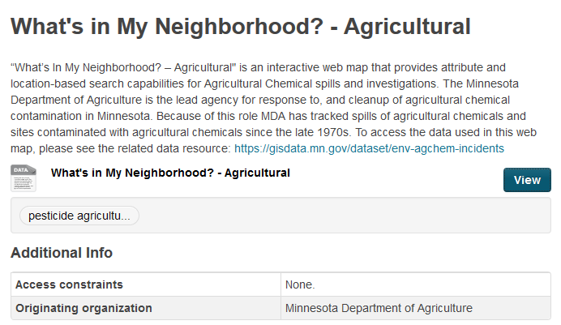
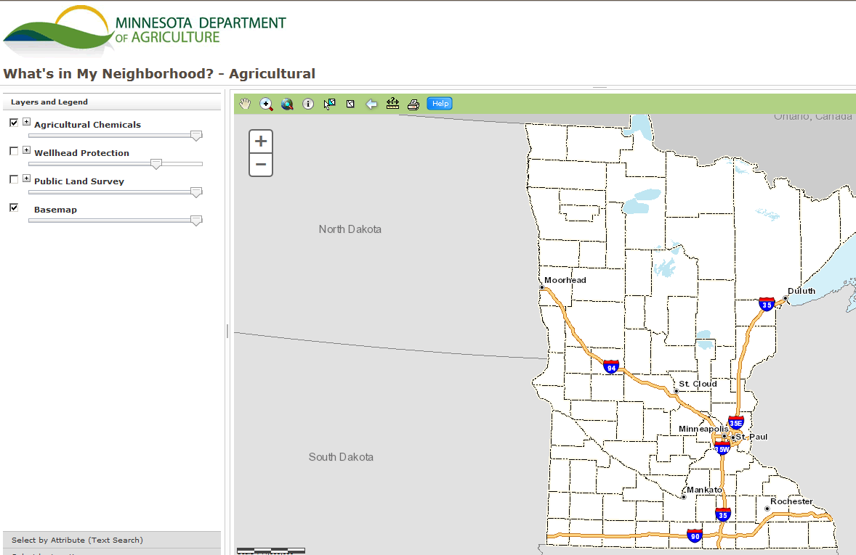
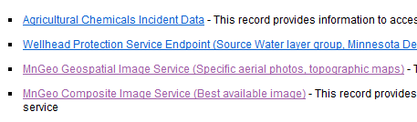

Slide 41
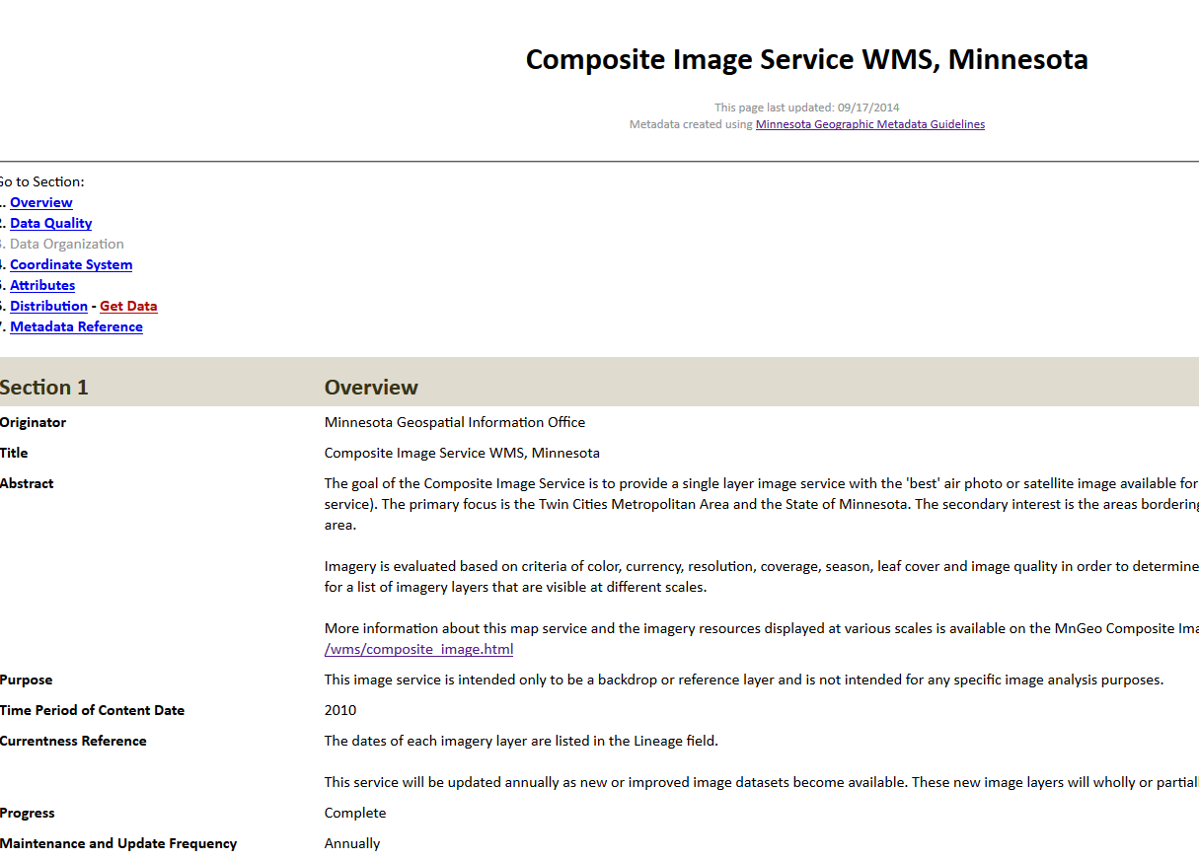
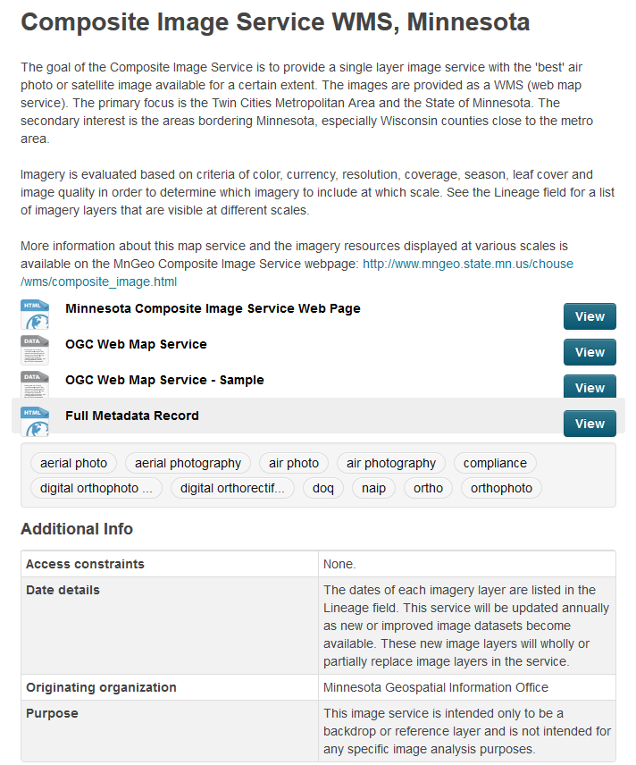

Slide 42
Data sharing Government to Government and Perhaps Beyond?
Dan Ross

Slide 43
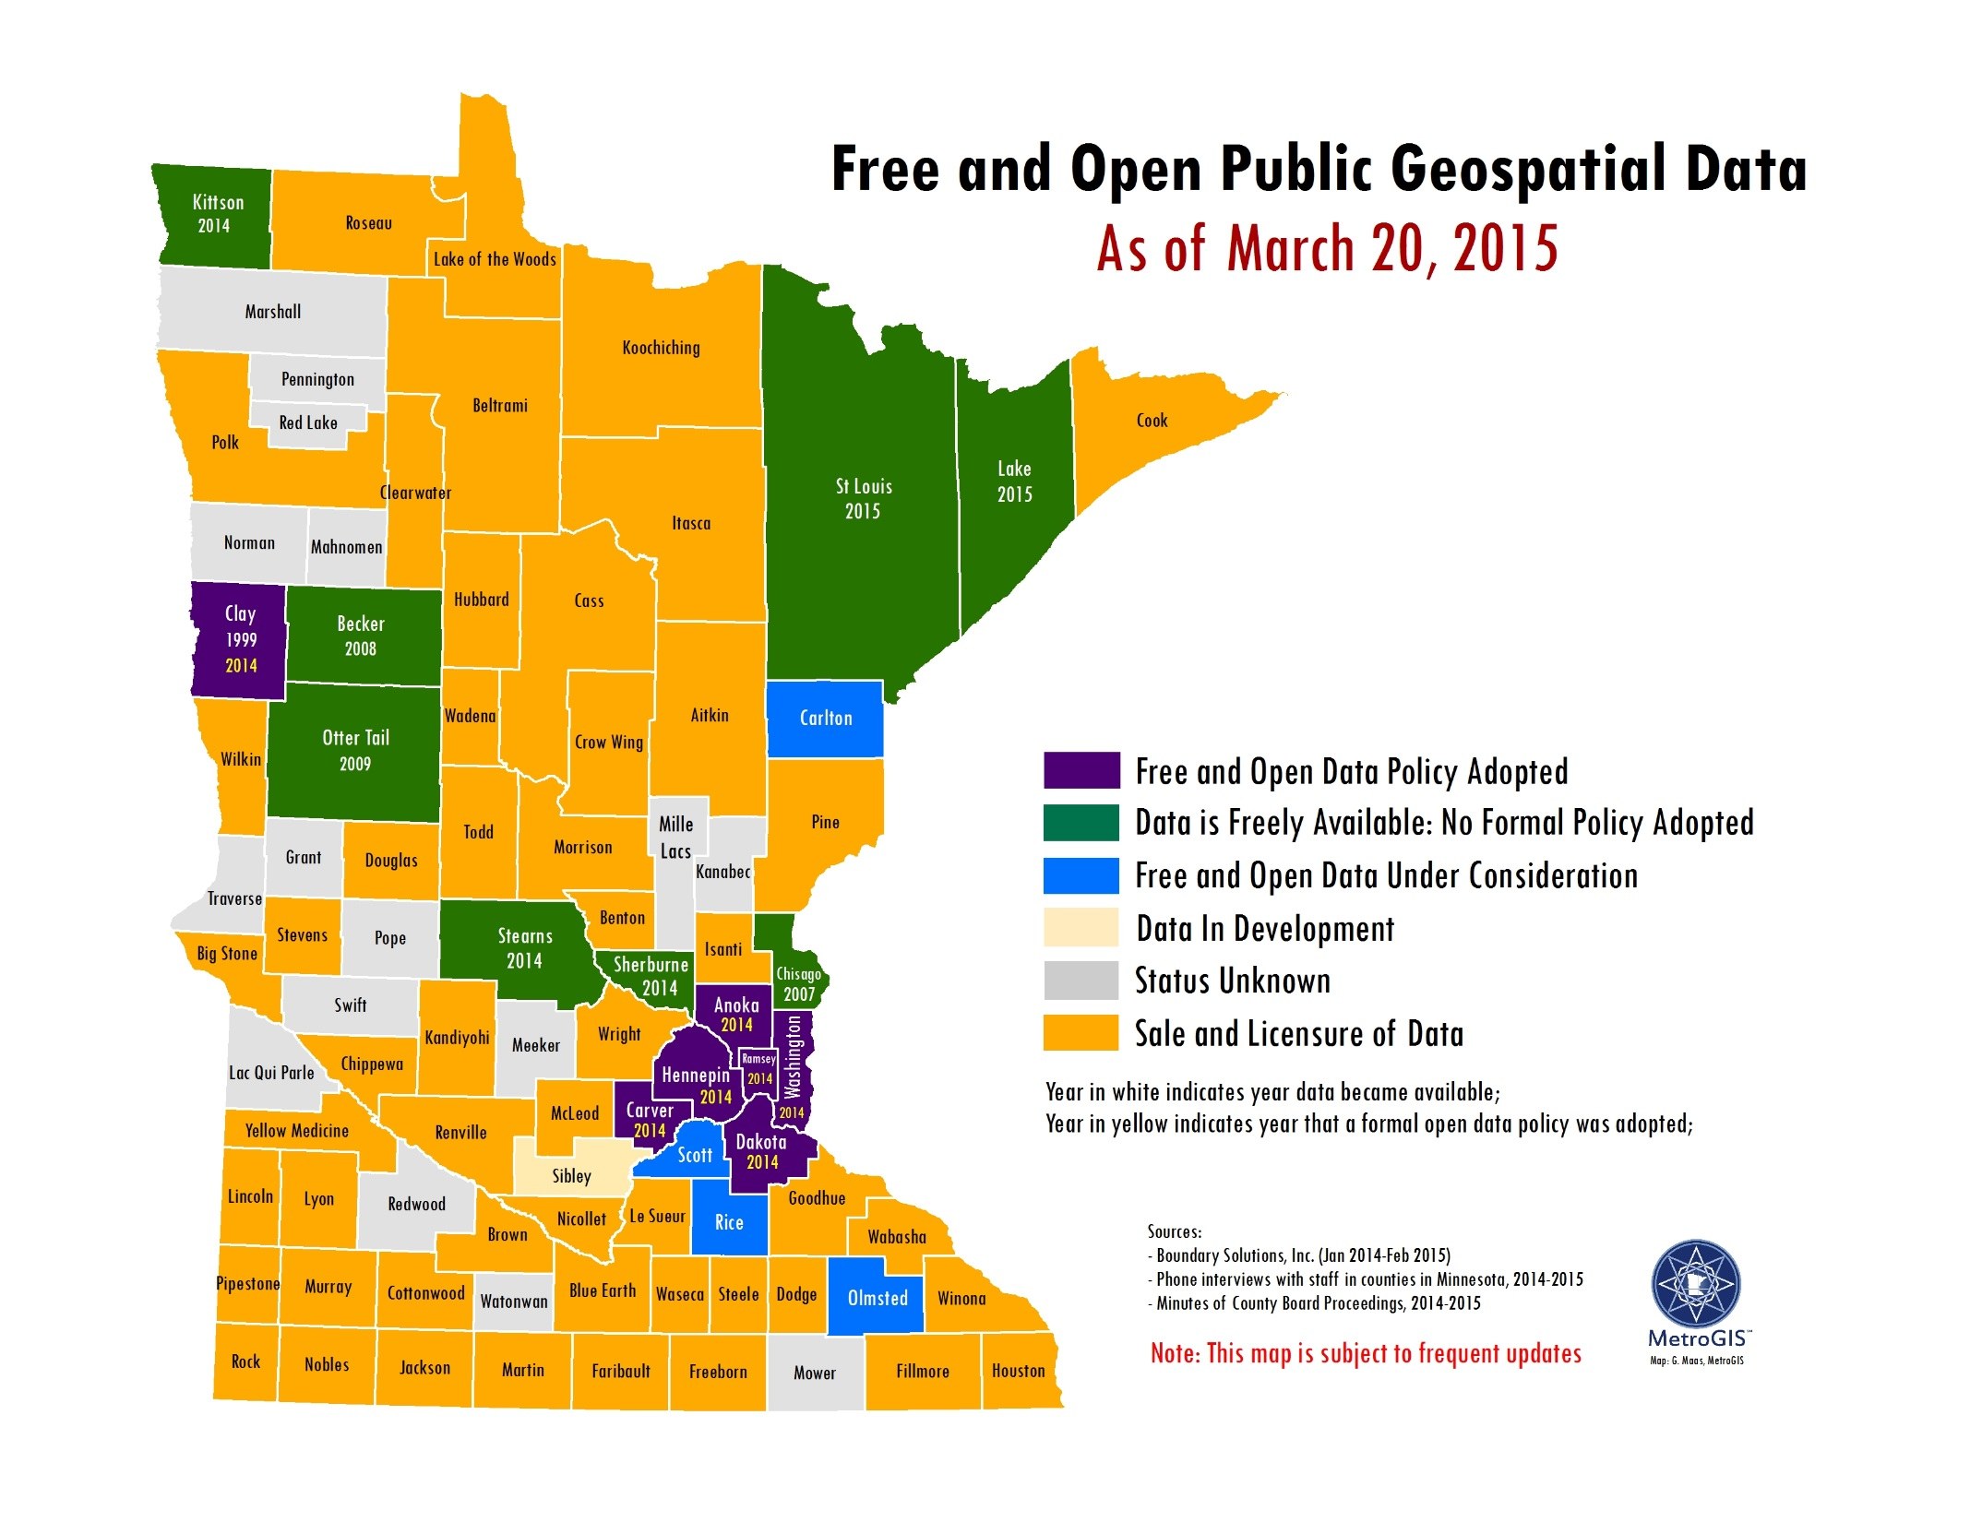

Slide 44
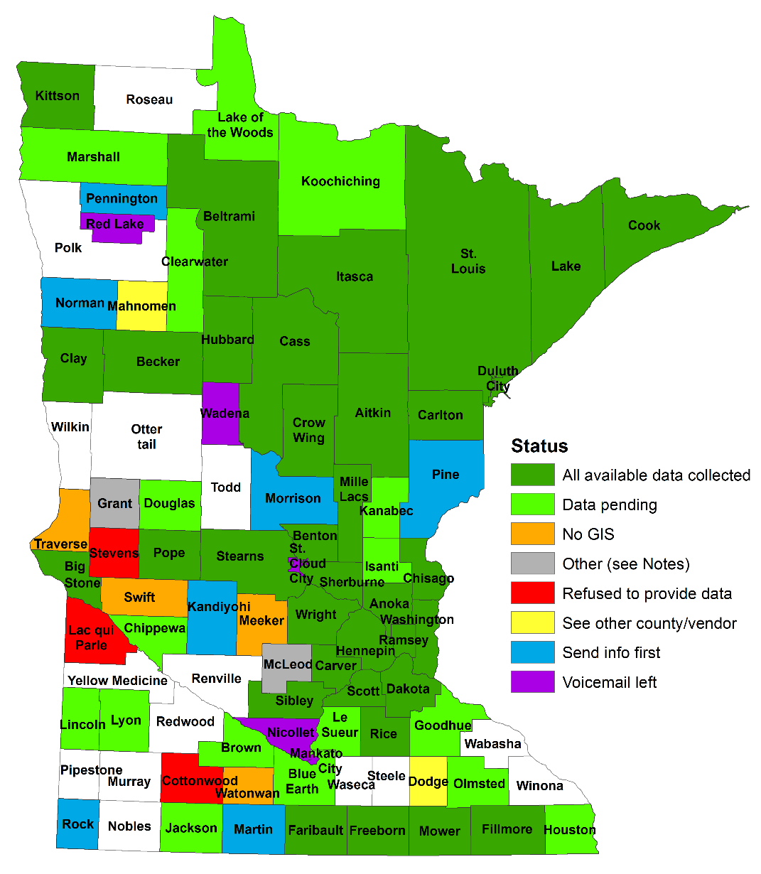
Status of current data sharing effort….
Each partner was asked about sharing
  Other Government
  Beyond Government
As expected partners at various stages of development
Others will ask for the data – (e.g. Census)
MnGeo checks with partners
  Point others to partners
Relationship to Geospatial Commons

Slide 45
Discussion?
With the Geospatial Commons opening up…
  Would like to see all shareable data referenced there
Three ways to share data
  Geospatial Commons – data available is considered free and open – Preferred method
  Behind the state firewall – only available to state agencies
  Reference that points to some other way to obtain the data

Slide 46
Discussion?
As we request data sharing we will be asking
Is it OK to share your data with other governments?
  Census Bureau request 14 counties
    12 approved sharing 2 refer to County
Is it OK to share your data beyond government?
For this group – thoughts on these questions and the approach?

Slide 47
MnGeo priority efforts and updates
Dan Ross, MnGeo

Slide 48
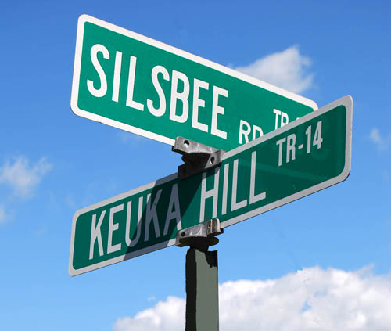
Statewide Addresses
Developed as part of NG9-1-1
Shaping the project now
Collaboration with DPS, State Patrol, MnDOT, local partners
Aligned with Street Centerlines
Will begin moving forward this spring

Slide 49
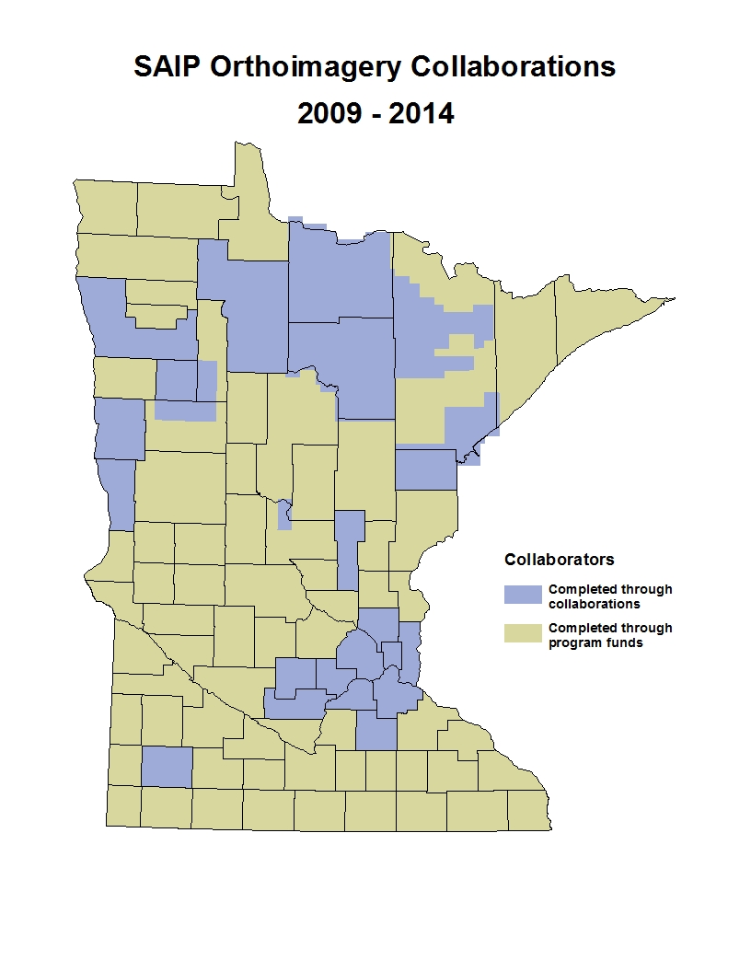
Spring Aerial Imagery Project 2009-2014
SAIP
  6-year project
  4-band & stereo imagery
  0.5-meter resolution
  Funded: ENRTF at $1.1-million
  Purpose: Update National Wetland Inventory
  Strategy: individual, annual contracts
Partnerships Offered
  To counties, tribes, federal agencies
  22 partnerships developed
  Most bought up from 0.5-meter to 1-foot
  Over an area representing 33% of MN
  Total project budget increase: ~$1-million

Slide 50
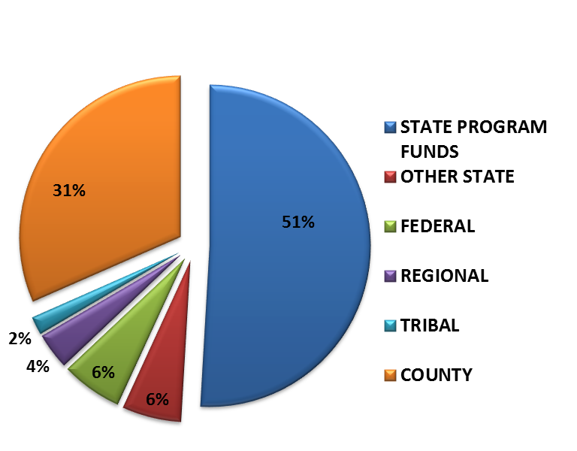
Spring Aerial Imagery Project 2009-2015
Roles
  DNR: Primary customer, funding source, ID technical specs
  MnGeo: project/contract mgmt; liaison with partners; imagery QC
  MnDOT: Tech specialists; positional accuracy assessment
  Counties, Tribes, Feds: partners engaged through JPAs and POs; involvement varied
Future
  Project ending in first quarter 2015
  Interest in continuing partnership program, but no dedicated state $$
  State would dedicate resources to develop and execute a new contract

Slide 51
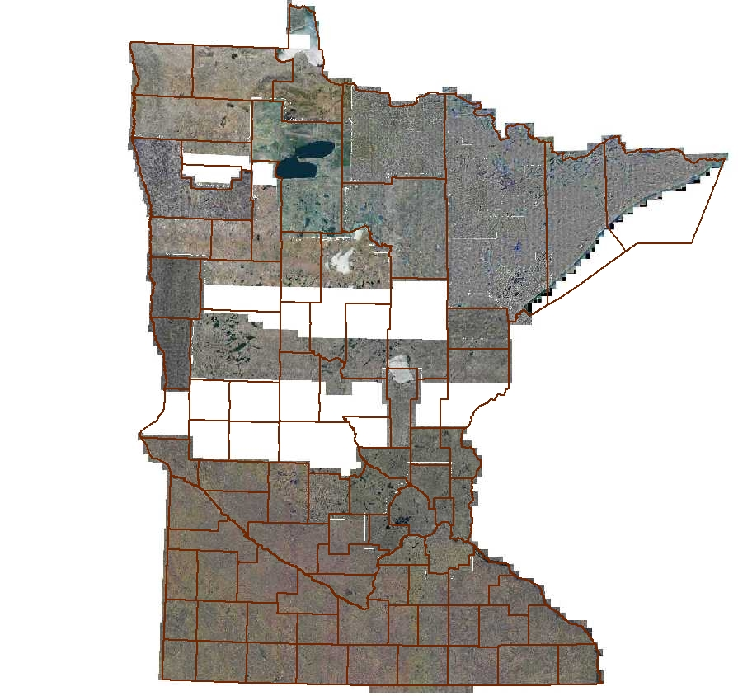
Status
All data delivered to MnGeo
Remaining areas to DOT for positional control
MnGeo data quality review underway
Look for the service to be updated in the next week or so

Slide 52

Master Services Contract (MSC)
Identify specifications for a set of products and/or services
Pre-approve a number of qualified vendors
Contract in force for multiple years
When products are desired, they are pooled and a work order is prepared
Vendor responses evaluated; best value selected
As new needs arise, new work orders can be issued over the life of the contract
For this contract, the primary products would be imagery and planimetrics:
  4-band; Resolution from 3- or 4-inch to ½-meter

Slide 53
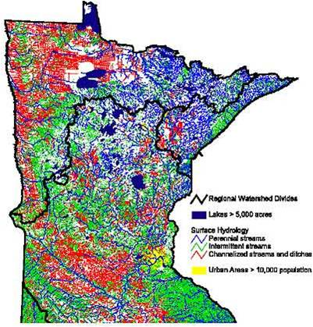
Drainage Records Modernization
Project Goal: Develop a GIS database template along with data standards and a web-based data portal for Minnesota’s public drainage system records.
Project Status:
Service Authorization (SA) between BWSR and MnGeo in place;
Project plan prepared;
Contractor (Houston Engineering Inc.) onboard
Project Advisory Committee is being created.
Project Funding: $230,000

Slide 54
Parcel, centerline, address points interim collect update

Slide 55
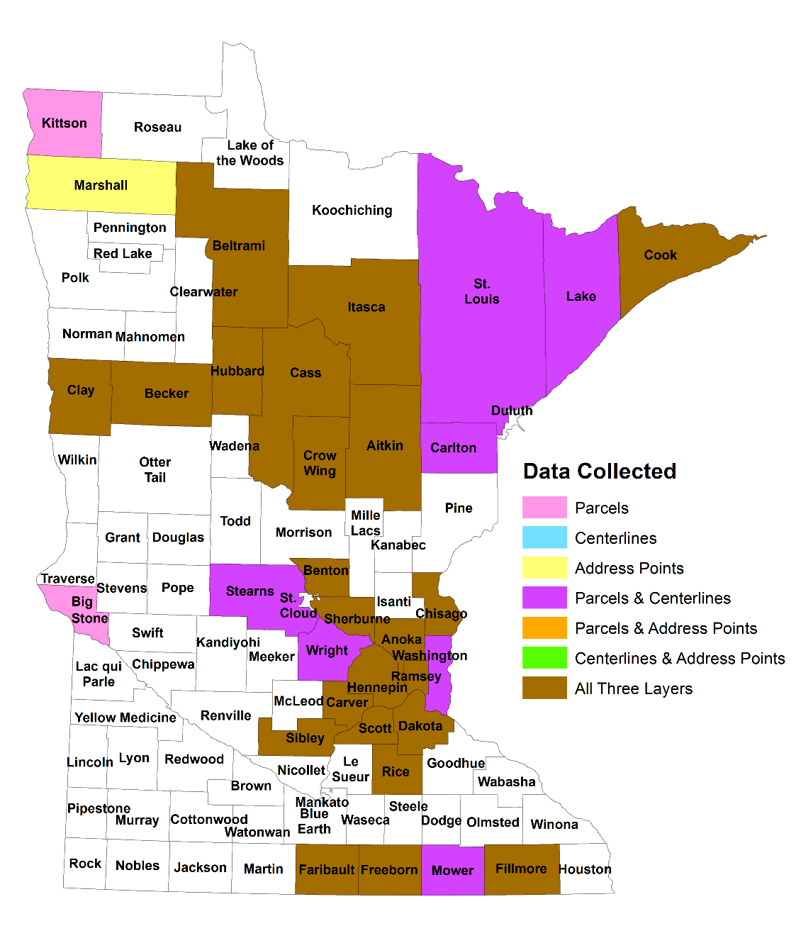
Status of County Data Collection
(as of 1/26/2015)
87 counties, 3 cities and 1 Indian Reservation
73 counties contacted
Data collected from 33

Slide 56
Schedule
Milestones | Target Date
Collect all available data | May 2015
Standardize the three layers | Oct 2015
Aggregate the three layers into single statewide datasets (likely to have gaps) | Jan 2016

Slide 57
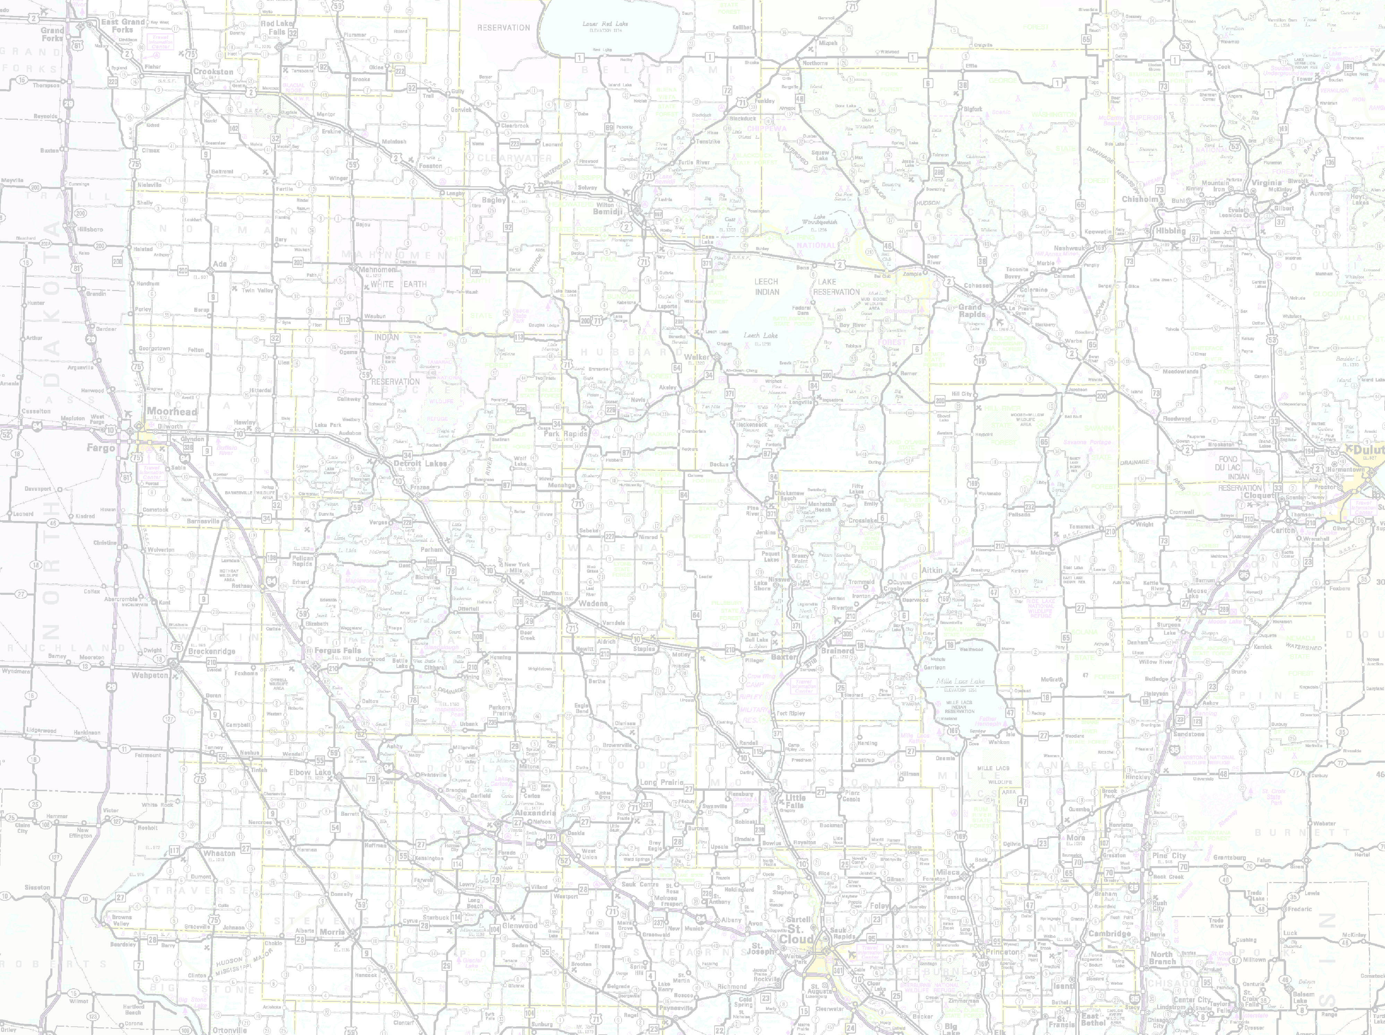









MnDOT in production internally
Update MnGeo instance of tools for the partners
Conflation of non-state data
Align with Metro counties GIS Centerlines, Next Generation 9-1-1 efforts
  2 data views – General use and Engineering
Statewide Centerline Initiative
To develop, test, refine, publish and perpetuate a single state- wide roadway dataset that meets the needs of a diverse user community…

Slide 58
Adjourn…
See you next meeting, June 24

