Slide 1
Statewide Geospatial Advisory Committee
June 24, 2015

Slide 2
AGENDA
Call to order and introductions
Approval of April 1, 2015 meeting minutes; review of action items
Update on legislative session
Next Generation 9-1-1 update
Discussion: Moving toward standards for Parcels, Centerlines, and Address Points
Discussion: Role of committees and workgroups
Break – Networking 30 min
Mn GIS/LIS Conference: 2015 and plans for 2016-18
MN Geospatial Commons
  Metadata recommendation
  Operational mode
Discussion: Year-end evaluation
Announcements or other business
Adjourn

Slide 3
Introductions

Slide 4
Approval of April 1 minutes
Nancy Rader, MnGeo

Slide 5
Update on Legislative Session

Slide 6
Legislative happenings related to GIS
Three legislative actions…
Buffer strips along waterways
U of M Parks and Trails effort
9-1-1 – Increase in fees to support the build out of Next Generation 911

Slide 7
Legislation - Water Quality Improvement
1) for all public waters, the more restrictive of:
(i) a 50-foot average width, 30-foot minimum width, continuous buffer of perennially rooted vegetation; or
(ii) the state shoreland standards and criteria adopted by the commissioner under section 103F.211; and
(2) for public drainage systems established under chapter 103E, a 16.5-foot minimum width continuous buffer of perennially rooted vegetation on ditches within the benefited area of public drainage systems.

Slide 8
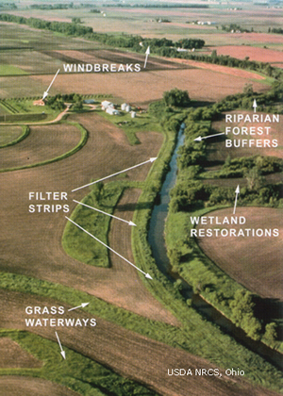
Legislation - Water Quality Improvement
Buffer Strips
$325,000 the first year and $325,000 the second year are for analysis and mapping in each county related to compliance with riparian buffer or alternate practice requirements and to provide statewide coordination and guidance to local units of government for implementation of buffer requirements. Maps must be provided to local units of government and made available to landowners on the Department of Natural Resources' Web site.

Slide 9
Minnesota Parks and Trails
74.7 (e) $536,000 the first year and $555,000 the
74.8 second year are for coordination and projects
74.9 between the department, the Metropolitan
74.10 Council, and the Greater Minnesota Regional
74.11 Parks and Trails Commission; enhanced
74.12 Web-based information for park and trail
74.13 users; and support of activities of the Parks
74.14 and Trails Legacy Advisory Committee. Of
74.15 this amount, $260,000 the first year shall
74.16 be used for a grant to the University of
74.17 Minnesota Center for Changing Landscapes
74.18 to complete a legacy tracking project and
74.19 to implement a survey on use patterns, user
74.20 needs, and perceptions related to parks and
74.21 trails in Minnesota. The tracking project and
74.22 survey work must be done in collaboration
74.23 with the Department of Natural Resources,
74.24 Metropolitan Council, and Greater Minnesota
74.25 Regional Parks and Trails Commission.

Slide 10
Minnesota Parks and Trails
Website project
  Two aspects
    Informational website
    Legacy Fund tracking
Survey of use, user needs, perceptions
Data integration

Slide 11








Partners
Counties and cities in Minnesota

Slide 12
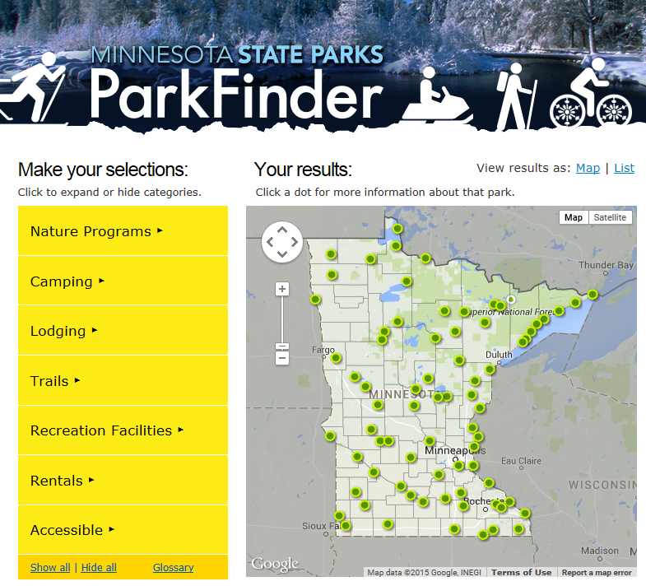
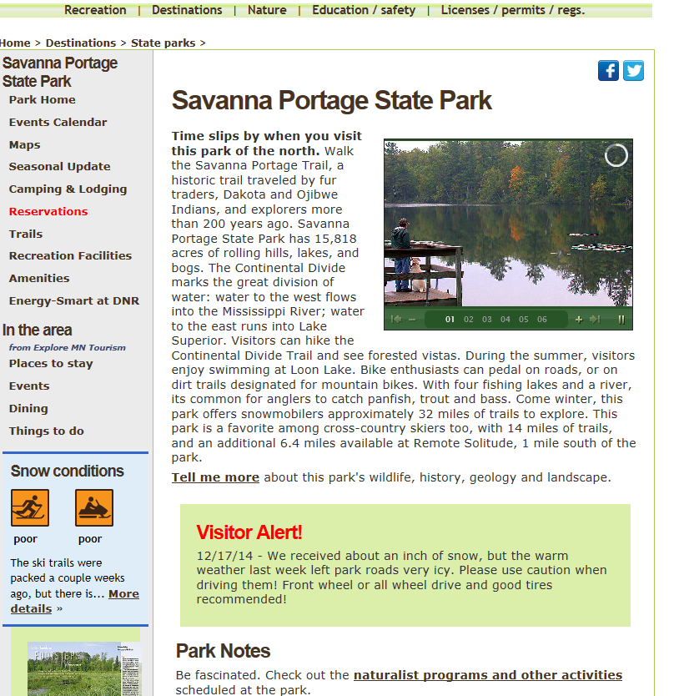
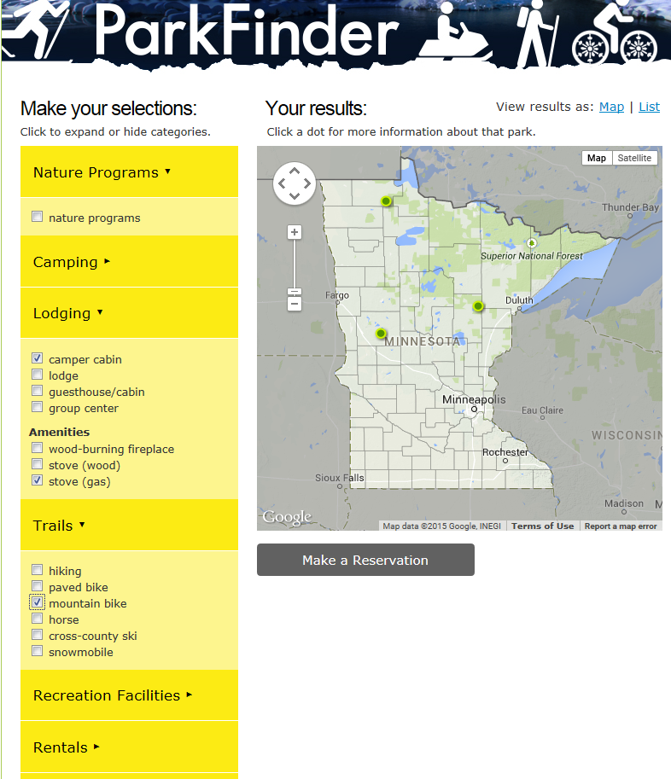
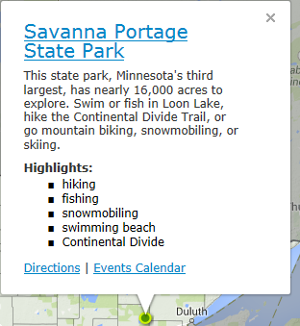
Purpose & Need

Slide 13
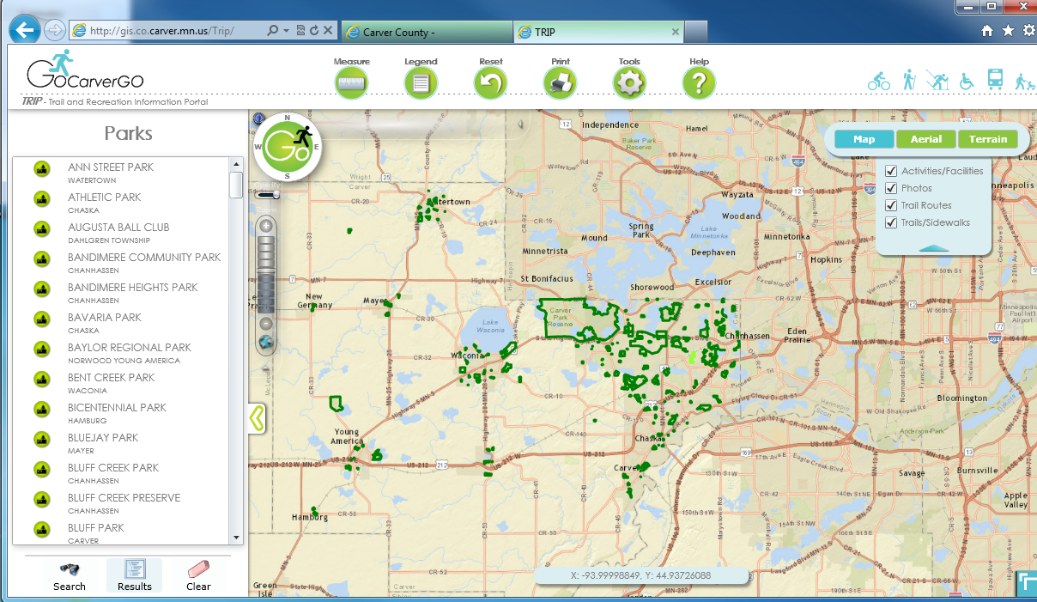
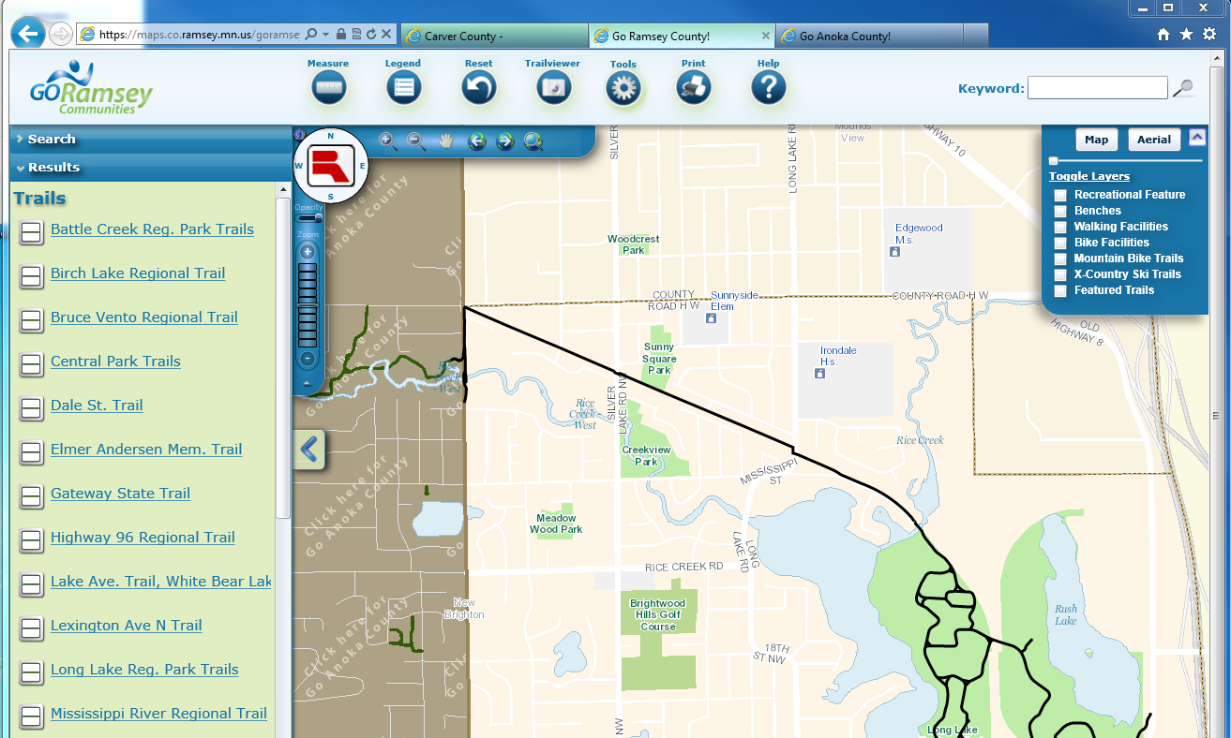
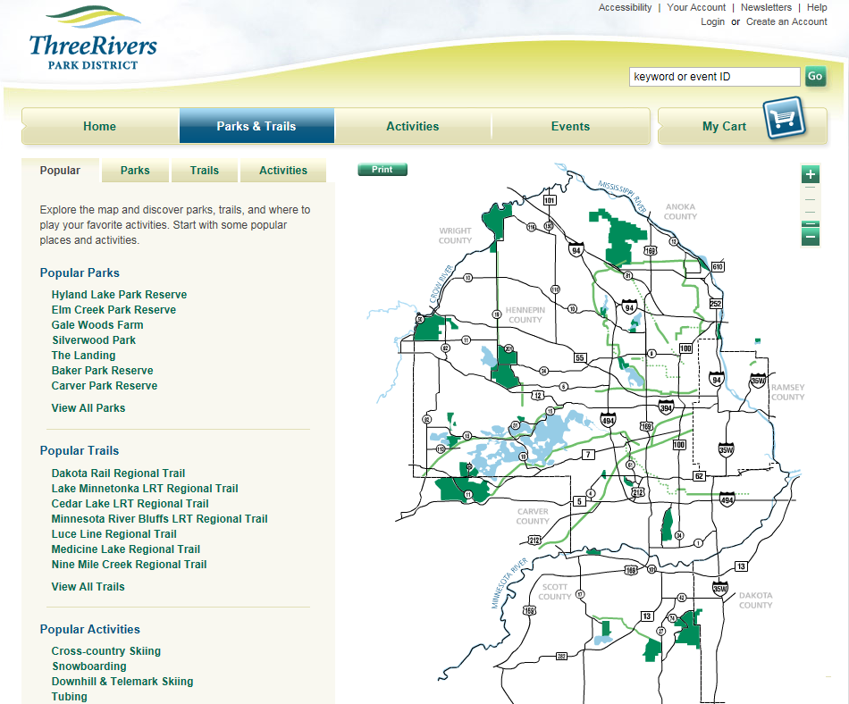
Purpose & Need

Slide 14
Goals
Short term:
  Park and Trail End User Website
  Development of a Recreation Data Standard
  Work with partners development of data standards
Long Term
  Consistently Structured Recreation Data and Services
  Consumable by wide variety of public and private apps.

Slide 15

Legacy Fund Parks and Trails
Create common definitions for parks and trails data in Minnesota.
Common terms, database, tools and methods for obtaining/maintaining the data
Accomplished through a series of stakeholder meetings

Slide 16
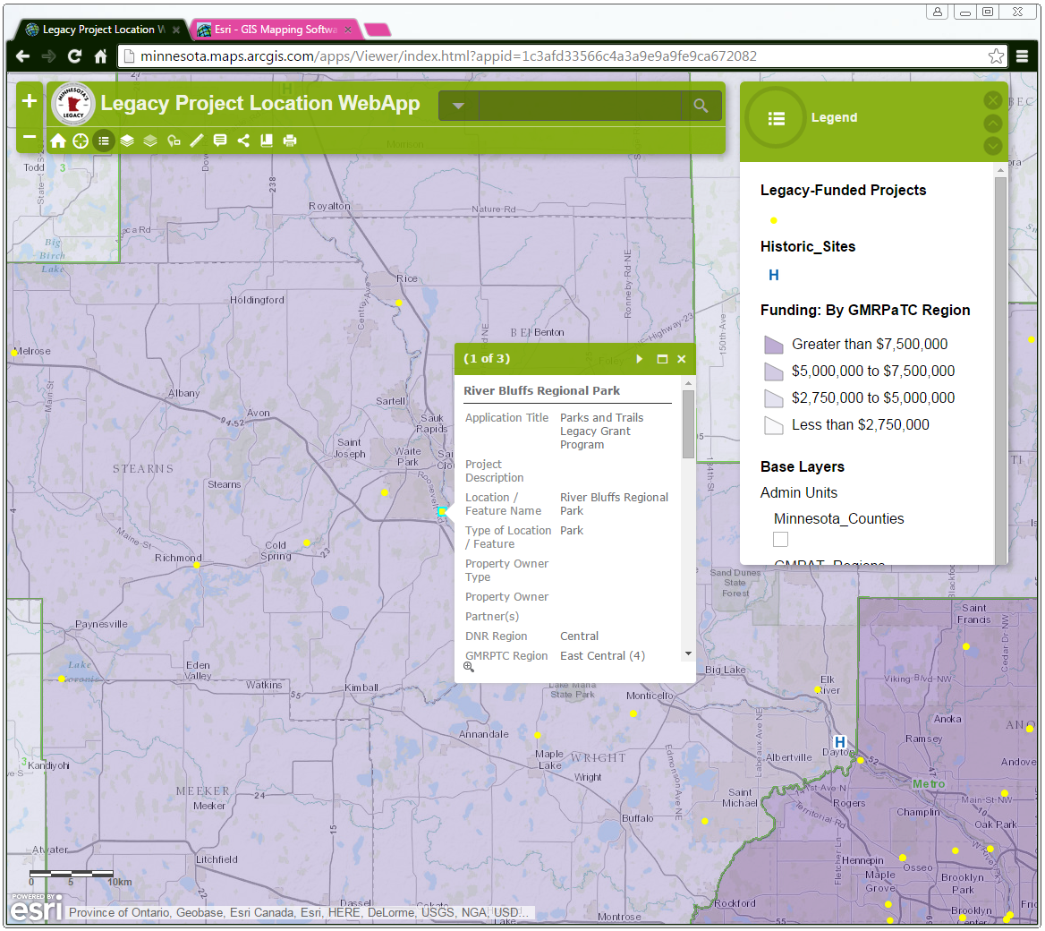
Legacy Fund Parks and Trails
Provide a mechanism to geographically locate and visually share the location and some information about each of the projects that have received funding from the Legacy Fund
Online web application that will allow multiple organizations and users to view and enter the data into a single hosted site
  Include geospatial data for existing trails, bikeways, parks from multiple jurisdictions (state, county, local)
  Align with other projects and authoritative data (e.g. DNR, GMPTC)

Slide 17
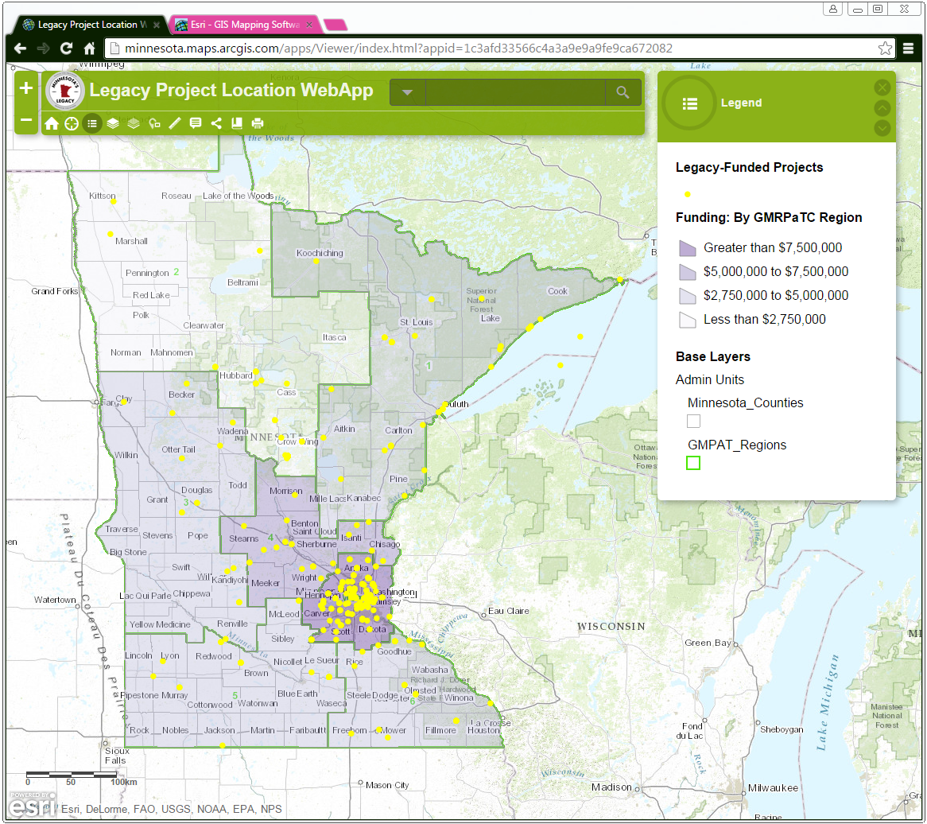
Legacy Fund Parks and Trails
Provide the ability to perform analysis on parks and trails data
Who has received funding – several different summaries
What types of strategic directives are being met with the funding
For planning - Where are there gaps and or needs for projects or connections in trails
Change in the system over time

Slide 18
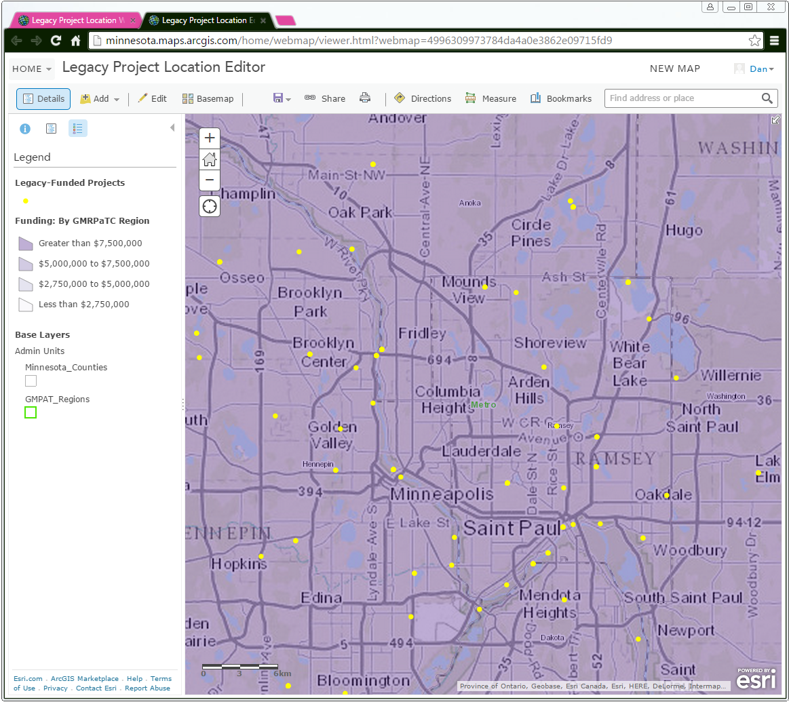
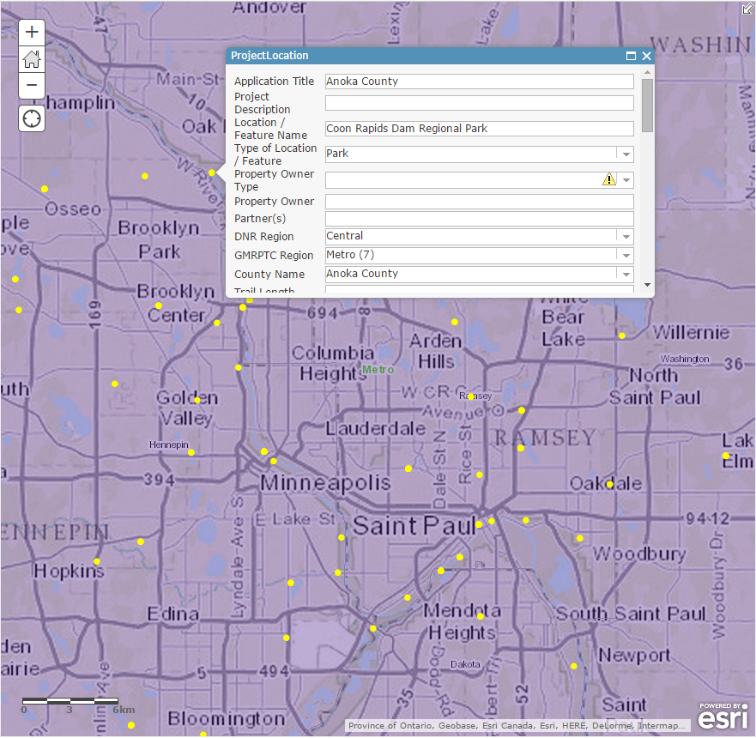
Legacy Fund Parks and Trails
Provide a sustainable approach for obtaining and keeping the data up-to-date.

Slide 19
9-1-1 – Increase in fees to support the build out of Next Generation 911

Slide 20

The Next Generation 9-1-1 Update
Adam Iten, MnGeo

Slide 21
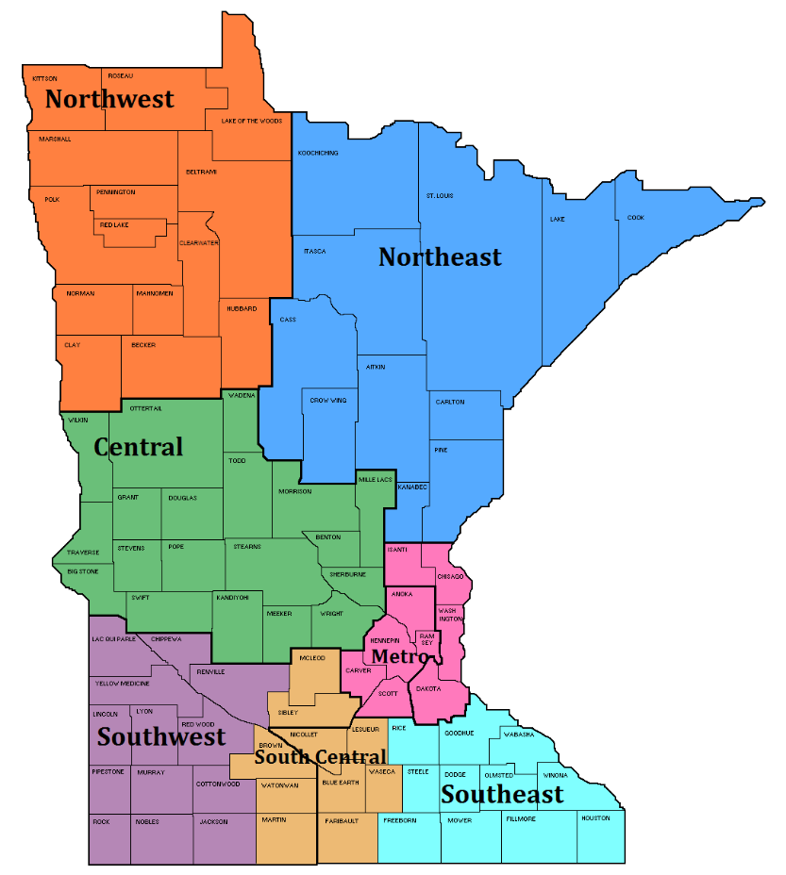
Current Project Tasks
  Outreach to PSAPs and GIS Sources – ongoing
  Project Scope and Work Plan – complete early March 2015
  Regional Kickoff Meetings – complete early June
    Northeast: April 9
    Metro: April 16
    Central: May 12
    South Central: May 13
    Southeast: May 19
    Southwest: May 20
    Northwest: June 2 and 3

Slide 22
Current Project Tasks
  PSAP Request for Information – distributed after kickoff meetings
  RFI Summary Report – July 2015
  FY16 Work Plan – complete by July 1
  Hire Two GIS Analysts – Q3 2015
  Initial Assessment of Existing County GIS Data – Q3 2015
  MN NG9-1-1 GIS Standards – October 2015
  Begin Design and Development of Data Collection, Standardization, Aggregation, QA, Reporting, Provisioning Processes – Q3 2015

Slide 23
PSAP Request for Information
  Purpose: to assess status of GIS data and software at every PSAP in Minnesota
  Current response status: 88 of 105 PSAPs (84%)
  Need 100% response
  Summary Report - distribute to stakeholders in July
  Link responses to interactive map

Slide 24
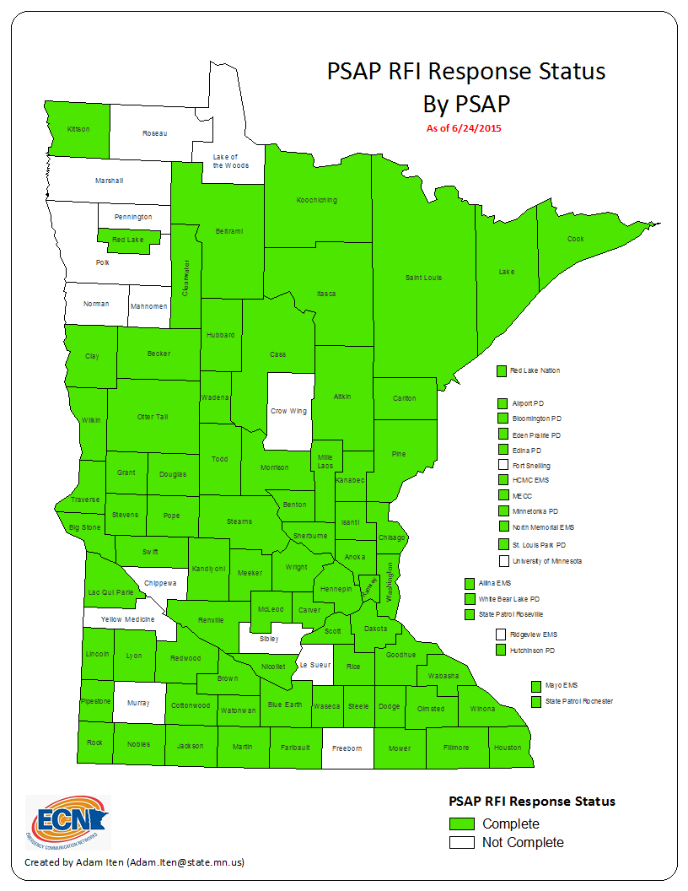

Slide 25
NG9-1-1 GIS Standards
  GIS data requirements for NG9-1-1 in Minnesota
  Standards Workgroup
    GIS Subcommittee
    NG9-1-1 Committee
    Statewide Emergency Communications Board (SECB)
  Align with NENA Standards
  Other States
    Iowa, North/South Dakota, Maine

Slide 26
Communication Plan
  ECN website
  Monthly
    Project newsletter
    GIS Subcommittee meeting
    NG9-1-1 Committee meeting
    SECB meeting
  Quarterly
    Regional PSAP/GIS meetings
    Statewide Geospatial Advisory Council meeting

Slide 27
Current Project Tasks
  PSAP GIS Survey – begin distribution in April 2015
  Outreach to PSAPs and GIS Sources – ongoing
  Initial GIS Data Assessment – begin summer 2015
  MN NG9-1-1 GIS Standards – complete October 2015

Slide 28
PSAP GIS Survey
  Purpose:
  To assess status of GIS data and software at every PSAP
  Vetted by:
    Statewide Emergency Communications Board (SECB) - reviewed and approved on 3/26
      NG9-1-1 Committee - reviewed and approved on 3/18
      GIS Subcommittee - reviewed and approved on 3/13
    MESB
    MnDOT
    NSGIC
    FirstNet – Televate

Slide 29
Moving toward standards for Parcels, Centerlines, and Address Points

Slide 30
Current Geospatial Governance

Slide 31
The conundrums we need to solve
We need to standardize data to meet multiple organizational needs
  We have more than 1 possible standard
  Standardizing data is a labor intensive process so we need to agree on one
    We need to automate where possible
    We need to work with our local partners and this committee
  Many local partners have significant concerns about sharing data with non-government partners

Slide 32
Stakeholder and Project Driven
Centerlines and Addresses
Stakeholder and Project Driven
  MRCC
  Next Generation 9-1-1/MnDOT
Short timeframe
Parcel standards
Many years in the making
Stakeholders prioritized
Business plan
PRISM

Slide 33
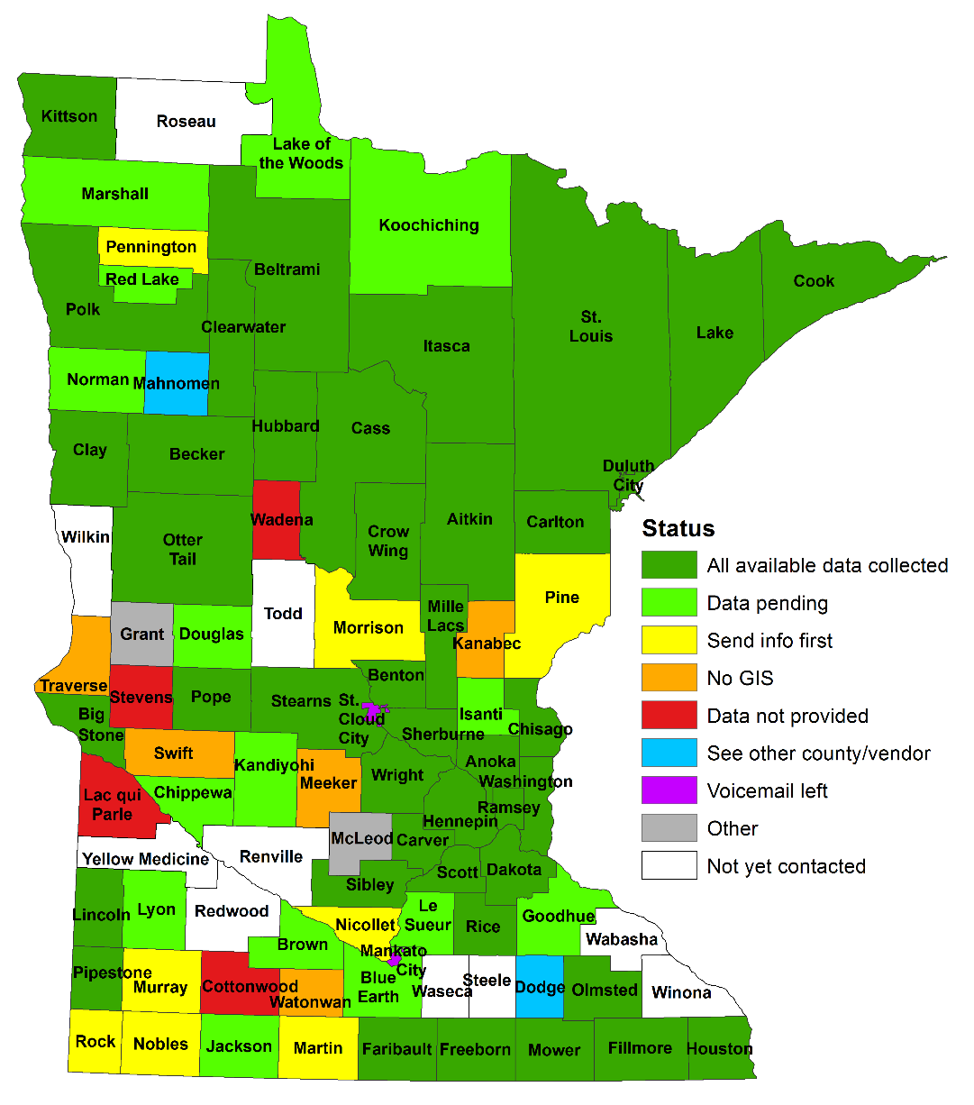
Statewide Parcels, Centerlines & Address Points Collect
87 counties, 3 cities and 1 Indian Reservation
77 entities contacted
Some data collected from 42
Purpose of the effort:
Multiple organizations need the data for use in meeting business goals
Precursor to Next Generation 9-1-1
  Understand what data is available
  What formats
  Quality
  What we need to do to standardize statewide

Slide 34

Centerlines
Multiple organizations need common street centerline data
Multiple collaborative initiatives and projects underway – all are related
  MnDOT Linear Referencing Project
  Shared Centerlines Initiative
  Metro Regional Centerline Collaborative (MRCC)
  Next Generation 9-1-1

Slide 35
Multiple efforts
MnDOT – modernize existing systems and incorporate data from authoritative sources to improve the quality of roadway information
Shared Centerlines Initiative – To develop, test, refine, publish and perpetuate a single statewide roadway dataset that meets the needs of a diverse user community…
MRCC – develop a common road centerline data model and dataset to meet the core business needs of local governments and regional interests
Next Generation 9-1-1 – create and perpetuate a standards based statewide centerline suitable for meeting the needs of NextGen 9-1-1

Slide 36

Multiple efforts - one centerline
Build it once use it many times - Goal is to create and use a single geographic representation of a centerline between all and make it publicly available
Data models may vary slightly but will roll-up
  Each program (e.g., NextGen 9-1-1) has some specific needs
  Likely start with the MRCC model as a draft standard
Will build some common business processes and rules as part of the standardization
  Edgematching

Slide 37

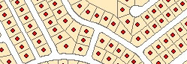
Address Points
Multiple efforts going on…
MetroGIS – develop and implement a workflow and technical solution for gathering address point data from the seven metro counties, aggregating the data into one file and distributing the points, metadata and other supplementary information to the user community.
Next Generation 9-1-1 – create and perpetuate a standards-based statewide address point file suitable for meeting the needs of NextGen 9-1-1
Where we are at – Comparing data models and assessing data received by counties
Goal – Choose a standard and understand the need for supporting tools and processes by the end of October 2015

Slide 38
Parcels
Background
In the works for some time
www.mngeo.state.mn.us/committee/standards/parcel_attrib/parcel_attrib.html
Business plan developed some time ago
Multiple standards have slowed the approval process
Data sharing beginning to open up thus bringing forward the need to agree on a standard
Recent statewide data collection efforts require that a standard needs to be agreed upon

Slide 39
Status of current effort….
Recently met with Parcels and Land Records Committee and State Agencies to move discussion forward
Need to share outcomes of those sessions
We need input from this Council
Move to Standards Committee next

Slide 40
How agency needs match up
COUNTY_ID | OWNER_NAME | EDIT_DATE
PIN | OWNER_MORE | EMV_BLDG
BLDG_NUM | OWN_ADD_L1
PREFIX_DIR | OWN_ADD_L2
PREFIXTYPE | OWN_ADD_L3
STREENAME | TAX_NAME
STREETTYPE | TAX_ADD_L1
SUFFIX_DIR | TAX_ADD_L2
UNIT_INFO | TAX_ADD_L3
CITY | HOMESTEAD
CITY_USPS | DWELL_TYPE
ZIP | NUM_UNITS
ZIP4 | USE_DESC
28 Common Elements from those sharing so far
28 in DCDATS
18 in PRISM
Owner/Address information is the primary difference
Review info from counties

Slide 41
Discussion
  Assumption: Digital Cadastral Data Attribute Transfer Standard (DCDATS) meets the current needs of committee members and others interested in parcel data?
  Outreach - Have we reached all stakeholders?

Slide 42
2 Possible Draft Standards
From this Committee - Digital Cadastral Data Attribute Transfer Standard (DCDATS)
  www.mngeo.state.mn.us/committee/cadastral/index.html
Data Transfer standard only
Based upon MetroGIS parcel standard – 7 additional fields and changes to 2 fields
  www.mngeo.state.mn.us/committee/standards/parcel_attrib/Cadastral_Data_Transfer_Standard_for_public_review.pdf

Slide 43
2 Possible Standards
PRISM
Property Record Information System of Minnesota (PRISM)
  www.revenue.state.mn.us/local_gov/prop_tax_admin/Pages/PRISM.aspx
Department of Revenue
  www.revenue.state.mn.us/local_gov/prop_tax_admin/data_reporting/prism_inst_PRISM_Logical_File_Layout_7.4.pdf
204 Fields
  Valuation Tree, Taxation Tree, Linking Tree, Taxing Authority Tree, TIF District Tree

Slide 44
DCDATS vs. PRISM
The next slides identify the two possible standards, similarities, differences, and a reminder of how agency needs match up.
Draft Standard | # Fields
DCDATS | 72
PRISM | 204
39 Common Attributes

Slide 45
Data Collect Sample Fields
41 Collected, 39 Reviewed
DCDATS | PRISM | Supplied
COUNTY_ID | County Code | 91
PIN | Parcel ID | 39
BLDG_NUM | Location House Number | 31
PREFIX_DIR | Location Street Prefix Direction | 24
PREFIXTYPE | Location Street Prefix Type | 22
STREETNAME | Location Street Name | 31
STREETTYPE | Location Street Type | 30
SUFFIX_DIR | Location Street Suffix Direction | 30
UNIT_INFO | Location Unit Information | 29
CITY | City/Township Code (derived from) | 25
CITY_USPS | -- | 7
ZIP | Location Zip Code | 26
ZIP4 | Location Zip Code (if given) | 15
PLAT_NAME | -- | 26
BLOCK | -- | 26
LOT | -- | 26
ACRES_POLY | Acreage (Data Type: Positive3DecimalType) | 91
ACRES_DEED | Deeded Acres | 22

Slide 46
How agency needs match up
COUNTY_ID | OWNER_NAME | EDIT_DATE
PIN | OWNER_MORE | EMV_BLDG
BLDG_NUM | OWN_ADD_L1
PREFIX_DIR | OWN_ADD_L2
PREFIXTYPE | OWN_ADD_L3
STREENAME | TAX_NAME
STREETTYPE | TAX_ADD_L1
SUFFIX_DIR | TAX_ADD_L2
UNIT_INFO | TAX_ADD_L3
CITY | HOMESTEAD
CITY_USPS | DWELL_TYPE
ZIP | NUM_UNITS
ZIP4 | USE_DESC
28 Common Elements from those state agencies sharing so far
28 in DCDATS
18 in PRISM
Owner/Address information is the primary difference
Review info from counties

Slide 47
Next Steps
Compile input from State Agencies – Complete
Meet with Land Records and Parcels Committee to gather their input – Complete
Propose a direction
  DCDATS + in short term – PRISM long term if can more closely meet agency needs
  Parcel Fabric template to improve adoption
Standards committee
Vet the direction – multiple groups

Slide 48
DCDATS +
Proposal is to have DCDATS include a new attribute representing Generalized Ownership
Proposed domain:
1 = County Fee
2 = Tax Forfeit
3 = State of Minnesota
4 = United States of America
5 = Municipal
6 = Unknown
7 = No Value
8 = Tribal
9 = Private

Slide 49
Discussion: Role of committees and workgroups

Slide 50
Goal of the discussion:
Provide a short update of committee activities
Setting the stage for next year – Discussion with Council members
  Improve engagement and leadership in the committees and workgroups

Slide 51
Status of committees and work groups
Parcels and Land Records (Active – looking for additional leaders)
Digital Elevation (Inactive – needs leadership)
  LiDAR Research and Education (Active)
Emergency Preparedness (Active)
Hydrography (Inactive)
Outreach (Inactive)
Standards (Active as needed)

Slide 52
Discussion
Small group of folks to work over the summer to identify how to move forward better?
Should Council members participate in committees and workgroup?

Slide 53


30 minutes…
+

Slide 54
Mn GIS/LIS conference
Heather Bergen-Albrecht, Consortium Chair

Slide 55

To develop and support the GIS professional in
Minnesota for the benefit of our state and its citizens.

Slide 56

2015 Annual Conference & Workshops
October 7-9, 2015
www.mngislis.org/2015
19 Workshops Confirmed
Esri Hands-on Lab
K-12 workshop on Wednesday Sponsored by MDE, Esri, and the Consortium
Entertainment Options; Tuesday, Wednesday and Thursday night
Fun Run planned for Friday Oct. 9th
User Groups / Birds of a feather
Higher education, Mentor Program, Student Competitions
Geolounge
Questions – gsjerven@allete.com, or conference@mngislis.org

Slide 57
Future Consortium Events
2016 Spring Workshops
26th Annual Conference & Workshops, Duluth – October 2016
27th Annual Conference & Workshops, Bemidji – October 2017
28th Annual Conference & Workshops 2018
  Bemidji, October
  Duluth, with NSGIC in October

Slide 58

MN Geospatial Commons – Metadata recommendation
Nancy Rader, MnGeo

Slide 59
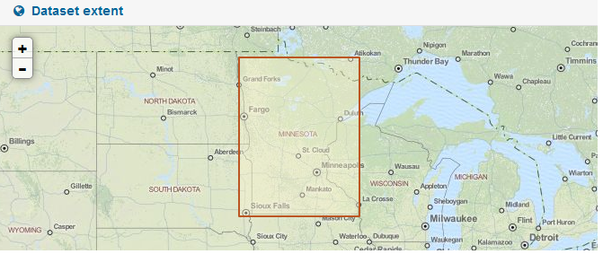
Metadata recommendation
Goal
  Which metadata elements are required
  for the Commons?
  Guidance on quality and quantity of info
Criteria
  Needed to determine fitness for use
  Needed to support a Commons function

Slide 60
Metadata recommendation
Categories:
  Mandatory
  Mandatory if applicable
  Desirable
  Optional

Slide 61
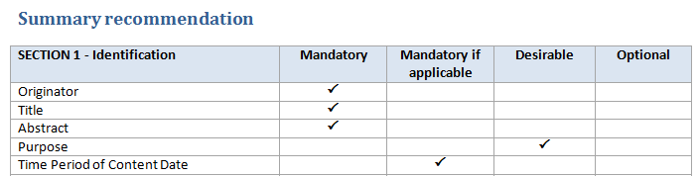
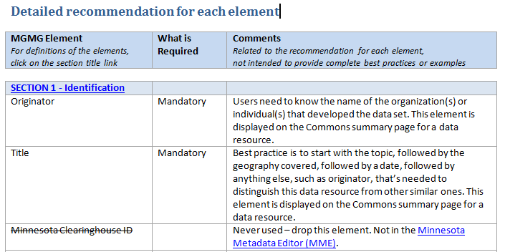
See handout for full recommendation:
www.mngeo.state.mn.us/councils/statewide/Commons_MGMG_element_requirements_recommendation.pdf

Slide 62
Metadata recommendation
Implementation:
  Training
  Work with new publishers
  Validate some elements automatically
  Monitor user feedback
  Periodic reminders to check records
  Improve metadata tools

Slide 63










Status
Focus - Migration of all significant state geospatial resources currently provided in the Data Deli, Minnesota Geographic Data Clearinghouse, DataFinder and other independent state agencies;
Published resources accessible
  11 Organizations
  237 Resources
Metadata training begins this week!
The site is being prepared to expand participation

Slide 64
Discussion: Year-end evaluation
What went well?
What could be changed?
Where do we go from here?

Slide 65
What went well?
Meetings have been a good way to share information
  What’s happening at the National, State, Local, Education, Legislative
  Member presentations
Open discussions on various topics
  Funding Proposal
  Legislative efforts
Support from Council
  Legislative Review of Council
Thoughts from the members…

Slide 66

What could be changed?
Agendas and supporting materials to members sooner
Meeting approach?
  Informal led by Dan
  Mostly informational
  More discussions and input from members?
Agenda driven by MnGeo
  Driven by Council members?
What do you as members want this council to be going forward?

Slide 67
Announcements and other business
Next term appointments
In process, multiple steps
Will move more quickly after July 1
Other thoughts from the members?

Slide 68
Adjourn…
Next year’s meeting dates:
September 23, 2015
December 2, 2015
March 2, 2016
June 1, 2016

