Slide 1

MnGeo Statewide Geospatial Advisory Council
Hot Topics
May 30, 2012
Drones, UAV’s, UAS’s

Slide 2
Terms
Drone – Unmanned robotic probe – air, land, sea
UAV – Unmanned Aerial Vehicle
UAS – Unmanned Aircraft System

Slide 3
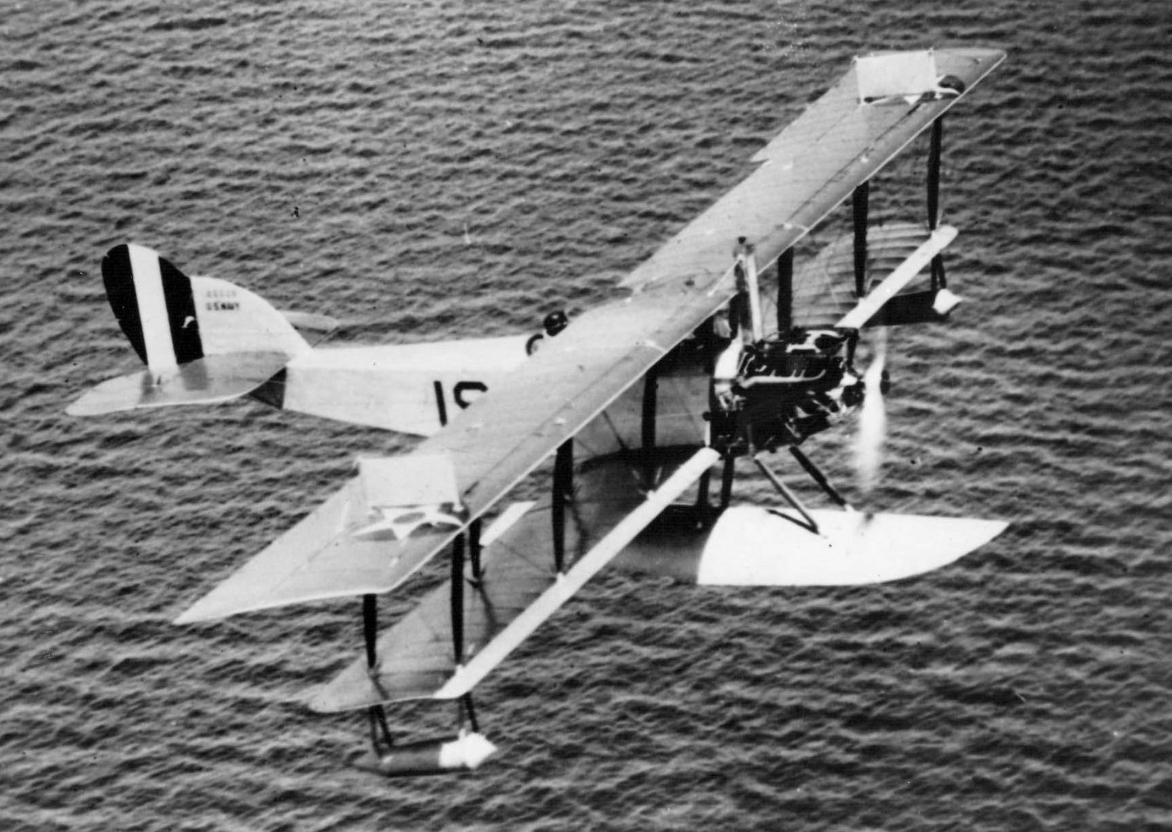
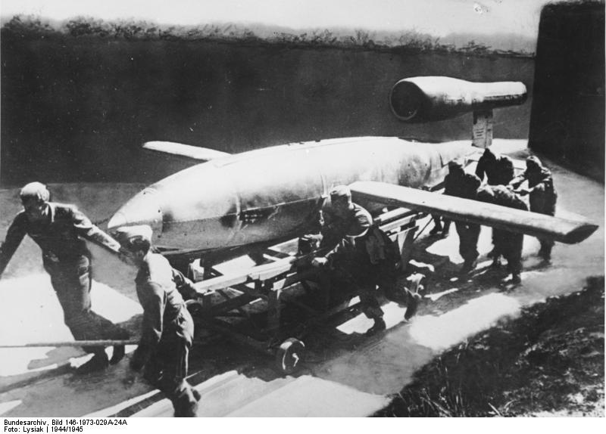
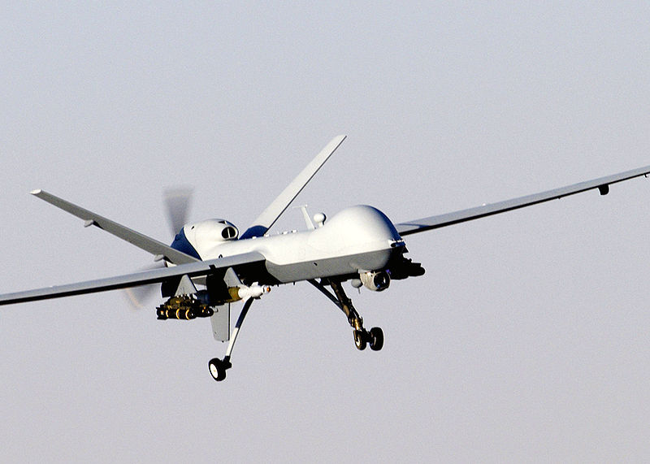
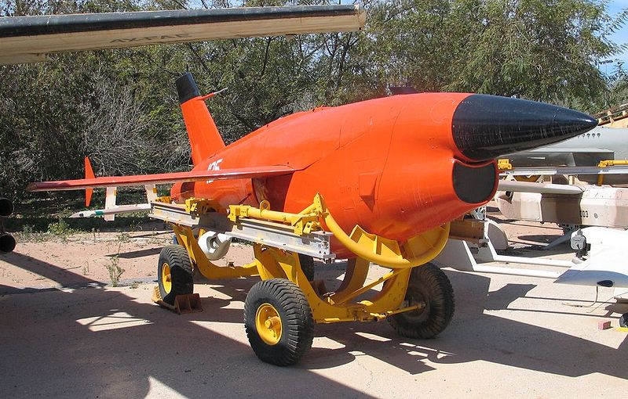
Quick History
1915 Hewitt-Sperry Automatic Airplane
Early 1940’s German V1 – Buzz Bomb
1950’s Remotely Piloted Vehicle (RPV) Target Drone
2000’s M-9 Reaper

Slide 4
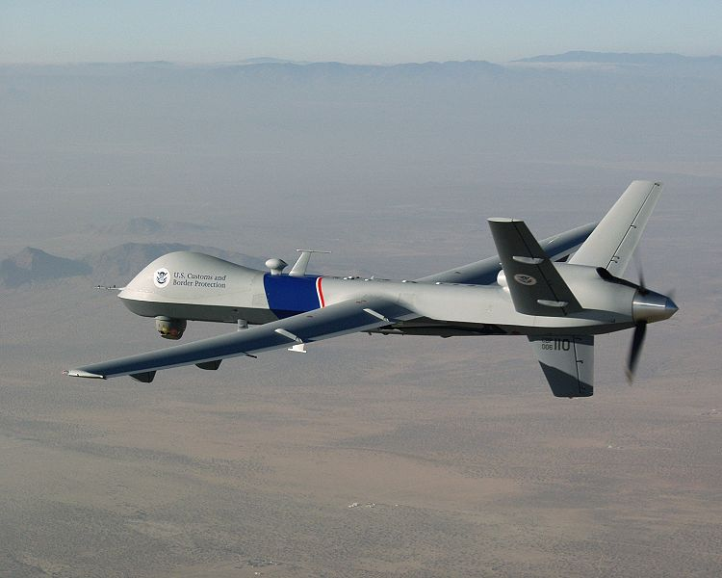
Local History
2006 – Minnesota National Guard Tactical Unmanned Aerial Vehicle (TUAV) Platoon, Company A, 634th Military Intelligence Battalion received the Army Aviation Association of America (AAAA) Unmanned Aircraft System Unit of the Year Award
2008 – DHS deploys some of first northern tier UAV’s Predator/ Reaper (2 airframes) to Grand Forks USAF
2009 – Used in Red River flooding response in 2009
2010 – UND offers nation’s first UAV pilot training program
2011 – First use of a drone during the arrest of a citizen inside U.S. borders
2012 – North Dakota National Guard takes delivery of 5 Northrup Grumman Global Hawks Block 40

Slide 5

Becoming a Booming Business/Dilemma

Slide 6

Congress Tells FAA to Get Busy
License versus airspace (Otter Tail County)
February 3, 2012 – Directed to open U.S. Airspace to Commercial UAS’s
March 7, 2012 – Issued notice it was looking for 6 test sites
May 14, 2012 – Public Safety can fly up to 25 lbs. UAV’s without license:
  UAS must be flown within the line of sight of the operator,
  less than 400 feet above the ground,
  during daylight conditions, and
  inside Class G (uncontrolled) airspace and more than five miles from any airport or other location with aviation activities.
Commercial operations fully integrated skies by September 2015

Slide 7
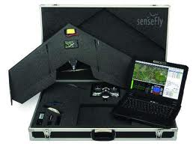


swinglet CAM by senseFly example
http://www.youtube.com/watch?v=OzlaNgKVX8o
Launches in 5 minutes
Automated flight
In-flight quality control
Geo-referenced orthomosaics
Digital Elevation Models (DEM)

Slide 8
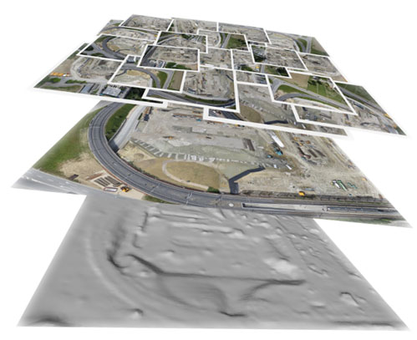
Post Event Processing via Upload

Slide 9


Slide 10

Perhaps – More to Come In Different Forms
Is There a Surveillance Aerostat in Your Future?
Questions?

