Slide 1
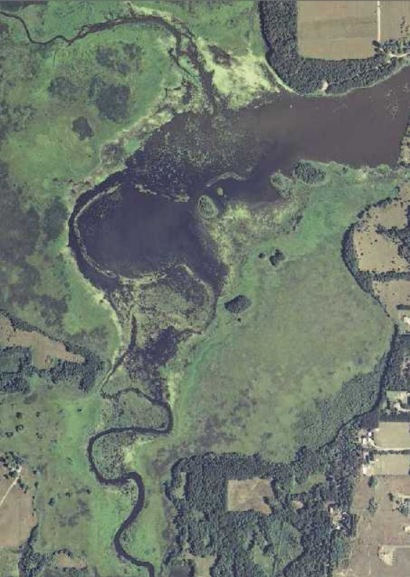
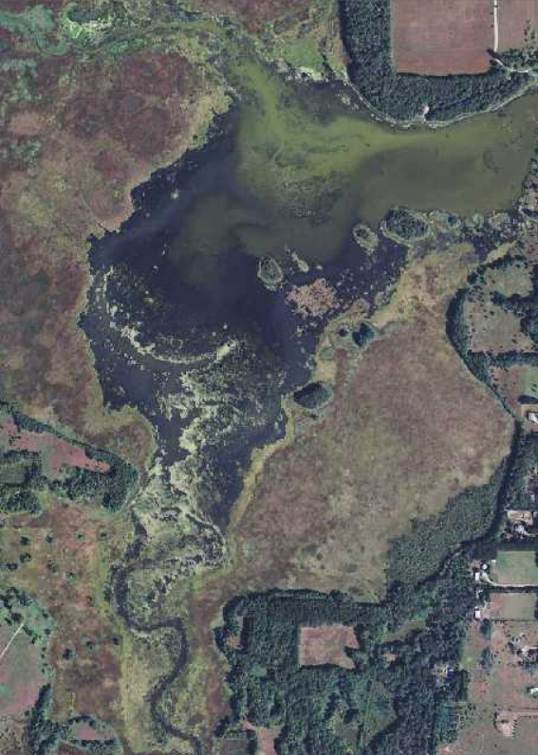
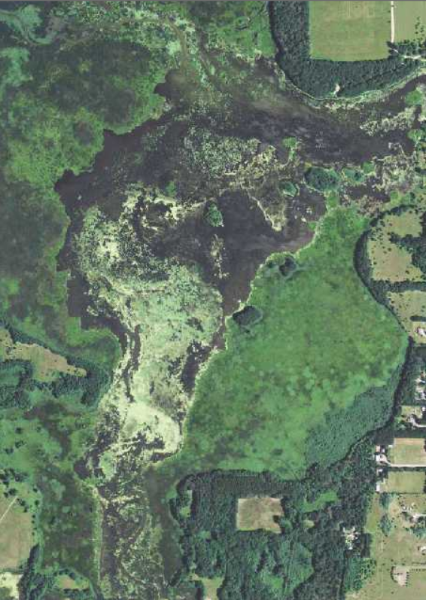
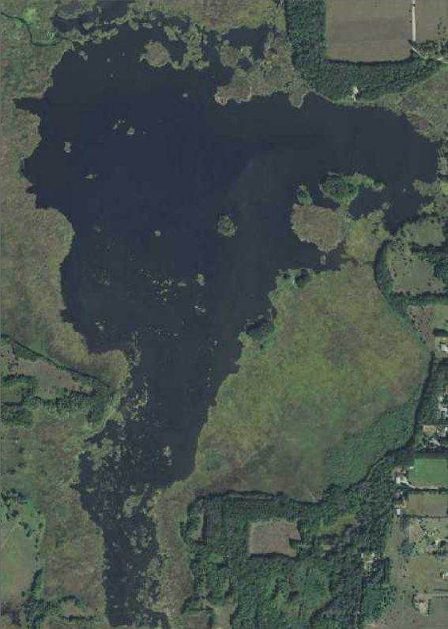
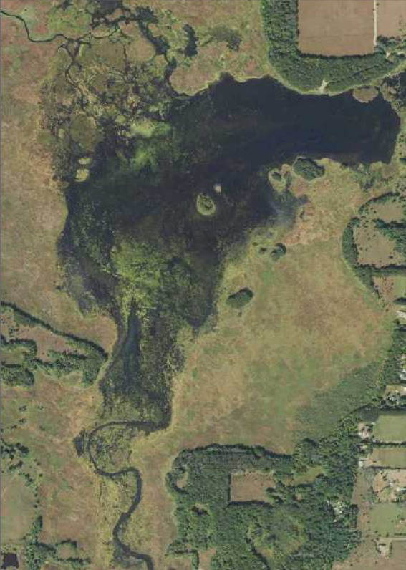
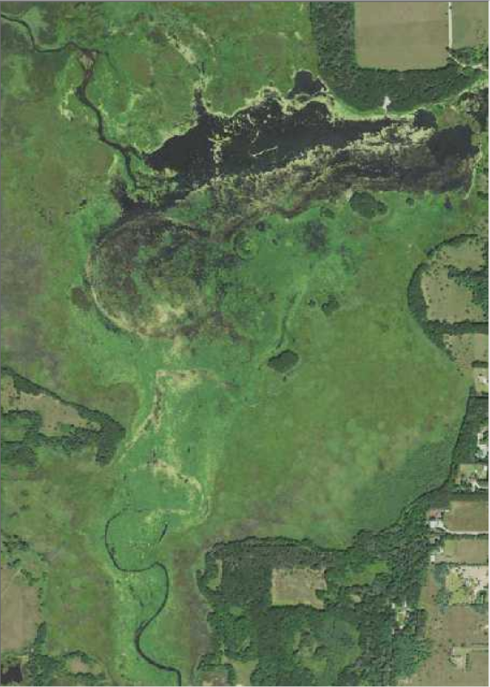
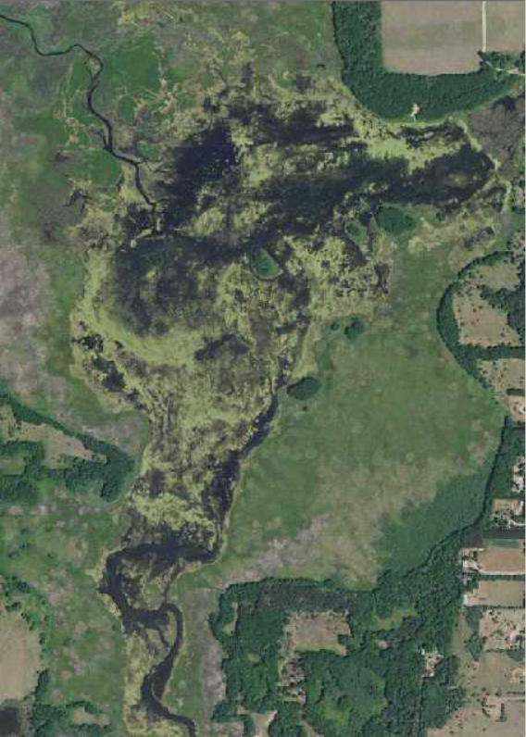
Variable Water Level/Extent
Notes:
Sunrise River Pool #1 – Near Stacy, Minnesota – This time series of aerial imagery shows how variable the water level is for this reservoir. Aerial imagery as accessed through MnGeo’s image service* as of June 2022.
Images show: 2008, 2010, 2013, 2015, 2017, 2019, and 2021.
* https://www.mngeo.state.mn.us/chouse/wms/geo_image_server.html

